Slide 1
Semi-automatic Fact Extraction and Organization of Persons in Genealogical Records
Joseph Park
Brigham Young University

Slide 2
Fact Extraction
Extraction ontology
Object identity resolution

Slide 3
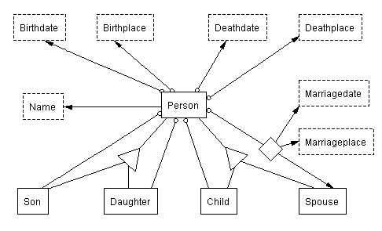
Extraction Ontology

Slide 4
Recognizers
\b([1][6-9]\d\d)\b
\b{Month}\.?\s*(1\d|2\d|30|31|\d)[.,]?\s*(\d\d\d\d)\b
Date recognizers
{Person}[.,]?.{0,50}\s*b[.,]?\s*{Birthdate}
Person-Birthdate recognizer
{Son}[.,]?.{0,50}\s*[sS]on\s+of\s*.*?\s*{Person} Son-Person recognizer
{Person}[.,]?.{0,50};\s*m[.,]\s*{MarriageDate}[,]?\s*{Spouse} Person-Marriagedate-Spouse recognizer

Slide 5
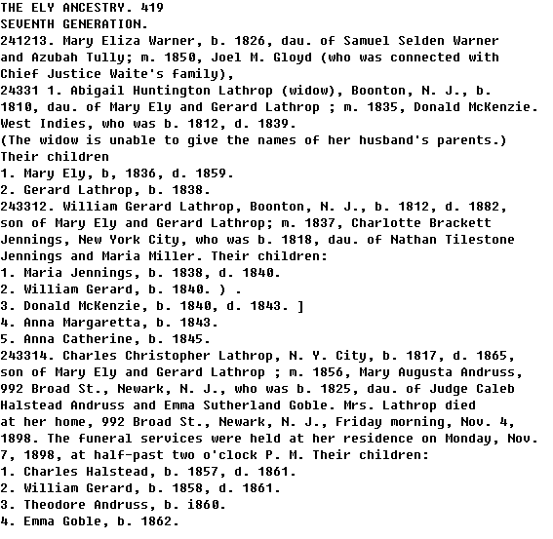
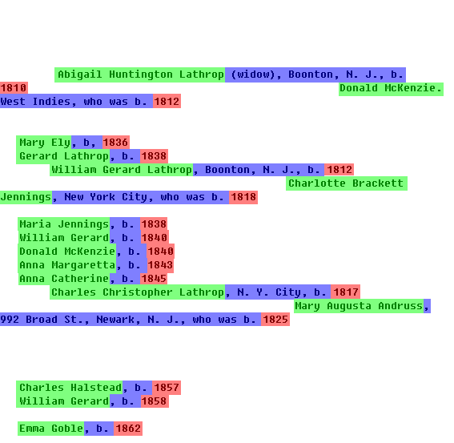
Example

Slide 6
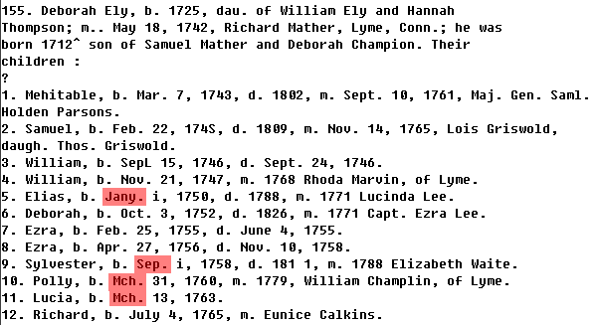
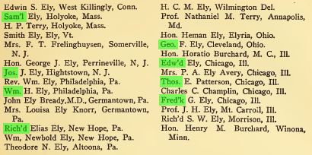
Canonicalization

Slide 7
Object Identity Resolution
Notes:
Ontological commitment

Slide 8
Fact Organization
Schema mapping
Logic rules
Entity resolution

Slide 9
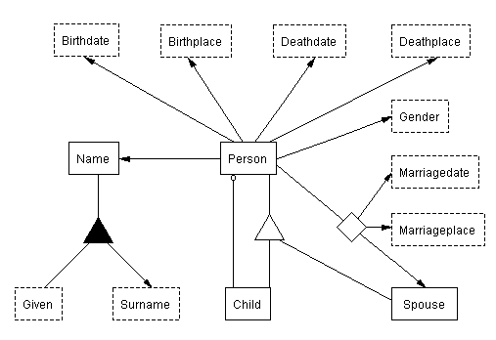
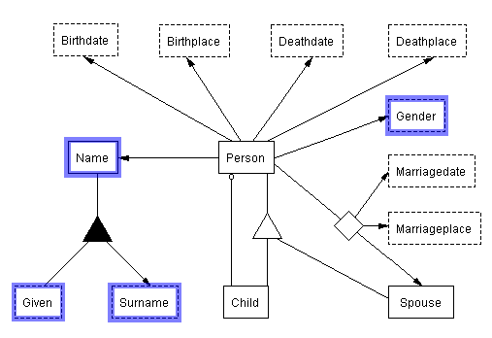
Schema Mapping
Extraction Ontology
View of genealogist

Slide 10
Example

Slide 11
Example

Slide 12
Logic Rules
Morphology
Onomastics
Cultural pragmatics

Slide 13
Morphology
male
female

Slide 14
Onomastics

Slide 15
Cultural Pragmatics

Slide 16
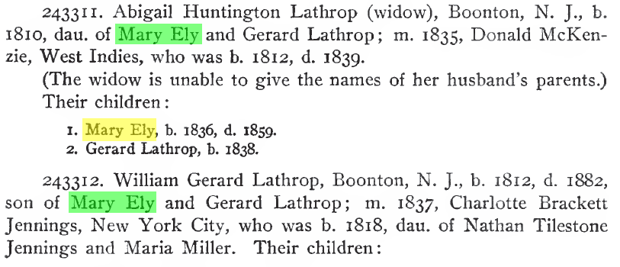
Entity Resolution

