Slide 1
Knowledge Discovery and Dissemination (KDD) Program
IARPA-BAA-09-10
Question Period: 22 Dec 09 – 2 Feb 10
Proposal Due Date: 16 Feb 10

Slide 2
Issues
Information Extraction / Annotation / Wrapper Generation
Wide Variety of Data Sets
(Possibly) Large Data Sets
(Possibly) Numerous Data Sets
Alignment of Data Sets
Schema Mapping & Schema Integration
Data Cleaning and Integration
Advanced Analytic Algorithms / Query / Reasoning
Performance

Slide 3
Unifying Solution Theme
Knowledge Bundles (KBs) ~ “discovered”/extracted/annotated knowledge organized for “dissemination”/query/analysis
Either actual or virtual, or, a combination
Queries, reasoning, algorithmic analysis, data mining
Queries & reasoning should always immediately work based on library of extraction ontologies, ontology snippets, and instance recognizers
“Pay as you go”: greater organization, more extraction, improved analysis based on just doing the KDD work
Knowledge-Bundle Builder (KBB)
Knowledge begets knowledge (KBs as extraction ontologies)
Fully automatic KBB tools
Semi-automatic KBB tools

Slide 4
Many Applications
Business planning and decision making
Scientific research studies
Purchase of large-ticket items
Genealogy and family history
Web of Knowledge
Interconnected KBs superimposed over a web of pages
Yahoo’s “Web of Concepts” initiative [Kumar et al., PODS09]
And Intelligence Gathering and Analysis
Notes:
Not just bio-research studies. I’ll draw from some of these as I further explain KBs and KBBs. (Switching applications because 1. Cui is not here to explain the medical biology & 2. it’s not implemented, but most of what I will present is implemented, although not fully integrated and not fully working as well as it should for the system to be commercialized.)

Slide 5
Prior Research (outline for next part of presentation)
Formalization of Ideas
Query Processing and Reasoning
AskOntos / SerFR
GenWoK
Extraction and Annotation (Semi- & Un-structured Sources)
OntoES
FOCIH, TANGO, TISP
NER
Reverse Engineering (Structured Sources)
RDB, XML, OWL
Nested Tables
Semantic Integration
Multifaceted mappings (including mappings based on OntoES)
Direct and indirect mappings
Semantic enrichment for integration (e.g., MOGO)
Notes:
Explain formal framework and semi-automatic creation in the rest of the presentation. Tie into ACM-L.

Slide 6
KB Formalization
KB—a 7-tuple: (O, R, C, I, D, A, L)
O: Object sets—one-place predicates
R: Relationship sets—n-place predicates
C: Constraints—closed formulas
I: Interpretations—predicate calc. models for (O, R, C)
D: Deductive inference rules—open formulas
A: Annotations—links from KB to source documents
L: Linguistic groundings—data frames—to enable:
high-precision document filtering
automatic annotation
free-form query processing

Slide 7
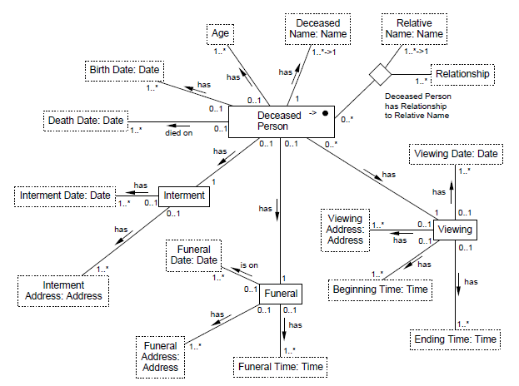
KB: (O, R, C, …)

Slide 8
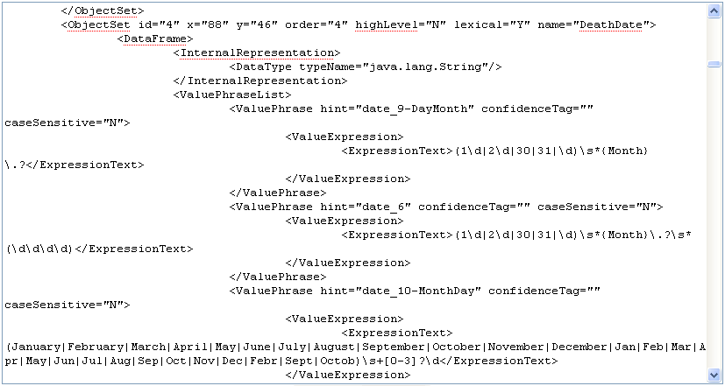
KB: (O, R, C, …, L)

Slide 9
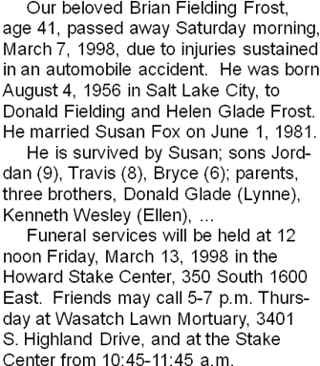
KB: (O, R, C, I, …, A, L)

Slide 10
KB: (O, R, C, I, D, A, L)
Age(x) :- ObituaryDate(y), BirthDate(z), AgeCalculator(x, y, z)
Notes:
Another reasoning possibility to point out: “Thursday”, which does not have a specific date attached to it can be reasoned about to realize that it must be March 12, 1998.

Slide 11
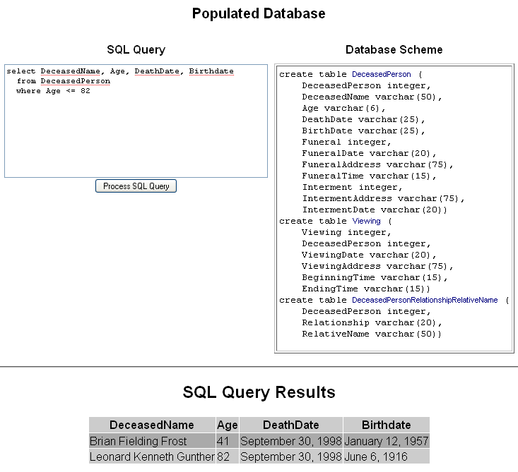
KB Query

Slide 12
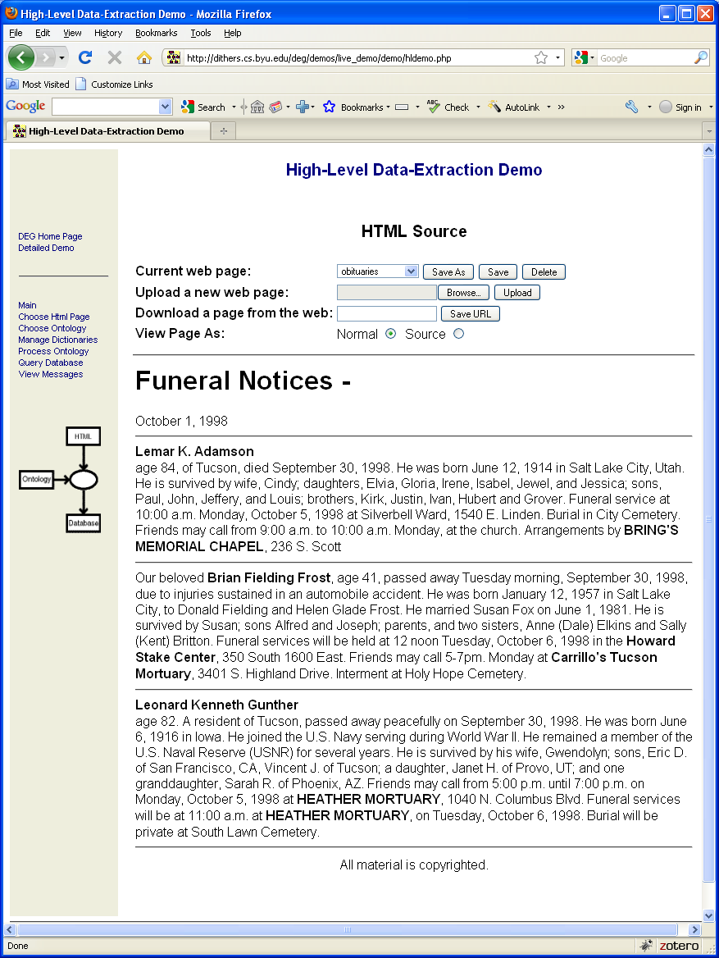
KB Query

Slide 13
KB Reasoning
Screenshots from CW’s thesis

Slide 14
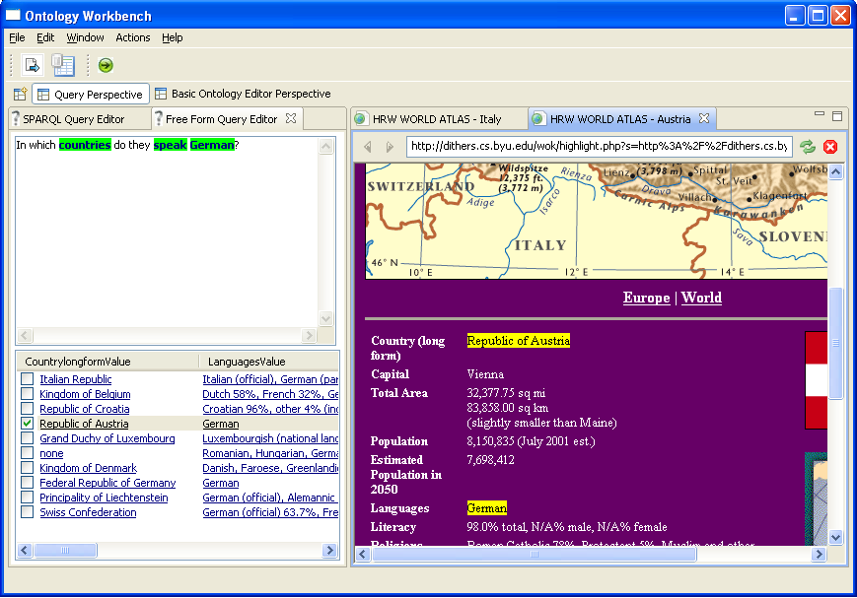
Free-form Query Processing with Annotated Results
Notes:
We are working toward KBs and KBBs …

Slide 15
KBB: (Semi)-Automatically Building KBs
OntologyEditor (manual; gives full control)
FOCIH (semi-automatic)
TANGO (semi-automatic)
TISP (fully automatic)
NER (Named-Entity Recognition research)

Slide 16
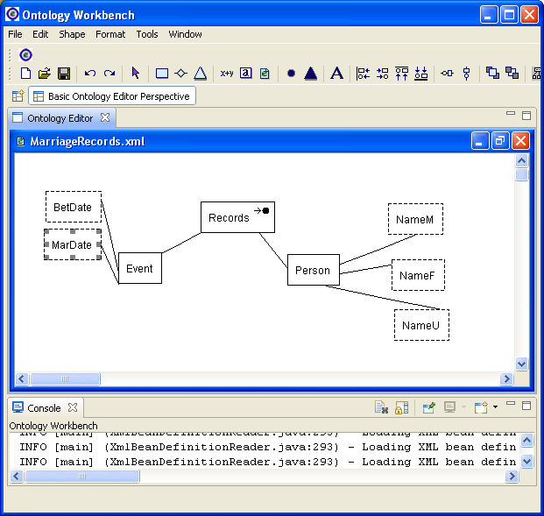
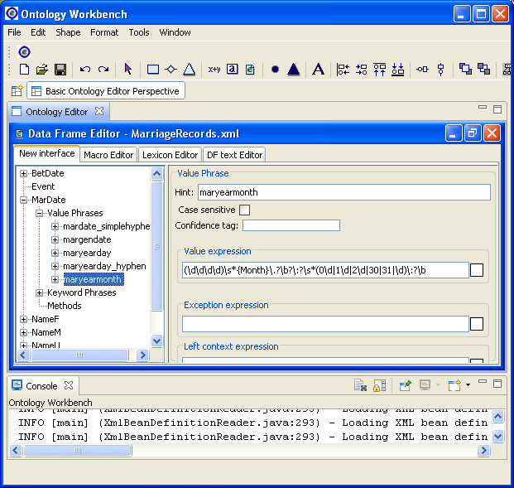
Ontology Editor

Slide 17
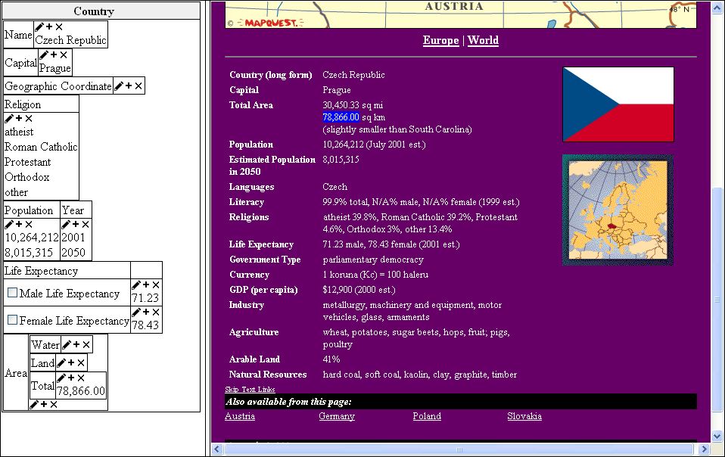
FOCIH: Form-based Ontology Creation and Information Harvesting

Slide 18
TANGO: Table ANalysis for Generating Ontologies
fleck | velter
 | gonsity (ld/gg) | hepth (gd)
burlam | 1.2 | 120
falder | 2.3 | 230
multon | 2.5 | 400
repeat:
understand table
generate mini-ontology
match with growing ontology
adjust & merge
until ontology developed
Growing
Ontology

Slide 19
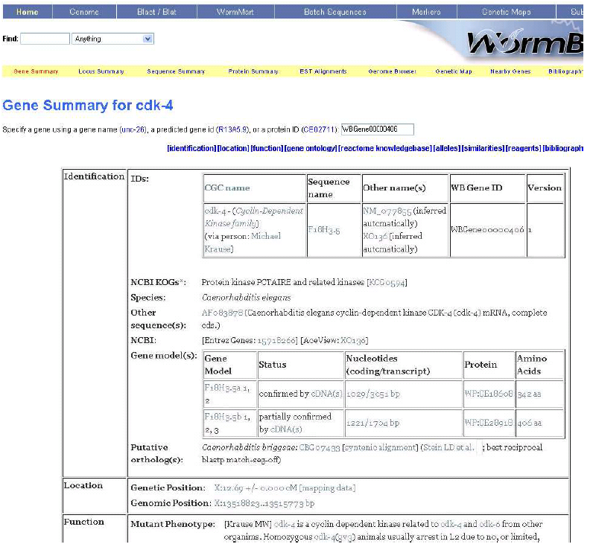
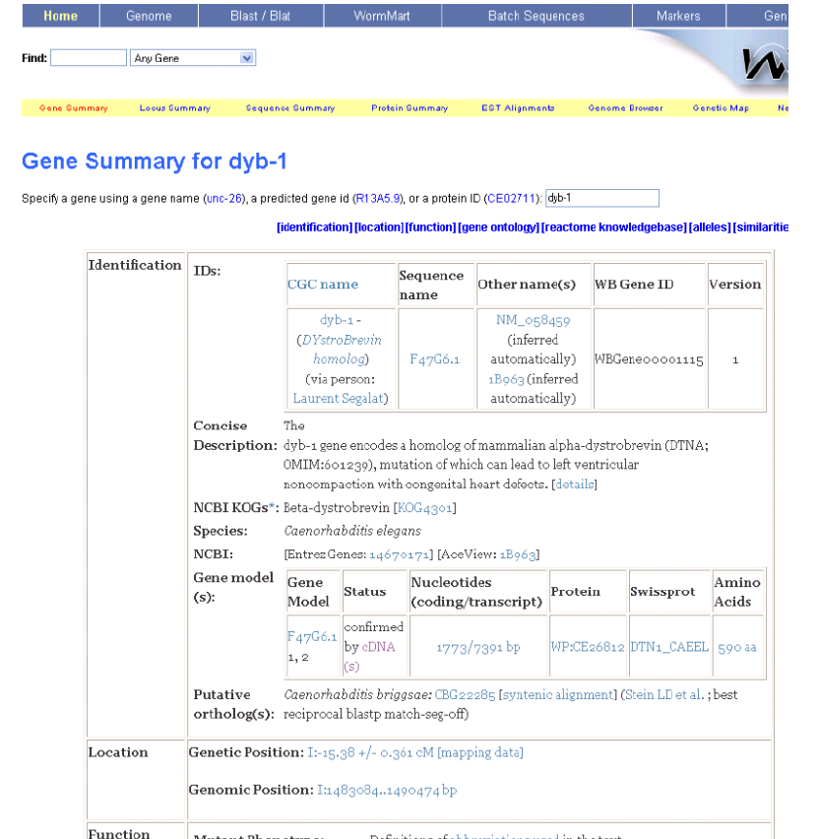
TISP: Table Interpretation by Sibling Pages
Same

Slide 20
TISP: Table Interpretation by Sibling Pages
Different
Same

Slide 21
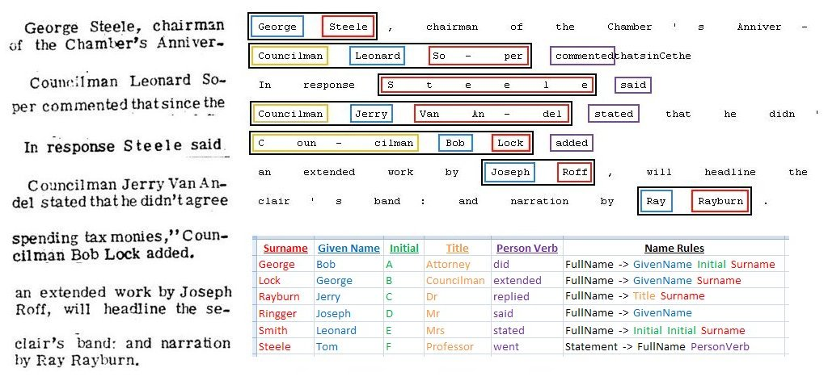
NER: Named-Entity Recognition
Notes:
Automated extraction is critical. OpenDMAP for biology

Slide 22
Reverse Engineering from Structured Sources
Transformation from source (?) to target (O, R, C, I, …)
Information Preserving
Constraint Preserving
Structured source
Predicates and constraints formalized in some way
Examples: RDB, XML, OWL, Nested Forms

Slide 23
RDB Reverse Engineering
Theorem. Let S be a relational database with its schema restricted as follows:
(1) the only declared constraints are single-attribute primary key constraints and
single-attribute foreign-key constraints, (2) every relation schema has a primary
key, (3) all foreign keys reference only primary keys and have the same name
as the primary key they reference, (4) except for attributes referencing foreign
keys, all attribute names are unique throughout the entire database schema, (5)
all relation schemas are in 3NF. Let T be an OSM-O model instance. A transformation
from S to T exists that preserves information and constraints.

Slide 24
C-XML: Conceptual XML
XML Schema
C- XML
Notes:
In general, reverse engineering from any structured schema.

Slide 25
OWL ↔ OSM
Yihong’s Converter Code

Slide 26
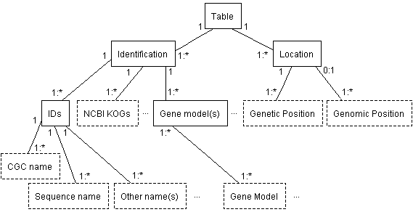
Nested Table Reverse Engineering via TISP
Theorem. Let S be a nested table with a single label path to each data item,
and let T be an OSM-O model instance. A transformation from S to T exists
that preserves information and constraints.

Slide 27
Semantic Integration
Schema Mapping
Direct & Indirect
Use of extraction ontologies
Semantic Enhancement for Integration
Semantics of many sources abstracted away
Alignment with global community knowledge
WordNet
Data-frame library

Slide 28
Multi-faceted Schema Mapping
Central Idea: Exploit All Data & Metadata
Matching Possibilities (Facets)
Attribute Names
Data-Value Characteristics
Expected Data Values (use of extraction ontologies)
Data-Dictionary Information
Structural Properties

Slide 29
Example
Year
Year
Year
Make
Year
Make
Feature
Make
Make
has
has
has
has
has
Car
Car
Cost
Model
Model
Car
Model
Car
has
Model
Style
has
has
has
has
has
has
has
Mileage
Phone
Mileage
Miles
Miles
Cost
Target Schema T
Source Schema S

Slide 30
Individual Facet Matching
Attribute Names
Data-Value Characteristics
Expected Data Values

Slide 31
Attribute Names
Target and Source Attributes
T : A
S : B
WordNet
C4.5 Decision Tree: feature selection, trained on schemas in DB books
f0: same word
f1: synonym
f2: sum of distances to a common hypernym root
f3: number of different common hypernym roots
f4: sum of the number of senses of A and B

Slide 32
WordNet Rule
The number of different common hypernym roots of A and B
The sum of the number of senses of A and B
The sum of distances of A and B to a common hypernym

Slide 33
Confidence Measures

Slide 34
Data-Value Characteristics
C4.5 Decision Tree
Features
Numeric data
(Mean, variation, standard deviation, …)
Alphanumeric data
(String length, numeric ratio, space ratio)

Slide 35
Confidence Measures

Slide 36
Expected Data Values
Target Schema T and Source Schema S
Regular expression recognizer for attribute A in T
Data instances for attribute B in S
Hit Ratio = N'/N for (A, B) match
N' : number of B data instances recognized by the regular expressions of A
N: number of B data instances

Slide 37
Confidence Measures

Slide 38
Combined Measures
1
0
0
0
0
0
0
0
1
0
0
0
0
0
0
0
1
0
0
0
0
0
0
0
1
0
0
0
0
0
0
0
0
0
1
0
0
0
0
0
0
0
0
0
0
0
0
0
0
0
Threshold: 0.5

Slide 39
Final Confidence Measures
0
0
0

Slide 40
Direct & Indirect Schema Mappings
Year
Year
Color
Make
Feature
Make
&
Model
Body Type
Model
Car
Cost
Car
Style
Mileage
Phone
Miles
Cost
Target
Source

Slide 41
Mapping Generation
Direct Matches as described earlier:
Attribute Names based on WordNet
Value Characteristics based on value lengths, averages, …
Expected Values based on regular-expression recognizers
Indirect Matches:
1-n, n-1, or n-m based on direct matches
Structure Evaluation
Union
Selection
Decomposition
Composition

Slide 42
Union and Selection
Year
Year
Color
Make
Feature
Make
&
Model
Body Type
Model
Car
Cost
Car
Style
Mileage
Phone
Miles
Cost
Target
Source

Slide 43
Decomposition and Composition
Year
Year
Color
Make
Feature
Make
&
Model
Body Type
Model
Car
Cost
Car
Style
Mileage
Phone
Miles
Cost
Target
Source

Slide 44
Semantic Enrichment (e.g., MOGO)
TANGO repeatedly turns raw tables into conceptual mini-ontologies and integrates them into a growing ontology.
fleck | velter
 | gonsity (ld/gg) | hepth (gd)
burlam | 1.2 | 120
falder | 2.3 | 230
multon | 2.5 | 400
Growing
Ontology
MOGO (Mini-Ontology GeneratOr)
generates mini-ontologies from
interpreted tables.

Slide 45
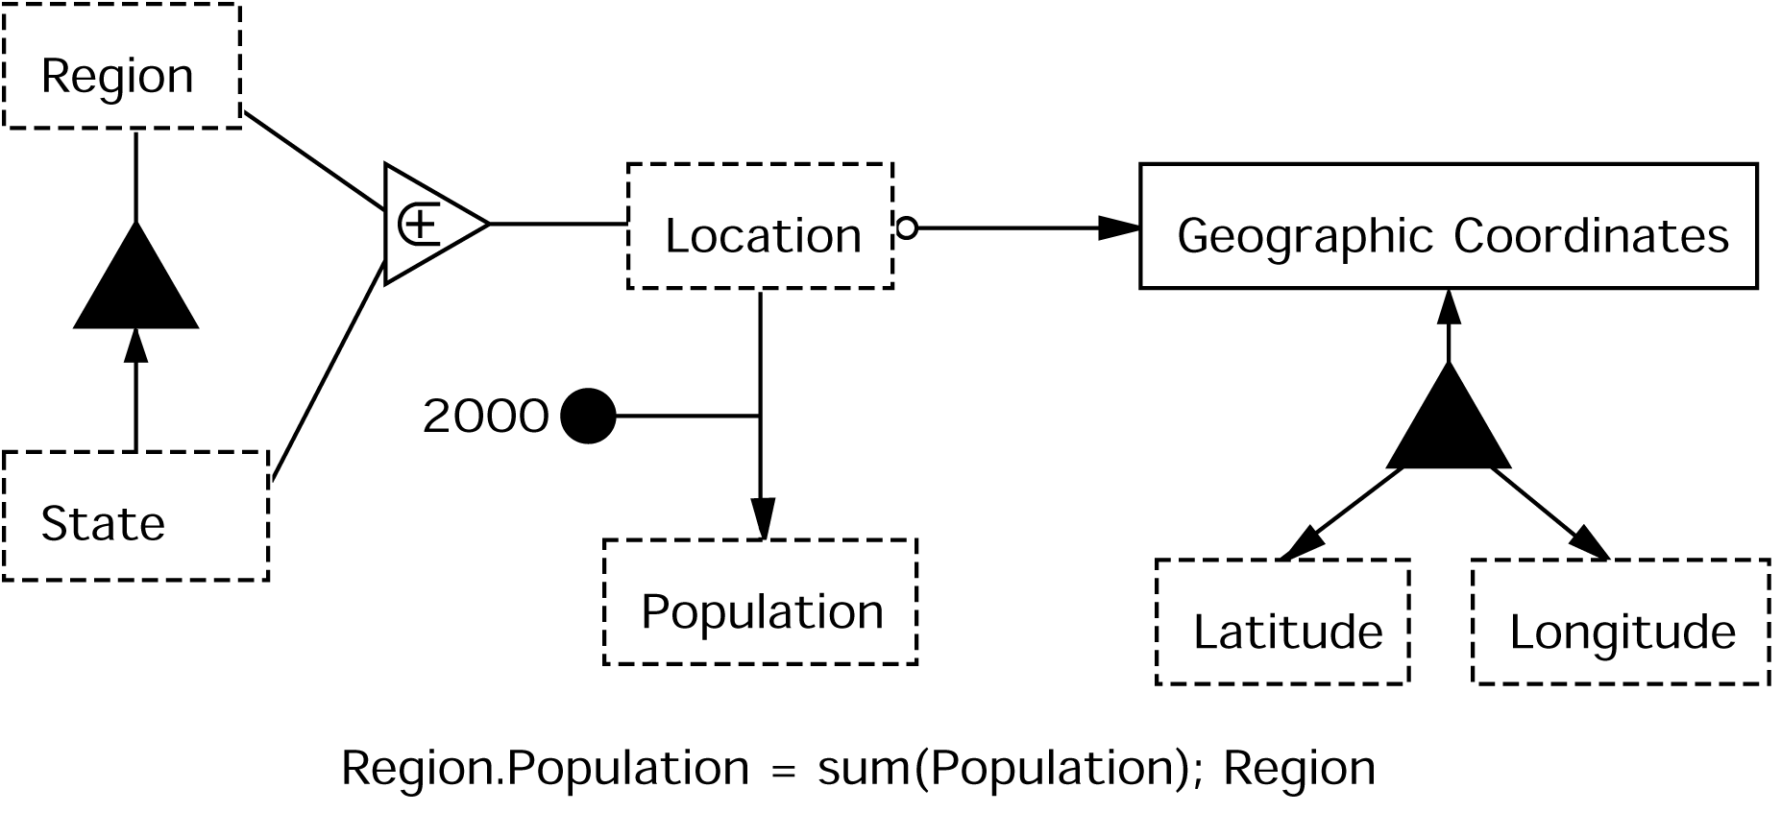
Sample Input
Region and State Information
Location | Population (2000) | Latitude | Longitude
Northeast | 2,122,869
Delaware | 817,376 | 45 | -90
Maine | 1,305,493 | 44 | -93
Northwest | 9,690,665
Oregon | 3,559,547 | 45 | -120
Washington | 6,131,118 | 43 | -120
Sample Output
Notes:
- Explain what is “mini” about the ontology
Walk user through the mini-ontology to explain what it tells us about the concepts/relationships

Slide 46
Concept/Value Recognition
Lexical Clues
Labels as data values
Data value assignment
Data Frame Clues
Labels as data values
Data value assignment
Default
Recognize concepts and values by syntax and layout

Slide 47
Concept/Value Recognition
Lexical Clues
Labels as data values
Data value assignment
Data Frame Clues
Labels as data values
Data value assignment
Default
Recognize concepts and values by syntax and layout
Concepts and Value Assignments
Location
Region
State
Northeast
Northwest
Delaware
Maine
Oregon
Washington

Slide 48
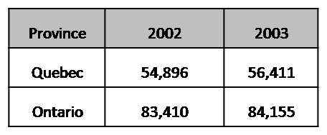
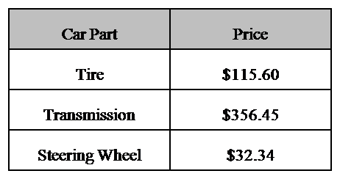
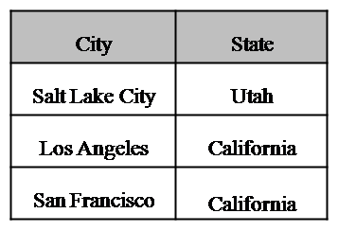
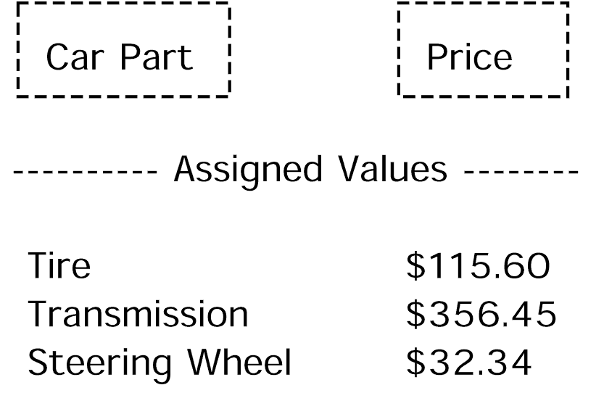
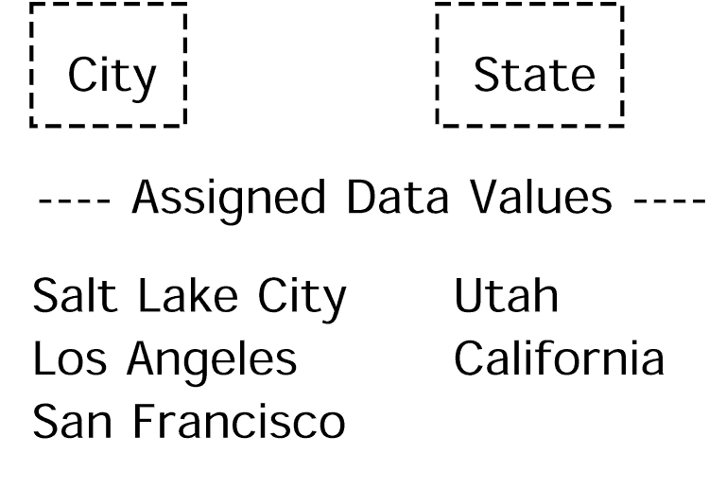
Concept/Value Recognition
Lexical Clues
Labels as data values
Data value assignment
Data Frame Clues
Labels as data values
Data value assignment
Default
Recognize concepts and values by syntax and layout
Year
2002
2003
Concepts and Value Assignments
Location
Region
State
Population
Latitude
Longitude
Northeast
Northwest
Delaware
Maine
Oregon
Washington
2,122,869
817,376
1,305,493
9,690,665
3,559,547
6,131,118
45
44
45
43
-90
-93
-120
-120

Slide 49
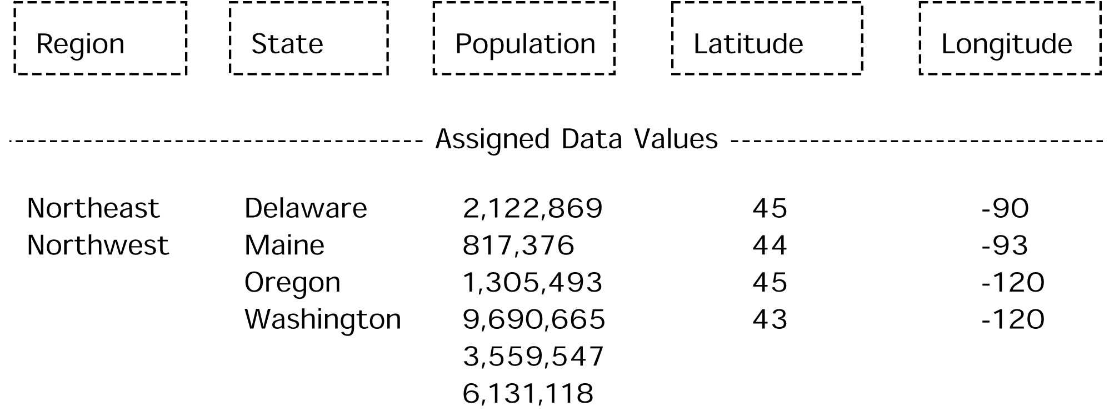
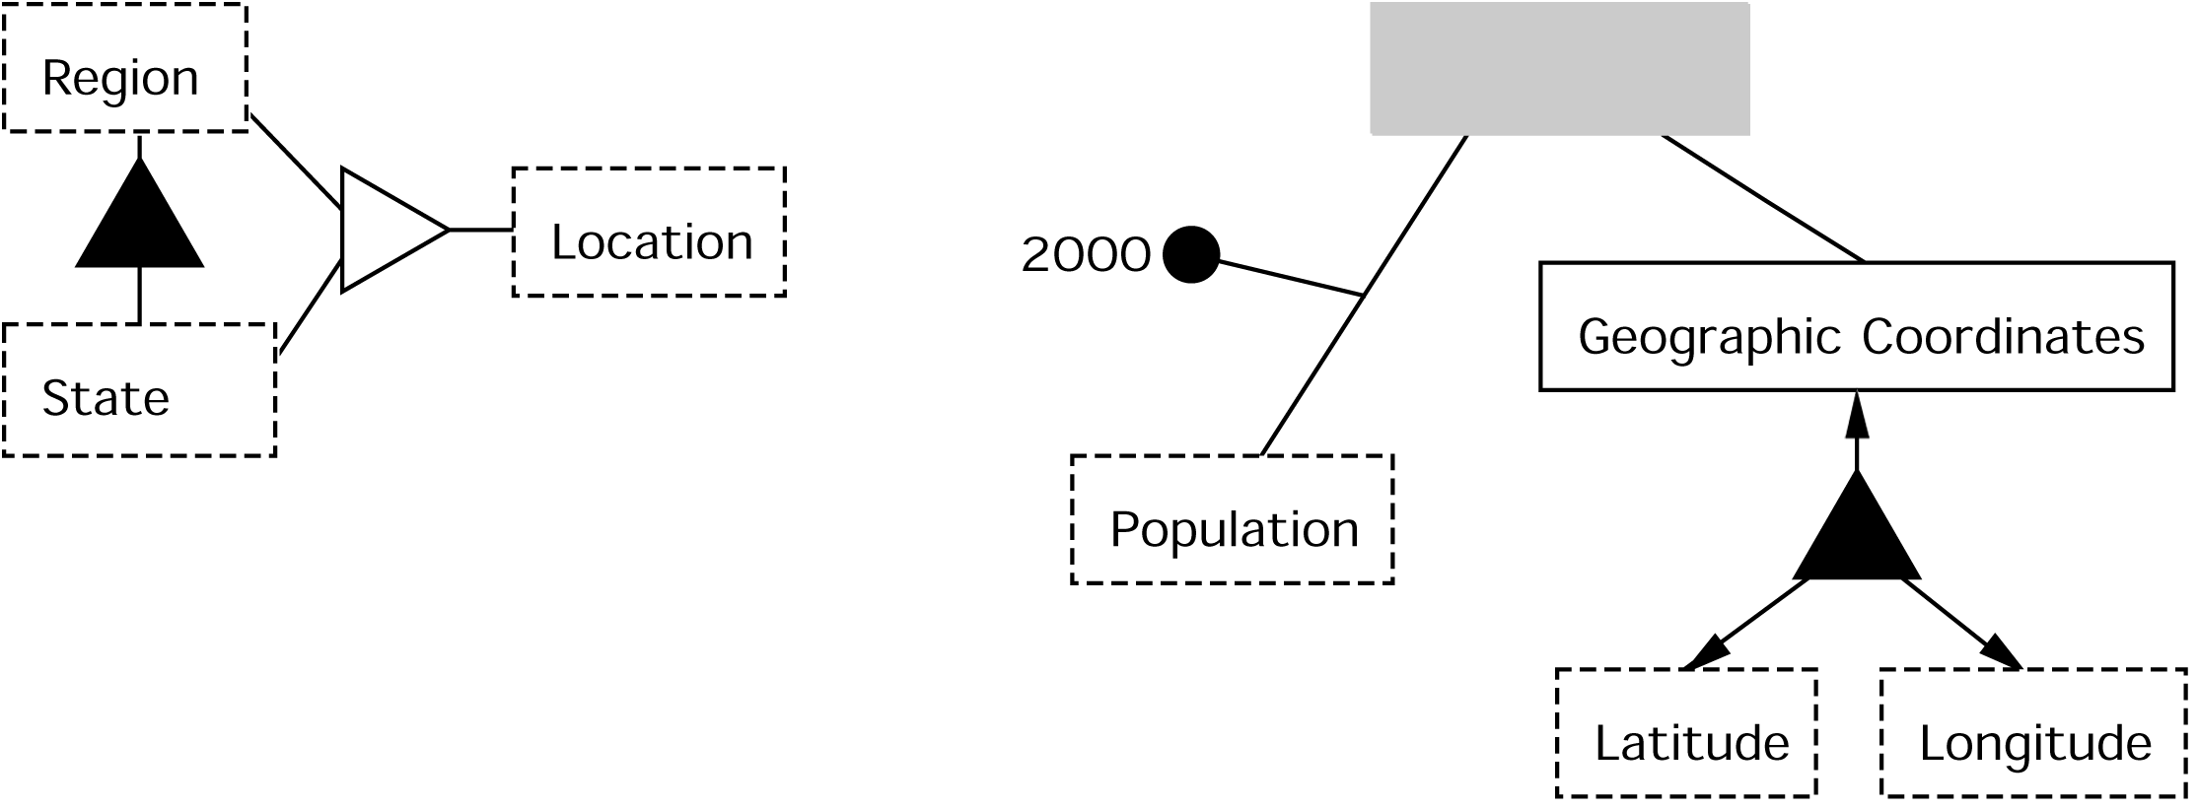
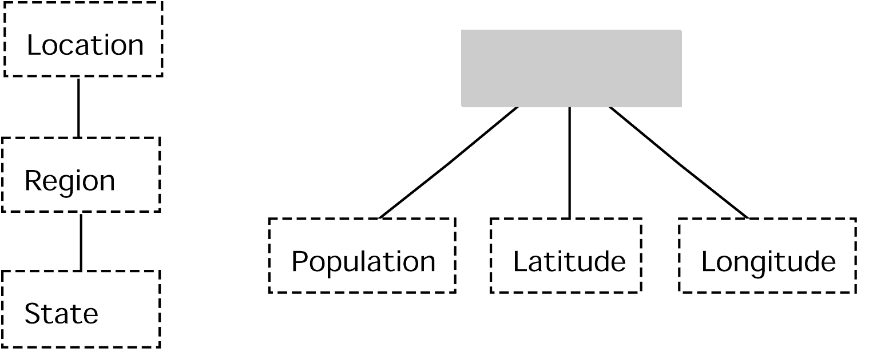
Relationship Discovery
2000
Dimension Tree Mappings
Lexical Clues
Generalization/Specialization
Aggregation
Data Frames
Ontology Fragment Merge

Slide 50
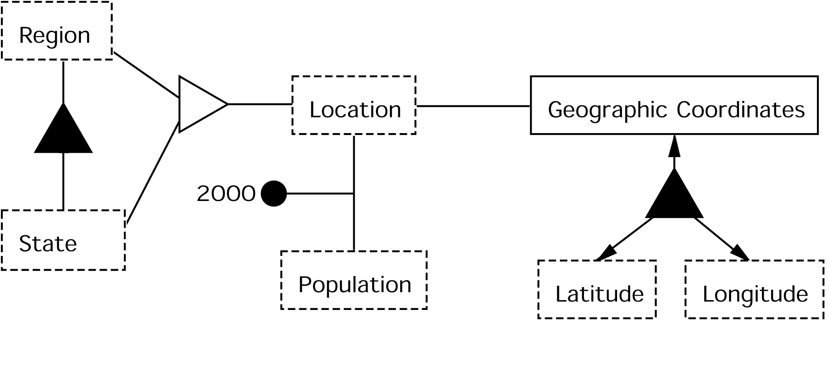
Relationship Discovery
Dimension Tree Mappings
Lexical Clues
Generalization/Specialization
Aggregation
Data Frames
Ontology Fragment Merge

Slide 51
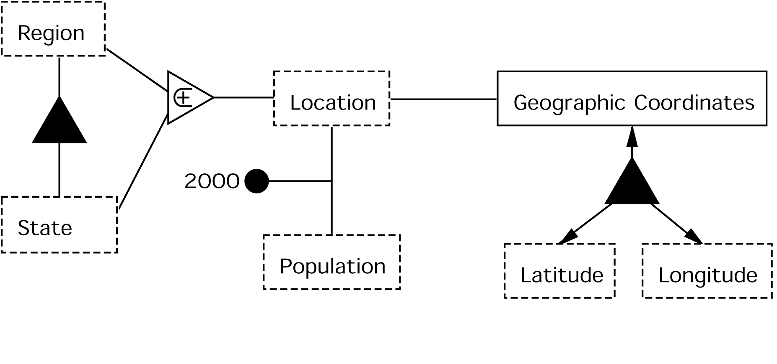
Constraint Discovery
Generalization/Specialization
Computed Values
Functional Relationships
Optional Participation
Region and State Information
Location | Population (2000) | Latitude | Longitude
Northeast | 2,122,869
Delaware | 817,376 | 45 | -90
Maine | 1,305,493 | 44 | -93
Northwest | 9,690,665
Oregon | 3,559,547 | 45 | -120
Washington | 6,131,118 | 43 | -120
Notes:
- Explain how functional dependencies are found better – values in original table are functionally determined

Slide 52
Ontology Workbench: Prototype Development Tool
Notes:
We are working toward KBs and KBBs …

Slide 53
Case Study: Knowledge Bundles for Bio-Research
Problem: locate, gather, organize data
Solution: semi-automatically create KBs with KBBs
KBs
Conceptualized data + reasoning and provenance links
Linguistically grounded & thus extraction ontologies
KBBs
KB Builder tool set
Actively “learns” to build KBs
Notes:
What’s my take-home message? “KBs and KBBs can play a significant role in assisting researchers locate, gather, and organize information for research studies.” As an example, this may well be the essence of what ACM-L means: conceptual modeling (CM) is the foundation for KBs and active learning (A…-L) is the foundation for KBBs.
Emphasize here and later. (What must listeners understand to be able to take the message home?)

Slide 54
Research Study: Objective and Task
Objective: Study the association of:
TP53 polymorphism and
Lung cancer
Task: locate, gather, organize data from:
Single Nucleotide Polymorphism database
Medical journal articles
Medical-record database
Notes:
Doesn’t matter whether it is the essence of ACM-L or not – may be better to pitch it as one possible way to achieve Active Conceptual Modeling for Learning (ACM-L).

Slide 55
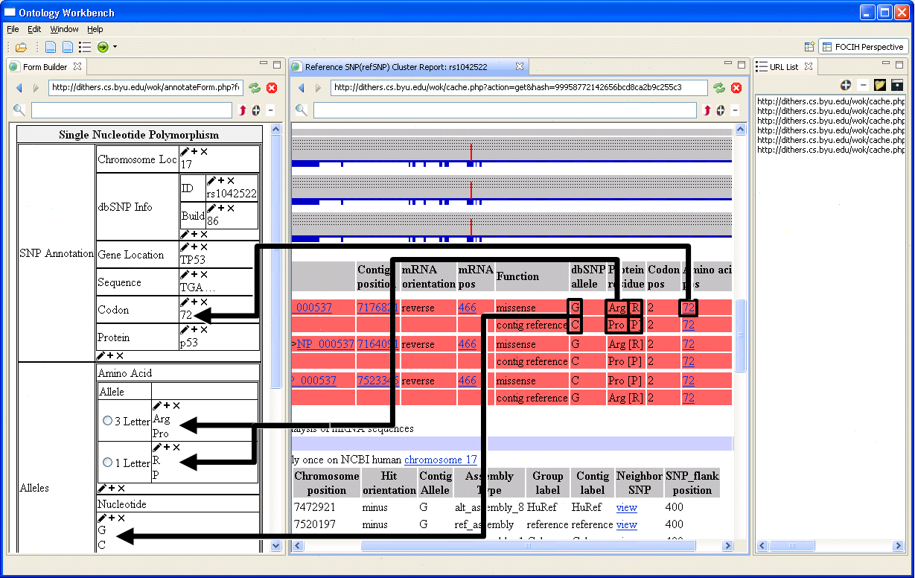
Gather SNP Information from the NCBI dbSNP Repository
SNP: Single Nucleotide Polymorphism
NCBI: National Center for Biotechnology Information
Notes:
Explain how FOCIH works. Also, how it will work when we add a filtering mechanism (e.g., minor allele frequency > 1%)

Slide 56
Search PubMed Literature
PubMed: Search-engine access to life sciences and biomedical scientific journal articles
Notes:
Works by linguistically grounding an extraction ontology. (e.g., people in the bioInformatics community may know about OpenDMAP)

Slide 57
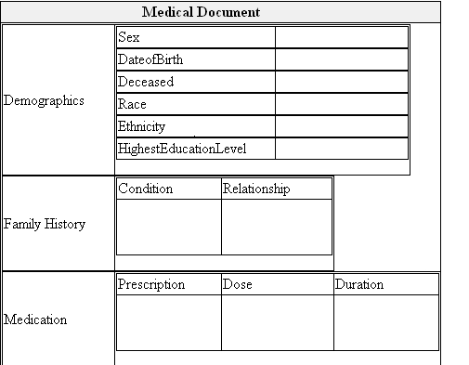
Reverse-Engineer Human Subject Information from INDIVO
INDIVO: personally controlled health record system

Slide 58
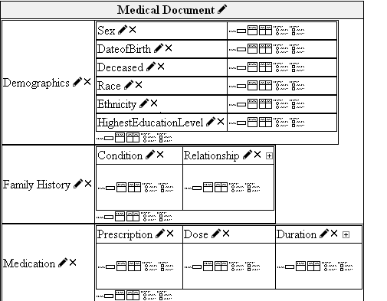
Reverse-Engineer Human Subject Information from INDIVO
INDIVO: personally controlled health record system

Slide 59
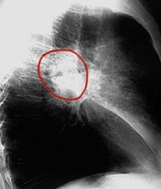
Add Annotated Images
Radiology Report
(John Doe, July 19, 12:14 pm)

Slide 60
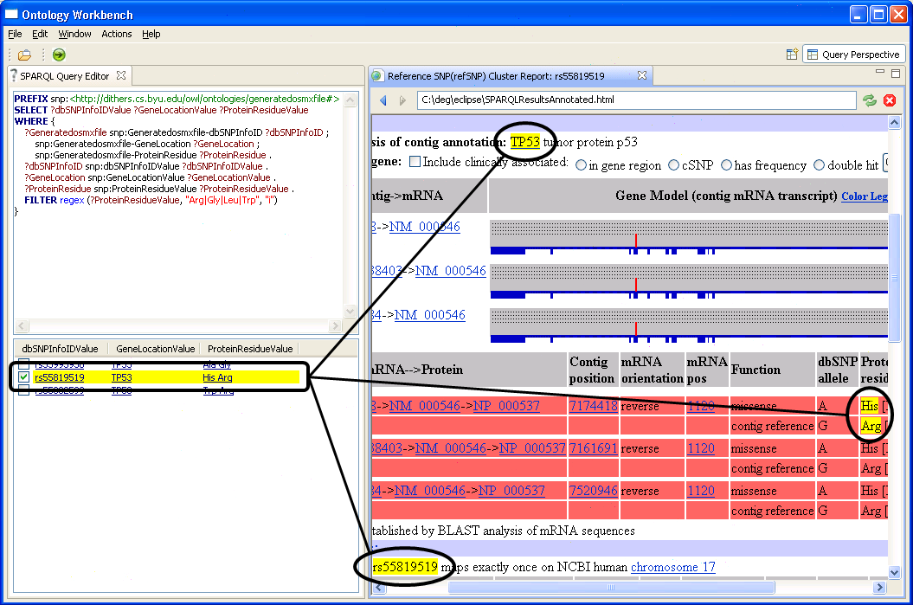
Query and Analyze Data in Knowledge Bundle (KB)

Slide 61
Research to Accomplish
Build Unified Prototype
Integrate projects
Enhance/Add KBB tools
Create Knowledge Repository
Data-frame recognizers
Ontology snippets
Extraction ontologies (both developed & developing)
Develop user interface
Allow for virtual KBs
Add/Develop analysis tools & data mining tools
Resolve performance issues
Decidability & tractability of basic algorithms
Architecture for web-scale system

Slide 62
Issue Resolution (Summary)
Wide variety of data sets
General references – the Web? CIA World Factbook? ... (OntoES, FOCIH, TISP)
Free-running text – news, technical journals (WePS, [Embley09], Ancestry.com)
Geospatial data ([Embley89b])
Entity databases (RelDB[Embley97], XML[Al-Kamha07,Al-Kamha08], IMS=heirarchical[Mok06,Mok10], Network=graph=OSM, OWL[Ding-converter])
Reports (Filled-in forms and semi-structured data [Tao09,Liddle99],TANGO)
And more (Attensity?)
Large and numerous data sets (extension to large and additional types; performance)
Alignment of data models (TANGO)
Schema mapping ([Xu03,Xu06], …)
Data integration ([Biskup03])
Semantic enrichment (MOGO)
Advanced analytic algorithms (Giraud-Carrier: knowledge-based semantic distance, record linkage, and hybrid social networks; best-effort, quick answers [Zitzelberger thesis])
Performance ([Al-Muhammed07b], IS/Liddle, Attensity?)

Slide 63
Vision: KBs & KBBs for “Knowledge Discovery and Dissemination”
Custom harvesting of information into KBs
KB creation via a KBB
Semi-automatic: shifts harvesting burden to machine
Synergistic: works without intrusive overhead
Actively “learns as it goes” & “improves with experience”
Resolve challenging research issues
KB/KBB prototype
Semantic integration
Analysis & data mining tools
Performance issues (including virtual KBs, large & diverse source repositories, quick construction & immediate usage)
www.deg.byu.edu

