Slide 1
Extracting Information from Diverse and Noisy Scanned Document Images
Thomas L. Packer
and
DEG & NLP Labs

Slide 2
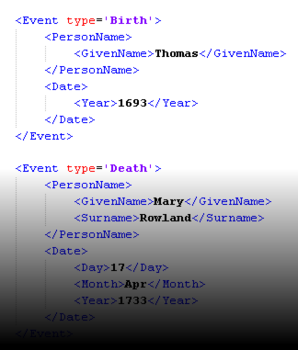
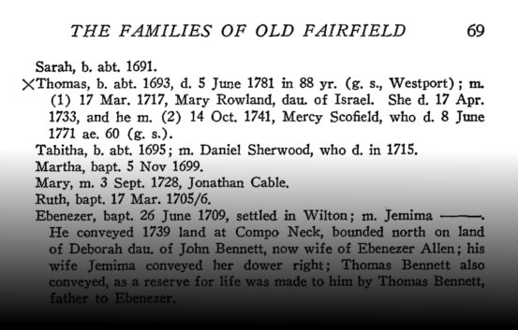
Goal
Extract topic-specific (e.g. genealogy-related) entities and relationships from scanned document images.
Notes:
For document search and knowledge engineering.

Slide 3
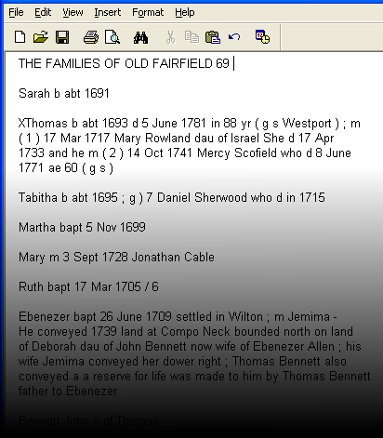
Sub-goals
Text Document Reconstruction (incl. OCR)
Information Extraction

Slide 4
Initial Approach
Use existing commercial OCR engine output (provided by Ancestry.com)
Use existing information extraction techniques
Hand-written regex and CFG rules and dictionaries
MEMM and CRF trained from CoNLL NER data

Slide 5
Results of Initial Approach
Notes:
BOPCRIS was getting 70-80% F-measure on their data.

Slide 6
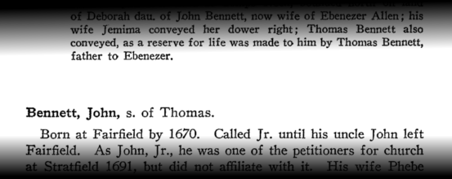
Challenge 1
Existing OCR lost punctuation and formatting.

Slide 7
Proposed Solution to Challenge 1
Re-OCR, preserve punctuation and formatting.

Slide 8
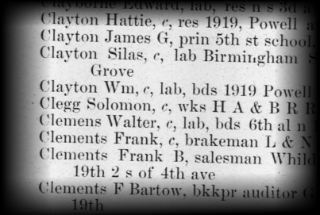
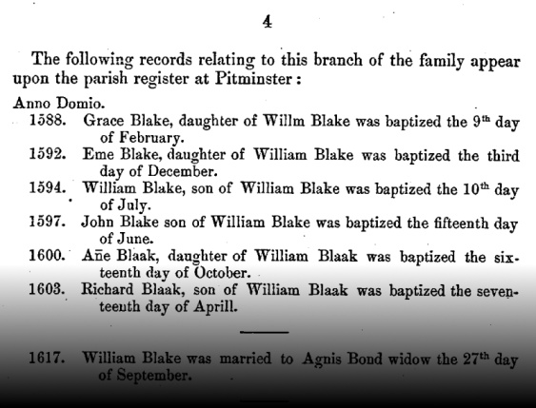
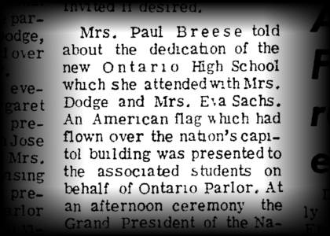
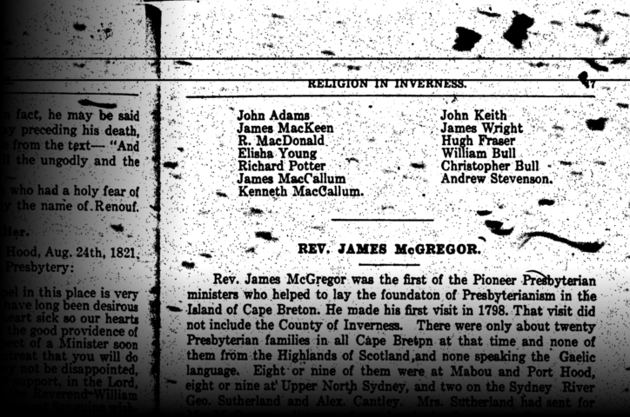
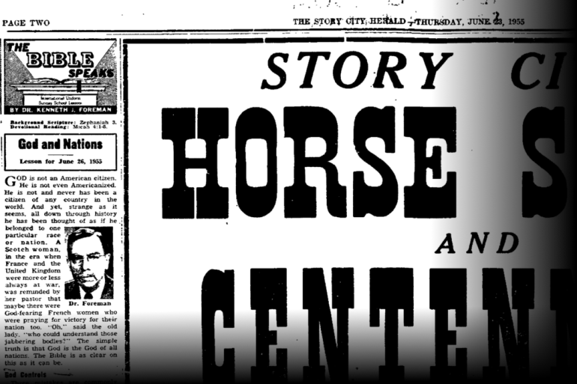
Challenge 2
Diverse document structure
Notes:
Line breaks in one document or paragraph mean something different than what they do in another.

Slide 9
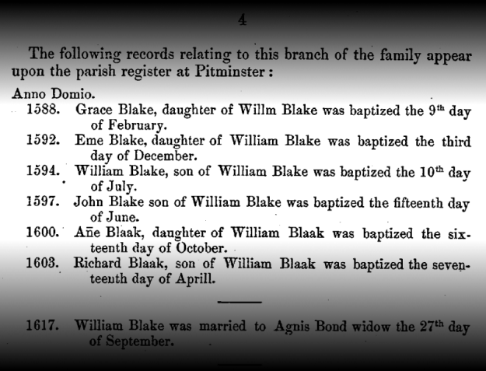
Proposed Solution to Challenge 2
Adaptive format interpretation (Grammar Induction)
Categorize lines by inferred tab stops (RANSAC).
Propose multiple candidate groupings.
Score candidates using language model, extraction quality or pattern similarity/compressibility.
Notes:
What I’d most like to consider is scoring indirectly by an extraction grammar applicability score to fuel semi-supervised grammar induction as part of bootstrapping.

Slide 10
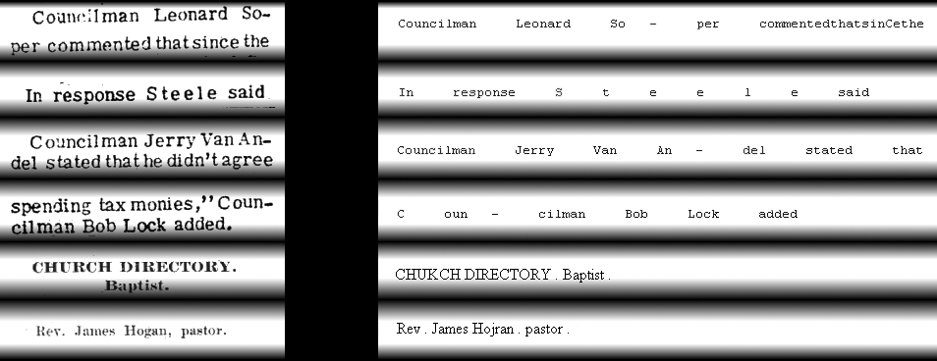
Challenge 3
OCR and other character-level noise

Slide 11
Proposed Solution 1 to Challenge 3
GivenName → “John” | “Margaret”
Surname → “Steele” | “Anderson”
PersonName → GivenName | GivenName Surname
ParentChildRelationship → PersonName ChildKeyWord PersonName
“Post-Terminal” CFG Rules
“Steele” → “S t e e l e”
MergedTokens → (SingleCharToken “ ”) {2-20}
“Anderson” → “Ander- son”
MergedTokens → AnyToken “-” “ ” AnyToken
“Anderson” → “Andersor”
NoiseModelMappedToken → AnyToken

Slide 12
Proposed Solution 2 to Challenge 3
Develop and compose weighted finite state transducers for:
Language modeling / OCR error correction
Information extraction
Plug into the OCRopus OCR engine.

Slide 13
Challenge 4
More (labeled) data needed:
Training data (supervised ML)
Evaluation data (statistical significance)
Knowledge sources (dictionaries, etc.)

Slide 14
Proposed Solutions to Challenge 4
Get more data and label it.
Use semi-supervised and indirectly-supervised ML:
Bootstrapping from a few labeled examples and/or a few rules + lots of unlabeled data.

Slide 15
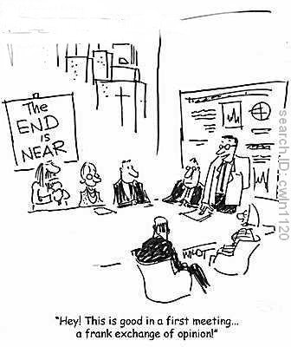
Questions? Feedback?

