Slide 1
Extracting Information from Diverse and Noisy Scanned Document Images
Thomas L. Packer
and
DEG & NLP Labs

Slide 2
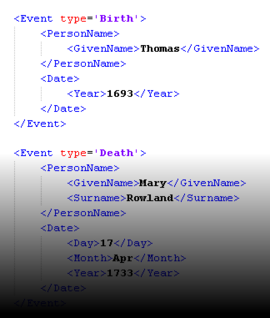
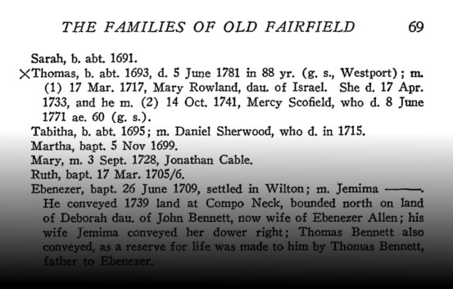
Goal
Extract topic-specific entities and relationships from scanned document images.
E.g., genealogy-related names and facts.
Notes:
For document search and knowledge engineering.

Slide 3
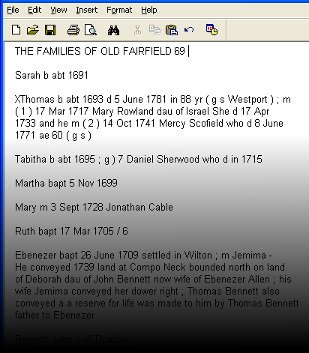
Sub-goals
Text Document Reconstruction (incl. OCR)
Information Extraction

Slide 4
Initial Approach
Use existing off-the-shelf OCR engine output (provided by Ancestry.com)
Use existing IE techniques:
Hand-written grammar rules and dictionaries
MEMM and CRF trained from CoNLL NER data

Slide 5
Initial IE Approaches: Full Names
Dictionary: Contiguous Dictionary Matches
Regex: Regular Expressions
CFG: Context Free Grammar and Chart Parser (Plus other entities and relations)
MEMM: Maximum Entropy Markov Model
CRF: Conditional Random Field
Ensemble: Majority Vote (input from 1, 2, 4)

Slide 6
Results of Initial Approach
All-or-None (green) and Partial-Credit (blue)
F-Measure of Full-Names,
Blind Test, a Dozen Different Documents
Notes:
BOPCRIS was getting 70-80% F-measure on their data.
Dictionary is so simple and good enough compared.

Slide 7
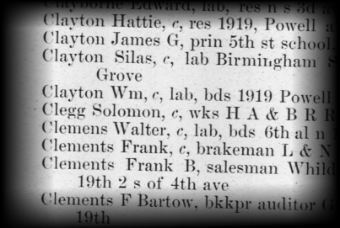
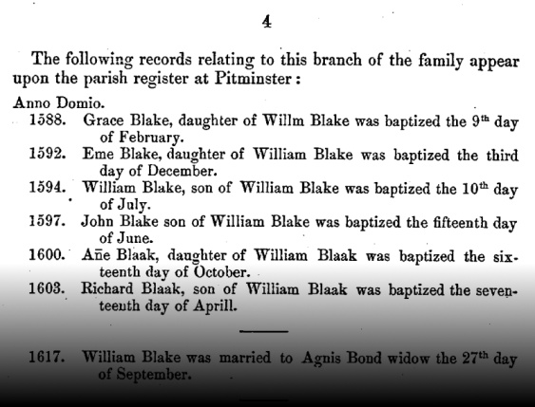
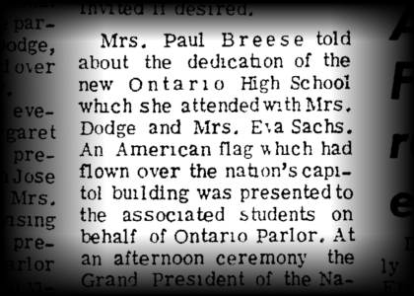
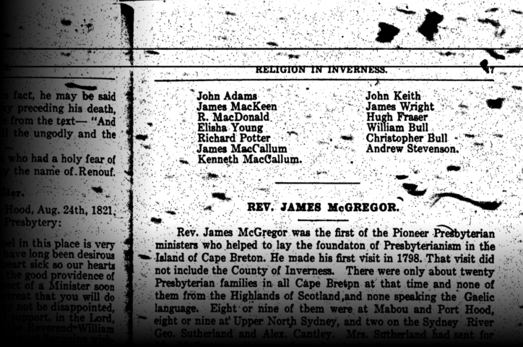
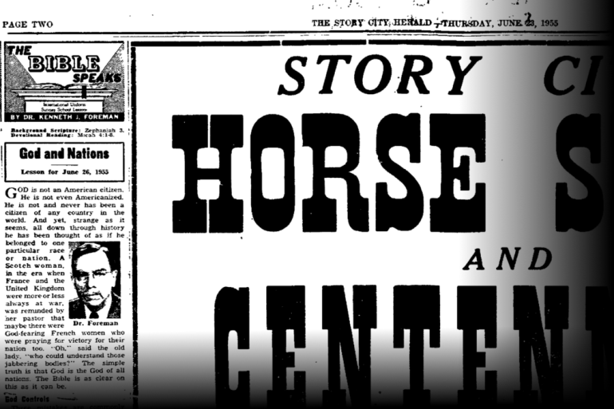
Challenges
Diverse document structure, little training data.
Notes:
Line breaks in one document or paragraph mean something different than what they do in another.

Slide 8
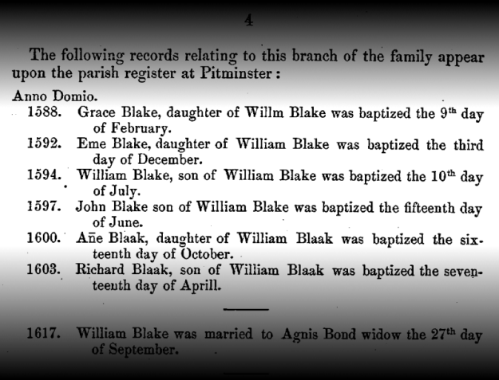
Proposed Solution to this Challenge
Adaptive format interpretation
Categorize lines by inferred tab stops (RANSAC).
Propose multiple candidate line groupings.
Train an extractor (e.g. HMM) for each candidate.
Score candidate grammars against:
Prior knowledge constraints (ontology) and
Simplicity (MDL) or data likelihood
Notes:
What I’d most like to consider is scoring indirectly by an extraction grammar applicability score to fuel semi-supervised grammar induction as part of bootstrapping.

Slide 9
System Name
SOCRATES: Synergistic OCR-based Acquisition of Textualized Entities and other Stuff
Notes:
It’s a smart-sounding name, isn’t it?

Slide 10
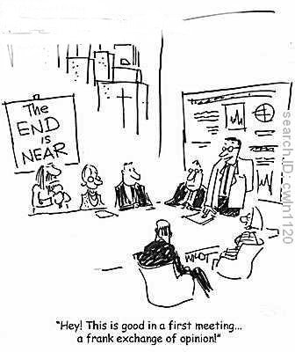
Questions?

