Slide 1
Extracting Information from Diverse and Noisy
Scanned Document Images
Thomas L. Packer
and
DEG & NLP Labs

Slide 2
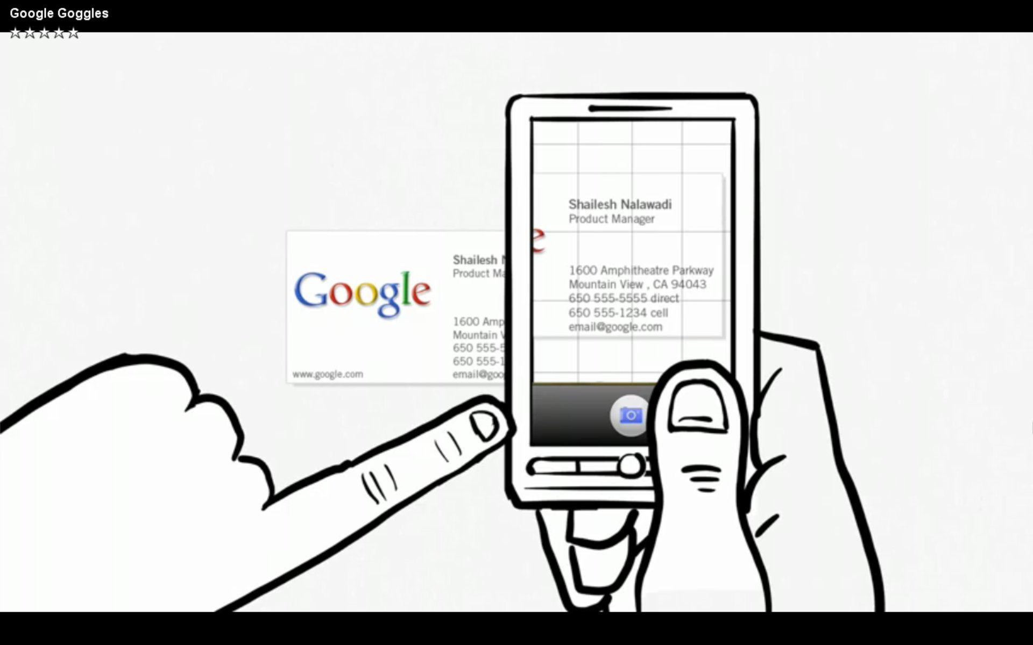
Lots of Analog Text and Cameras

Slide 3
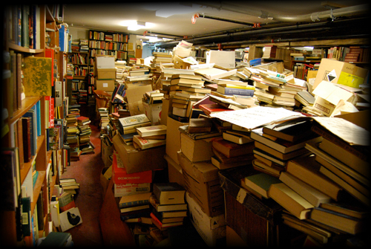
Lots of Old Printed Information
Notes:
How can they reach the information age / digital age?
For document search and knowledge engineering.

Slide 4
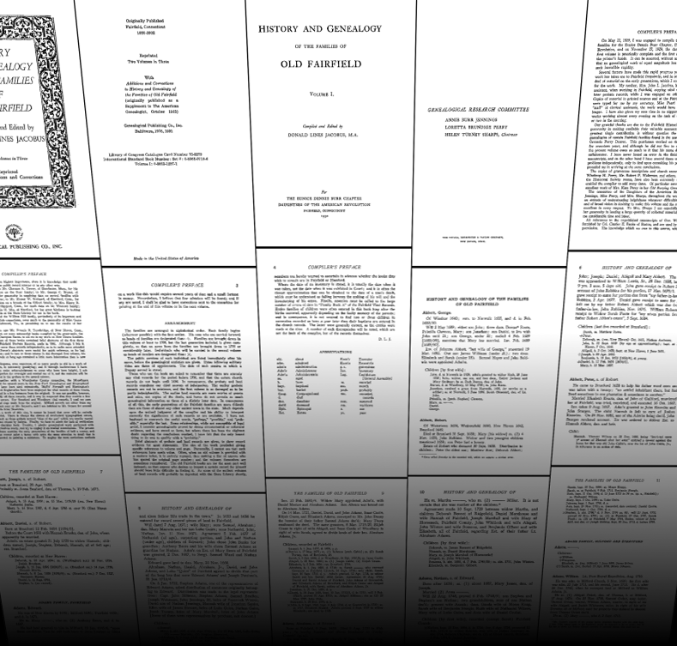
Scanning: Are we there yet?
Notes:
Brings them to the web: multiple, remote viewers.
http://seadragon.com/showcase/chris-jordan/#office-paper

Slide 5
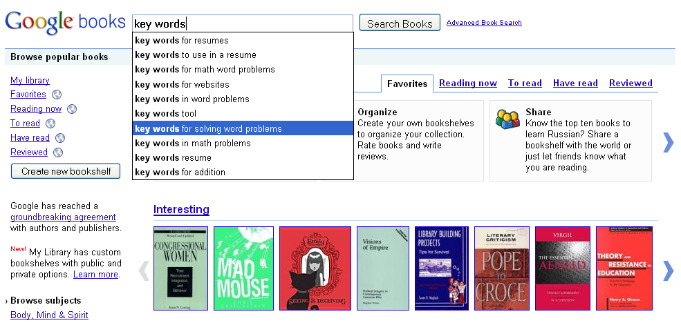
OCR: Are we there yet?
Notes:
Key-word search. OCR errors
Want:
OCR error correction
Search for entities, not words

Slide 6
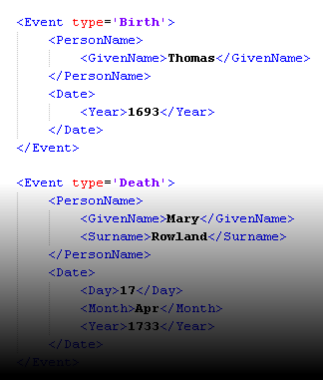
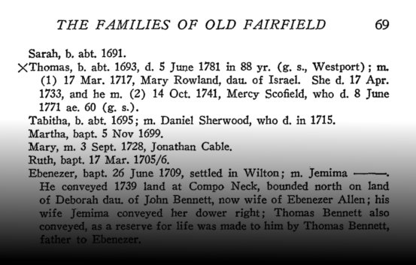
Process
Extract topic-specific (e.g. genealogy-related) entities and relationships from scanned document images.
Notes:
For document discoverability and knowledge engineering.
Discoverability: search and browsing with metadata.

Slide 7
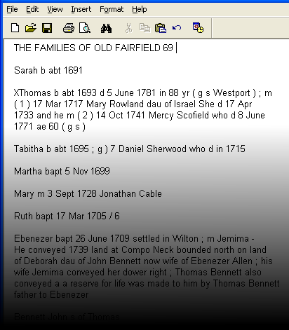
Sub-Processes
Document Image Analysis (incl. OCR)
Information Extraction

Slide 8
Initial Approach
Use existing commercial OCR engine output (provided by Ancestry.com)
Use existing IE techniques:
  Hand-written grammar rules and dictionaries
  MEMM and CRF trained from CoNLL NER data

Slide 9
Initial IE Approaches: Full Names
Dictionary: Contiguous Dictionary Matches
Regex: Regular Expressions
CFG: Context Free Grammar and Chart Parser (Plus other entities and relations)
MEMM: Maximum Entropy Markov Model
CRF: Conditional Random Field
Ensemble: Majority Vote (input from 1, 2, 4)

Slide 10
Results of Initial Approach
All-or-None (green) and Partial-Credit (blue)
F-Measure of Full-Names,
Blind Test, a Dozen Different Documents
Notes:
BOPCRIS was getting 70-80% F-measure on their data.
Dictionary is so simple and good enough compared.

Slide 11
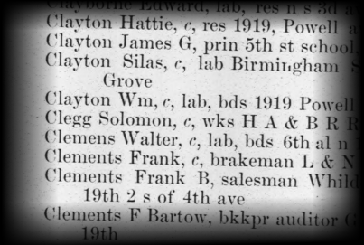
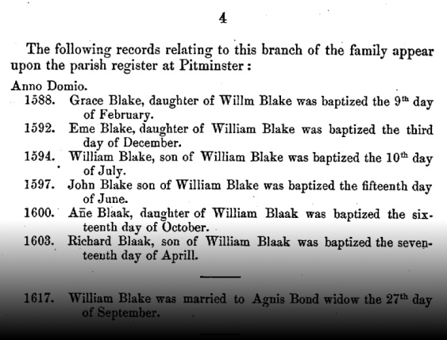
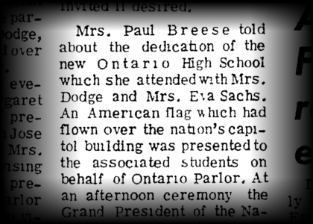
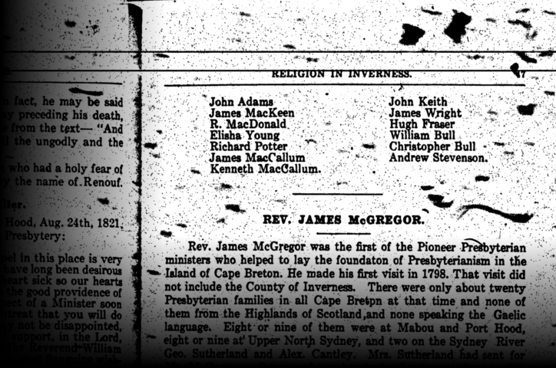
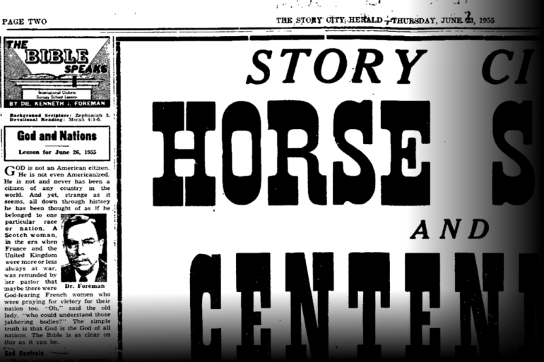
Challenges
Diverse document structure, little training data.
Notes:
Line breaks in one document or paragraph mean something different than what they do in another.

Slide 12
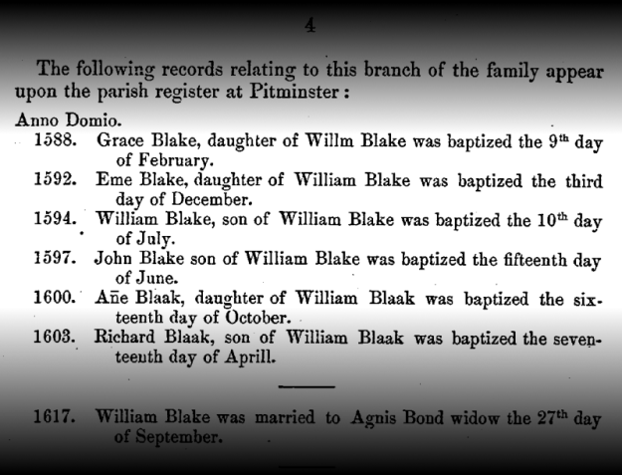
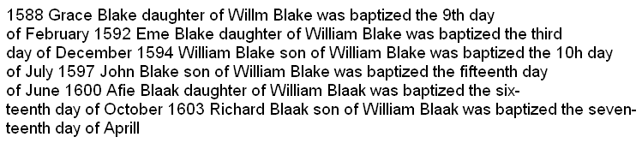
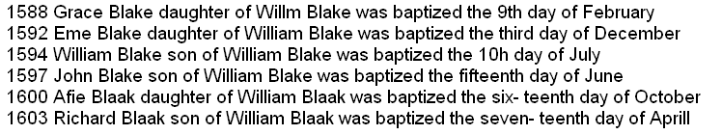
Proposed Solution: Step One
Adaptive page structure interpretation
  Categorize lines by inferred tab stops (RANSAC).
  Propose multiple candidate line groupings.
  Induce an extractor (e.g. HMM) for each candidate.
  Score candidate grammars against:
    Prior knowledge constraints (ontology) and
    Simplicity (MDL) or data likelihood

Slide 13
Proposed Solution: Step Two
Semi-supervised Training of Multiple Multi-level HMMs
  Input semantic constraints and domain knowledge from ontology.
  Optionally label a few page images.
  Build HMM structure from ontology constraints.
  Estimate HMM parameters (probabilities) using modified Viterbi and EM.
  Bootstrapping: feedback acquired knowledge among multiple HMMs.

Slide 14
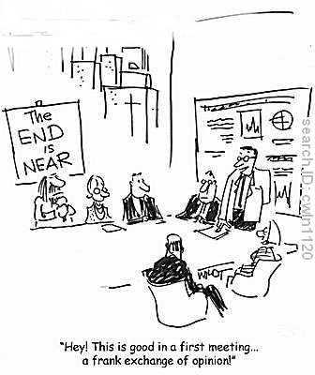
Questions?

Slide 15
System Name
SOCRATES: Synergistic OCR-based Acquisition of Textualized Entities and other Stuff

