Slide 1
“Automatic Segmentation of Text into Structured Records” written by
V. Borkar, K. Deshmukh, S. Sarawagi
presented by
Thomas L. Packer

Slide 2
Background

Slide 3
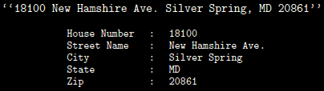
The Challenge: Segmenting Semi-Regular Text into Semantic Fields

Slide 4
HMM: A Probabilistic
Finite State Machine
Other
lived
in
of
walls
…
… lived in Virginia.
… Stone Phillips of NBC … Conoco Phillips hired Tom.
Stone walls stand well.
Given Name
Surname
Tom
Virginia
Stone
Phillips

Slide 5
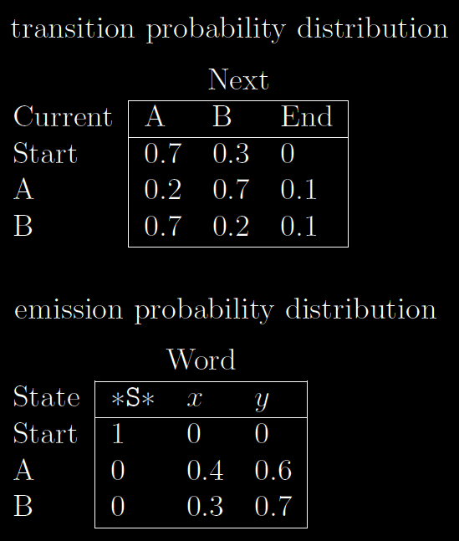
HMM Structure
set of n states (semantic label is a function of state)
dictionary of m output symbols (words, numerals, punctuation)
n x n transition matrix A:
  a_{ij} := prob. of making transition from state i to state j
n x m emission matrix B:
  b_{jk} := prob. of emitting k^{th} output symbol while in state j

Slide 6


HMM Training
Learn Structure
  Choose HMM structure (number of states n).
  Fill dictionary (union of all words in training data).
Estimate Probabilities
  a_{ij} =
  b_{jk} =
  Smoothing

Slide 7
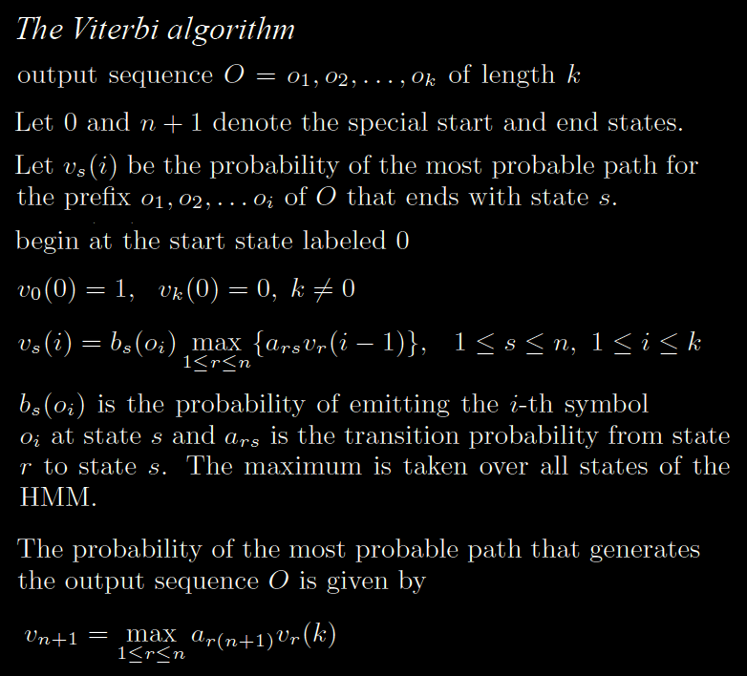
HMM Execution

Slide 8
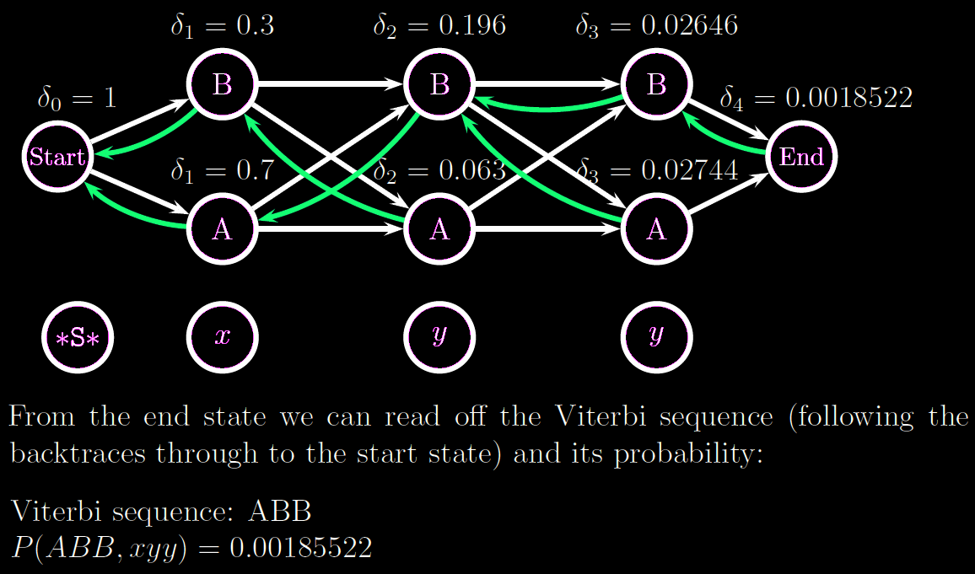
HMM Execution

Slide 9
Deterministic State Machine
Given Name
Surname
… lived in Virginia.
… Stone Phillips of NBC … Conoco Phillips hired Tom.
Stone walls stand well.
… lived in Virginia.
… Stone Phillips of NBC …
Conoco Phillips hired Tom.
Stone walls stand well.
… lived in Virginia.
… Stone Phillips of NBC …
Conoco Phillips hired Tom.
Stone walls stand well.
Tom
Virginia
Stone
Phillips
Given Name
Surname
Tom
Virginia
Stone
Phillips
Given Name
Surname
Tom
Virginia
<Cap>
Phillips

Slide 10
Probabilistic State Machine
Given Name
Surname
… lived in Virginia.
… Stone Phillips of NBC … Conoco Phillips hired Tom.
Stone walls stand well.
Tom (high)
Virginia (low)
Stone (low)
Phillips

Slide 11
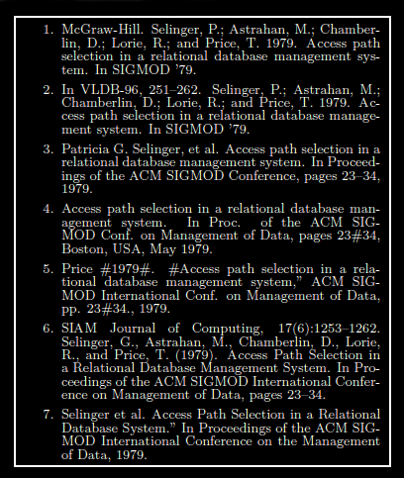
More Example Data: Bibliographies

Slide 12
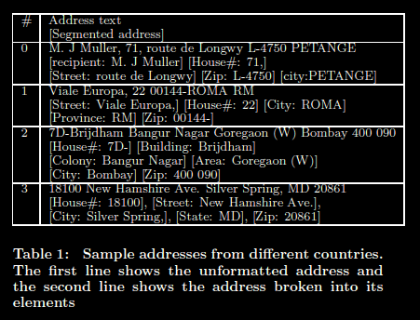
More Example Data:
International Addresses

Slide 13
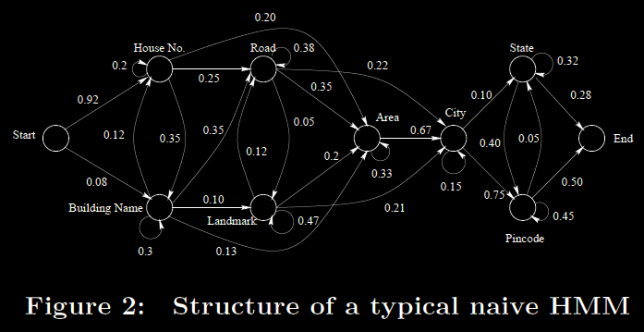
Typical HMM for
International Addresses

Slide 14
Ontos and Related
Ontology-Based Extractors
Strength: Semantic Model
  Goal-driven semantic constraints
  Eliminates wrong choices not seen on surface (syntactic evidence)
Weakness: Syntactic Model
  Dictionary-based Regular Expressions
  Hand-coded
  Brittle in the face of complex, unknown and contradictory evidence

Slide 15
Hidden Markov Models (HMMs) and Related Statistical Models
Strength:
  Data-driven syntactic constraints
  Simple, probabilistic syntactic model
  Combines evidence from multiple words in sequence
  Weighs contradictory evidences
Weaknesses:
  Ignorant of coarse-grained syntax
  Must also handle unknown evidence
  Weak semantic constraints

Slide 16
Methods

Slide 17
Improvements in this Paper:
DataMold
Ignorant of coarse-grained syntax:
  Nested structure
Must also handle unknown evidence:
  Partially-learned feature taxonomy
  Smoothing
There are no semantic constraints:
  Integrate semantic constraints

Slide 18
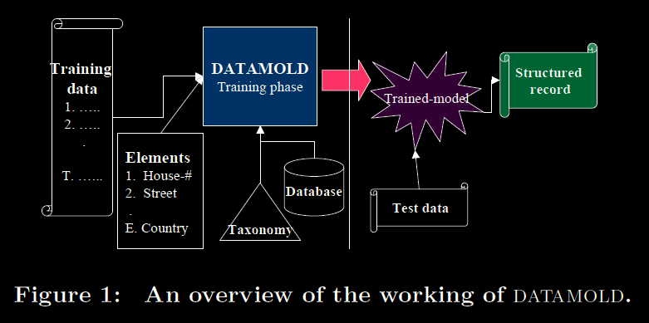
DataMold

Slide 19
Typical HMM for
International Addresses

Slide 20
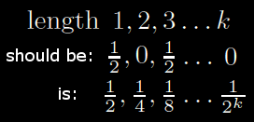
Typical HMMs’ Flat Structure
Captures ordering relationships among entities (external patterns).
Because of one state per entity, ignores internal sequence patterns.
  Most road names end with “Road”, “Street”, “Avenue”, etc.
  Country state outputs both “New” and “Zealand” and in either order.
Limited self-loop probability:
  Half of entity length 1, half length 3
  Self-loop probability = 0.5
  Subsequent state probabilities:

Slide 21
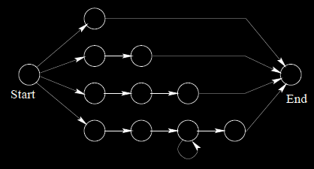
DataMold Adds
Nested HMM Structure
Outer HMM is learned from label sequence (length of each label is reduced to 1).
Separate inner HMM learned for each label.
  One parallel path per possible length.
  Merge paths with sparse training data.

Slide 22
Typical HMMs’ Fine-grained Features
Uses the raw text of each token as the feature.
Zip code HMM-state:
  Must learn prob. of each distinct number
  Sparse training data
  Should learn prob. of five-digit number

Slide 23
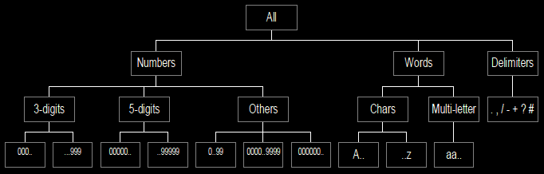
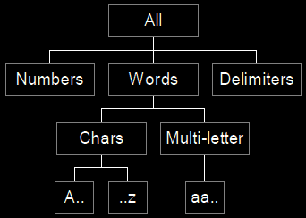
DataMold Adds
Hierarchy of Features
Enter word feature taxonomy (ontology constraints).
Automatically prune frontier: optimize trade-off between data sparseness and discrimination power.

Slide 24
Typical HMM’s
Syntax-oriented Parsing
Input “… New York, California …”
“New York” has high prob. for city
“California” has high prob. for state
City followed by state is high prob.
The labeling is obvious … and wrong!
Similarly “Tbilisi, Georgia”
Georgia is a country, not a state.

Slide 25

DataMold Adds
Semantic Constraints to Viterbi
Modify recursive Viterbi formula.
Restrict it from exploring invalid paths based on ontology.
  Take max over only valid states
  Valid means no semantic contraction between current position and any previous states found in best path.
  Don’t do database look-up for any non-max states.
Make it optimal.

Slide 26
Results

Slide 27
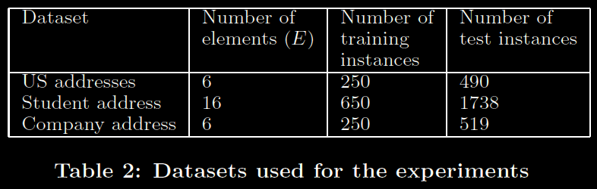
Datasets Used

Slide 28
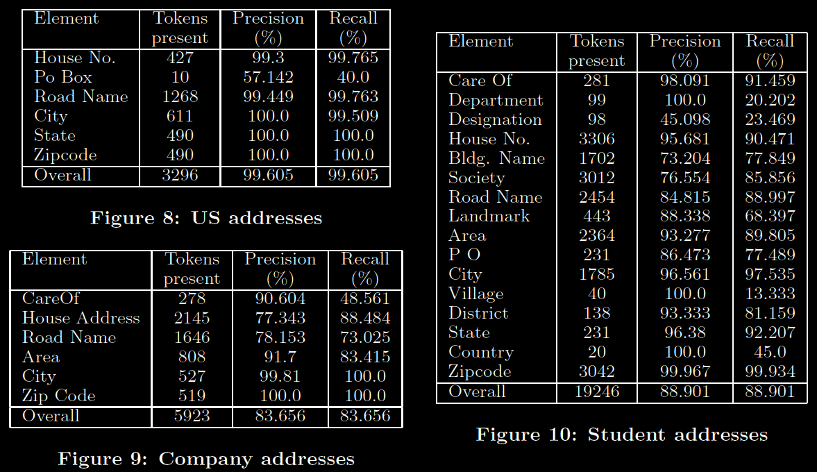
Final P-R Results over Datasets

Slide 29
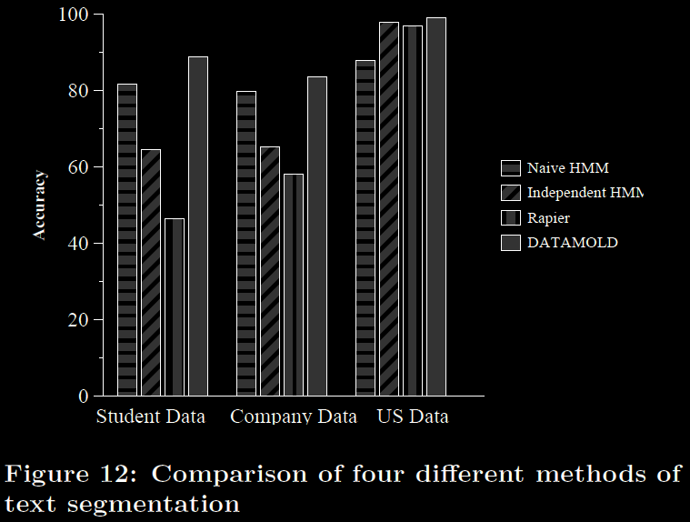
Comparative Accuracy Results over Datasets

Slide 30
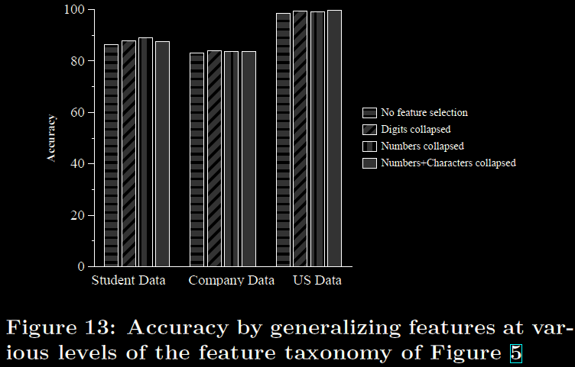
Comparative Accuracy Results over Datasets

Slide 31
Future Work

Slide 32
Potential Future Work from DataMold
More detailed feature taxonomy lattice.
More than 2-levels of HMM hierarchy.
Reduce time-complexity of 2-level Viterbi.
  They hand-wave.
Use entity taxonomy for higher HMMs.
More (or naturally available) semantic constraints.
  They hand-wave.
Probabilistic semantic constraints.
Semi-supervised training of HMM using EM.
Bootstrap semantic constraints.

