Slide 1
Extracting Full Names from Diverse and Noisy Scanned Document Images
Thomas L. Packer,
BYU Noisy OCR Group,
Lee Jensen, Ancestry.com, Inc.

Slide 2
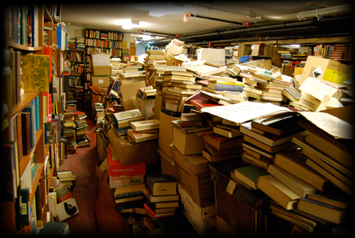
Lots of Old, Inaccessible Printed Information
Notes:
How can they reach the information age / digital age?
For document search and knowledge engineering.

Slide 3
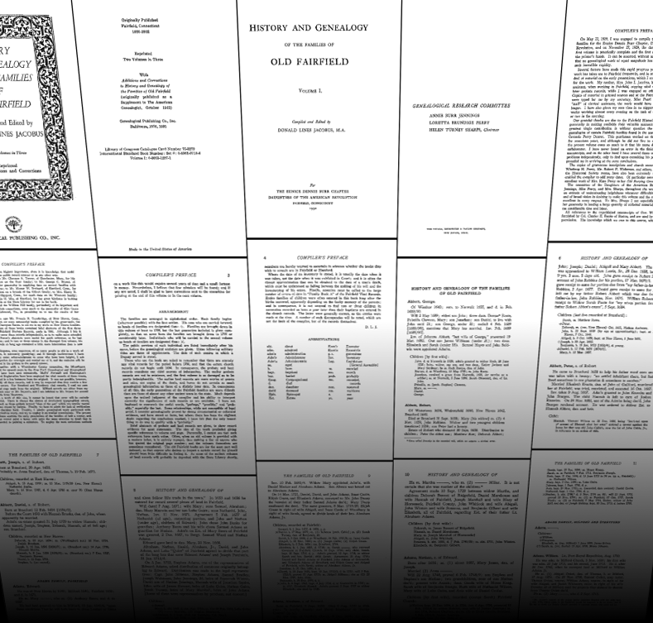
Scanning: Good for Web Distribution
Notes:
Brings them to the web: multiple, remote viewers.
Don’t want to read all of it to find information.

Slide 4
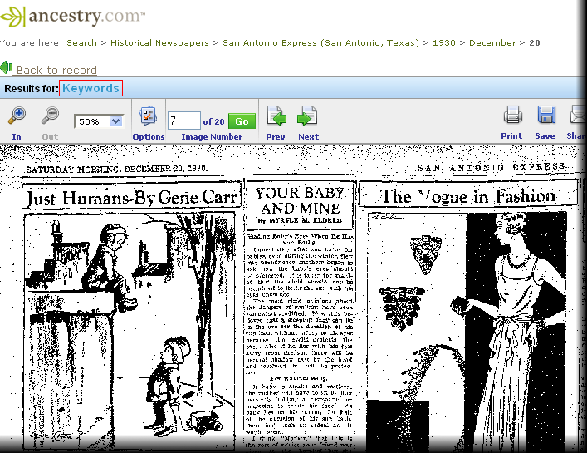
OCR: Good for Keyword Search
Notes:
Key-word search. OCR errors
Want:
OCR error correction
I’m looking for a human, not a word.
Search for entities like humans – people names – not words
Example: Packers as an occupation. (notes)

Slide 5
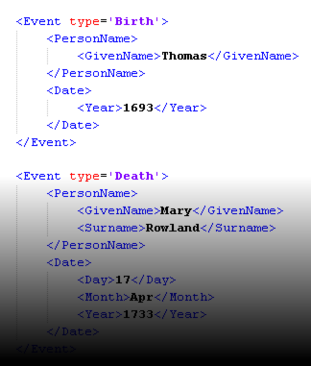
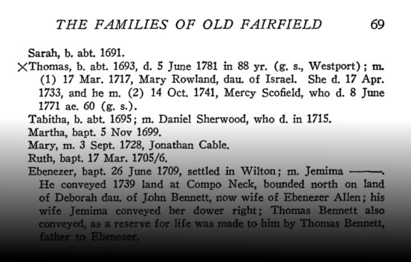
Process
Take scanned document images.
Extract topic-specific information,
e.g. person names, event and relationships.
Goal: Fielded search or record linkage.
Notes:
For document discoverability and knowledge engineering.
Discoverability: search and browsing with metadata.

Slide 6
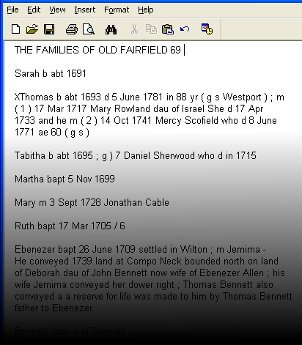
Sub-Processes
Document Image Analysis (incl. OCR)
Information Extraction
Notes:
Evaluate with respect to OCR and then image. (notes)

Slide 7
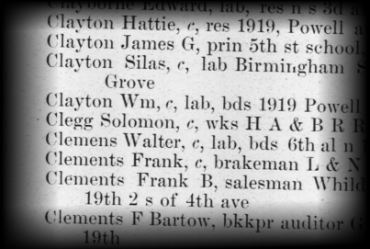
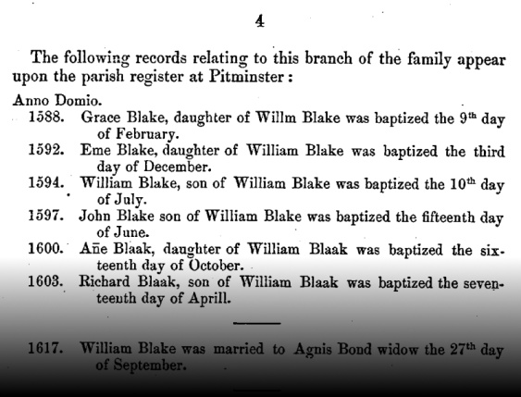
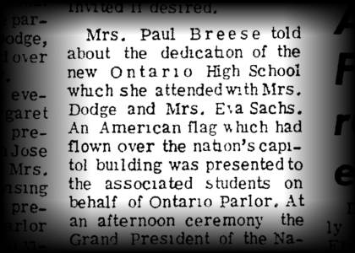
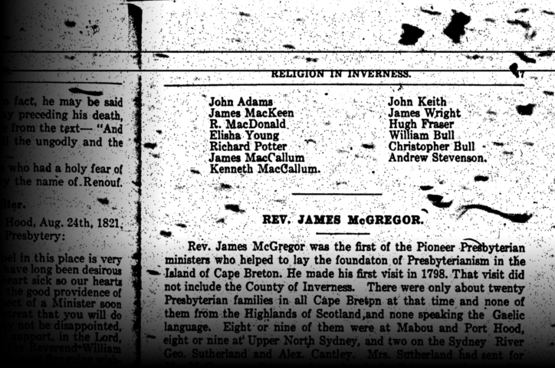
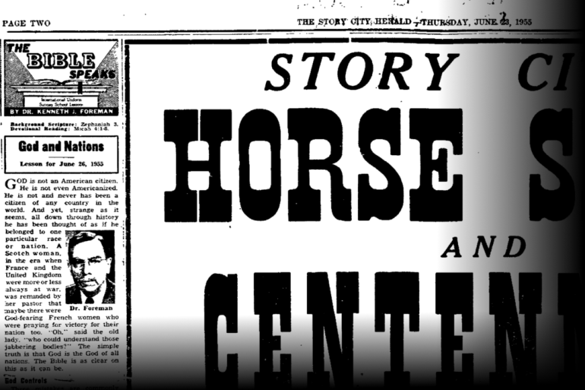
Challenges with Diversity
Diverse document structure, little training data.
Notes:
City directories, church year books, family histories, local histories, navy cruise books, newspapers.
Line breaks in one document or paragraph mean something different than what they do in another.
Name order.

Slide 8
Challenges with Images and OCR
evening when your aching bones are crying for a respite from the Charles son of hn Ban was married twice had oneaught heat and rush of existence when the cooling zephers of the night are by first and no issue y second wife spent a brow like large part of his playing on your fevered the cosmic r Balm of Gilead life in quo Quebec and died a calm clear beneficent sky e Ontario but in effulgent in the lights of heaven
Notes:
Mixed columns, no line boundaries, missing punctuation,

Slide 9
Our Approach
Use existing commercial OCR engine output (provided by Ancestry.com)
Use existing IE techniques:
Hand-written grammar rules and dictionaries
Statistical sequence models (machine learning)
Ensembles

Slide 10
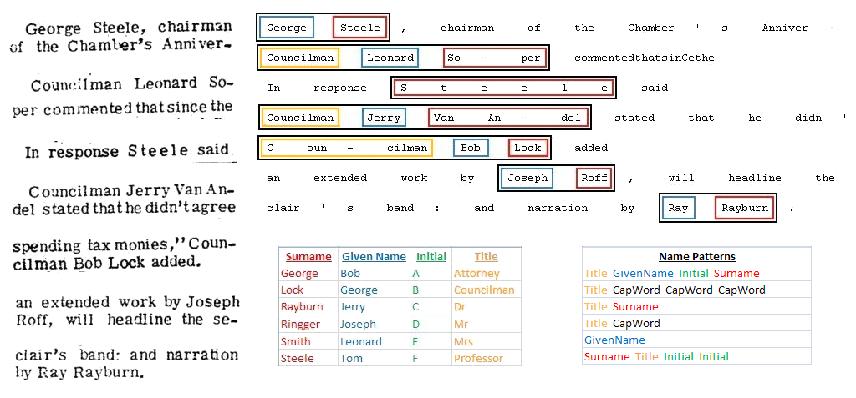
Rule-Based Extractors
Dictionary: Contiguous Dictionary Matches
Regex: Regular Expressions
CFG: Context Free Grammar and Chart Parser
Notes:
Rules tested on dev test set.

Slide 11
Machine Learning Based Extractors
MEMM: Maximum Entropy Markov Model
CRF: Conditional Random Field
Other
lived
in
of
walls
…
… lived in Virginia.
… Stone Phillips of NBC … Conoco Phillips hired Joe.
Stone walls stand well.
Given Name
Surname
Joe
Virginia
Stone
Phillips

Slide 12
Characteristic Outputs and Ensemble
OCR Output | John Lilbby
Image-Based Standard | John Libby
Dictionary | John
Regex
MEMM | John Lilbby
Ensemble (Majority) | John

Slide 13
Results
F-Measure of Full-Names (green)
and Full-Name Fragments (blue)
on Blind Test, 10 Documents, 490 Names
Notes:
Dictionary is so simple and good enough compared.
Rule-based does well.
ML does help when adding to an ensemble.

Slide 14
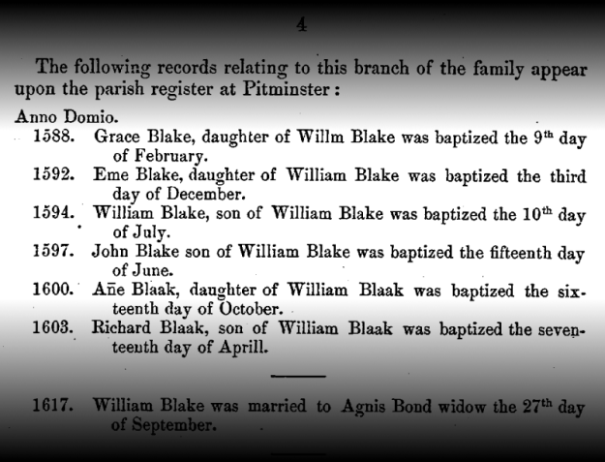
Conclusions & Future Work
New research group, learned a lot. More to come…
Public data set.
Page layout analysis.
Ambiguous cases: Generate and test hypotheses.
Combine strengths of hand-coding and machine learning:
Apply specialized extractors to tabular and unstructured text
Semi-supervised machine learning of HMMs with semantic constraints.

Slide 15
Questions?

