Slide 1
Table Recognition (Detection and Analysis): A Pathetically Incomplete Survey
presented by
Thomas L. Packer

Slide 2
Motivation

Slide 3
The Challenge
Given a document image, recognize tables:
Table Detection:
Find boundaries of each table
I.e. instances of a table model are segmented
Table Analysis
A.k.a. table structure recognition
Find components of each table
I.e. detected tables are analyzed and decomposed using the table model

Slide 4
Why do we Care?
Tables occur in many documents.
Accuracy of the following activities are limited by not understanding document structure:
Information extraction
Data mining
CL-based text processing
Information retrieval
Question answering

Slide 5
Table Extraction Using Conditional Random Fields
David Pinto, Andrew McCallum,
Xing Wei, W. Bruce Croft

Slide 6
Table Extraction Sub-problems
Locate the table.
Identify the row positions and types.
Identify the column positions and types.
Segment the table into cells.
Tag the cells as data or headers.
Associate data cells with their corresponding headers.

Slide 7
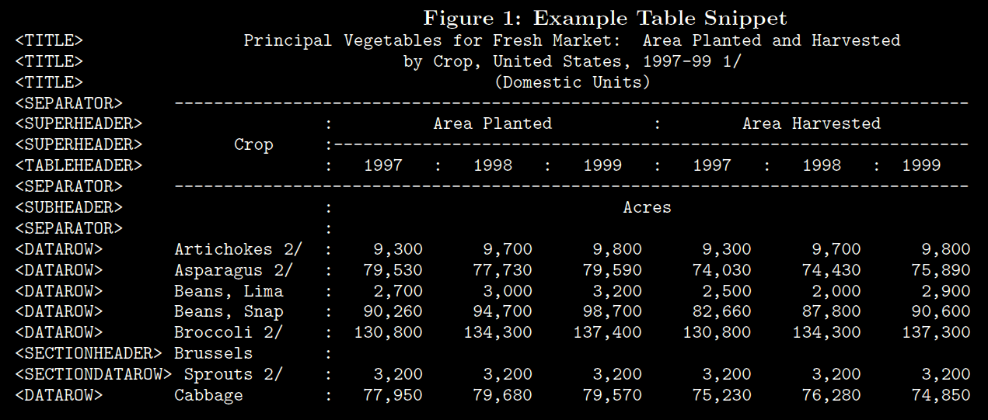
Table Extraction Sub-problems

Slide 8
A survey of table recognition: Models, observations, transformations, and inferences
Richard Zanibbi,
Dorothea Blostein,
James R. Cordy

Slide 9
Table Recognition Models
Play a crucial role in the decision-making process of recognition
Define which structures are sought after
Define or imply a set of assumptions about table locations and structure
Must support two tasks:
Detection of tables
Decomposition of table regions into logical structure descriptions
Tend to be more complex than generative models because they must define and relate additional structures for recovering the components of generative models

Slide 10
Table Recognition Models
Parameters can be:
Fixed (hard coded) or
Adaptive (altered at run-time using machine learning)

Slide 11
Usefulness of Table Recognition Models
Usefulness of a model in a set of documents is determined by:
The proportion of tables described by the model (recall)
The degree to which the model excludes other types of data, e.g. machine drawings (precision),
How reliably the objects and relations of the model can be inferred (precision and recall of table elements).

Slide 12
Implicit Table Recognition Models
Table models are usually implicit in operations.
Example:
Operation of locating column separators at gaps of vertical projection profile histograms.
Implicit model contains notion of columns separated by uninterrupted whitespace gaps.
Cannot handle tables that have titles that span columns.

Slide 13
Table Recognition Operations
Zanibbi et al (2004) describe both detection and analysis in terms of three basic operations:
Observations
Feature measurements
Data lookups
Transformations
Operations that alter or restructure data
Inferences
Generate and test hypotheses

Slide 14
Table Recognition Processes

Slide 15
Observations
Measure and collect the data used for decision making in a table recognizer
Provide the data used by inferences
These are
Feature measurements
Data lookups
Performed on
Input document
Table model
Input parameters
Existing features and hypotheses

Slide 16
Transformations
Permit additional observations
Restructure existing observations to emphasize features of a data set to make subsequent observations easier or more reliable
E.g. Hough Transform, image rotation, binarization, etc.

Slide 17
Inferences
Decide whether or how a table model can be fit to a document
Done through the generation and testing of hypotheses
Decide whether physical and logical structures of the table model exist in a document using data observed from the input document, input parameters, table model, transformed observations, and table hypotheses
E.g. table location and structure hypotheses, through typing, locating, and relating structures:
Classifiers: assign structure and relation types in the table model to data.
Segmenters: determine the existence and scope of a type of table model structure in data.
Parsers: produce graphs on structures according to table syntax, defined in the table model.

Slide 18
Layout and Language: Integrating Spatial and Linguistic Knowledge for Layout Understanding Tasks
Matthew Hurst
and
Tetsuya Nasukawa

Slide 19
Motivation
Deducing layout from spatial info. doesn’t always work.
Multi-column text (line breaks)
Apposed/marginal material
Unmarked headers
Double spacing
Elliptical lists (factored beginnings)
Short paragraphs
Multi-column table cell
Multi-row table cell
Elliptical cell content (factored beginnings)
Grid quantization (table cells not quite aligned)
Orientation detection (vertical or horizontal text blocks)

Slide 20
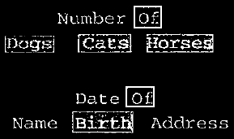
Ambiguity in Text Continuations

Slide 21
Proposal
Combine textual and spatial “cohesion” to infer boundaries of document elements.
Spatial gaps
Spatial alignment of text and “global interactions”
Collocation-based language modeling of text
Rejected CFG because input is short text fragments.

Slide 22
Operations
Generate and test hypotheses:
Observe ambiguity in text flow and cohesion (e.g. across column or line breaks).
Transform text by removing line breaks (consistent with layout model that constrains continuation options).
Test hypotheses by scoring transformed text using a language model.

Slide 23
Ideas

