Slide 1
Automatic Wrapper Induction: “Look Mom, no hands!”
Thomas L. Packer
BYU CS

Slide 2
Notes:
Dangerous work.

Slide 3
Introduction

Slide 4
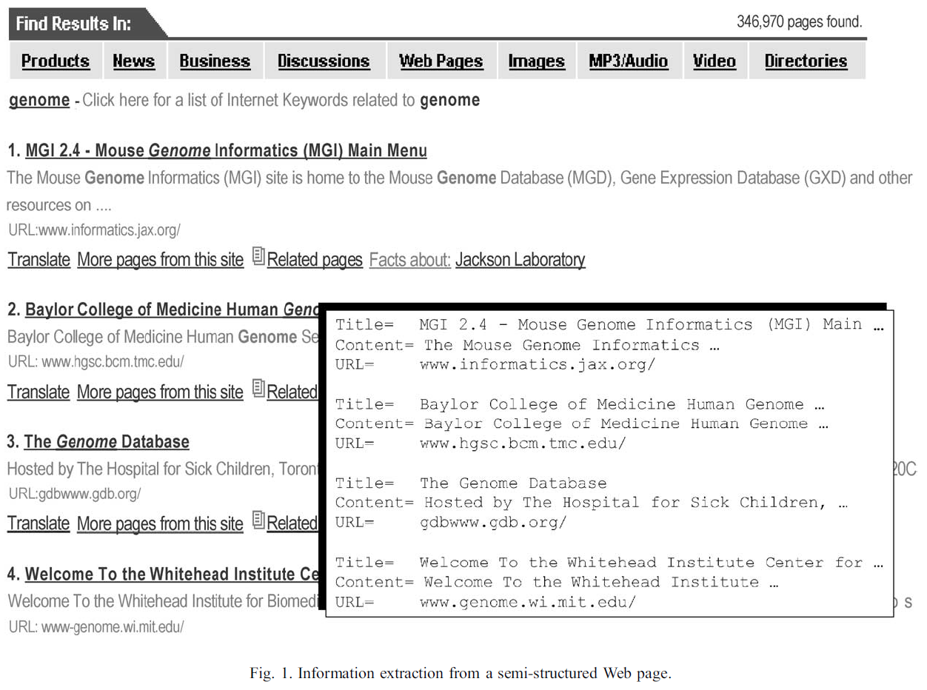
Wrapping a Semi-structured Website
Notes:
Problem of identifying tuples in a semi-structured web page to insert into database. Easy to do manually for one website. Try hundreds or thousands of websites each using a different structure. We need to do it automatically, without having to write rules manually or train an ML system with hand-labeled examples for each website.

Slide 5
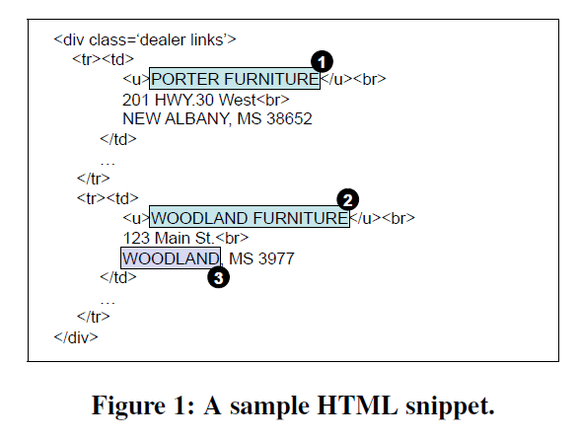
Wrapping a Semi-structured Website

Slide 6
Challenges
Many topics (domains) with different target schema.
Many document formats.
Separate rule-set needed for each format-schema combination.
Rules can be constructed by hand or by machine learning which requires hand-labeled training examples.

Slide 7
Goal
Do more work automatically.
Minimize the human input requirement, per web site.

Slide 8
Two Approaches
Find patterns in tag-strings:
“Automatic Information Extraction from Semi-structured Web Pages by Pattern Discovery”
C. Chang, C. Hsu, and S. Lui
2003
Find patterns in cheaply labeled fields:
“Automatic Wrappers for Large Scale Web Extraction”
N. Dalvi, R. Kumar, and M. Soliman
2010
Notes:
How can they reach the information age / digital age?
For document search and knowledge engineering.

Slide 9
“Automatic Information Extraction from Semi-structured Web Pages by Pattern Discovery”
C. Chang, C. Hsu, and S. Lui
2003

Slide 10
Assumptions
Semi-structured web pages are laid out in a pattern that is regular (repeating multiple times) and contiguous (few gaps among fields or records).
A limited number of patterns are consistent with each web site and can be discovered automatically.
Manually selecting the correct pattern from among a few alternatives is possible and cheaper than manually specifying that correct pattern.
Language is unnecessary for structured web extraction. (Records and fields are findable using HTML tags alone).
Notes:
How can they reach the information age / digital age?
For document search and knowledge engineering.

Slide 11
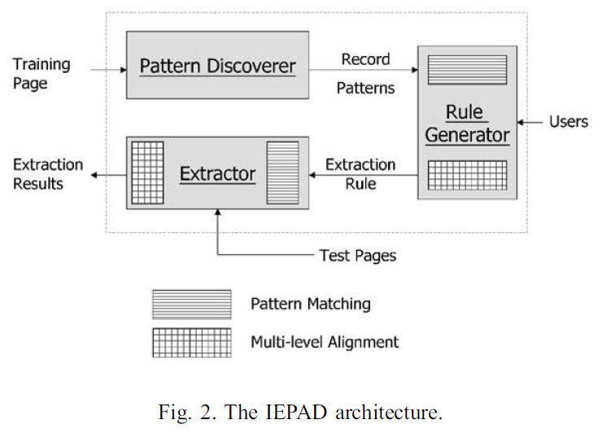
Their Approach
IEPAD: Information Extraction based on PAttern Discovery

Slide 12
IEPAD Architecture
Pattern Discoverer:
Discovers candidate patterns.
Rule Generator:
Displays candidate patterns.
User selects correct pattern, assigns schema labels to fields.
Rules are “remembered”.
Extractor:
Applies rules to new pages.
Notes:
Brings them to the web: multiple, remote viewers.
Don’t want to read all of it to find information.

Slide 13
Patterns
A pattern is a restricted regular expression over a token alphabet.
May contain options and alternatives (no repeats).
Simplest pattern is a string of tokens.
Each pattern matches a set of strings in HTML.
HTML tags are removed during extraction.
Remaining text becomes a data tuple to record.

Slide 14
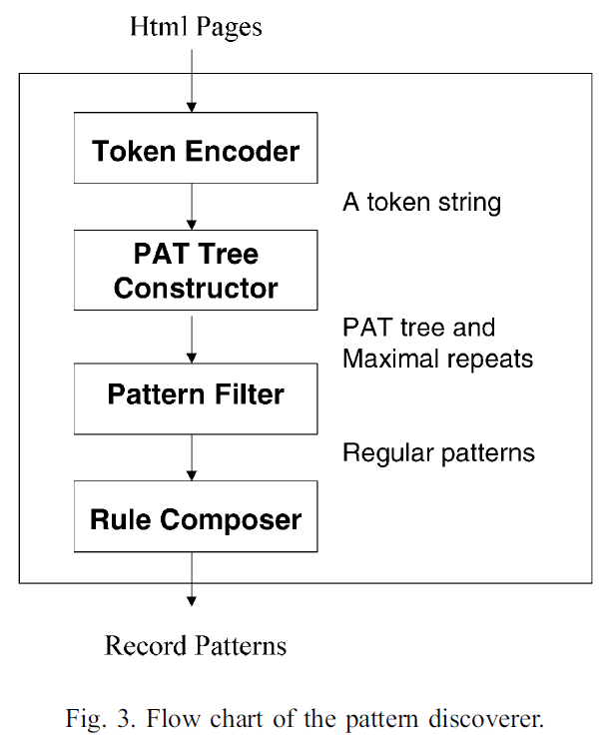
How to Discover Patterns
Input HTML page.
Encode HTML tokens.
Construct PAT-tree.
Filter patterns.
Compose extraction rules.
Output candidate patterns (less than a dozen).
Notes:
The PAT-tree technique [[13,23]] is the key that
enables efficient and accurate discovery of the patterns
for data records in the Web page.

Slide 15
Encode HTML Tokens
Encode “important” HTML tags:
<tag_name>
Discard “unimportant” (variable) HTML tags:
e.g. <i>, <b>, <u>
Fine-grained field extraction is handled later.
Encode any text between two tags as one token:
<text>
Assign each encoded token a fixed-length binary code:
<ul> → 000 </ul> → 001
<li> → 010 </li> → 011 …

Slide 16
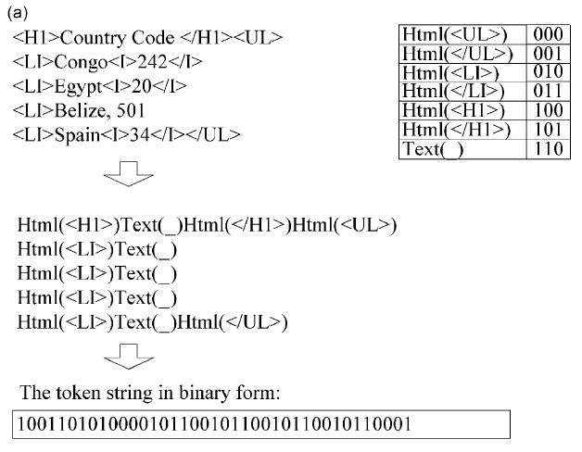
Encode HTML
Convert HTML into binary string

Slide 17
Definitions
Repeat: Any substring occurring at least k times.
Maximal Repeat: A repeat that cannot be lengthened to the left or right without losing occurrences. (You cannot find a longer string that contains the repeat with as many occurrences.)
a is the induced pattern (regex).
|a| is it’s length.

Slide 18
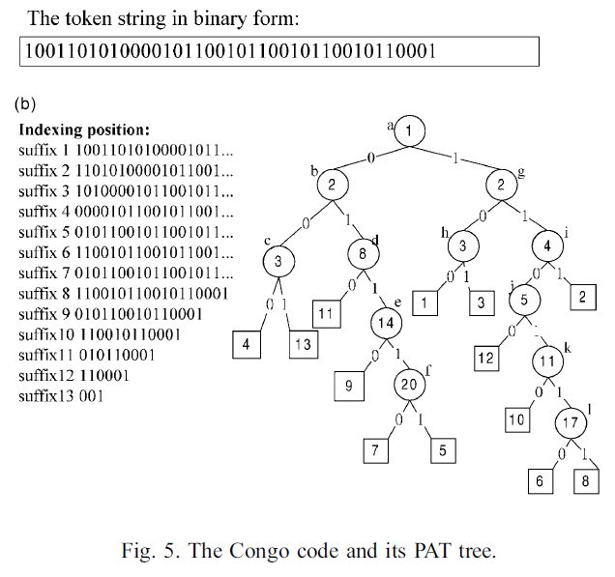
PAT-tree
PAT Tree: Or Patricia Tree, “Practical Algorithm to Retrieve Information Coded in Alphanumeric”
Strings from doc. are coded in binary, inserted into tree along with occurrence counts and pointers back to doc.
Locate strings with prefix by searching binary tree (0 means take left branch, 1 means right branch).

Slide 19
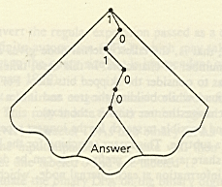
PAT-tree Properties
All strings with common prefix are in same subtree, which is the labels the nodes from tree root to subtree root.
Longest repeating string is at the deepest internal node.
Most frequently repeating string of a given size is at the root of the largest sub-tree at the given depth.
Notes:
Intensional Definition.

Slide 20
Find Candidate Pattern using PAT-tree
Some fancy traversal of the PAT-tree finds all maximal repeats with at least k occurrences and |a| length.
Defaults: k = 5, |a| = 3.
Is this a good candidate pattern?
Notes:
Intensional Definition.

Slide 21
Evaluate Candidate Patterns
Want candidate patterns that are regular and contiguous.
Accept patterns with:
Low variance
Measures how consistently-spaced the occurrences are.
Like Dr. Embley’s “standard deviation” heuristic.
High density
Percentage of tokens covered by occurrences between first and last occurrences.
Notes:
Intensional Definition.

Slide 22
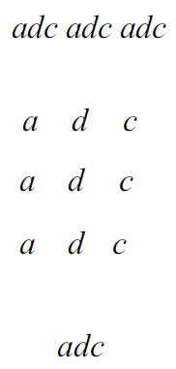
Generate Extraction Pattern
Split string so substrings match.
Align matching substrings.
The extraction pattern (regex) is the corresponding tokens in the aligned substrings.

Slide 23
Exception 1: High Variance
Some good patterns are obscured by extra stuff (e.g. ads) inserted throughout.
Identify additional good patterns using clustering:
Group contiguous occurrences into blocks.
If the individual blocks have low variance, accept them.
Notes:
Intensional Definition.

Slide 24
Exception 2: Low Density
PAT-trees only locate exactly matching tag sequences. Some good patterns are partially obscured by tag variation.
Generalize the discovered pattern using multiple string alignment …

Slide 25
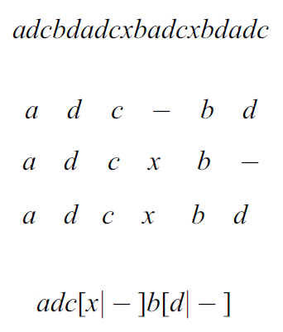
Generate Extraction Pattern
Split string so maximal repeats match as prefixes.
Multiple-align substrings.
The generalized extraction pattern (regex) is the corresponding tokens, including alternatives, in the aligned substrings.
Notes:
Intensional Definition.

Slide 26
Rotate to Find Best/Alternate Record Boundaries
d a d c – b d
a d c x b d
a d c x b d
a d c [x|–] b d → d a d c [x|–] b
Stop rotating just before complexity of regex increases.
Notes:
Intensional Definition.

Slide 27
Hands Still Needed
More than one pattern can be discovered on a web page. The user still needs to select the best pattern. (Better than writing regex from scratch.)
Extraction patterns do not assign attribute names to text until the user provides labels.
User can adjust parameters:
Token encoding scheme
Min. pattern length
Min. occurrence count (k)
Max. variance
Min. density
Test final rules on test pages.
Notes:
Intensional Definition.

Slide 28
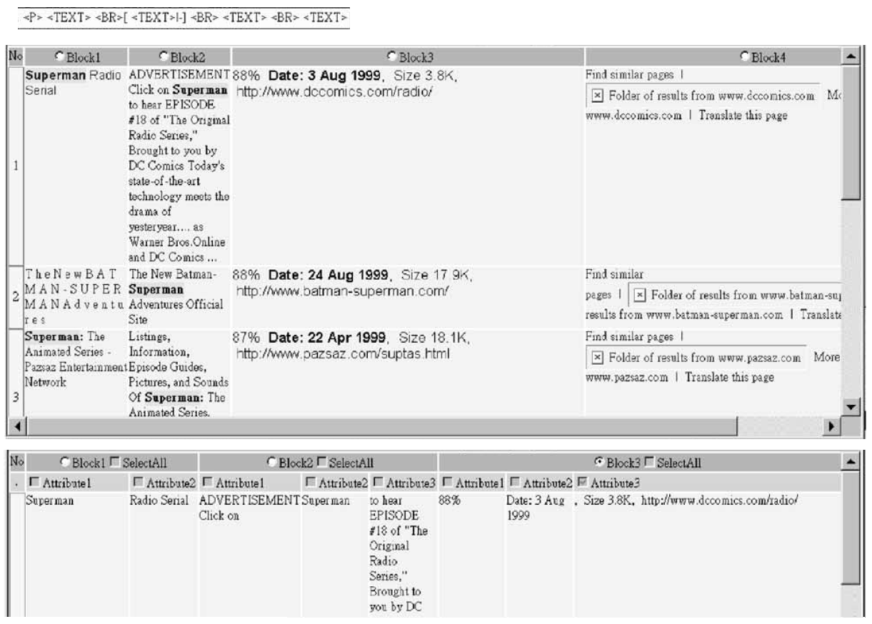
Do it all Again with Finer-grained Tags
Notes:
Intensional Definition.

Slide 29
Extraction
Input test HTML page.
Encode page using first-level token-encoding scheme.
Match all occurrences of the first-level pattern (regex).
Multiple matches are possible – take the longest match.
Do alignment on each column in the block matrix and match second-level extraction rules.
Notes:
Intensional Definition.

Slide 30
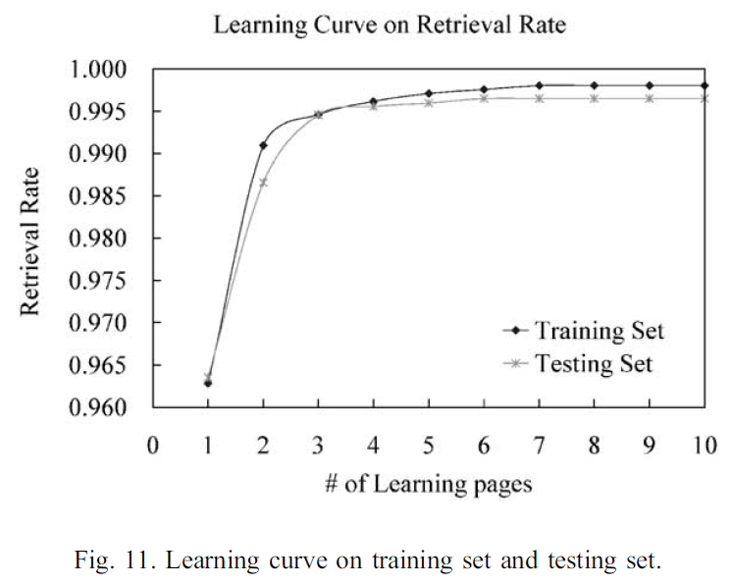
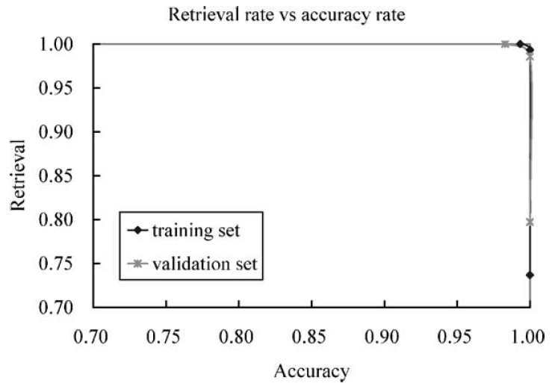
Testing Results
Parameters are tuned on each website.
Why do they only show recall learning curve?
Why do they only show one of their 12 websites in the PR curve?
Notes:
Intensional Definition.

Slide 31
“Automatic Wrappers for Large Scale Web Extraction”
N. Dalvi, R. Kumar, and M. Soliman
2010

Slide 32
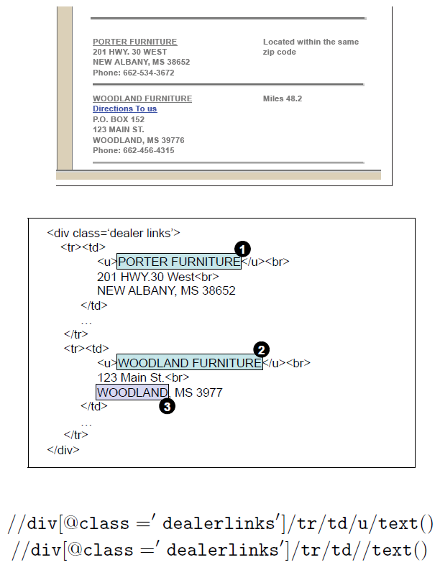
Assumptions
Traditional web wrapping, requiring any amount of hand labeling for each website, is infeasible at Web-scale.
Traditional learning can’t handle noise.
Semi-structured web pages are laid out in a similar structure within each website.
Equivalently, simple rules (wrappers) can effectively extract information from every page on the same website.
For some domains, noisy automatic annotation will be good enough to suggest the correct pattern.

Slide 33
Their Approach
Generic framework making supervised wrapper induction noise-tolerant (and therefore scalable):
Label training data cheaply and automatically using dictionaries and regexes for each site (345) in each domain (2).
No more site-level annotation: scales to the entire web (within a given domain).
Train an existing wrapper induction language and algorithm (2) as a black box. (They use learned-rule-based systems: XPath and prefix-suffix string extractors.)

Slide 34
Method: Generate-and-Test
Label set of HTML text noisily.
Enumerate all subsets of labeled text nodes.
Induce a wrapper from each subset.
Rank wrappers by quality…

Slide 35
Intuition
If label noise is not too excessive, one of the generated wrappers will be trained on sufficiently many noise-free labels and a careful definition of quality will rank it high.

Slide 36
Components of Wrapper Quality
Annotation model: Prob. of wrapper’s labels corresponding to the noisy labels
Web publication model: Prob. of wrapper’s labels being laid out in HTML

Slide 37
Annotation Model
A set of HTML pages (H),
Represent text elements and tags with vector A = <A₁, …, A_{n}>.
A set of annotators, corresponding to types in T, label a subset of text elements to produce set of annotations, L, of the form (A_{i}, t).
Each annotator has some (high) precision p_{t} and (low) recall r_{t}.

Slide 38
Web Publication Model
Given a domain,
With a set of types (T),
Select a schema (S) over T.
Apply rendering script to S to obtain a set of HTML pages (H).
Business Listings
{name, address, phone}
(name, address, phone)*
<table><td><tr><b>name1</b></tr><tr>address1</tr><tr>phone1</tr></td><td><b>name2</b><td>…

Slide 39
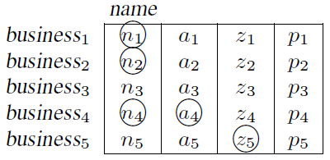
Example: Table Inducer
Training Set
Induced Set

Slide 40
Enumerate Noisy Label Subsets
5 noisy labels → 2⁵ = 32 possible subsets.
Only 8 unique wrappers can be learned by Table Inducer.
How to enumerate efficiently and in general?

Slide 41
Efficient Enumeration
We can efficiently enumerate subsets if the wrapper inducer has three properties:
Fidelity: The induced set includes all of the training set,
Closure: No change if you add any of the induced set to the training set, and
Monotonicity: If we increase the training set then the induced set will not be smaller.
We can enumerate subsets with maximum efficiently if the wrapper inducer is “feature-based”, by sub-dividing feature space of training set.

Slide 42
Extraction
L: set of noisy labels
X: set of wrapper-predicted labels
Find:
arg max_{X} P(X|L) =
arg max_{X} P(L|X) P(X) / P(L) =
arg max_{X} P(L|X) P(X)
P(L|X) models annotation process.
P(X) models publication process.

Slide 43
Rank Wrappers
The score of wrapper w_{i} is P(L|X_{i})P(X_{i})
X_{i} is set of nodes labeled by w_{i}.
P(L|X_{i}) is based on mistakes in labels L compared to X_{i}.
P(X_{i}) is based on how good X_{i} looks in terms of schema size and repeating structure.

Slide 44
Annotation Score
P(L|X) = prob. of the noisy labels given wrapper’s labels true.
r = prob. of correct node included in L. = P(true positive)
p = prob. of incorrect node not included in L. = P(true negative)
1-r = P(false negative) 1-p = P(false positive)
A = {all nodes} \ X (a, z, p)
X₁ = X ∩ L (n₁) X₂ = X \ L (n₃)
A₁ = A ∩ L (a₄) A₂ = A \ L (a₁)

Slide 45
Publication (Layout) Score
P(X) = prob. that the wrapper’s labels make sense from a webpage layout perspective.
Simple layout grammar, or a regular pattern of records, implies a good list.
Schema size and alignment features.
Use nodes in X as record boundaries.
Collect records using pre-order traversal of DOM-tree.
P(X) = prob. of values of features of list of record segments produce by X.

Slide 46
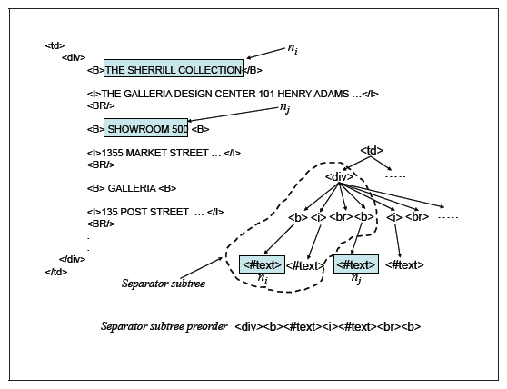
Pre-order Traversal

Slide 47
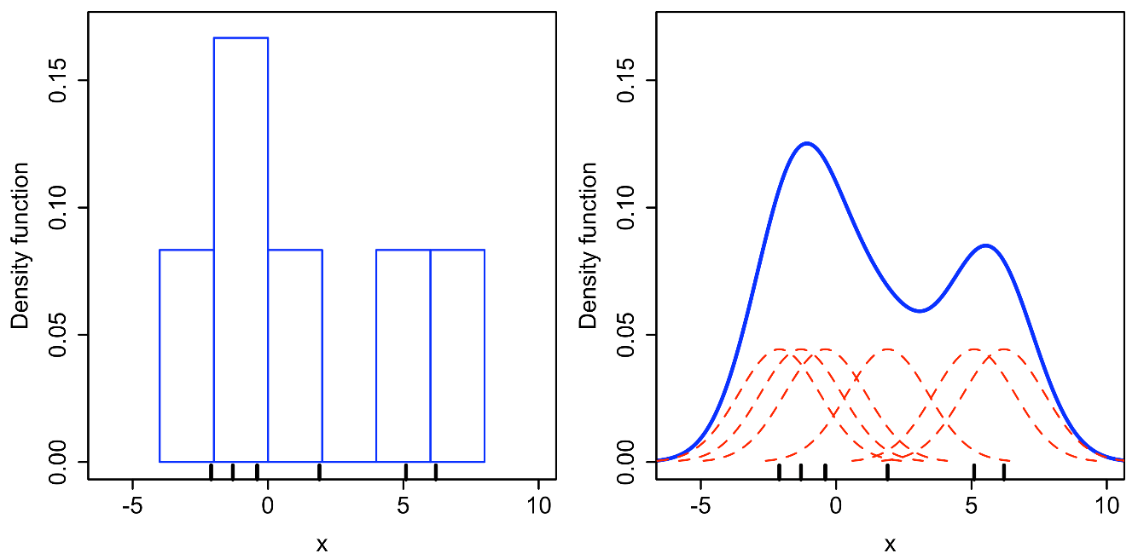
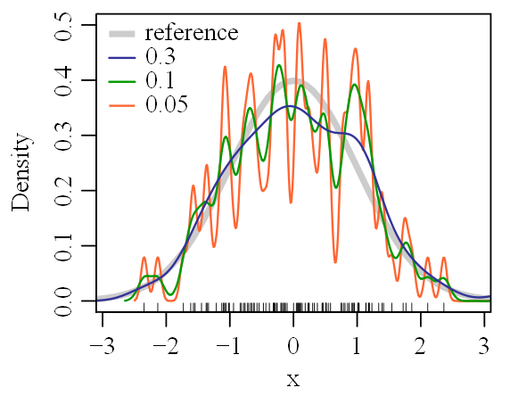
Layout Features
Schema size: Num. text nodes in longest common substring between pairs of records.
Approximates num. text attributes in every record in list.
Alignment: Max. edit distance between pairs of record.
Approximates how well records align.
Learn these distributions from sample websites in domain.
Could use domain-specific feature (value distributions) like address count or zip-code count.
Smooth PDF with Kernel Density Estimation.

Slide 48
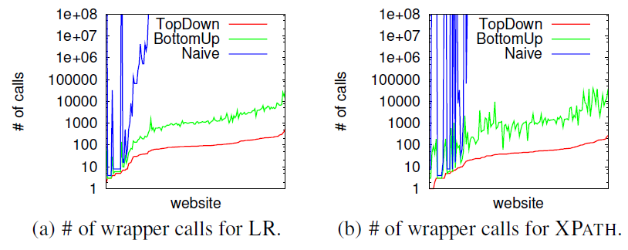
Results: Efficiency of Enumeration

Slide 49
Results: Accuracy of Noise-Tolerance

Slide 50
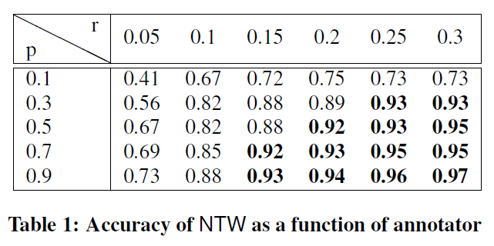
Results: Accuracy with Added Noise

Slide 51
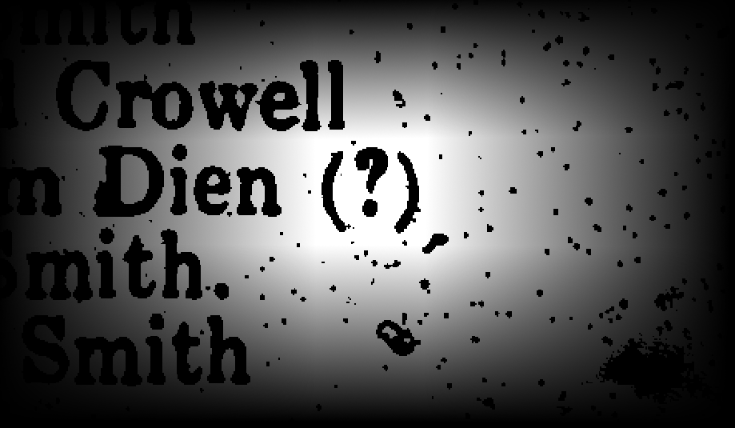
Thank you. Questions

