Slide 1
Extracting Data from Lists
Thomas L. Packer
BYU CS DEG
Notes:
Name
Group
Tell you about …

Slide 2
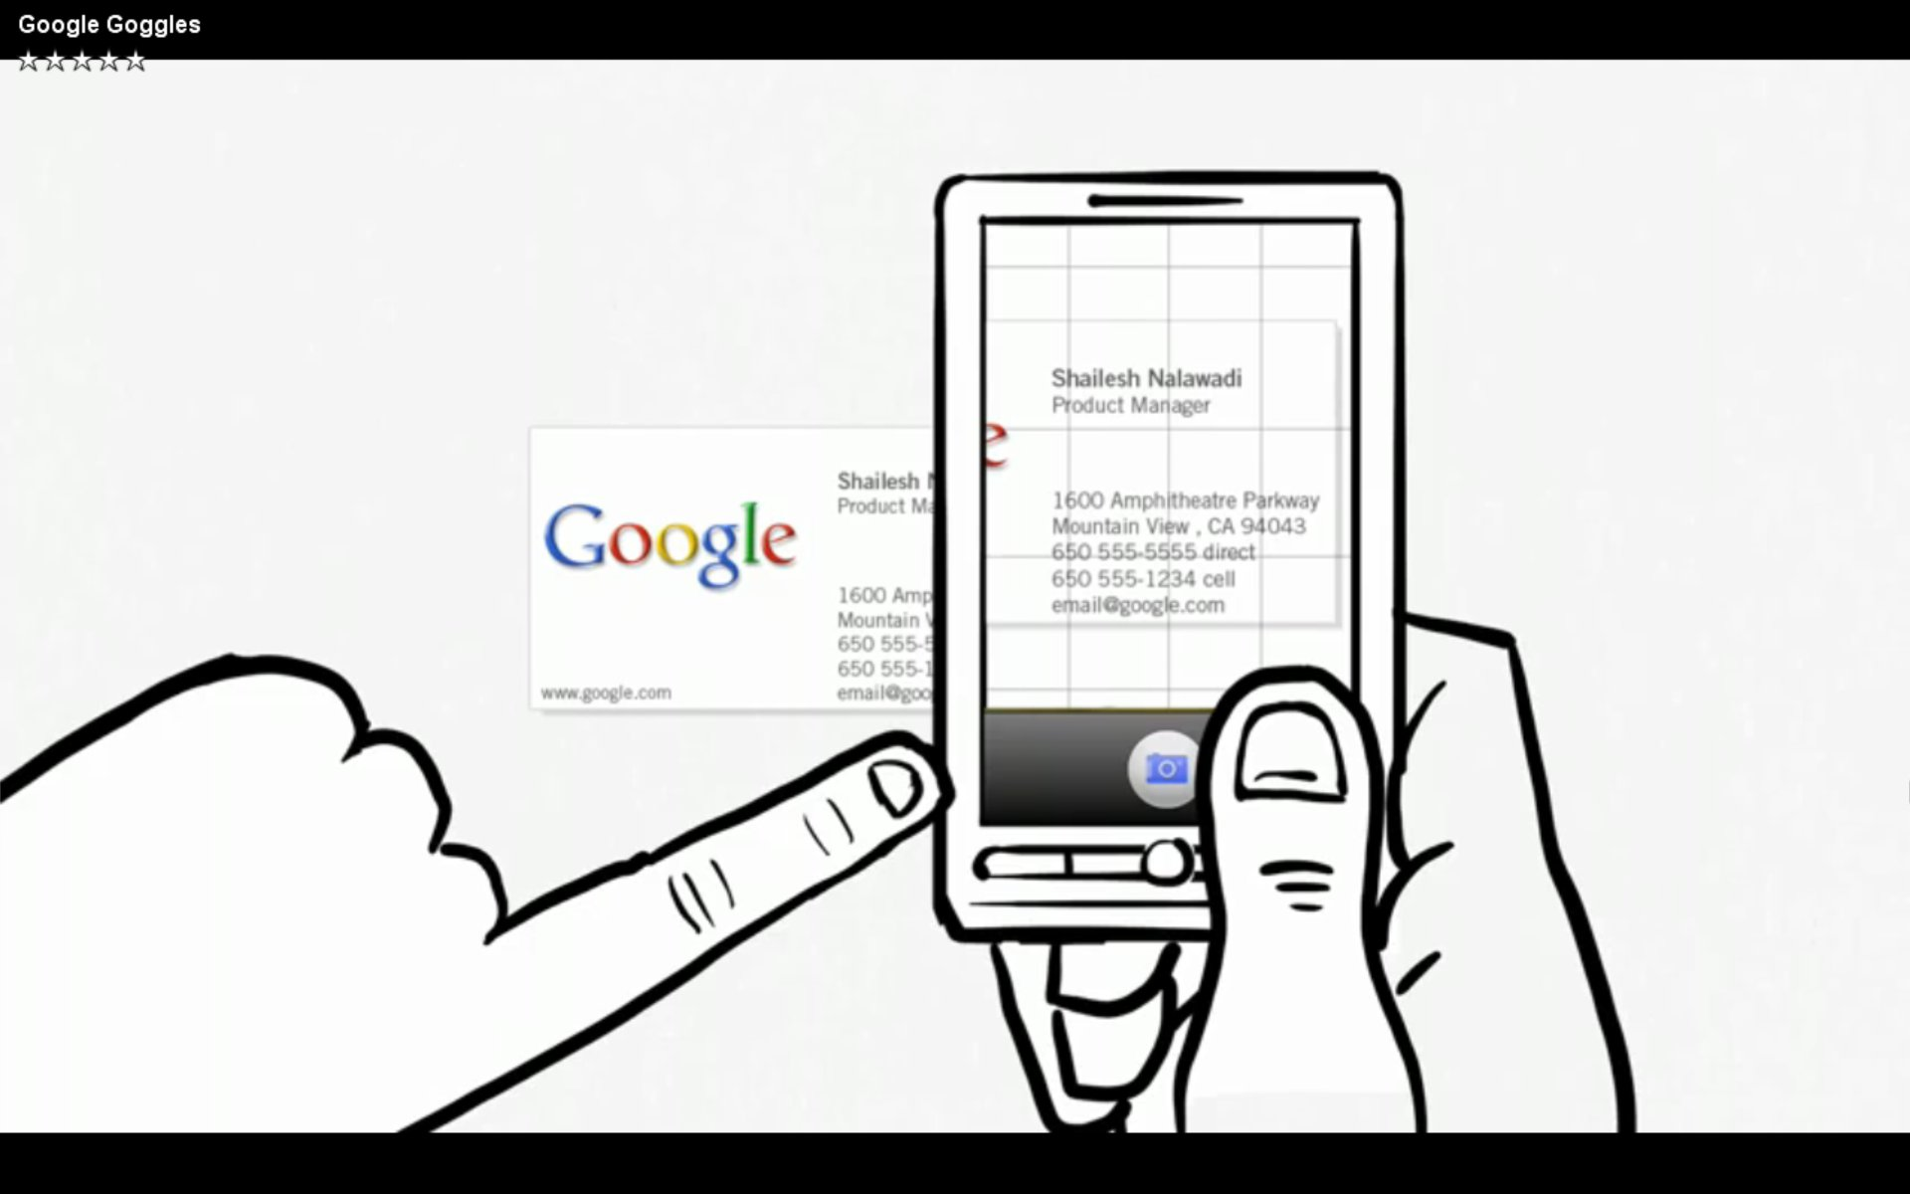
Access New Printed Information
Notes:
We’re interested in making information accessible.
This involves extracting and categorizing “fields” from text.

Slide 3
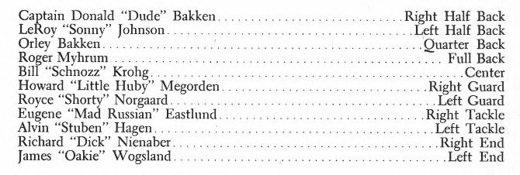
Wrapper Induction for (Short) Lists
Notes:
Efficiently and accurately?
Short lists: Few training examples.
Varying field lengths, but order of fields is very constrained.

Slide 4
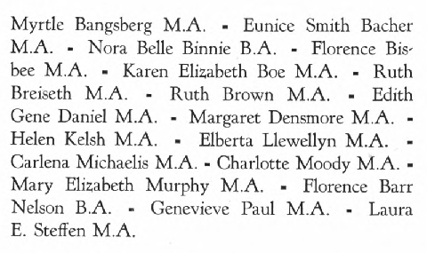
Running Example
Myrtle Bangsberg M A - Eunice Smith Bacher
MA - Nora Belle Binnie B A - Florence Bisbee
M A - Karen Elizabeth Boe M A - Ruth
Breiseth M A - Ruth Brown MA - Edith
Gene Daniel M A - Margaret Densmore M A -
Helen Kelsh M A - Elberta Llewellyn M A -
Carlena Michaehs M A - Charlotte Moody M A -
Mary Elizabeth Murphy M A - Florence Barr
Nelson BA - Genevieve Paul M A • Laura
E SteffenMA
Notes:
Running example: list of female teachers and their degrees.
Want to segment and label given name, surname and “other” fields.

Slide 5
HMM Typical – Unconstrained Order, Lacks Field Length
Other
-
M
A
B
…
G
S
O
O
O
G
Myrtle Bangsberg M A - Eunice Smith Bacher MA - Nora Belle Binnie B A - Florence Bisbee M A - Karen Elizabeth Boe M A …
Given Name
Surname
Myrtle
Eunice
Florence
Karen
Bangsberg
Bacher
Binnie
Notes:
Induce from labeled training data.
Any order is possible by default with HMM.
Too expressive for our list data.
Does not help with variable-length fields especially when vocabulary is limited.

Slide 6
Hypothesis: Record pairs with short edit-distance → aligned tokens have same labels
Myrtle Bangsberg M A –
Eunice Smith Bacher MA –
Nora Belle Binnie B A –
Florence Bisbee M A –
Karen Elizabeth Boe M A –
Ruth Breiseth M A –
Ruth Brown MA –
Edith Gene Daniel M A –
Margaret Densmore M A -
Helen Kelsh M A –
Elberta Llewellyn M A -
Carlena Michaehs M A –
Charlotte Moody M A -
Mary Elizabeth Murphy M A –
Florence Barr Nelson BA –
Genevieve Paul M A •
Laura E SteffenMA
Notes:
Why induce a model allowing all possible field lengths? Transduce directly.
The most similar records should have fields with similar lengths.

Slide 7
k-Nearest Neighbors for Sequences (k = 1)
G
S
O
O
O
Ruth Breiseth M A –
G
G
S
O
O
O
Karen Elizabeth Boe B A –
dist. = 5
dist. = 3
Mary Elizabeth Murphy B S –
Notes:
kNN is transductive.
Align records.
Transfer labels from nearest neighbor based on edit distance.
Labels of aligned words are assumed to have the same label.

Slide 8
Infer Labels by Alignment
Edit distance and alignment by Levensthein
 |  | Karen | Elizabeth | Boe | B | A | -
 | 0 | 1 | 2 | 3 | 4 | 5 | 6
Mary | 1 | 1 | 2 | 3 | 4 | 5 | 6
Elizabeth | 2 | 2 | 1 | 2 | 3 | 4 | 5
Murphy | 3 | 3 | 2 | 2 | 3 | 4 | 5
B | 4 | 4 | 3 | 3 | 2 | 3 | 4
S | 5 | 5 | 4 | 4 | 3 | 3 | 4
- | 6 | 6 | 5 | 5 | 4 | 4 | 3
dist. = 3

Slide 9
Alignment based on Field Co-occurrence Model
Word similarity := probability that two words occur in same field
Leverages sparse training data
We used naïve Bayes
Notes:
Edit distance is based on word similarity (joint/co-occurrence probability)
Co-occurrence not restricted by how far apart the words are, whether they appear in the same record or which field label they share.
Generates a lot of word associations.

Slide 10
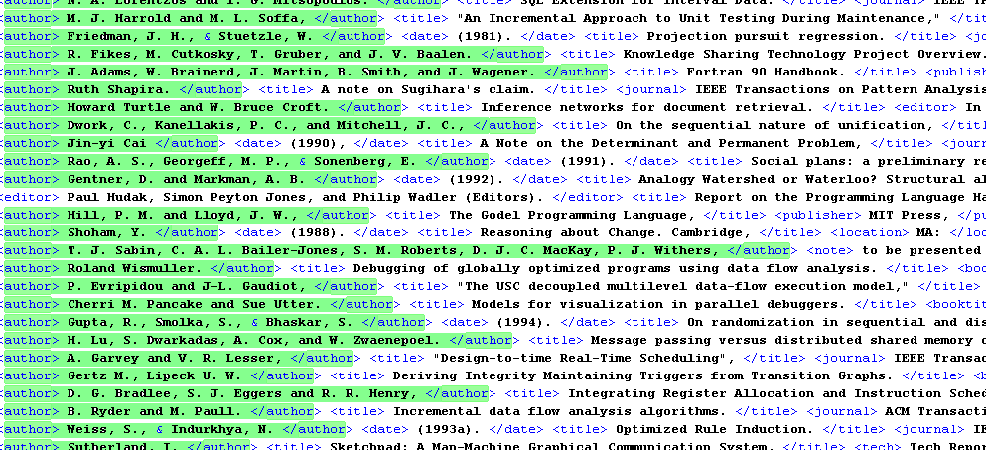
Cora Citation Dataset
Fields: author, title, date, editor, booktitle, location, pages, journal, tech, institution, volume, publisher, note
Notes:
Longer fields, varying lengths.

Slide 11
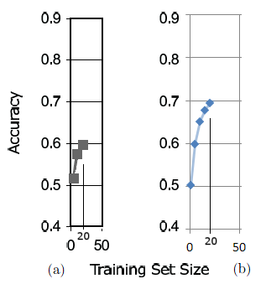
Results with Little Training Data (50-fold Cross-validation)
(a) HMM by Trond Grenager, Dan Klein, Chris Manning
(b) Alignment-KNN by Thomas Packer
Notes:
Alignment plus leveraging every word association in the training data.

Slide 12
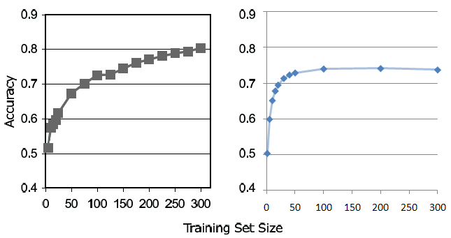
Results with More Training Data (50-fold Cross-validation)
Notes:
HMM benefits because the state emission model is more specific or fine-grained than our word similarity model.
With more data, more and more word pairs are found together in the same field.
If two words appear in the title field, this could affects the similarity of words showing up in different fields.

Slide 13
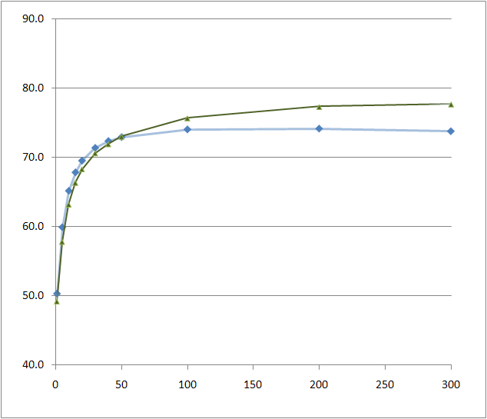
Without Field Co-occurrence Model
Notes:
No training whatsoever.

Slide 14
Conclusions
Alignment is sensitive to how word pair similarity is defined.
Alignment with the field co-occurrence model helps with sparse training data.
Doing this (based on naïve Bayes) is detrimental when training data is abundant.

