Slide 1
Performing Information Extraction to Improve OCR Error Detection in Semi-structured Historical Documents
Thomas L. Packer
BYU CS DEG
Notes:
Name
Group
Tell you about …

Slide 2
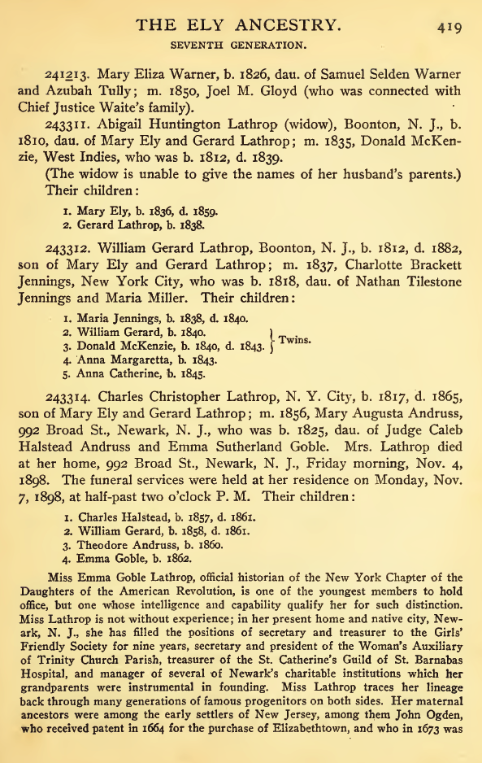
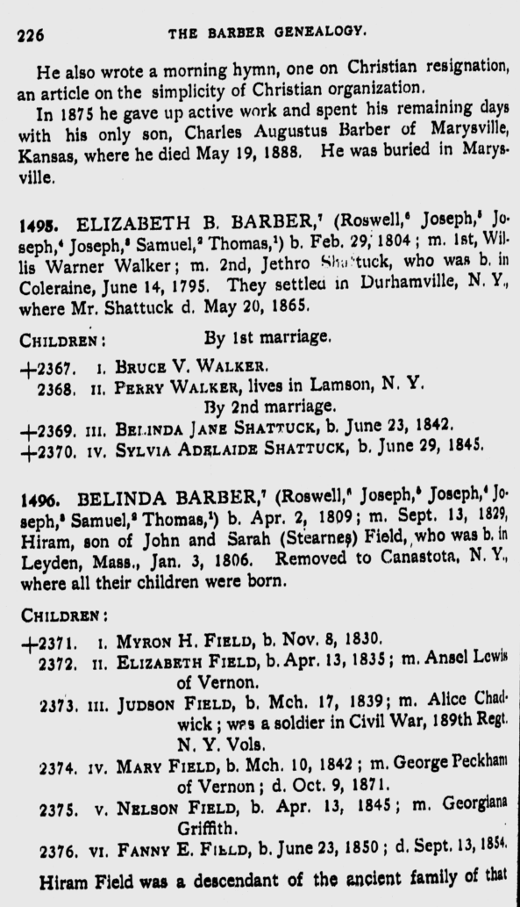
Historical Documents
Notes:
They contain a wealth of information.
These contain rich genealogical data.

Slide 3
OCR for Usability
Notes:
We must scan, OCR and do other digital processing to make use of that information.
Sadly, some fully automated processes are not 100% accurate.

Slide 4
Dealing with OCR Errors
Ignore
Auto-correct
Manually correct

Slide 5
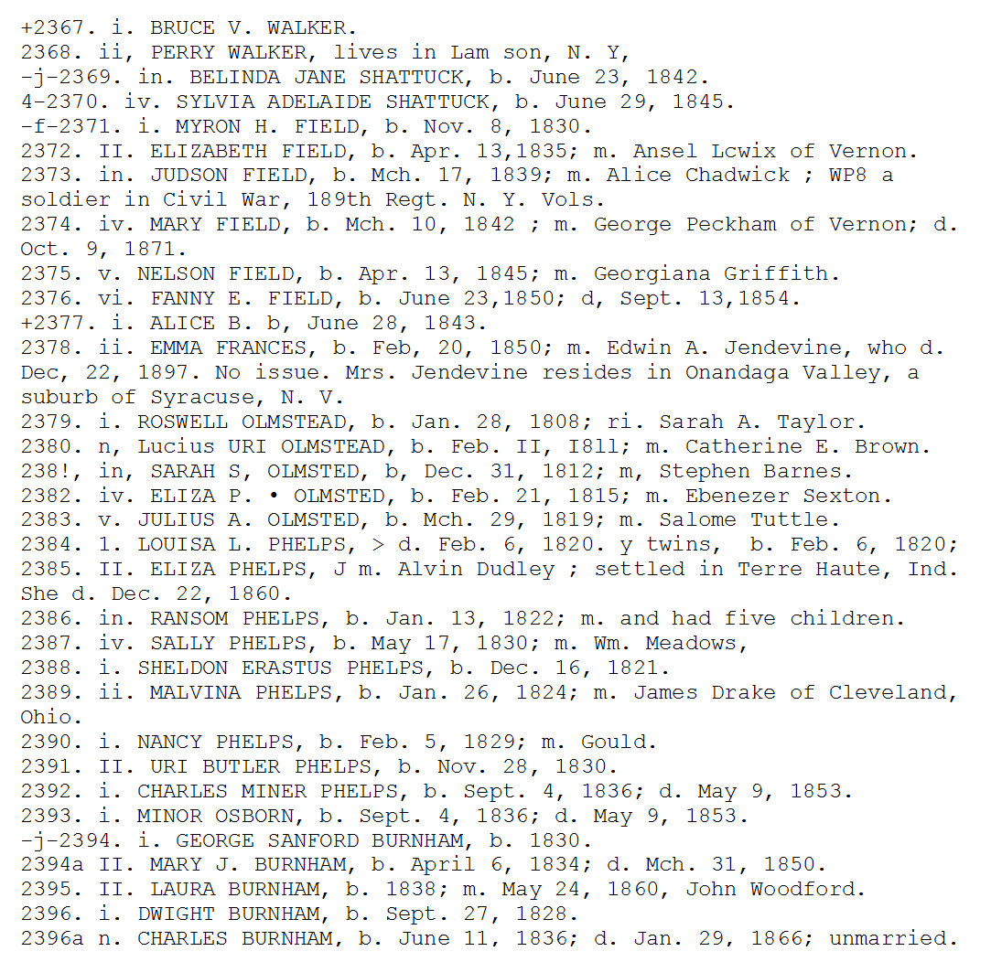
Manual Correction
Notes:
Suppose you wanted to manually correct the OCR errors in this document. Would you prefer to look at it this way?

Slide 6
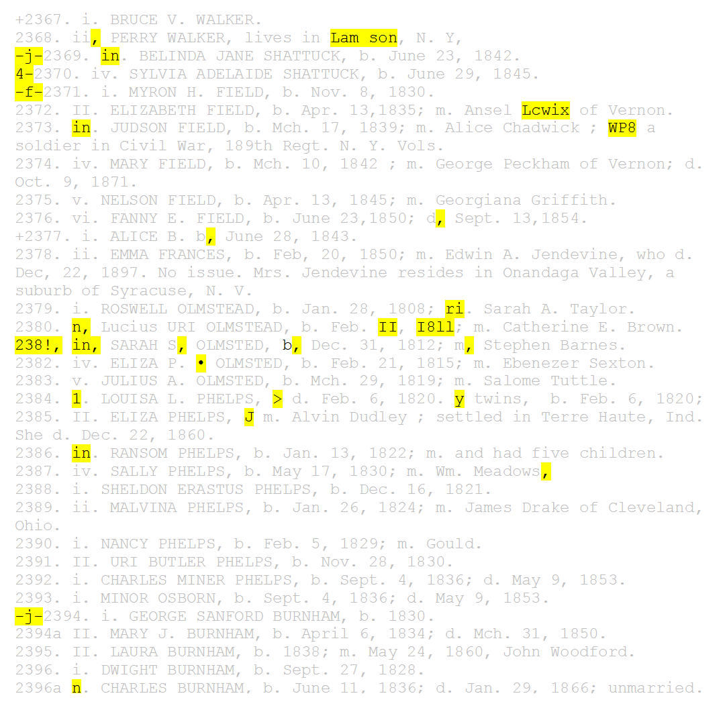
Manual Correction
Notes:
Or this way?
Motivates automatic finding of errors.

Slide 7
Dictionary Matching
Lewis
Match = OCR correct
No match = OCR error
Lcwix
Notes:
Easy to implement.
The work is finding and tuning word lists.

Slide 8
Dictionaries
Given names (18,000 instances)
Surnames (150,000 instances)
Initials (capital letters A through W)
Person titles (10 instances including Mr and Jr)
Days of the week (16 names and abbreviations)
Months (26 names and abbreviations)
Common English words (1.7 million)
Punctuation (. , ; + ”)
Notes:
Last three letters in our alphabet are borrowed from Greek

Slide 9
Using Word Categories
Child Number
III
HI
HI
General / Unknown
Notes:
Knowing category helps, but we have to predict category along with error label.

Slide 10
Approaches
Dictionary Matching (baseline)
Hidden Markov Model
Error (baseline)
Field-Error
Entity-Error

Slide 11
OCR Error Detection and IE
Error Label
IE + Error Label
Text
Notes:
Define OCR Error Detection
If joining it with IE helps, so much the better.
We aim to automatically produce the top row.
Would it help to produce the middle row as an intermediate step?

Slide 12
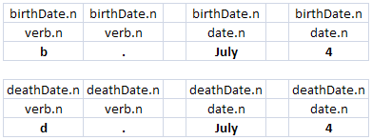
IE Labeling Schemes
Field + Error
Entity + Error
Text
Field + Error
Entity + Error
Text
Notes:
Define OCR Error Detection
If joining it with IE helps, so much the better.
We aim to automatically produce the top row.
Would it help to also produce one of the other two rows?

Slide 13
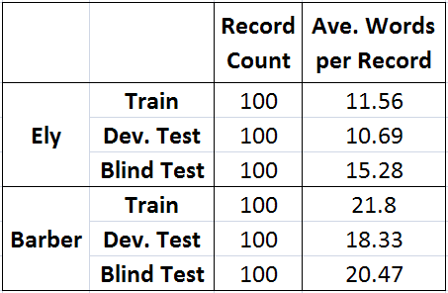
Corpus
Notes:
Trained
Variations selected on intermediate tests
Final testing
*** Records change format the further into the book you go.

Slide 14
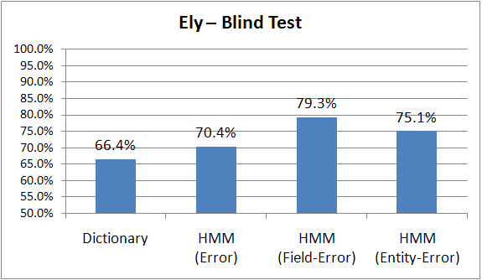
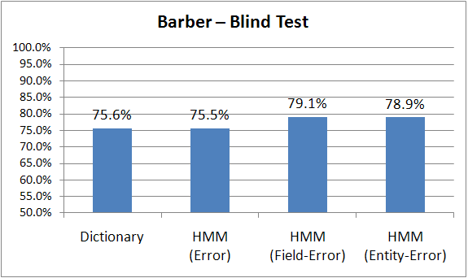
Macro-ave’d F-measure – Blind Test

Slide 15
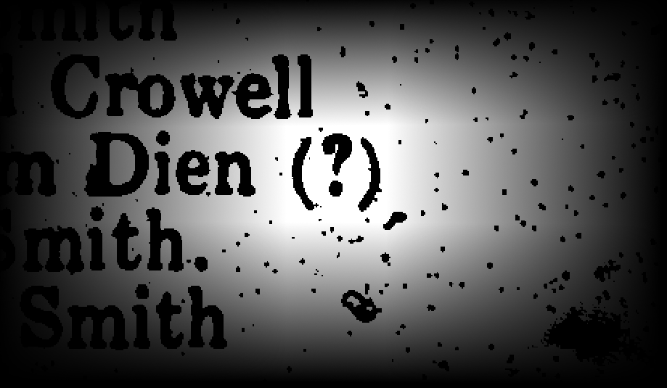
Conclusions
Jointly performing IE and OCR error detection can be better than doing error detection alone.
Training an HMM on text labeled with field/NER labels and OCR error labels is one way to do this.

Slide 16
Extra Slides

Slide 17
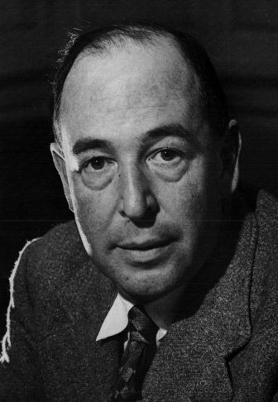
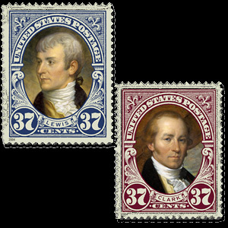
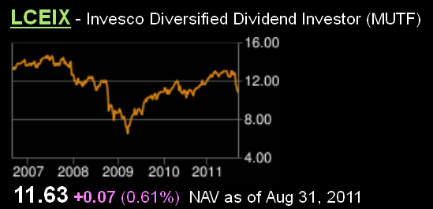
Automatic Correction
Surname
Lewis
Lcwix
LCEIX
Ticker Symbol
Notes:
Suppose you want to automatically correct errors.
First you need to know which words to correct.
Assuming you knew this text was erroneous, how would you automatically correct this text?
It would be a lot easier if you knew what kind of thing it referred to.

Slide 18
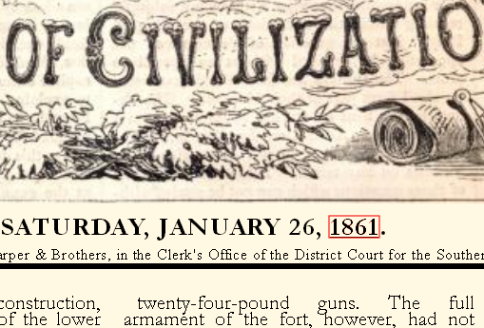
Automatic Correction
Year
1861
I86 1
I⁻86 |
Inter-state
Edge of Page (Noise)
Notes:
Assuming you knew this was erroneous, how would you automatically correct this text?
It would be a lot easier if you knew what kind of thing it referred to.

Slide 19
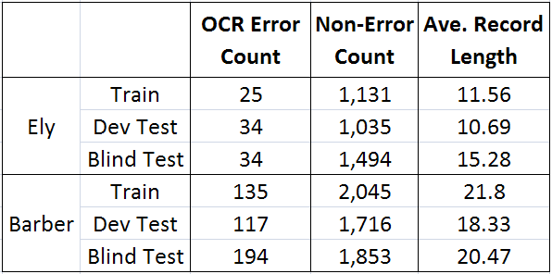
Corpus
Notes:
Trained
Variations selected on intermediate tests
Final testing

Slide 20
Training the HMMs
Error
Field-Error
Entity-Error
Text
e → e 2
e → n 1
n → n 8
n → e 0
e → 243 1
e → ! 1
n → . 2
n → July 1
…
Notes:
Label training data.
State for each label.
Probabilities of transition from one state to another based on label statistics.
Probs of associating each state with a particular word string also based on label stats.

Slide 21
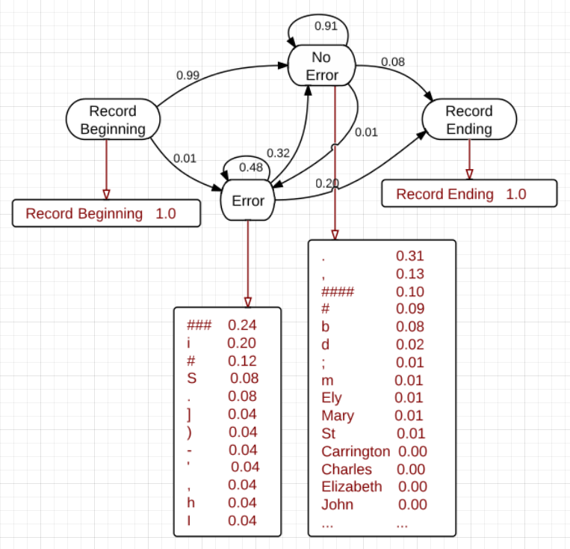
The Trained HMMs
Notes:
This is the actual HMM trained on Error-labeled text.
Using this we find the sequence of word-labels with maximum probability for each record.

Slide 22
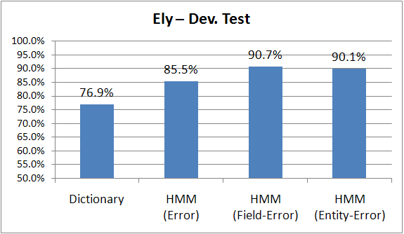
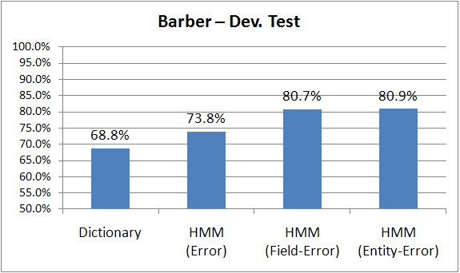
Macro-ave’d F-measure – Dev. Test

Slide 23
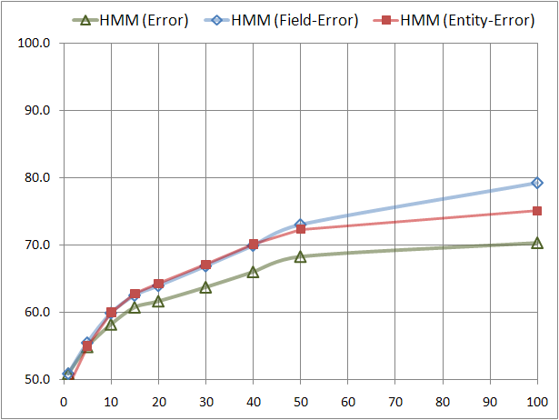
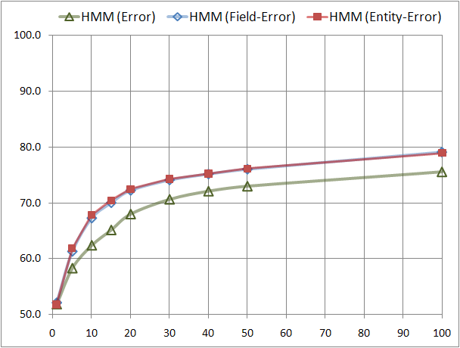
Varying the Training Set Size
Ely
(Blind Test)
Barber
(Blind Test)

