Slide 1
Lessons Learned in Automatically Detecting Lists in OCRed Historical Documents
Thomas L. Packer
David W. Embley
February 3, 2012
RootsTech
Family History Technology Workshop
Notes:
First attempt at general list detection, for us and for anyone we know.

Slide 2
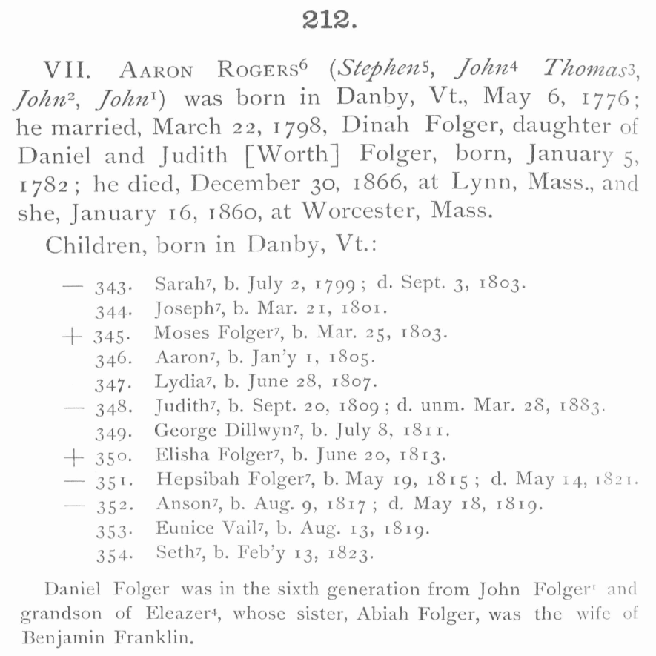
Lists are Data-rich
Notes:
You are genealogy researchers.
Make genealogy data findable.
Lists are data-rich.
Leverage structure of lists to efficiently extract information.
Must first find the lists cheaply (automatically).
Means categorizing words, binary classification right now.

Slide 3
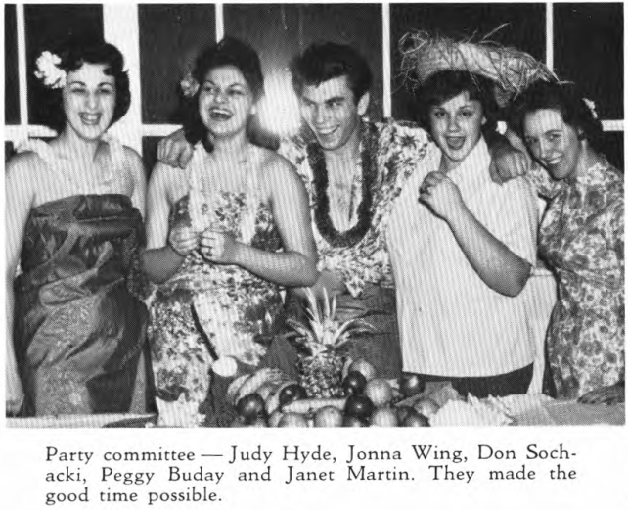
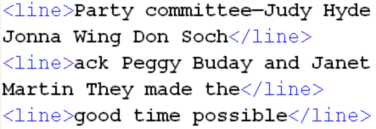
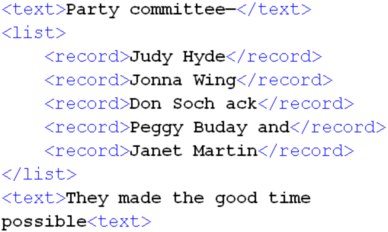
General List Reading Pipeline
OCR
List Detection
List Structure Recognition
Information Extraction
Notes:
Pipeline context for our task.
Lists of 5 names in a high school yearbook.
Pipeline for general list reading.
We also used historical Australian newspapers.
Constructing larger hand-annotated corpus for public use.
Thanks, Ancestry.com.

Slide 4
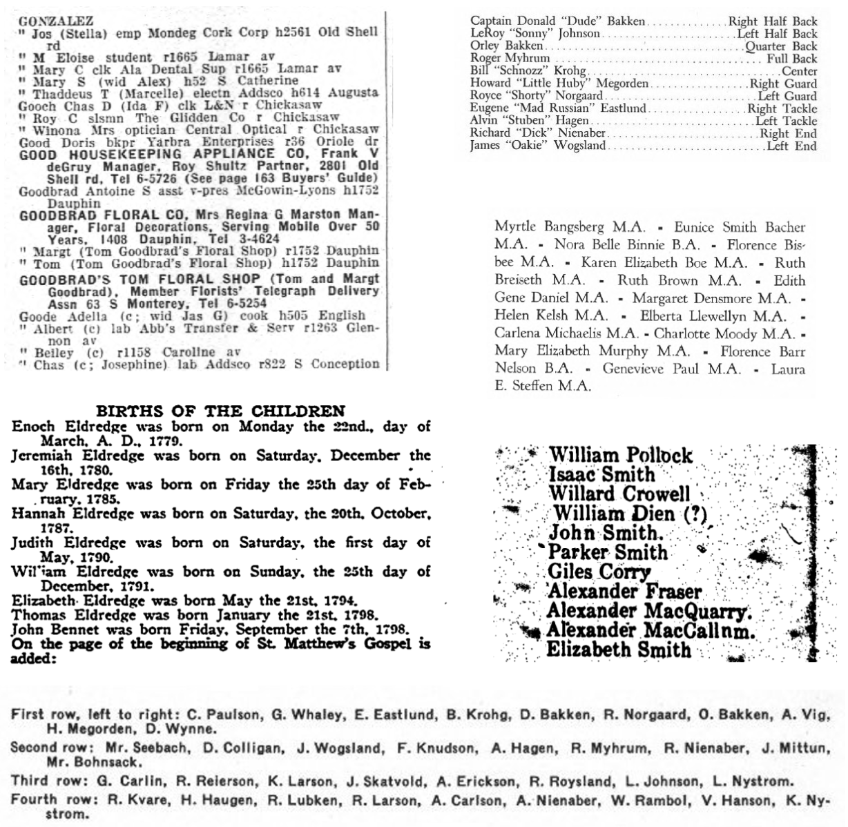
Lists are Diverse
Notes:
Challenge
Diverse in format, delimiters, content, topic
Diverse in surrounding text, sometimes with similar content as the list, set apart differently
Patterns especially inconsistent with OCR errors, like different or missing delimiters

Slide 5
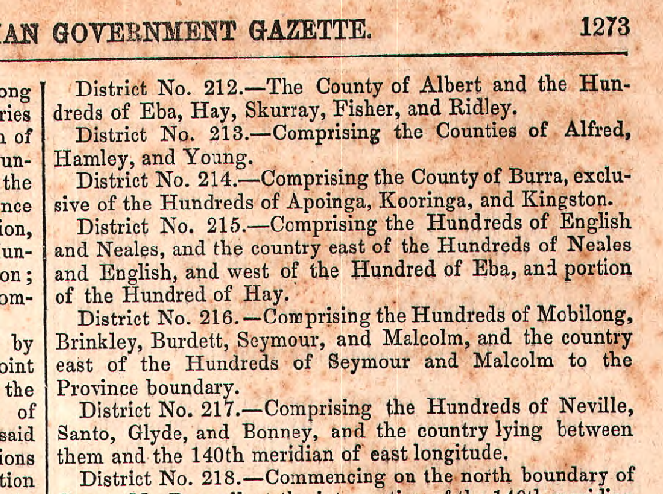
Literal Pattern Area
Score =
2 x 6 = 12
Notes:
Four approaches: One is very simple. The other three are variations on the theme.
Essence of first is to find repeating text.
Score each substring of a page with product of length in words x instance count on page
Highest scoring pattern wins.
Classify all words between first and last occurrence as “list”.
One pattern repeats.

Slide 6
Literal Pattern Area
Score =
3 x 7 = 21
Notes:
This other pattern on same page repeats more and is longer, so its score is higher, and is preferred.
Notice missing numerals.

Slide 7
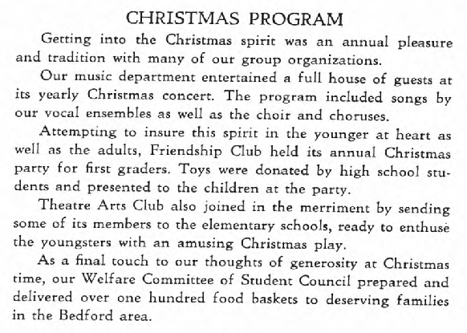
Literal Pattern Area
Score =
1 x 5 = 5
Notes:
Some pages contain no list.
Cannot just take the highest scoring pattern and call it a list.
Threshold of 10 based on training data sampled from yearbook and newspaper.

Slide 8
Literal Pattern Area
Score =
2 x 3 = 6

Slide 9
Beyond Literal Patterns
Score =
1 x 1 = 1
Notes:
Returning to district numbers.
Numeral not recognized as part of pattern because it does not repeat exactly.

Slide 10
Pattern Area
Score =
1 x 7 = 7
Notes:
If we recognize word categories, we can not only see this as a non-literal pattern, but …

Slide 11
Pattern Area
Score =
6 x 7 = 42
Notes:
…it can be part of a larger pattern.
Here it joins two shorter literal patterns.

Slide 12
Matching Word Categories
The word itself, case sensitive
Dictionaries (& sizes):
Given name ……………….. 8,400
Surname ………………… 142,000
Title ………………………………… 13
Australian city ………………. 200
Australian state ………………… 8
Religion ………………………….. 15
Regular expressions:
Numeral ………………… [0-9]{1,4}
Initial + dot ……………. [A-Z] \.
Initial …………………….. [A-Z]
Capitalized word ....... [A-Z][a-z]*
Notes:
We cheaply assembled 10 additional word categorizers / noisy labelers.
We reduce knowledge engineering cost by not specifying which pages each labeler might apply to.
The more the better, right?
Only if we can correctly use them all.

Slide 13
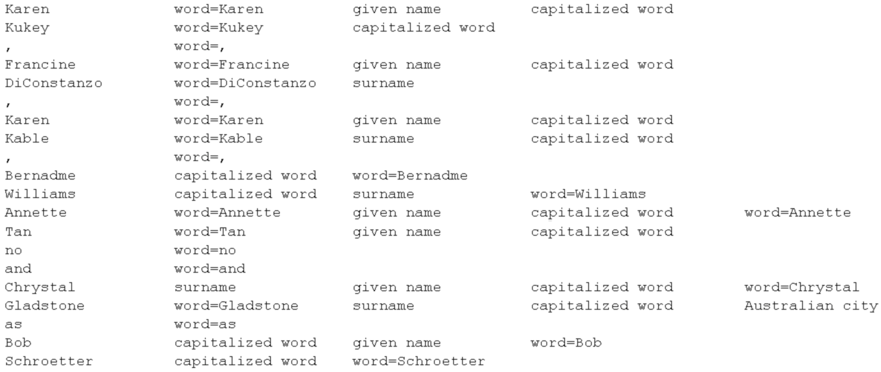
One Label per Token:
OCR Text Noisy Word Categories
Notes:
Problem with overlapping categories.
Four out of eleven labels
Option one: select one at random.

Slide 14
One Label per Token: Naïve Bayes Classifier
OCR Text Noisy Word Categories
Notes:
Option two:
NB: Select the label for a word that we see is often applied to other words on the same page with a similar context.
Using a neighborhood of all labels and positions on six neighbors, plus the current word.
If there is a list, contexts will repeat and neighboring fields will tend to co-occur.
If there is no list, the co-occurrences won’t happen. We need the labels to look random anyway so patterns won’t repeat.

Slide 15
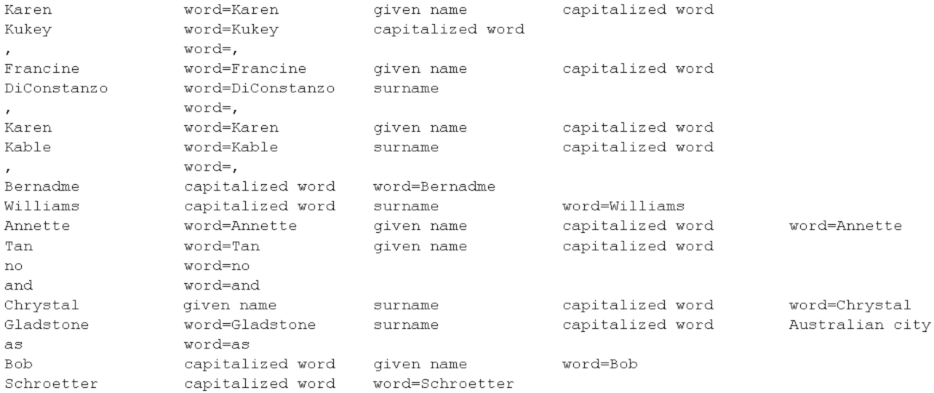
One Label per Token: Standard Deviation
OCR Text Noisy Word Categories
Notes:
SD: Select the label for a word that is most consistently spaced (lowest standard deviation among the options for that word).
If there is a list, similar distances will repeat and the stdev will be low for labels involved.
If there is no list, the distances won’t be similar. We need the labels to look random anyway so patterns won’t repeat.

Slide 16
26 Pages for Dev / Parameter Setting, F-measure on 16 Separate Test Pages
Notes:
Important to note how different results look depending on the metric, or even on how you average over pages.
In all cases, we see improvements in both metrics.

Slide 17
Conclusions and Contributions
First published method for general list detection in plain text or OCR output.
Good baseline for further research.
Improved by cheaply-constructed word categorizers—no added training data.
Public corpus of diverse OCRed historical documents hand-annotated with list structure and relation data extraction.

Slide 18
Future Work
Combine and supplement label selection heuristics
List structure recognition
Weakly-supervised information extraction from lists

Slide 19
The End
Please send feedback to
tpacker@byu.net

Slide 21
Moving Beyond Standard Deviation
Notes:
Plotting stdev as a function of hit count for 4 kinds of labels over the 6 newspaper pages.
Outlier is initials, e.g. “B.A.” which is a good pattern for the page.

Slide 22
Can my Computer Find Arbitrary Lists?
w01 w02 w03 w66 w03 w04 w05 w09 w11 w19 w10 w05 w08 w00 w11 w29 w06 w23 w06 w20 w06 w21 w06 w10 w22 w03 w00 w01 w02 w03 w67 w03 w04 w07 w05 w31 w11 w32 w06 w00 w28 w06 w10 w27 w03 w00 w01 w02 w03 214 w03 w04 w07 w05 w09 w11 w33 w06 w34 w00 w11 w05 w08 w11 w20 w06 w26 w06 w10 w35 w03 w00 w01 w02 w03 w64 w03 w04 w07 w05 w08 w11 w12 w00 w10 w30 w06 w10 w05 w16 w18 w11 w05 w08 w11 w30 w00 w10 w12 w06 w10 w24 w11 w05 w15 w11 w29 w06 w10 w36 w00 w11 w05 w15 w11 w23 w03 w00 w01 w02 w03 w68 w03 w04 w07 w05 w08 w11 w37 w06 w00 w39 w06 w38 w06 w14 w06 w10 w17 w06 w10 w05 w16 w00 w18 w11 w05 w08 w11 w14 w10 w17 w61 w05 w00 w40 w13 w03 w00 w01 w02 w03 w65 w03 w04 w07 w05 w08 w11 w50 w06 w00 w41 w06 w60 w06 w10 w42 w06 w10 w05 w16 w48 w49 w47 w00 w05 w51 w10 w05 w52 w53 w44 w11 w18 w45 w03 w00 w01 w02 w03 w69 w03 w04 w43 w61 w05 w46 w13 w11

Slide 23
Can my Computer Find Arbitrary Lists?
w01 w02 w03 w66 w03 w04 w05 w09 w11 w19 w10 w05 w08 w00 w11 w29 w06 w23 w06 w20 w06 w21 w06 w10 w22 w03 w00 w01 w02 w03 w67 w03 w04 w07 w05 w31 w11 w32 w06 w00 w28 w06 w10 w27 w03 w00 w01 w02 w03 214 w03 w04 w07 w05 w09 w11 w33 w06 w34 w00 w11 w05 w08 w11 w20 w06 w26 w06 w10 w35 w03 w00 w01 w02 w03 w64 w03 w04 w07 w05 w08 w11 w12 w00 w10 w30 w06 w10 w05 w16 w18 w11 w05 w08 w11 w30 w00 w10 w12 w06 w10 w24 w11 w05 w15 w11 w29 w06 w10 w36 w00 w11 w05 w15 w11 w23 w03 w00 w01 w02 w03 w68 w03 w04 w07 w05 w08 w11 w37 w06 w00 w39 w06 w38 w06 w14 w06 w10 w17 w06 w10 w05 w16 w00 w18 w11 w05 w08 w11 w14 w10 w17 w61 w05 w00 w40 w13 w03 w00 w01 w02 w03 w65 w03 w04 w07 w05 w08 w11 w50 w06 w00 w41 w06 w60 w06 w10 w42 w06 w10 w05 w16 w48 w49 w47 w00 w05 w51 w10 w05 w52 w53 w44 w11 w18 w45 w03 w00 w01 w02 w03 w69 w03 w04 w43 w61 w05 w46 w13 w11

Slide 24
Can my Computer Find Arbitrary Lists?
w01 w02 w03 w66 w03 w04 w05 w09 w11 w19 w10 w05 w08 w00 w11 w29 w06 w23 w06 w20 w06 w21 w06 w10 w22 w03 w00 w01 w02 w03 w67 w03 w04 w07 w05 w31 w11 w32 w06 w00 w28 w06 w10 w27 w03 w00 w01 w02 w03 214 w03 w04 w07 w05 w09 w11 w33 w06 w34 w00 w11 w05 w08 w11 w20 w06 w26 w06 w10 w35 w03 w00 w01 w02 w03 w64 w03 w04 w07 w05 w08 w11 w12 w00 w10 w30 w06 w10 w05 w16 w18 w11 w05 w08 w11 w30 w00 w10 w12 w06 w10 w24 w11 w05 w15 w11 w29 w06 w10 w36 w00 w11 w05 w15 w11 w23 w03 w00 w01 w02 w03 w68 w03 w04 w07 w05 w08 w11 w37 w06 w00 w39 w06 w38 w06 w14 w06 w10 w17 w06 w10 w05 w16 w00 w18 w11 w05 w08 w11 w14 w10 w17 w61 w05 w00 w40 w13 w03 w00 w01 w02 w03 w65 w03 w04 w07 w05 w08 w11 w50 w06 w00 w41 w06 w60 w06 w10 w42 w06 w10 w05 w16 w48 w49 w47 w00 w05 w51 w10 w05 w52 w53 w44 w11 w18 w45 w03 w00 w01 w02 w03 w69 w03 w04 w43 w61 w05 w46 w13 w11

Slide 25
Can my Computer Find Arbitrary Lists?
w01 w02 w03 w66 w03 w04 w05 w09 w11 w19 w10 w05 w08 w00 w11 w29 w06 w23 w06 w20 w06 w21 w06 w10 w22 w03 w00 w01 w02 w03 w67 w03 w04 w07 w05 w31 w11 w32 w06 w00 w28 w06 w10 w27 w03 w00 w01 w02 w03 214 w03 w04 w07 w05 w09 w11 w33 w06 w34 w00 w11 w05 w08 w11 w20 w06 w26 w06 w10 w35 w03 w00 w01 w02 w03 w64 w03 w04 w07 w05 w08 w11 w12 w00 w10 w30 w06 w10 w05 w16 w18 w11 w05 w08 w11 w30 w00 w10 w12 w06 w10 w24 w11 w05 w15 w11 w29 w06 w10 w36 w00 w11 w05 w15 w11 w23 w03 w00 w01 w02 w03 w68 w03 w04 w07 w05 w08 w11 w37 w06 w00 w39 w06 w38 w06 w14 w06 w10 w17 w06 w10 w05 w16 w00 w18 w11 w05 w08 w11 w14 w10 w17 w61 w05 w00 w40 w13 w03 w00 w01 w02 w03 w65 w03 w04 w07 w05 w08 w11 w50 w06 w00 w41 w06 w60 w06 w10 w42 w06 w10 w05 w16 w48 w49 w47 w00 w05 w51 w10 w05 w52 w53 w44 w11 w18 w45 w03 w00 w01 w02 w03 w69 w03 w04 w43 w61 w05 w46 w13 w11

Slide 26
Score and Select Substrings
W00 → 1 x 17 = 17
w01 w02 w03 w66 w03 w04 → 6 x 7 = 42
w03 w00 w01 w02 w03 w65 w03 w04 w07 → 9 x 5 = 45
w00 w39 w06 w38 w06 w14 w06 w10 w17 w06 w10 w05 w16 w00 w18 w11 w05 w08 w11 w14 w10 w17 w61 w05 w00 w40 w13 w03 w00 w01 → 30 x 1 = 30

