Slide 1
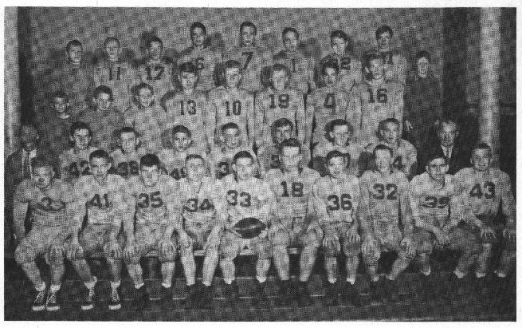
ListReader: Wrapper Induction for Lists in OCRed Documents
Thomas Packer
BYU CS DEG
2012.03.17
Notes:
[Punch it with energy.]
Let me define wrapper in my research area.
An information extraction wrapper is code or a grammar specific to a document used to extract information from it.

Slide 2
We Love Data (In Digital Form)
Notes:
More usable data

Slide 3
Lots of Paper Documents in the World
Notes:
Data not fully accessible or usable.

Slide 4
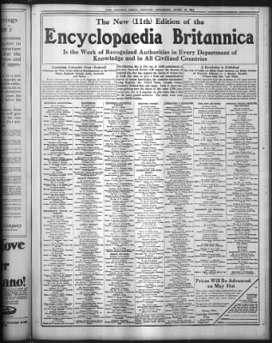
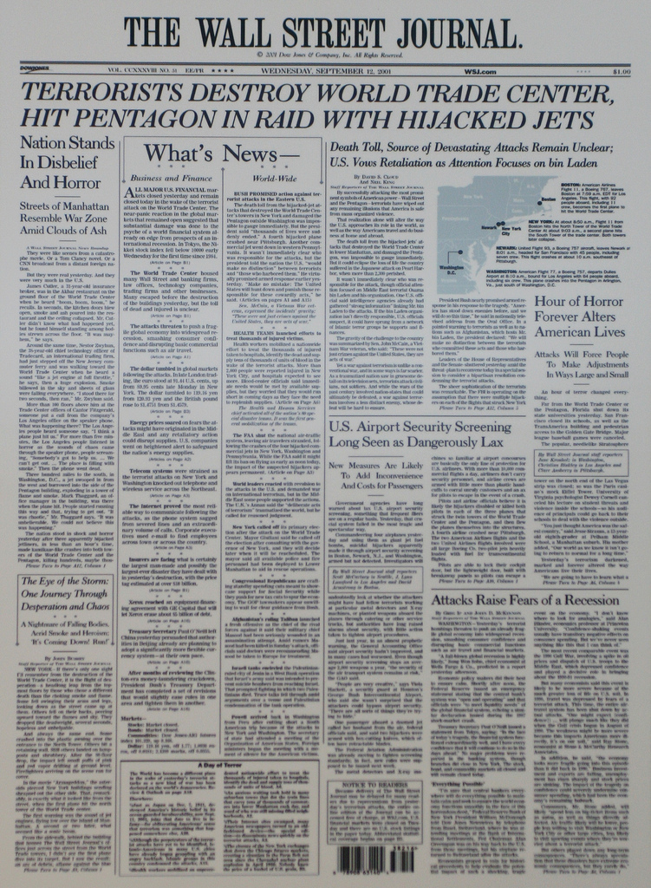
Lots of Text in Paper Documents
Notes:
Paper documents contain a lot of text.

Slide 5
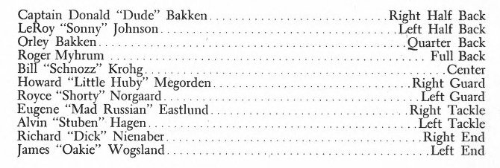
Lots of Lists in Text Lots of Data in Lists
Notes:
In text, lots of lists.
In lists, lots of data.
How to digitize data?

Slide 6
Manual Data Entry
Notes:
Traditional
Still in use

Slide 7
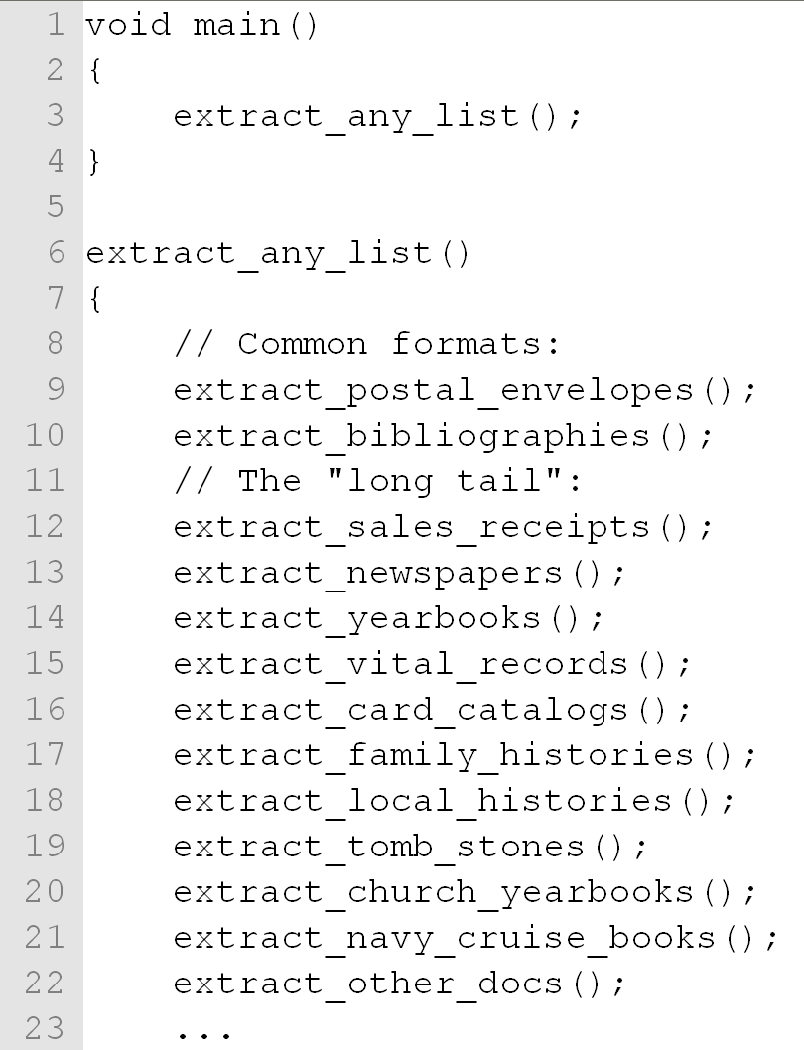
Wrappers: Individualized Extraction Rules
Notes:
Writing code specific to one format is doable.
What about arbitrary list data?
Tackling the “long tail” this way, is not.
Each category has multiple formats.

Slide 8
Semi-Automatic Wrapper Induction

Slide 9
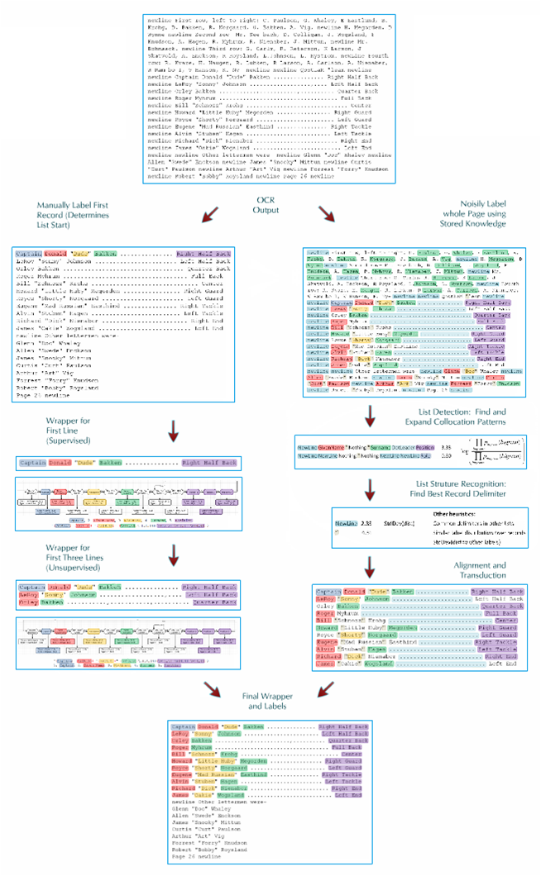
Semi-supervised Wrapper Induction
Weakly-supervised Wrapper Induction

Slide 10
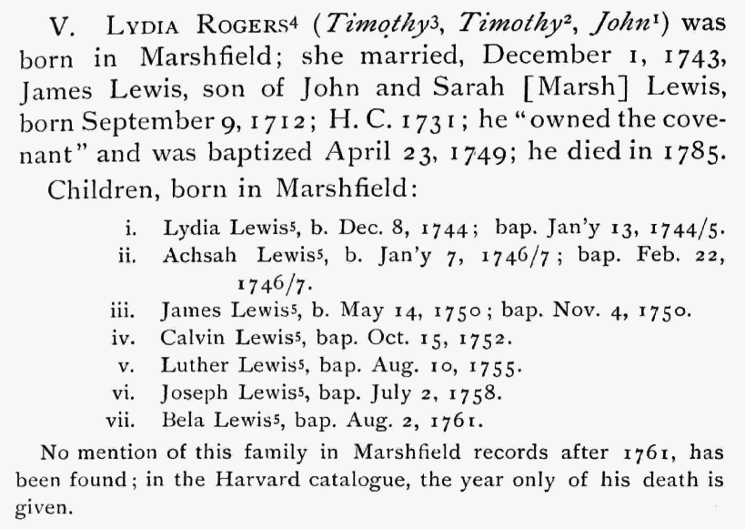
Data: Image
Notes:
Running example.
Family history book.

Slide 11
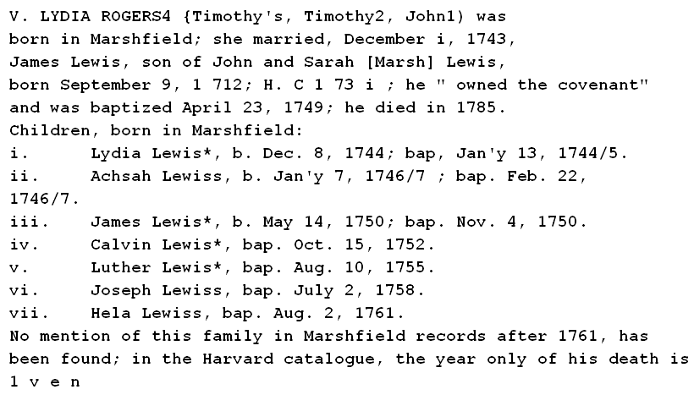
Data: OCR
Notes:
Errors highlighted.

Slide 12
Data: Hand-Labeled OCR

Slide 13
Induced Regex Wrappers
Single-Specific
Character Classes
(i)(\. )(Lydia)( )(Lewis)(\*, )(b\. ) …
[a-z]
[A-Z]
[0-9]
[ \t\r\n]
<each punct.>
Single-General
([a-z]{1,5})([ \t\r\n\.]{1,6})([a-zA-Z]{3,9})([ \t\r\n]{1,5}) ([a-zA-Z]{3,9})([ \t\r\n\*,]{1,7})([ \t\r\n\.a-z]{1,7}) …
Multi-General
([iv]{1,3})([ \.]{2,2})([ACHJLacdehilmnrstuvy]{4,6})([ ]{1,1}) ([Leisw]{5,6})([ \*,]{2,3})([ \.abp]{3,5}) …
Notes:
[Be faster.]
Assign capture groups to segments and associate labels with each.
Replace each character by its class, take the union of those as the final character class
Take union of aligned characters themselves and lowest lower-bound and highest upper-bound

Slide 14
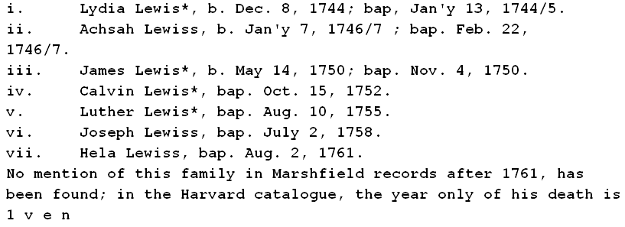
Data: Hand-Labeled OCR
Notes:
Transduction is a legitimate way to label fields. It is just less efficient to apply repeatedly.

Slide 15
Preliminary Results (Field Label F-measure, Small Dataset)
Notes:
No extra
Half with one extra
All with some extra

Slide 16
Conclusions and Future Work
Notes:
No extra
Half with one extra
All with some extra

Slide 17
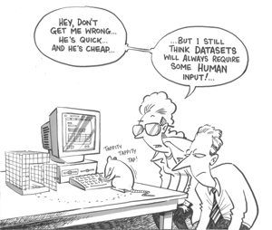
All done. Suggestions?

