Slide 1
Populating Ontologies with Data from Lists in Family History Books
Thomas L. Packer
David W. Embley
2013.03 RT.FHTW BYU.CS
Notes:
Happy (and confident) to be here!
Happy to see some familiar faces.
Valuable
Original
Doable
Measurably Successful

Slide 2
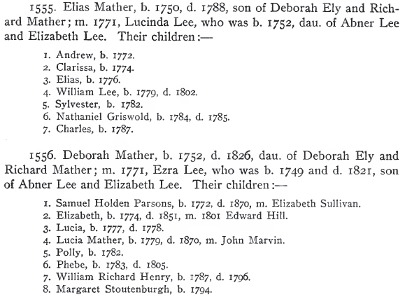
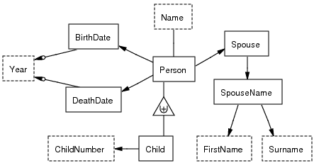
What’s the challenge?
Notes:
Pull out richly structured data
From semi-structured noisy OCR text
For various kinds of lists
using no knowledge engineering, no feature engineering, and as little as one hand-label per field per list.

Slide 3
What “rich data” is found in lists?
Lexical vs. non-lexical
Arbitrary relationship arity
Arbitrary ontology path lengths
Functional and optional constraints
Generalization-specialization class hierarchies (with inheritance)
Name(“Elias”) vs. Person(p₁)
Husband-married-Wife-in-Year(p₁, p₂, “1702”)
<Person.Father.Name.Surname>
Person-Birth() vs. Person-Marriage()
Child(p₃) → Person(p₃), Parent(p₂) → Person(p₂)
Notes:
What richly structured data in lists?
More expressive than other research
5 points of expressiveness or distinctions
Person entity different from name
Relationships among any number of entities
Meaningful relationship paths composed of many individual relationship steps
Not all relationships apply the same number of times to a given entity.
Generalization hierarchies allow us to represent different classes of entities sharing common attributes and relationships while still having their own.

Slide 4
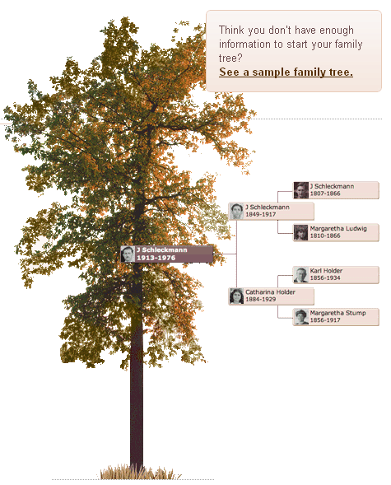
What’s the value?
Notes:
What is the value of rich, expressive data?
Extract from lists where no one else has.
Expressiveness, distinctions, more unique attributes
→ more versatility and accuracy in downstream application
perform information retrieval, querying, reasoning, record linkage, duplicate detection, tree stitching, question answering

Slide 5
What’s been done already?
Wrapper Induction | General Lists | Noise Tolerant | Rich Data | Effort-Scalable
Blanco, 2010 | 0.5 | 0.0 | 0.5 | 1.0
Dalvi, 2010 | 0.5 | 0.0 | 0.0 | 0.8
Gupta, 2009 | 1.0 | 0.0 | 0.5 | 0.8
Carlson, 2008 | 0.0 | 0.0 | 0.0 | 1.0
Heidorn, 2008 | 0.8 | 0.5 | 0.5 | 0.2
Chang, 2003 | 0.5 | 0.0 | 0.0 | 0.5
Crescenzi, 2001 | 0.0 | 0.0 | 0.0 | 1.0
Lerman, 2001 | 0.8 | 0.0 | 0.0 | 0.8
Chidlovskii, 2000 | 0.8 | 0.0 | 0.0 | 0.8
Kushmerick, 2000 | 0.0 | 0.0 | 0.0 | 1.0
Lerman, 2000 | 0.8 | 0.0 | 0.0 | 0.8
Thomas, 1999 | 0.0 | 0.0 | 0.0 | 0.5
Adelberg, 1998 | 1.0 | 0.0 | 0.5 | 0.2
Kushmerick, 1997 | 0.5 | 0.0 | 0.5 | 1.0
1.0 = well-covered
0.0 = not covered
Notes:
Challenging piece is wrapper induction
Means robust, scalable induction of grammars individualized to extract information from diverse input formats
No work is strong across all four areas
We’d like to add a row

Slide 6
What’s our contribution? ListReader Mappings
Formal correspondence among
Populated ontologies (predicates)
Inline annotated text (labels)
List wrappers (grammars)
Data entry (forms)
Notes:
Contribution is ListReader
Formal mapping among 4 KR
Reduces the ontology population problem …
… to a sequence labeling problem
… to a wrapper induction problem (simple wrappers, tailored to each list)
… to user building form and clicking (cheap training data)

Slide 7
What’s our contribution? ListReader Wrapper Induction
Low-cost wrapper induction
Semi-supervised + active learning
Decreasing-cost wrapper induction
Self-supervised + active learning
Notes:
Requiring a single labeling of each field in a list (optimal training) for a certain class of lists
Requiring fewer labels at higher accuracy than state-of-the-art ML-IE for a larger class of lists
Requiring a decreasing number of labels for new lists in same domain as knowledge is accumulated
Define three kinds of learning

Slide 8
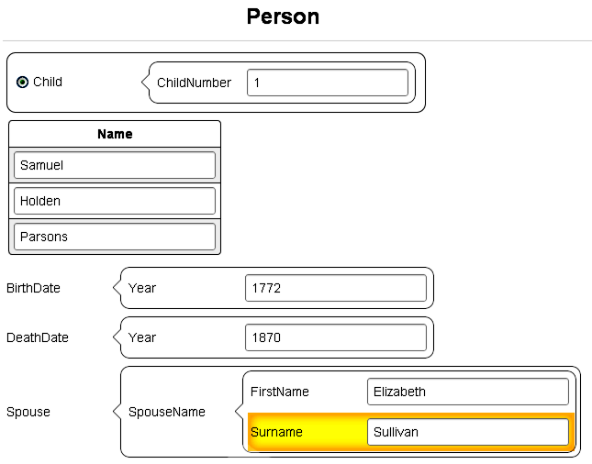
Cheap Training Data
Notes:
Click once per field in the order specified by the form.
One record to start the process.

Slide 9
Automatic Mapping
Child(p₁)
Person(p₁)
Child-ChildNumber(p₁, “1”)
Child-Name(p₁, n₁)
…
Notes:
Empty Form → ontology schema
Filled-in form → inline labeled text
Induction & execution → inline labeled text → predicates → populated ontology
Person.BirthDate.Year vs. Person.DeathDate.Year

Slide 10
Semi-supervised Induction
<C>1</C>. <FN>Andy</FN> b. <BD>1816</BD>
2. Becky Beth h, i818
3. Charles Conrad
Initialize
C FN BD
\n(1)\. (Andy) b\. (1816)\n
Generalize
C FN BD
\n([\dlio])[.,] (\w{4}) [bh][.,] ([\dlio]{4})\n
Alignment-Search
Expansion
Insertion
Deletion
Many more …
C FN Unknown BD
\n([\dlio])[.,] (\w{4,5}) (\S{1,10}) [bh][.,] ([\dlio]{4})\n
C FN BD
\n([\dlio])\[.,] (\w{4}) [bh][.,] ([\dlio]{4})\n
X
Evaluate (edit sim. * match prob.)
1. Andy b. 1816
2. Becky Beth h, 1818
3. Charles Conrad
1. Andy b. 1816
2. Becky Beth h, 1818
3. Charles Conrad
One match!
No Match
<C>1</C>. <FN>Andy</FN> b. <BD>1816</BD>
2. Becky <MN>Beth</MN> h, i818
3. Charles Conrad
Active Learning
C FN MN BD
\n([\dlio])[.,] (\w{4,5}) (\w{4}) [bh][.,] ([\dlio]{4})\n
Extract
<C>1</C>. <FN>Andy</FN> b. <BD>1816</BD>
<C>2</C>. <FN>Becky</FN> <MN>Beth</MN> h, <BD>i818</BD>
<C>3</C>. <FN>Charles</FN> <MN>Conrad</MN>
Notes:
(Say step number. Point out pieces.)
Expand matchable text to include common OCR errors
A* over each line
Posterior = prior * likelihood
“Unknown” insertion to cover “Beth”
Predicates into ontology
Search is most critical/expensive

Slide 11
Alignment-Search
Start State
A B C E F G
Substitution @ 3
Insertion @ 7
Branching Factor = 6 * 4 = 24
A B C’ E F G
A B C E F G H
Tree Depth = 3
And many more …
Deletion @ 6
This search space size = ~24³ = 13,824
A B C’ E F
Other search space sizes = ~ (12*4)⁷ = 48⁷ = 587,068,342,272
Insertion @ 4
A B C’ D E F
Goal State
Notes:
4 kinds of edit operators, 6 positions (sub-expressions)
Big search space

Slide 12
A* Alignment-Search
Start State
A B C E F G
Substitution @ 3
Insertion @ 7
Branching Factor = 2 * 4 = 8
f(s) = g(s) + h(s)
3 = 1 + 2
A B C’ E F G
A B C E F G H
f(s) = g(s) + h(s)
4 = 1 + 3
Tree Depth = 3
Never traverses this branch
Deletion @ 6
This search space size = ~10 (hard and soft constraints)
Instead of ~8³ = 512 (hard constraint)
or 13,824 (no constraint)
A B C’ E F
Other search space sizes = ~1000
instead of 587,068,342,272
Insertion @ 4
A B C’ D E F
Goal State
Notes:
Edit only failed sub-expressions small to large
Order operators left to right
Search lower estimated-cost paths first
14K to 10
Our A* with our admissible heuristic (estimate total path length) reduces the search space in two ways.
Our heuristic counts the number of sub-expressions that do not match any text from small to large.
Our heuristic imposes a hard constraint on which operators can be applied to which capture groups and in which order.
The heuristic constrains multiple independent edits to happen in a single serial order instead of multiple parallel permutations of the same set of edits, imposing an order of left-to-right and small-to-large sub-expressions.
This reduces the branching factor at each node/state. This reduces the search space.
Numbers show size of space with hard constraint, not soft constraint, which results in a space of about 10.
The A* priority queue also uses the heuristic to impose a soft constraint such that more promising paths are tried first.

Slide 13
Self-supervised Induction
Limited additional labeling via active learning
No additional labeling required
Notes:
Repository from one list

Slide 14
Why is this approach promising?
Semi-supervised Regex Induction vs. CRF
+
+
+
Self-supervised Regex Induction vs. CRF
30 lists | 137 records | ~10 fields / list
Stat. Sig. at p < 0.01 using both a paired t-test and McNemar’s test
Notes:
Feasible
Higher F-measure at lower cost than CRF
Reduced cost in self-supervision

Slide 15
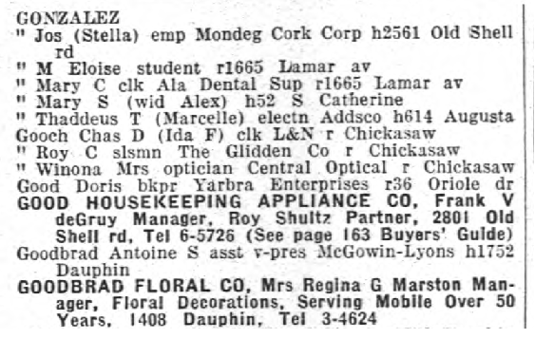
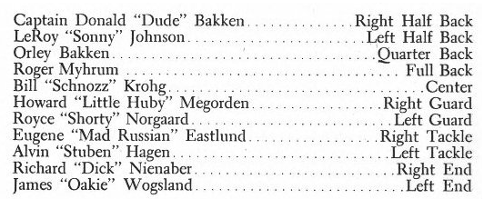
What next?
Improve time, space, and accuracy with HMM wrappers
Expanded class of input lists

Slide 16
Conclusions
Ontology population to sequence labeling
Induce wrapper with single click per field
Noise tolerant and accurate
Notes:
Demonstrated feasibility of approach

Slide 18
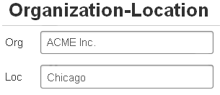
Typical Ontology Population
Notes:
Most work extracts one or two kinds of facts:
Specialization (unary)
Properties (binary)
These do not represent the full range of expressiveness in lists data.

Slide 19
Why not Apply Web Wrapper Induction to OCR Text?
Noise tolerance:
Allow character variations → increase recall → decrease precision
Populate only the simplest ontologies
Problems with wrapper language:
Left-right context (Wien, Kushmeric 2000)
Disjunction rule nad FSA model to traverse landmarks along tree structure (Stalker, Softmealy)
Xpath (Dalvi 2009, etc.)
CRF (Gupta 2009)
Notes:
We must come up with a new way to improve recall and keep precision up
HTML assumptions: machine/template-generated pages, x-path can isolate subsequences of text, tag-separable fields or other landmarks, landmarks do not contain OCR errors, not hand-typed.
Gupta’s web-scale assumptions

Slide 20
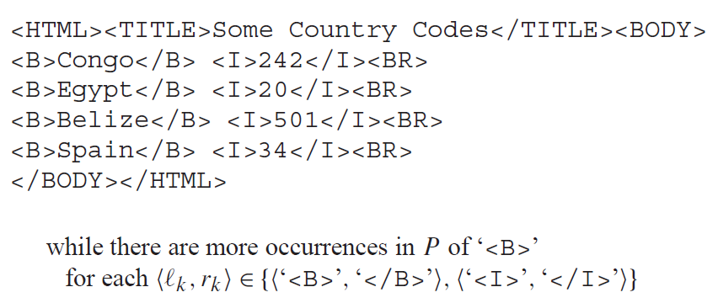
Why not use left-right context?
Field boundaries
Field position and character content
Record boundaries
OCRed List:
Notes:
Often no unique delimiters in OCR: must look for combination of position of field among all the other fields and character content of field.
Before that, we need to delimit records.
The typical wrapper learns a vector of delimiters.
Delimiters aren’t going to be consistent (noise) or unique (need more context and content clues) or expressive (won’t extract richly structured data to populate an ontology without some additions like record structure delimiters and path labels).

Slide 21
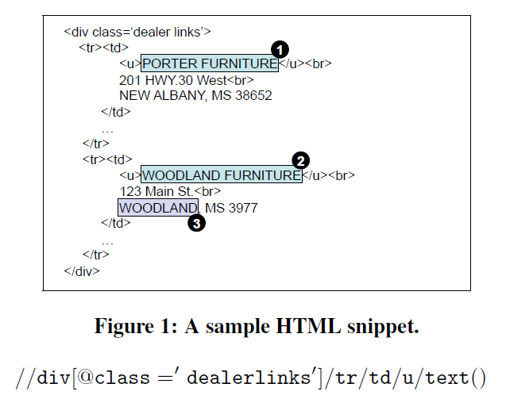
Why not use xpaths?
OCR text has no explicit XML DOM tree structure
Xpaths require HTML tag to perfectly mark field text

Slide 22
Why not Use (Gupta’s) CRFs?
HTML lists and records are explicitly marked
Different application: Augment tables using tuples from any lists on web
At web scale, they can throw away harder-to-process lists
They rely on more training data than we will
We will compare our approach to CRFs

Slide 23
Page Grammars
Conway [1993]
2-D CFG and chart parser for page layout recognition from document images
Can assign logical labels to blocks of text
Manually constructed grammars
Rely on spatial features

Slide 24
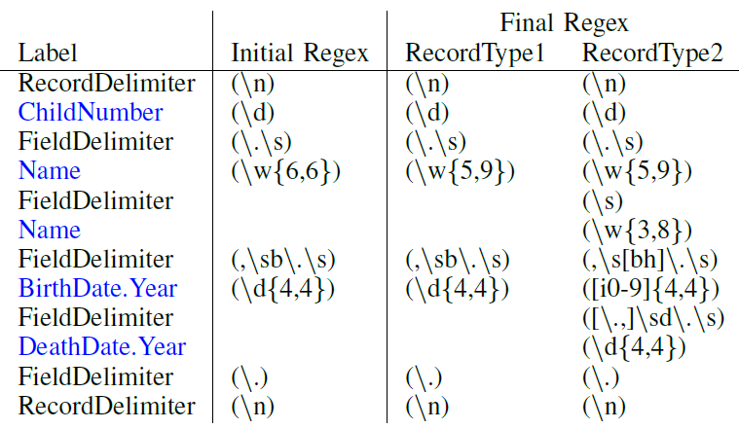
Semi-supervised Regex Induction
Notes:
Including expanding text to include common OCR errors.

Slide 26
List Reading
Specialized for one kind of list:
Printed ToC: Marinai 2010, Dejean 2009, Lin 2006
Printed bibs: Besagni 2004, Besagni 2003, Belaid 2001
HTML lists: Elmeleegy 2009, Gupta 2009, Tao 2009, Embley 2000, Embley 1999
Use specialized hand-crafted knowledge
Rely on clean input text containing useful HTML structure or tags
NER or flat attribute extraction–limited ontology population
Omit one or more reading steps
Notes:
Long tail of list formats, the uncommon ones.

Slide 27
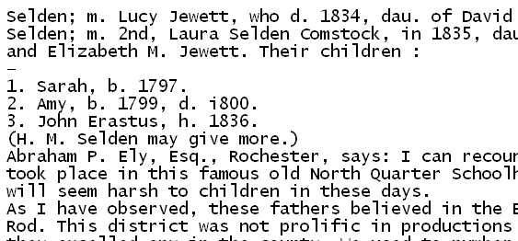
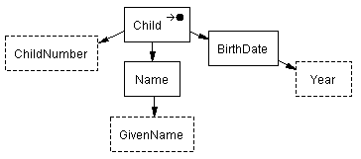
Research Project
Child(child₁)
Child-ChildNumber(child₁, “1”)
Child-Name(child₁, name₁)
Name-GivenName(name₁, “Sarah”)
Child-BirthDate(child₁, date₁)
BirthDate-Year(date₁, “1797”)
Motivation
Related Work
Project Description
Validation
Conclusion
Notes:
We have a list of the children of a person in a family history book.
We would like to extract the data from lists as predicates to enter into a user-specified ontology.
Reduce manual effort in that red arrow.

Slide 28
Wrapper Induction for Printed Text
Adelberg 1998:
Grammar induction for any structured text
Not robust to OCR errors
No empirical evaluation
Heidorn 2008:
Wrapper induction for museum specimen labels
Not typical lists
Supervised—will not scale well
Entity attribute extraction–limited ontology population
Motivation
Related Work
Project Description
Validation
Conclusion

Slide 29
Semi-supervised Wrapper Induction
Child(child₁)
Child-ChildNumber(child₁, “1”)
Child-Name(child₁, name₁)
Name-GivenName(name₁, “Sarah”)
Child-BirthDate(child₁, date₁)
BirthDate-Year(date₁, “1797”)
Motivation
Related Work
Project Description
Validation
Conclusion
Notes:
We have a list of children of a person in a family history book.
We would like a user-specified ontology and to extract data from lists as predicates to enter into that ontology.
Point out OCR errors
We wish to extract these facts from this list and insert them into this ontology.
To start with, we have no ontology and no way to know how facts are represented in this list.

Slide 30
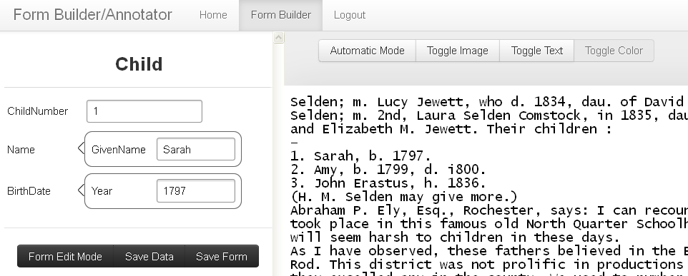
Construct Form, Label First Record
<Child.ChildNumber>1</Child.ChildNumber>. <Child.Name.GivenName>Sarah</Child.Name.GivenName>, b. <Child.BirthDate.Year>1797</Child.BirthDate.Year>.
Motivation
Related Work
Project Description
Validation
Conclusion
Notes:
User constructs an ontology by constructing a entry form.
User labels first record by inserting text into form.

Slide 31
Wrapper Generalization
1. Sarah, b. 1797.
2. Amy, h. 1799, d. i800.
3. John Erastus, b. 1836, d. 1876.
…
,
b
.
Child.BirthDate.Year
.
\n
…
,
b/h
.
Child.BirthDate.Year
?
?
?
?
.
\n
Motivation
Related Work
Project Description
Validation
Conclusion
Notes:
User constructs an ontology by constructing a entry form.
User labels first record by inserting text into form.
ListReader inserts OCR variants (matching whole records constrains and filters out bad wrappers, increases precision)
ListReader opts to insert a few words into the wrapper and request labels for them.

Slide 32
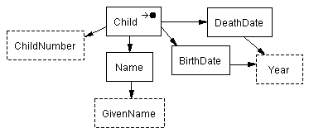
Wrapper Generalization
1. Sarah, b. 1797.
2. Amy, h. 1799, d. i800.
3. John Erastus, b. 1836, d. 1876.
…
,
b
.
Child.BirthDate.Year
.
\n
…
,
b/h
.
Child.BirthDate.Year
?
?
?
?
.
\n
…
,
b/h
.
Child.BirthDate.Year
,
d
.
Child.DeathDate.Year
.
\n
Motivation
Related Work
Project Description
Validation
Conclusion
Notes:
The user updates the form which adds another object set to the ontology.
The user labels the new field which then updates the wrapper and allows it to extract the second record.

Slide 33
Wrapper Generalization as Beam Search
Initialize wrapper from first record
Apply predefined set of wrapper adjustments
Score alternate wrappers with:
“Prior” (is like known list structure)
“Likelihood” (how well they match next text)
Add best to wrapper set
Repeat until end of list
Motivation
Related Work
Project Description
Validation
Conclusion
Notes:
Add word to field.
Remove word in field.
Add field.
Remove field.
Generalize character class of word.
Generalize length of word.

Slide 34
Mapping Sequential Labels to Predicates
\n
Child.ChildNumber
.
Child.Name.GivenName
,
b
.
Child.BirthDate.Year
.
\n
<Child.ChildNumber>1</Child.ChildNumber>. <Child.Name.GivenName>Sarah</Child.Name.GivenName>, b. <Child.BirthDate.Year>1797</Child.BirthDate.Year>.
Child(child₁)
Child-ChildNumber(child₁, “1”)
Child-Name(child₁, name₁)
Name-GivenName(name₁, “Sarah”)
Child-BirthDate(child₁, date₁)
BirthDate-Year(date₁, “1797”)
Motivation
Related Work
Project Description
Validation
Conclusion
Notes:
Labels unlike any I’ve seen before.
Sequential labels are like the lexical object sets.
But when we add death year, we add a new kind of year or keep it the same year. Ontologies allow us to say the new year is of the same type but has a different relationship to the child.
So we label with respect to ontology, using label paths to specify exactly the predicates to be extracted.

Slide 35
Weakly Supervised Wrapper Induction
Apply wrappers and ontologies
Spot list by repeated patterns
Find best ontology fragments for best-labeled record
Generalize wrapper
Both above and below
Active learning without human input
Motivation
Related Work
Project Description
Validation
Conclusion

Slide 36
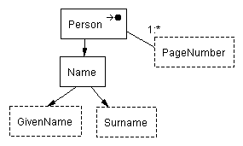
Knowledge from Previously Wrapped Lists
\n
Child.ChildNumber
.
Child.Name.GivenName
,
b
.
Child.BirthDate.Year
;
d
.
Child.DeathDate.Year
;
m
.
Child.Spouse.Name.GivenName
Child.Spouse.Name.Surname
.
\n
Motivation
Related Work
Project Description
Validation
Conclusion
Notes:
No form or input ontology.
John Erastus could have been ordered backward in the index and still work.
First part has newline, ChildNumber, period, Child GivenName.
Last part has m., Spouse GivenName, Spouse Surname.
Ontology from book name index has a person name containing John as GivenName and Erastus as Surname and relationships that link them togther.

Slide 37
List Spotting
\n
Child.ChildNumber
.
Child.Name.GivenName
.
\n
1. Sarah, b. 1797.
2. Amy, h. 1799, d. i800.
3. John Erastus, b. 1836.
\n
\n
\n
\n
\n
\n
Motivation
Related Work
Project Description
Validation
Conclusion
Notes:
The other records probably had labels too.
We clean them up by preserving only the ones with the most support from multiple recognizers and save them as the oracle—a fully automated oracle instead of a human oracle.

Slide 38
Select Ontology Fragments and Label the Starting Record
1. Sarah, b. 1797.
2. Amy, h. 1799, d. i800.
3. John Erastus, b. 1836.
\n
Child.ChildNumber
.
,
b
.
Child.BirthDate.Year
Motivation
Related Work
Project Description
Validation
Conclusion
Notes:
Identify the ontology fragments (not just the labels)

Slide 39
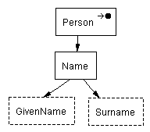
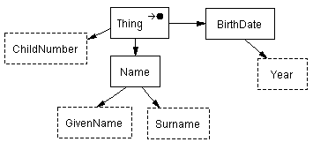
Merge Ontology and Wrapper Fragments
Motivation
Related Work
Project Description
Validation
Conclusion
Notes:
Identify the ontology fragments (not just the labels)

Slide 40
Generalize Wrapper, & Learn New Fields without User
d
.
Child.DeathDate.Year
.
1. Sarah, b. 1797.
2. Amy, h. 1799, d. i800.
3. John Erastus, b. 1836.
Motivation
Related Work
Project Description
Validation
Conclusion
Notes:
The other records had labels too.
If they had fields not in the initial record, use them like the oracle instead of the human user.
We clean them up by preserving only the ones with the most support from multiple recognizers and save them as the oracle—a fully automated oracle instead of a human oracle.

Slide 41
Thesis Statement
It is possible to populate an ontology semi-automatically, with better than state-of-the-art accuracy and cost, by inducing information extraction wrappers to extract the stated facts in the lists of an OCRed document, firstly relying only on a single user-provided field label for each field in each list, and secondly relying on less ongoing user involvement by leveraging the wrappers induced and facts extracted previously from other lists.
Motivation
Related Work
Project Description
Validation
Conclusion

Slide 42
Four Hypotheses
Is a single labeling of each field sufficient?
Is fully automatic induction possible?
Does ListReader perform increasingly better?
Are induced wrappers better than the best?
Motivation
Related Work
Project Description
Validation
Conclusion

Slide 43
Hypothesis 1
Single user labeling of each field per list
Evaluate detecting new optional fields
Evaluate semi-supervised wrapper induction
Motivation
Related Work
Project Description
Validation
Conclusion

Slide 44
Hypothesis 2
No user input required with imperfect recognizers
Find required level of noisy recognizer P & R
Motivation
Related Work
Project Description
Validation
Conclusion

Slide 45
Hypothesis 3
Increasing repository knowledge decreases the cost
Show repository can produce P- and R-level recognizers
Evaluate number of user-provided labels over time
Motivation
Related Work
Project Description
Validation
Conclusion
Notes:
Bootstrapping
A wrapper fragment or ontology fragment with n fields selected as a match of one or more record fragments of a list reduces the number of user-specified labels needed to extract all stated facts from L by n.
Show that bootstrapping beginning with Scenario 1 can produce P- and R-level noisy recognizers.
Determine how much user-specified labeling decreases in Scenario 2 using noisy recognizers induced in the bootstrapping process.
Call it tranfser learning

Slide 46
Hypothesis 4
ListReader performs better than a representative state-of-the-art information extraction system
Compare ListReader with the supervised CRF in Mallet
Motivation
Related Work
Project Description
Validation
Conclusion
Notes:
Comparison

Slide 47
Evaluation Metrics
Precision
Recall
F-measure
Accuracy
Number of user-provided labels
Motivation
Related Work
Project Description
Validation
Conclusion
Notes:
Precision: proportion of extracted fields that are correctly labeled.
Recall: proportion of true fields that were extracted.
F-measure: harmonic mean of precision and recall.
Accuracy: Proportion of words with correct field labels.
Number of user-provided labels: Number of labels provided to train wrapper induction and correct false extractions. Combines training cost and execution accuracy in one metric.

Slide 48
Work and Results Thus Far
Large, diverse corpus of OCRed documents
Semi-supervised regex and HMM induction
Both beat CRF trained on three times the data
Designed label to predicate mapping
Implemented preliminary mapping
85% accuracy of word-level list spotting
Motivation
Related Work
Project Description
Validation
Conclusion
Notes:
Collected large and diverse corpus of OCRed documents and images in family history domain from Ancestry and FamilySearch
Initial semi-supervised regex induction, including:
Field insertion, field deletion, field lengthening, field shortening, word length and character set generalization, new field spotting, and end-of-list finding, all using text matching to select among transformations
Initial semi-supervised HMM induction (outperforms regex)
Worked out the mapping between labels and ontology schema elements and predicates on paper for our target schema elements
Translation of flat labels to OSMX ontology schema and facts (using early version of labels)
That is, my early semi-supervised wrapper induction beats a state-of-the-art supervised model that was given three times as much training data.
Label selection and list spotting based on noisy labels from dictionaries works at 85% accuracy on word-level granularity
Accuracy should be higher for finding any one record rather than every word.

Slide 49
Questions & Answers

Slide 50
What Does that Mean?
Populating Ontologies
A machine-readable and mathematically specified conceptualization of a collection of facts
Semi-automatically Inducing
Pushing more work to the machine
Information Extraction Wrappers
Specialized processes exposing data in documents
Lists in OCRed Documents
Data-rich with variable format and noisy content
Motivation
Related Work
Project Description
Validation
Conclusion

Slide 51
Who Cares?
Populating Ontologies
Versatile, expressive, structured, digital information is queryable, linkable, editable.
Semi-automatically Inducing
Lowers cost of data
Information Extraction Wrappers
Accurate by specializing for each document format
Lists in OCRed Documents
Lots of data useful for family history, marketing, personal finance, etc. but challenging to extract
Motivation
Related Work
Project Description
Validation
Conclusion

Slide 52
Reading Steps
List spotting
Record segmentation
Field segmentation
Field labeling
Nested list recognition
Members of the football team:
Captain: Donald Bakken.................Right Half Back
LeRoy "sonny' Johnson.........,........Lcft Half Back
Orley "Dude" Bakken......,.......,......Quarter Back
Roger Jay Myhrum........................ .Full Back
Bill "Snoz" Krohg,...........................Center
They had a good year.
Motivation
Related Work
Project Description
Validation
Conclusion

Slide 53
Special Labels Resolve Ambiguity
Child(child₁)
Child-ChildNumber(child₁, “1”)
Child-Name(child₁, name₁)
Name-GivenName(name₁, “Sarah”)
Child-BirthDate(child₁, date₁)
BirthDate-Year(date₁, “1797”)
1. Sarah, b. 1797.
2. Amy, h. 1799, d. i800.
3. John Erastus, b. 1836, d. 1876.
\n
Child.ChildNumber
.
Child.Name.GivenName
,
b
.
Child.BirthDate.Year
.
\n
<Child.ChildNumber>1</Child.ChildNumber>. <Child.Name.GivenName>Sarah</Child.Name.GivenName>, b. <Child.BirthDate.Year>1797</Child.BirthDate.Year>.
Motivation
Related Work
Project Description
Validation
Conclusion
Notes:
So we label with respect to ontology, using label paths to specify exactly the predicates to be extracted.
Page 141 Ely Ancestry

