Slide 1

Populating Ontologies with Data from OCRed Lists
Thomas L. Packer
3/2013 CS/BYU
Notes:
Happy to be here!

Slide 2
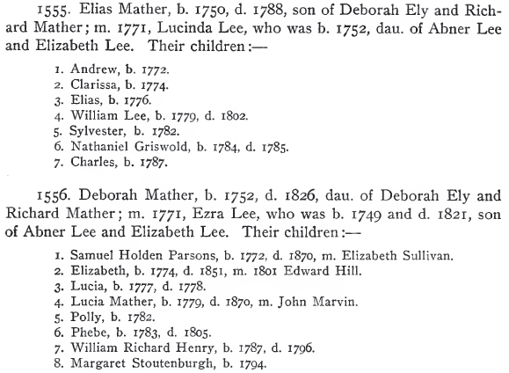
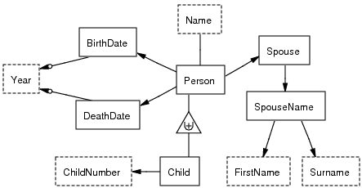
What’s the challenge?
Notes:
Semi-structured noisy OCR text to richly-structured populated ontologies (like a database with a schema, which allows…) using no knowledge engineering, no feature engineering, and as little as one hand-label per field per list.

Slide 3
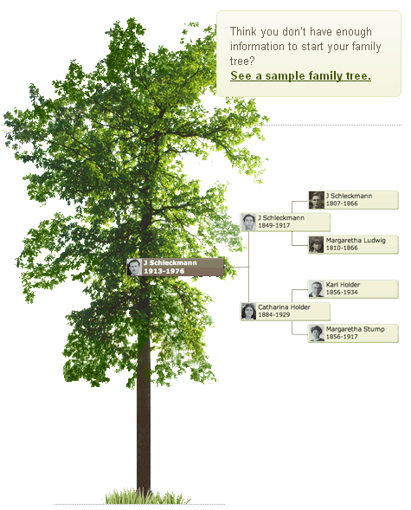
What’s the value?

Slide 4
What’s been done already?
Wrapper Induction | Lists | Noise Tolerant | Rich Ontology | Scalable
blanco_redundancy_2010 | 0.5 | 0.0 | 0.5 | 1.0
dalvi_automatic_2010 | 0.5 | 0.0 | 0.0 | 0.8
gupta_answering_2009 | 1.0 | 0.0 | 0.5 | 0.8
carlson_bootstrapping_2008 | 0.0 | 0.0 | 0.0 | 1.0
heidorn_automatic_2008 | 0.8 | 0.5 | 0.5 | 0.2
chang_automatic_2003 | 0.5 | 0.0 | 0.0 | 0.5
crescenzi_roadrunner_2001 | 0.0 | 0.0 | 0.0 | 1.0
lerman_automatic_2001 | 0.8 | 0.0 | 0.0 | 0.8
chidlovskii_wrapper_2000 | 0.8 | 0.0 | 0.0 | 0.8
kushmerick_wrapper_2000 | 0.0 | 0.0 | 0.0 | 1.0
lerman_learning_2000 | 0.8 | 0.0 | 0.0 | 0.8
thomas_t-wrappers_1999 | 0.0 | 0.0 | 0.0 | 0.5
adelberg_nodose_1998 | 1.0 | 0.0 | 0.5 | 0.2
kushmerick_wrapper_1997 | 0.5 | 0.0 | 0.5 | 1.0
1.0 = well-covered
0.0 = not covered
Notes:
Challenging piece of the process is wrapper induction which has come to mean scalable grammar induction to extract information from various input formats.

Slide 5
What’s our contribution? ListReader
Formal correspondence among
  Data entry forms
  Inline annotated text
  List wrappers/grammars
  Populated ontologies/predicates
Low-cost wrapper induction
  Semi-supervised + active learning
Decreasing-cost wrapper induction
  Self-supervised + active learning
Notes:
Formal correspondence (mapping) among. Reduces the ontology population problem to a sequence labeling problem. (Allows easy training data to drive wrapper induction of wrappers tailored for each list and allows simple wrapper languages to produce expressive ontologically-defined data as output.)
Data entry forms
Inline annotated text
List wrappers (grammars)
Populated ontologies (predicates)
Low-cost wrapper induction (semi-supervised wrapper induction):
Requiring a single labeling of each field in a list (optimal training) for a certain class of lists (using semi-supervised wrapper induction)
Requiring fewer labels at higher accuracy than state-of-the-art ML-IE for a larger class of lists
Decreasing-cost wrapper induction (self-supervised wrapper induction):
Requiring a decreasing number of labels for new lists in same domain as knowledge is accumulated

Slide 6
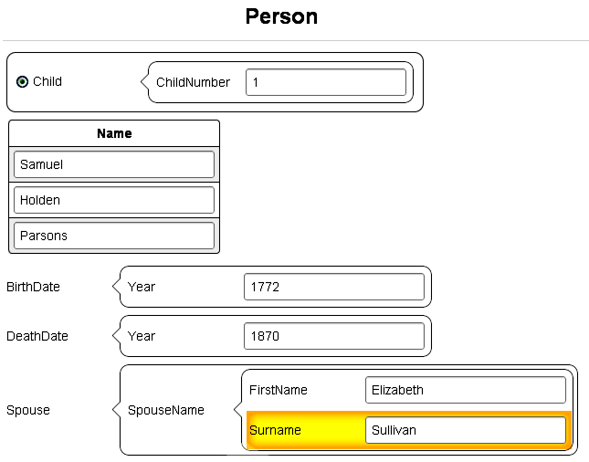
Easy Data Entry

Slide 7
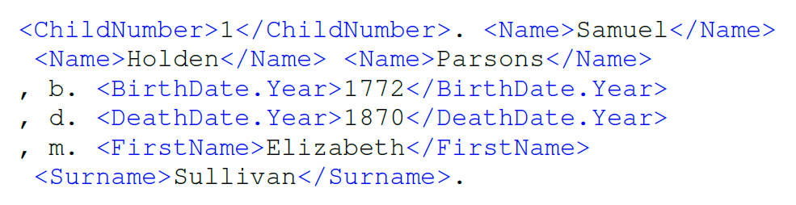
Automatic Mapping
Notes:
Form → ontology schema
Filled-in form → inline labeled text
Induction → inline labeled text → predicates → populated ontology

Slide 8
Semi-supervised Regex Induction
<C>1</C>. <FN>Andy</FN> b. <BD>1816</BD>
2. Becky Beth h, i818
3. Charles Conrad
Initialize
C FN BD
\n(1)\. (Andy) b\. (1816)\n
Expand
C FN BD
\n([\dlio])[.,] (\w{4}) [bh][.,] ([\dlio]{4})\n
Expansion
Insertion
Deletion
Many more …
Enumerate
C FN Unknown BD
\n([\dlio])[.,] (\w{4,5}) (\S{1,10}) [bh][.,] ([\dlio]{4})\n
C FN BD
\n([\dlio])\[.,] (\w{4}) [bh][.,] ([\dlio]{4})\n
X
Evaluate (edit sim. * match prob.)
1. Andy b. 1816
2. Becky Beth h, 1818
3. Charles Conrad
1. Andy b. 1816
2. Becky Beth h, 1818
3. Charles Conrad
Match!
No Match
<C>1</C>. <FN>Andy</FN> b. <BD>1816</BD>
2. Becky <SN>Beth</SN> h, i818
3. Charles Conrad
Active Learning
C FN SN BD
\n([\dlio])[.,] (\w{4,5}) (\w{4}) [bh][.,] ([\dlio]{4})\n
Extract
<C>1</C>. <FN>Andy</FN> b. <BD>1816</BD>
<C>2</C>. <FN>Becky</FN> <SN>Beth</SN> h, <BD>i818</BD>
<C>3</C>. <FN>Charles</FN> <SN>Conrad</SN>
Notes:
Expand class of matchable text to include common OCR errors.

Slide 9
Self-supervised Regex Induction
Limited additional labeling via active learning
No additional labeling required

Slide 10
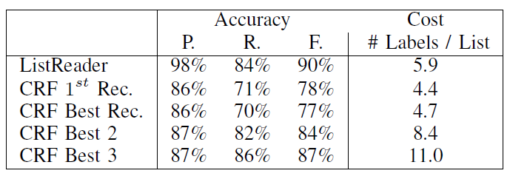
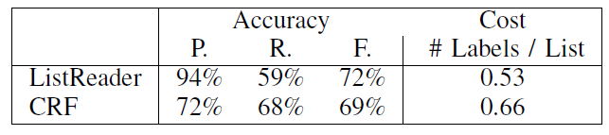
Why is our approach promising?
Semi-supervised Regex Induction vs. CRF
Self-supervised Regex Induction vs. CRF
30 lists | 137 records
Stat. Sig. at p < 0.01 using McNemar’s Test
Notes:
Feasible

Slide 11
What next?
Expanded class of lists
Improve time and space complexity and accuracy with:
  A* search, one record at a time
  HMM wrapper
Accuracy and Cost | F-measure | # Labels per List
ListReader (A* Enumeration ) | 92% | 4.5
ListReader (Exhaustive Enumeration) | 90% | 5.9
CRF | 87% | 11

Slide 12
Conclusions
Reduce rich ontology population to sequence labeling
Induce a wrapper for some lists with a single click per field
Noise tolerant and accurate even using regular expressions
Notes:
Demonstrated feasibility of approach

Slide 14
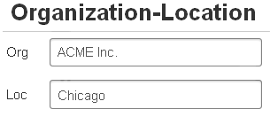


Typical Ontology Population
Notes:
Most work extracts one or two kinds of facts:
Specialization (unary)
Properties (binary)
These do not represent the full range of expressiveness in lists data.

Slide 15
Expressive Ontology Population
Lexical vs. non-lexical
N-ary relationships
M degrees of separation
Functionality and optionality
Generalization-specialization class hierarchies
GivenName(“Joe”) vs. Person(p₁)
City-Population-Year(“Provo”, “115000”, “2011”)
Husband-Wife(p₁, p₂), Wife-BirthDate(p₂, d₂), BirthDate-Year(d₂, “1876”)
Person-Birth() vs. Person-Marriage()
Business vs. Person
Notes:
Need this expressive information to perform querying of database, record linkage, question answering, better information retrieval.

Slide 16
Why not Apply Web Wrapper Induction to OCR Text?
Noise tolerance:
  Allow character variations → increase recall → decrease precision
Populate only the simplest ontologies
Problems with wrapper language:
  Left-right context (Kushmeric 2000)
  Xpath (Dalvi 2009, etc.)
  CRF (Gupta 2009)
Notes:
We must come up with a new way to improve recall and keep precision up
HTML assumptions: machine/template-generated pages, x-path can isolate subsequences of text, tag-separable fields or other landmarks, landmarks do not contain OCR errors, not hand-typed.
Gupta’s web-scale assumptions

Slide 17
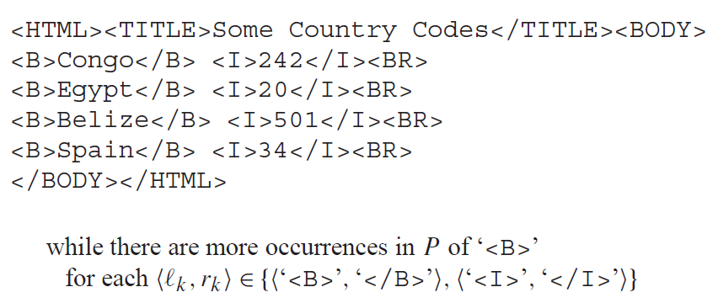
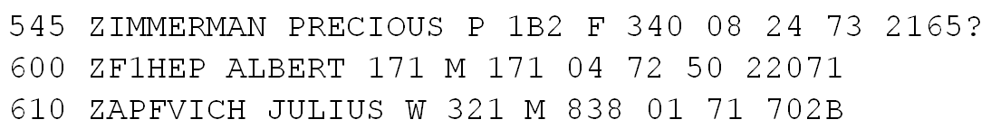
Why not use left-right context?
Field boundaries
Field position and character content
Record boundaries
OCRed List:
Notes:
Often no unique delimiters in OCR: must look for combination of position of field among all the other fields and character content of field.
Before that, we need to delimit records.

Slide 18
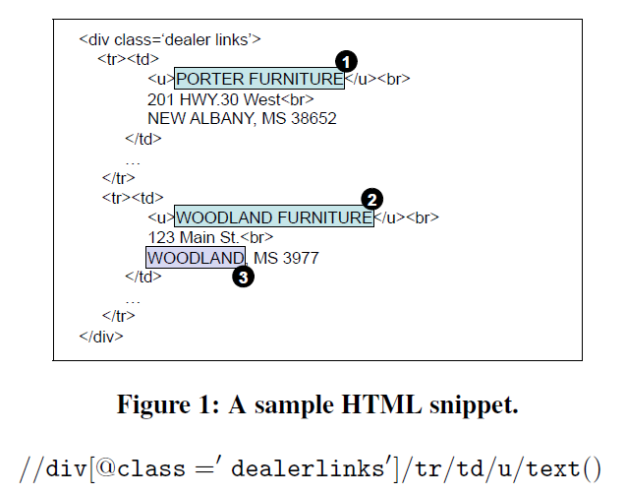
Why not use xpaths?
OCR text has no explicit XML DOM tree structure
Xpaths require HTML tag to perfectly mark field text

Slide 19
Why not Use (Gupta’s) CRFs?
HTML lists and records are explicitly marked
Different application: Augment tables using tuples from any lists on web
At web scale, they can throw away harder-to-process lists
They rely on more training data than we will
We will compare our approach to CRFs

Slide 20
Page Grammars
Conway [1993]
2-D CFG and chart parser for page layout recognition from document images
Can assign logical labels to blocks of text
Manually constructed grammars
Rely on spatial features

Slide 21
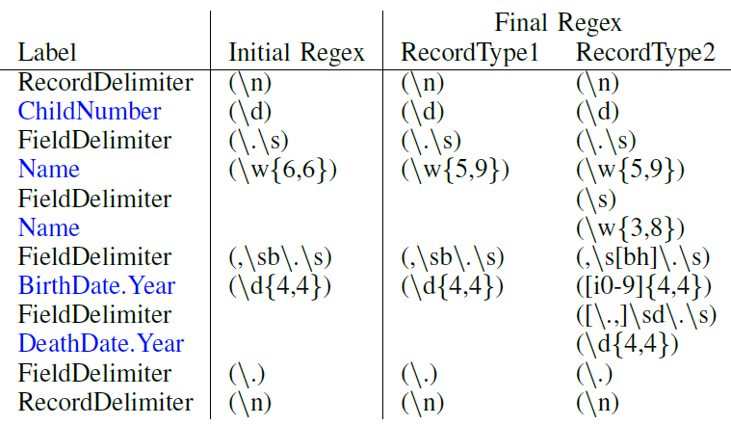
Semi-supervised Regex Induction
Notes:
Including expanding text to include common OCR errors.

Slide 23
x
x
Motivation
Related Work
Project Description
Validation
Conclusion

Slide 24
List Reading
Specialized for one kind of list:
  Printed ToC: Marinai 2010, Dejean 2009, Lin 2006
  Printed bibs: Besagni 2004, Besagni 2003, Belaid 2001
  HTML lists: Elmeleegy 2009, Gupta 2009, Tao 2009, Embley 2000, Embley 1999
Use specialized hand-crafted knowledge
Rely on clean input text containing useful HTML structure or tags
NER or flat attribute extraction–limited ontology population
Omit one or more reading steps
Notes:
Long tail of list formats, the uncommon ones.

Slide 25
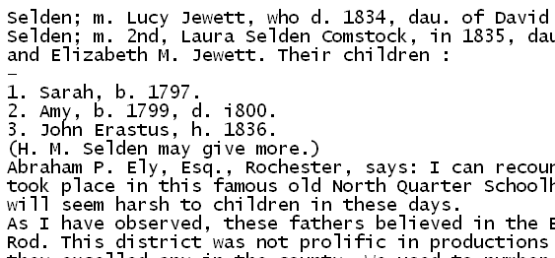
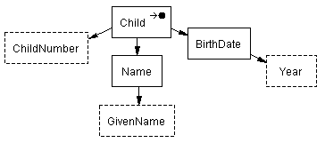
Research Project
Child(child₁)
Child-ChildNumber(child₁, “1”)
Child-Name(child₁, name₁)
Name-GivenName(name₁, “Sarah”)
Child-BirthDate(child₁, date₁)
BirthDate-Year(date₁, “1797”)
Motivation
Related Work
Project Description
Validation
Conclusion
Notes:
We have a list of the children of a person in a family history book.
We would like to extract the data from lists as predicates to enter into a user-specified ontology.
Reduce manual effort in that red arrow.

Slide 26
Wrapper Induction for Printed Text
Adelberg 1998:
  Grammar induction for any structured text
  Not robust to OCR errors
  No empirical evaluation
Heidorn 2008:
  Wrapper induction for museum specimen labels
  Not typical lists
Supervised—will not scale well
Entity attribute extraction–limited ontology population
Motivation
Related Work
Project Description
Validation
Conclusion

Slide 27
Semi-supervised
Wrapper Induction
Child(child₁)
Child-ChildNumber(child₁, “1”)
Child-Name(child₁, name₁)
Name-GivenName(name₁, “Sarah”)
Child-BirthDate(child₁, date₁)
BirthDate-Year(date₁, “1797”)
Motivation
Related Work
Project Description
Validation
Conclusion
Notes:
We have a list of children of a person in a family history book.
We would like a user-specified ontology and to extract data from lists as predicates to enter into that ontology.
Point out OCR errors
We wish to extract these facts from this list and insert them into this ontology.
To start with, we have no ontology and no way to know how facts are represented in this list.

Slide 28
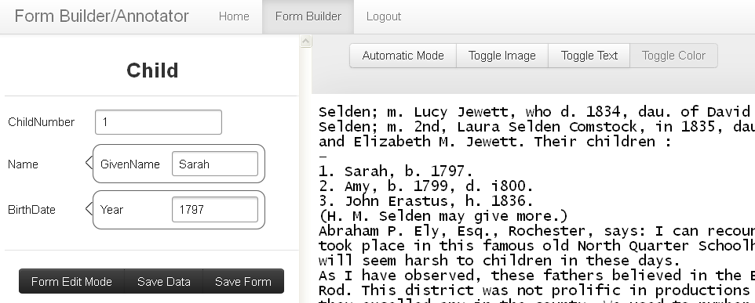
Construct Form,
Label First Record
<Child.ChildNumber>1</Child.ChildNumber>. <Child.Name.GivenName>Sarah</Child.Name.GivenName>, b. <Child.BirthDate.Year>1797</Child.BirthDate.Year>.
Motivation
Related Work
Project Description
Validation
Conclusion
Notes:
User constructs an ontology by constructing a entry form.
User labels first record by inserting text into form.

Slide 29
Wrapper Generalization
1. Sarah, b. 1797.
2. Amy, h. 1799, d. i800.
3. John Erastus, b. 1836, d. 1876.
…
,
b
.
Child.BirthDate.Year
.
\n
…
,
b/h
.
Child.BirthDate.Year
?
?
?
?
.
\n
Motivation
Related Work
Project Description
Validation
Conclusion
Notes:
User constructs an ontology by constructing a entry form.
User labels first record by inserting text into form.
ListReader inserts OCR variants (matching whole records constrains and filters out bad wrappers, increases precision)
ListReader opts to insert a few words into the wrapper and request labels for them.

Slide 30
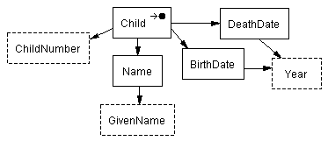
Wrapper Generalization
1. Sarah, b. 1797.
2. Amy, h. 1799, d. i800.
3. John Erastus, b. 1836, d. 1876.
…
,
b
.
Child.BirthDate.Year
.
\n
…
,
b/h
.
Child.BirthDate.Year
?
?
?
?
.
\n
…
,
b/h
.
Child.BirthDate.Year
,
d
.
Child.DeathDate.Year
.
\n
Motivation
Related Work
Project Description
Validation
Conclusion
Notes:
The user updates the form which adds another object set to the ontology.
The user labels the new field which then updates the wrapper and allows it to extract the second record.

Slide 31
Wrapper Generalization as Beam Search
Initialize wrapper from first record
Apply predefined set of wrapper adjustments
Score alternate wrappers with:
  “Prior” (is like known list structure)
  “Likelihood” (how well they match next text)
Add best to wrapper set
Repeat until end of list
Motivation
Related Work
Project Description
Validation
Conclusion
Notes:
Add word to field.
Remove word in field.
Add field.
Remove field.
Generalize character class of word.
Generalize length of word.

Slide 32
Mapping Sequential Labels to Predicates
\n
Child.ChildNumber
.
Child.Name.GivenName
,
b
.
Child.BirthDate.Year
.
\n
<Child.ChildNumber>1</Child.ChildNumber>. <Child.Name.GivenName>Sarah</Child.Name.GivenName>, b. <Child.BirthDate.Year>1797</Child.BirthDate.Year>.
Child(child₁)
Child-ChildNumber(child₁, “1”)
Child-Name(child₁, name₁)
Name-GivenName(name₁, “Sarah”)
Child-BirthDate(child₁, date₁)
BirthDate-Year(date₁, “1797”)
Motivation
Related Work
Project Description
Validation
Conclusion
Notes:
Labels unlike any I’ve seen before.
Sequential labels are like the lexical object sets.
But when we add death year, we add a new kind of year or keep it the same year. Ontologies allow us to say the new year is of the same type but has a different relationship to the child.
So we label with respect to ontology, using label paths to specify exactly the predicates to be extracted.

Slide 33
Weakly Supervised
Wrapper Induction
Apply wrappers and ontologies
Spot list by repeated patterns
Find best ontology fragments for best-labeled record
Generalize wrapper
  Both above and below
  Active learning without human input
Motivation
Related Work
Project Description
Validation
Conclusion

Slide 34
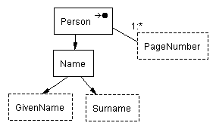
Knowledge from
Previously Wrapped Lists
\n
Child.ChildNumber
.
Child.Name.GivenName
,
b
.
Child.BirthDate.Year
;
d
.
Child.DeathDate.Year
;
m
.
Child.Spouse.Name.GivenName
Child.Spouse.Name.Surname
.
\n
Motivation
Related Work
Project Description
Validation
Conclusion
Notes:
No form or input ontology.
John Erastus could have been ordered backward in the index and still work.
First part has newline, ChildNumber, period, Child GivenName.
Last part has m., Spouse GivenName, Spouse Surname.
Ontology from book name index has a person name containing John as GivenName and Erastus as Surname and relationships that link them togther.

Slide 35
List Spotting
\n
Child.ChildNumber
.
Child.Name.GivenName
.
\n
1. Sarah, b. 1797.
2. Amy, h. 1799, d. i800.
3. John Erastus, b. 1836.
\n
\n
\n
\n
\n
\n
Motivation
Related Work
Project Description
Validation
Conclusion
Notes:
The other records probably had labels too.
We clean them up by preserving only the ones with the most support from multiple recognizers and save them as the oracle—a fully automated oracle instead of a human oracle.

Slide 36
Select Ontology Fragments and Label the Starting Record
1. Sarah, b. 1797.
2. Amy, h. 1799, d. i800.
3. John Erastus, b. 1836.
\n
Child.ChildNumber
.
,
b
.
Child.BirthDate.Year
Motivation
Related Work
Project Description
Validation
Conclusion
Notes:
Identify the ontology fragments (not just the labels)

Slide 37
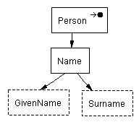
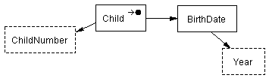
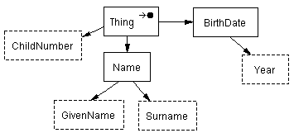
Merge Ontology and
Wrapper Fragments
Motivation
Related Work
Project Description
Validation
Conclusion
Notes:
Identify the ontology fragments (not just the labels)

Slide 38
Generalize Wrapper,
& Learn New Fields without User
d
.
Child.DeathDate.Year
.
1. Sarah, b. 1797.
2. Amy, h. 1799, d. i800.
3. John Erastus, b. 1836.
Motivation
Related Work
Project Description
Validation
Conclusion
Notes:
The other records had labels too.
If they had fields not in the initial record, use them like the oracle instead of the human user.
We clean them up by preserving only the ones with the most support from multiple recognizers and save them as the oracle—a fully automated oracle instead of a human oracle.

Slide 39
Thesis Statement
It is possible to populate an ontology semi-automatically, with better than state-of-the-art accuracy and cost, by inducing information extraction wrappers to extract the stated facts in the lists of an OCRed document, firstly relying only on a single user-provided field label for each field in each list, and secondly relying on less ongoing user involvement by leveraging the wrappers induced and facts extracted previously from other lists.
Motivation
Related Work
Project Description
Validation
Conclusion

Slide 40
Four Hypotheses
Is a single labeling of each field sufficient?
Is fully automatic induction possible?
Does ListReader perform increasingly better?
Are induced wrappers better than the best?
Motivation
Related Work
Project Description
Validation
Conclusion

Slide 41
Hypothesis 1
Single user labeling of each field per list
Evaluate detecting new optional fields
Evaluate semi-supervised wrapper induction
Motivation
Related Work
Project Description
Validation
Conclusion

Slide 42
Hypothesis 2
No user input required with imperfect recognizers
Find required level of noisy recognizer P & R
Motivation
Related Work
Project Description
Validation
Conclusion

Slide 43
Hypothesis 3
Increasing repository knowledge decreases the cost
Show repository can produce P- and R-level recognizers
Evaluate number of user-provided labels over time
Motivation
Related Work
Project Description
Validation
Conclusion
Notes:
Bootstrapping
A wrapper fragment or ontology fragment with n fields selected as a match of one or more record fragments of a list reduces the number of user-specified labels needed to extract all stated facts from L by n.
Show that bootstrapping beginning with Scenario 1 can produce P- and R-level noisy recognizers.
Determine how much user-specified labeling decreases in Scenario 2 using noisy recognizers induced in the bootstrapping process.
Call it tranfser learning

Slide 44
Hypothesis 4
ListReader performs better than a representative state-of-the-art information extraction system
Compare ListReader with the supervised CRF in Mallet
Motivation
Related Work
Project Description
Validation
Conclusion
Notes:
Comparison

Slide 45
Evaluation Metrics
Precision
Recall
F-measure
Accuracy
Number of user-provided labels
Motivation
Related Work
Project Description
Validation
Conclusion
Notes:
Precision: proportion of extracted fields that are correctly labeled.
Recall: proportion of true fields that were extracted.
F-measure: harmonic mean of precision and recall.
Accuracy: Proportion of words with correct field labels.
Number of user-provided labels: Number of labels provided to train wrapper induction and correct false extractions. Combines training cost and execution accuracy in one metric.

Slide 46
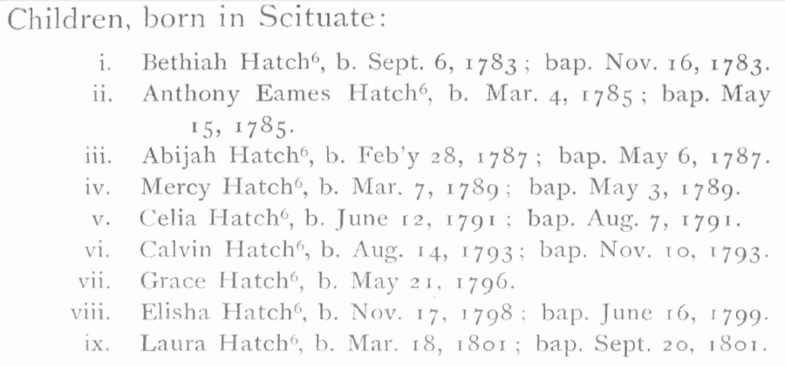
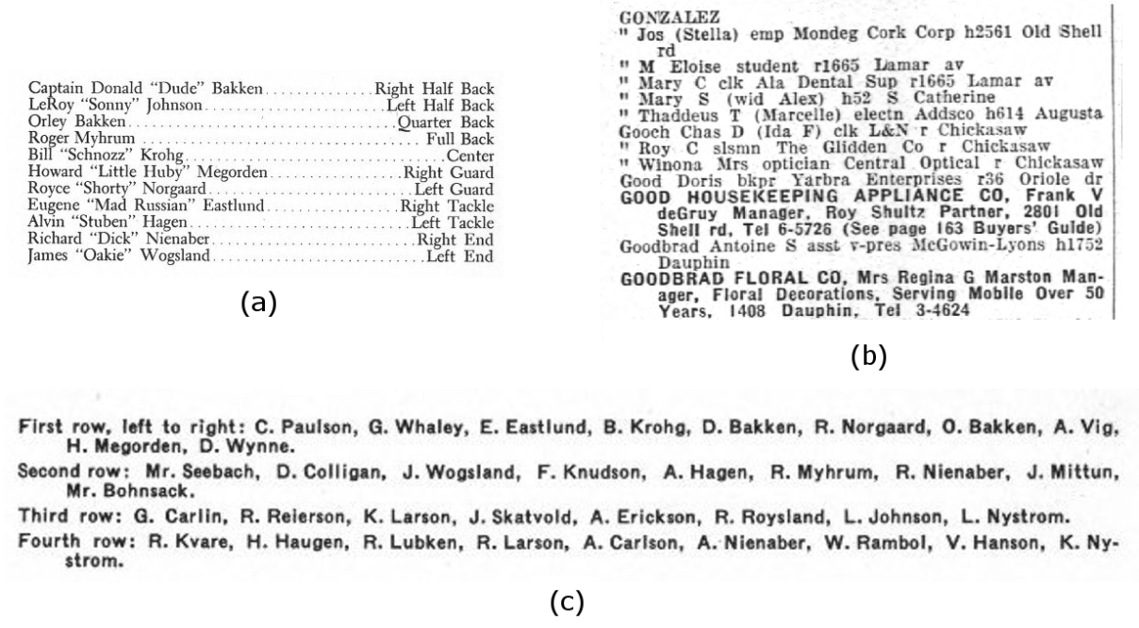
Corpus
Lists in several types of historical docs
Dev. set: ~100 pages
Blind set: ~400 pages
Motivation
Related Work
Project Description
Validation
Conclusion
Notes:
Compute statistically significant

Slide 47
Research Schedule
Prepare datasets --------------------------------------------------------------------------------------- Incremental
Semi-supervision and label mapping ------------------------------------------------------------------ Fall 2012
ICDAR conference paper “Semi-supervised Wrapper Induction for OCRed Lists” ------- Feb. 1 2013
Journal paper “Semi-supervised Wrapper Induction for OCRed Lists” -------------------- Winter 2013
Weak supervision -------------------------------------------------------------------------------------- Winter 2013
Journal paper “Weakly-supervised Wrapper Induction for OCRed Lists” ----------------- Winter 2013
Dissertation -------------------------------------------------------------------------------------------- Summer 2013
Dissertation defense --------------------------------------------------------------------------------------- Fall 2013
(Journals considered: IJDAR first; JASIST, PAMI, PR, TKDE, DKE second)
Motivation
Related Work
Project Description
Validation
Conclusion

Slide 48
Work and Results Thus Far
Large, diverse corpus of OCRed documents
Semi-supervised regex and HMM induction
Both beat CRF trained on three times the data
Designed label to predicate mapping
Implemented preliminary mapping
85% accuracy of word-level list spotting
Motivation
Related Work
Project Description
Validation
Conclusion
Notes:
Collected large and diverse corpus of OCRed documents and images in family history domain from Ancestry and FamilySearch
Initial semi-supervised regex induction, including:
Field insertion, field deletion, field lengthening, field shortening, word length and character set generalization, new field spotting, and end-of-list finding, all using text matching to select among transformations
Initial semi-supervised HMM induction (outperforms regex)
Worked out the mapping between labels and ontology schema elements and predicates on paper for our target schema elements
Translation of flat labels to OSMX ontology schema and facts (using early version of labels)
That is, my early semi-supervised wrapper induction beats a state-of-the-art supervised model that was given three times as much training data.
Label selection and list spotting based on noisy labels from dictionaries works at 85% accuracy on word-level granularity
Accuracy should be higher for finding any one record rather than every word.

Slide 49
Expected Contributions
ListReader
  Wrapper induction
  OCRed lists
  Population ontologies
  Accuracy and cost
Motivation
Related Work
Project Description
Validation
Conclusion

Slide 50
Questions & Answers

Slide 51
What Does that Mean?
Populating Ontologies
  A machine-readable and mathematically specified conceptualization of a collection of facts
Semi-automatically Inducing
  Pushing more work to the machine
Information Extraction Wrappers
  Specialized processes exposing data in documents
Lists in OCRed Documents
  Data-rich with variable format and noisy content
Motivation
Related Work
Project Description
Validation
Conclusion

Slide 52
Who Cares?
Populating Ontologies
  Versatile, expressive, structured, digital information is queryable, linkable, editable.
Semi-automatically Inducing
  Lowers cost of data
Information Extraction Wrappers
  Accurate by specializing for each document format
Lists in OCRed Documents
  Lots of data useful for family history, marketing, personal finance, etc. but challenging to extract
Motivation
Related Work
Project Description
Validation
Conclusion

Slide 53
Reading Steps
  List spotting
  Record segmentation
  Field segmentation
  Field labeling
  Nested list recognition
Members of the football team:
Captain: Donald Bakken.................Right Half Back
LeRoy "sonny' Johnson.........,........Lcft Half Back
Orley "Dude" Bakken......,.......,......Quarter Back
Roger Jay Myhrum........................ .Full Back
Bill "Snoz" Krohg,...........................Center
They had a good year.
Motivation
Related Work
Project Description
Validation
Conclusion

Slide 54
Special Labels
Resolve Ambiguity
Child(child₁)
Child-ChildNumber(child₁, “1”)
Child-Name(child₁, name₁)
Name-GivenName(name₁, “Sarah”)
Child-BirthDate(child₁, date₁)
BirthDate-Year(date₁, “1797”)
1. Sarah, b. 1797.
2. Amy, h. 1799, d. i800.
3. John Erastus, b. 1836, d. 1876.
\n
Child.ChildNumber
.
Child.Name.GivenName
,
b
.
Child.BirthDate.Year
.
\n
<Child.ChildNumber>1</Child.ChildNumber>. <Child.Name.GivenName>Sarah</Child.Name.GivenName>, b. <Child.BirthDate.Year>1797</Child.BirthDate.Year>.
Motivation
Related Work
Project Description
Validation
Conclusion
Notes:
So we label with respect to ontology, using label paths to specify exactly the predicates to be extracted.
Page 141 Ely Ancestry

