Slide 1
Regular- expression Generator
Tae Woo Kim

Slide 2
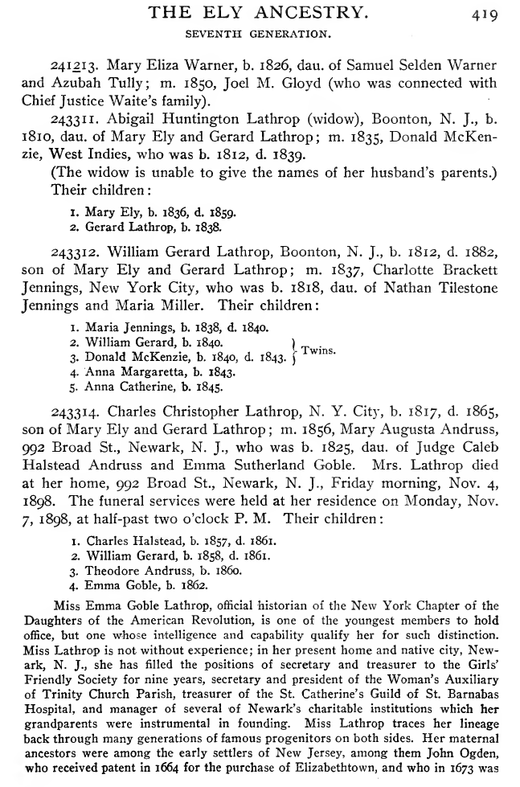
Problem
Extracting the facts from digitized documents

Slide 3
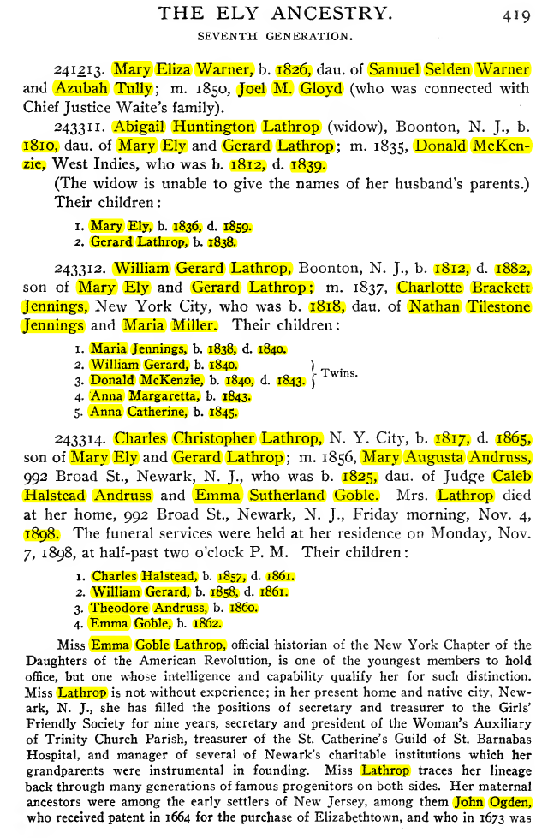
Motivation
About 500 pages out of 830 pages
85 facts of first name, surname, birth year, and death year
About 42,500 facts!

Slide 4
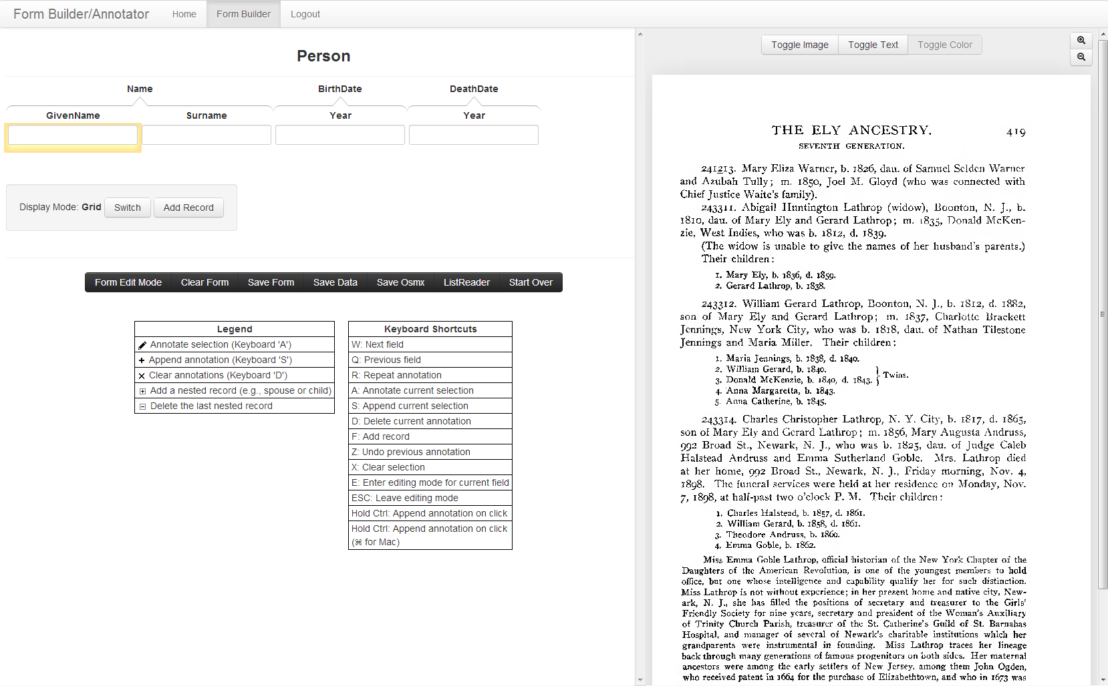
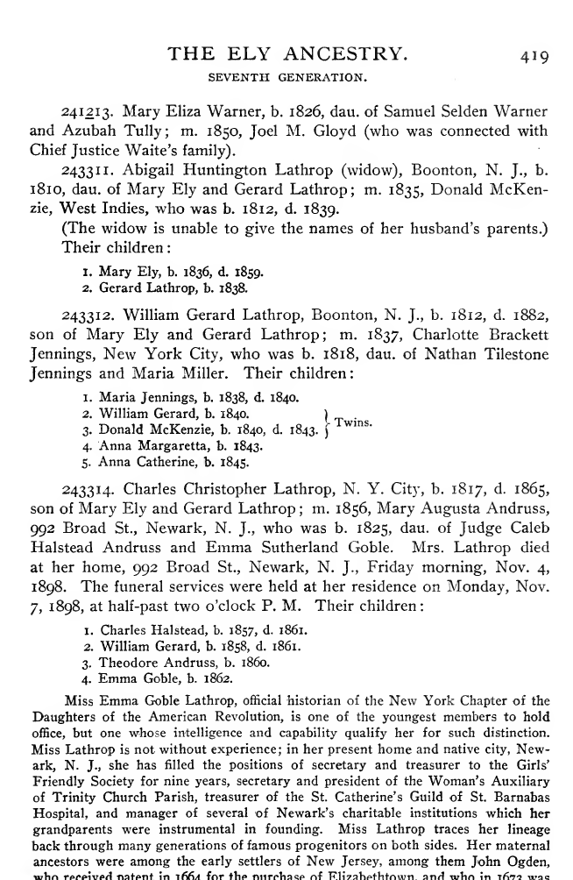
How it Works

Slide 5
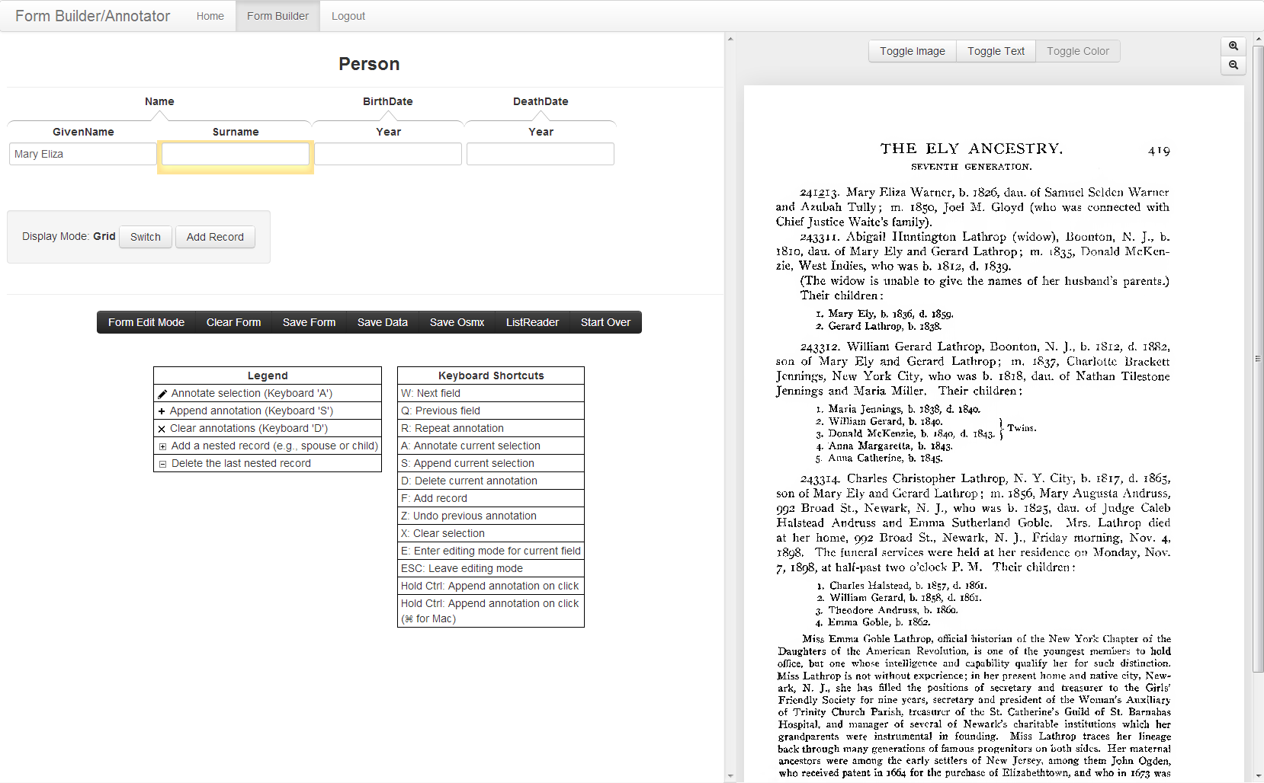
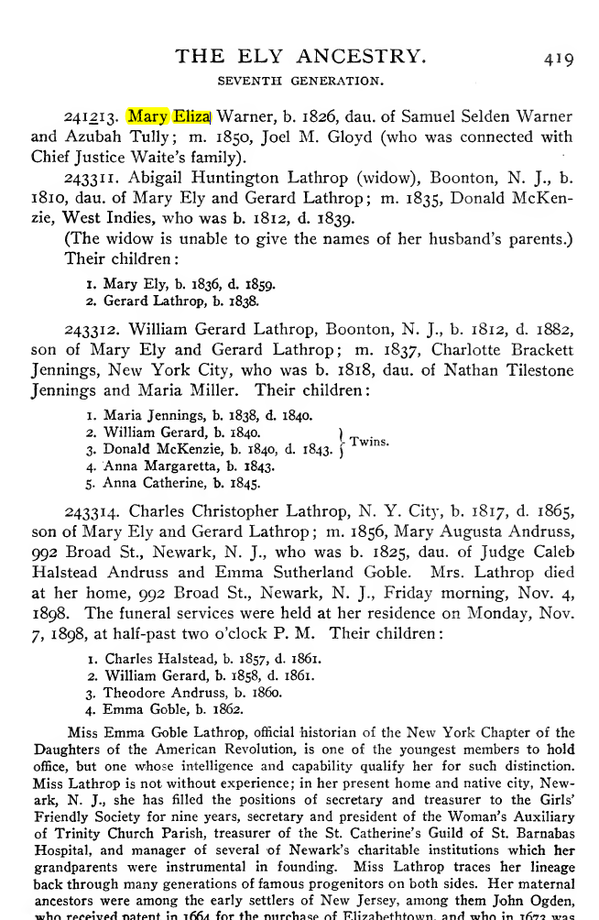
How it Works

Slide 6
How it Works

Slide 7
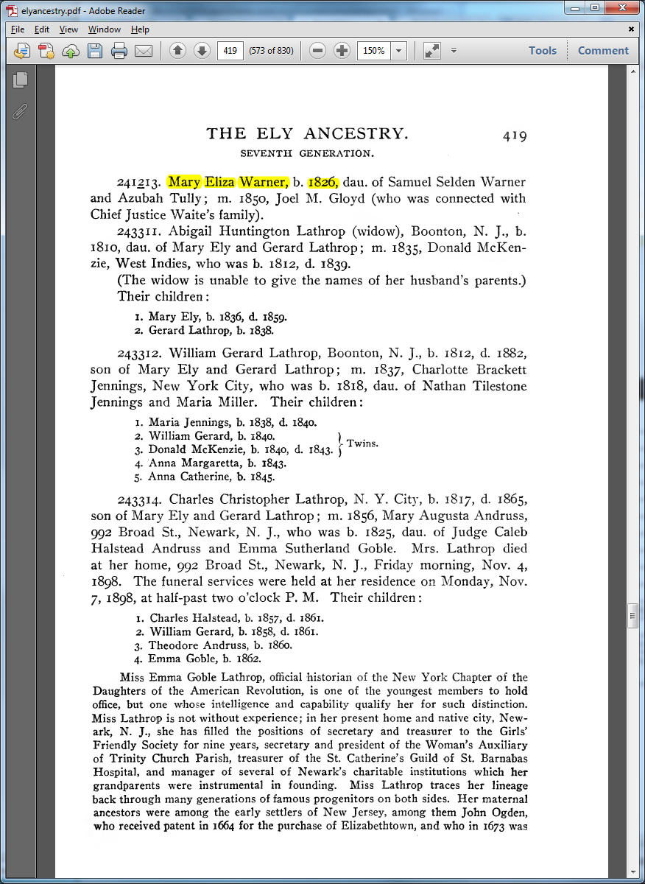
How it Works

Slide 8
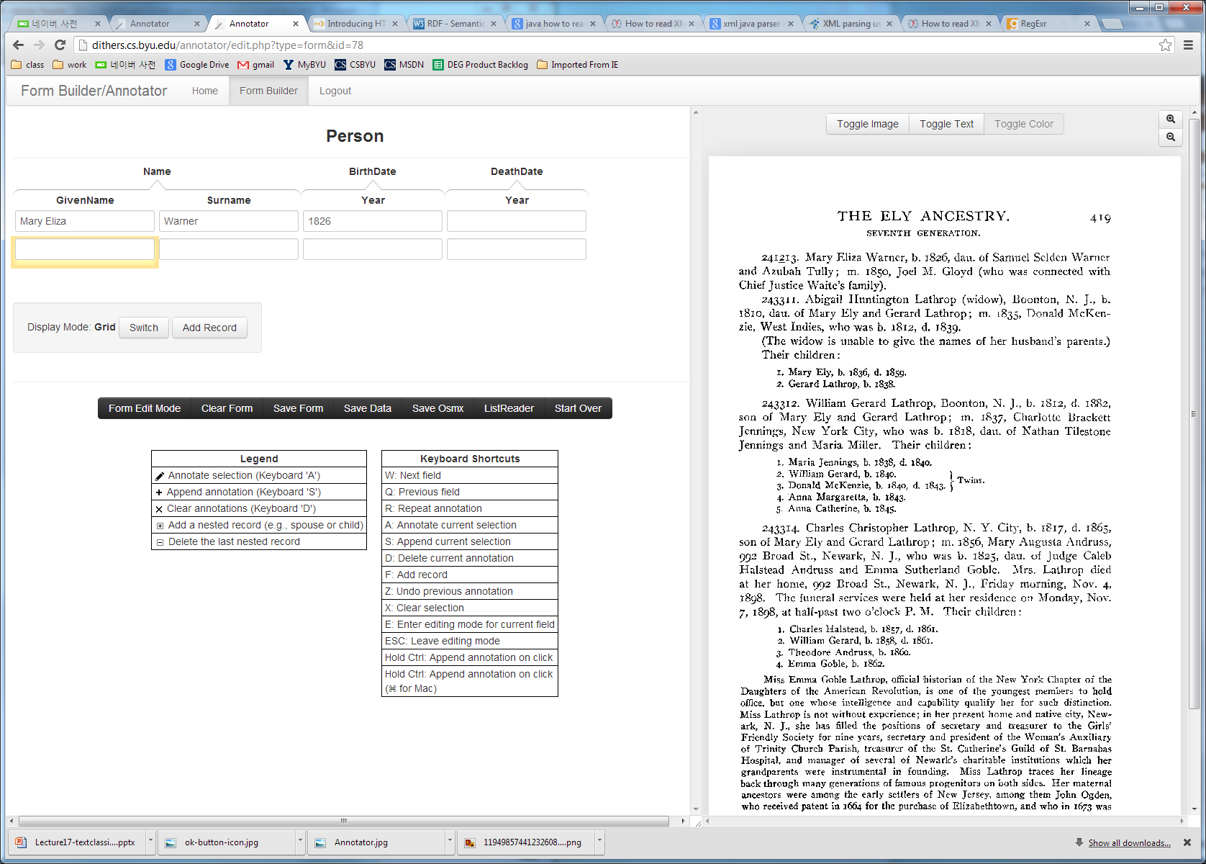
How it Works

Slide 9
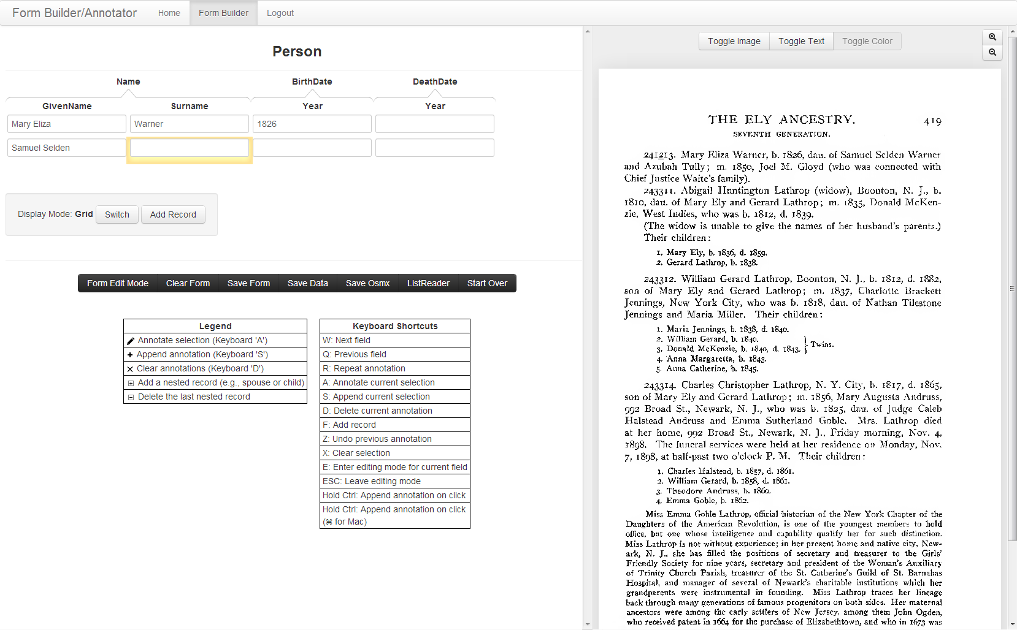
How it Works

Slide 10
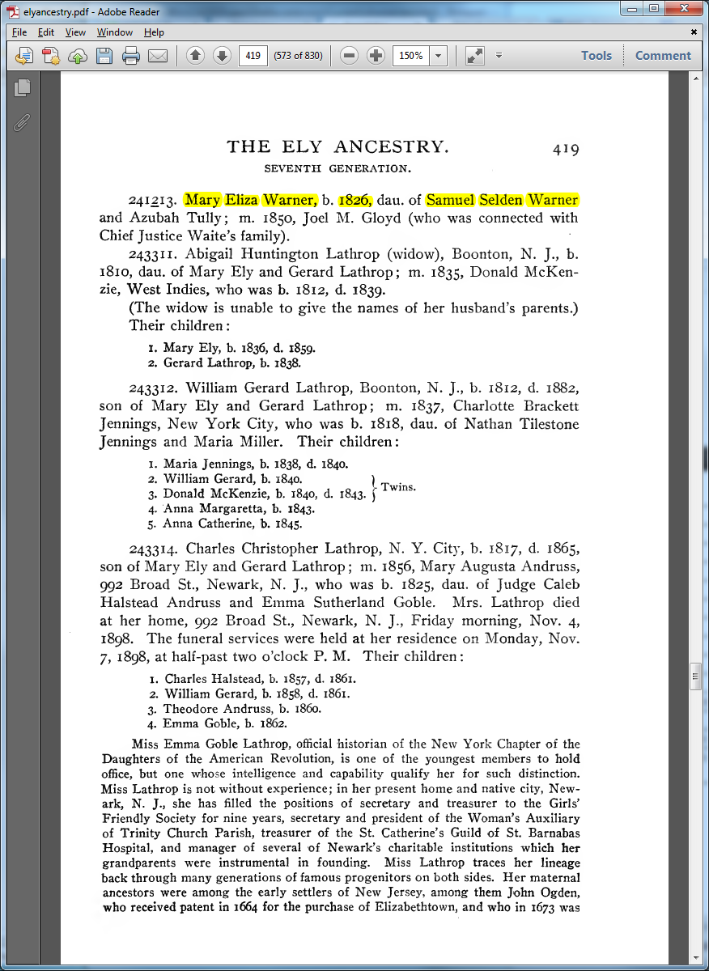
How it Works

Slide 11
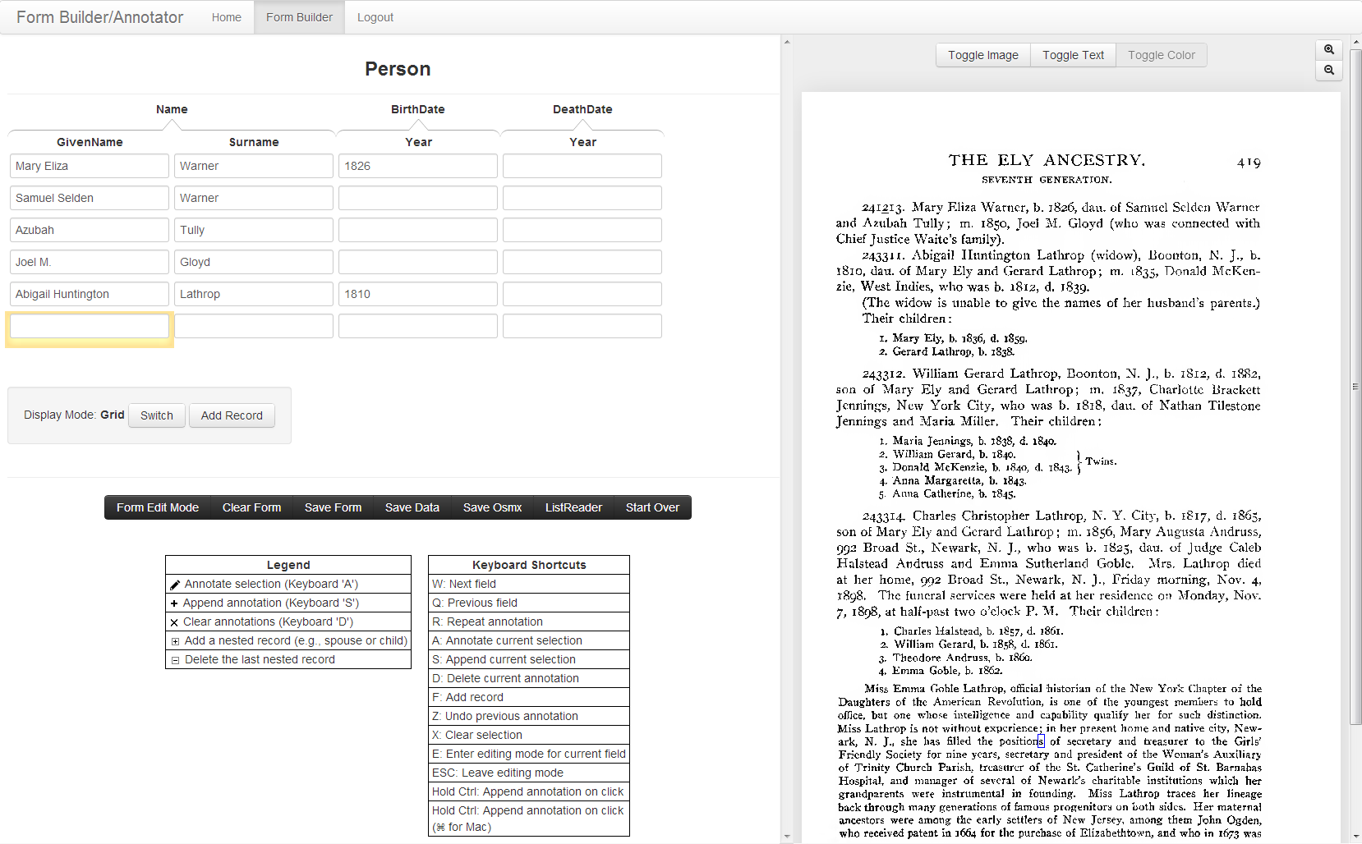
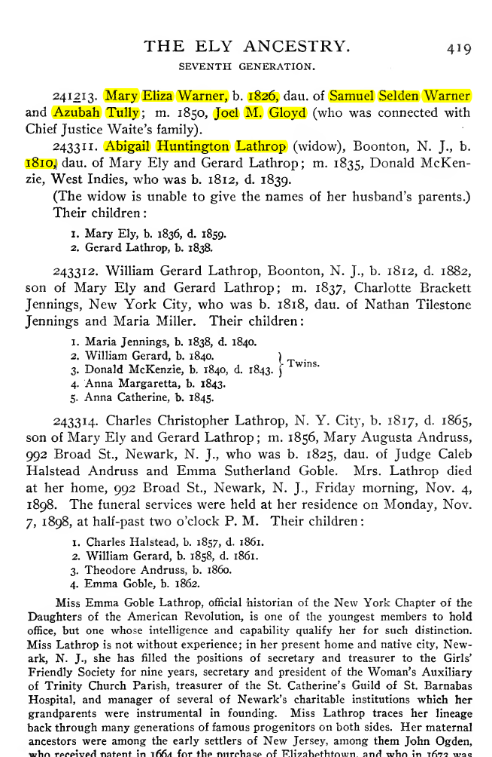
How it Works

Slide 12
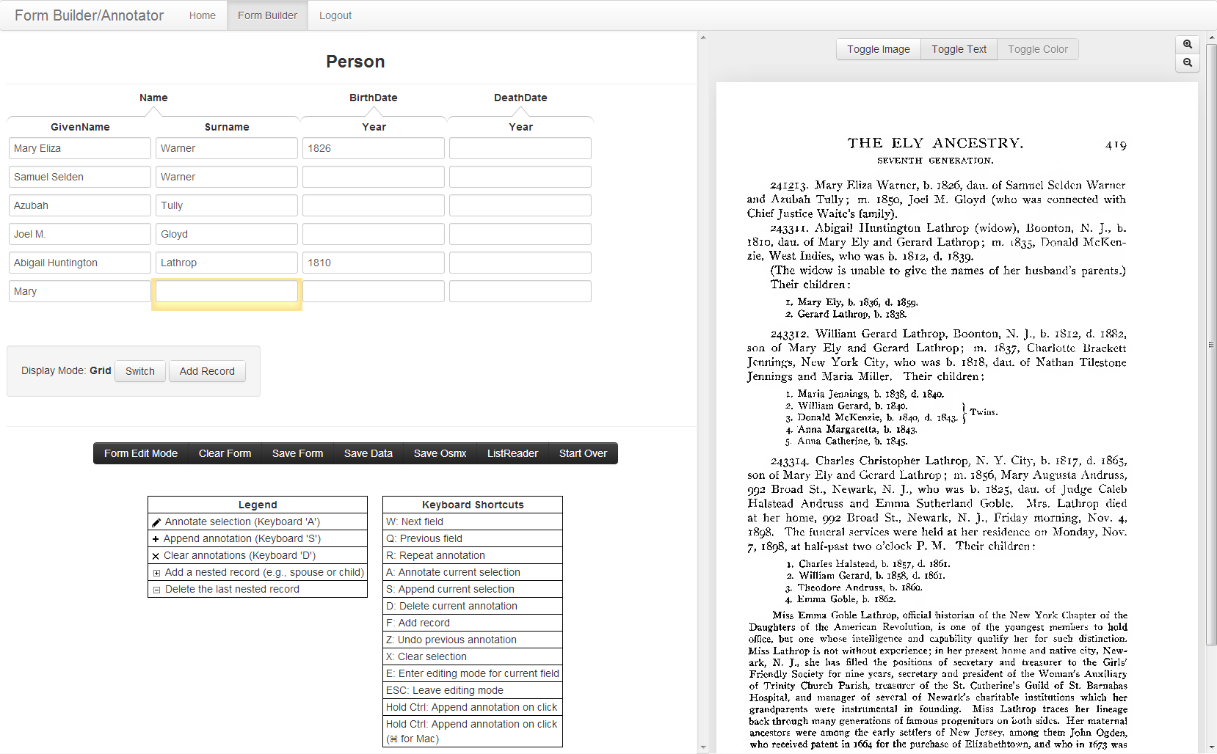
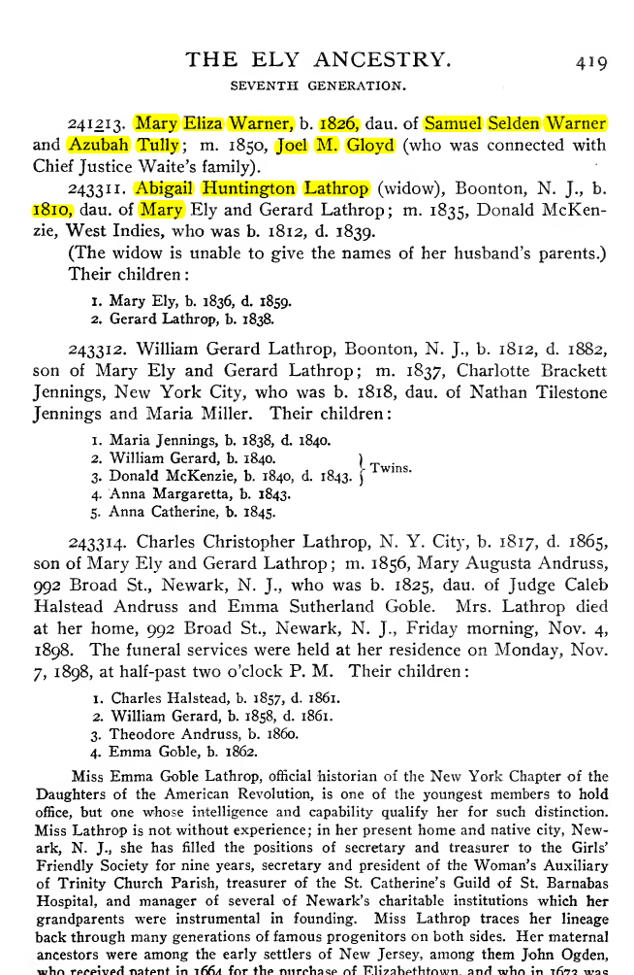
How it Works

Slide 13
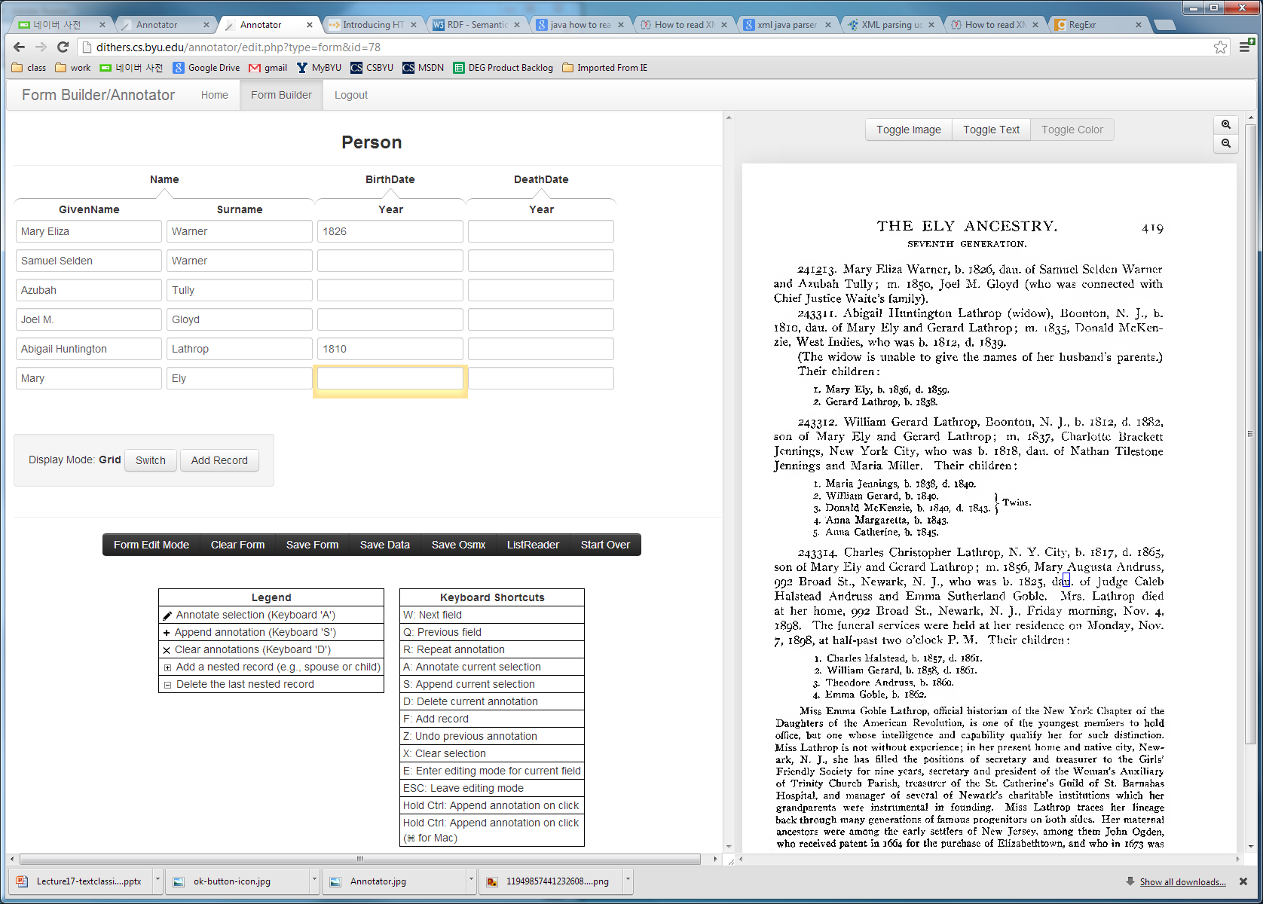
How it Works

Slide 14
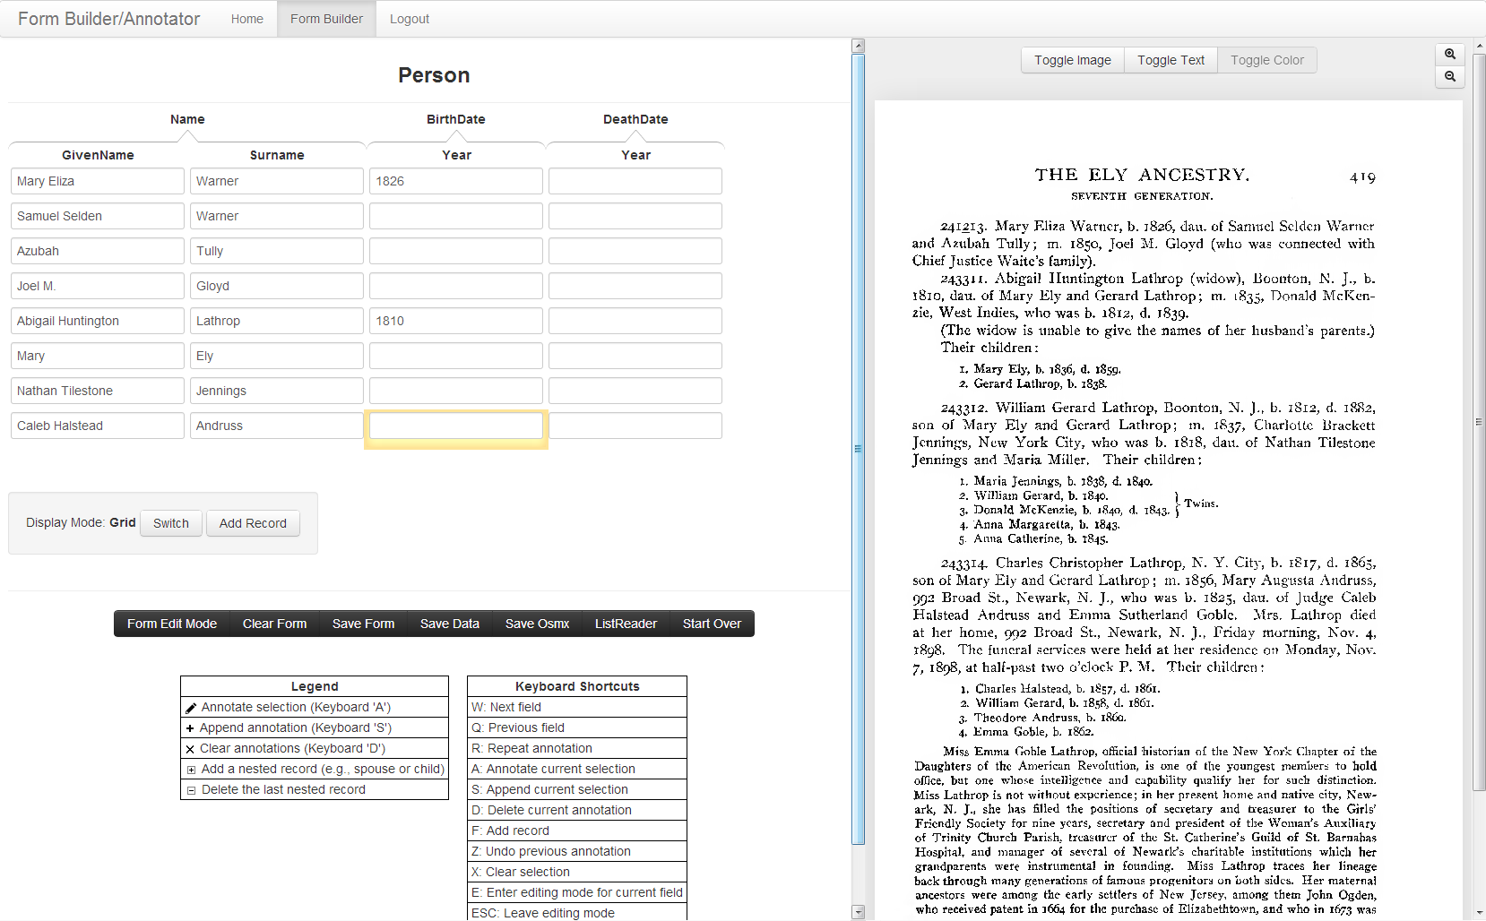
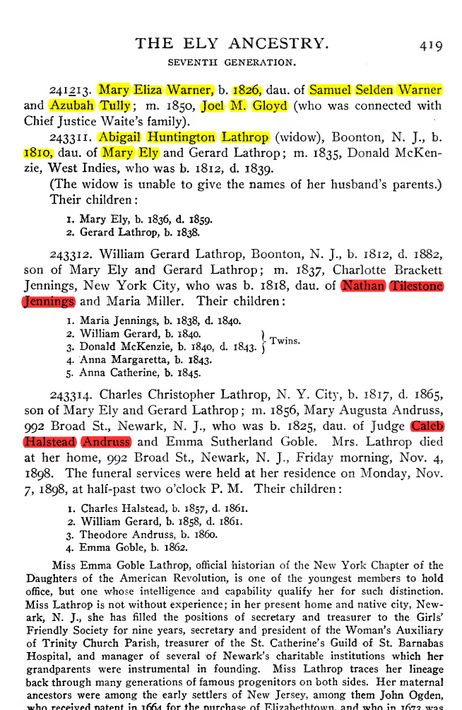
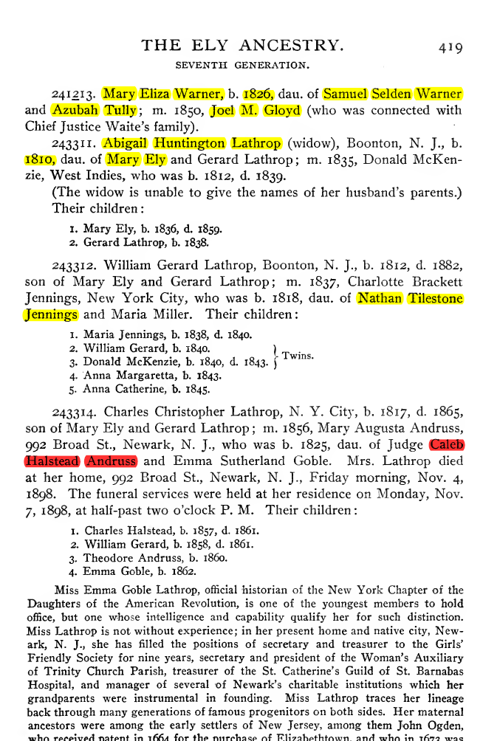
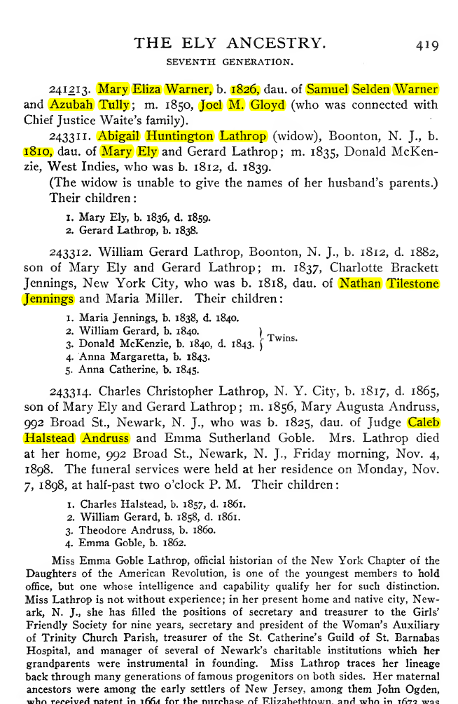
How it Works

Slide 15
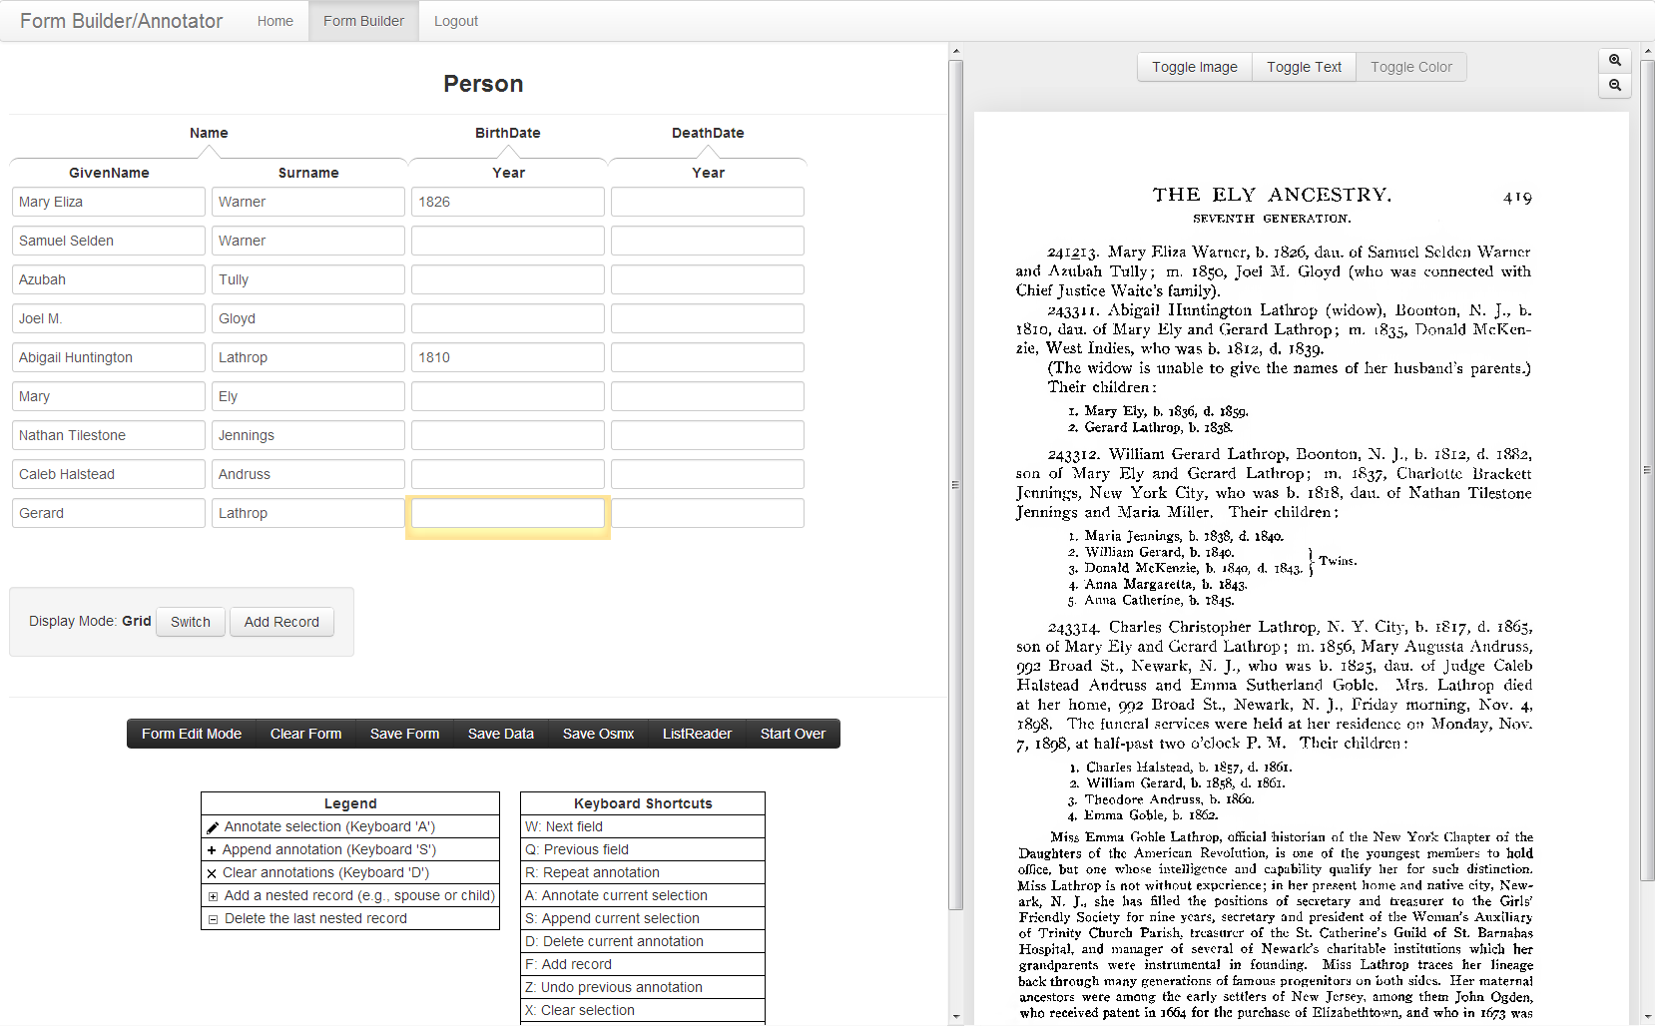
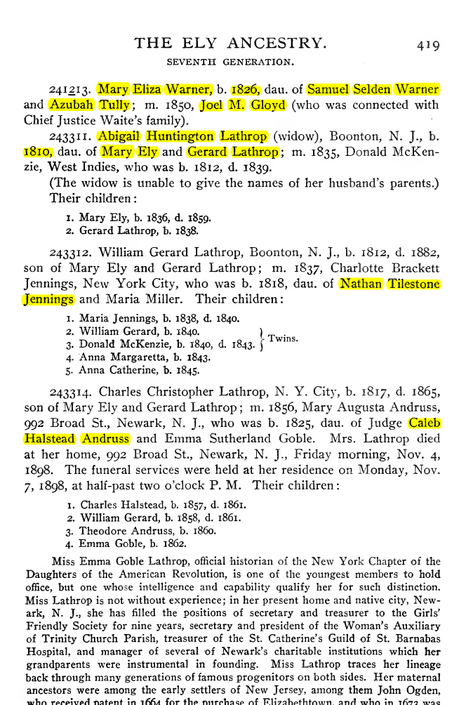
How it Works

Slide 16
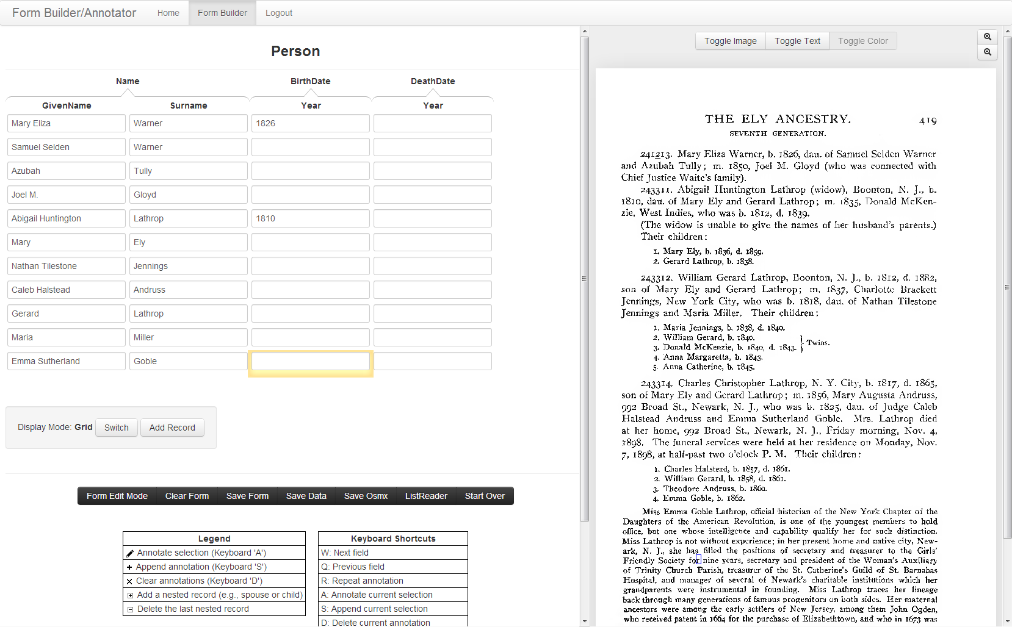
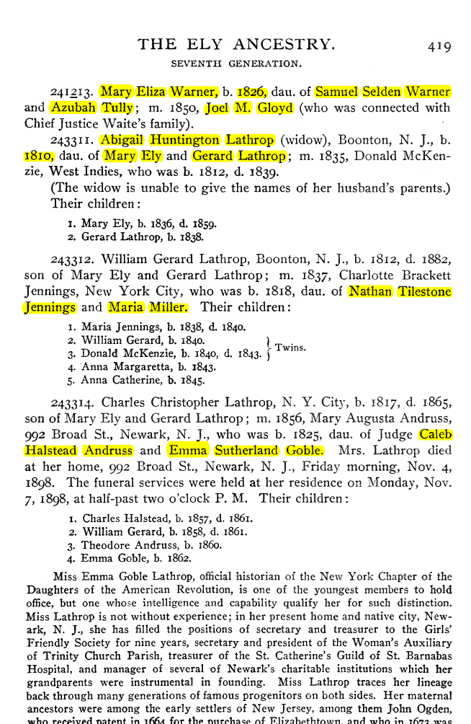
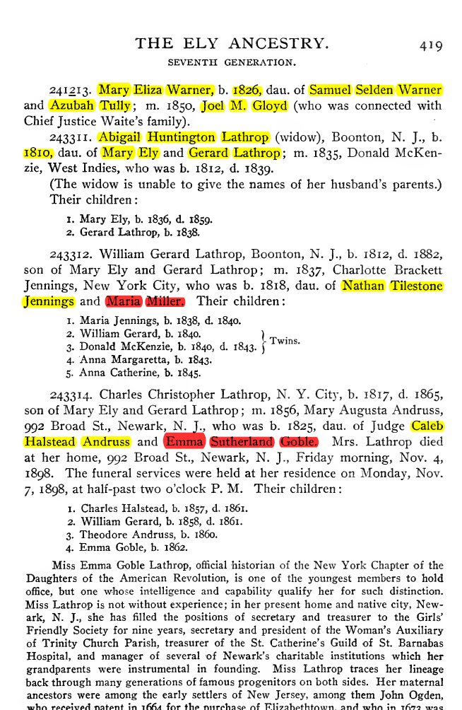
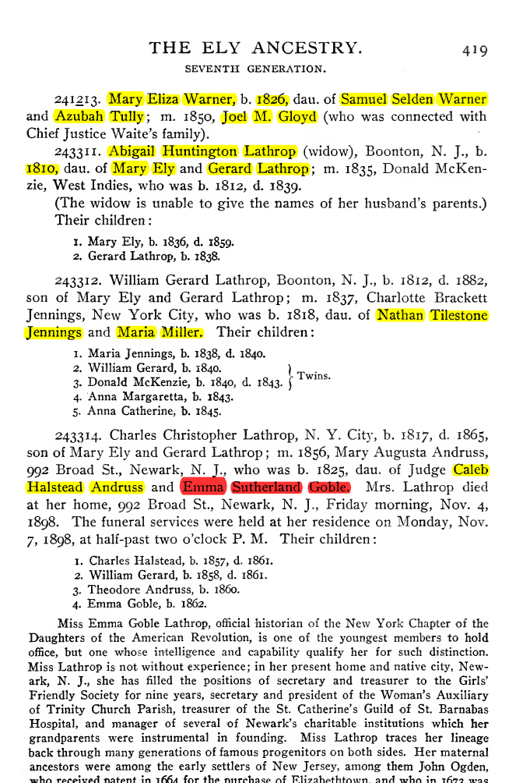
How it Works

Slide 17
Behind the Scenes
241213 | . | _ | Mary_Eliza | _ | Warner | , | _ | b | . | _ | 1826 | , | _ | dau

Slide 18
Behind the Scenes
241213 | . | _ | Mary_Eliza | _ | Warner | , | _ | b | . | _ | 1826 | , | _ | dau
dau | . | _ | of | _ | Samuel_Selden | _ | Warner | _ | and | _
Notes:
Add picture of after clicking “Add Record”

Slide 19
Behind the Scenes
Field
Field
241213 | . | _ | Mary_Eliza | _ | Warner | , | _ | b | . | _ | 1826 | , | _ | dau
dau | . | _ | of | _ | Samuel_Selden | _ | Warner | _ | and | _
delimiter
delimiter
delimiter
_ | and | _ | Azubah | _ | Tully | ; | _ | m
. | _ | 1850 | , | _ | Joel_M. | _ | Gloyd | _ | ( | who
243311 | . | _ | Abigail_Huntington | _ | Lathrop | _ | ( | widow | ) | , | _ | Doonton | , | _
dau | . | _ | of | _ | Mary | _ | Ely | _ | and | _
Notes:
Add picture of after clicking “Add Record”

Slide 20
Behind the Scenes
dau | . | _ | of | _ | Samuel_Selden | _ | Warner | _ | and | _
dau | . | _ | of | _ | Mary | _ | Ely | _ | and | _
dau\.\sof\s[A-Za-z]{2,9}(\s[A-Za-z]{3,9}){0,2}\s[A-Za-z]{1,9}\sand\s
dau | . | _ | of | _ | Nathan_Tilestone | _ | Jennings | _ | and | _
dau | . | _ | of | _ | Caleb_Halstead | _ | Andruss | _ | and | _
Notes:
Add 30% of max to max, subtract 30% of min to min
dau\.\sof\s[A-Za-z\s]{3,8}(\s[A-Za-z]{4,8} <= doesn’t catch Tilestone(size 9). If 40%(from34%) and always round up, it would
}(\s[A-Za-z]{4,8}){0,1} <={ 0, 1} would not catch Jdge_Caleb_Halstead
After adding patterns:
dau\.\sof\s[A-Za-z]{2,9}(\s[A-Za-z]{3,13}){0,2}\s[A-Za-z]{1,12}\sand\s

Slide 21
Behind the Scenes
_ | and | _ | Azubah | _ | Tully | ; | _ | m | .
_ | and | _ | Gerard | _ | Lathrop | ; | _ | m | .
and\s[A-Za-z]{3,9}\s[A-Za-z]{3,10};\sm\.\s
_ | and | _ | Gerard | _ | Lathrop | ; | _ | m | .
_ | and | _ | Gerard | _ | Lathrop | ; | _ | m | .
Notes:
Add picture of after clicking “Add Record”

Slide 22
Behind the Scenes
1 | . | _ | Mary_Ely | , | _ | b | . | _ | 1836 | , | _ | d | . | _ | 1859 | .
1 | . | _ | Maria_Jennings | , | _ | b | . | _ | 1838 | , | _ | d | . | _ | 1840 | .
[0-9]{1}\.\s[A-Za-z]{2,7}(\s[A-Za-z]{1,12}){1},\sb\.\s[0-9]{4},\sd\.\s[0-9]{4}\.
3 | . | _ | Donald_McKenzie | , | _ | b | . | _ | 1840 | , | _ | d | . | _ | 1843 | .
1 | . | _ | Charles_Halstead | , | _ | b | . | _ | 1857 | , | _ | d | . | _ | 1861 | .
2 | . | _ | William_Gerard | , | _ | b | . | _ | 1858 | , | _ | d | . | _ | 1861 | .
Notes:
after

Slide 23
Behind the Scenes
2 | . | _ | Gerard_Lathrop | , | _ | b | . | _ | 1838 | .
2 | . | _ | William_Gerard | , | _ | b | . | _ | 1840 | .
[0-9]{1}\.\s[A-Za-z]{3,10}(\s[A-Za-z]{3,10}){1},\sb\.\s[0-9]{4}\.
4 | . | _ | Anna_Margaretta | , | _ | b | . | _ | 1843 | .
5 | . | _ | Anna_Catherine | , | _ | b | . | _ | 1845 | .
3 | . | _ | Theodore_Andruss | , | _ | b | . | _ | 1860 | .
4 | . | _ | Emma_Goble | , | _ | b | . | _ | 1862 | .
Notes:
[0-9]{1}\.\s[A-Za-z]{4,9}(\s[A-Za-z]{4,9} <= 4,9 would not catch Margaretta(10) if 40% or 30% and always round up, it would catch

Slide 24
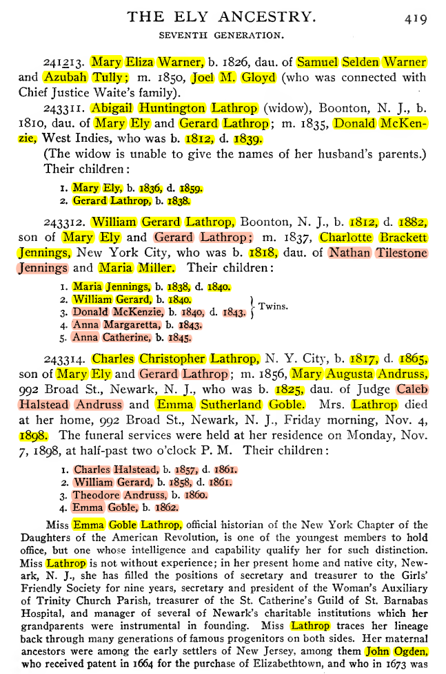
Results
Finds 19 patterns
4 patterns used
25/85 facts found by the system

Slide 25
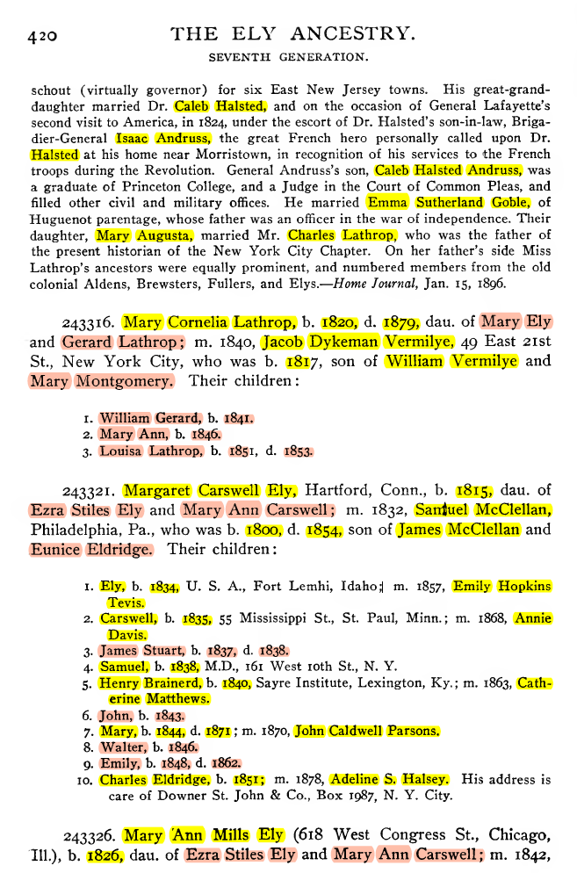
Results
Next page(before annotation)
5/19 previous patterns used
33/87 facts automatically annotated

Slide 26
Results
Next page(after annotation)
Finds 16 new patterns
3 patterns used
12 new facts found
45/86 facts automatically annotated
Page1: 29%
Page2: 52%
Page3: 69%
Notes:
Change the pdf => james McClellan can be automated after human annotates William vermilye

Slide 27
Conclusion
Automatically finds and uses patterns
Decreases amount of user effort

