Slide 1



Cost-effective Ontology Population with Data from Lists in OCRed Historical Documents
Thomas L. Packer
David W. Embley
HIP ’13 BYU CS

Slide 2
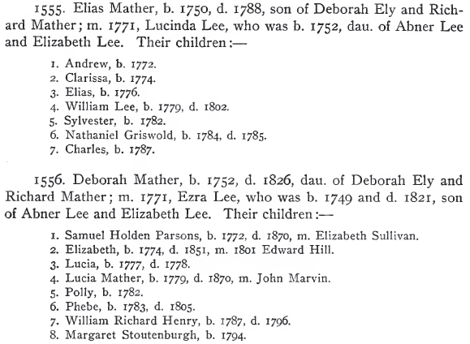
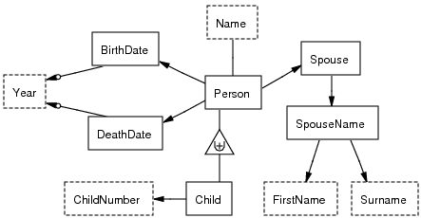
Challenge and Benefits
1555. Elias Mather, b. 1750, d. 1788, son of Deborah Ely and Rich-
ard Mather; m. 1771, Lucinda Lee, who was b. 1752, dau. of Abner Lee
and EHzabeth Lee. Their children :—
1. Andrew, b. 1772.
2. Clarissa, b. 1774.
3. Elias, b. 1776.
4. William Lee, b. 1779, d. 1802.
5. Sylvester, b. 1782.
6. Nathaniel Griswold, b. 1784, d. 1785.
7. Charles, b. 1787.
1556. Deborah Mather, b. 1752, d. 1826, dau. of Deborah Ely and
Richard Mather; m. 1771, Ezra Lee, who was b. 1749 and d. 1821, son
of Abner Lee and Elizabeth Lee. Their children :—
1. Samuel Holden Parsons, b. 1772, d. 1870, m. Elizabeth Sullivan.
2. Elizabeth, b. 1774, d. 1851, m. 1801 Edward Hill.
3. Lucia, b. 1777, d. 1778.
4. Lucia Mather, b. 1779, d. 1870, m. John Marvin.
5. Polly, b. 1782.
6. Phebe, b. 1783, d. 1805.
7. William Richard Henry, b. 1787, d. 1796.
8. Margaret Stoutenburgh, b. 1794.
Notes:
The research background.
Tens of thousands of family history books; many other books containing mostly lists of records
Extract from lists where no one else has.
No one has extracted this rich information into machine-readable format even manually because currently the cost outweighs the benefit.
The information seemed just beyond our reach.
Pull out richly structured data including relationships
From semi-structured noisy OCR text without spatial layout information
Common, simple OCR
For various kinds of lists
using no knowledge engineering (dictionaries, grammars), no feature engineering, and as little hand-labeled text as possible.
What is the value of rich, expressive data?
An ontology is a machine-readable, mathematically specified conceptualization of a collection of facts.
Expressiveness, distinctions, more unique attributes
→ more versatility and accuracy in downstream applications
perform information retrieval, querying, reasoning, record linkage, duplicate detection, tree stitching, question answering

Slide 3
Related Work and Our Contribution
Wrapper Induction | General Lists | Noise Tolerant | Rich Data | Low Cost
Our Eventual Goal: | 1.0 | 1.0 | 1.0 | 1.0
Blanco, 2010 | 0.5 | 0.0 | 0.5 | 1.0
Dalvi, 2010 | 0.5 | 0.0 | 0.0 | 0.8
Gupta, 2009 | 1.0 | 0.0 | 0.5 | 0.8
Carlson, 2008 | 0.0 | 0.0 | 0.0 | 1.0
Heidorn, 2008 | 0.8 | 0.5 | 0.5 | 0.2
Chang, 2003 | 0.5 | 0.0 | 0.0 | 0.5
Crescenzi, 2001 | 0.0 | 0.0 | 0.0 | 1.0
Lerman, 2001 | 0.8 | 0.0 | 0.0 | 0.8
Chidlovskii, 2000 | 0.8 | 0.0 | 0.0 | 0.8
Kushmerick, 2000 | 0.0 | 0.0 | 0.0 | 1.0
Lerman, 2000 | 0.8 | 0.0 | 0.0 | 0.8
Thomas, 1999 | 0.0 | 0.0 | 0.0 | 0.5
Adelberg, 1998 | 1.0 | 0.0 | 0.5 | 0.2
Kushmerick, 1997 | 0.5 | 0.0 | 0.5 | 1.0
1.0 = well-covered
0.0 = not covered
Notes:
The area or challenge is wrapper (grammar) induction from web extraction
Means robust, scalable induction of grammars individualized to extract information from multiple input formats
Not yet applied to such noisy (non-HTML) lists
No work is strong across all four areas; little correlation between scalable and other facets.
We’d like to add a row
Our contribution is a unique combination of four valuable properties.

Slide 4
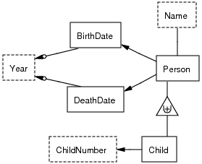
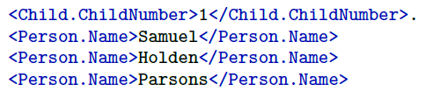
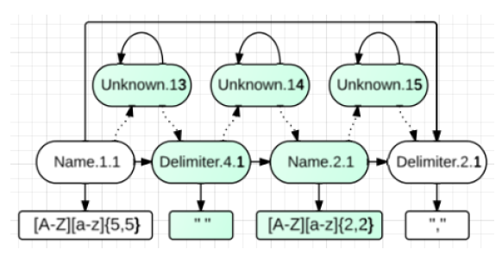
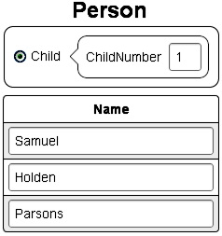
ListReader Architecture
Four types of knowledge rep. and mappings:
Predicates in ontologies
Labeled fields in plain text
List wrappers (regex and HMM)
Data entry forms
Notes:
Contribution is ListReader
Formal mapping among 4 KR
Reduces the ontology population problem …
… to a sequence labeling problem
… to a wrapper induction problem (simple wrappers, tailored to each list)
… to user building form and clicking (cheap training data)

Slide 5
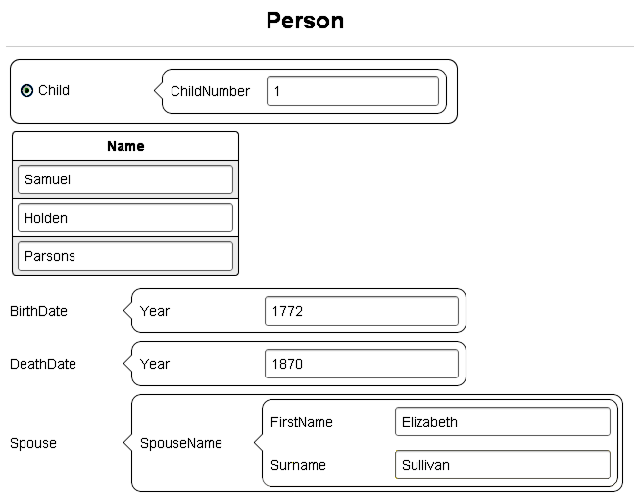

Low Cost
ListReader Form
OCR Text
Notes:
User:
View page
Select list
First record
Build form
Click fields
(Form filled in)
Click once per field in the order specified by the form.
One record to start the process (in this old approach)
Low-cost:
* No knowledge engineering
* No ML feature engineering
* Semi-supervised
* Active learning

Slide 6
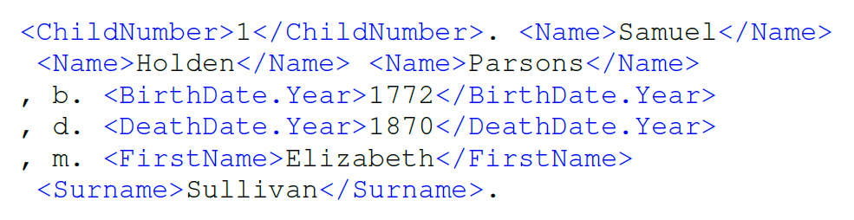
ListReader
Child(p₁)
Person(p₁)
Child-ChildNumber(p₁, “1”)
Child-Name(p₁, n₁)
…
Notes:
ListReader takes over:
Empty Form → ontology schema
Filled-in form + OCR text → labeled text
Induction & execution → more labeled text → predicates → populated ontology
Person.BirthDate.Year vs. Person.DeathDate.Year

Slide 7
Semi-supervised Regex Induction
<C>1</C>. <FN>Andy</FN> b. <BD>1816</BD>
2. Becky Beth h, i818
3. Charles Conrad
Initialize
C FN BD
\n(1)\. (Andy) b\. (1816)\n
Generalize
C FN BD
\n([\dlio])[.,] (\w{4}) [bh][.,] ([\dlio]{4})\n
Alignment-Search
Expansion
Insertion
Deletion
Many more …
C FN Unknown BD
\n([\dlio])[.,] (\w{4,5}) (\S{1,10}) [bh][.,] ([\dlio]{4})\n
C FN BD
\n([\dlio])\[.,] (\w{4}) [bh][.,] ([\dlio]{4})\n
X
Evaluate (edit sim. * match prob.)
1. Andy b. 1816
2. Becky Beth h, 1818
3. Charles Conrad
1. Andy b. 1816
2. Becky Beth h, 1818
3. Charles Conrad
One match!
No match
<C>1</C>. <FN>Andy</FN> b. <BD>1816</BD>
2. Becky <MN>Beth</MN> h, i818
3. Charles Conrad
Active Learning
(Novelty Detection)
C FN MN BD
\n([\dlio])[.,] (\w{4,5}) (\w{4}) [bh][.,] ([\dlio]{4})\n
Extract
<C>1</C>. <FN>Andy</FN> b. <BD>1816</BD>
<C>2</C>. <FN>Becky</FN> <MN>Beth</MN> h, <BD>i818</BD>
<C>3</C>. <FN>Charles</FN> <MN>Conrad</MN>
Notes:
(Say step number. Point out pieces.)
Expand matchable text to include common OCR errors, dot → dot+comma
A* over each line, states, operators
Posterior = prior * likelihood
“Unknown” insertion “Beth”
Predicates
Search is most critical/expensive

Slide 8
A* Alignment-Search
Start State
A B C E F G
Substitution @ 3
Insertion @ 7
Branching Factor = 2 * 4 = 8
f(r) = g(r) + h(r)
3 = 1 + 2
A B C’ E F G
A B C E F G H
f(r) = g(r) + h(r)
4 = 1 + 3
Tree Depth = 3
Never traverses this branch
Deletion @ 6
This search space size = ~10
Instead of 13,824
A B C’ E F
Other search space sizes = ~1000
instead of 587,068,342,272
Insertion @ 4
A B C’ D E F
Goal State
Notes:
Our admissible cost function, part of estimated total edit distance, prioritizes branches for search.
A* searches candidate regexes in a particular order using distance function f
Distance is edit distance between regex states.
Intuitively, f is the total predicted distance from start state to nearest goal state following a path through the evaluated state/node/regex.
f = g + h, known edit distance from start state to current state + admissible heuristic estimate from current state to nearest goal state.
Admissible means it never over-estimates the true distance to the nearest goal state.
This allows us to be sure that when we have found a goal state it is the one with lowest edit distance.
1. One path deletes the “G” before expanding the “C”. Needless path is pruned with part of our heuristic cost function.
2. Other paths apply operators to capture groups like “A” and “B” that already match. Needless paths are pruned with another part of our heuristic cost function.
3. Another path does edits that don’t actually help get closer to the goal. These paths are not followed to the end because we are expected to reach the goal faster along the correct path using the last part of the heuristic that counts the number of capture groups that don’t match the goal record.
1. Edit only failed sub-expressions small to large
2. Order operators applied to capture groups from left to right
3. Search lower estimated-cost paths first.
14K to 10
Our A* with our admissible heuristic (estimate total path length) reduces the search space in two ways.
Our heuristic counts the number of sub-expressions that do not match any text from small to large.
Our heuristic imposes a hard constraint on which operators can be applied to which capture groups and in which order.
The heuristic constrains multiple independent edits to happen in a single serial order instead of multiple parallel permutations of the same set of edits, imposing an order of left-to-right and small-to-large sub-expressions.
This reduces the branching factor at each node/state. This reduces the search space.
Numbers show size of space with hard constraint, not soft constraint, which results in a space of about 10.
The A* priority queue also uses the heuristic to impose a soft constraint such that more promising paths are tried first.

Slide 9

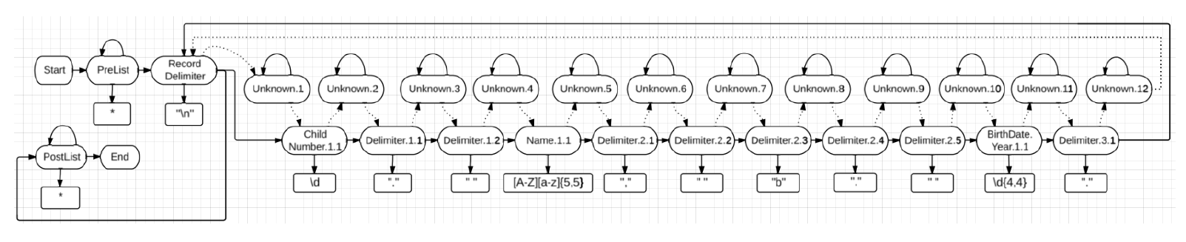
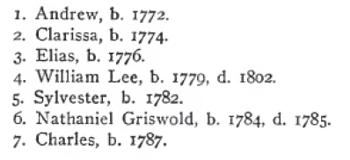
HMM Induction
Initialize
Active Learning
(Novelty Detection)
Notes:
HMM is a model of the joint probability of hidden states, transitions, and text emissions.
Hidden states map functionally to labels.
Same high-level process.
Start with first labeled record.
One state per word token.
Each state emits the corresponding text with prob. 1.0.
Each state transitions to the unique next state with prob. 1.0.
Generalize and specialize it such a way that it accounts for the sparseness, noisiness, and list-like variations of the data.
AL

Slide 10
HMM Modeling Details
Sparse, Noisy Data:
Parameter smoothing: Prior knowledge as non-zero Dirichlet priors
Emission model parameter tying for shared lexical object sets
Cluster field words in emiss. model with 5 character classes
List Structure:
Transition model is fine-grained total order among word states
Tr. model is cyclical only at record delimiters
Tr. model is a total order: non-zero priors allow for deletions
Tr. model has unique “unknown” states to allow for insertions
Delimiter state emiss. models don’t use word clustering like field states
Notes:
Sparse, Noisy Data:
1. Non-zero Dirichlet priors using knowledge of lists as parameter smoothing
2. Emission-model parameter tying based on shared lexical object sets
3. Cluster words in emission model using 5 character classes
List Structure:
4. Transition model is cyclical only at record delimiters, with fine-grained sub-label states
5. Transition model is a total order using non-zero priors for deletions
6. Transition model has unknown states for insertions
7. Delimiter state emission model does not use word clustering like field states

Slide 11
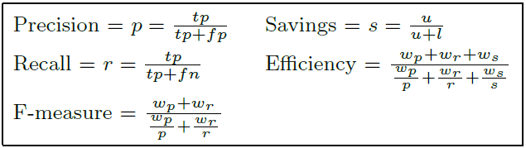
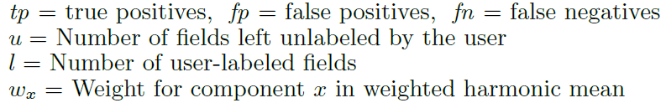
Evaluation Metrics
Evaluated on 60 lists from “The Ely Ancestry” family history book containing 3088 non-space word tokens, 1254 extractable field strings
Notes:
F-measure, alone, doesn’t tell us how good a system is.
You can get really high accuracy if you keep labeling training data forever.
So we add new metric, Eff.
Extends F-measure
Includes S with P and R in harmonic mean.
S = proportion of fields the user did not have to label.

Slide 12
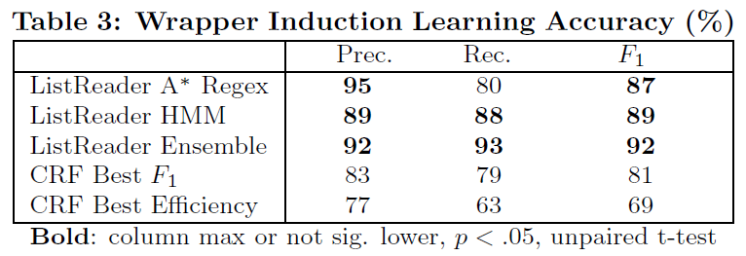
ListReader Accuracy
Notes:
Feasible
Higher F-measure at lower cost than CRF
Reduced cost in self-supervision

Slide 13
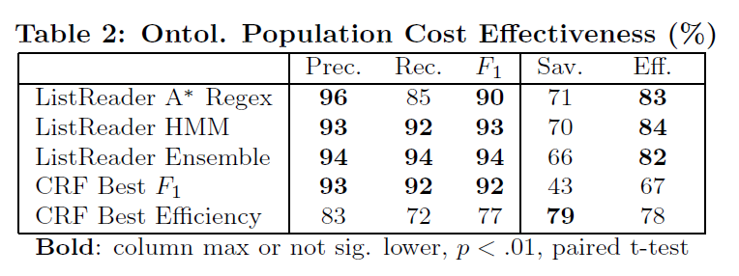
ListReader Efficiency
Notes:
Feasible
Higher F-measure at lower cost than CRF
Reduced cost in self-supervision

Slide 14
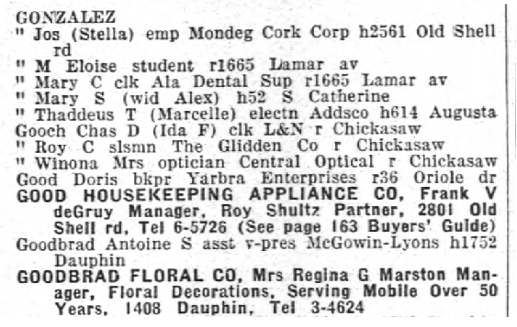
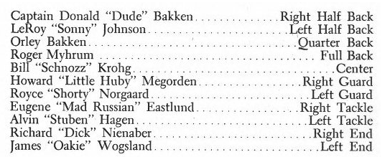
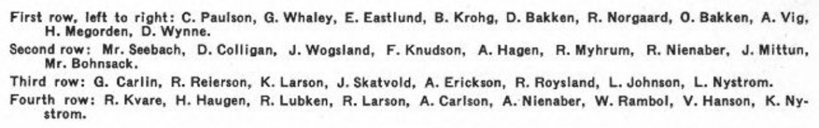
Next Steps
Unsupervised list discovery and regex induction
Higher-precision regex trains higher-recall HMM
Expanded class of input lists in full OCR pages
Notes:
Text suffix tree
Grammar induction
MDL principle from info. Theory
Expanded collection of full-pages

Slide 15
Conclusions
ListReader:
Wrapper induction
Lists
Noise tolerant
Low cost
Rich data
Notes:
Requiring a single labeling of each field in a list (optimal training) for a certain class of lists
Requiring fewer labels at higher accuracy than state-of-the-art ML-IE for a larger class of lists

