Slide 1
The Wizard Words and Worlds of ACM-L
David W. Embley
Brigham Young University
Notes:
I’ve been asked to elaborate on my views about what ACM-L is and what its possibilities are – I have chosen to do so in terms of the wizard Words and Worlds of ACM-L. And what do I mean by wizard words and worlds? … in a nutshell, they are words and worlds that make you dizzy to think about …
A possible approach is to address what some call “Wizard” words and worlds – those words, phrases, and applications that are crucial to think about in various ways and usually don’t mean the same thing to everyone. This opens up: (1) a philosophical view for definition, (2) highlights from previous workshops, (3) modeling formalism, including time, in particular, (4) wizard worlds: examples from newspapers, novels, … (5) fact extraction and organization and a LITTLE BIT on what we’re doing. It’s critical that I not just describe our work in a keynote address!!
Original Notes (created when I started working on this presentation):
Describe high-level dream
Pick out phrases from [cfp]
Mention applications
In essence (and to make the research directions concrete), it’s about:
Gathering and organizing facts
Potentially billions of facts (all time sensitive)
Uncertain facts, probabilistic facts
Missing relevant facts (know what’s missing)
Dynamic model that changes to accommodate initially unknown items of interest
Analyzing the facts to draw conclusions and make decisions
Focus on acronym (from my perspective)
Learning in two senses [ontology learning]
Learning the model (meta-model construction, including populating the model)
Learning about the application—dynamically adjusting the model as time passes
Active
Dynamically changing (the model changes as well as the facts and facts about the facts)
What if scenarios (easy to specify and play out; amenable to analysis)
Conceptual model (possible example: the home security system in my ODD book)
Includes behavior (state nets & interaction diagrams) as well as static information (structure diagram)
Formal definition needed (Steve Clyde’s formalism for recording temporal facts)
Example
Challenges
Worthwhile even if can only accomplish some of the goals:
Annotation (by itself) already worthwhile (semantic web / web of data / WoK)
Knowledge bundles for research studies
Learning: ref ABCs of learning for ways to learn
Can we build more of the dream?

Slide 2
Wizard Words & Worlds
Wizard Words:
  “words that mean exactly what you want them to mean”
  Eg: knowledge, model, ontology, semantics, architecture
Wizard Worlds:
  “abstract application worlds as you envision them”
  Your conceptualized model of some reality
Notes:
… just like this slide … and “no” I’m not going to try to make you dizzy by having you read slides like this … but this is the way to introduce dizzying wizard words and worlds. More precisely, wizard words are …

Slide 3
Conceptual
Modeling
Active
Learning
ACM-L-2010 WORKSHOP
Description / Problem / Topics / Capability / Application / Status / Deadlines / Paper submission / Chairs / Committee
Third International Workshop on Active Conceptual Modeling of Learning – ACM-L 2010
Workshop Description and Call for Papers
We will study a framework for the active conceptual modeling of learning based on the Entity-Relationship (ER) approach and human cognition paradigm for developing a learning-base to support and develop complex applications, act on inevitable “surprises” and cognitive capability development. The goal is to develop new technology for building computer systems that help us learn from the past, cope with the present and plan for the future.
A need for active conceptual modeling for information systems rises from several sources: active modeling, emergency management, learning from surprises, data provenance, modification of the events/conditions/actions as the system evolves, actively evolving conceptual models, schema changes in conceptual models, historical information in conceptual models, ontological modeling in domain-aware systems, spatio-temporal and multi-representation modeling, etc. The most important needs are perhaps emergency management and learning from surprises, because they often appear in big disasters and catastrophes, as in a tsunami or earthquake. In these kinds of situations, information systems must collect large amounts raw data, analyze it, conceptualize it, map it to the domain, distribute it, make conclusions, make plans for new activities, and manage cooperation of active officials.
This effort aims to enhance our fundamental understanding of how to capture knowledge from transitions between system states, model continual learning from past experiences, and construct new interpretations on the basis of evolution of recognized system states. This understanding will enable us to provide traceable lessons learned for improving current situations, adapting to new situations and potentially predicting future actions. Important applications may include global situation monitoring (scientific, environmental, economical, etc.), homeland security, adaptive C4ISR, antiterrorism activities, etc.), the inevitable ?surprises? and cognitive capability development.
Problem: The advent of information technology allows us to model the world by mapping real-world scenarios onto information systems and applications in a more sophisticated way. However, today’s databases and knowledge bases only reflect the static characteristics of the intended Universe of Discourse, captured by the conceptual model as distinct snapshots. The information system, which provides us with ?almost recent? information, neither supports applications that require historical information nor provides information for projecting the future based on past experience and lessons learned. Without the relationships between snapshots, it is difficult to simulate the ?what if? scenarios. Temporal and spatial relationships between entity behaviors and uncertainty cannot be fully modeled. Temporal concepts are not taken into account properly. Therefore, historical information and their changes cannot be managed, and the certainty of information cannot be assessed. Inadequate dynamic modeling constructs (e.g. perspective, dynamic relationships and changes, degree of importance of relationships) result in incomplete representation of the changing real-world domain.
Approach: To achieve active information processing, learning from our past experience is essential. Learning is a continuous process by which relatively permanent behavioral changes occur, potentially as a result of an experience. Lessons learned are knowledge gained by reflecting on experiences that can avoid the repetitions of past mishaps to share observations and to improve future actions. While learning is an ongoing process that transfers knowledge from one state to another, a lesson learned summarizes knowledge at a point in time. To describe an experience is to model past events and associated knowledge from a different perspective. This historical perspective allows us to describe a lesson learned from the interaction of episodic and semantic memories. The domain can be described in terms of topic, time/space, people, scenarios/events, cause/effect and general knowledge about the situation or domain. Active conceptual modeling is a continual process of describing all concepts and aspects of a domain, its activities, and changes under different perspectives. The model is viewed as a multilevel (e.g. strategic, tactical, operational) and multi-perspective high-level abstraction of reality. Our effort focuses on relationships between past knowledge/data and current knowledge/data from different perspectives. We propose a framework for active conceptual modeling of learning.
Conventional conceptual modeling for database design is a simple case of active modeling. The active conceptual model will provide the necessary control and traceability for the evolving domain. The moving snapshots could potentially become frames for creating a movie of the past, present, and future; and help simulate the target systems to answer the ?what if? questions. It will also allow us to continually learn and make inferences to provide foresight from hindsight. The user will be notified when the alerted situations are detected, based on the monitoring requirements under dynamic constraints and related information from the underlying data sources and learning-base.
Topics:
Technical Areas: Accomplishing our goal will require investigation of the following basic and exploratory research areas. Some other relevant areas may also be found.
• Integrating time, space, and perspective dimensions in a theoretical framework of conceptual models
- Theory of human concepts, human cognition
- ER theory
- Mathematical active conceptual models
- Multi-level conceptual modeling
- Multi-perspective conceptual modeling
- Multi-media information modeling
- Mapping of constructs among conceptual models
• Management of continuous changes and learning
- Conceptual change
- Continuous knowledge acquisition
- Experience modeling and management
- Learning from experience
- Representation and management of changes
- Transfer learning in time dimension
- Lessons learned capturing
- Information extraction, discovery, and summarization
• Behaviors of evolving systems – including model evolution, patterns, interpretation, uncertainty, integration
- Time and events in evolving systems
- Situation monitoring (system- and user-level)
- Schema evolution and version management
- Content awareness and context awareness
- Modeling of context changes
- Information integration and interpretation
- Pattern recognition over a time period
- Uncertainty management WRT integrity
- Reactive, proactive, adaptive, deductive capability in support of active behavior
- Combined episodic and semantic memory paradigm for structuring of historical information
• Executable conceptual models for implementation of active systems
- Dynamic reserve modeling
- Storage management
- Security
- User interface
- Bench marking for Test & Evaluation
- Languages for information manipulation
- Architectures for information system based on the active conceptual model
Capability: The active model can only be realized by integrating technology (e.g. AI, software engineering, information/knowledge management, cognitive science, philosophy, etc.) and combining modeling techniques. We will provide an enhanced situational awareness and monitoring capability through the following services:
• Information provenance for understanding and interpreting information in a holistic manner
• Contextual information integration with uncertainty indication
• Rewind memory to specific times and/or situations and move forward with different assumptions
• Trace scenarios and discover hidden and implicit relationships between events
• Detect changes in evolving situations over time
• Situation monitoring with context-awareness adaptation
• Event patterns discovery (related and seemingly unrelated events)
• Anomaly detection with respect to situational changes
• Notification when similar situations are occurring
• Dynamic reserve modeling to derive context models based on data at a given time
• Learning, inferring, and reasoning of forensics and present for predicting future actions
• Interactive user interface
Applications: The ACM-L capability can be applied to a large class of applications including the following:
• Active learning
• Adaptive C4ISR
• Counter-terrorism for tracking “surprises”
• Homeland Security
• Info-Forensics
• Law enforcement
• Lessons-learned systems
• Medical/patient information systems
• Situation awareness and monitoring (MDA, GWOT)
• Simulation and modeling
• Many others…
Status: To begin framing the problem, SPAWARSYSCEN Pacific hosted two workshops on ACM-L in 2006. The first event was held at SPAWARSYSCEN Pacific to introduce the Science & Technology (S&T) Initiative and identify a Research and Development agenda for the technology development investigation. Eleven invited experts in Conceptual Modeling presented position papers on the proposed S&T Initiative. The first open workshop was held at the 25th International Conference on Conceptual Modeling, ER 2006, 6-9 November 2006, in Tucson, Arizona. An application, AWARE (Active Wisdom Advancing Retrospective Exploration), is being identified. The second open workshop was held at the 28th International Conference on Conceptual Modeling, ER 2009, 9-12 November 2009, in Gramado, Brazil. The workshop covered a wide spectrum of issues from operational requirements to basic research in concepts, learning, thinking, and communication.
Workshop deadlines:
Abstract Submission: April 20, 2010 Full Paper Submission:April 28, 2010 Author Notification:June 7, 2010 Camera-ready Paper Submission:June 30, 2010 Workshop:November 1-4, 2010 Paper Submission
Formatting Guidelines
ACM-L 2010 proceedings will be part of the ER 2010 Workshop volume published by Springer-Verlag in the LNCS series. Thus, authors must submit manuscripts using the Springer-Verlag LNCS style for Lecture Notes in Computer Science. Refer to http://www.springer.de/comp/lncs/authors.html for style files and details. Papers in the final proceedings are strictly limited to 10 pages. Therefore, submitted papers should also not exceed 10 pages, but technical appendices, e.g. containing proofs, can be added to a submission.
Papers must be in English, formatted in LNCS style and submitted as PDF-files. Submitted papers must be original and not submitted or accepted for publication in any other workshop, conference, or journal.
Submission Guidelines
Submission to ACM-L 2010 will be by electronic mail, only, to all three workshop chairs to addresses below. Submission must be in PostScript or PDF format, by the due date. All correspondence with authors will be via e-mail. Please ensure that your submission includes an e-mail address for the corresponding author.
Workshop chairs and their e-mail addresses:
Hannu Kangassalo; University of Tampere, Finland; hk@cs.uta.fi
Salvatore T. March; Vanderbilt University, U.S.A; Sal.March@owen.vanderbilt.edu
Leah Y Wong; SPAWARSYSCEN Pacific, U.S.A; leah.wong@navy.mil
PROGRAM COMMITTEE MEMBERS (to be extended)
Stefano Borgo, Laboratory for Applied Ontology, ISTC-CNR, Italy
Alfredo Cuzzocrea, University of Calabria, Italy
Giancarlo Guizzardi, Universidade Federal do Espírito Santo, Brazil
Raymond A Liuzzi, Raymond Technologies, USA
Jari Palomäki, Tampere University of Technology/Pori, Finland
Oscar Pastor, Valencia University of Technology, Spain
Sudha Ram, University of Arizona, USA
Laura Spinsanti, LBD lab ? EPFL, Swizerland
Il-Yeol Song, Drexel University, USA
Bernhard Thalheim, Christian Albrechts University Kiel, Germany
Related Links
ER 2010
University of Tampere
©2010 Department of Computer Sciences. Tampere Finland
Notes:
… and I’m not going to insist that you read the small text either …
C4ISR: Command, Control, Communications, Computers, Intelligence, Surveillance, and Reconnaissance = Military “Battle Command”

Slide 4
Conceptual
Modeling
Active
Learning
ACM-L-2010 WORKSHOP
Description / Problem / Topics / Capability / Application / Status / Deadlines / Paper submission / Chairs / Committee
Third International Workshop on Active Conceptual Modeling of Learning – ACM-L 2010
Workshop Description and Call for Papers
We will study a framework for the active conceptual modeling of learning based on the Entity-Relationship (ER) approach and human cognition paradigm for developing a learning-base to support and develop complex applications, act on inevitable “surprises” and cognitive capability development. The goal is to develop new technology for building computer systems that help us learn from the past, cope with the present and plan for the future.
A need for active conceptual modeling for information systems rises from several sources: active modeling, emergency management, learning from surprises, data provenance, modification of the events/conditions/actions as the system evolves, actively evolving conceptual models, schema changes in conceptual models, historical information in conceptual models, ontological modeling in domain-aware systems, spatio-temporal and multi-representation modeling, etc. The most important needs are perhaps emergency management and learning from surprises, because they often appear in big disasters and catastrophes, as in a tsunami or earthquake. In these kinds of situations, information systems must collect large amounts raw data, analyze it, conceptualize it, map it to the domain, distribute it, make conclusions, make plans for new activities, and manage cooperation of active officials.
This effort aims to enhance our fundamental understanding of how to capture knowledge from transitions between system states, model continual learning from past experiences, and construct new interpretations on the basis of evolution of recognized system states. This understanding will enable us to provide traceable lessons learned for improving current situations, adapting to new situations and potentially predicting future actions. Important applications may include global situation monitoring (scientific, environmental, economical, etc.), homeland security, adaptive C4ISR, antiterrorism activities, etc.), the inevitable ?surprises? and cognitive capability development.
Problem: The advent of information technology allows us to model the world by mapping real-world scenarios onto information systems and applications in a more sophisticated way. However, today’s databases and knowledge bases only reflect the static characteristics of the intended Universe of Discourse, captured by the conceptual model as distinct snapshots. The information system, which provides us with ?almost recent? information, neither supports applications that require historical information nor provides information for projecting the future based on past experience and lessons learned. Without the relationships between snapshots, it is difficult to simulate the ?what if? scenarios. Temporal and spatial relationships between entity behaviors and uncertainty cannot be fully modeled. Temporal concepts are not taken into account properly. Therefore, historical information and their changes cannot be managed, and the certainty of information cannot be assessed. Inadequate dynamic modeling constructs (e.g. perspective, dynamic relationships and changes, degree of importance of relationships) result in incomplete representation of the changing real-world domain.
Approach: To achieve active information processing, learning from our past experience is essential. Learning is a continuous process by which relatively permanent behavioral changes occur, potentially as a result of an experience. Lessons learned are knowledge gained by reflecting on experiences that can avoid the repetitions of past mishaps to share observations and to improve future actions. While learning is an ongoing process that transfers knowledge from one state to another, a lesson learned summarizes knowledge at a point in time. To describe an experience is to model past events and associated knowledge from a different perspective. This historical perspective allows us to describe a lesson learned from the interaction of episodic and semantic memories. The domain can be described in terms of topic, time/space, people, scenarios/events, cause/effect and general knowledge about the situation or domain. Active conceptual modeling is a continual process of describing all concepts and aspects of a domain, its activities, and changes under different perspectives. The model is viewed as a multilevel (e.g. strategic, tactical, operational) and multi-perspective high-level abstraction of reality. Our effort focuses on relationships between past knowledge/data and current knowledge/data from different perspectives. We propose a framework for active conceptual modeling of learning.
Conventional conceptual modeling for database design is a simple case of active modeling. The active conceptual model will provide the necessary control and traceability for the evolving domain. The moving snapshots could potentially become frames for creating a movie of the past, present, and future; and help simulate the target systems to answer the ?what if? questions. It will also allow us to continually learn and make inferences to provide foresight from hindsight. The user will be notified when the alerted situations are detected, based on the monitoring requirements under dynamic constraints and related information from the underlying data sources and learning-base.
Topics:
Technical Areas: Accomplishing our goal will require investigation of the following basic and exploratory research areas. Some other relevant areas may also be found.
• Integrating time, space, and perspective dimensions in a theoretical framework of conceptual models
- Theory of human concepts, human cognition
- ER theory
- Mathematical active conceptual models
- Multi-level conceptual modeling
- Multi-perspective conceptual modeling
- Multi-media information modeling
- Mapping of constructs among conceptual models
• Management of continuous changes and learning
- Conceptual change
- Continuous knowledge acquisition
- Experience modeling and management
- Learning from experience
- Representation and management of changes
- Transfer learning in time dimension
- Lessons learned capturing
- Information extraction, discovery, and summarization
• Behaviors of evolving systems – including model evolution, patterns, interpretation, uncertainty, integration
- Time and events in evolving systems
- Situation monitoring (system- and user-level)
- Schema evolution and version management
- Content awareness and context awareness
- Modeling of context changes
- Information integration and interpretation
- Pattern recognition over a time period
- Uncertainty management WRT integrity
- Reactive, proactive, adaptive, deductive capability in support of active behavior
- Combined episodic and semantic memory paradigm for structuring of historical information
• Executable conceptual models for implementation of active systems
- Dynamic reserve modeling
- Storage management
- Security
- User interface
- Bench marking for Test & Evaluation
- Languages for information manipulation
- Architectures for information system based on the active conceptual model
Capability: The active model can only be realized by integrating technology (e.g. AI, software engineering, information/knowledge management, cognitive science, philosophy, etc.) and combining modeling techniques. We will provide an enhanced situational awareness and monitoring capability through the following services:
• Information provenance for understanding and interpreting information in a holistic manner
• Contextual information integration with uncertainty indication
• Rewind memory to specific times and/or situations and move forward with different assumptions
• Trace scenarios and discover hidden and implicit relationships between events
• Detect changes in evolving situations over time
• Situation monitoring with context-awareness adaptation
• Event patterns discovery (related and seemingly unrelated events)
• Anomaly detection with respect to situational changes
• Notification when similar situations are occurring
• Dynamic reserve modeling to derive context models based on data at a given time
• Learning, inferring, and reasoning of forensics and present for predicting future actions
• Interactive user interface
Applications: The ACM-L capability can be applied to a large class of applications including the following:
• Active learning
• Adaptive C4ISR
• Counter-terrorism for tracking “surprises”
• Homeland Security
• Info-Forensics
• Law enforcement
• Lessons-learned systems
• Medical/patient information systems
• Situation awareness and monitoring (MDA, GWOT)
• Simulation and modeling
• Many others…
Status: To begin framing the problem, SPAWARSYSCEN Pacific hosted two workshops on ACM-L in 2006. The first event was held at SPAWARSYSCEN Pacific to introduce the Science & Technology (S&T) Initiative and identify a Research and Development agenda for the technology development investigation. Eleven invited experts in Conceptual Modeling presented position papers on the proposed S&T Initiative. The first open workshop was held at the 25th International Conference on Conceptual Modeling, ER 2006, 6-9 November 2006, in Tucson, Arizona. An application, AWARE (Active Wisdom Advancing Retrospective Exploration), is being identified. The second open workshop was held at the 28th International Conference on Conceptual Modeling, ER 2009, 9-12 November 2009, in Gramado, Brazil. The workshop covered a wide spectrum of issues from operational requirements to basic research in concepts, learning, thinking, and communication.
Workshop deadlines:
Abstract Submission: April 20, 2010 Full Paper Submission:April 28, 2010 Author Notification:June 7, 2010 Camera-ready Paper Submission:June 30, 2010 Workshop:November 1-4, 2010 Paper Submission
Formatting Guidelines
ACM-L 2010 proceedings will be part of the ER 2010 Workshop volume published by Springer-Verlag in the LNCS series. Thus, authors must submit manuscripts using the Springer-Verlag LNCS style for Lecture Notes in Computer Science. Refer to http://www.springer.de/comp/lncs/authors.html for style files and details. Papers in the final proceedings are strictly limited to 10 pages. Therefore, submitted papers should also not exceed 10 pages, but technical appendices, e.g. containing proofs, can be added to a submission.
Papers must be in English, formatted in LNCS style and submitted as PDF-files. Submitted papers must be original and not submitted or accepted for publication in any other workshop, conference, or journal.
Submission Guidelines
Submission to ACM-L 2010 will be by electronic mail, only, to all three workshop chairs to addresses below. Submission must be in PostScript or PDF format, by the due date. All correspondence with authors will be via e-mail. Please ensure that your submission includes an e-mail address for the corresponding author.
Workshop chairs and their e-mail addresses:
Hannu Kangassalo; University of Tampere, Finland; hk@cs.uta.fi
Salvatore T. March; Vanderbilt University, U.S.A; Sal.March@owen.vanderbilt.edu
Leah Y Wong; SPAWARSYSCEN Pacific, U.S.A; leah.wong@navy.mil
PROGRAM COMMITTEE MEMBERS (to be extended)
Stefano Borgo, Laboratory for Applied Ontology, ISTC-CNR, Italy
Alfredo Cuzzocrea, University of Calabria, Italy
Giancarlo Guizzardi, Universidade Federal do Espírito Santo, Brazil
Raymond A Liuzzi, Raymond Technologies, USA
Jari Palomäki, Tampere University of Technology/Pori, Finland
Oscar Pastor, Valencia University of Technology, Spain
Sudha Ram, University of Arizona, USA
Laura Spinsanti, LBD lab ? EPFL, Swizerland
Il-Yeol Song, Drexel University, USA
Bernhard Thalheim, Christian Albrechts University Kiel, Germany
Related Links
ER 2010
University of Tampere
©2010 Department of Computer Sciences. Tampere Finland
paradigm
plan
human cognition
framework
cope
learning-base
learn
complex applications
Notes:
C4ISR: Command, Control, Communications, Computers, Intelligence, Surveillance, and Reconnaissance = Military “Battle Command”

Slide 5
Conceptual
Modeling
Active
Learning
ACM-L-2010 WORKSHOP
Description / Problem / Topics / Capability / Application / Status / Deadlines / Paper submission / Chairs / Committee
Third International Workshop on Active Conceptual Modeling of Learning – ACM-L 2010
Workshop Description and Call for Papers
We will study a framework for the active conceptual modeling of learning based on the Entity-Relationship (ER) approach and human cognition paradigm for developing a learning-base to support and develop complex applications, act on inevitable “surprises” and cognitive capability development. The goal is to develop new technology for building computer systems that help us learn from the past, cope with the present and plan for the future.
A need for active conceptual modeling for information systems rises from several sources: active modeling, emergency management, learning from surprises, data provenance, modification of the events/conditions/actions as the system evolves, actively evolving conceptual models, schema changes in conceptual models, historical information in conceptual models, ontological modeling in domain-aware systems, spatio-temporal and multi-representation modeling, etc. The most important needs are perhaps emergency management and learning from surprises, because they often appear in big disasters and catastrophes, as in a tsunami or earthquake. In these kinds of situations, information systems must collect large amounts raw data, analyze it, conceptualize it, map it to the domain, distribute it, make conclusions, make plans for new activities, and manage cooperation of active officials.
This effort aims to enhance our fundamental understanding of how to capture knowledge from transitions between system states, model continual learning from past experiences, and construct new interpretations on the basis of evolution of recognized system states. This understanding will enable us to provide traceable lessons learned for improving current situations, adapting to new situations and potentially predicting future actions. Important applications may include global situation monitoring (scientific, environmental, economical, etc.), homeland security, adaptive C4ISR, antiterrorism activities, etc.), the inevitable ?surprises? and cognitive capability development.
Problem: The advent of information technology allows us to model the world by mapping real-world scenarios onto information systems and applications in a more sophisticated way. However, today’s databases and knowledge bases only reflect the static characteristics of the intended Universe of Discourse, captured by the conceptual model as distinct snapshots. The information system, which provides us with ?almost recent? information, neither supports applications that require historical information nor provides information for projecting the future based on past experience and lessons learned. Without the relationships between snapshots, it is difficult to simulate the ?what if? scenarios. Temporal and spatial relationships between entity behaviors and uncertainty cannot be fully modeled. Temporal concepts are not taken into account properly. Therefore, historical information and their changes cannot be managed, and the certainty of information cannot be assessed. Inadequate dynamic modeling constructs (e.g. perspective, dynamic relationships and changes, degree of importance of relationships) result in incomplete representation of the changing real-world domain.
Approach: To achieve active information processing, learning from our past experience is essential. Learning is a continuous process by which relatively permanent behavioral changes occur, potentially as a result of an experience. Lessons learned are knowledge gained by reflecting on experiences that can avoid the repetitions of past mishaps to share observations and to improve future actions. While learning is an ongoing process that transfers knowledge from one state to another, a lesson learned summarizes knowledge at a point in time. To describe an experience is to model past events and associated knowledge from a different perspective. This historical perspective allows us to describe a lesson learned from the interaction of episodic and semantic memories. The domain can be described in terms of topic, time/space, people, scenarios/events, cause/effect and general knowledge about the situation or domain. Active conceptual modeling is a continual process of describing all concepts and aspects of a domain, its activities, and changes under different perspectives. The model is viewed as a multilevel (e.g. strategic, tactical, operational) and multi-perspective high-level abstraction of reality. Our effort focuses on relationships between past knowledge/data and current knowledge/data from different perspectives. We propose a framework for active conceptual modeling of learning.
Conventional conceptual modeling for database design is a simple case of active modeling. The active conceptual model will provide the necessary control and traceability for the evolving domain. The moving snapshots could potentially become frames for creating a movie of the past, present, and future; and help simulate the target systems to answer the ?what if? questions. It will also allow us to continually learn and make inferences to provide foresight from hindsight. The user will be notified when the alerted situations are detected, based on the monitoring requirements under dynamic constraints and related information from the underlying data sources and learning-base.
Topics:
Technical Areas: Accomplishing our goal will require investigation of the following basic and exploratory research areas. Some other relevant areas may also be found.
• Integrating time, space, and perspective dimensions in a theoretical framework of conceptual models
- Theory of human concepts, human cognition
- ER theory
- Mathematical active conceptual models
- Multi-level conceptual modeling
- Multi-perspective conceptual modeling
- Multi-media information modeling
- Mapping of constructs among conceptual models
• Management of continuous changes and learning
- Conceptual change
- Continuous knowledge acquisition
- Experience modeling and management
- Learning from experience
- Representation and management of changes
- Transfer learning in time dimension
- Lessons learned capturing
- Information extraction, discovery, and summarization
• Behaviors of evolving systems – including model evolution, patterns, interpretation, uncertainty, integration
- Time and events in evolving systems
- Situation monitoring (system- and user-level)
- Schema evolution and version management
- Content awareness and context awareness
- Modeling of context changes
- Information integration and interpretation
- Pattern recognition over a time period
- Uncertainty management WRT integrity
- Reactive, proactive, adaptive, deductive capability in support of active behavior
- Combined episodic and semantic memory paradigm for structuring of historical information
• Executable conceptual models for implementation of active systems
- Dynamic reserve modeling
- Storage management
- Security
- User interface
- Bench marking for Test & Evaluation
- Languages for information manipulation
- Architectures for information system based on the active conceptual model
Capability: The active model can only be realized by integrating technology (e.g. AI, software engineering, information/knowledge management, cognitive science, philosophy, etc.) and combining modeling techniques. We will provide an enhanced situational awareness and monitoring capability through the following services:
• Information provenance for understanding and interpreting information in a holistic manner
• Contextual information integration with uncertainty indication
• Rewind memory to specific times and/or situations and move forward with different assumptions
• Trace scenarios and discover hidden and implicit relationships between events
• Detect changes in evolving situations over time
• Situation monitoring with context-awareness adaptation
• Event patterns discovery (related and seemingly unrelated events)
• Anomaly detection with respect to situational changes
• Notification when similar situations are occurring
• Dynamic reserve modeling to derive context models based on data at a given time
• Learning, inferring, and reasoning of forensics and present for predicting future actions
• Interactive user interface
Applications: The ACM-L capability can be applied to a large class of applications including the following:
• Active learning
• Adaptive C4ISR
• Counter-terrorism for tracking “surprises”
• Homeland Security
• Info-Forensics
• Law enforcement
• Lessons-learned systems
• Medical/patient information systems
• Situation awareness and monitoring (MDA, GWOT)
• Simulation and modeling
• Many others…
Status: To begin framing the problem, SPAWARSYSCEN Pacific hosted two workshops on ACM-L in 2006. The first event was held at SPAWARSYSCEN Pacific to introduce the Science & Technology (S&T) Initiative and identify a Research and Development agenda for the technology development investigation. Eleven invited experts in Conceptual Modeling presented position papers on the proposed S&T Initiative. The first open workshop was held at the 25th International Conference on Conceptual Modeling, ER 2006, 6-9 November 2006, in Tucson, Arizona. An application, AWARE (Active Wisdom Advancing Retrospective Exploration), is being identified. The second open workshop was held at the 28th International Conference on Conceptual Modeling, ER 2009, 9-12 November 2009, in Gramado, Brazil. The workshop covered a wide spectrum of issues from operational requirements to basic research in concepts, learning, thinking, and communication.
Workshop deadlines:
Abstract Submission: April 20, 2010 Full Paper Submission:April 28, 2010 Author Notification:June 7, 2010 Camera-ready Paper Submission:June 30, 2010 Workshop:November 1-4, 2010 Paper Submission
Formatting Guidelines
ACM-L 2010 proceedings will be part of the ER 2010 Workshop volume published by Springer-Verlag in the LNCS series. Thus, authors must submit manuscripts using the Springer-Verlag LNCS style for Lecture Notes in Computer Science. Refer to http://www.springer.de/comp/lncs/authors.html for style files and details. Papers in the final proceedings are strictly limited to 10 pages. Therefore, submitted papers should also not exceed 10 pages, but technical appendices, e.g. containing proofs, can be added to a submission.
Papers must be in English, formatted in LNCS style and submitted as PDF-files. Submitted papers must be original and not submitted or accepted for publication in any other workshop, conference, or journal.
Submission Guidelines
Submission to ACM-L 2010 will be by electronic mail, only, to all three workshop chairs to addresses below. Submission must be in PostScript or PDF format, by the due date. All correspondence with authors will be via e-mail. Please ensure that your submission includes an e-mail address for the corresponding author.
Workshop chairs and their e-mail addresses:
Hannu Kangassalo; University of Tampere, Finland; hk@cs.uta.fi
Salvatore T. March; Vanderbilt University, U.S.A; Sal.March@owen.vanderbilt.edu
Leah Y Wong; SPAWARSYSCEN Pacific, U.S.A; leah.wong@navy.mil
PROGRAM COMMITTEE MEMBERS (to be extended)
Stefano Borgo, Laboratory for Applied Ontology, ISTC-CNR, Italy
Alfredo Cuzzocrea, University of Calabria, Italy
Giancarlo Guizzardi, Universidade Federal do Espírito Santo, Brazil
Raymond A Liuzzi, Raymond Technologies, USA
Jari Palomäki, Tampere University of Technology/Pori, Finland
Oscar Pastor, Valencia University of Technology, Spain
Sudha Ram, University of Arizona, USA
Laura Spinsanti, LBD lab ? EPFL, Swizerland
Il-Yeol Song, Drexel University, USA
Bernhard Thalheim, Christian Albrechts University Kiel, Germany
Related Links
ER 2010
University of Tampere
©2010 Department of Computer Sciences. Tampere Finland
paradigm
plan
human cognition
framework
cope
learning base
learn
complex applications
Theory of human concepts
Mathematical active conceptual modeling
Multi-level conceptual modeling
Multi-perspective conceptual modeling
Notes:
C4ISR: Command, Control, Communications, Computers, Intelligence, Surveillance, and Reconnaissance = Military “Battle Command”

Slide 6
ACM-L-2010 WORKSHOP
Description / Problem / Topics / Capability / Application / Status / Deadlines / Paper submission / Chairs / Committee
Third International Workshop on Active Conceptual Modeling of Learning – ACM-L 2010
Workshop Description and Call for Papers
We will study a framework for the active conceptual modeling of learning based on the Entity-Relationship (ER) approach and human cognition paradigm for developing a learning-base to support and develop complex applications, act on inevitable “surprises” and cognitive capability development. The goal is to develop new technology for building computer systems that help us learn from the past, cope with the present and plan for the future.
A need for active conceptual modeling for information systems rises from several sources: active modeling, emergency management, learning from surprises, data provenance, modification of the events/conditions/actions as the system evolves, actively evolving conceptual models, schema changes in conceptual models, historical information in conceptual models, ontological modeling in domain-aware systems, spatio-temporal and multi-representation modeling, etc. The most important needs are perhaps emergency management and learning from surprises, because they often appear in big disasters and catastrophes, as in a tsunami or earthquake. In these kinds of situations, information systems must collect large amounts raw data, analyze it, conceptualize it, map it to the domain, distribute it, make conclusions, make plans for new activities, and manage cooperation of active officials.
This effort aims to enhance our fundamental understanding of how to capture knowledge from transitions between system states, model continual learning from past experiences, and construct new interpretations on the basis of evolution of recognized system states. This understanding will enable us to provide traceable lessons learned for improving current situations, adapting to new situations and potentially predicting future actions. Important applications may include global situation monitoring (scientific, environmental, economical, etc.), homeland security, adaptive C4ISR, antiterrorism activities, etc.), the inevitable ?surprises? and cognitive capability development.
Problem: The advent of information technology allows us to model the world by mapping real-world scenarios onto information systems and applications in a more sophisticated way. However, today’s databases and knowledge bases only reflect the static characteristics of the intended Universe of Discourse, captured by the conceptual model as distinct snapshots. The information system, which provides us with ?almost recent? information, neither supports applications that require historical information nor provides information for projecting the future based on past experience and lessons learned. Without the relationships between snapshots, it is difficult to simulate the ?what if? scenarios. Temporal and spatial relationships between entity behaviors and uncertainty cannot be fully modeled. Temporal concepts are not taken into account properly. Therefore, historical information and their changes cannot be managed, and the certainty of information cannot be assessed. Inadequate dynamic modeling constructs (e.g. perspective, dynamic relationships and changes, degree of importance of relationships) result in incomplete representation of the changing real-world domain.
Approach: To achieve active information processing, learning from our past experience is essential. Learning is a continuous process by which relatively permanent behavioral changes occur, potentially as a result of an experience. Lessons learned are knowledge gained by reflecting on experiences that can avoid the repetitions of past mishaps to share observations and to improve future actions. While learning is an ongoing process that transfers knowledge from one state to another, a lesson learned summarizes knowledge at a point in time. To describe an experience is to model past events and associated knowledge from a different perspective. This historical perspective allows us to describe a lesson learned from the interaction of episodic and semantic memories. The domain can be described in terms of topic, time/space, people, scenarios/events, cause/effect and general knowledge about the situation or domain. Active conceptual modeling is a continual process of describing all concepts and aspects of a domain, its activities, and changes under different perspectives. The model is viewed as a multilevel (e.g. strategic, tactical, operational) and multi-perspective high-level abstraction of reality. Our effort focuses on relationships between past knowledge/data and current knowledge/data from different perspectives. We propose a framework for active conceptual modeling of learning.
Conventional conceptual modeling for database design is a simple case of active modeling. The active conceptual model will provide the necessary control and traceability for the evolving domain. The moving snapshots could potentially become frames for creating a movie of the past, present, and future; and help simulate the target systems to answer the ?what if? questions. It will also allow us to continually learn and make inferences to provide foresight from hindsight. The user will be notified when the alerted situations are detected, based on the monitoring requirements under dynamic constraints and related information from the underlying data sources and learning-base.
Topics:
Technical Areas: Accomplishing our goal will require investigation of the following basic and exploratory research areas. Some other relevant areas may also be found.
• Integrating time, space, and perspective dimensions in a theoretical framework of conceptual models
- Theory of human concepts, human cognition
- ER theory
- Mathematical active conceptual models
- Multi-level conceptual modeling
- Multi-perspective conceptual modeling
- Multi-media information modeling
- Mapping of constructs among conceptual models
• Management of continuous changes and learning
- Conceptual change
- Continuous knowledge acquisition
- Experience modeling and management
- Learning from experience
- Representation and management of changes
- Transfer learning in time dimension
- Lessons learned capturing
- Information extraction, discovery, and summarization
• Behaviors of evolving systems – including model evolution, patterns, interpretation, uncertainty, integration
- Time and events in evolving systems
- Situation monitoring (system- and user-level)
- Schema evolution and version management
- Content awareness and context awareness
- Modeling of context changes
- Information integration and interpretation
- Pattern recognition over a time period
- Uncertainty management WRT integrity
- Reactive, proactive, adaptive, deductive capability in support of active behavior
- Combined episodic and semantic memory paradigm for structuring of historical information
• Executable conceptual models for implementation of active systems
- Dynamic reserve modeling
- Storage management
- Security
- User interface
- Bench marking for Test & Evaluation
- Languages for information manipulation
- Architectures for information system based on the active conceptual model
Capability: The active model can only be realized by integrating technology (e.g. AI, software engineering, information/knowledge management, cognitive science, philosophy, etc.) and combining modeling techniques. We will provide an enhanced situational awareness and monitoring capability through the following services:
• Information provenance for understanding and interpreting information in a holistic manner
• Contextual information integration with uncertainty indication
• Rewind memory to specific times and/or situations and move forward with different assumptions
• Trace scenarios and discover hidden and implicit relationships between events
• Detect changes in evolving situations over time
• Situation monitoring with context-awareness adaptation
• Event patterns discovery (related and seemingly unrelated events)
• Anomaly detection with respect to situational changes
• Notification when similar situations are occurring
• Dynamic reserve modeling to derive context models based on data at a given time
• Learning, inferring, and reasoning of forensics and present for predicting future actions
• Interactive user interface
Applications: The ACM-L capability can be applied to a large class of applications including the following:
• Active learning
• Adaptive C4ISR
• Counter-terrorism for tracking “surprises”
• Homeland Security
• Info-Forensics
• Law enforcement
• Lessons-learned systems
• Medical/patient information systems
• Situation awareness and monitoring (MDA, GWOT)
• Simulation and modeling
• Many others…
Status: To begin framing the problem, SPAWARSYSCEN Pacific hosted two workshops on ACM-L in 2006. The first event was held at SPAWARSYSCEN Pacific to introduce the Science & Technology (S&T) Initiative and identify a Research and Development agenda for the technology development investigation. Eleven invited experts in Conceptual Modeling presented position papers on the proposed S&T Initiative. The first open workshop was held at the 25th International Conference on Conceptual Modeling, ER 2006, 6-9 November 2006, in Tucson, Arizona. An application, AWARE (Active Wisdom Advancing Retrospective Exploration), is being identified. The second open workshop was held at the 28th International Conference on Conceptual Modeling, ER 2009, 9-12 November 2009, in Gramado, Brazil. The workshop covered a wide spectrum of issues from operational requirements to basic research in concepts, learning, thinking, and communication.
Workshop deadlines:
Abstract Submission: April 20, 2010 Full Paper Submission:April 28, 2010 Author Notification:June 7, 2010 Camera-ready Paper Submission:June 30, 2010 Workshop:November 1-4, 2010 Paper Submission
Formatting Guidelines
ACM-L 2010 proceedings will be part of the ER 2010 Workshop volume published by Springer-Verlag in the LNCS series. Thus, authors must submit manuscripts using the Springer-Verlag LNCS style for Lecture Notes in Computer Science. Refer to http://www.springer.de/comp/lncs/authors.html for style files and details. Papers in the final proceedings are strictly limited to 10 pages. Therefore, submitted papers should also not exceed 10 pages, but technical appendices, e.g. containing proofs, can be added to a submission.
Papers must be in English, formatted in LNCS style and submitted as PDF-files. Submitted papers must be original and not submitted or accepted for publication in any other workshop, conference, or journal.
Submission Guidelines
Submission to ACM-L 2010 will be by electronic mail, only, to all three workshop chairs to addresses below. Submission must be in PostScript or PDF format, by the due date. All correspondence with authors will be via e-mail. Please ensure that your submission includes an e-mail address for the corresponding author.
Workshop chairs and their e-mail addresses:
Hannu Kangassalo; University of Tampere, Finland; hk@cs.uta.fi
Salvatore T. March; Vanderbilt University, U.S.A; Sal.March@owen.vanderbilt.edu
Leah Y Wong; SPAWARSYSCEN Pacific, U.S.A; leah.wong@navy.mil
PROGRAM COMMITTEE MEMBERS (to be extended)
Stefano Borgo, Laboratory for Applied Ontology, ISTC-CNR, Italy
Alfredo Cuzzocrea, University of Calabria, Italy
Giancarlo Guizzardi, Universidade Federal do Espírito Santo, Brazil
Raymond A Liuzzi, Raymond Technologies, USA
Jari Palomäki, Tampere University of Technology/Pori, Finland
Oscar Pastor, Valencia University of Technology, Spain
Sudha Ram, University of Arizona, USA
Laura Spinsanti, LBD lab ? EPFL, Swizerland
Il-Yeol Song, Drexel University, USA
Bernhard Thalheim, Christian Albrechts University Kiel, Germany
Related Links
ER 2010
University of Tampere
©2010 Department of Computer Sciences. Tampere Finland
Wizard Worlds: “Applications”
antiterrorism activities
global situation monitoring
- scientific
- environmental
- economical
Military “Battle Command”
homeland security
Notes:
C4ISR: Command, Control, Communications, Computers, Intelligence, Surveillance, and Reconnaissance = Military “Battle Command”

Slide 7
ACM-L-2010 WORKSHOP
Description / Problem / Topics / Capability / Application / Status / Deadlines / Paper submission / Chairs / Committee
Third International Workshop on Active Conceptual Modeling of Learning – ACM-L 2010
Workshop Description and Call for Papers
We will study a framework for the active conceptual modeling of learning based on the Entity-Relationship (ER) approach and human cognition paradigm for developing a learning-base to support and develop complex applications, act on inevitable “surprises” and cognitive capability development. The goal is to develop new technology for building computer systems that help us learn from the past, cope with the present and plan for the future.
A need for active conceptual modeling for information systems rises from several sources: active modeling, emergency management, learning from surprises, data provenance, modification of the events/conditions/actions as the system evolves, actively evolving conceptual models, schema changes in conceptual models, historical information in conceptual models, ontological modeling in domain-aware systems, spatio-temporal and multi-representation modeling, etc. The most important needs are perhaps emergency management and learning from surprises, because they often appear in big disasters and catastrophes, as in a tsunami or earthquake. In these kinds of situations, information systems must collect large amounts raw data, analyze it, conceptualize it, map it to the domain, distribute it, make conclusions, make plans for new activities, and manage cooperation of active officials.
This effort aims to enhance our fundamental understanding of how to capture knowledge from transitions between system states, model continual learning from past experiences, and construct new interpretations on the basis of evolution of recognized system states. This understanding will enable us to provide traceable lessons learned for improving current situations, adapting to new situations and potentially predicting future actions. Important applications may include global situation monitoring (scientific, environmental, economical, etc.), homeland security, adaptive C4ISR, antiterrorism activities, etc.), the inevitable ?surprises? and cognitive capability development.
Problem: The advent of information technology allows us to model the world by mapping real-world scenarios onto information systems and applications in a more sophisticated way. However, today’s databases and knowledge bases only reflect the static characteristics of the intended Universe of Discourse, captured by the conceptual model as distinct snapshots. The information system, which provides us with ?almost recent? information, neither supports applications that require historical information nor provides information for projecting the future based on past experience and lessons learned. Without the relationships between snapshots, it is difficult to simulate the ?what if? scenarios. Temporal and spatial relationships between entity behaviors and uncertainty cannot be fully modeled. Temporal concepts are not taken into account properly. Therefore, historical information and their changes cannot be managed, and the certainty of information cannot be assessed. Inadequate dynamic modeling constructs (e.g. perspective, dynamic relationships and changes, degree of importance of relationships) result in incomplete representation of the changing real-world domain.
Approach: To achieve active information processing, learning from our past experience is essential. Learning is a continuous process by which relatively permanent behavioral changes occur, potentially as a result of an experience. Lessons learned are knowledge gained by reflecting on experiences that can avoid the repetitions of past mishaps to share observations and to improve future actions. While learning is an ongoing process that transfers knowledge from one state to another, a lesson learned summarizes knowledge at a point in time. To describe an experience is to model past events and associated knowledge from a different perspective. This historical perspective allows us to describe a lesson learned from the interaction of episodic and semantic memories. The domain can be described in terms of topic, time/space, people, scenarios/events, cause/effect and general knowledge about the situation or domain. Active conceptual modeling is a continual process of describing all concepts and aspects of a domain, its activities, and changes under different perspectives. The model is viewed as a multilevel (e.g. strategic, tactical, operational) and multi-perspective high-level abstraction of reality. Our effort focuses on relationships between past knowledge/data and current knowledge/data from different perspectives. We propose a framework for active conceptual modeling of learning.
Conventional conceptual modeling for database design is a simple case of active modeling. The active conceptual model will provide the necessary control and traceability for the evolving domain. The moving snapshots could potentially become frames for creating a movie of the past, present, and future; and help simulate the target systems to answer the ?what if? questions. It will also allow us to continually learn and make inferences to provide foresight from hindsight. The user will be notified when the alerted situations are detected, based on the monitoring requirements under dynamic constraints and related information from the underlying data sources and learning-base.
Topics:
Technical Areas: Accomplishing our goal will require investigation of the following basic and exploratory research areas. Some other relevant areas may also be found.
• Integrating time, space, and perspective dimensions in a theoretical framework of conceptual models
- Theory of human concepts, human cognition
- ER theory
- Mathematical active conceptual models
- Multi-level conceptual modeling
- Multi-perspective conceptual modeling
- Multi-media information modeling
- Mapping of constructs among conceptual models
• Management of continuous changes and learning
- Conceptual change
- Continuous knowledge acquisition
- Experience modeling and management
- Learning from experience
- Representation and management of changes
- Transfer learning in time dimension
- Lessons learned capturing
- Information extraction, discovery, and summarization
• Behaviors of evolving systems – including model evolution, patterns, interpretation, uncertainty, integration
- Time and events in evolving systems
- Situation monitoring (system- and user-level)
- Schema evolution and version management
- Content awareness and context awareness
- Modeling of context changes
- Information integration and interpretation
- Pattern recognition over a time period
- Uncertainty management WRT integrity
- Reactive, proactive, adaptive, deductive capability in support of active behavior
- Combined episodic and semantic memory paradigm for structuring of historical information
• Executable conceptual models for implementation of active systems
- Dynamic reserve modeling
- Storage management
- Security
- User interface
- Bench marking for Test & Evaluation
- Languages for information manipulation
- Architectures for information system based on the active conceptual model
Capability: The active model can only be realized by integrating technology (e.g. AI, software engineering, information/knowledge management, cognitive science, philosophy, etc.) and combining modeling techniques. We will provide an enhanced situational awareness and monitoring capability through the following services:
• Information provenance for understanding and interpreting information in a holistic manner
• Contextual information integration with uncertainty indication
• Rewind memory to specific times and/or situations and move forward with different assumptions
• Trace scenarios and discover hidden and implicit relationships between events
• Detect changes in evolving situations over time
• Situation monitoring with context-awareness adaptation
• Event patterns discovery (related and seemingly unrelated events)
• Anomaly detection with respect to situational changes
• Notification when similar situations are occurring
• Dynamic reserve modeling to derive context models based on data at a given time
• Learning, inferring, and reasoning of forensics and present for predicting future actions
• Interactive user interface
Applications: The ACM-L capability can be applied to a large class of applications including the following:
• Active learning
• Adaptive C4ISR
• Counter-terrorism for tracking “surprises”
• Homeland Security
• Info-Forensics
• Law enforcement
• Lessons-learned systems
• Medical/patient information systems
• Situation awareness and monitoring (MDA, GWOT)
• Simulation and modeling
• Many others…
Status: To begin framing the problem, SPAWARSYSCEN Pacific hosted two workshops on ACM-L in 2006. The first event was held at SPAWARSYSCEN Pacific to introduce the Science & Technology (S&T) Initiative and identify a Research and Development agenda for the technology development investigation. Eleven invited experts in Conceptual Modeling presented position papers on the proposed S&T Initiative. The first open workshop was held at the 25th International Conference on Conceptual Modeling, ER 2006, 6-9 November 2006, in Tucson, Arizona. An application, AWARE (Active Wisdom Advancing Retrospective Exploration), is being identified. The second open workshop was held at the 28th International Conference on Conceptual Modeling, ER 2009, 9-12 November 2009, in Gramado, Brazil. The workshop covered a wide spectrum of issues from operational requirements to basic research in concepts, learning, thinking, and communication.
Workshop deadlines:
Abstract Submission: April 20, 2010 Full Paper Submission:April 28, 2010 Author Notification:June 7, 2010 Camera-ready Paper Submission:June 30, 2010 Workshop:November 1-4, 2010 Paper Submission
Formatting Guidelines
ACM-L 2010 proceedings will be part of the ER 2010 Workshop volume published by Springer-Verlag in the LNCS series. Thus, authors must submit manuscripts using the Springer-Verlag LNCS style for Lecture Notes in Computer Science. Refer to http://www.springer.de/comp/lncs/authors.html for style files and details. Papers in the final proceedings are strictly limited to 10 pages. Therefore, submitted papers should also not exceed 10 pages, but technical appendices, e.g. containing proofs, can be added to a submission.
Papers must be in English, formatted in LNCS style and submitted as PDF-files. Submitted papers must be original and not submitted or accepted for publication in any other workshop, conference, or journal.
Submission Guidelines
Submission to ACM-L 2010 will be by electronic mail, only, to all three workshop chairs to addresses below. Submission must be in PostScript or PDF format, by the due date. All correspondence with authors will be via e-mail. Please ensure that your submission includes an e-mail address for the corresponding author.
Workshop chairs and their e-mail addresses:
Hannu Kangassalo; University of Tampere, Finland; hk@cs.uta.fi
Salvatore T. March; Vanderbilt University, U.S.A; Sal.March@owen.vanderbilt.edu
Leah Y Wong; SPAWARSYSCEN Pacific, U.S.A; leah.wong@navy.mil
PROGRAM COMMITTEE MEMBERS (to be extended)
Stefano Borgo, Laboratory for Applied Ontology, ISTC-CNR, Italy
Alfredo Cuzzocrea, University of Calabria, Italy
Giancarlo Guizzardi, Universidade Federal do Espírito Santo, Brazil
Raymond A Liuzzi, Raymond Technologies, USA
Jari Palomäki, Tampere University of Technology/Pori, Finland
Oscar Pastor, Valencia University of Technology, Spain
Sudha Ram, University of Arizona, USA
Laura Spinsanti, LBD lab ? EPFL, Swizerland
Il-Yeol Song, Drexel University, USA
Bernhard Thalheim, Christian Albrechts University Kiel, Germany
Related Links
ER 2010
University of Tampere
©2010 Department of Computer Sciences. Tampere Finland
Wizard Worlds: “Applications”
world peace
antiterrorism activities
global situation monitoring
- scientific
- environmental
- economical
Military “Battle Command”
homeland security
Notes:
C4ISR: Command, Control, Communications, Computers, Intelligence, Surveillance, and Reconnaissance = Military “Battle Command”

Slide 8
“De-wizardize” the Worlds & Words of ACM-L (from my perspective)
ACM-L applications
  Gathering and organizing (time-dependent) facts
  Analyzing facts and making predictions
ACM-L components
  Conceptual modeling (enabling)
  Active learning (gathering, organizing, analyzing)
Benefits of pursuing the dream!
Notes:
So, first I’ll de-wizardize “worlds” and then “words.” I’ll de-wizardize “worlds” by giving examples from ACM-L-mentioned apps, and I’ll de-wizardize “words” (to the extent I reasonably can) by showing how I think we can achieve the dream. Formalize, automate construction of both meta-data and content, apply analysis tools including “what-if” scenarios, continue to “learn” and dynamically adjust, continue to monitor and apply “what-if.”
Take Home Message: Benefits of Pursuing the Dream (both short-term & long-term research challenges)

Slide 9

Terrorist Example
Notes:
Splash the facts on the screen, play what if to connect the dots, and say that in the story the dots did connect and the terrorists took over. (The book itself is a “what-if” scenario – high ranking intelligence officials can create their own what-if’s from scratch, and perhaps train the system.)
Here’s the story (for my reference):
Fictional, but illustrative
Facts needed to connect the dots
Facts about Azia (all individually telling, but together should trigger the possibility of an impending disaster)
Known terrorist (Rafique Aziz) whereabouts unaccounted for
Aziz represented himself as a prince(?) of (?) who presumably wanted to give a large sum of money to the DNP (careful not to name—say “political party” instead)
Befriended Russ Piper, national chair of political party P (the DNP) and obtained through him an audience with the president (President Hayes)
Piper subverted protocol so that there was no Secret Service check on Aziz
Facts about remaining terrorists (in country but not known)
Abu Hasan, alias Vinney Vitelli, obtained job with (delivery company, White Knight Linen Service) to Whitehouse underground receiving docks (access to tunnel leading to Whitehouse)
Arranged for demise of driver of Whitehouse route by causing sickness of driver & volunteering to take route; eventually, later arranged for drivers death by poisoning at a dinner for drivers
Befriended over a long period of time (8 months) the gatekeeper at the Whitehouse (e.g., offered tickets to a baseball game for the gatekeeper’s family)
Check of cargo not made (after befriending)—built trust
Delivery (this time with a group of armed insurgents) coordinated with the visit of Aziz
With these facts bundled together, the consequences are pretty obvious
Complete the story of the takeover (very briefly)

Slide 10
Terrorist Example
Notes:
Splash the facts on the screen, play what if to connect the dots, and say that in the story the dots did connect and the terrorists took over. (The book itself is a “what-if” scenario – high ranking intelligence officials can create their own what-if’s from scratch, and perhaps train the system.) A quintessential example for ACM-L.
Here’s the story (for my reference):
Fictional, but illustrative
Facts needed to connect the dots
Facts about Azia (all individually telling, but together should trigger the possibility of an impending disaster)
Known terrorist (Rafique Aziz) whereabouts unaccounted for
Aziz represented himself as a prince(?) of (?) who presumably wanted to give a large sum of money to the DNP (careful not to name—say “political party” instead)
Befriended Russ Piper, national chair of political party P (the DNP) and obtained through him an audience with the president (President Hayes)
Piper subverted protocol so that there was no Secret Service check on Aziz
Facts about remaining terrorists (in country but not known)
Abu Hasan, alias Vinney Vitelli, obtained job with (delivery company, White Knight Linen Service) to Whitehouse underground receiving docks (access to tunnel leading to Whitehouse)
Arranged for demise of driver of Whitehouse route by causing sickness of driver & volunteering to take route; eventually, later arranged for drivers death by poisoning at a dinner for drivers
Befriended over a long period of time (8 months) the gatekeeper at the Whitehouse (e.g., offered tickets to a baseball game for the gatekeeper’s family)
Check of cargo not made (after befriending)—built trust
Delivery (this time with a group of armed insurgents) coordinated with the visit of Aziz
With these facts bundled together, the consequences are pretty obvious
Complete the story of the takeover (very briefly)

Slide 11
Terrorist Example
Abu
Aziz
?
White House
White House
Notes:
Splash the facts on the screen, play what if to connect the dots, and say that in the story the dots did connect and the terrorists took over. (The book itself is a “what-if” scenario – high ranking intelligence officials can create their own what-if’s from scratch, and perhaps train the system.)
Here’s the story (for my reference):
Fictional, but illustrative
Facts needed to connect the dots
Facts about Azia (all individually telling, but together should trigger the possibility of an impending disaster)
Known terrorist (Rafique Aziz) whereabouts unaccounted for
Aziz represented himself as a prince(?) of (?) who presumably wanted to give a large sum of money to the DNP (careful not to name—say “political party” instead)
Befriended Russ Piper, national chair of political party P (the DNP) and obtained through him an audience with the president (President Hayes)
Piper subverted protocol so that there was no Secret Service check on Aziz
Facts about remaining terrorists (in country but not known)
Abu Hasan, alias Vinney Vitelli, obtained job with (delivery company, White Knight Linen Service) to Whitehouse underground receiving docks (access to tunnel leading to Whitehouse)
Arranged for demise of driver of Whitehouse route by causing sickness of driver & volunteering to take route; eventually, later arranged for drivers death by poisoning at a dinner for drivers
Befriended over a long period of time (8 months) the gatekeeper at the Whitehouse (e.g., offered tickets to a baseball game for the gatekeeper’s family)
Check of cargo not made (after befriending)—built trust
Delivery (this time with a group of armed insurgents) coordinated with the visit of Aziz
With these facts bundled together, the consequences are pretty obvious
Complete the story of the takeover (very briefly)

Slide 12
Terrorist Example
Abu
Aziz
?
White House
White House
Notes:
Splash the facts on the screen, play what if to connect the dots, and say that in the story the dots did connect and the terrorists took over. (The book itself is a “what-if” scenario – high ranking intelligence officials can create their own what-if’s from scratch, and perhaps train the system.)
Here’s the story (for my reference):
Fictional, but illustrative
Facts needed to connect the dots
Facts about Azia (all individually telling, but together should trigger the possibility of an impending disaster)
Known terrorist (Rafique Aziz) whereabouts unaccounted for
Aziz represented himself as a prince(?) of (?) who presumably wanted to give a large sum of money to the DNP (careful not to name—say “political party” instead)
Befriended Russ Piper, national chair of political party P (the DNP) and obtained through him an audience with the president (President Hayes)
Piper subverted protocol so that there was no Secret Service check on Aziz
Facts about remaining terrorists (in country but not known)
Abu Hasan, alias Vinney Vitelli, obtained job with (delivery company, White Knight Linen Service) to Whitehouse underground receiving docks (access to tunnel leading to Whitehouse)
Arranged for demise of driver of Whitehouse route by causing sickness of driver & volunteering to take route; eventually, later arranged for drivers death by poisoning at a dinner for drivers
Befriended over a long period of time (8 months) the gatekeeper at the Whitehouse (e.g., offered tickets to a baseball game for the gatekeeper’s family)
Check of cargo not made (after befriending)—built trust
Delivery (this time with a group of armed insurgents) coordinated with the visit of Aziz
With these facts bundled together, the consequences are pretty obvious
Complete the story of the takeover (very briefly)

Slide 13
Terrorist Example
Abu
Aziz
What If!
?
White House
White House
Notes:
Splash the facts on the screen, play what if to connect the dots, and say that in the story the dots did connect and the terrorists took over. (The book itself is a “what-if” scenario – high ranking intelligence officials can create their own what-if’s from scratch, and perhaps train the system.)
Here’s the story (for my reference):
Fictional, but illustrative
Facts needed to connect the dots
Facts about Azia (all individually telling, but together should trigger the possibility of an impending disaster)
Known terrorist (Rafique Aziz) whereabouts unaccounted for
Aziz represented himself as a prince(?) of (?) who presumably wanted to give a large sum of money to the DNP (careful not to name—say “political party” instead)
Befriended Russ Piper, national chair of political party P (the DNP) and obtained through him an audience with the president (President Hayes)
Piper subverted protocol so that there was no Secret Service check on Aziz
Facts about remaining terrorists (in country but not known)
Abu Hasan, alias Vinney Vitelli, obtained job with (delivery company, White Knight Linen Service) to Whitehouse underground receiving docks (access to tunnel leading to Whitehouse)
Arranged for demise of driver of Whitehouse route by causing sickness of driver & volunteering to take route; eventually, later arranged for drivers death by poisoning at a dinner for drivers
Befriended over a long period of time (8 months) the gatekeeper at the Whitehouse (e.g., offered tickets to a baseball game for the gatekeeper’s family)
Check of cargo not made (after befriending)—built trust
Delivery (this time with a group of armed insurgents) coordinated with the visit of Aziz
With these facts bundled together, the consequences are pretty obvious
Complete the story of the takeover (very briefly)

Slide 14



Crop Failure Example
How to Profit from Russian Wheat Shortage
by Jack Barnes
Having grown up on a working farm in Oregon, I understand this all too well. …
Wild fires are racing through unharvested wheat fields … destroyed more than one-fifth of [Russia’s] wheat crop. … wheat prices … double this summer.
… spawned an export ban … removes the third-largest exporter in the world from the market. … major profit opportunity …
… unlike anything … seen in 37 years …
Notes:
How to Profit from Russian Wheat Shortage (26 Aug 2010)
by Jack Barnes
Having grown up on a working farm in Oregon, I understand this all too well. Those days taught me a lot about hard work and patience. Four decades later, as I read news stories about the current travails of Russian wheat farmers, the memories of getting up on wet winter mornings for the pre-dawn goat milking - or having to drive a tractor when I was only six years old - engender a lot of empathy for the difficult challenges the wheat farmers face.
Wild fires are racing through unharvested wheat fields, the result of a Russian heat wave that has destroyed more than one-fifth of that country's wheat crop. In addition to causing the farmers considerable pain, the crop losses have caused wheat prices to double this summer.
This has spawned an export ban in Russia, which effectively removes the third-largest exporter in the world from the market. It's also created a major profit opportunity for U.S. investors.
Let me explain.
Anatomy of an Export Ban
Russia initially banned exports of wheat, barley, rye, corn and flour from Aug. 15 to Dec. 31, and most observers now expect that ban to be extended into the spring. Russian officials have said they will reassess the ban on Oct. 31 - an announcement that caused a short-term buying imbalance known as a "lock-limit-up" situation (which had the shorts scrambling to cover their positions even as prices moved higher).
The grain markets are currently "backfilling," a normal condition that leads to a near-term price decline after a major move up by a commodity. I expect that, in a few weeks, we will start to see prices resume their advance - after the market has had a chance to digest a move unlike anything we have seen in 37 years. There is a real chance that this winter's crop will be a driver for higher prices. We want to be ready for that one.
In some locations in Europe, the summer heat wave has yet to break. This means that the heavy summer rains are running late, and are maybe just now starting. But what you really need to understand is that with a lack of rain soaking into the fields to prepare them for the next planting, farmers are stuck waiting.
This lack of precipitation and scorching sun left the spring crop unharvested and burning out of control, at times. If a large volume of rain doesn't arrive soon, it will start to impact the next crop of wheat, - the "winter wheat" - which isn't even planted yet. This will be a key determinant of grain prices for 2011.
In a forecast released earlier this month, the U.S. Department of Agriculture projected a Russian wheat harvest of 45 million tons or less - well below the original expectations of 53 million tons. The reality is even worse: Just yesterday (Monday), Russia said its grain harvest through last week was 40.3 million tons, down 38% from the year before.
It gets worse: Just to meet its own needs, Russia needs to produce 77 million tons of wheat. But Russia is now saying that, in the most optimistic of circumstances, it could produce 65 million to 67 million tons for 2010 - although a more realistic forecast is for only 60 million tons. With national stocks of about 22 million to 24 million tons - and winter sowing needs to consider - this puts Russia's supply/demand balance "on a knife edge," according to a Reuters report filed from Moscow that came out yesterday evening.
About 3.6 million tons had already been shipped abroad before Russia's Aug.15 export ban went into effect, analysts said. Now those forecasters are expecting Russia to import 1.5 million to 2 million tons of wheat. A report from the Vedomosti business daily last week said Russia could import at least 5 million tons.
"If the weather continues, the damage to the spring wheat crop is probably done at this point," grain analyst Brian Liedl stated during a press briefing at the Minneapolis Grain Exchange earlier this month. "The big threat now is getting the winter wheat crop in the ground."
This drop in current production - combined with those worries about next winter's wheat crop - prompted Russian Prime Minister Vladimir Putin to announce that the country was banning wheat exports at least until 2011.
"I think it is expedient to temporarily ban exports of grain and grain products from Russia," said Putin, who even suggested that neighboring countries halt exports, too. "We shouldn't allow domestic prices in Russia to rise, and we need to preserve our cattle and build up supplies for next year."
The USDA is now forecasting a drop of at least 10% - and possibly more - in grain output from the former Soviet Union breadbasket states of Russia, the Ukraine and Kazakhstan. Russian grain is a key ingredient in "unleavened" bread - a Middle East staple - with Egypt, Turkey, Syria, Iran and Libya ranking as the top importers.
With a total cutoff of supply, Egypt and other countries will have to find a new supplier of the soft wheat that's a Russian specialty - a tall order in a world that possesses few other exporters. And Japan - famous for its Kobe beef - is reportedly sourcing livestock grains from the United States to make up for the loss of the supply it usually gets from Russia.
The United States is expected to pick up the majority of the extra market share this year and next if the Russian export ban is extended. That means that U.S. farmers will profit from these additional supply disruptions.
The Looming Profit Opportunity
The good news is that, currently, world stocks of wheat stand at 174.8 million tons. Worldwide reserves of wheat stocks are projected to be 49.9 million tons higher than they were during the 2007-2008 period, when prices soared to record levels. However, if the winter crop is affected by continued extreme weather, do not be surprised to see new highs set in some of the must-have food staples.
Currently, the United States is the only country with a major surplus in grains, with expectations of historic production in domestically grown corn and soybeans. If there are any additional crises in the world grain supply, it falls to the United States to meet that market demand.
Luckily, the U.S. futures markets are the most transparent in the world. That doesn't mean that someone won't try to corner a market. Russia even did that in the 1970s - once. In fact, Putin's actions this month have those of us with a long memory and a healthy skepticism wondering if he isn't perhaps reaching back into history for a chance to make money today.
For three profit strategies involving the projected world wheat shortage, please see the "Actions to Take" section that follows.
Actions to Take: The weather in the next few weeks will decide the trajectory of wheat prices in the New Year. We will use rains and a pullback in prices to look for an entry point.
There are three ways we can play this opportunity:
-Exchange-traded funds (ETFs).
-Options on futures.
-And commodity futures themselves.
Most major brokerages - including self-directed discount brokers - now provide futures accounts. Needless to say, take the time to do your own "due diligence." Make certain that these strategies have a place in - fit in with - you overall personal investment plan. And make sure that you understand the risks involved in trades that include unlimited potential risk. That said, this situation does pose a remarkable opportunity. So let's take a look at the strategies investors can use in each of the three areas we've outlined.
Exchange-Traded Funds (ETFs): ETFs such as the choices that we outline here provide investors with access to managed, semi-diversified pools of futures contracts. Those pools sometimes include "swaps" and other investments that are designed to mimic the anticipated percentage move. You will want to research each individual ETF you are considering in order to understand how much of a "weighting" it has in the grain(s) or food(s) you wish to be exposed to. ETFs provide the lowest risk exposure to futures available.
-PowerShares DB Agriculture Fund (NYSE: DBA).
-iPath Dow Jones-UBS Agriculture Subindex Total Return ETN (NYSE: JJA).
-E-TRACS UBS Bloomberg CMCI Agriculture ETN (NYSE: UAG).
-E-TRACS UBS Bloomberg CMCI Food ETN (NYSE: FUD).
-PowerShares DB Agriculture Long (NYSE: AGF).
Currently, there are also two ETFs that provide exposure to the global agribusiness sector: The first one is the Market Vectors Agribusiness ETF (NYSE: MOO) and the second is called the PowerShares Global Agricultural Fund (Nasdaq: PAGG). These funds have a lot in common, exposure-wise.
Options: We can use a number of successful strategies via options on ETFs, or options on futures. My favorite would be to buy options on futures for specific contracts of interest. So if you like the March 2011 contract, for instance, you would buy long "calls" on it in anticipation of a bullish move. A long call, or long put on a futures contract, gives you the right (but not the obligation) to convert. You will need to sell the position before it expires, or will be converted if it's in the money. This allows you to have direct exposure to the futures market, without any margin risk.
The options-on-futures markets are notoriously illiquid and extremely hard to trade through anything that is not "at the money." On the bright side, as long as you are only buying long "calls" or "puts," you get the leverage of a futures trade without the margin exposure that a futures position typically carries.
Futures: The third approach would be to buy futures directly. This opens up your risk levels, but it also gives you direct exposure to the underlying market without a lot of other variables. I would suggest that you get professional advice before placing trades in the futures pits. I like that you can play the difference between grain markets. These types of strategies are deployed if, for example, you think there will be demand for soft rice, but not for hard rice. Or, in the case of Egypt, you are expecting a real run on soft wheat, but not on hard wheat.
Let's look for the price of grains to pull back a bit, from these overbought levels. We can let Mother Nature be our guide, telling us when to position a trade or trades in anticipation of a second upward bounce in the wheat market. At that point, we'll know a little more about weather conditions in such other global locales as Russia. As far as timing goes, we could be looking to make these moves sometime between the last part of September to the first of November as we get a feel for how the winter wheat crop is coming along. If we have a short fall, with a late planting, we could have a less-than-expected crop again. This would be the catalyst for a historic move in wheat prices. (Courtesy: Money Morning)

Slide 15
Crop Failure Example
How to Profit from Russian Wheat Shortage
by Jack Barnes
Having grown up on a working farm in Oregon, I understand this all too well. …
Wild fires are racing through unharvested wheat fields … destroyed more than one-fifth of [Russia’s] wheat crop. … wheat prices … double this summer.
… spawned an export ban … removes the third-largest exporter in the world from the market. … major profit opportunity …
… unlike anything … seen in 37 years …
Notes:
How to Profit from Russian Wheat Shortage (26 Aug 2010)
by Jack Barnes
Having grown up on a working farm in Oregon, I understand this all too well. Those days taught me a lot about hard work and patience. Four decades later, as I read news stories about the current travails of Russian wheat farmers, the memories of getting up on wet winter mornings for the pre-dawn goat milking - or having to drive a tractor when I was only six years old - engender a lot of empathy for the difficult challenges the wheat farmers face.
Wild fires are racing through unharvested wheat fields, the result of a Russian heat wave that has destroyed more than one-fifth of that country's wheat crop. In addition to causing the farmers considerable pain, the crop losses have caused wheat prices to double this summer.
This has spawned an export ban in Russia, which effectively removes the third-largest exporter in the world from the market. It's also created a major profit opportunity for U.S. investors.
Let me explain.
Anatomy of an Export Ban
Russia initially banned exports of wheat, barley, rye, corn and flour from Aug. 15 to Dec. 31, and most observers now expect that ban to be extended into the spring. Russian officials have said they will reassess the ban on Oct. 31 - an announcement that caused a short-term buying imbalance known as a "lock-limit-up" situation (which had the shorts scrambling to cover their positions even as prices moved higher).
The grain markets are currently "backfilling," a normal condition that leads to a near-term price decline after a major move up by a commodity. I expect that, in a few weeks, we will start to see prices resume their advance - after the market has had a chance to digest a move unlike anything we have seen in 37 years. There is a real chance that this winter's crop will be a driver for higher prices. We want to be ready for that one.
In some locations in Europe, the summer heat wave has yet to break. This means that the heavy summer rains are running late, and are maybe just now starting. But what you really need to understand is that with a lack of rain soaking into the fields to prepare them for the next planting, farmers are stuck waiting.
This lack of precipitation and scorching sun left the spring crop unharvested and burning out of control, at times. If a large volume of rain doesn't arrive soon, it will start to impact the next crop of wheat, - the "winter wheat" - which isn't even planted yet. This will be a key determinant of grain prices for 2011.
In a forecast released earlier this month, the U.S. Department of Agriculture projected a Russian wheat harvest of 45 million tons or less - well below the original expectations of 53 million tons. The reality is even worse: Just yesterday (Monday), Russia said its grain harvest through last week was 40.3 million tons, down 38% from the year before.
It gets worse: Just to meet its own needs, Russia needs to produce 77 million tons of wheat. But Russia is now saying that, in the most optimistic of circumstances, it could produce 65 million to 67 million tons for 2010 - although a more realistic forecast is for only 60 million tons. With national stocks of about 22 million to 24 million tons - and winter sowing needs to consider - this puts Russia's supply/demand balance "on a knife edge," according to a Reuters report filed from Moscow that came out yesterday evening.
About 3.6 million tons had already been shipped abroad before Russia's Aug.15 export ban went into effect, analysts said. Now those forecasters are expecting Russia to import 1.5 million to 2 million tons of wheat. A report from the Vedomosti business daily last week said Russia could import at least 5 million tons.
"If the weather continues, the damage to the spring wheat crop is probably done at this point," grain analyst Brian Liedl stated during a press briefing at the Minneapolis Grain Exchange earlier this month. "The big threat now is getting the winter wheat crop in the ground."
This drop in current production - combined with those worries about next winter's wheat crop - prompted Russian Prime Minister Vladimir Putin to announce that the country was banning wheat exports at least until 2011.
"I think it is expedient to temporarily ban exports of grain and grain products from Russia," said Putin, who even suggested that neighboring countries halt exports, too. "We shouldn't allow domestic prices in Russia to rise, and we need to preserve our cattle and build up supplies for next year."
The USDA is now forecasting a drop of at least 10% - and possibly more - in grain output from the former Soviet Union breadbasket states of Russia, the Ukraine and Kazakhstan. Russian grain is a key ingredient in "unleavened" bread - a Middle East staple - with Egypt, Turkey, Syria, Iran and Libya ranking as the top importers.
With a total cutoff of supply, Egypt and other countries will have to find a new supplier of the soft wheat that's a Russian specialty - a tall order in a world that possesses few other exporters. And Japan - famous for its Kobe beef - is reportedly sourcing livestock grains from the United States to make up for the loss of the supply it usually gets from Russia.
The United States is expected to pick up the majority of the extra market share this year and next if the Russian export ban is extended. That means that U.S. farmers will profit from these additional supply disruptions.
The Looming Profit Opportunity
The good news is that, currently, world stocks of wheat stand at 174.8 million tons. Worldwide reserves of wheat stocks are projected to be 49.9 million tons higher than they were during the 2007-2008 period, when prices soared to record levels. However, if the winter crop is affected by continued extreme weather, do not be surprised to see new highs set in some of the must-have food staples.
Currently, the United States is the only country with a major surplus in grains, with expectations of historic production in domestically grown corn and soybeans. If there are any additional crises in the world grain supply, it falls to the United States to meet that market demand.
Luckily, the U.S. futures markets are the most transparent in the world. That doesn't mean that someone won't try to corner a market. Russia even did that in the 1970s - once. In fact, Putin's actions this month have those of us with a long memory and a healthy skepticism wondering if he isn't perhaps reaching back into history for a chance to make money today.
For three profit strategies involving the projected world wheat shortage, please see the "Actions to Take" section that follows.
Actions to Take: The weather in the next few weeks will decide the trajectory of wheat prices in the New Year. We will use rains and a pullback in prices to look for an entry point.
There are three ways we can play this opportunity:
-Exchange-traded funds (ETFs).
-Options on futures.
-And commodity futures themselves.
Most major brokerages - including self-directed discount brokers - now provide futures accounts. Needless to say, take the time to do your own "due diligence." Make certain that these strategies have a place in - fit in with - you overall personal investment plan. And make sure that you understand the risks involved in trades that include unlimited potential risk. That said, this situation does pose a remarkable opportunity. So let's take a look at the strategies investors can use in each of the three areas we've outlined.
Exchange-Traded Funds (ETFs): ETFs such as the choices that we outline here provide investors with access to managed, semi-diversified pools of futures contracts. Those pools sometimes include "swaps" and other investments that are designed to mimic the anticipated percentage move. You will want to research each individual ETF you are considering in order to understand how much of a "weighting" it has in the grain(s) or food(s) you wish to be exposed to. ETFs provide the lowest risk exposure to futures available.
-PowerShares DB Agriculture Fund (NYSE: DBA).
-iPath Dow Jones-UBS Agriculture Subindex Total Return ETN (NYSE: JJA).
-E-TRACS UBS Bloomberg CMCI Agriculture ETN (NYSE: UAG).
-E-TRACS UBS Bloomberg CMCI Food ETN (NYSE: FUD).
-PowerShares DB Agriculture Long (NYSE: AGF).
Currently, there are also two ETFs that provide exposure to the global agribusiness sector: The first one is the Market Vectors Agribusiness ETF (NYSE: MOO) and the second is called the PowerShares Global Agricultural Fund (Nasdaq: PAGG). These funds have a lot in common, exposure-wise.
Options: We can use a number of successful strategies via options on ETFs, or options on futures. My favorite would be to buy options on futures for specific contracts of interest. So if you like the March 2011 contract, for instance, you would buy long "calls" on it in anticipation of a bullish move. A long call, or long put on a futures contract, gives you the right (but not the obligation) to convert. You will need to sell the position before it expires, or will be converted if it's in the money. This allows you to have direct exposure to the futures market, without any margin risk.
The options-on-futures markets are notoriously illiquid and extremely hard to trade through anything that is not "at the money." On the bright side, as long as you are only buying long "calls" or "puts," you get the leverage of a futures trade without the margin exposure that a futures position typically carries.
Futures: The third approach would be to buy futures directly. This opens up your risk levels, but it also gives you direct exposure to the underlying market without a lot of other variables. I would suggest that you get professional advice before placing trades in the futures pits. I like that you can play the difference between grain markets. These types of strategies are deployed if, for example, you think there will be demand for soft rice, but not for hard rice. Or, in the case of Egypt, you are expecting a real run on soft wheat, but not on hard wheat.
Let's look for the price of grains to pull back a bit, from these overbought levels. We can let Mother Nature be our guide, telling us when to position a trade or trades in anticipation of a second upward bounce in the wheat market. At that point, we'll know a little more about weather conditions in such other global locales as Russia. As far as timing goes, we could be looking to make these moves sometime between the last part of September to the first of November as we get a feel for how the winter wheat crop is coming along. If we have a short fall, with a late planting, we could have a less-than-expected crop again. This would be the catalyst for a historic move in wheat prices. (Courtesy: Money Morning)

Slide 16
Crop Failure Example
How to Profit from Russian Wheat Shortage
by Jack Barnes
Having grown up on a working farm in Oregon, I understand this all too well. …
Wild fires are racing through unharvested wheat fields … destroyed more than one-fifth of [Russia’s] wheat crop. … wheat prices … double this summer.
… spawned an export ban … removes the third-largest exporter in the world from the market. … major profit opportunity …
… unlike anything … seen in 37 years …
Notes:
How to Profit from Russian Wheat Shortage (26 Aug 2010)
by Jack Barnes
Having grown up on a working farm in Oregon, I understand this all too well. Those days taught me a lot about hard work and patience. Four decades later, as I read news stories about the current travails of Russian wheat farmers, the memories of getting up on wet winter mornings for the pre-dawn goat milking - or having to drive a tractor when I was only six years old - engender a lot of empathy for the difficult challenges the wheat farmers face.
Wild fires are racing through unharvested wheat fields, the result of a Russian heat wave that has destroyed more than one-fifth of that country's wheat crop. In addition to causing the farmers considerable pain, the crop losses have caused wheat prices to double this summer.
This has spawned an export ban in Russia, which effectively removes the third-largest exporter in the world from the market. It's also created a major profit opportunity for U.S. investors.
Let me explain.
Anatomy of an Export Ban
Russia initially banned exports of wheat, barley, rye, corn and flour from Aug. 15 to Dec. 31, and most observers now expect that ban to be extended into the spring. Russian officials have said they will reassess the ban on Oct. 31 - an announcement that caused a short-term buying imbalance known as a "lock-limit-up" situation (which had the shorts scrambling to cover their positions even as prices moved higher).
The grain markets are currently "backfilling," a normal condition that leads to a near-term price decline after a major move up by a commodity. I expect that, in a few weeks, we will start to see prices resume their advance - after the market has had a chance to digest a move unlike anything we have seen in 37 years. There is a real chance that this winter's crop will be a driver for higher prices. We want to be ready for that one.
In some locations in Europe, the summer heat wave has yet to break. This means that the heavy summer rains are running late, and are maybe just now starting. But what you really need to understand is that with a lack of rain soaking into the fields to prepare them for the next planting, farmers are stuck waiting.
This lack of precipitation and scorching sun left the spring crop unharvested and burning out of control, at times. If a large volume of rain doesn't arrive soon, it will start to impact the next crop of wheat, - the "winter wheat" - which isn't even planted yet. This will be a key determinant of grain prices for 2011.
In a forecast released earlier this month, the U.S. Department of Agriculture projected a Russian wheat harvest of 45 million tons or less - well below the original expectations of 53 million tons. The reality is even worse: Just yesterday (Monday), Russia said its grain harvest through last week was 40.3 million tons, down 38% from the year before.
It gets worse: Just to meet its own needs, Russia needs to produce 77 million tons of wheat. But Russia is now saying that, in the most optimistic of circumstances, it could produce 65 million to 67 million tons for 2010 - although a more realistic forecast is for only 60 million tons. With national stocks of about 22 million to 24 million tons - and winter sowing needs to consider - this puts Russia's supply/demand balance "on a knife edge," according to a Reuters report filed from Moscow that came out yesterday evening.
About 3.6 million tons had already been shipped abroad before Russia's Aug.15 export ban went into effect, analysts said. Now those forecasters are expecting Russia to import 1.5 million to 2 million tons of wheat. A report from the Vedomosti business daily last week said Russia could import at least 5 million tons.
"If the weather continues, the damage to the spring wheat crop is probably done at this point," grain analyst Brian Liedl stated during a press briefing at the Minneapolis Grain Exchange earlier this month. "The big threat now is getting the winter wheat crop in the ground."
This drop in current production - combined with those worries about next winter's wheat crop - prompted Russian Prime Minister Vladimir Putin to announce that the country was banning wheat exports at least until 2011.
"I think it is expedient to temporarily ban exports of grain and grain products from Russia," said Putin, who even suggested that neighboring countries halt exports, too. "We shouldn't allow domestic prices in Russia to rise, and we need to preserve our cattle and build up supplies for next year."
The USDA is now forecasting a drop of at least 10% - and possibly more - in grain output from the former Soviet Union breadbasket states of Russia, the Ukraine and Kazakhstan. Russian grain is a key ingredient in "unleavened" bread - a Middle East staple - with Egypt, Turkey, Syria, Iran and Libya ranking as the top importers.
With a total cutoff of supply, Egypt and other countries will have to find a new supplier of the soft wheat that's a Russian specialty - a tall order in a world that possesses few other exporters. And Japan - famous for its Kobe beef - is reportedly sourcing livestock grains from the United States to make up for the loss of the supply it usually gets from Russia.
The United States is expected to pick up the majority of the extra market share this year and next if the Russian export ban is extended. That means that U.S. farmers will profit from these additional supply disruptions.
The Looming Profit Opportunity
The good news is that, currently, world stocks of wheat stand at 174.8 million tons. Worldwide reserves of wheat stocks are projected to be 49.9 million tons higher than they were during the 2007-2008 period, when prices soared to record levels. However, if the winter crop is affected by continued extreme weather, do not be surprised to see new highs set in some of the must-have food staples.
Currently, the United States is the only country with a major surplus in grains, with expectations of historic production in domestically grown corn and soybeans. If there are any additional crises in the world grain supply, it falls to the United States to meet that market demand.
Luckily, the U.S. futures markets are the most transparent in the world. That doesn't mean that someone won't try to corner a market. Russia even did that in the 1970s - once. In fact, Putin's actions this month have those of us with a long memory and a healthy skepticism wondering if he isn't perhaps reaching back into history for a chance to make money today.
For three profit strategies involving the projected world wheat shortage, please see the "Actions to Take" section that follows.
Actions to Take: The weather in the next few weeks will decide the trajectory of wheat prices in the New Year. We will use rains and a pullback in prices to look for an entry point.
There are three ways we can play this opportunity:
-Exchange-traded funds (ETFs).
-Options on futures.
-And commodity futures themselves.
Most major brokerages - including self-directed discount brokers - now provide futures accounts. Needless to say, take the time to do your own "due diligence." Make certain that these strategies have a place in - fit in with - you overall personal investment plan. And make sure that you understand the risks involved in trades that include unlimited potential risk. That said, this situation does pose a remarkable opportunity. So let's take a look at the strategies investors can use in each of the three areas we've outlined.
Exchange-Traded Funds (ETFs): ETFs such as the choices that we outline here provide investors with access to managed, semi-diversified pools of futures contracts. Those pools sometimes include "swaps" and other investments that are designed to mimic the anticipated percentage move. You will want to research each individual ETF you are considering in order to understand how much of a "weighting" it has in the grain(s) or food(s) you wish to be exposed to. ETFs provide the lowest risk exposure to futures available.
-PowerShares DB Agriculture Fund (NYSE: DBA).
-iPath Dow Jones-UBS Agriculture Subindex Total Return ETN (NYSE: JJA).
-E-TRACS UBS Bloomberg CMCI Agriculture ETN (NYSE: UAG).
-E-TRACS UBS Bloomberg CMCI Food ETN (NYSE: FUD).
-PowerShares DB Agriculture Long (NYSE: AGF).
Currently, there are also two ETFs that provide exposure to the global agribusiness sector: The first one is the Market Vectors Agribusiness ETF (NYSE: MOO) and the second is called the PowerShares Global Agricultural Fund (Nasdaq: PAGG). These funds have a lot in common, exposure-wise.
Options: We can use a number of successful strategies via options on ETFs, or options on futures. My favorite would be to buy options on futures for specific contracts of interest. So if you like the March 2011 contract, for instance, you would buy long "calls" on it in anticipation of a bullish move. A long call, or long put on a futures contract, gives you the right (but not the obligation) to convert. You will need to sell the position before it expires, or will be converted if it's in the money. This allows you to have direct exposure to the futures market, without any margin risk.
The options-on-futures markets are notoriously illiquid and extremely hard to trade through anything that is not "at the money." On the bright side, as long as you are only buying long "calls" or "puts," you get the leverage of a futures trade without the margin exposure that a futures position typically carries.
Futures: The third approach would be to buy futures directly. This opens up your risk levels, but it also gives you direct exposure to the underlying market without a lot of other variables. I would suggest that you get professional advice before placing trades in the futures pits. I like that you can play the difference between grain markets. These types of strategies are deployed if, for example, you think there will be demand for soft rice, but not for hard rice. Or, in the case of Egypt, you are expecting a real run on soft wheat, but not on hard wheat.
Let's look for the price of grains to pull back a bit, from these overbought levels. We can let Mother Nature be our guide, telling us when to position a trade or trades in anticipation of a second upward bounce in the wheat market. At that point, we'll know a little more about weather conditions in such other global locales as Russia. As far as timing goes, we could be looking to make these moves sometime between the last part of September to the first of November as we get a feel for how the winter wheat crop is coming along. If we have a short fall, with a late planting, we could have a less-than-expected crop again. This would be the catalyst for a historic move in wheat prices. (Courtesy: Money Morning)

Slide 17
Crop Failure Example
How to Profit from Russian Wheat Shortage
by Jack Barnes
Having grown up on a working farm in Oregon, I understand this all too well. …
Wild fires are racing through unharvested wheat fields … destroyed more than one-fifth of [Russia’s] wheat crop. … wheat prices … double this summer.
… spawned an export ban … removes the third-largest exporter in the world from the market. … major profit opportunity …
… unlike anything … seen in 37 years …
Notes:
How to Profit from Russian Wheat Shortage (26 Aug 2010)
by Jack Barnes
Having grown up on a working farm in Oregon, I understand this all too well. Those days taught me a lot about hard work and patience. Four decades later, as I read news stories about the current travails of Russian wheat farmers, the memories of getting up on wet winter mornings for the pre-dawn goat milking - or having to drive a tractor when I was only six years old - engender a lot of empathy for the difficult challenges the wheat farmers face.
Wild fires are racing through unharvested wheat fields, the result of a Russian heat wave that has destroyed more than one-fifth of that country's wheat crop. In addition to causing the farmers considerable pain, the crop losses have caused wheat prices to double this summer.
This has spawned an export ban in Russia, which effectively removes the third-largest exporter in the world from the market. It's also created a major profit opportunity for U.S. investors.
Let me explain.
Anatomy of an Export Ban
Russia initially banned exports of wheat, barley, rye, corn and flour from Aug. 15 to Dec. 31, and most observers now expect that ban to be extended into the spring. Russian officials have said they will reassess the ban on Oct. 31 - an announcement that caused a short-term buying imbalance known as a "lock-limit-up" situation (which had the shorts scrambling to cover their positions even as prices moved higher).
The grain markets are currently "backfilling," a normal condition that leads to a near-term price decline after a major move up by a commodity. I expect that, in a few weeks, we will start to see prices resume their advance - after the market has had a chance to digest a move unlike anything we have seen in 37 years. There is a real chance that this winter's crop will be a driver for higher prices. We want to be ready for that one.
In some locations in Europe, the summer heat wave has yet to break. This means that the heavy summer rains are running late, and are maybe just now starting. But what you really need to understand is that with a lack of rain soaking into the fields to prepare them for the next planting, farmers are stuck waiting.
This lack of precipitation and scorching sun left the spring crop unharvested and burning out of control, at times. If a large volume of rain doesn't arrive soon, it will start to impact the next crop of wheat, - the "winter wheat" - which isn't even planted yet. This will be a key determinant of grain prices for 2011.
In a forecast released earlier this month, the U.S. Department of Agriculture projected a Russian wheat harvest of 45 million tons or less - well below the original expectations of 53 million tons. The reality is even worse: Just yesterday (Monday), Russia said its grain harvest through last week was 40.3 million tons, down 38% from the year before.
It gets worse: Just to meet its own needs, Russia needs to produce 77 million tons of wheat. But Russia is now saying that, in the most optimistic of circumstances, it could produce 65 million to 67 million tons for 2010 - although a more realistic forecast is for only 60 million tons. With national stocks of about 22 million to 24 million tons - and winter sowing needs to consider - this puts Russia's supply/demand balance "on a knife edge," according to a Reuters report filed from Moscow that came out yesterday evening.
About 3.6 million tons had already been shipped abroad before Russia's Aug.15 export ban went into effect, analysts said. Now those forecasters are expecting Russia to import 1.5 million to 2 million tons of wheat. A report from the Vedomosti business daily last week said Russia could import at least 5 million tons.
"If the weather continues, the damage to the spring wheat crop is probably done at this point," grain analyst Brian Liedl stated during a press briefing at the Minneapolis Grain Exchange earlier this month. "The big threat now is getting the winter wheat crop in the ground."
This drop in current production - combined with those worries about next winter's wheat crop - prompted Russian Prime Minister Vladimir Putin to announce that the country was banning wheat exports at least until 2011.
"I think it is expedient to temporarily ban exports of grain and grain products from Russia," said Putin, who even suggested that neighboring countries halt exports, too. "We shouldn't allow domestic prices in Russia to rise, and we need to preserve our cattle and build up supplies for next year."
The USDA is now forecasting a drop of at least 10% - and possibly more - in grain output from the former Soviet Union breadbasket states of Russia, the Ukraine and Kazakhstan. Russian grain is a key ingredient in "unleavened" bread - a Middle East staple - with Egypt, Turkey, Syria, Iran and Libya ranking as the top importers.
With a total cutoff of supply, Egypt and other countries will have to find a new supplier of the soft wheat that's a Russian specialty - a tall order in a world that possesses few other exporters. And Japan - famous for its Kobe beef - is reportedly sourcing livestock grains from the United States to make up for the loss of the supply it usually gets from Russia.
The United States is expected to pick up the majority of the extra market share this year and next if the Russian export ban is extended. That means that U.S. farmers will profit from these additional supply disruptions.
The Looming Profit Opportunity
The good news is that, currently, world stocks of wheat stand at 174.8 million tons. Worldwide reserves of wheat stocks are projected to be 49.9 million tons higher than they were during the 2007-2008 period, when prices soared to record levels. However, if the winter crop is affected by continued extreme weather, do not be surprised to see new highs set in some of the must-have food staples.
Currently, the United States is the only country with a major surplus in grains, with expectations of historic production in domestically grown corn and soybeans. If there are any additional crises in the world grain supply, it falls to the United States to meet that market demand.
Luckily, the U.S. futures markets are the most transparent in the world. That doesn't mean that someone won't try to corner a market. Russia even did that in the 1970s - once. In fact, Putin's actions this month have those of us with a long memory and a healthy skepticism wondering if he isn't perhaps reaching back into history for a chance to make money today.
For three profit strategies involving the projected world wheat shortage, please see the "Actions to Take" section that follows.
Actions to Take: The weather in the next few weeks will decide the trajectory of wheat prices in the New Year. We will use rains and a pullback in prices to look for an entry point.
There are three ways we can play this opportunity:
-Exchange-traded funds (ETFs).
-Options on futures.
-And commodity futures themselves.
Most major brokerages - including self-directed discount brokers - now provide futures accounts. Needless to say, take the time to do your own "due diligence." Make certain that these strategies have a place in - fit in with - you overall personal investment plan. And make sure that you understand the risks involved in trades that include unlimited potential risk. That said, this situation does pose a remarkable opportunity. So let's take a look at the strategies investors can use in each of the three areas we've outlined.
Exchange-Traded Funds (ETFs): ETFs such as the choices that we outline here provide investors with access to managed, semi-diversified pools of futures contracts. Those pools sometimes include "swaps" and other investments that are designed to mimic the anticipated percentage move. You will want to research each individual ETF you are considering in order to understand how much of a "weighting" it has in the grain(s) or food(s) you wish to be exposed to. ETFs provide the lowest risk exposure to futures available.
-PowerShares DB Agriculture Fund (NYSE: DBA).
-iPath Dow Jones-UBS Agriculture Subindex Total Return ETN (NYSE: JJA).
-E-TRACS UBS Bloomberg CMCI Agriculture ETN (NYSE: UAG).
-E-TRACS UBS Bloomberg CMCI Food ETN (NYSE: FUD).
-PowerShares DB Agriculture Long (NYSE: AGF).
Currently, there are also two ETFs that provide exposure to the global agribusiness sector: The first one is the Market Vectors Agribusiness ETF (NYSE: MOO) and the second is called the PowerShares Global Agricultural Fund (Nasdaq: PAGG). These funds have a lot in common, exposure-wise.
Options: We can use a number of successful strategies via options on ETFs, or options on futures. My favorite would be to buy options on futures for specific contracts of interest. So if you like the March 2011 contract, for instance, you would buy long "calls" on it in anticipation of a bullish move. A long call, or long put on a futures contract, gives you the right (but not the obligation) to convert. You will need to sell the position before it expires, or will be converted if it's in the money. This allows you to have direct exposure to the futures market, without any margin risk.
The options-on-futures markets are notoriously illiquid and extremely hard to trade through anything that is not "at the money." On the bright side, as long as you are only buying long "calls" or "puts," you get the leverage of a futures trade without the margin exposure that a futures position typically carries.
Futures: The third approach would be to buy futures directly. This opens up your risk levels, but it also gives you direct exposure to the underlying market without a lot of other variables. I would suggest that you get professional advice before placing trades in the futures pits. I like that you can play the difference between grain markets. These types of strategies are deployed if, for example, you think there will be demand for soft rice, but not for hard rice. Or, in the case of Egypt, you are expecting a real run on soft wheat, but not on hard wheat.
Let's look for the price of grains to pull back a bit, from these overbought levels. We can let Mother Nature be our guide, telling us when to position a trade or trades in anticipation of a second upward bounce in the wheat market. At that point, we'll know a little more about weather conditions in such other global locales as Russia. As far as timing goes, we could be looking to make these moves sometime between the last part of September to the first of November as we get a feel for how the winter wheat crop is coming along. If we have a short fall, with a late planting, we could have a less-than-expected crop again. This would be the catalyst for a historic move in wheat prices. (Courtesy: Money Morning)

Slide 18
Crop Failure Example
How to Profit from Russian Wheat Shortage
by Jack Barnes
Having grown up on a working farm in Oregon, I understand this all too well. …
Wild fires are racing through unharvested wheat fields … destroyed more than one-fifth of [Russia’s] wheat crop. … wheat prices … double this summer.
… spawned an export ban … removes the third-largest exporter in the world from the market. … major profit opportunity …
… unlike anything … seen in 37 years …
Notes:
How to Profit from Russian Wheat Shortage (26 Aug 2010)
by Jack Barnes
Having grown up on a working farm in Oregon, I understand this all too well. Those days taught me a lot about hard work and patience. Four decades later, as I read news stories about the current travails of Russian wheat farmers, the memories of getting up on wet winter mornings for the pre-dawn goat milking - or having to drive a tractor when I was only six years old - engender a lot of empathy for the difficult challenges the wheat farmers face.
Wild fires are racing through unharvested wheat fields, the result of a Russian heat wave that has destroyed more than one-fifth of that country's wheat crop. In addition to causing the farmers considerable pain, the crop losses have caused wheat prices to double this summer.
This has spawned an export ban in Russia, which effectively removes the third-largest exporter in the world from the market. It's also created a major profit opportunity for U.S. investors.
Let me explain.
Anatomy of an Export Ban
Russia initially banned exports of wheat, barley, rye, corn and flour from Aug. 15 to Dec. 31, and most observers now expect that ban to be extended into the spring. Russian officials have said they will reassess the ban on Oct. 31 - an announcement that caused a short-term buying imbalance known as a "lock-limit-up" situation (which had the shorts scrambling to cover their positions even as prices moved higher).
The grain markets are currently "backfilling," a normal condition that leads to a near-term price decline after a major move up by a commodity. I expect that, in a few weeks, we will start to see prices resume their advance - after the market has had a chance to digest a move unlike anything we have seen in 37 years. There is a real chance that this winter's crop will be a driver for higher prices. We want to be ready for that one.
In some locations in Europe, the summer heat wave has yet to break. This means that the heavy summer rains are running late, and are maybe just now starting. But what you really need to understand is that with a lack of rain soaking into the fields to prepare them for the next planting, farmers are stuck waiting.
This lack of precipitation and scorching sun left the spring crop unharvested and burning out of control, at times. If a large volume of rain doesn't arrive soon, it will start to impact the next crop of wheat, - the "winter wheat" - which isn't even planted yet. This will be a key determinant of grain prices for 2011.
In a forecast released earlier this month, the U.S. Department of Agriculture projected a Russian wheat harvest of 45 million tons or less - well below the original expectations of 53 million tons. The reality is even worse: Just yesterday (Monday), Russia said its grain harvest through last week was 40.3 million tons, down 38% from the year before.
It gets worse: Just to meet its own needs, Russia needs to produce 77 million tons of wheat. But Russia is now saying that, in the most optimistic of circumstances, it could produce 65 million to 67 million tons for 2010 - although a more realistic forecast is for only 60 million tons. With national stocks of about 22 million to 24 million tons - and winter sowing needs to consider - this puts Russia's supply/demand balance "on a knife edge," according to a Reuters report filed from Moscow that came out yesterday evening.
About 3.6 million tons had already been shipped abroad before Russia's Aug.15 export ban went into effect, analysts said. Now those forecasters are expecting Russia to import 1.5 million to 2 million tons of wheat. A report from the Vedomosti business daily last week said Russia could import at least 5 million tons.
"If the weather continues, the damage to the spring wheat crop is probably done at this point," grain analyst Brian Liedl stated during a press briefing at the Minneapolis Grain Exchange earlier this month. "The big threat now is getting the winter wheat crop in the ground."
This drop in current production - combined with those worries about next winter's wheat crop - prompted Russian Prime Minister Vladimir Putin to announce that the country was banning wheat exports at least until 2011.
"I think it is expedient to temporarily ban exports of grain and grain products from Russia," said Putin, who even suggested that neighboring countries halt exports, too. "We shouldn't allow domestic prices in Russia to rise, and we need to preserve our cattle and build up supplies for next year."
The USDA is now forecasting a drop of at least 10% - and possibly more - in grain output from the former Soviet Union breadbasket states of Russia, the Ukraine and Kazakhstan. Russian grain is a key ingredient in "unleavened" bread - a Middle East staple - with Egypt, Turkey, Syria, Iran and Libya ranking as the top importers.
With a total cutoff of supply, Egypt and other countries will have to find a new supplier of the soft wheat that's a Russian specialty - a tall order in a world that possesses few other exporters. And Japan - famous for its Kobe beef - is reportedly sourcing livestock grains from the United States to make up for the loss of the supply it usually gets from Russia.
The United States is expected to pick up the majority of the extra market share this year and next if the Russian export ban is extended. That means that U.S. farmers will profit from these additional supply disruptions.
The Looming Profit Opportunity
The good news is that, currently, world stocks of wheat stand at 174.8 million tons. Worldwide reserves of wheat stocks are projected to be 49.9 million tons higher than they were during the 2007-2008 period, when prices soared to record levels. However, if the winter crop is affected by continued extreme weather, do not be surprised to see new highs set in some of the must-have food staples.
Currently, the United States is the only country with a major surplus in grains, with expectations of historic production in domestically grown corn and soybeans. If there are any additional crises in the world grain supply, it falls to the United States to meet that market demand.
Luckily, the U.S. futures markets are the most transparent in the world. That doesn't mean that someone won't try to corner a market. Russia even did that in the 1970s - once. In fact, Putin's actions this month have those of us with a long memory and a healthy skepticism wondering if he isn't perhaps reaching back into history for a chance to make money today.
For three profit strategies involving the projected world wheat shortage, please see the "Actions to Take" section that follows.
Actions to Take: The weather in the next few weeks will decide the trajectory of wheat prices in the New Year. We will use rains and a pullback in prices to look for an entry point.
There are three ways we can play this opportunity:
-Exchange-traded funds (ETFs).
-Options on futures.
-And commodity futures themselves.
Most major brokerages - including self-directed discount brokers - now provide futures accounts. Needless to say, take the time to do your own "due diligence." Make certain that these strategies have a place in - fit in with - you overall personal investment plan. And make sure that you understand the risks involved in trades that include unlimited potential risk. That said, this situation does pose a remarkable opportunity. So let's take a look at the strategies investors can use in each of the three areas we've outlined.
Exchange-Traded Funds (ETFs): ETFs such as the choices that we outline here provide investors with access to managed, semi-diversified pools of futures contracts. Those pools sometimes include "swaps" and other investments that are designed to mimic the anticipated percentage move. You will want to research each individual ETF you are considering in order to understand how much of a "weighting" it has in the grain(s) or food(s) you wish to be exposed to. ETFs provide the lowest risk exposure to futures available.
-PowerShares DB Agriculture Fund (NYSE: DBA).
-iPath Dow Jones-UBS Agriculture Subindex Total Return ETN (NYSE: JJA).
-E-TRACS UBS Bloomberg CMCI Agriculture ETN (NYSE: UAG).
-E-TRACS UBS Bloomberg CMCI Food ETN (NYSE: FUD).
-PowerShares DB Agriculture Long (NYSE: AGF).
Currently, there are also two ETFs that provide exposure to the global agribusiness sector: The first one is the Market Vectors Agribusiness ETF (NYSE: MOO) and the second is called the PowerShares Global Agricultural Fund (Nasdaq: PAGG). These funds have a lot in common, exposure-wise.
Options: We can use a number of successful strategies via options on ETFs, or options on futures. My favorite would be to buy options on futures for specific contracts of interest. So if you like the March 2011 contract, for instance, you would buy long "calls" on it in anticipation of a bullish move. A long call, or long put on a futures contract, gives you the right (but not the obligation) to convert. You will need to sell the position before it expires, or will be converted if it's in the money. This allows you to have direct exposure to the futures market, without any margin risk.
The options-on-futures markets are notoriously illiquid and extremely hard to trade through anything that is not "at the money." On the bright side, as long as you are only buying long "calls" or "puts," you get the leverage of a futures trade without the margin exposure that a futures position typically carries.
Futures: The third approach would be to buy futures directly. This opens up your risk levels, but it also gives you direct exposure to the underlying market without a lot of other variables. I would suggest that you get professional advice before placing trades in the futures pits. I like that you can play the difference between grain markets. These types of strategies are deployed if, for example, you think there will be demand for soft rice, but not for hard rice. Or, in the case of Egypt, you are expecting a real run on soft wheat, but not on hard wheat.
Let's look for the price of grains to pull back a bit, from these overbought levels. We can let Mother Nature be our guide, telling us when to position a trade or trades in anticipation of a second upward bounce in the wheat market. At that point, we'll know a little more about weather conditions in such other global locales as Russia. As far as timing goes, we could be looking to make these moves sometime between the last part of September to the first of November as we get a feel for how the winter wheat crop is coming along. If we have a short fall, with a late planting, we could have a less-than-expected crop again. This would be the catalyst for a historic move in wheat prices. (Courtesy: Money Morning)

Slide 19

Crop Failure Example
How to Profit from Russian Wheat Shortage
by Jack Barnes
Having grown up on a working farm in Oregon, I understand this all too well. …
Wild fires are racing through unharvested wheat fields … destroyed more than one-fifth of [Russia’s] wheat crop. … wheat prices … double this summer.
… spawned an export ban … removes the third-largest exporter in the world from the market. … major profit opportunity …
… unlike anything … seen in 37 years …
Notes:
Perhaps it’s good that we didn’t have ACM-L 37 years ago, which would have suggested that the US not sell wheat to Russia or that the US sell it at an exorbitant price.
How to Profit from Russian Wheat Shortage (26 Aug 2010)
by Jack Barnes
Having grown up on a working farm in Oregon, I understand this all too well. Those days taught me a lot about hard work and patience. Four decades later, as I read news stories about the current travails of Russian wheat farmers, the memories of getting up on wet winter mornings for the pre-dawn goat milking - or having to drive a tractor when I was only six years old - engender a lot of empathy for the difficult challenges the wheat farmers face.
Wild fires are racing through unharvested wheat fields, the result of a Russian heat wave that has destroyed more than one-fifth of that country's wheat crop. In addition to causing the farmers considerable pain, the crop losses have caused wheat prices to double this summer.
This has spawned an export ban in Russia, which effectively removes the third-largest exporter in the world from the market. It's also created a major profit opportunity for U.S. investors.
Let me explain.
Anatomy of an Export Ban
Russia initially banned exports of wheat, barley, rye, corn and flour from Aug. 15 to Dec. 31, and most observers now expect that ban to be extended into the spring. Russian officials have said they will reassess the ban on Oct. 31 - an announcement that caused a short-term buying imbalance known as a "lock-limit-up" situation (which had the shorts scrambling to cover their positions even as prices moved higher).
The grain markets are currently "backfilling," a normal condition that leads to a near-term price decline after a major move up by a commodity. I expect that, in a few weeks, we will start to see prices resume their advance - after the market has had a chance to digest a move unlike anything we have seen in 37 years. There is a real chance that this winter's crop will be a driver for higher prices. We want to be ready for that one.
In some locations in Europe, the summer heat wave has yet to break. This means that the heavy summer rains are running late, and are maybe just now starting. But what you really need to understand is that with a lack of rain soaking into the fields to prepare them for the next planting, farmers are stuck waiting.
This lack of precipitation and scorching sun left the spring crop unharvested and burning out of control, at times. If a large volume of rain doesn't arrive soon, it will start to impact the next crop of wheat, - the "winter wheat" - which isn't even planted yet. This will be a key determinant of grain prices for 2011.
In a forecast released earlier this month, the U.S. Department of Agriculture projected a Russian wheat harvest of 45 million tons or less - well below the original expectations of 53 million tons. The reality is even worse: Just yesterday (Monday), Russia said its grain harvest through last week was 40.3 million tons, down 38% from the year before.
It gets worse: Just to meet its own needs, Russia needs to produce 77 million tons of wheat. But Russia is now saying that, in the most optimistic of circumstances, it could produce 65 million to 67 million tons for 2010 - although a more realistic forecast is for only 60 million tons. With national stocks of about 22 million to 24 million tons - and winter sowing needs to consider - this puts Russia's supply/demand balance "on a knife edge," according to a Reuters report filed from Moscow that came out yesterday evening.
About 3.6 million tons had already been shipped abroad before Russia's Aug.15 export ban went into effect, analysts said. Now those forecasters are expecting Russia to import 1.5 million to 2 million tons of wheat. A report from the Vedomosti business daily last week said Russia could import at least 5 million tons.
"If the weather continues, the damage to the spring wheat crop is probably done at this point," grain analyst Brian Liedl stated during a press briefing at the Minneapolis Grain Exchange earlier this month. "The big threat now is getting the winter wheat crop in the ground."
This drop in current production - combined with those worries about next winter's wheat crop - prompted Russian Prime Minister Vladimir Putin to announce that the country was banning wheat exports at least until 2011.
"I think it is expedient to temporarily ban exports of grain and grain products from Russia," said Putin, who even suggested that neighboring countries halt exports, too. "We shouldn't allow domestic prices in Russia to rise, and we need to preserve our cattle and build up supplies for next year."
The USDA is now forecasting a drop of at least 10% - and possibly more - in grain output from the former Soviet Union breadbasket states of Russia, the Ukraine and Kazakhstan. Russian grain is a key ingredient in "unleavened" bread - a Middle East staple - with Egypt, Turkey, Syria, Iran and Libya ranking as the top importers.
With a total cutoff of supply, Egypt and other countries will have to find a new supplier of the soft wheat that's a Russian specialty - a tall order in a world that possesses few other exporters. And Japan - famous for its Kobe beef - is reportedly sourcing livestock grains from the United States to make up for the loss of the supply it usually gets from Russia.
The United States is expected to pick up the majority of the extra market share this year and next if the Russian export ban is extended. That means that U.S. farmers will profit from these additional supply disruptions.
The Looming Profit Opportunity
The good news is that, currently, world stocks of wheat stand at 174.8 million tons. Worldwide reserves of wheat stocks are projected to be 49.9 million tons higher than they were during the 2007-2008 period, when prices soared to record levels. However, if the winter crop is affected by continued extreme weather, do not be surprised to see new highs set in some of the must-have food staples.
Currently, the United States is the only country with a major surplus in grains, with expectations of historic production in domestically grown corn and soybeans. If there are any additional crises in the world grain supply, it falls to the United States to meet that market demand.
Luckily, the U.S. futures markets are the most transparent in the world. That doesn't mean that someone won't try to corner a market. Russia even did that in the 1970s - once. In fact, Putin's actions this month have those of us with a long memory and a healthy skepticism wondering if he isn't perhaps reaching back into history for a chance to make money today.
For three profit strategies involving the projected world wheat shortage, please see the "Actions to Take" section that follows.
Actions to Take: The weather in the next few weeks will decide the trajectory of wheat prices in the New Year. We will use rains and a pullback in prices to look for an entry point.
There are three ways we can play this opportunity:
-Exchange-traded funds (ETFs).
-Options on futures.
-And commodity futures themselves.
Most major brokerages - including self-directed discount brokers - now provide futures accounts. Needless to say, take the time to do your own "due diligence." Make certain that these strategies have a place in - fit in with - you overall personal investment plan. And make sure that you understand the risks involved in trades that include unlimited potential risk. That said, this situation does pose a remarkable opportunity. So let's take a look at the strategies investors can use in each of the three areas we've outlined.
Exchange-Traded Funds (ETFs): ETFs such as the choices that we outline here provide investors with access to managed, semi-diversified pools of futures contracts. Those pools sometimes include "swaps" and other investments that are designed to mimic the anticipated percentage move. You will want to research each individual ETF you are considering in order to understand how much of a "weighting" it has in the grain(s) or food(s) you wish to be exposed to. ETFs provide the lowest risk exposure to futures available.
-PowerShares DB Agriculture Fund (NYSE: DBA).
-iPath Dow Jones-UBS Agriculture Subindex Total Return ETN (NYSE: JJA).
-E-TRACS UBS Bloomberg CMCI Agriculture ETN (NYSE: UAG).
-E-TRACS UBS Bloomberg CMCI Food ETN (NYSE: FUD).
-PowerShares DB Agriculture Long (NYSE: AGF).
Currently, there are also two ETFs that provide exposure to the global agribusiness sector: The first one is the Market Vectors Agribusiness ETF (NYSE: MOO) and the second is called the PowerShares Global Agricultural Fund (Nasdaq: PAGG). These funds have a lot in common, exposure-wise.
Options: We can use a number of successful strategies via options on ETFs, or options on futures. My favorite would be to buy options on futures for specific contracts of interest. So if you like the March 2011 contract, for instance, you would buy long "calls" on it in anticipation of a bullish move. A long call, or long put on a futures contract, gives you the right (but not the obligation) to convert. You will need to sell the position before it expires, or will be converted if it's in the money. This allows you to have direct exposure to the futures market, without any margin risk.
The options-on-futures markets are notoriously illiquid and extremely hard to trade through anything that is not "at the money." On the bright side, as long as you are only buying long "calls" or "puts," you get the leverage of a futures trade without the margin exposure that a futures position typically carries.
Futures: The third approach would be to buy futures directly. This opens up your risk levels, but it also gives you direct exposure to the underlying market without a lot of other variables. I would suggest that you get professional advice before placing trades in the futures pits. I like that you can play the difference between grain markets. These types of strategies are deployed if, for example, you think there will be demand for soft rice, but not for hard rice. Or, in the case of Egypt, you are expecting a real run on soft wheat, but not on hard wheat.
Let's look for the price of grains to pull back a bit, from these overbought levels. We can let Mother Nature be our guide, telling us when to position a trade or trades in anticipation of a second upward bounce in the wheat market. At that point, we'll know a little more about weather conditions in such other global locales as Russia. As far as timing goes, we could be looking to make these moves sometime between the last part of September to the first of November as we get a feel for how the winter wheat crop is coming along. If we have a short fall, with a late planting, we could have a less-than-expected crop again. This would be the catalyst for a historic move in wheat prices. (Courtesy: Money Morning)

Slide 20
Cancer Research Study Example
Study the association of
  TP53 polymorphism and
  Lung cancer
Locate, gather, organize data from
  Single Nucleotide Polymorphism (SNP) database
  Medical journal articles
  Medical-record database
Analyze
  Query, mine, check statistical significance, …
  Maintain provenance
Notes:
introduce here as an example of science research aided by ACM-L … perhaps just take the pictures from the paper … then later mention is in proceedings & is an example of short-term benefit of pursuing the dream

Slide 21
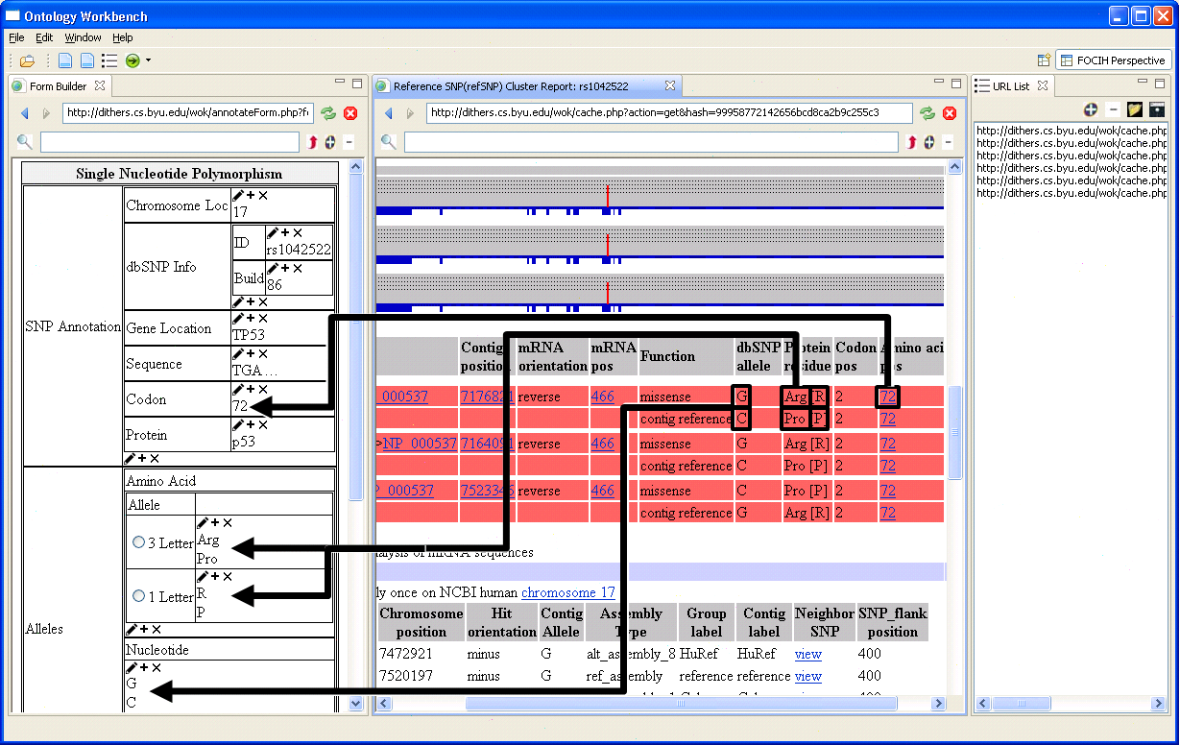
Cancer Research Study Example
Study the association of
  TP53 polymorphism and
  Lung cancer
Locate, gather, organize data from:
  Single Nucleotide Polymorphism (SNP) database
  Medical journal articles
  Medical-record database
Analyze
  Query, mine, check statistical significance, …
  Maintain provenance
Notes:
… maybe only at the end as an example of short-term … but could introduce here as an example of science … perhaps just take the pictures from the paper … then later mention is in proceedings & is an example of short-term benefit of pursuing the dream

Slide 22

Cancer Research Study Example
Study the association of
  TP53 polymorphism and
  Lung cancer
Locate, gather, organize data from:
  Single Nucleotide Polymorphism (SNP) database
  Medical journal articles
  Medical-record database
Analyze
  Query, mine, check statistical significance, …
  Maintain provenance
Notes:
… maybe only at the end as an example of short-term … but could introduce here as an example of science … perhaps just take the pictures from the paper … then later mention is in proceedings & is an example of short-term benefit of pursuing the dream

Slide 23

Cancer Research Study Example
Study the association of
  TP53 polymorphism and
  Lung cancer
Locate, gather, organize data from:
  Single Nucleotide Polymorphism (SNP) database
  Medical journal articles
  Medical-record database
Analyze
  Query, mine, check statistical significance, …
  Maintain provenance
Notes:
… maybe only at the end as an example of short-term … but could introduce here as an example of science … perhaps just take the pictures from the paper … then later mention is in proceedings & is an example of short-term benefit of pursuing the dream

Slide 24
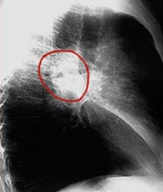
Cancer Research Study Example
Study the association of
  TP53 polymorphism and
  Lung cancer
Locate, gather, organize data from:
  Single Nucleotide Polymorphism (SNP) database
  Medical journal articles
  Medical-record database
Analyze
  Query, mine, check statistical significance, …
  Maintain provenance
Notes:
… maybe only at the end as an example of short-term … but could introduce here as an example of science … perhaps just take the pictures from the paper … then later mention is in proceedings & is an example of short-term benefit of pursuing the dream

Slide 25
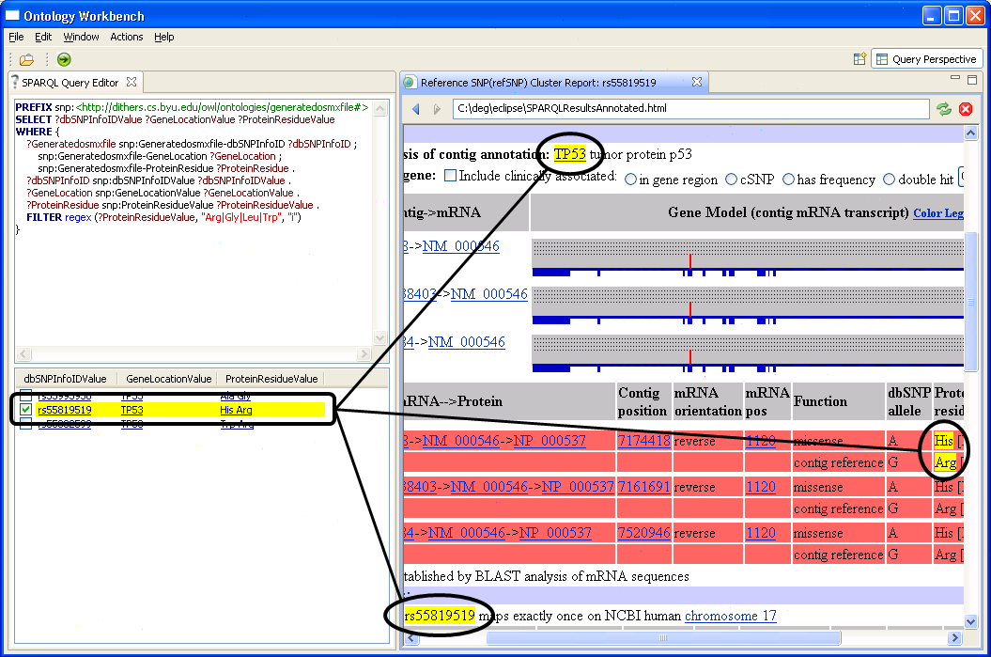
Cancer Research Study Example
Study the association of
  TP53 polymorphism and
  Lung cancer
Locate, gather, organize data from:
  Single Nucleotide Polymorphism (SNP) database
  Medical journal articles
  Medical-record database
Analyze
  Query, mine, check statistical significance, …
  Maintain provenance
Notes:
… maybe only at the end as an example of short-term … but could introduce here as an example of science … perhaps just take the pictures from the paper … then later mention is in proceedings & is an example of short-term benefit of pursuing the dream

Slide 26
Cancer Research Study Example
Study the association of
  TP53 polymorphism and
  Lung cancer
Locate, gather, organize data from:
  Single Nucleotide Polymorphism (SNP) database
  Medical journal articles
  Medical-record database
Analyze
  Query, mine, check statistical significance, …
  Maintain provenance
Notes:
… maybe only at the end as an example of short-term … but could introduce here as an example of science … perhaps just take the pictures from the paper … then later mention is in proceedings & is an example of short-term benefit of pursuing the dream

Slide 27
How to Make ACM-L Work
Formalize
Automate
  Construct both metadata and content
  Learn and dynamically adjust
Analyze
  Apply analysis tools including “what-if” scenarios
  Monitor changing situations
Notes:
As I present this, refer back to the Medical Example: (1) Formalize in the ontology sense, (2) construction automation, (3) analysis and hypothesis testing, (4) add facts and meta-information, (5) continued hypothesis testing. The big picture of “How” – next we’ll try to fill in some details. (Formalizing, the key, is what the conceptual-modeling community does best.) FoIKS & Steve Clyde’s dissertation for formalism, information extraction work and ontology learning work for construction, ?? for analysis tools (look up or ask Christophe, perhaps after showing him what I have), “learn” and dynamically adjust are direct results of continuing construction (ABCs of learning), monitor is a continuation of applying analysis tools and “what-if”’s

Slide 28
Formalize (key to all the rest)
Formalize conceptual model
  Objects & relationships among objects
  Behavior & object interaction
  Time
Formalize conceptual-model metamodel
Formalize ways to
  Automate learning
  Predict outcomes
Notes:
Formalization is what we do as computer scientists – formalize so that machines can process.
Formalize conceptual-model metamodel to provide for dynamic adjustment of conceptual model.

Slide 29

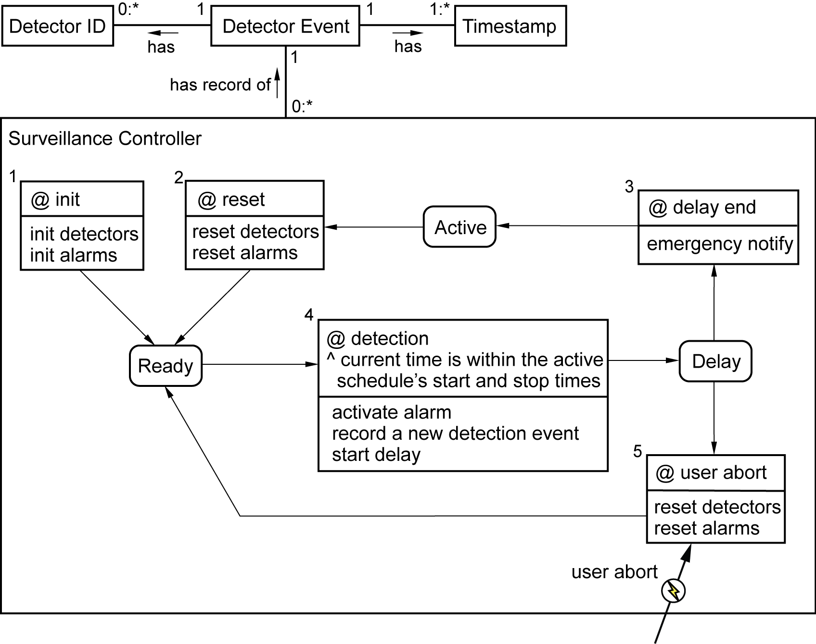
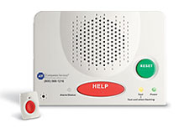

Home Security Example
[Dori 11, EKW 92, Thalheim 00]
Notes:
Will take as an example to show formalism, fact & metadata creation (extract from newspaper, threats to home ??).
Many conceptual models; many formalizations of conceptual models; many that integrate static models, behavior models, interaction models, … (see references)
Likely important: Objects, Relationships, Behavior, Interaction all modeled together in a conceptual model.
Eventual application (miniscule example wrt to the larger picture, but nonetheless an example): analyze “Detection Event” sequences.
Reference to formalisms (Dori 11, OPM: Object-Process Methodology; EKW, OSM; Thalheim 00, CoDesign)
With both model and meta-model intertwined we have a something like the “tangled hierarchy” described by (Douglas R. Hofstadter in Gödel, Escher, Bach: an Eternal Golden Braid))

Slide 30
Fact Formalization
Detection Event(x) has Detector ID(y)
Detection Event(x) has Timestamp(y)
Surveillance Controller(x) has record of Detection Event(y)
Notes:
States: predicate asserts time period in state.
Transitions: predicates assert time period inactive, enabled, committed, executing, finishing
Triggers: predicate asserts time period true
Interactions: predicate asserts the time the interaction event occurs

Slide 31
Fact Formalization
Surveillance Controller(x) in state Active(t₁, t₂)
Surveillance Controller(x) transition 5 enabled(t1, t2)
user abort(t₁)
Notes:
States: predicate asserts time period in state.
Transitions: predicates assert time period inactive, enabled, committed, executing, finishing
Triggers: predicate asserts time period true
Interactions: predicate asserts the time the interaction event occurs

Slide 32
Fact Formalization
Detection Event(x) has Detector ID(y) (t₁, t₂)
Detection Event(x) has Timestamp(y) (t₁, t₂)
Surveillance Controller(x) has record of Detection Event(y) (t₁, t₂)
Surveillance Controller(x) in state Active(t₁, t₂)
Surveillance Controller(x) transition 5 enabled(t1, t2)
user abort(t₁)
[Clyde 93]
Notes:
States: predicate asserts time period in state.
Transitions: predicates assert time period inactive, enabled, committed, executing, finishing
Triggers: predicate asserts time period true
Interactions: predicate asserts the time the interaction event occurs

Slide 33
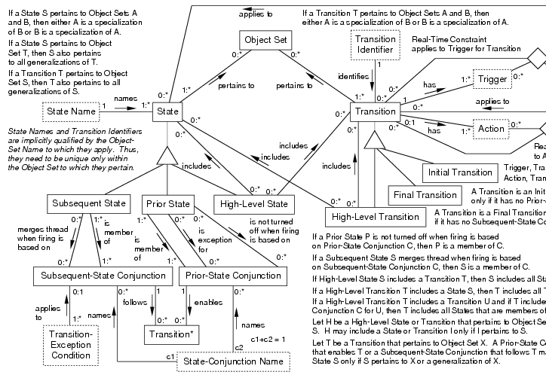
Metamodel Formalization
State Name(“Active”) names State(State₃)
State(State₃) pertains to Object Set (ObjectSet₁)
Object Set Name(“Surveillance Controller”) names Object Set(ObjectSet₁)
Notes:
Give examples of filling in x and y

Slide 34
Metamodel Formalization
State Name(“Active”) names State(State₃) (t₁, t₂)
State(State₃) pertains to Object Set (ObjectSet₁) (t₁, t₂)
Object Set Name(“Surveillance Controller”) names Object Set(ObjectSet₁) (t₁, t₂)
Notes:
Give examples of filling in x and y

Slide 35

Formalization Enables Learning
Fact learning
  Populate a conceptual model with facts
  Attach timestamps to facts
Model learning
  Populate a meta-model with facts
  Assert the existence of
    Objects
    Relationships among objects
    Object behavior
    Object interaction
[Cimiano 06]
Notes:
So, we’re left with the problem of learning and adapting and then monitoring, analyzing, and drawing conclusions.

Slide 36
Some ABC’s of Learning and Populating Ontologies
A teacher tells it (e.g., OntologyEditor)
A teacher shows it a pattern (e.g., FOCIH)
It understands structured documents (reverse engineering from RDB, OWL/RDF, and XML)
It can often understand semi-structured documents (e.g., TISP, TAT)
It knows how to piece together knowledge (e.g., TANGO)
It can read, extract facts, and assimilate knowledge (e.g., OntoES)
[ELL 11]
Notes:
Be sure to say what “it” is.
These are some ways a computer can be taught to learn and populate ontologies. (It’s too labor intensive on the part of the “teacher” if the only way an entity can know a fact is for the “teacher” to tell it.)
These ABC’s point to challenge areas. They are current challenge areas for many researchers world-wide, and are all examples of ontology learning and population. (My particular list is motivated by research we have explored, but by no means have conquered.)
FOCIH: Form-based Ontology Creation and Information Harvesting
TISP: Table Interpretation by Sibling Pages
TAT: Table Abstraction Tool
TANGO: Table Analysis for Generating Ontologies
OntoES: Ontology Extraction System

Slide 37
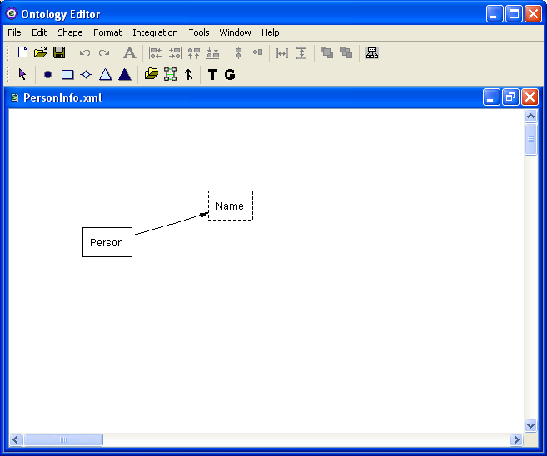
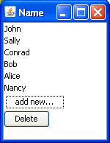
Some ABC’s of Learning and Populating Ontologies
A teacher tells it (e.g., OntologyEditor)
A teacher shows it a pattern (e.g., FOCIH)
It understands structured documents (reverse engineering from RDB, OWL/RDF, and XML)
It can often understand semi-structured documents (e.g., TISP, TAT)
It knows how to piece together knowledge (e.g., TANGO)
It can read, extract facts, and assimilate knowledge (e.g., OntoES)
[ELL 11]
Notes:
These are some ways a computer can be taught to learn and populate ontologies. (It’s too labor intensive on the part of the “teacher” if the only way an entity can know a fact is for the “teacher” to tell it.)
These ABC’s point to challenge areas. They are current challenge areas for many researchers world-wide, and are all examples of ontology learning and population. (My particular list is motivated by research we have explored, but by no means have conquered.)
FOCIH: Form-based Ontology Creation and Information Harvesting
TISP: Table Interpretation by Sibling Pages
TAT: Table Abstraction Tool
TANGO: Table Analysis for Generating Ontologies
OntoES: Ontology Extraction System

Slide 38
Some ABC’s of Learning and Populating Ontologies
A teacher tells it (e.g., OntologyEditor)
A teacher shows it a pattern (e.g., FOCIH)
It understands structured documents (reverse engineering from RDB, OWL/RDF, and XML)
It can often understand semi-structured documents (e.g., TISP, TAT)
It knows how to piece together knowledge (e.g., TANGO)
It can read, extract facts, and assimilate knowledge (e.g., OntoES)
[ELL 11]
Notes:
These are some ways a computer can be taught to learn and populate ontologies. (It’s too labor intensive on the part of the “teacher” if the only way an entity can know a fact is for the “teacher” to tell it.)
These ABC’s point to challenge areas. They are current challenge areas for many researchers world-wide, and are all examples of ontology learning and population. (My particular list is motivated by research we have explored, but by no means have conquered.)
FOCIH: Form-based Ontology Creation and Information Harvesting
TISP: Table Interpretation by Sibling Pages
TAT: Table Abstraction Tool
TANGO: Table Analysis for Generating Ontologies
OntoES: Ontology Extraction System

Slide 39
Some ABC’s of Learning and Populating Ontologies
A teacher tells it (e.g., OntologyEditor)
A teacher shows it a pattern (e.g., FOCIH)
It understands structured documents (reverse engineering from RDB, OWL/RDF, and XML)
It can often understand semi-structured documents (e.g., TISP, TAT)
It knows how to piece together knowledge (e.g., TANGO)
It can read, extract facts, and assimilate knowledge (e.g., OntoES)
[ELL 11]
Notes:
These are some ways a computer can be taught to learn and populate ontologies. (It’s too labor intensive on the part of the “teacher” if the only way an entity can know a fact is for the “teacher” to tell it.)
These ABC’s point to challenge areas. They are current challenge areas for many researchers world-wide, and are all examples of ontology learning and population. (My particular list is motivated by research we have explored, but by no means have conquered.)
FOCIH: Form-based Ontology Creation and Information Harvesting
TISP: Table Interpretation by Sibling Pages
TAT: Table Abstraction Tool
TANGO: Table Analysis for Generating Ontologies
OntoES: Ontology Extraction System

Slide 40
Some ABC’s of Learning and Populating Ontologies
A teacher tells it (e.g., OntologyEditor)
A teacher shows it a pattern (e.g., FOCIH)
It understands structured documents (reverse engineering from RDB, OWL/RDF, and XML)
It can often understand semi-structured documents (e.g., TISP, TAT)
It knows how to piece together knowledge (e.g., TANGO)
It can read, extract facts, and assimilate knowledge (e.g., OntoES)
[ELL 11]
Notes:
These are some ways a computer can be taught to learn and populate ontologies. (It’s too labor intensive on the part of the “teacher” if the only way an entity can know a fact is for the “teacher” to tell it.)
These ABC’s point to challenge areas. They are current challenge areas for many researchers world-wide, and are all examples of ontology learning and population. (My particular list is motivated by research we have explored, but by no means have conquered.)
FOCIH: Form-based Ontology Creation and Information Harvesting
TISP: Table Interpretation by Sibling Pages
TAT: Table Abstraction Tool
TANGO: Table Analysis for Generating Ontologies
OntoES: Ontology Extraction System

Slide 41
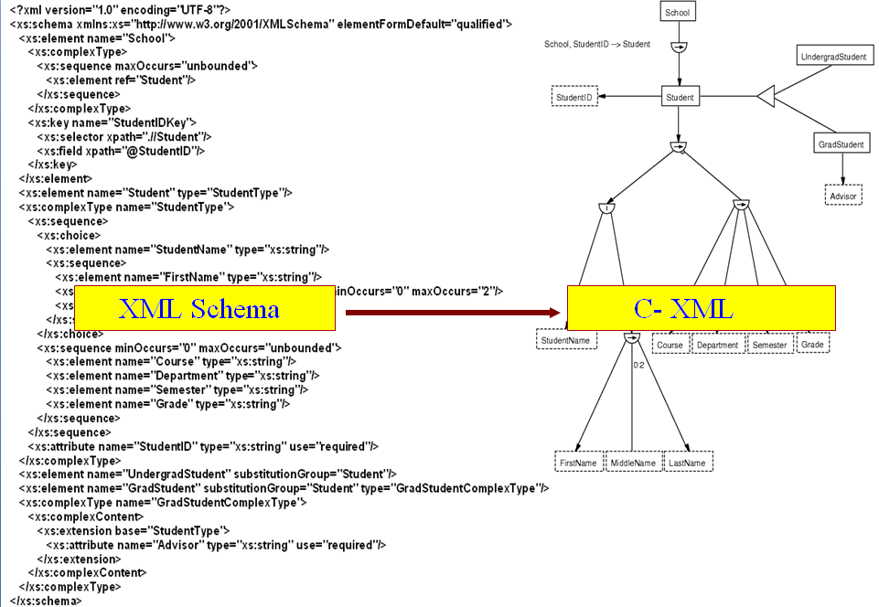
Some ABC’s of Learning and Populating Ontologies
A teacher tells it (e.g., OntologyEditor)
A teacher shows it a pattern (e.g., FOCIH)
It understands structured documents (reverse engineering from RDB, OWL/RDF, and XML)
It can often understand semi-structured documents (e.g., TISP, TAT)
It knows how to piece together knowledge (e.g., TANGO)
It can read, extract facts, and assimilate knowledge (e.g., OntoES)
[ELL 11]
Notes:
These are some ways a computer can be taught to learn and populate ontologies. (It’s too labor intensive on the part of the “teacher” if the only way an entity can know a fact is for the “teacher” to tell it.)
These ABC’s point to challenge areas. They are current challenge areas for many researchers world-wide, and are all examples of ontology learning and population. (My particular list is motivated by research we have explored, but by no means have conquered.)
FOCIH: Form-based Ontology Creation and Information Harvesting
TISP: Table Interpretation by Sibling Pages
TAT: Table Abstraction Tool
TANGO: Table Analysis for Generating Ontologies
OntoES: Ontology Extraction System

Slide 42
Some ABC’s of Learning and Populating Ontologies
A teacher tells it (e.g., OntologyEditor)
A teacher shows it a pattern (e.g., FOCIH)
It understands structured documents (reverse engineering from RDB, OWL/RDF, and XML)
It can often understand semi-structured documents (e.g., TISP, TAT)
It knows how to piece together knowledge (e.g., TANGO)
It can read, extract facts, and assimilate knowledge (e.g., OntoES)
[ELL 11]
Notes:
These are some ways a computer can be taught to learn and populate ontologies. (It’s too labor intensive on the part of the “teacher” if the only way an entity can know a fact is for the “teacher” to tell it.)
These ABC’s point to challenge areas. They are current challenge areas for many researchers world-wide, and are all examples of ontology learning and population. (My particular list is motivated by research we have explored, but by no means have conquered.)
FOCIH: Form-based Ontology Creation and Information Harvesting
TISP: Table Interpretation by Sibling Pages
TAT: Table Abstraction Tool
TANGO: Table Analysis for Generating Ontologies
OntoES: Ontology Extraction System

Slide 43
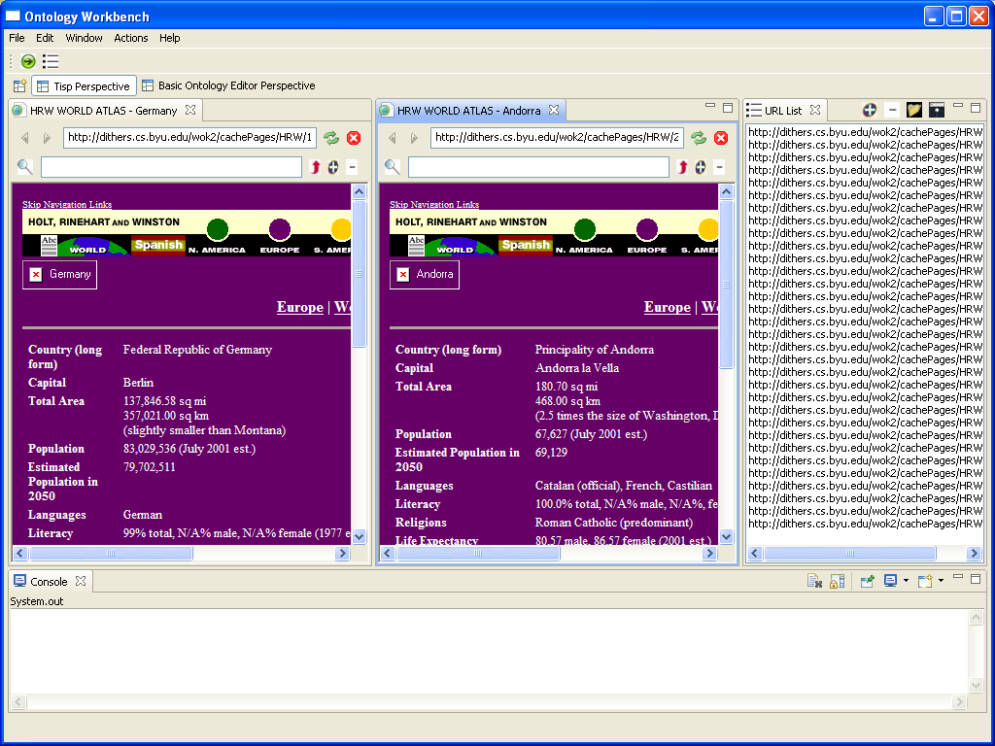
Some ABC’s of Learning and Populating Ontologies
A teacher tells it (e.g., OntologyEditor)
A teacher shows it a pattern (e.g., FOCIH)
It understands structured documents (reverse engineering from RDB, OWL/RDF, and XML)
It can often understand semi-structured documents (e.g., TISP, TAT)
It knows how to piece together knowledge (e.g., TANGO)
It can read, extract facts, and assimilate knowledge (e.g., OntoES)
[ELL 11]
Notes:
These are some ways a computer can be taught to learn and populate ontologies. (It’s too labor intensive on the part of the “teacher” if the only way an entity can know a fact is for the “teacher” to tell it.)
These ABC’s point to challenge areas. They are current challenge areas for many researchers world-wide, and are all examples of ontology learning and population. (My particular list is motivated by research we have explored, but by no means have conquered.)
FOCIH: Form-based Ontology Creation and Information Harvesting
TISP: Table Interpretation by Sibling Pages
TAT: Table Abstraction Tool
TANGO: Table Analysis for Generating Ontologies
OntoES: Ontology Extraction System

Slide 44
Some ABC’s of Learning and Populating Ontologies
A teacher tells it (e.g., OntologyEditor)
A teacher shows it a pattern (e.g., FOCIH)
It understands structured documents (reverse engineering from RDB, OWL/RDF, and XML)
It can often understand semi-structured documents (e.g., TISP, TAT)
It knows how to piece together knowledge (e.g., TANGO)
It can read, extract facts, and assimilate knowledge (e.g., OntoES)
[ELL 11]
Notes:
These are some ways a computer can be taught to learn and populate ontologies. (It’s too labor intensive on the part of the “teacher” if the only way an entity can know a fact is for the “teacher” to tell it.)
These ABC’s point to challenge areas. They are current challenge areas for many researchers world-wide, and are all examples of ontology learning and population. (My particular list is motivated by research we have explored, but by no means have conquered.)
FOCIH: Form-based Ontology Creation and Information Harvesting
TISP: Table Interpretation by Sibling Pages
TAT: Table Abstraction Tool
TANGO: Table Analysis for Generating Ontologies
OntoES: Ontology Extraction System

Slide 45
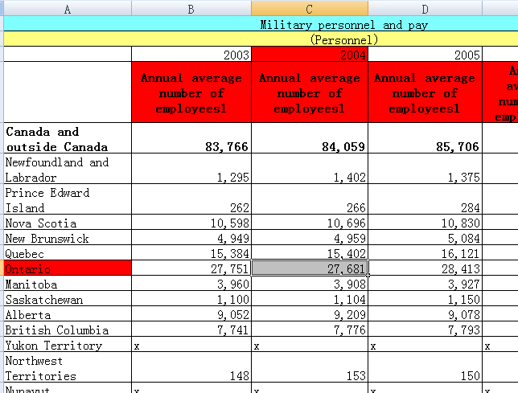
Some ABC’s of Learning and Populating Ontologies
A teacher tells it (e.g., OntologyEditor)
A teacher shows it a pattern (e.g., FOCIH)
It understands structured documents (reverse engineering from RDB, OWL/RDF, and XML)
It can often understand semi-structured documents (e.g., TISP, TAT)
It knows how to piece together knowledge (e.g., TANGO)
It can read, extract facts, and assimilate knowledge (e.g., OntoES)
[ELL 11]
Notes:
These are some ways a computer can be taught to learn and populate ontologies. (It’s too labor intensive on the part of the “teacher” if the only way an entity can know a fact is for the “teacher” to tell it.)
These ABC’s point to challenge areas. They are current challenge areas for many researchers world-wide, and are all examples of ontology learning and population. (My particular list is motivated by research we have explored, but by no means have conquered.)
FOCIH: Form-based Ontology Creation and Information Harvesting
TISP: Table Interpretation by Sibling Pages
TAT: Table Abstraction Tool
TANGO: Table Analysis for Generating Ontologies
OntoES: Ontology Extraction System

Slide 46
Some ABC’s of Learning and Populating Ontologies
A teacher tells it (e.g., OntologyEditor)
A teacher shows it a pattern (e.g., FOCIH)
It understands structured documents (reverse engineering from RDB, OWL/RDF, and XML)
It can often understand semi-structured documents (e.g., TISP, TAT)
It knows how to piece together knowledge (e.g., TANGO)
It can read, extract facts, and assimilate knowledge (e.g., OntoES)
[ELL 11]
Notes:
These are some ways a computer can be taught to learn and populate ontologies. (It’s too labor intensive on the part of the “teacher” if the only way an entity can know a fact is for the “teacher” to tell it.)
These ABC’s point to challenge areas. They are current challenge areas for many researchers world-wide, and are all examples of ontology learning and population. (My particular list is motivated by research we have explored, but by no means have conquered.)
FOCIH: Form-based Ontology Creation and Information Harvesting
TISP: Table Interpretation by Sibling Pages
TAT: Table Abstraction Tool
TANGO: Table Analysis for Generating Ontologies
OntoES: Ontology Extraction System

Slide 47
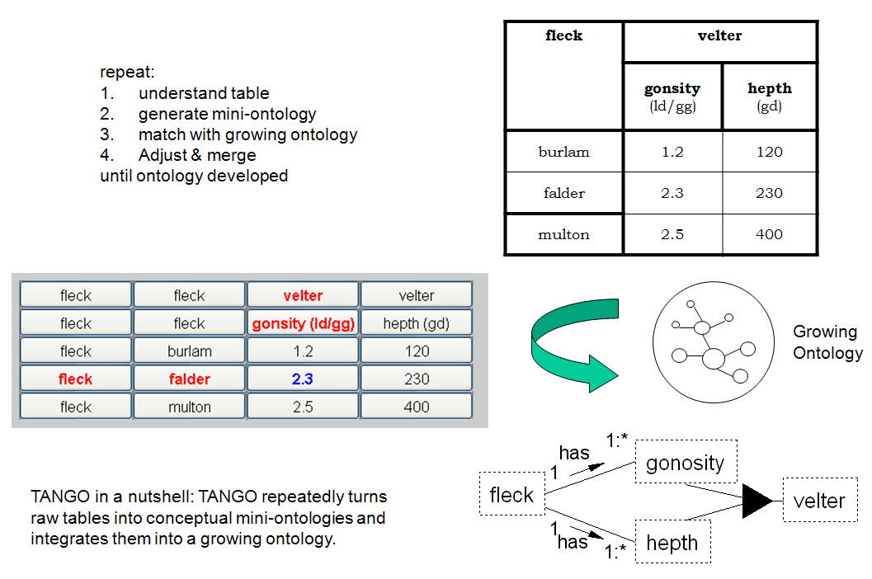
Some ABC’s of Learning and Populating Ontologies
A teacher tells it (e.g., OntologyEditor)
A teacher shows it a pattern (e.g., FOCIH)
It understands structured documents (reverse engineering from RDB, OWL/RDF, and XML)
It can often understand semi-structured documents (e.g., TISP, TAT)
It knows how to piece together knowledge (e.g., TANGO)
It can read, extract facts, and assimilate knowledge (e.g., OntoES)
[ELL 11]
Notes:
These are some ways a computer can be taught to learn and populate ontologies. (It’s too labor intensive on the part of the “teacher” if the only way an entity can know a fact is for the “teacher” to tell it.)
These ABC’s point to challenge areas. They are current challenge areas for many researchers world-wide, and are all examples of ontology learning and population. (My particular list is motivated by research we have explored, but by no means have conquered.)
FOCIH: Form-based Ontology Creation and Information Harvesting
TISP: Table Interpretation by Sibling Pages
TAT: Table Abstraction Tool
TANGO: Table Analysis for Generating Ontologies
OntoES: Ontology Extraction System

Slide 48
Some ABC’s of Learning and Populating Ontologies
A teacher tells it (e.g., OntologyEditor)
A teacher shows it a pattern (e.g., FOCIH)
It understands structured documents (reverse engineering from RDB, OWL/RDF, and XML)
It can often understand semi-structured documents (e.g., TISP, TAT)
It knows how to piece together knowledge (e.g., TANGO)
It can read, extract facts, and assimilate knowledge (e.g., OntoES)
[ELL 11]
Notes:
These are some ways a computer can be taught to learn and populate ontologies. (It’s too labor intensive on the part of the “teacher” if the only way an entity can know a fact is for the “teacher” to tell it.)
These ABC’s point to challenge areas. They are current challenge areas for many researchers world-wide, and are all examples of ontology learning and population. (My particular list is motivated by research we have explored, but by no means have conquered.)
FOCIH: Form-based Ontology Creation and Information Harvesting
TISP: Table Interpretation by Sibling Pages
TAT: Table Abstraction Tool
TANGO: Table Analysis for Generating Ontologies
OntoES: Ontology Extraction System

Slide 49
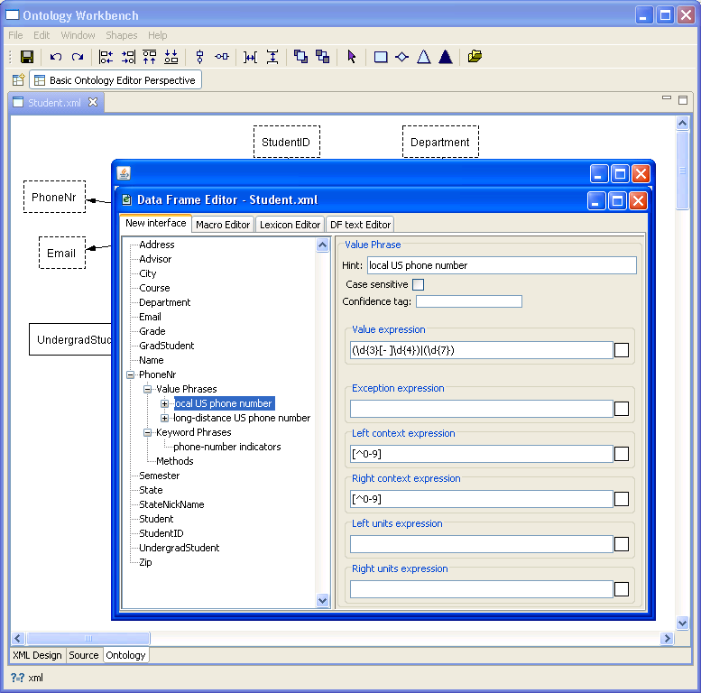
Some ABC’s of Learning and Populating Ontologies
A teacher tells it (e.g., OntologyEditor)
A teacher shows it a pattern (e.g., FOCIH)
It understands structured documents (reverse engineering from RDB, OWL/RDF, and XML)
It can often understand semi-structured documents (e.g., TISP, TAT)
It knows how to piece together knowledge (e.g., TANGO)
It can read, extract facts, and assimilate knowledge (e.g., OntoES)
[ELL 11]
Notes:
These are some ways a computer can be taught to learn and populate ontologies. (It’s too labor intensive on the part of the “teacher” if the only way an entity can know a fact is for the “teacher” to tell it.)
These ABC’s point to challenge areas. They are current challenge areas for many researchers world-wide, and are all examples of ontology learning and population. (My particular list is motivated by research we have explored, but by no means have conquered.)
FOCIH: Form-based Ontology Creation and Information Harvesting
TISP: Table Interpretation by Sibling Pages
TAT: Table Abstraction Tool
TANGO: Table Analysis for Generating Ontologies
OntoES: Ontology Extraction System

Slide 50
Some ABC’s of Learning and Populating Ontologies
A teacher tells it (e.g., OntologyEditor)
A teacher shows it a pattern (e.g., FOCIH)
It understands structured documents (reverse engineering from RDB, OWL/RDF, and XML)
It can often understand semi-structured documents (e.g., TISP, TAT)
It knows how to piece together knowledge (e.g., TANGO)
It can read, extract facts, and assimilate knowledge (e.g., OntoES)
[ELL 11]
Notes:
These are some ways a computer can be taught to learn and populate ontologies. (It’s too labor intensive on the part of the “teacher” if the only way an entity can know a fact is for the “teacher” to tell it.)
These ABC’s point to challenge areas. They are current challenge areas for many researchers world-wide, and are all examples of ontology learning and population. (My particular list is motivated by research we have explored, but by no means have conquered.)
FOCIH: Form-based Ontology Creation and Information Harvesting
TISP: Table Interpretation by Sibling Pages
TAT: Table Abstraction Tool
TANGO: Table Analysis for Generating Ontologies
OntoES: Ontology Extraction System

Slide 51
Formalization of Time-Stamped Populated Facts Enables Analysis
Wide open (lots of ideas from many research areas)
  Statistical Analysis
  Data Mining
  KDD
  Decision Theory
  AI Planning
  …
What-if Analysis
Situation Monitoring
Notes:
Wide open (tons of ideas – I can’t begin to list, nor do I have a good handle on this)

Slide 52
Learning, Planning, Predicting
Learning
  “A machine learns if it improves performance on some task in the presence of data.” [Mitchell, 1997]
  Does ACM-L lead to new ways to think about machine-learning?
Planning
  Can we automate planning for ACM-L? [GNT 04]
  Particularly, can we automate planning in the face of uncertainty? [Bryce 07]
Predicting
  Are events such as earthquakes predictable? [Kagan 97]
  Can we automate learning to predict?
Notes:
The opportunity for machine learning to predict future events is elusive, but is within sight (based on formalization, ontology learning and population, and analysis).
Can we use machine-learning techniques to adjust models as well as the content of models?
Bryce: Planning in the face of uncertainty: Autonomous agents commonly rely on models of their environment to predict, plan, and otherwise reason about their actions. However, the task of designing effective models is fraught with peril from either the top-down, knowledge engineering perspective, or the bottom-up machine learning approach. This talk will describe work on striking a middle-ground where agents can accept as much knowledge as given and learn the task-relevant knowledge on demand. By combining planning with incomplete knowledge and model-based reinforcement learning, agents can exploit the knowledge given and identify learning goals that can be achieved by designing experiments or querying human domain experts.

Slide 53
Challenges
Short term
  Information extraction
  Automated organization & information integration
  Knowledge-bundle building
  Example: recent IARPA initiative
Long term
  “De-wizardize” ACM-L: make interesting aspects of it work
  Keep the ACM-L dream alive: work toward its realization
Notes:
Main take-home message: ACM-L provides us with some interesting research challenges; solving them is worthwhile, both in the short term & in the long term.

Slide 54
Challenges
Intelligence analysts must gather and analyze information from a wide variety of data sets that include: general references, news, technical journals and reports, geospatial data, entity databases, internal reports and more. The different terminologies, formats, data models, and contexts make it difficult to perform advanced analytic tasks across different data sets.
If there are only a small, fixed number of data sets involved in an intelligence problem, then it may be practical to map all of the data sets to a common data model and to develop specialized analytic tools tailored to the problem. However, if the problem changes over time, the data sets are large or numerous, or there are new data sets that need to be integrated with those already in use, then a new approach is required. The focus of the KDD program is to develop novel approaches that will enable the intelligence analyst to effectively derive actionable intelligence from multiple, large, disparate sources of information, to include newly available data sets previously unknown to the analyst.
The ability to quickly produce actionable intelligence from unanticipated, multiple, varied data sets require research advances in two key areas: (1) alignment of data models; and (2) advanced analytic algorithms. Making advances in these two research areas, and fully characterizing the performance of the research results using real Intelligence problems, is the focus of the IARPA Knowledge Discovery and Dissemination (KDD) Program.
Short term
  Information extraction
  Automated organization & information integration
  Knowledge-bundle building
  Example: recent IARPA initiative
Long term
  “De-wizardize” ACM-L: make interesting aspects of it work
  Keep the ACM-L dream alive: work toward its realization
Notes:
… like a black cloud hanging over us …

Slide 55
Challenges
Short term
  Information extraction
  Automated organization & information integration
  Knowledge-bundle building
  Example: recent IARPA initiative
Long term
  “De-wizardize” ACM-L: make interesting aspects work
  Keep the ACM-L dream alive: work toward its realization

Slide 56
Selected References
Formalized Active Conceptual Models
  S.W. Clyde, An Initial Theoretical Foundation for object-Oriented Systems Analysis and Design, PhD Dissertation, 1993.
  D. Dori, Object-Process Methodology for Structure-Behavior Co-Design, Chapter 7 of The Handbook of Conceptual Modeling: Theory, Practice, and Research Challenges, Springer, 2011.
  D.W. Embley, B.D. Kurtz, and S.N. Woodfield, Object-oriented Systems Analysis: A Model-Driven Approach, Prentice Hall, 1992.
  B. Thalheim. Entity-Relationship Modeling: Foundations of Database Technology. Springer, 2000.
Learning Facts and Conceptualizations
  P. Cimiano, Ontology Learning and Population from Text: Algorithms, Evaluation and Applications, Springer, New York, New York, 2006.
  D.W. Embley, S.W. Liddle, and D.W. Lonsdale, Conceptual Modeling Foundations for a Web of Knowledge, Chapter 15 of The Handbook of Conceptual Modeling: Theory, Practice, and Research Challenges, Springer, 2011.
Analysis, Decision Making, Planning, Predictive Learning, …
  D. Bryce, Scalable Planning Under Uncertainty, PhD Dissertation, May 2007.
  M. Ghallab, D. Nau, P. Traverso, Automated Planning: Theory and Practice, Morgan Kaufmann Publishers, 2004.
  Y.Y. Kagan, Are Earthquakes Predictable?, Geophysical Journal International, 131(3), 1997.
  T. Mitchell, Machine Learning, McGraw Hill, 1997.
Notes:
Bryce: 2009 ICAPS outstanding dissertation award (ICAPS: International Conference on Automatid Planning and Scheduling)
Mitchell: Machine Learning is the study of computer algorithms that improve automatically through experience.

