Slide 1
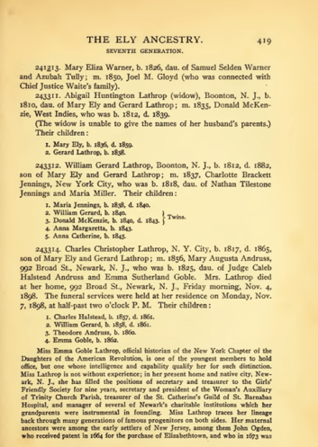
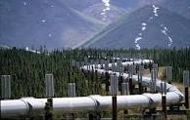
Research in the Acquisition Pipeline
David W. Embley
Christopher Almquist, Bill Barrett, Alan Cannaday, Robert Clawson, Jake Gehring, Doug Kennard, Tae Woo Kim, Steve Liddle, Peter Lindes, Deryle Lonsdale, Thomas Packer, Joseph Park, Pat Schone, Scott Woodfield

Slide 2
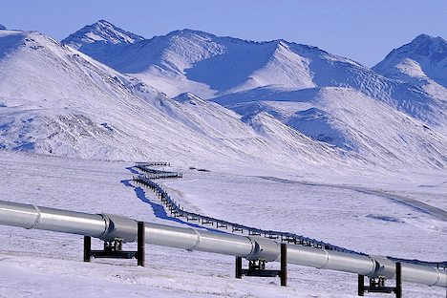
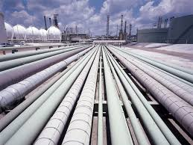
Acquisition Pipeline
Strategic Planning
Field Negotiations
Field Capture
HQ Image & Metadata Ingest
Image Auditing
Cataloging
Collection Treatment
Waypointing
Book Scanning
Oral History Recording
Indexing
Post-Processing/Quality Control
Load to Search Engine, Publish
Notes:
Strategic Planning (what records are there, which do we want)
Collection Treatment (how shall we publish these records: treatment, schedule, etc.)
Waypointing (creating browse structures for unindexed images)

Slide 3
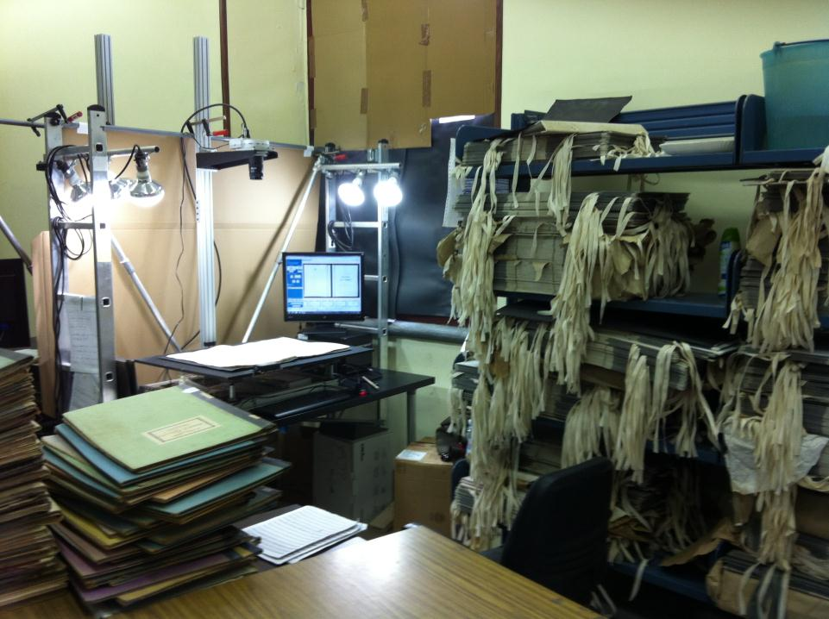
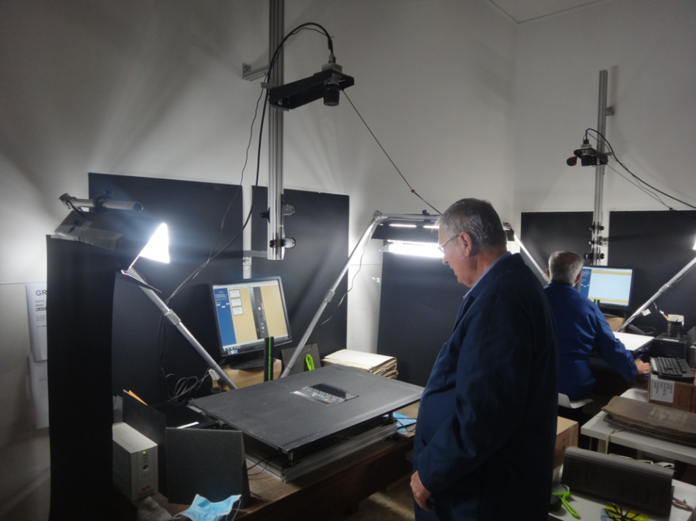
Field Capture: Blur Detection (Alan Cannaday)

Slide 4
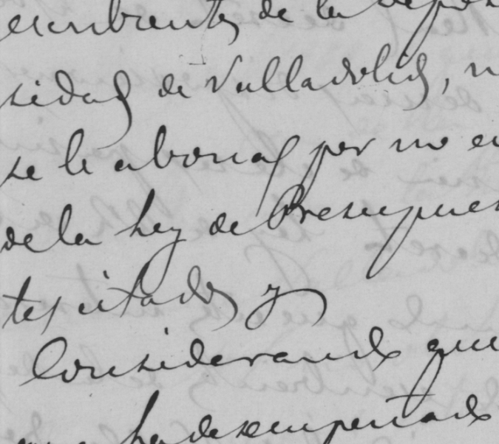
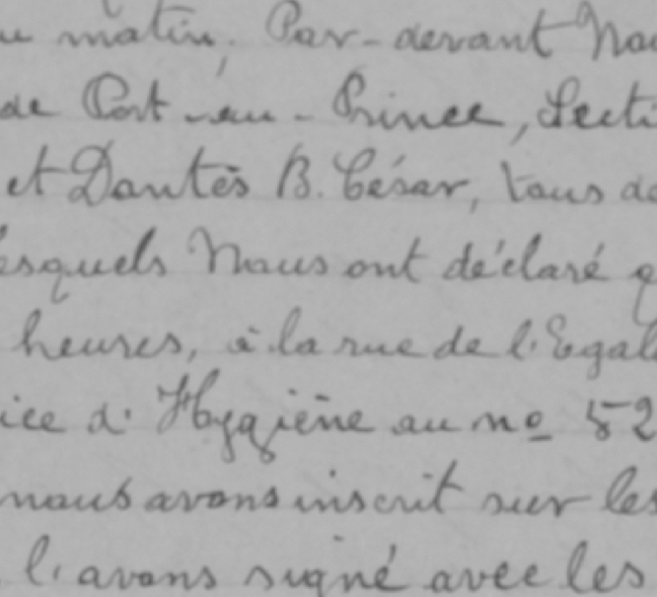
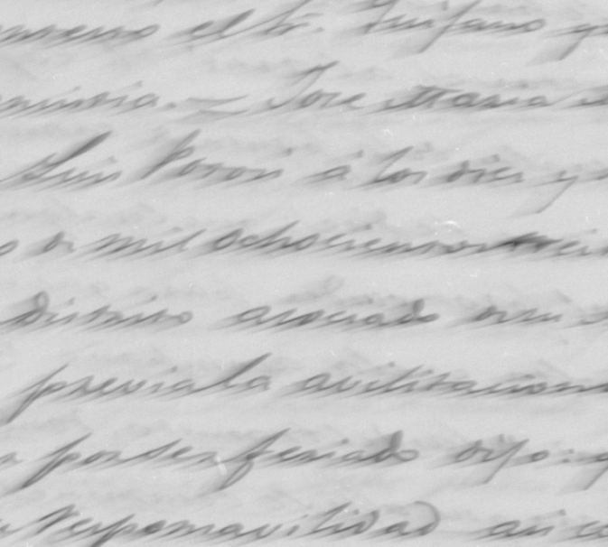
Field Capture: Blur Detection
Sharp/Focused
Out of Focus
Motion Blur

Slide 5
Field Capture: Blur Detection
Sharp/Focused
Out of Focus
Motion Blur
“More than two transitional pixels between the edge of a high contrast line and the background.”
“Transitional pixels in a single direction exceed one pixel.”

Slide 6
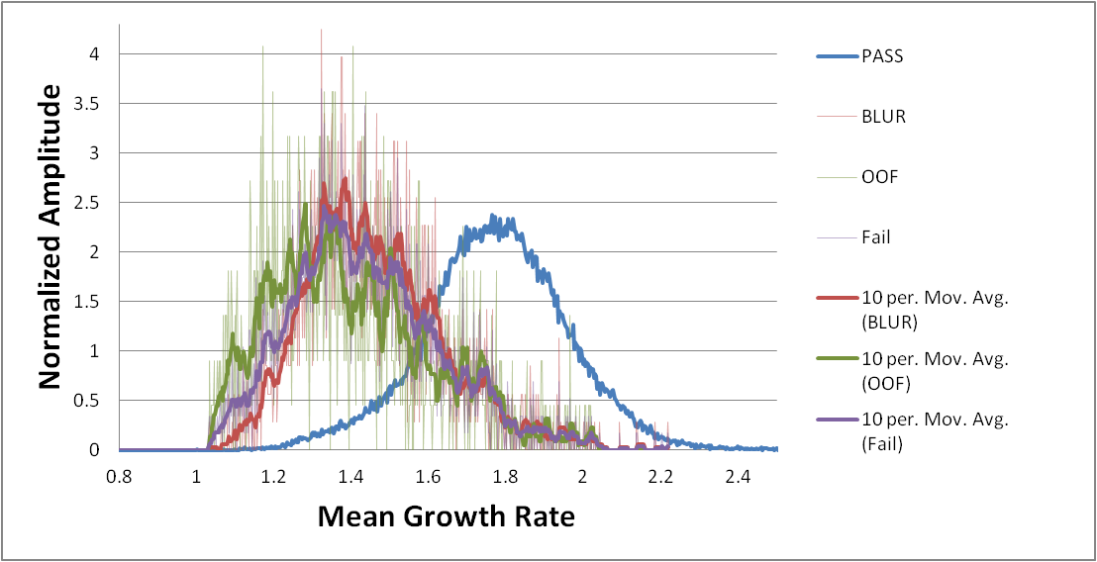
Field Capture: Blur Detection
Failed
82.0%
Passed
83.5%
Pass
Fail
(smoothed)
Blur
(smoothed)
Out of Focus
(smoothed)

Slide 7
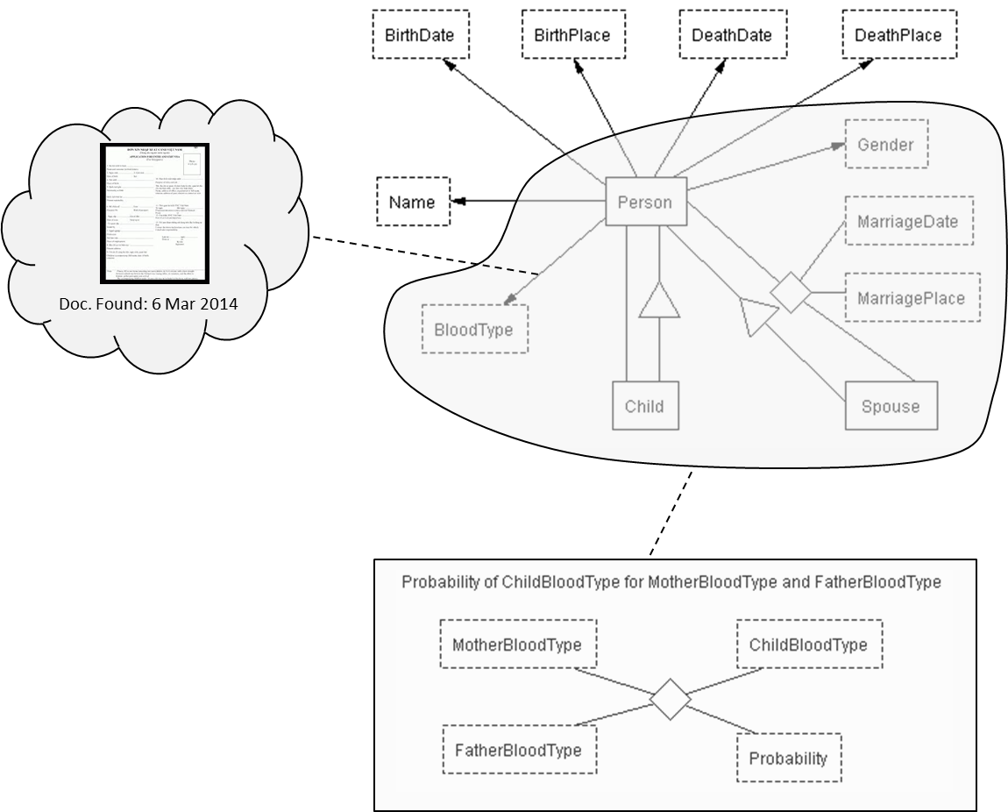
Load to Search Engine: Constraint Satisfaction (Scott Woodfield)

Slide 8
Load to Search Engine: Constraint Satisfaction (Scott Woodfield)
Existing assertions:
Blood type of father, mother, and child all A-.
New assertion:
Child’s blood type B-
Conclusions: Probability = 0.0.
Parentage wrong
One or more blood types wrong
Notes:
Wrt automatic constraint checking, the world is stuck in the mode of database system integrity constraints – must satisfy constraints. Working within those constraints causes us to create “strange” conceptualizations (e.g., model must allow a person to have two mothers, or two blood types). Working without them means that we have to write programs to check constraints. We would also like to have “soft” constraints, so we can check reasonableness (e.g., mothers have between 1 & 65? children, highly skewed to the average of 2.7? and probability of parentage given blood types) So, allow constraint violations, declare hard and soft constraints and compute certainty. Furthermore we would like to formally attach evidence to assertions so the system can formally reason with them (e.g., addition of blood type info checked against parentage constraints on load, yields a warning message, and furthermore, suggestions about what to do)

Slide 9
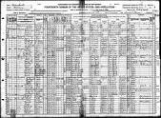
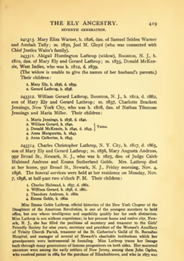
Automated “Green” Indexing
“Green”: improves with use—learns from user interaction
Intelligent Indexing
“Click” Annotator
GreenFIE-HD
Obituaries (100M+)
FROntIER
Machine Learning
Scanned Books (100K+)
ListReader
FormReader/TableReader
OntoSoar
GreenFIE-HD⁺⁺

Slide 10
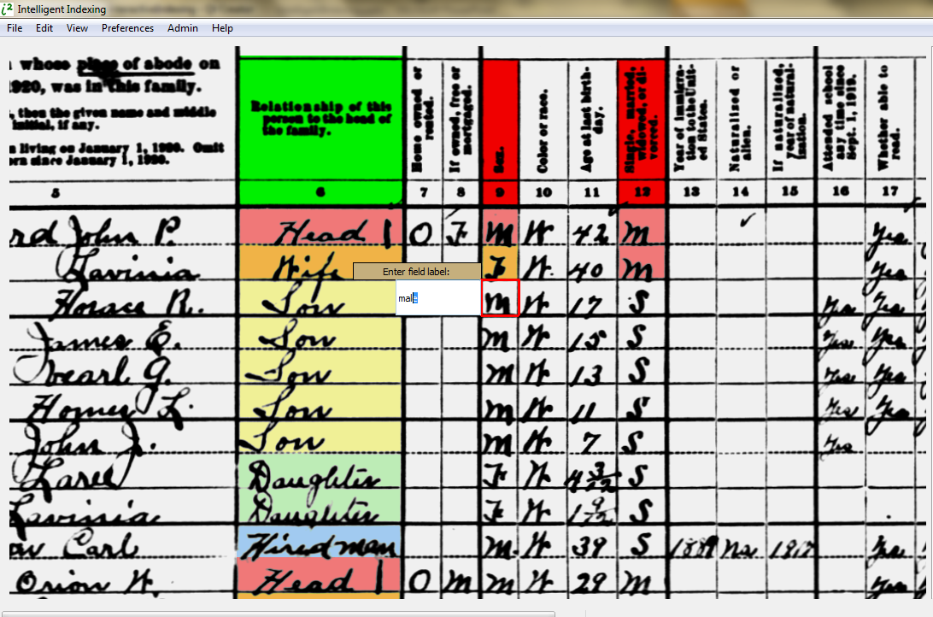
“Green” Intelligent Indexing (Robert Clawson, Doug Kennard, …, Bill Barrett)
Notes:
“Use” is use in getting actual work done – so that a user just proceeds to do work and the system watches, helps, learns, and improves.

Slide 11
“Green” Intelligent Indexing

Slide 12
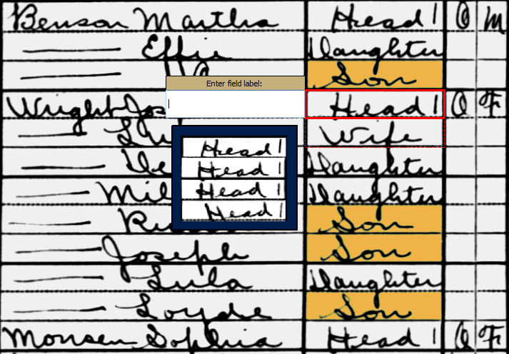
“Green” Intelligent Indexing

Slide 13
“Green” Intelligent Indexing

Slide 14
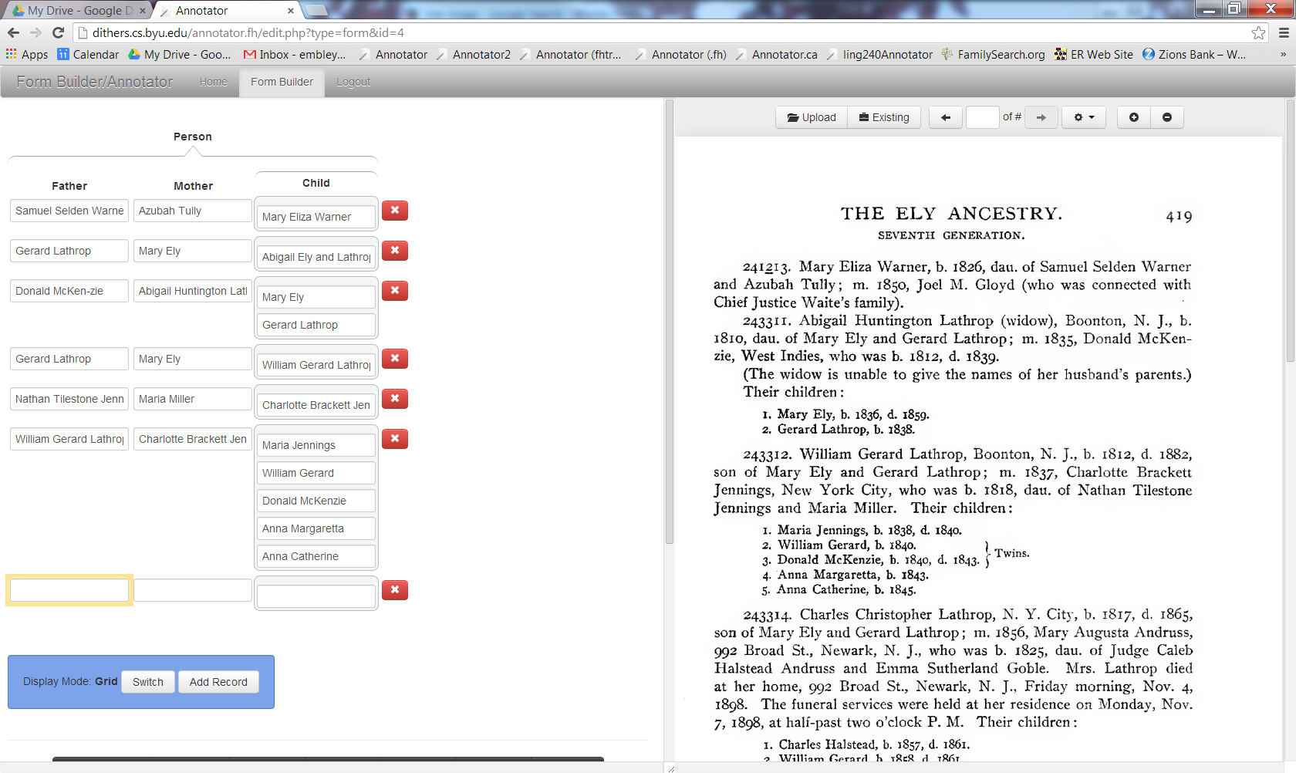
Annotator (Christopher Almquist, …, Steve Liddle)

Slide 15
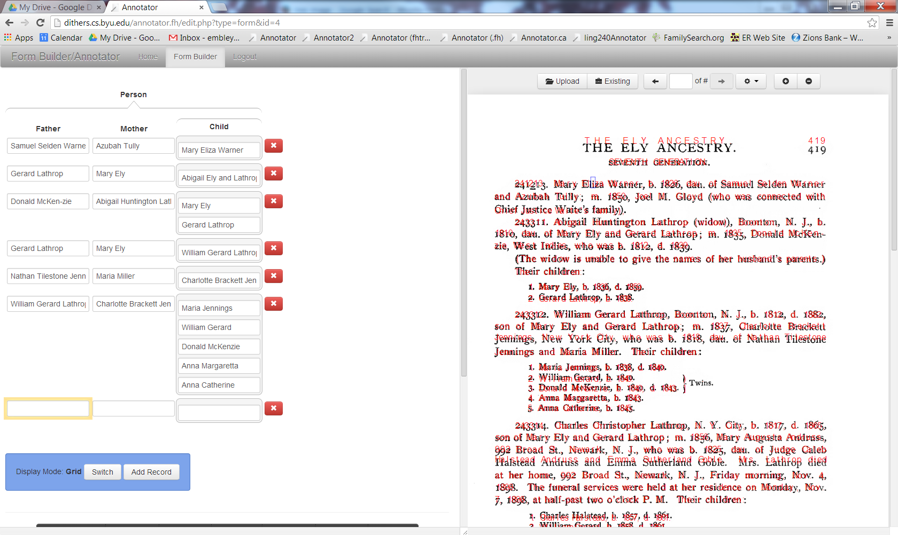
Annotator (Christopher Almquist, …, Steve Liddle)

Slide 16
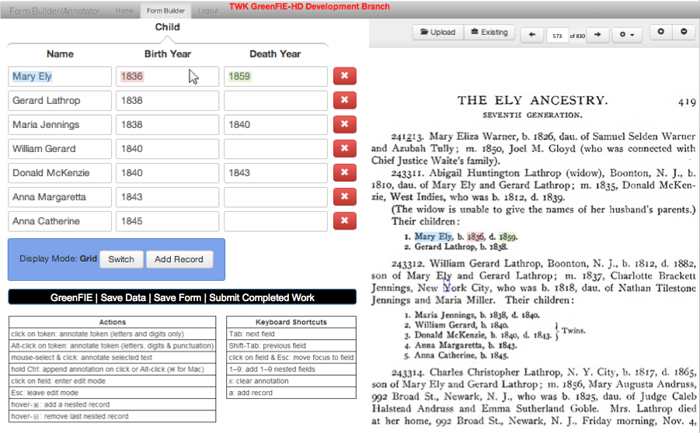
GreenFIE-HD (Tae Woo Kim)
“Green” Form-based Information Extraction for Historical Documents

Slide 17
GreenFIE-HD: Extraction Rule Creation
\d{1}\.\s([A-Z][a-z]{2,6})\s([A-Z][a-z]{4,10}),\sb\.\s(\d{4}),\sd\.\s(\d{4})\.
Notes:
So first, let me tell you how does it create rules.
When a user fills in this form, the system knows exactly where those strings are on the page. So it is trivial to create a regular-expression and adjust it so that it will be more general for the fields.
When it applies its rules, sometimes it’s wrong.

Slide 18
GreenFIE-HD: Recall Error Resolution
i860
\d{1}\.\s([A-Z][a-z]{2,8})\s([A-Z][a-z]{1,8}),\sb\.\s(\d{4})(\.|,\sd\.\s(\d{4}))
\d{1}\.\s([A-Z][a-z]{2,8})\s([A-Z][a-z]{1,8}),\sb\.\s(\d{4}|i\d{3})(\.|,\sd\.\s(\d{4}))
Notes:
And here is a example. It misses whole record because of OCR error.
A user can fix this by clicking “Add Record” button to add blank record and then annotate the missing record. Then the system adjust the rule.

Slide 19
GreenFIE-HD: Precision Error Resolution
\.\s([A-Z][a-z]{2,8})\s([A-Z][a-z]{1,8}),
\d{1}\.\s ([A-Z][a-z]{2,8})\s([A-Z][a-z]{1,8}),\sb\.\s
Notes:
Sometimes, a rule picks up something it shouldn’t. A user can delete this record by clicking this red x button. And the system makes the pattern more robust by looking for more contexts to the left and right side of pattern.

Slide 20
GreenFIE-HD: Principles
Look-ahead: automatic extraction
Look-behind: rule derivation and adjustment
“Green”: improves with use
Notes:
GreenFIE-HD is a green annotation tool that gets better with use.
It looks ahead and do automatic extraction, and
looks behind the user’s annotation to derive extraction rules and adjust them
to reduce the cost of human labor.

Slide 21
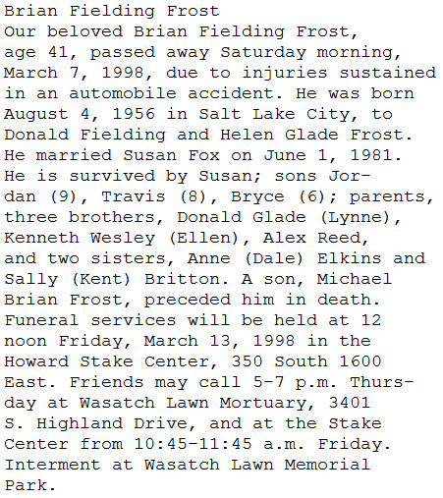
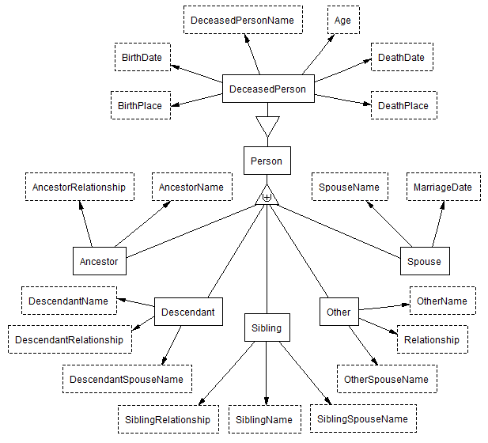
Obituaries with FROntIER (Joseph Park)
(Fact Recognizer for Ontologies with Inference and Entity Resolution)

Slide 22
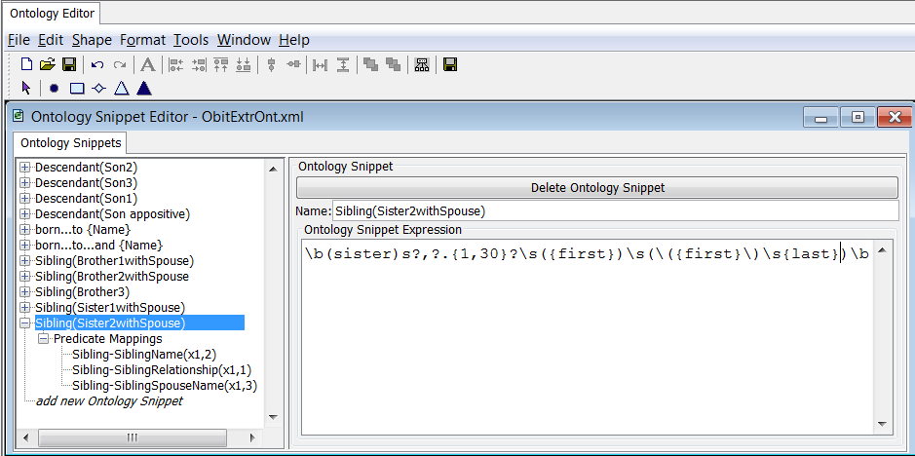
Obituaries with FROntIER

Slide 23
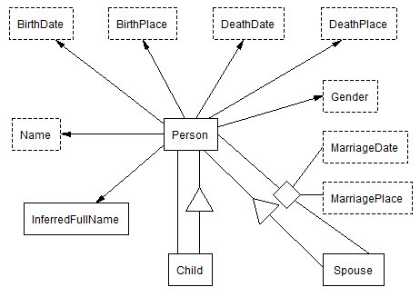
Obituaries with FROntIER

Slide 24
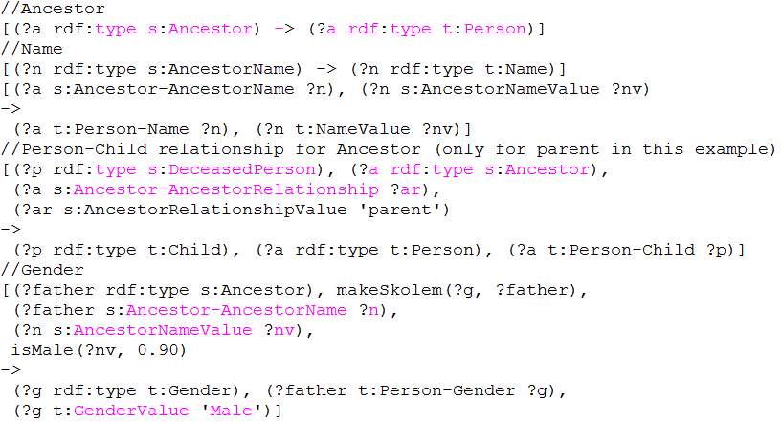
Obituaries with FROntIER

Slide 25
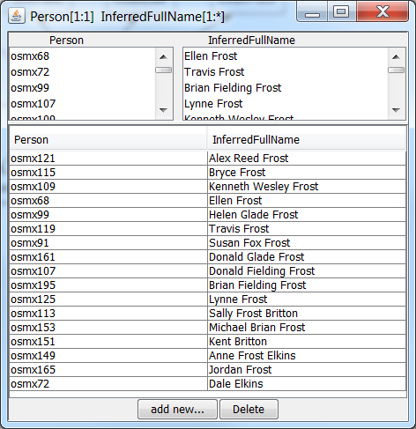
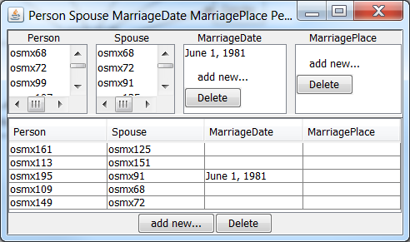
Obituaries with FROntIER

Slide 26
Obituaries with FROntIER
Jordan Frost
Travis Frost
Michael Brian Frost
Bryce Frost
Brian Fielding & Susan Fox Frost
Alex Reed Frost
Kenneth Wesley & Ellen Frost
Dale & Anne Frost Elkins
Kent & Sally Frost Britton
Donald Glade & Lynn Frost
Donald Fielding Frost & Helen Glade Frost

Slide 27
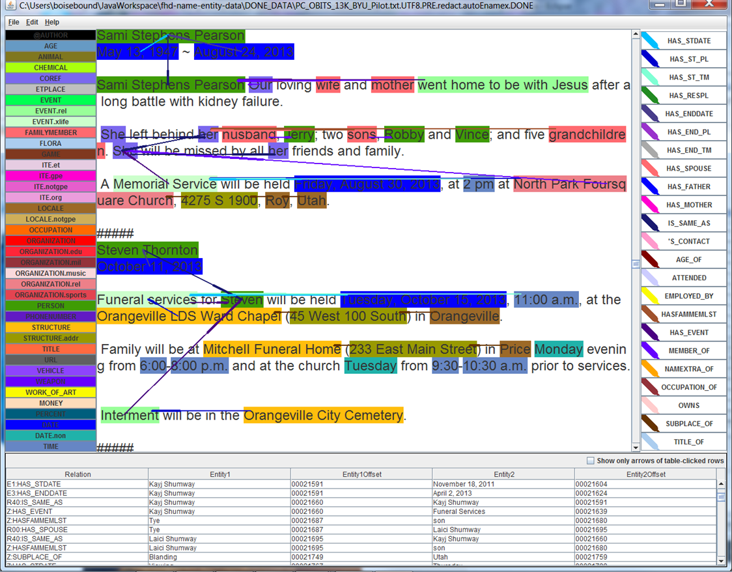
Obituaries with Machine Learning (Pat Schone)

Slide 28
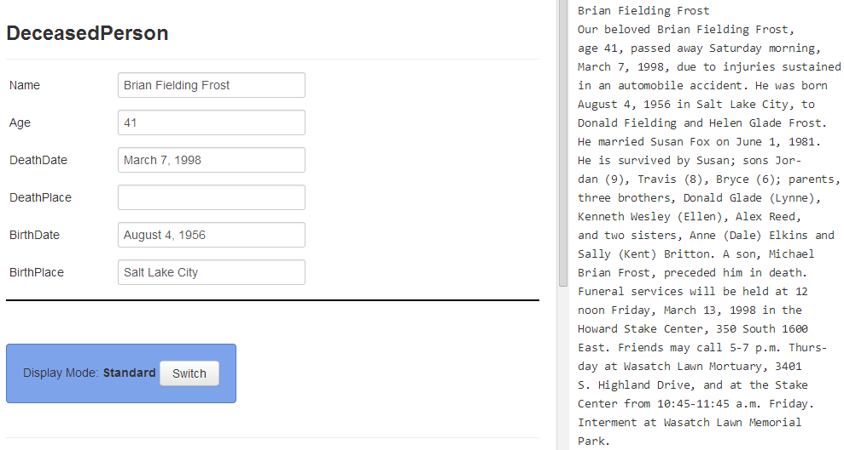
Obituaries with GreenFIE-HD

Slide 29
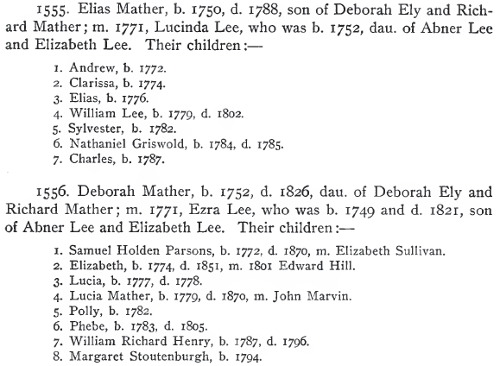
ListReader (Thomas Packer)

Slide 30
ListReader

Slide 31
ListReader

Slide 32
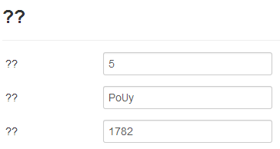
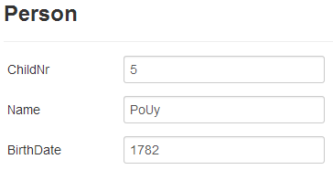
ListReader
(([\n])([\d]{1})(\.[ \n])(([A-Z]+[a-z]+|[A-Z]+[a-z]+[A-Z]+[a-z]+)))((,)([ \n])([\d]{4}))((\.)([\n]))
Label Fields

Slide 33
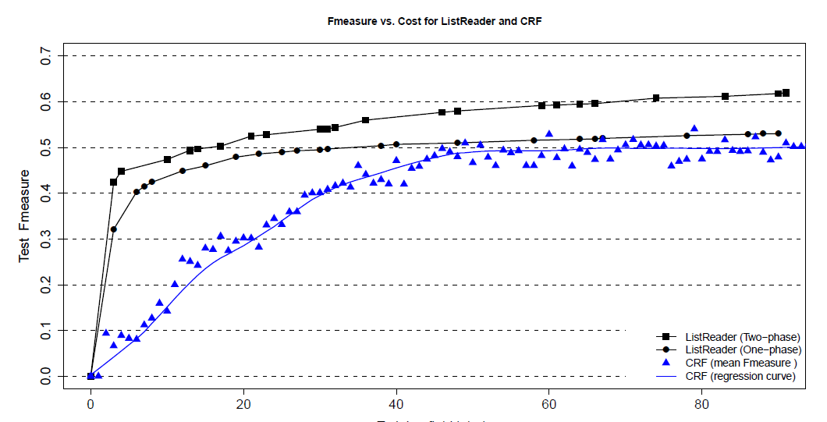
ListReader (Thomas Packer)

Slide 34
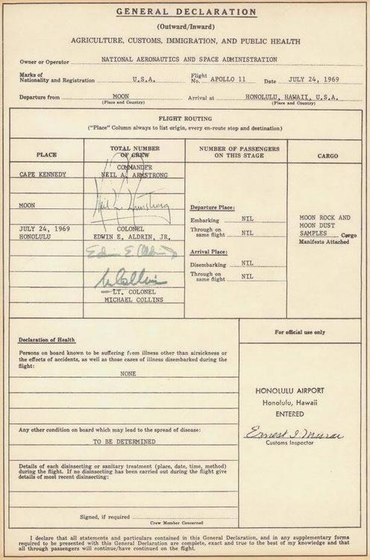
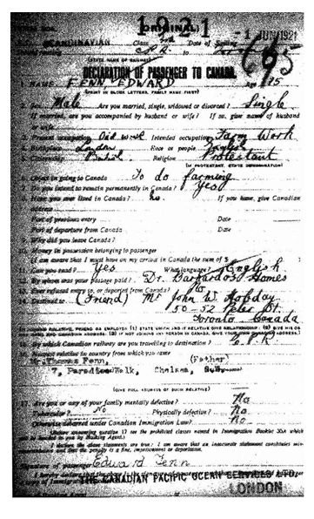
FormReader
Notes:
Research Team – evaluating “Lexmarc”?’s classification algorithm – is a form – fields are here.
Interesting for us because it’s form based – just like the Annotator. Could we OCR these documents, determine the field structure, map the field structure into the Annotator and thus build an ontology, and then automatically fill out the form? (Research challenge!!)

Slide 35
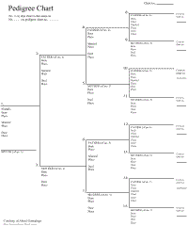
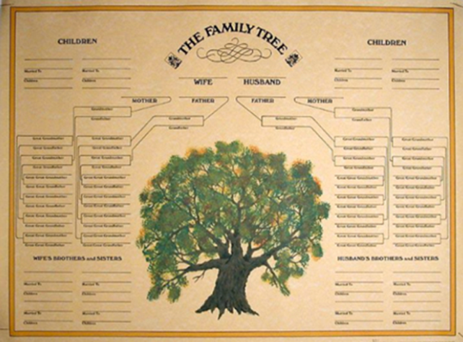
ChartReader, Table Reader, …
Jordan Frost
Travis Frost
Michael Brian Frost
Bryce Frost
Brian Fielding & Susan Fox Frost
Alex Reed Frost
Kenneth Wesley & Ellen Frost
Dale & Anne Frost Elkins
Kent & Sally Frost Britton
Donald Glade & Lynn Frost
Donald Fielding Frost & Helen Glade Frost

Slide 36
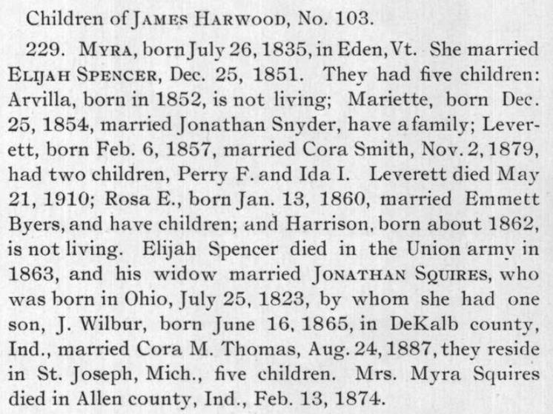
OntoSoar (Peter Lindes, Deryle Lonsdale)
Notes:
The “was” comes from recognizing the appositive construction.
Recognizers need not be regex-based. Any recognizer works, so long as it’s results can be mapped to an ontology. NLP: shows how NLP and extraction ontologies work together to find assertions and populate conceptual models.
NLP recognizers: discourse analysis.
Reemphasize: no hand-produced training data; no human engineering – for BIG DATA applications.

Slide 37
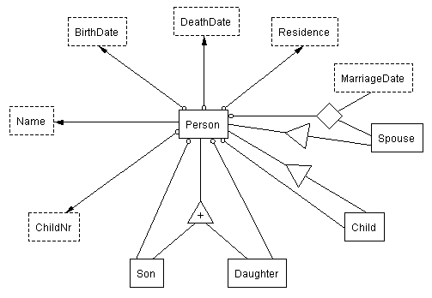
OntoSoar (Peter Lindes, Deryle Lonsdale)
+--------------Xp-------------+
+Wd+--Ss-+MVp+IN-+ |
| | | | | |
^ Mary died.v in 1853 .
died
on
Soar
in(died,N4)
1853(N4)
Mary(N2)
died(N2)
OntoES
Person(…)
Name(…)
Person(…) has Name(…)
DeathDate(…)
Person(…) died on DeathDate(…)
Person(X1)
Name(X2,"Mary")
Person(X1) has Name(X2)
DeathDate(X3,"1853")
Person(X1) died on DeathDate(X3)
Notes:
Mary died in 1853.
OntoSoar: RUNNING LG PARSER
+------------Xp-----------+
+---Wd--+--Ss-+-MVp+-IN+ |
| | | | | |
LEFT-WALL Mary died.v in 1853 .
OntoSoar: RUNNING LG SOAR LEXICAL SEMANTICS
...
in(died,N4)
1853(N4)
Mary(N2)
died(N2)
...
Person(X1)
Name(X2,"Mary")
Person(X1) has Name(X2)
DeathDate(X3,"1853")
Person(X1) died on DeathDate(X3)
My next steps will be to get it to work for as broad a range of sentences as possible and do the import and export of OSMX files.

Slide 38
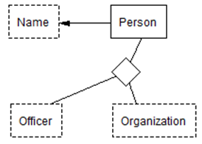
OntoSoar (Peter Lindes, Deryle Lonsdale)
Notes:
Recognizers need not be regex-based. Any recognizer works, so long as it’s results can be mapped to an ontology. NLP: shows how NLP and extraction ontologies work together to find assertions and populate conceptual models.
Soar is a cognitive architecture, created by John Laird, Allen Newell, and Paul Rosenbloom at Carnegie Mellon University, now maintained by John Laird's research group at the University of Michigan. It is both a view of what cognition is and an implementation of that view through a computer programming architecture for Artificial Intelligence (AI). Since its beginnings in 1983 and its presentation in a paper in 1987, it has been widely used by AI researchers to model different aspects of human behavior.
NLP recognizers: discourse analysis.
Reemphasize: no hand-produced training data; no human engineering – for BIG DATA applications.

Slide 39
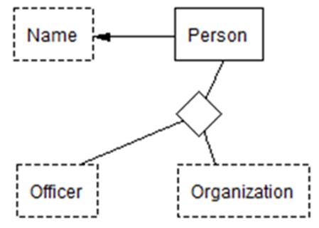
OntoSoar (Peter Lindes, Deryle Lonsdale)
+---------------------------------Xp------------------------------+
| +--------Ost--------+ +-----Js-----+ |
+-Wd-+-Ss-+ +-----A-----+--Mp---+ +---DG--+ |
| | | | | | | | |
^ Emma was.v official.a historian.n of the NYCDAR .
Soar
OntoES
“of”(x1,x2)
“NYCDAR”(x2)
“Emma”(x1)
“historian”(x1)
“official”(x1)
Name(“Emma”)
Officer(“historian”)
Organization(“NYCDAR”)
Person–Name(y1,“Emma”)
Person-Officer-Organization(y1,“official historian”,“NYCDAR”)
Notes:
The “was” comes from recognizing the appositive construction.
Recognizers need not be regex-based. Any recognizer works, so long as it’s results can be mapped to an ontology. NLP: shows how NLP and extraction ontologies work together to find assertions and populate conceptual models.
NLP recognizers: discourse analysis.
Reemphasize: no hand-produced training data; no human engineering – for BIG DATA applications.

Slide 40
GreenFIE-HD⁺⁺
FROntIER
ListReader
OntoSoar
}
GreenFIE-HD
Ever learning & improving

Slide 41
Research Wish List
Strategic Planning
Field Negotiations
Field Capture
HQ Image & Metadata Ingest
Image Auditing
Cataloging
Collection Treatment
Waypointing
Book Scanning
Oral History Recording
Indexing
Post-Processing/Quality Control
Load to Search Engine, Publish
OCR alignment with images across fonts and typesetting layouts
Automated extraction from filled-in forms, tables and ahnentafel templates
Semantic OCR error correction
Notes:
SOME TECHNICAL SOLUTIONS THAT ARE UNDERWAY, WITH ASSIGNEES
A. Ontological extraction of lineage-linked family data from prose text (Embley)
B. Handwriting recognition (Schone) <<Paused>>
C. Records Annotation (Search Team)
D. New Browser-Based Indexing Platform (Indexing Team)
E. New Version Digital Image Capture Software (DCAM Team)
F. New Development, Workflow Systems (SHIELD Team)
G. Records Hinting, Historical Collections from Family Tree (Search Team)
H. Newspaper Scanning (Field Ops)
I. Automatic Document Classification (Research Team)
J. Camera auto-focus, blur and focus elimination (Research Team)
K. More efficient routing of indexing work to volunteers (Indexing Team)
UNADDRESSED TECHNICAL PROBLEMS
A. Volunteer Data Entry of Lineage-Linked Data (i.e., register-style tables, jiapu)
B. Social / collaborative indexing user environments
C. “Genealogical” facial recognition (find faces in unindexed b/w photos based on labeled faces in other photos)
D. Workflow including registration and extraction for small form-factor mobile device document transcription (aka snippet indexing)
E. Search results clustering based on kinship networks

Slide 42
Research Wish List (Jake Gehring)
Strategic Planning
Field Negotiations
Field Capture
HQ Image & Metadata Ingest
Image Auditing
Cataloging
Collection Treatment
Waypointing
Book Scanning
Oral History Recording
Indexing
Post-Processing/Quality Control
Load to Search Engine, Publish
Facial recognition based on labeled faces in other photos
Social/collaborative indexing environments
Snippet indexing on mobile devices
Notes:
SOME TECHNICAL SOLUTIONS THAT ARE UNDERWAY, WITH ASSIGNEES
A. Ontological extraction of lineage-linked family data from prose text (Embley)
B. Handwriting recognition (Schone) <<Paused>>
C. Records Annotation (Search Team)
D. New Browser-Based Indexing Platform (Indexing Team)
E. New Version Digital Image Capture Software (DCAM Team)
F. New Development, Workflow Systems (SHIELD Team)
G. Records Hinting, Historical Collections from Family Tree (Search Team)
H. Newspaper Scanning (Field Ops)
I. Automatic Document Classification (Research Team)
J. Camera auto-focus, blur and focus elimination (Research Team)
K. More efficient routing of indexing work to volunteers (Indexing Team)
UNADDRESSED TECHNICAL PROBLEMS
A. Volunteer Data Entry of Lineage-Linked Data (i.e., register-style tables, jiapu)
B. Social / collaborative indexing user environments
C. “Genealogical” facial recognition (find faces in unindexed b/w photos based on labeled faces in other photos)
D. Workflow including registration and extraction for small form-factor mobile device document transcription (aka snippet indexing)
E. Search results clustering based on kinship networks

Slide 43
Research Wish List (Jake Gehring)
Strategic Planning
Field Negotiations
Field Capture
HQ Image & Metadata Ingest
Image Auditing
Cataloging
Collection Treatment
Waypointing
Book Scanning
Oral History Recording
Indexing
Post-Processing/Quality Control
Load to Search Engine, Publish
Extraction of lineage-linked data in register-style tables
Handwriting recognition
Search results clustering based on kinship networks
Notes:
SOME TECHNICAL SOLUTIONS THAT ARE UNDERWAY, WITH ASSIGNEES
A. Ontological extraction of lineage-linked family data from prose text (Embley)
B. Handwriting recognition (Schone) <<Paused>>
C. Records Annotation (Search Team)
D. New Browser-Based Indexing Platform (Indexing Team)
E. New Version Digital Image Capture Software (DCAM Team)
F. New Development, Workflow Systems (SHIELD Team)
G. Records Hinting, Historical Collections from Family Tree (Search Team)
H. Newspaper Scanning (Field Ops)
I. Automatic Document Classification (Research Team)
J. Camera auto-focus, blur and focus elimination (Research Team)
K. More efficient routing of indexing work to volunteers (Indexing Team)
UNADDRESSED TECHNICAL PROBLEMS
A. Volunteer Data Entry of Lineage-Linked Data (i.e., register-style tables, jiapu)
B. Social / collaborative indexing user environments
C. “Genealogical” facial recognition (find faces in unindexed b/w photos based on labeled faces in other photos)
D. Workflow including registration and extraction for small form-factor mobile device document transcription (aka snippet indexing)
E. Search results clustering based on kinship networks

Slide 44
Research Wish List (Jake Gehring)
Strategic Planning
Field Negotiations
Field Capture
HQ Image & Metadata Ingest
Image Auditing
Cataloging
Collection Treatment
Waypointing
Book Scanning
Oral History Recording
Indexing
Post-Processing/Quality Control
Load to Search Engine, Publish
Extraction of lineage-linked data from text
Newspaper scanning, zoning, article concatenation
Records hinting for historical collections
Notes:
SOME TECHNICAL SOLUTIONS THAT ARE UNDERWAY, WITH ASSIGNEES
A. Ontological extraction of lineage-linked family data from prose text (Embley)
B. Handwriting recognition (Schone) <<Paused>>
C. Records Annotation (Search Team)
D. New Browser-Based Indexing Platform (Indexing Team)
E. New Version Digital Image Capture Software (DCAM Team)
F. New Development, Workflow Systems (SHIELD Team)
G. Records Hinting, Historical Collections from Family Tree (Search Team)
H. Newspaper Scanning (Field Ops)
I. Automatic Document Classification (Research Team)
J. Camera auto-focus, blur and focus elimination (Research Team)
K. More efficient routing of indexing work to volunteers (Indexing Team)
UNADDRESSED TECHNICAL PROBLEMS
A. Volunteer Data Entry of Lineage-Linked Data (i.e., register-style tables, jiapu)
B. Social / collaborative indexing user environments
C. “Genealogical” facial recognition (find faces in unindexed b/w photos based on labeled faces in other photos)
D. Workflow including registration and extraction for small form-factor mobile device document transcription (aka snippet indexing)
E. Search results clustering based on kinship networks

Slide 45
Research Wish List (Jake Gehring)
Strategic Planning
Field Negotiations
Field Capture
HQ Image & Metadata Ingest
Image Auditing
Cataloging
Collection Treatment
Waypointing
Book Scanning
Oral History Recording
Indexing
Post-Processing/Quality Control
Load to Search Engine, Publish
Automatic document classification
Image capture software to eliminate blur and focus issues
Efficient routing of work to volunteers
Notes:
SOME TECHNICAL SOLUTIONS THAT ARE UNDERWAY, WITH ASSIGNEES
A. Ontological extraction of lineage-linked family data from prose text (Embley)
B. Handwriting recognition (Schone) <<Paused>>
C. Records Annotation (Search Team)
D. New Browser-Based Indexing Platform (Indexing Team)
E. New Version Digital Image Capture Software (DCAM Team)
F. New Development, Workflow Systems (SHIELD Team)
G. Records Hinting, Historical Collections from Family Tree (Search Team)
H. Newspaper Scanning (Field Ops)
I. Automatic Document Classification (Research Team)
J. Camera auto-focus, blur and focus elimination (Research Team)
K. More efficient routing of indexing work to volunteers (Indexing Team)
UNADDRESSED TECHNICAL PROBLEMS
A. Volunteer Data Entry of Lineage-Linked Data (i.e., register-style tables, jiapu)
B. Social / collaborative indexing user environments
C. “Genealogical” facial recognition (find faces in unindexed b/w photos based on labeled faces in other photos)
D. Workflow including registration and extraction for small form-factor mobile device document transcription (aka snippet indexing)
E. Search results clustering based on kinship networks

Slide 46
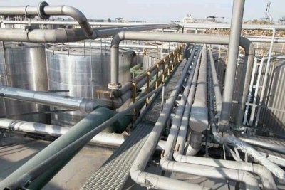
Summary
Streamline the Pipeline: Research Opportunities
“turn … the heart of the children to their fathers”

