Slide 1
Ancestry OCR Project: Data
Thomas L. Packer
2009.08.18

Slide 2
Outline
Pipeline overview
Books and Categories
Images
Data Preparation
Three data file formats
Limitations
Future Work
Notes:
Each step.

Slide 3
Pipeline
Images
Ancestry .DAT Data Files
Data Prep.
.XML
Experiment File
Extractor
Experimenter
Extractor
Extractor
Predicted Labels
Annotator
Hand Labels
Evaluator
Report
Notes:
Each step.

Slide 4
Books

Slide 5
Images
Notes:
Notice all-caps names.

Slide 6
Data Preparation
Parse several .DAT formats (thanks to Aaron).
Unified page and token objects.
Write objects to XML.
Split corpus into 3 labeled sets:
dev. training
dev. test
blind test
Hand-label names in 3 sets.
Notes:
15 points for the approach -- explain the basic problem and how the authors attacked and solved the problem;

Slide 7
.DAT Files
Genealogy-glh19239901þThe Blake family in Englandþ1þTitle pageþ254,732,612,879;THEý757,724,1359,871;BLAKEý1504,713,2189,864;FAMILYý621,1058,791,1201;INý933,1048,1811,1198;ENGLANDý1203,1779,1277,1815;BYý852,1860,1201,1917;FRANCISý1200,1860,1292,1913;Eý1311,1857,1621,1913;BLAKEý1118,1966,1171,1992;OFý1171,1964,1355,1992;BOSTONý244,2695,466,2746;Reprintedý466,2694,591,2734;fromý590,2694,678,2733;theý677,2693,796,2733;Newý796,2690,1005,2741;Englandý1004,2687,1241,2729;Historicalý1240,2686,1340,2727;andý1339,2682,1646,2734;Genealogicalý1645,2681,1844,2731;Registerý1843,2680,1925,2720;forý1923,2679,2125,2727;Januaryý2136,2674,2248,2725;1891ý1029,3462,1441,3517;BOSTONý1479,3480,1494,3512;:ý2137,3529,2149,3531;*ý2149,3517,2199,3532;Iý2206,3517,2268,3531;81ý2136,3553,2150,3560;*ý2160,3545,2234,3560;0gý737,3567,942,3611;DAVIDý942,3564,1178,3609;CLAPPý1177,3561,1248,3605;&ý1248,3560,1405,3605;SONý1417,3554,1762,3610;PRINTERSý2067,3568,2082,3584;*ý2069,3581,2086,3600;3sý2139,3579,2194,3584;EZE
…
Notes:
Syntax highlighting

Slide 8
.HTML Files
THE BLAKE FAMILY IN ENGLAND BY FRANCIS E BLAKE OF BOSTON Reprinted from the New England Historical and Genealogical Register for January 1891 BOSTON : * I 81 * 0g DAVID CLAPP & SON PRINTERS * 3s EZE ' 1 I 1891 * f 3 * - ? 33 2 I ? l * * ? 2 2 3 ' 00 Ia 1 2 2 t 221 2 2i I * t ( - ' Lt = 3a ? 22 3 1 ( 0 22 ' J '
THE BLAKE FAMILY IN ENGLAND BY FRANCIS E BLAKE OF BOSTON Reprinted from the New England Historical and Genealogical Register for January 1891 BOSTON : DAVID CLAPP & SON PRINTERS * 3s * * EZE I 0g ' 1 81 1891 I 00 Ia 1 2 2 t 221 2 * t ( - ' = Lt 3a 2i ? 22 3 0 1 ( J 22 I ' '
Notes:
With and without line parsing.

Slide 9
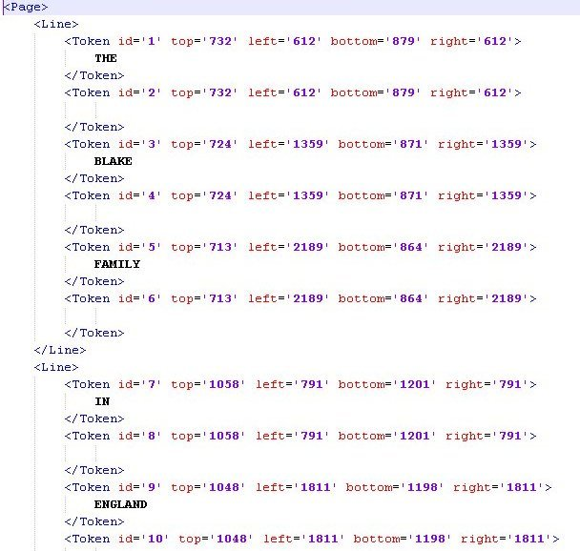
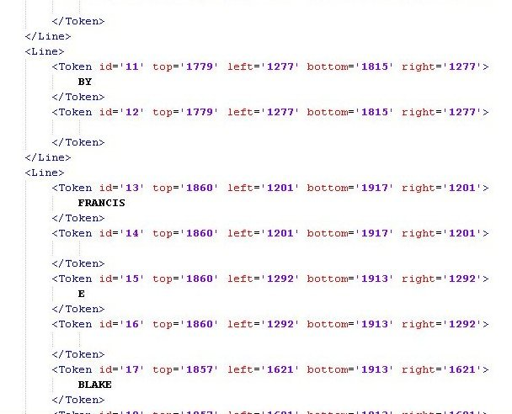
.XML Files
Notes:
Now have token IDs.

Slide 10
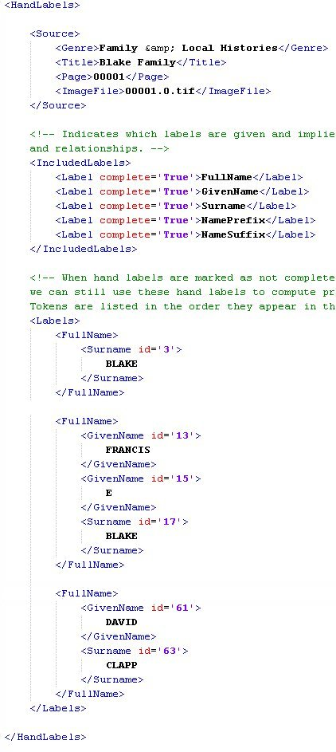
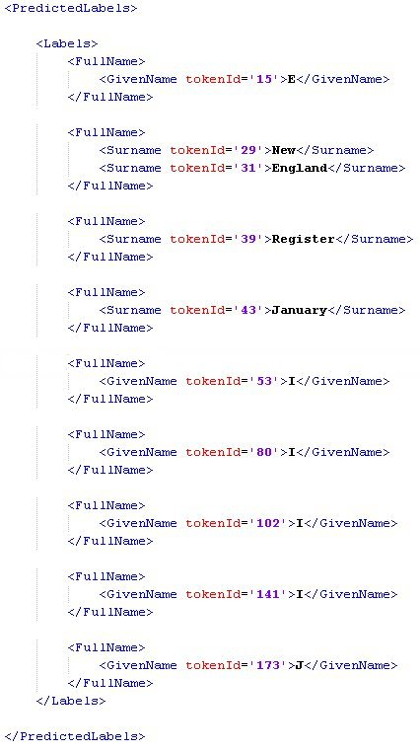
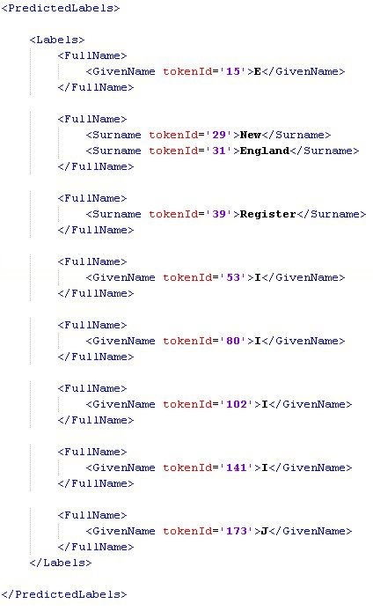
Extractions

Slide 11
Limitations
Labeled data sets may not be representative of the whole corpus.
All target entity types are not represented in the dev. test data.
Different extractors target different entity structures.
Entity labeling issues
Not seen in OCR
Ambiguous or overlapping labels (name within place)
OCR errors: correct them?

Slide 12
Future Work
Hand-label more pages.
Hand-label more entity types and relations.
Define labeling standard.
Compute IAA.
Compare OCR error rate to other metrics.
Improve line parsing and page structure inference.
Notes:
Each point.

Slide 13
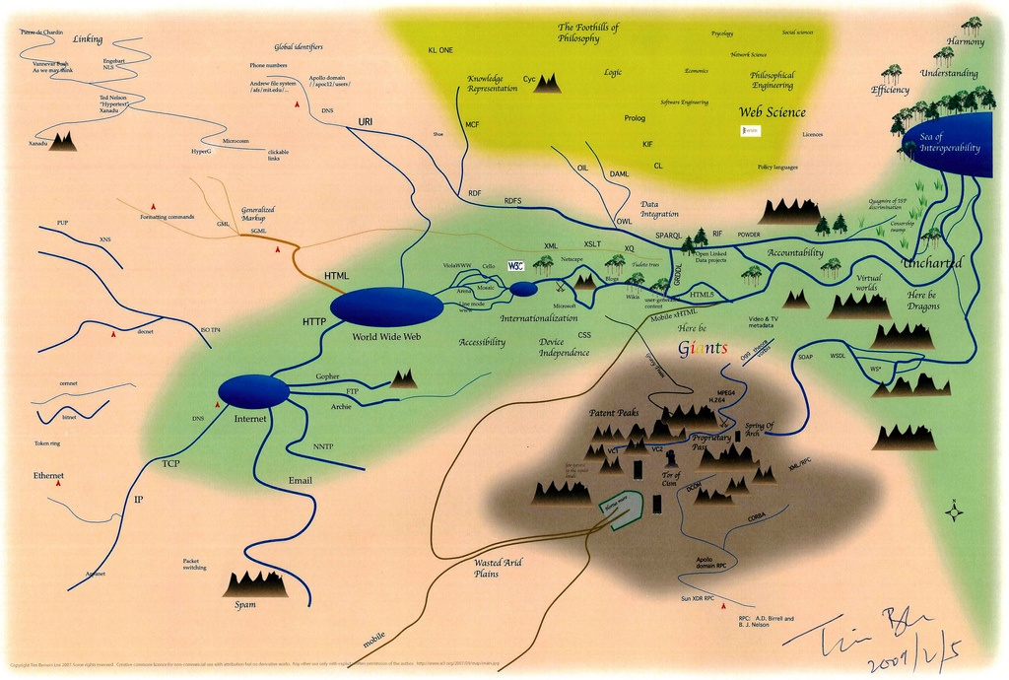
Questions
Notes:
5 points for answers to questions -- answer the questions as posed by the class.

