Slide 1
Ancestry OCR Project:
Extractors
Thomas L. Packer
2009.08.18

Slide 2
Outline
Baseline (Dictionary) Extractor and Results
Co-trained Extractor
Correct Name for “Co-trained” Extractor
Limited Results
Limitations
Future Work
Notes:
Each step.

Slide 3
Baseline (Dictionary) Extractor
Tokens
  First matching dictionary
  18,000 given names from Project Gutenberg (by Grady Ward)
  160,000 surnames from Ancestry.com Message Boards
  Hand-written list of initials, titles, stop-words, etc.
Full Name Entities
  Any contiguous sequence of labeled tokens.
Notes:
5 points for the overview -- introduce the work and state the goals and objectives of the authors;

Slide 4
Baseline Extractor (F-Measure, All Data)
Notes:
Three experiments with baseline.

Slide 5
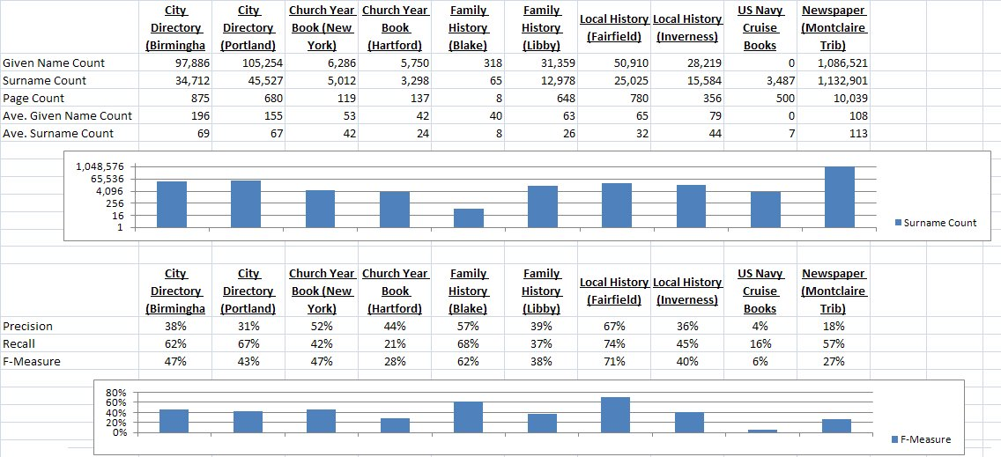
Books

Slide 6
Co-trained Extractor
Complimentary base learners/views:
  Internal model
  External model
Internal model:
  Initialized from baseline dictionaries
  Only feature: token text
External Model:
  Neighbor text (2)
  Neighbor label (2)
Notes:
5 points for the overview -- introduce the work and state the goals and objectives of the authors;

Slide 7
Co-trained Extractor
Base learner = Decision list
Iteratively trained by adding new rule or updating its probability.
Changes occur on each iteration based on token labels assigned in previous iteration (by other model).
Each rule maps a feature to a probability distribution over labels.
Probability of seeing a label on a token given the feature.
For each token, final label is a combination of both model’s decisions.
Notes:
5 points for the overview -- introduce the work and state the goals and objectives of the authors;

Slide 8
Would Tom Mitchell call it co-training?
It is co-training:
  Two base learners trained on each others’ most confident decisions.
  Each learner uses a different view of same data.
It is not co-training:
  Is each view sufficient?
  Does not start with hand-labeled training data.
  New labels based on both base learners on each iteration.
Notes:
Each step.

Slide 9
Would Tom Packer call it co-training?
I’ll call it: Tightly-coupled, Unsupervised Co-training
Only his thesis committee will care.
Notes:
Each step.

Slide 10
OCR Documents
Seed models:
  Prefix: “Mrs”, Miss”, “Mr”
  Initials: “A”, “B”, “C”, …
  Given Name: “Charles”, “Francis”, Herbert”
  Surname: “Goodrich”, Wells”
  Stopword: “Jewell”, “Graves”
Updates:
  Prefix: first token in line
  Given Name: between ‘Prefix’ and ‘Initial’
  Surname: between initial and </S>
M RS CHARLES A JEWELL
MRS FRANCIS B COOI EN
MRS P W ELILSWVORT
MRs HERBERT C ADSWVORTH
MRS HENRY E TAINTOR
MR DANIEl H WELLS
MRS ARTHUR L GOODRICH
Miss JOSEPHINE WHITE
Mss JULIA A GRAVES
Ms H B LANGDON
Miss MARY H ADAMS
Miss ELIZA F Mix
'MRs MIARY C ST )NEC
MIRS AI I ERT H PITKIN
Notes:
Green are correct from initial models.
Red are incorrect from initial models.
Orange are correct updates to initial models.

Slide 11
Baseline & Co-training (Blake)
Notes:
Blake given name.
No co-training for full names.
Even better macro-average (over 10% increase in all P, R, F).

Slide 12
Limitations
Very little time spent:
  Baseline extractor: 1 day
  Co-trained extractor: 3 days
  Overhead: 2 months
Extractor’s parameters tuned on dev test
  Need to evaluate on blind test data
Micro-averages are reported here
  Small classes dominated by large classes

Slide 13
Future Work
Continue fun competition (and beat NLP lab ☺).
Improve baseline.
True co-training:
  Use training data to initialize bootstrapping.
  Uncouple the base learners.
More features (conjunctions and coordinates).
Different base learners.
Bootstrap entities and relations (beyond tokens).
More data, distributed execution.
Theoretically sound ML foundation.
Resurrect CFG chart-parser extractor for comparison.
Trade-offs of manual book-specific rules.
Notes:
Each point.

Slide 14
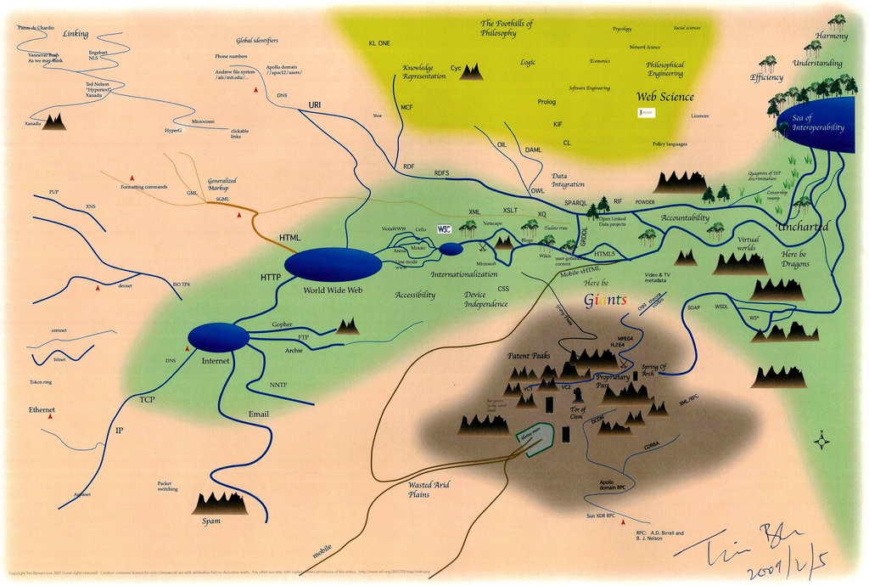
Questions
Notes:
5 points for answers to questions -- answer the questions as posed by the class.

