Slide 1
Books: Information Extraction & Curation
Senior Team Contributors
David Embley, Deryle Lonsdale, Stephen Liddle, George Nagy, Jim Norris, Scott Woodfield
Student Team Contributors
Tae Woo Kim, Peter Lindes, Thomas Packer, Joseph Park

Slide 2
Big Picture Overview
Document Preparation (scanning & establishing the input files needed to process a book)
Ontology-based Information Extraction (populating the underlying conceptual model)
Ontology-based Information Curation (preparing records for CDS and compiled genealogies for LLS and the FamilySearch-tree)
Adding compiled genealogies to the FamilySearch-tree
Notes:
… Curated: “carefully chosen and thoughtfully organized or presented”
… should be enough for two deep-dive sessions (1) doc prep & extraction (2) curation & add to tree
Document Preparation (scanning & establishing the input files needed to process a book)
Page Cleaning
OCR-error Correction
Input File Generation
Ontology-based Information Extraction (populate the underlying conceptual model)
… lexical object sets (entity recognizer, lexical analyzer, one-shot learning, ontological commitment for non-lexical object sets)
… relationship sets (parser for an unknown grammar constrained by the ontology, active learning, data-log-like semantic check)
Ontology-based Information Curation (indexed records for CDS & compiled genealogies for LLS and the FS-tree)
… inference in preparation for a deep analysis
… persona record merge
… family tree creation
Adding compiled genealogies to the FS-tree
… duplicate detection ~ persona record merge
… helps for human-in-the-loop
… process management

Slide 3
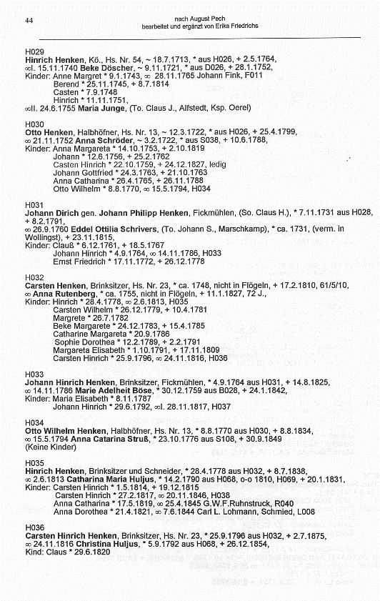
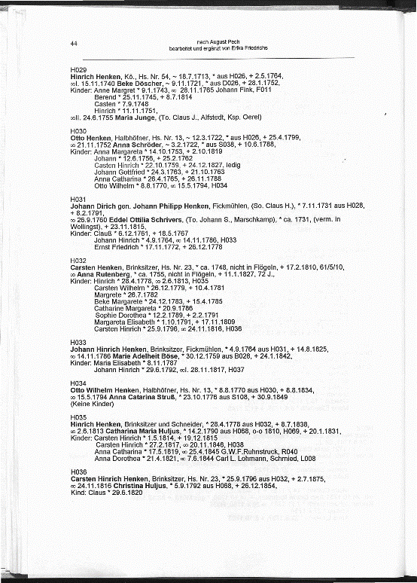
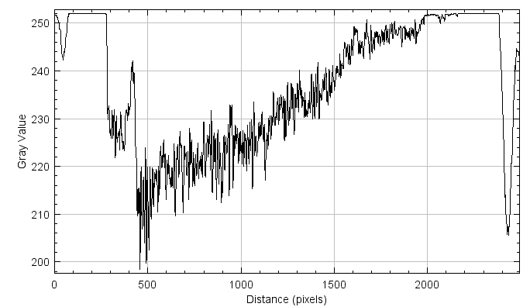
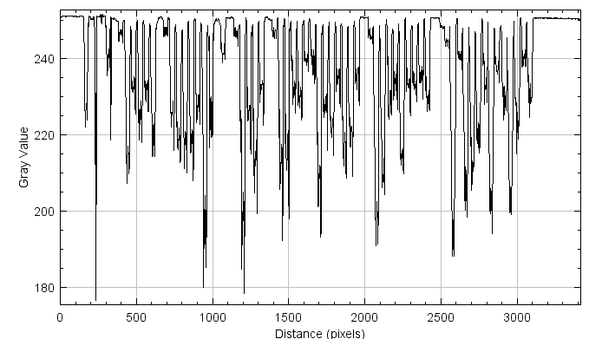
Page Cleaning

Slide 4
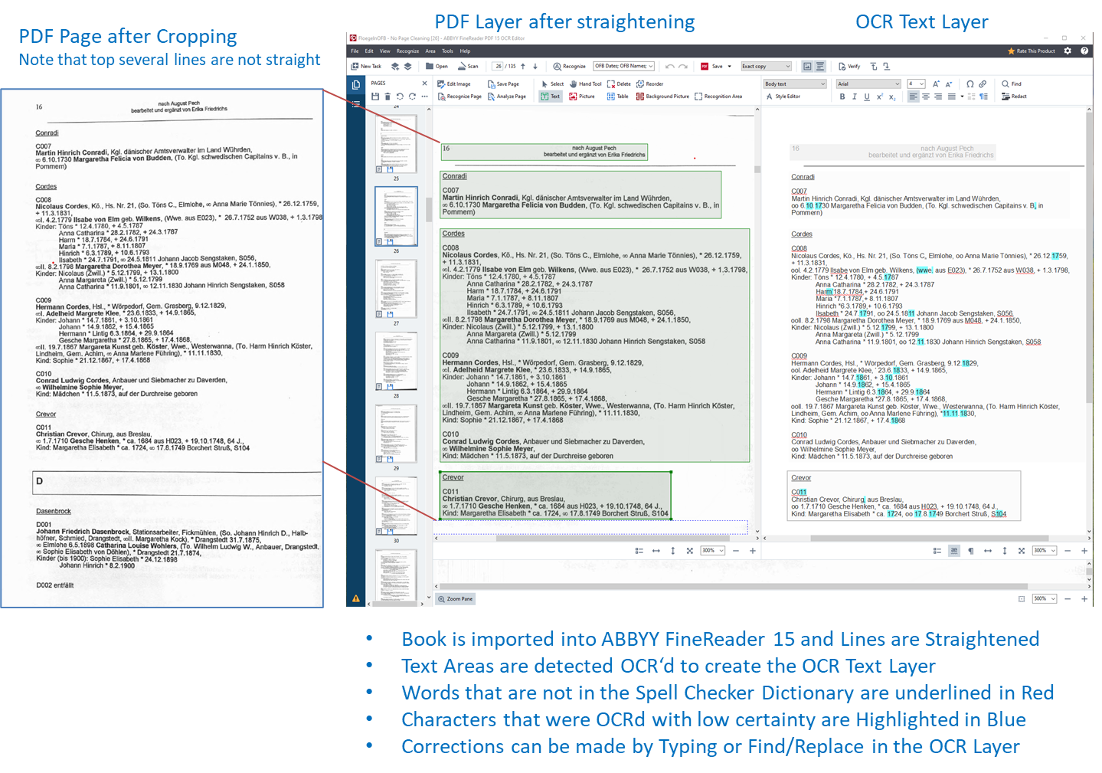
OCR Error Correction
Notes:
… enough here to do a deep dive on this by itself … especially if we do it in connection with Page Cleaning and Input File Generation
… Abbyy is easy to use … much like editing in Word

Slide 5
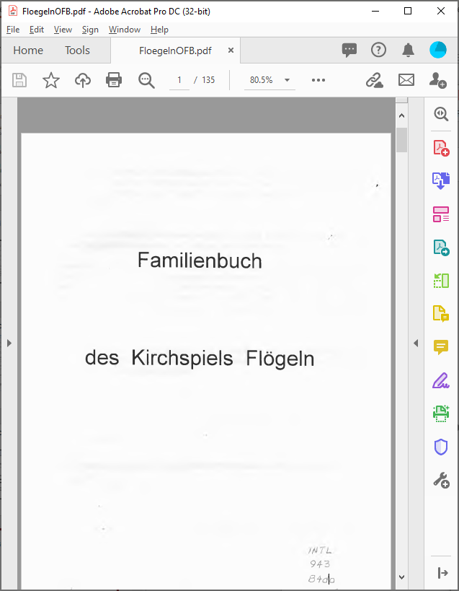
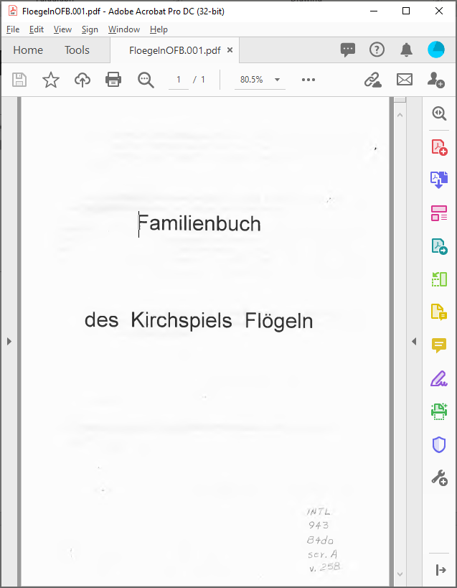
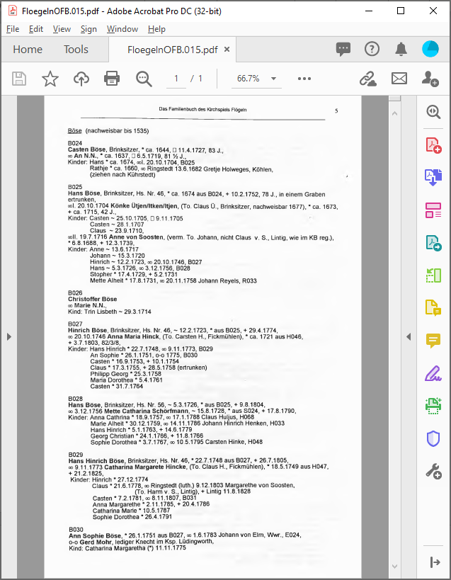
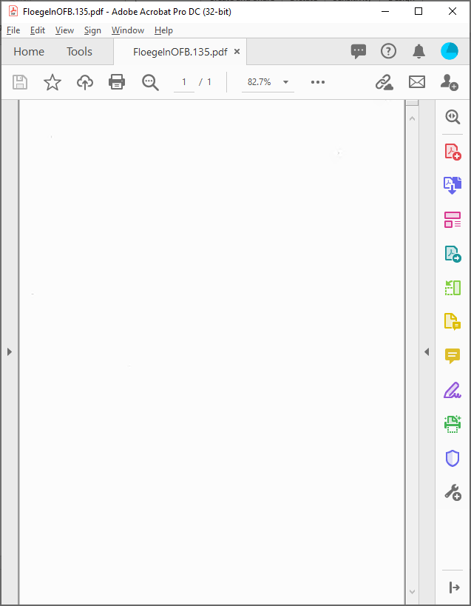
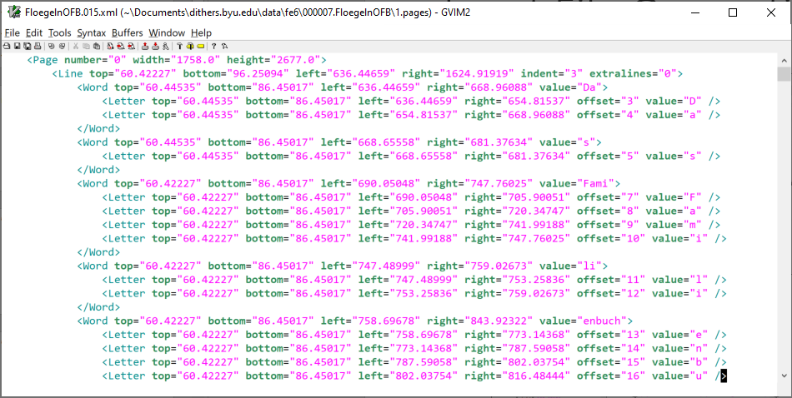
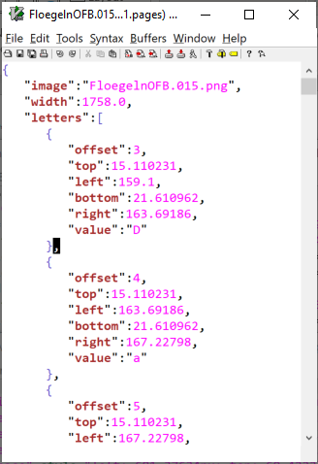
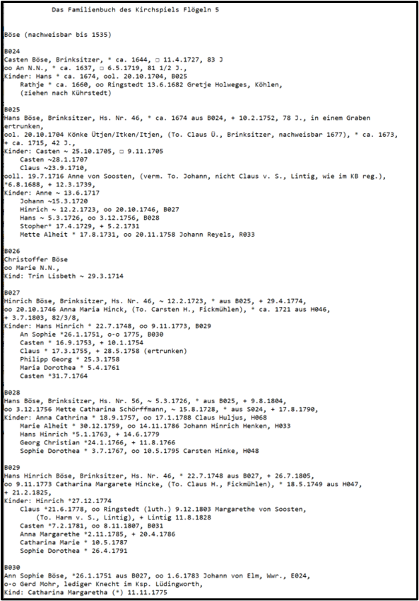
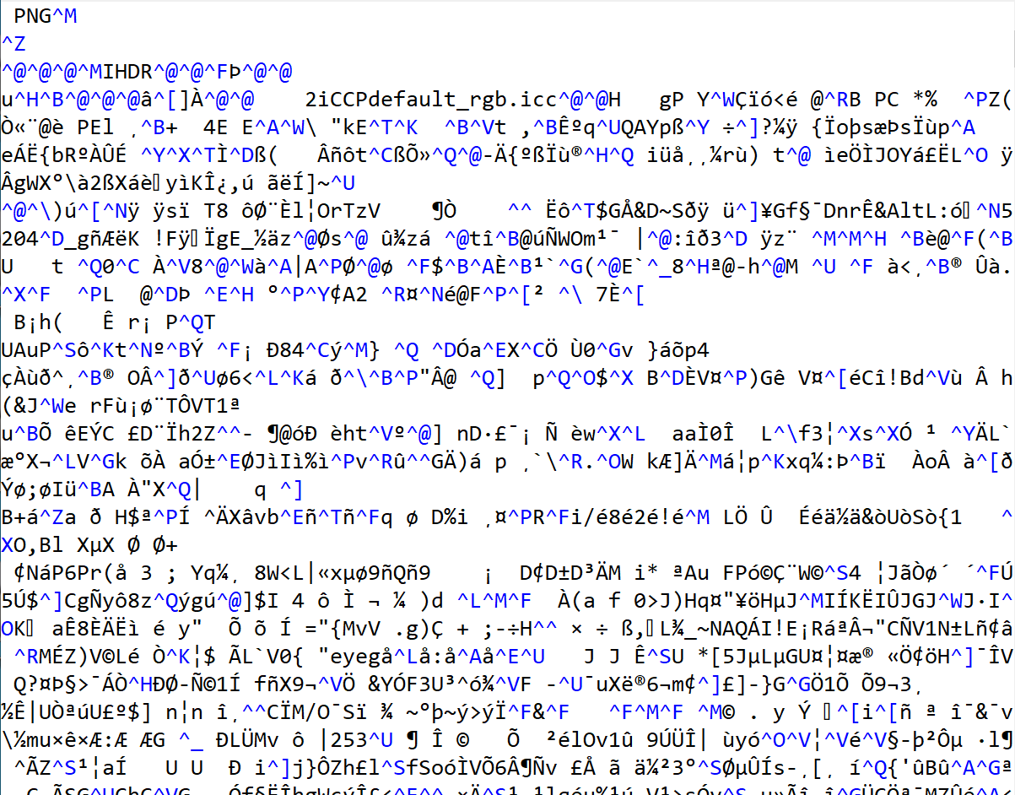
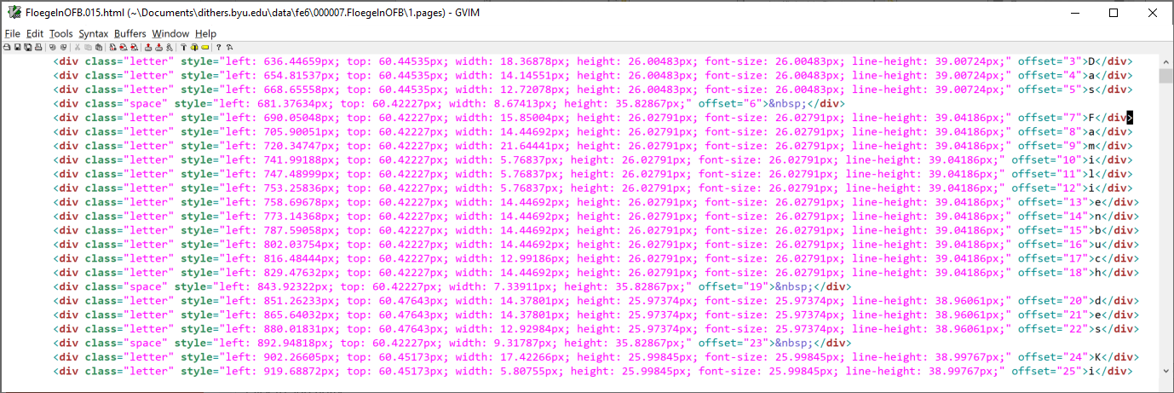
Input File Generation
…
…
xml
json
png
html
txt
Notes:
… it’s the text file we’ll be dealing most with here
… non-trivial to generate perfectly, particularly the white space … note the indentation and blank lines – more difficult than one would expect and perhaps more important that one would expect for extraction

Slide 6
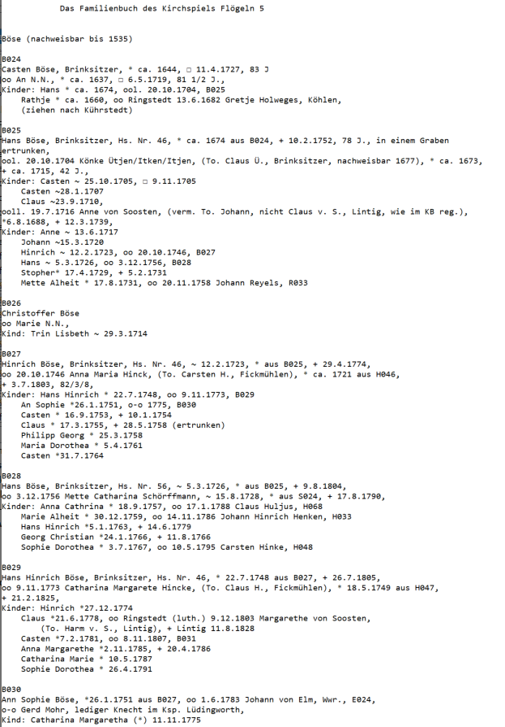
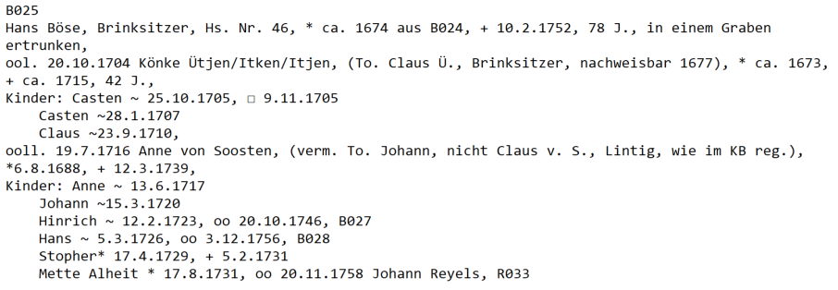
Input for Information Extraction
Notes:
… nachweisbar = verifiable

Slide 7
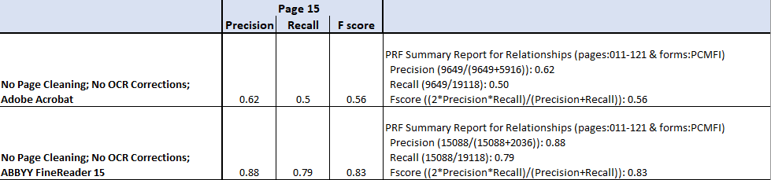
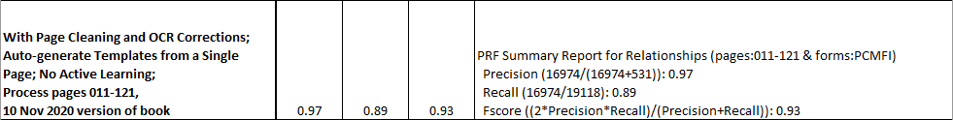
OCR Error Correction
Notes:
… it matters a lot which OCR engine we use
… and it matters that pages are cleaned, OCR errors are corrected, and that the text, especially, the white space is accurately reflected
… and you don’t have to do that great of a job of template development to get good results … just make it work for a page (so long as it’s a typical page) and you’re likely to get good results
… simulating the GreenQQ UI we are designing; these results were obtained by 38 COMET-like user labelings … assuming 15 seconds per labeling, that’s 570 seconds = 9.5 minutes to produce ~5, 000 CDS-like indexed records
…. Compared to the number of COMET-like user labelings it would take to just go through the book label all the information in all the book (an estimate of over 50,000? labelings) - @ 15 sec/labeling = 208 hours (Elder Norris worked for 40 hours/week for 6 weeks, 240 hours to create the complete ground truth)
… some day we should do a deep dive into the miracles that happen along the way and to shout praises of joy for being able to see God’s hand in the details of this work – no ours alone, but yours, and all of ours

Slide 8
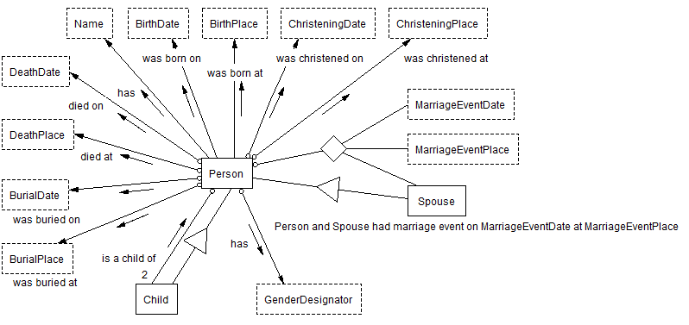
Ontology-Based-Information Extraction
Predicates for a Datalog-like reasoner:
Person(x) was christened on ChristeningDate(y)
Person(x) and Spouse(y) had marriage event on MarriageEventDate(z) at MarriageEventPlace(w)
Ontological Commitment:
Name ⇒ Person
Data Frame:
Entity Recognizer
Operations
Standardizer
…
The ontology is language independent!
The ontology restricts document authors!
Participation Constraints: Each Child has 2 parents; every Person has one and only one BirthDate; …
General Constraints: A Person cannot die before being born; A mother(x) giving birth at age(y) has probability(z)
Generalization/Specialization Constraints: Child ⊆ Person, Spouse ⊆ Person
Notes:
“Ontology … is the study of being, of what there is.”
“In computer and information science, ontology is a technical term denoting an artifact that is designed for a purpose, which is to enable the modeling of knowledge about some domain, real or imagined.”
… conceptual model … 1992 Prentice-Hall book: Embley, Kurtz, Woodfield: “Object-Oriented Systems Analysis: A Model-Driven Approach … (also includes a conceptual behavioral model and interaction model) … designed for analysis (i.e., understanding the problem at enough depth to derive an implementation) … models object, relationship, and constraints
… Ontological Commitment: “an object postulated to exist via language” Here, we postulate the existence of a Person when the person’s Name appears.
… data frame … early 1970 paper when frames in AI were all the rage … a package of information about a data item including how it is recognized
… language independent: Biology101 … We are working with English, German, Norwegian, and we have dabbled a bit with Chinese (Derek Dobson & Chuck Liu) and with COMET only, Japanese, Korean, and Arabic
…

Slide 9
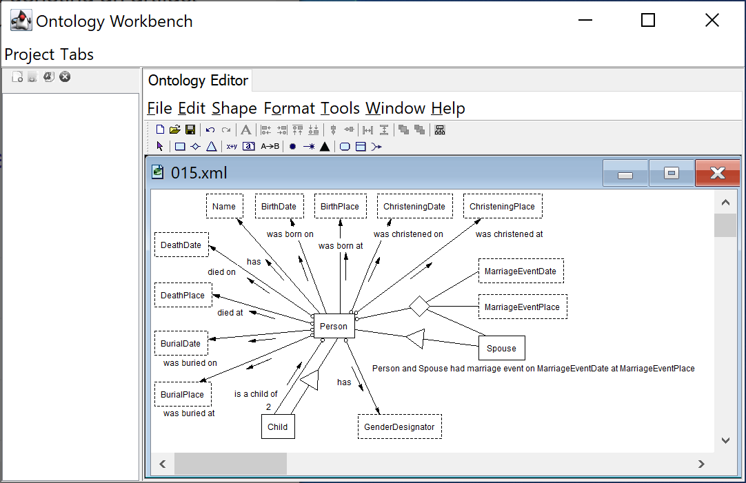
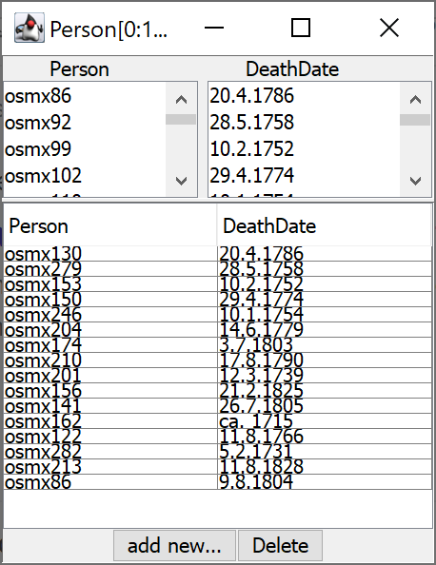
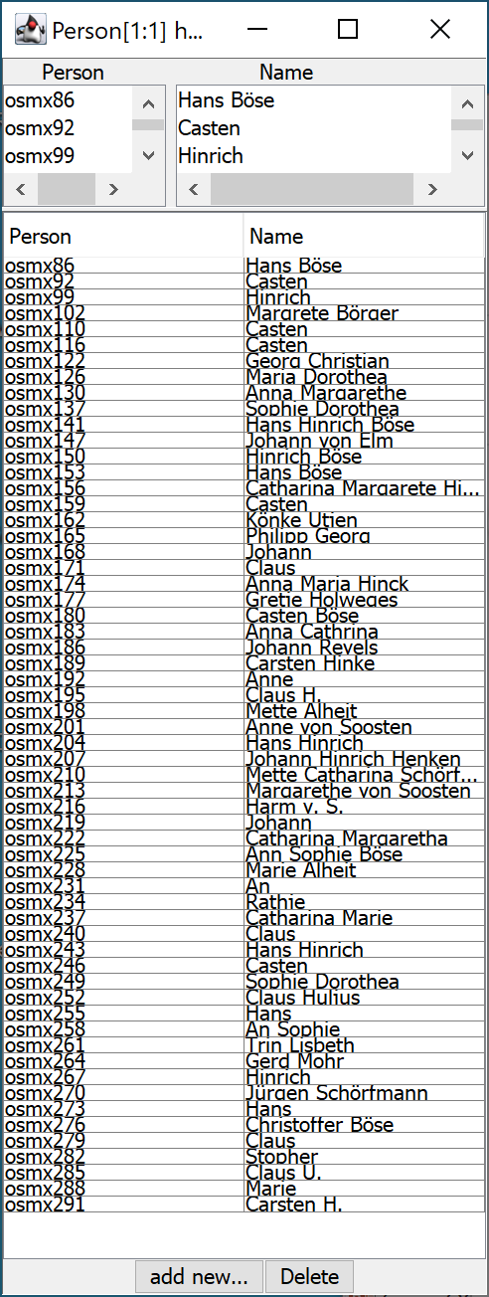
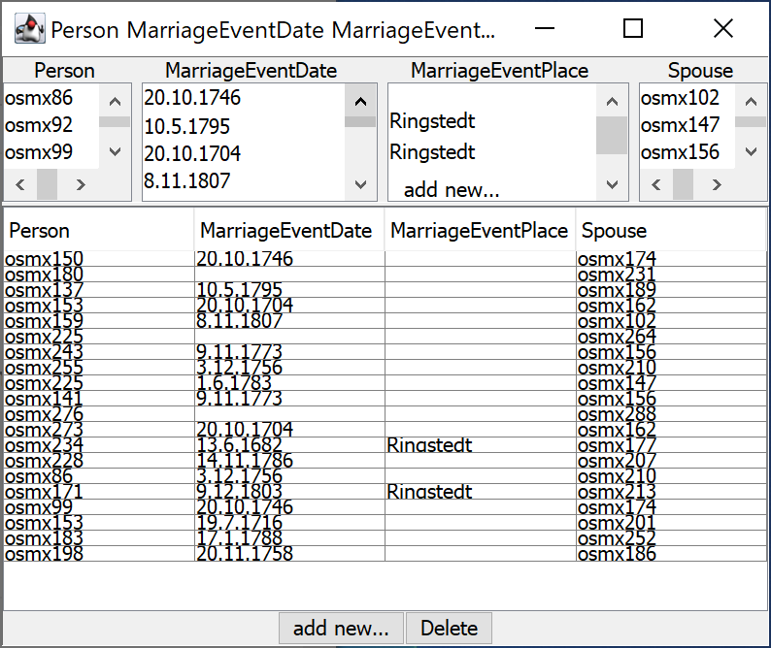
Objective: Populate Conceptual Model
Person(osmx153) has Name(Hans Böse), was born on BirthDate(ca. 1674), died on DeathDate(10.2.1752). Hans Böse and Könke Ütjen had marriage event on MarriageEventDate(20.10.1704) at MarriageEventPlace(?). Hans Böse and Anne von Soosten had marriage event on 19.7.1716 at (?). Casten is a child of Hans Böse; …, Metta Alheit is a child of Hans Böse.
Notes:
… “Person(osmx153)” can be replaced by “Hans Böse”, “Spouse(osmx162)” by “Könke Ütjen”, …
… 7 more children between Casten and Metta Alheit

Slide 10
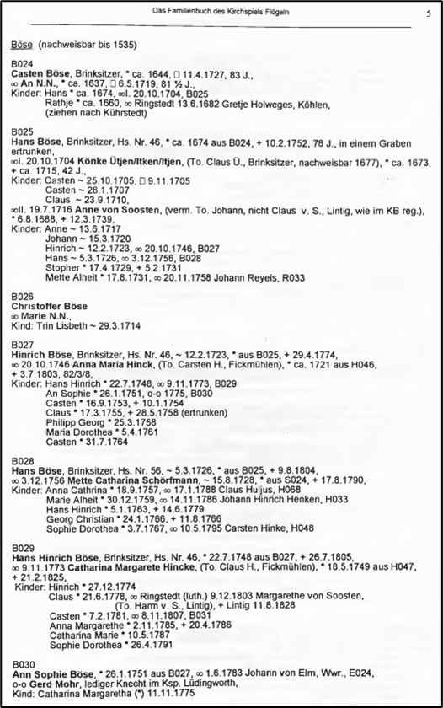
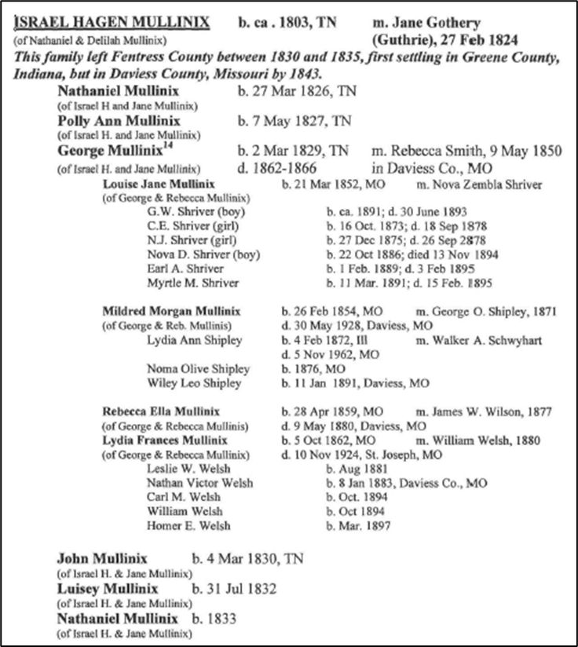
Extraction: Semi-structured Layout Requirements
Individual
Family
Intergenerational
X
X
Semi-structured: (0) not free-running text, (1) the text that constitutes an entity must be a contiguous string of characters and (2) the text following a person’s name is the person’s “information space” and does not overlap with any other person’s information space with respect to a record type (a record segmentation issue).
Notes:
… free-running text: pronoun references (or any other type of references, Mrs. Jones referring to Mabel Jones); interleaved commentary about various persons; … OntoSoar (Peter Lindes)
… not factored text: factored surnames, factored years from dates, …
… basic semi-structured document types: Individual (no overlap within basic unit), Family (within household overlap of head information with information about other household member’s), and Intergenerational (household heads’ information overlaps with other household heads’ information).
… easy to segment Individual; for intergenerational, we recursively tease out the households and handle households as we do Family; for Family see next slides

Slide 11
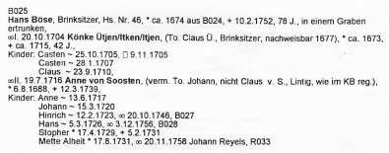

Record Segmentation
Person
Replace this example with Margarethe von Soosten, who has a death date and place and a parent.
Notes:
… head-to-head on household member segments the document wrt Person vital information
… to form the record, we then ignore everything inside and outside each segmented record that is not one of the object sets in the view

Slide 12
Record Segmentation
ChildOf
Notes:
… head-to-head on household head segments the document wrt ChildOf information
… to form the record, we then ignore everything inside and outside each segmented record that is not one of the object sets in the view
… “aus B024” means from or in household B024 so we know that the household head is a parent … note that we cannot know to which household spouse the child belongs (in the curation step we are able to infer this information
… “To.” is “Tochter des/r” – corresponds to “daughterOf”; we also have “So.” – corresponds to “sonOf”

Slide 13
Record Segmentation
ParentOf or Family
Notes:
… head-to-head on household head segments the document wrt ChildOf information
… to form the record, we then ignore everything inside and outside each segmented record that is not one of the object sets in the view
… we only get relationships for the FamilyHead to each of the Children

Slide 14
Record Segmentation
Marriage (Household Spouses)
Notes:
… head-to-head on household head segments the document wrt ChildOf information
… to form the record, we then ignore everything inside and outside each segmented record that is not one of the object sets in the view

Slide 15
Record Segmentation
Marriage (Other Spouses Of Household Members)
Bad choice of example (chasing E024 leads back to Ann Sophie Böse)
Notes:
… head-to-head on household head segments the document wrt ChildOf information
… to form the record, we then ignore everything inside and outside each segmented record that is not one of the object sets in the view
… note that the first three marriages are for household children and that the last is for a household head (household spouses can also have spouses) … and everything works as before
… the highlighted “Johann von Elm, Wwr., E024” is a record embedded in another record – here the record is another marriage record: Johann is the widower of someone in household E024. … we handle embedded records in our recursive-descent parser (for in fact embedded records can have embedded records)

Slide 16
Record Merge
Notes:
… when we populate the ontology, we merge all these records to form a full record for each person

Slide 17
Record Compilation
Problem: create a record compiler for a document whose grammar is unknown
Solution:
  For each record type
    Lexical Analyzer: Given the data-frame recognizers for the lexical object sets, rewrite the document as a sequence of ordered label-value pairs over the record’s fields (the record’s lexical object sets).
    Parser: With respect to the properties of each ontology relationship in the record type, parse each segmented rewritten record.
      Participation constraints (1:1, 1:many; many:many)
      Relationship arity (binary, n-ary)
      Recursive/non-recursive
    As needed, replace each reference identifier by the name of the person referenced.
  Merge records whose record-head person Name is found at the same character offset on the same page.
Notes:
… a compiler problem but the grammar is unknown
…. “luckily” the ontology holds the key to turning the document into records that can be parsed and compiled into the conceptual model

Slide 18
GreenQQ
Data-frame entity recognizer (for the ontology’s lexical object sets)
By-example specification (like machine-learning training data)
Named to identify its properties
  Green = “self-improving system”
    Refers to its active learning component
    GreenQQ can tell the user which examples it needs to improve itself
  QQ = Quick & Quality
    Runs in linear time
    Produces quality results
Notes:
… George Nagy

Slide 19
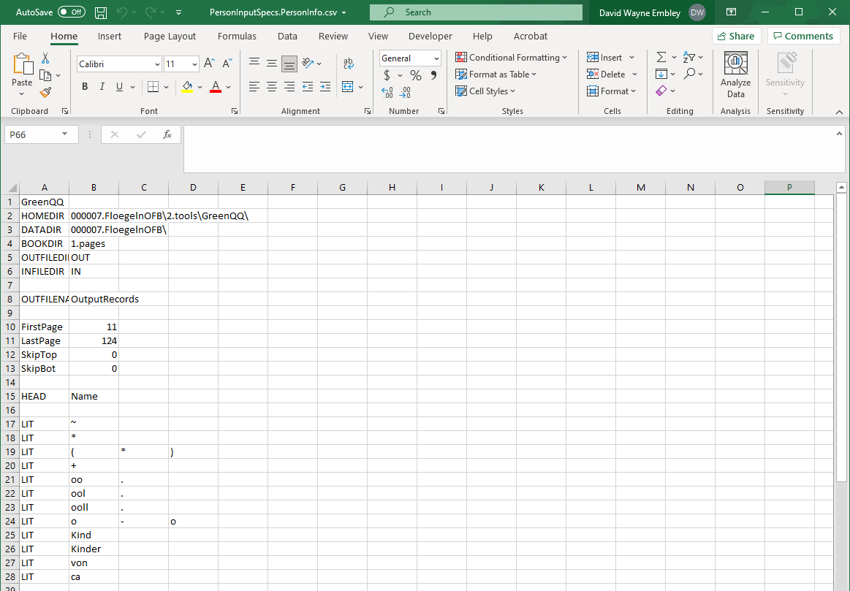
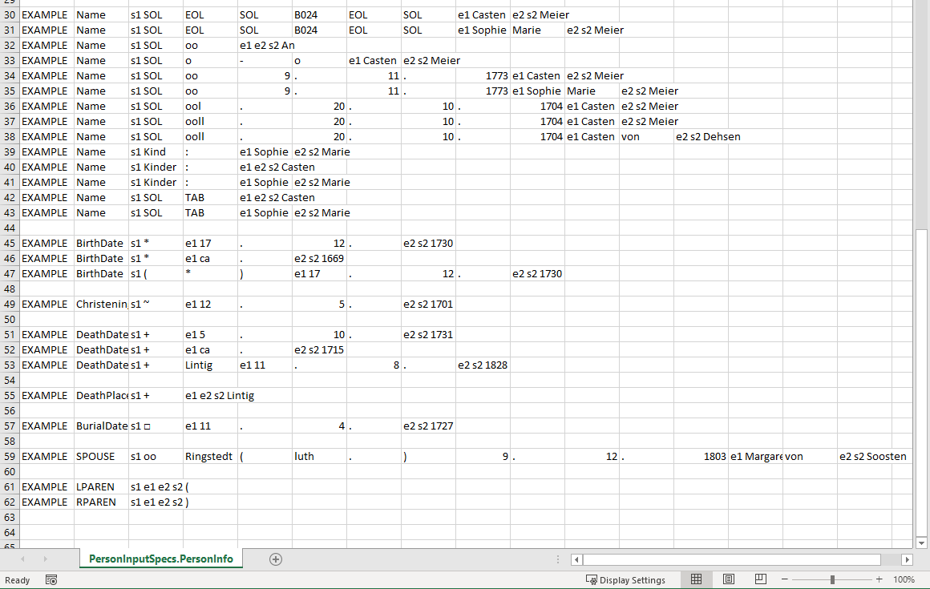
PersonInputSpecs
Notes:
… we are beginning to build a more user-friendly and user-efficient interface
… user-friendly by giving examples with COMET-like user actions over a form matching the book type
… user-efficient by generating templates by auto-copy of templates common to different record types and by expanding, in cross-product fashion, with SearchPhrase sets and value FormatVarient sets

Slide 20
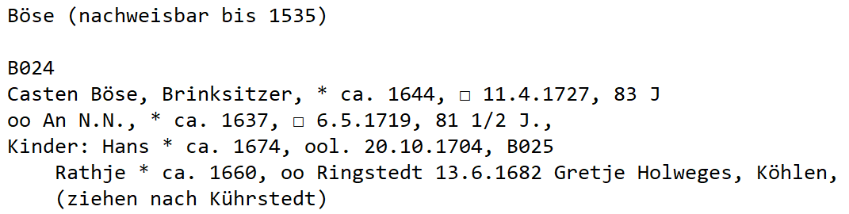
Template/Text Matching
… SOL EOL SOL PNUM EOL SOL CAP CAP , CAP , * ca . YEAR , ⃞ NUM1or2 . NUM1or2 . YEAR , NUM1or2 ACAP EOL …
T1
SOL EOL SOL PNUM EOL SOL CAP CAP
T16
* ca . YEAR
T23
⃞ NUM1or2 . NUM1or2 . YEAR
Notes:
… many thousands of lines of text in the book … lexemes
… nachweisbar ~ verifiable
… YEAR was GN’s choice (4 digits where the first is 1)
… Check file output is provided for debugging

Slide 21
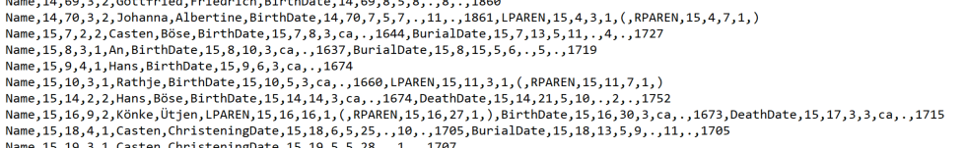
Lexical Analysis Output (rewrite of the book)
)
)
)
(
(
(
Notes:
… segmented as Person records
… sequence of label-value pairs

Slide 22
Person Parser
(
(
)
(
)
)
Person
Notes:
… the lexical analyzer is GN’s and the parser and its extensions for active learning are ours.
… examples: Person simple; Person nested records + Individual; Marriage (n-ary grouping); ChildOf (2 participation constraint); Family (recursive nesting)
… then examples of the parser detecting errors for the record type (Person and missing heads), … lead into COMET corrections

Slide 23
Person Parser
(
)
Person
Notes:
… In ChildOf, we’ll get another Individual record component and the Name field will be identical to the name field here – Name,15,61,22,3,Margarethe,von,Soosten
… the record component from ChildOf will be merged with the record Individual record component here

Slide 24
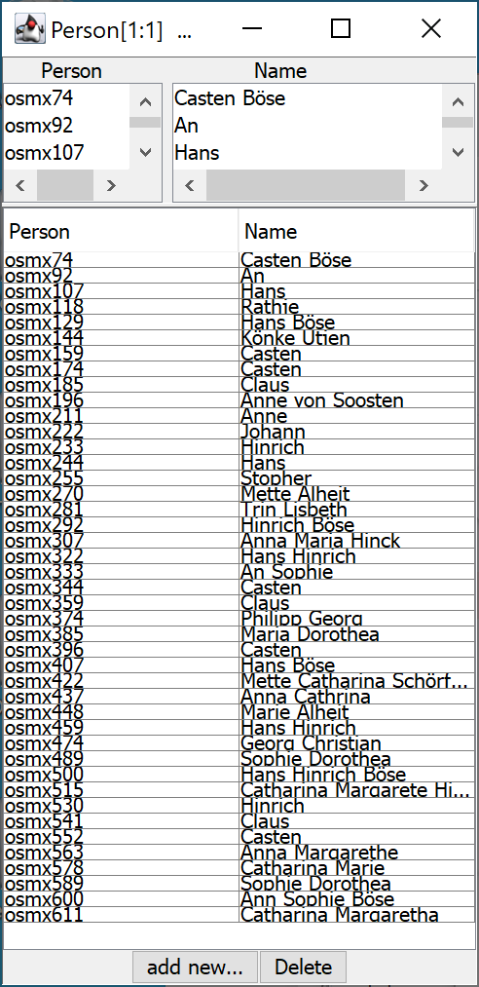
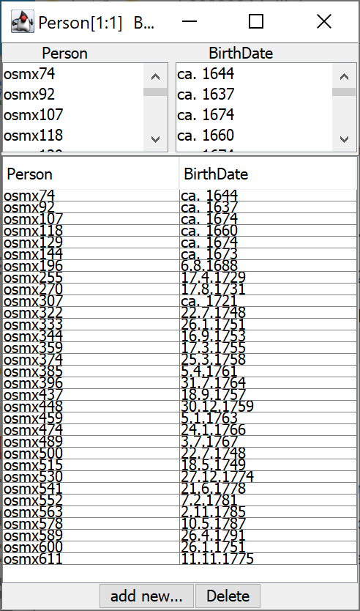
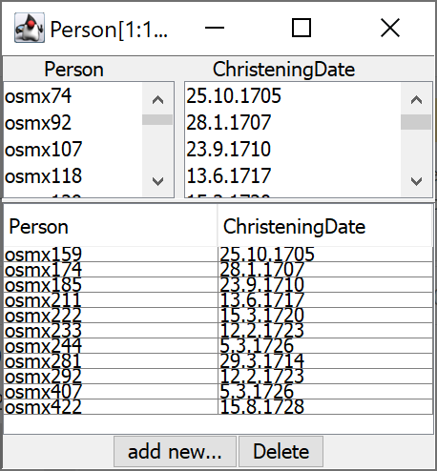
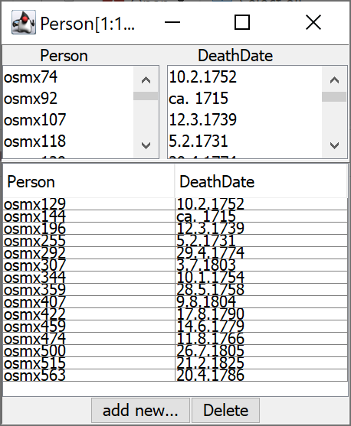
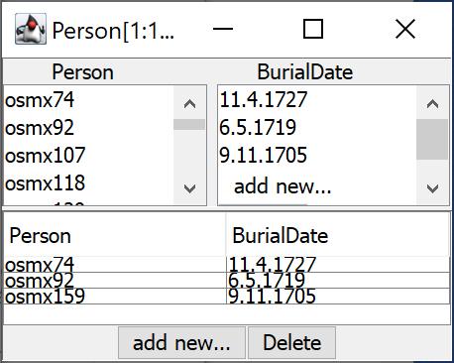
Person Parser Results
Notes:
… the parse results for Individual comes later
… the parser not only knows to reject a second BirthDate etc. for a person, but can and does return a parse-error message suggesting that a person has been missed!

Slide 25
ChildOf Parser
ChildOf
Notes:
… Parent2 does come up – a marriage symbol and a person name follows the Parent1 name

Slide 26
ChildOf Parser
(
)
ChildOf

Slide 27
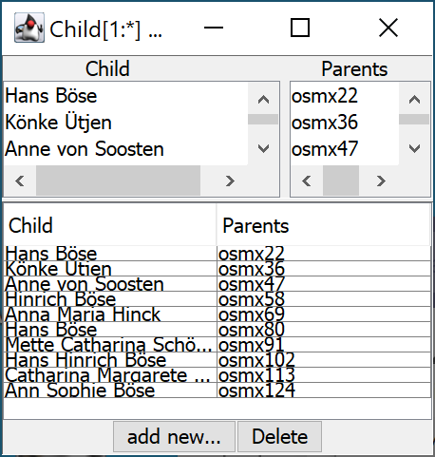
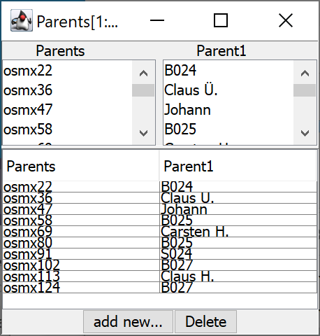
ChildOf Parser Results
Notes:
… note that the Reference IDs have not yet been resolved
… here again, the Individual records are still being built and will be parsed later

Slide 28
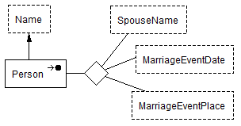
Marriage Parser
Notes:
… 4-ary relationship set … must group

Slide 29
Marriage Parser
SpouseName
Notes:
… EXTRA – a stopper for run away spouse lists

Slide 30
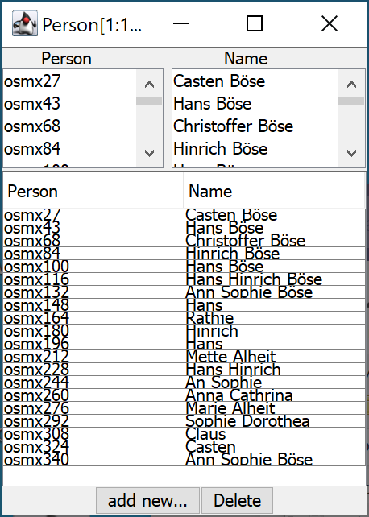
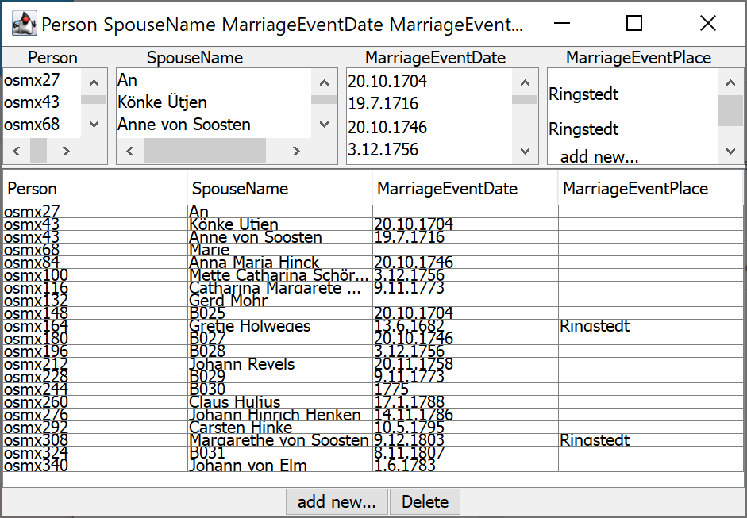
Marriage Parser Results
Notes:
… again note that the Reference IDs have not been resolved

Slide 31
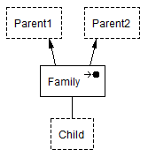
Family Parser
ParentOf or Family
Notes:
… ChildOf was from the Child point of view … Family is from the parent point of view
… EXTRA stops run-away lists (if we were to miss the next Parent1 record head, we would run into the next family

Slide 32
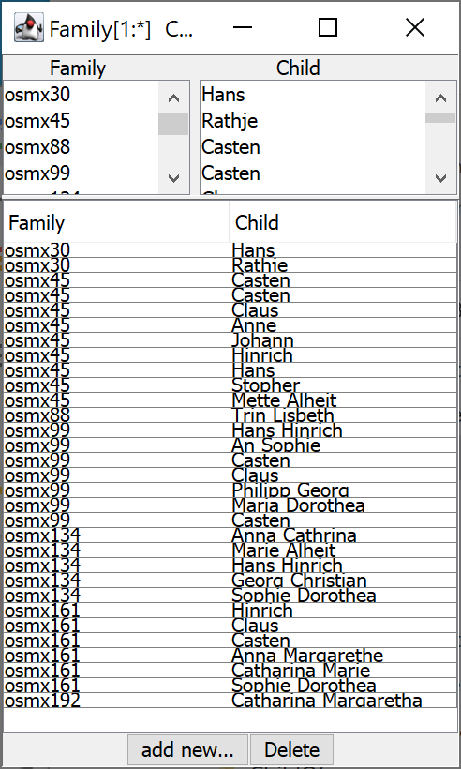
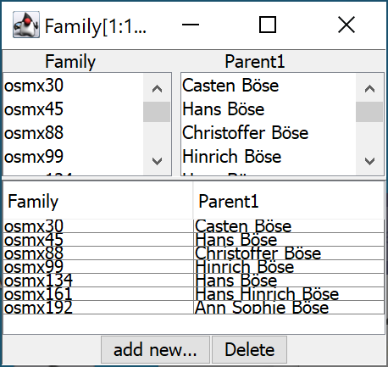
Family Parser Results
Notes:
… ChildOf was from the Child point of view … Family is from the parent point of view
… EXTRA stops run-away lists (if we were to miss the next Parent1 record head, we would run into the next family

Slide 33
Family Parser Results – Parent2
Notes:
… note: no Parent2 results … at this point we don’t attempt to get them because …

Slide 34
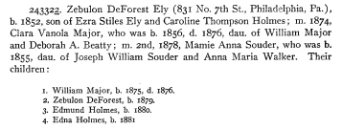
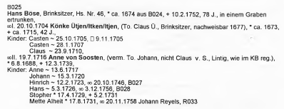
Family Parser Results – Parent2
Notes:
… note: no Parent2 results … at this point we don’t attempt to get them because … (1) sometimes it’s impossible to syntactically get them because head-to-head record segmentation fails (Ely), and (2) when we can, the effort in light of the fact that we can almost always correctly infer them during record curation does not appear to be worth the cost

Slide 35
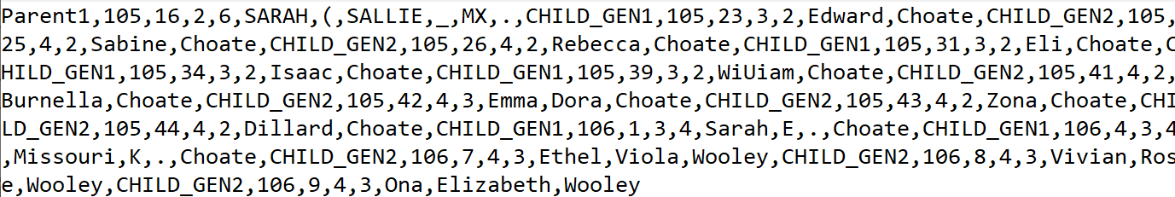
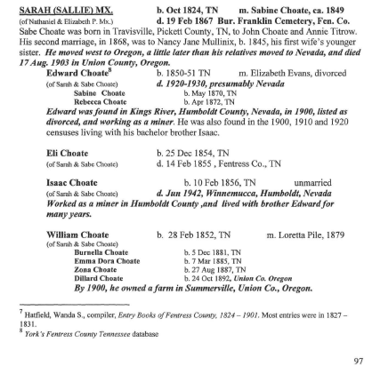
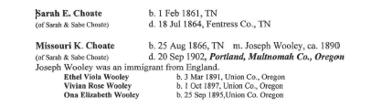
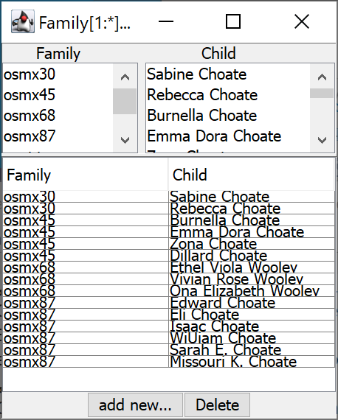
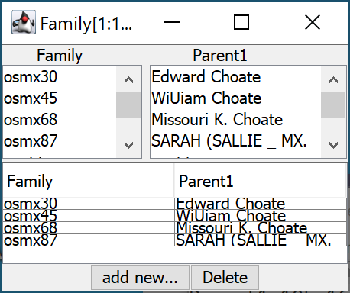
Intergenerational Family Parser
Notes:
... OCR error in “(SALLIE)”

Slide 36

Individual Parser
Generated Individual Records
Notes:
… page 15 lone persona records
… Johann record generated from Marriage
… Margarethe generated from Person and ChildOf and then merged

Slide 37





Individual Parser Results

Slide 38

Reference ID Resolution
Parent Resolution
Spouse Resolution

Slide 39


Reference ID Resolution

Slide 40








Record Merge
Records with Person Names that have the same page coordinates are merged.
Notes:
Using our simulated GreenQQ-UI-generated templates, these results were obtained with 38 labelings (38 ML training examples, 38 COMET annotations).
AND, when applied to the whole book, the results were a precision of 0.97, a recall of 0.89, and an F-score of 0.93.

Slide 41
Record Merge
Records with Person Names that have the same page coordinates are merged.
Using our simulated GreenQQ-UI-generated templates:
These results were obtained with 38 training examples
When applied to the whole book, the results were:
  Precision: 0.97
  Recall: 0.89
  F-score: 0.93
Notes:
Using our simulated GreenQQ-UI-generated templates, these results were obtained with 38 labelings (38 ML training examples, 38 COMET annotations). … for all names household heads, household spouses, household children, parents of household parents, former spouses of household parents, spouses of household children, and all dates and places of events (births, christenings, deaths, burials, marriages, and banns) … up to 19 of the 38 are for the different labels and the rest are for the different combinations of patterns in which these 19 different entities can appear (e.g., 1st, 2nd, 3rd, and illegitimate marriages, widows and widowers, only child, first of several children, children after the first, variations on missing place or date for events)
AND, when applied to the whole book, the results were a precision of 0.97, a recall of 0.89, and an F-score of 0.93.
Next, we consider the Active Learning component of our ontology-based information extraction system.

Slide 42
Active Learning:
The system points the user to needed corrections and additions.
Missing record heads
Bogus person and place names
Unparsable dates
Semantic inconsistencies
Notes:
… bogus person and place names … rare in other books … the Flögeln book author, Erika Friedrichs, makes lots of comments about names: “presumably”, “possibly”, “not sure”, “this or that”, …

Slide 43



Missing Record Heads (Household Head Names)
Notes:
… Dutch “tor” = German “von”
… missing heads are to be found and fixed in the GreenQQ UI we are building
… it’s usually not necessary to fix every one of these individually: example for B090a on page 023, the name is “N.N. Bruns” and a template for this name form also works for three others: F019 page 047, G018 page 049, and H066 … altogether I created 7 to get all 23 (one with a slash in the first name was common enough to do 12 with one EXAMPLE)
… note also Lütje Hudag/Hudaf … OK because it’s the last name with a “this or that” … but several times this happens in given names (e.g., a child name “Mars/Marx Hinrich”) in which case we want to extract all of it … remember our semi-structured requirement that the text for an entity must be contiguous

Slide 44


Missing Record Heads (FD Violations)
…
(94 more)
Notes:
… the parser catches these (they’re parsing errors wrt the conceptual model induced grammar)
… my FDs are over birth events – BirthDate & ChristeningDate equated – and yes, I must realize that a person can have both (but then when they’re recorded in a semi-structured document, they’re usually adjacent … I look for reasonable separation)

Slide 45


Template Creation for Missing Record Heads
(some may be unresolvable)
Kinder: Engel ~ 25.10.1703, oo Ringstedt (luth.) 21.10.1727 Johann Holwegs, Alfstedt, * ca. 1693, + Alfstedt 2.11.1776, sie + 28.11.1783
oo 26.7.1795 Anna Margareta Struß/Struuß, (unsicher: entweder Catharina Margareta, (To. Albert S.), *28.2.1762 aus S105 oder Anna Margaretha (To. Harm S.), *27.10.1778 aus S106,
Albert Struß, * 22.4.1754 aus S100, oo 21.4.1785 Mette Margareta Dröge, * 19.1.1761 aus D062 Kind: (*) 1.1.1785, + 12.1.1785
Notes:
… so

Slide 46


Overall Template Creation Results
Notes:
… We’d like missing heads to catch all … for we have a goal of 100% recall for persons along with sufficient supporting evidence so that the temple work can be completed for every person in the book; but we’re not quite there
… the recall denominator gives the total number of relationships in the ground truth: 19,118 relationships expected, 17,599 extracted; for Person ONLY, 9,757 expected with 9,015 extracted before dealing with missing heads and 9,232 afterwards
… Jim why are we still missing so many?
… the precision went up, presumably because some of the data associated with missing heads was assigned to the wrong person – the number correct increased from 9,015 to 9,232 and the number incorrect fell from 145 to 78 for persons (i.e. 67 relationships shifted from being incorrect to being correct
…. after resolving missing heads, the first part of Active Learning where we create more templates to resolve issues (in the second part of active learning, we only make COMET corrections … ideally we should lose no not lose Recall, but hopefully increase Precision to near 100% … hopefully we will have increased Recall measurably when we only consider PRF for Person---Name relationships)
… keep the following for later use in the summary:
… it matters a lot which OCR engine we use
… and it matters that pages are cleaned, OCR errors are corrected, and that the text, especially, the white space is accurately reflected
… and you don’t have to do that great of a job of template development to get good results … just make it work for a page (so long as it’s a typical page) and you’re likely to get good results
… simulating the GreenQQ UI we are designing; these results were obtained by 38 COMET-like user labelings … assuming 15 seconds per labeling, that’s 570 seconds = 9.5 minutes to produce ~5, 000 CDS-like indexed records
…. Compared to the number of COMET-like user labelings it would take to just go through the book label all the information in all the book (an estimate of over 50,000? labelings) - @ 15 sec/labeling = 208 hours (Elder Norris worked for 40 hours/week for 6 weeks, 240 hours to create the complete ground truth)

Slide 47
Active Learning:
The system points the user to needed corrections and additions.
Missing record heads
Bogus person and place names
Unparsable dates
Semantic inconsistencies
COMET Corrections
Notes:
… because Erika Friedrichs, makes lots of comments about names (“presumably”, “possibly”, “not sure”, “this or that”, …), we need to unravel them
… these bogus names violate our semi-structured requirement of contiguous text for an entity; and thus, we cannot unravel them with GreenQQ templates
… neither can GreenQQ fix unparsable dates and semantic inconsistencies such as an assertion that a person died many years before their birth

Slide 48
Unresolved Missing Heads
Kinder: Engel ~ 25.10.1703, oo Ringstedt (luth.) 21.10.1727 Johann Holwegs, Alfstedt, * ca. 1693, + Alfstedt 2.11.1776, sie + 28.11.1783
Add 28.11.1783 as Engel’s death date.
Add a new record for Catharina Margareta with her father and birth date and do the same for Anna Margaretha.
Delete any incorrect relationships added to the ontology.
oo 26.7.1795 Anna Margareta Struß/Struuß, (unsicher: entweder Catharina Margareta, (To. Albert S.), *28.2.1762 aus S105 oder Anna Margaretha (To. Harm S.), *27.10.1778 aus S106,
Albert Struß, * 22.4.1754 aus S100, oo 21.4.1785 Mette Margareta Dröge, * 19.1.1761 aus D062 Kind: (*) 1.1.1785, + 12.1.1785
(Ab 1776 in Neuenwalde, dort noch 6 Kinder)
Do nothing.
Notes:
… the user is also pointed to unresolved missing heads …
… the extraction engine populated the ontology with (Anna Margareta Struß---BirthDate(12.2.1762)) and (Anna Margareta Struß---Parent1(Albert S.)); if the user somehow knows that this is right, there’s nothing to delete.
… Do nothing, but do dismiss the comment, the (?) … the idea is that a user must resolve all concerns. (The interface will be programmed so that the user can navigate from (?) to (?).)

Slide 49


Bogus Person and Place Names
…
41 more; 56 altogether

Slide 50

Bogus Person and Place Names
Notes:
… if time, I can show the correction of this example
… we plan to make COMET work when correcting names to correct all … e.g., both “Ilsabe/Ilse Wienpen”’s would be done here with one correction

Slide 51

Unparsable Dates
Notes:
… LATER (after initial curation): here we can get the right date and correcting it by following the ReferenceID to household E014 and get the correct date: 19.5.1750

Slide 52

Semantic Inconsistencies

Slide 53

Semantic Inconsistencies
Notes:
Note how we make use of the ontological predicates. The ontology-based extraction system knows how to both “read” and “write”.
… here we might be able to guess that the author meant to have written 1810 instead of 1710 … but at this point the user is not allowed to edit it, so it should be deleted

Slide 54

Results after Adding COMET-Only Active Learning
Notes:
… complete ground truth for this part is still underway
… these results were obtained by resolving only the generated Active Learning issues – no additional corrections even if spotted
Goal: create a temple-submission-worthy record for every individual in the book who has associated genealogical information (birth and death info or a one-hop relationship to someone else or both)
How close to we come to achieving this goal?
The process yields greater than 95% recall of the targeted individuals
The ontological approach yields a populated conceptual model that fully satisfies all the constraints approaching 100% precision

Slide 55






Conclusion: Results
Person records created:
Page 15: 4109/4245
Page 46: 4080/4244
Notes:
Created by carefully following a protocol that we believe an ordinary trained user (a senior service missionary) could successfully work through in a reasonable time (a few hours), i.e., able to index several thousand names in one afternoon’s session.
Elder Norris and I each choose one page and created templates to correctly extract & label ALL entities on the page that should be extracted & labeled; we then created templates in an active learning mode for missing heads (adding no others).
To get the data in the table, we needed a new ground truth – one with all the names and unparsable dates fixed and the semantic inconsistencies resolved, but only insofar as COMET would allow by extraction only without hand editing (only what’s directly extractable from the document – e.g., no correction of the document itself, e.g., author errors, typesetting errors, spelling errors, …; these errors, insofar as possible can be fixed in the next stage, which includes record correction and record preparation for adding to the FS-Tree.)

Slide 56
Overview for
Ontology-based Information Curation
Objectives … standardize, infer, correct in preparation for record search (CDS), persona merge and family tree generation (LLS), and user-directed add-to-tree (FS-Tree)
Curation Pipeline and User Interfaces
  … user interface actions
    … COMET edit corrections (e.g., those that cannot be resolved by extraction)
    … new issues arising from inability to standardize and infer
    … preparation for adding to FS-Tree
  … dates, names, and places standardized
  … inference
  … UI for record correction for CDS and for adding a persona record to the FS-Tree
  … persona record merge
    … defective
    … contradictory and thus unmergeable
    … probabilistically unmergeable
    … unconfident
  … organized into intergenerational family trees
  … UI and process for adding a generated tree to the FS-Tree

Slide 57

Inferred Information
New Object Sets Added
Values Standardized and Canonicalized
Relationships Augmented
Notes:
… includes all ontology properties
… canonicalizes
… adds inference of three new object sets, which are filled in for each person
… based on what’s known about the family structure, spouse inverses are added, and many more parent-child relationships are added

Slide 58
… editing corrections of bogus name, unparsable dates, and semantic inconsistencies that were caught but couldn’t be corrected by COMET extraction but could be by COMET hand editing
An incorrect date that could be fixed because it appeared elsewhere
An incorrect death date almost clearly a century off
An incorrect spelling of “Johannn” … although this one is not likely caught
… any others? (I don’t seem to have a record, but I should be able to recreate those caught in 6 by not resolved)

Slide 59
… pg 15 remaining semantic inconsistencies
10127. In the error threshold( 0.10000%)
The automated extractors found asChildBeingBornYearsAfterMarriageEventDateOfParentPerson constraint Hinrich(osmx99-097-1919) was rejected because
its probability ( 0.0%) did NOT meet the sertions stating:
Hinrich is a child of Marie Sophie Steffens
Hinrich was born on BirthDate (12.9.1868)
Marie Sophie Steffens and Julius Heinr had marriage event on MarriageEventDate (22.9.1878) at MarriageEventPlace (unknown)
so that
Hinrich being born Years(-10) after marriage date of parent Marie Sophie Steffens has Probability(0.00)
10133. In the ChildBeingBornYearsAfterMarriageEventDateOfParentPerson constraint Claus(osmx228-097-1886) was rejected because
its probability ( 0.0%) did NOT meet the error threshold( 0.10000%)
The automated extractors found assertions stating:
Claus is a child of Marie Sophie Steffens
Claus was born on BirthDate (3.3.1866)
Marie Sophie Steffens and Julius Heinr had marriage event on MarriageEventDate (22.9.1878) at MarriageEventPlace (unknown)
so that
Claus being born Years(-12) after marriage date of parent Marie Sophie Steffens has Probability(0.00)
10265. In the ParentsOfChildCantHaveSameGenderConstraint constraint Marten Struß der ältere(osmx137-098-1016) was rejected because
its probability ( 0.0%) did NOT meet the error threshold( 0.00001%)
The automated extractors found assertions stating:
Margret Struß is a child of Marten Struß der ältere
Margret Struß is a child of Marten Struß der jüngere
Marten Struß der ältere has inferred Gender (MALE)
Marten Struß der jüngere has inferred Gender (MALE)
so that
Marten Struß der ältere of Margret Struß and other Marten Struß der jüngere and Parent( + has MALE and other Marten Struß der jüngere has Gender( osmx9223372036854763185) has Probability(0.00)
10266. In the ParentsOfChildCantHaveSameGenderConstraint constraint Marten Struß der jüngere(osmx116-099-1068) was rejected because
its probability ( 0.0%) did NOT meet the error threshold( 0.00001%)
The automated extractors found assertions stating:
Margret Struß is a child of Marten Struß der jüngere
Margret Struß is a child of Marten Struß der ältere
Marten Struß der jüngere has inferred Gender (MALE)
Marten Struß der ältere has inferred Gender (MALE)
so that
Marten Struß der jüngere of Margret Struß and other Marten Struß der ältere and Parent( + has MALE and other Marten Struß der ältere has Gender( osmx9223372036854763234) has Probability(0.00)

Slide 60
Conclusion for
Ontology-based Information Curation
Objectives … standardize, infer, correct in preparation for record search (CDS), persona merge and family tree generation (LLS), and user-directed add-to-tree (FS-Tree)
Curation Pipeline and User Interfaces
  … user interface actions
    … COMET edit corrections (e.g., those that cannot be resolved by extraction)
    … new issues arising from inability to standardize and infer
    … preparation for adding to FS-Tree
  … dates, names, and places standardized
  … inference
  … persona record merge
    … defective
    … contradictory and thus unmergeable
    … probabilistically unmergeable
    … unconfident
  … organized into intergenerational family trees
Notes:
… here we put results for all of this in some way

Slide 61
Adding Records to the FamilySearch-Tree
CDS: extracted and curated persona records
  Our system does not add records from CDS to the FS-Tree.
  A search for a record in CDS should yield that record (possibly merged) in LLS.
LLS: genealogies of merged extracted and curated persona records
  Computer-assisted paradigm (hopefully, greatly assisted).
  Patrons make all decisions about what is added/changed.
Notes:
… users can, if they wish, just do what they normally do when finding a record in CDS
… aside: for our records we can use COMET to do record correction

Slide 62

Add LLS Record to Tree (no matching FS-Tree record)
Push to Tree
Notes:
… if no match on FS-Tree, instantiate a new person record with all vital information and instantiate a new person record for each of the person’s one-hop relationships.
… if match on FS-Tree, then under the patron’s direction, merge all vital information and all one-hop relationships with the matched FS-Tree person.
… here when we click “Add to Tree”, …

Slide 63

Add LLS Record to Tree (no matching FS-Tree record)
☑
Notes:
Via the API, we enter all the vital information and all one-hop relationships; for Hans Hinrich Böse the system returns “No Match Found” or “Possible Matches Found”.
We intercept these messages and:
“No Match Found”: Create Person without a patron doing anything and include all vital and one-hop relationships
“Possible Matches Found”: Allow the patron to work with FamilySearch to resolve the possible matches. In the example here, Anna Margarethe died when she was less than a year old and could not possibly have had a spouse, so the patron should choose Create Person.
… in this case, no matching record was found; so, with the API we intercept the Create Person message, and with no further action on the user’s part we automatically add this record to the tree

Slide 64


Add LLS Record to Tree (no matching FS-Tree record)
Notes:
At this point Hans’s record is complete and there are new records for all his one-hop relationship.
The one-hop relationships are also there; ideally, the user should work with each of these to add their vital information and see if there are duplicates and, if so, to merge them. Indeed, we can help the user do this by locating this record in LLS and working with the user as explained below.
Interesting aside: note the three research-help suggestions:
Hans Hinrich Böse (the first one) is not a match even though the wife’s given name matches because all other information marriage date and place, father’s name, … does not match
Hans Hinrich Böse (the second one) is a match; it’s a record of a christening of their child Anna Margaretha Böse on 2 Nov 1784 in Flögeln. However, there are discrepancies between the indexed record and the book (e.g., the birth date in the book is the christening record’s day and month and (almost) year (1784 in the record and 1785 in the book), the birth date in the record is 2 Jul 1784, …; the original hand-written record is available, but I can’t read the handwriting well enough to know what it says.)
Hans Hinrich Böhr is a match; to me, the handwriting looks like Bösr – it’s likely the “r” that wasn’t written as an “e” that threw off the indexer (the father’s surname was indexed as Böhre); all the rest of the information matches exactly: marriage date and place spouse’s name

Slide 65

Add LLS Record to Tree (no matching FS-Tree record)
Notes:
Hans’s record is complete and there are new records for all his one-hop relationships

Slide 66


Add LLS Record to Tree (no matching FS-Tree record)
Notes:
Documentation is also be added (we need advice from legal about exactly what we can display … here we have the text from the first highlighted text to the last)
… now we continue in depth first search with any one and eventually all these degenerate records we have on our LLS tree

Slide 67

Add LLS Record to Tree (matching Tree record)
?
?
Push to Tree
Notes:
… but first, we return to the case of a CDS record that has an existing duplicate … and show some additional features: incoming warning messages from our upstream extraction and curation work
… all warning messages must be dealt with before “Add to Tree” turns green. (We don’t necessarily catch everything, and the patron can edit even if nothing is caught and can do it before clicking on “Add to Tree”.)

Slide 68

Add LLS Record to Tree (matching Tree record)
Push to Tree
Notes:
Here, the patron should change the Spouse name to “Harm Hinrich Dröge” and the Alternate Name to “Felicia Elonora Dröge” and click on the now green “Add to Tree” button.
… FamilySearch finds a match and we may even want to use the API match command in our implementation to do the same thing for us

Slide 69
Add LLS Record to Tree (matching Tree record)
Add to Tree
Notes:
… FamilySearch finds a match
… we may even want to use the API match command in our implementation to do the same thing so that the next thing for the user to do is click on View Person …

Slide 70

Add LLS Record to Tree (matching Tree record)
(married name)
Update Tree
Notes:
… we attempt to automatically be sure we have the right correspondence by adding FS IDs; if not the user can make corrections on the COMET side.
… as a visual help, we can mark in green all new information to be added … with all this information, the user can assess the update and make edits as needed
… clicking on “Add to Tree” yields …

Slide 71


Add LLS Record to Tree (matching Tree record)
Notes:
… after click on “Add to Tree” button
… note that the sources changed from 1 to 3; note also that we have a different view of records (we’re not sure
… here again, information in LLS may be used to encourage continuing to work on the added persons (indeed we show this follow up for this example for adding LLS genealogies to the tree)

Slide 72
Add LLS Genealogy to FS-Tree
Start with any merged persona record P in the Genealogy.
Add P to the FS-Tree and keep track of the FS-IDs of all one-hop relationships of P.
Next direct the user to add to the FS-Tree any one of these one-hop relationships, say Q
  If there is a duplicate of Q on the FS-Tree (other than the auto-added degenerate Q itself),
    it becomes the target for update;
    otherwise, the auto-added degenerate person becomes the target for update.
  Update the target record on the FS-Tree.
  If the target is a duplicate D (not the auto-added degenerate person Q), merge Q into D.
Continue through the entire genealogy in a depth-first traversal

Slide 73
Add One-Hop Relationship to Tree (target: degenerate record)
Notes:
… assume we start with the LLS genealogy that includes Felicia Eleonora Meier and that we start with Felicia; then we begin by adding Felicia to the FS-Tree as just explained
… next the user will be directed to one of Felicia’s one-hop relationships; for the example, we consider Felicia’s father, Johann Friedrich Meier, to be the choice

Slide 74

Add One-Hop Relationship to Tree (target: degenerate record)
Push to Tree
Notes:
… we do a search using the information in this record, and get …

Slide 75
Add One-Hop Relationship to Tree (target: degenerate record)
Notes:
… we see that the Johann Friedrich Meier (G8W4-8WP) is the record we added as Felicia’s father
… we also see that the other suggested duplicate is not a match (the place is not right for a Flögeln person, and while the names match, both given names and even the surname are very common)
… thus, the target is the degenerate record we added, and we

Slide 76



Add One-Hop Relationship to Tree (target: degenerate record)
Notes:
… we should check the proposed alignment (the added FS IDs)
… we see that it’s immediately ready to go and a click on Add to Tree, which yields …

Slide 77



Add One-Hop Relationship to Tree (target: degenerate record)
Add to Tree
Notes:
... now we have some additional new one-hop relations to keep track of and resolve as we continue

Slide 78

Add One-Hop Relationship to Tree (target: FS-Tree record)
Push to Tree
Notes:
... an example when one of the to-be-processed one-hop relationships has a pre-existing duplicate
… clicking on Push to Tree, yields …

Slide 79


Add One-Hop Relationship to Tree (target: FS-Tree record)
Notes:
… first, after the user agrees that the top pre-existing duplicate is indeed a duplicate, the system does its alignment and reports any conflicts, yielding …

Slide 80



Add One-Hop Relationship to Tree (target: FS-Tree record)
?
Push to Tree
Notes:
… the orange (?) and underline shows a conflict; if the user wants the name changed to “Anna Margareta Struß” (and we assume so), the user should dismiss the orange (?) …
... the orange turns green …

Slide 81
Add One-Hop Relationship to Tree (target: FS-Tree record)
Push to Tree
Notes:
… now, clicking on the green Push to Tree yields …

Slide 82



Add One-Hop Relationship to Tree (target: FS-Tree record)
Add to Tree

