Slide 1
Instructions for COMET Users
“COMET” stands for Click Only (or at least Mostly) Extraction Tool.

Slide 2
Instructions
General
  To let the system know where on the page the information is being extracted, always click or highlight and click to add entries to the form. (Don’t just type information into the fields.)
  After adding an entry to the form, edit it if necessary to fix errors (OCR errors, typographical errors, removal of unwanted noise, addition or removal of punctuation erroneously omitted or added by the system).
Person Name
  Extract names as they appear including titles, suffixes, and any punctuation such as periods for abbreviations, commas indicating last name first, and parentheses designating alternative names.
  When a person is referred to by several names, choose the most complete name.
Date
  Extract complete dates as they appear including punctuation and modifiers such as “about” or “before”.
  Use substitute event dates such as funeral date for burial date and marriage-announcement date for marriage date when the event date itself is not given.
Place Name
  Extract place names as they appear, giving details to the level of city, town, or similar locale.
  When locations are only described, such as “near Chimney Rock”, extract the description.
Gender Designator
  Extract a word that refers to a person and designates gender such as “son”, “dau.”, “he”, “her”, “Mrs.”, “widower”. (If there are several, choose any one that clearly designates the gender.)
  If no gender designator appears, leave the entry blank (i.e. don’t type in “male” or “female” or anything else); add form entries only by clicking or highlighting and clicking.

Slide 3
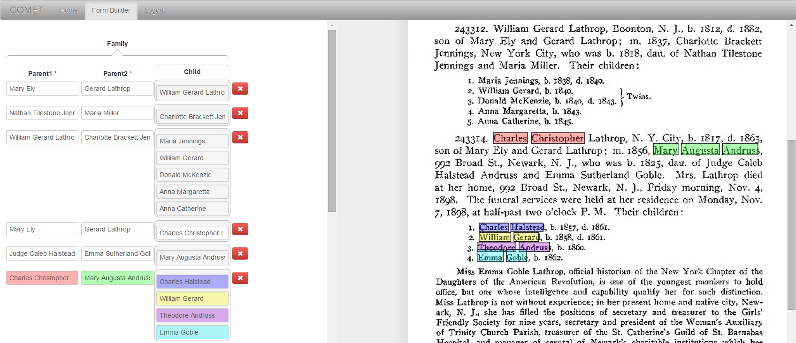
COMET Interface
Click on text in the page on the right to fill in fields in the form on the left
√
√
√
√

Slide 4
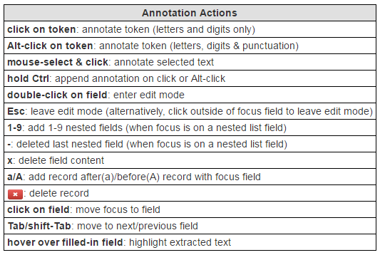

Slide 5
  Get full name, including any punctuation, title(s) and suffix, but not non-name components associated with the name such as possessives.
Mrs. Lathrop (include title “Mrs.”)
Isaac Steel, Sr. (include the comma after “Steele” but not after “Sr.”)
Chief Justice Waite (omit apostrophe “s”)

Slide 6

For combined names, get complete names of both.
George McKown
Myrtle Parker McKown
Mr. Ovidio D. Ferrara
Mrs. Ovidio D. Ferrara
Rex Call
Arta (Shippee) Call
Note: Retain the parentheses in the name.

Slide 7
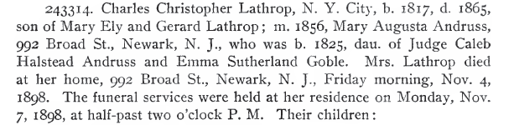
Get full date and place names, including modifiers and punctuation.
date modifiers (include)
not date modifiers, not date explanations
(exclude)
punctuation part of place (include)
street addresses (exclude)
days of the week (exclude)
punctuation part of date
(include)
punctuation not part of date (exclude)
punctuation not part of place (exclude)
Notes:
Picking up “Newark, N. J.” by clicking only is tricky: one way to do it is Alt-click on “Newark,”, Alt-click on “N.”, and select-click for “J.” where the selection omits the trailing comma “,”. Another way: select-click “Newark, N. J.” (omitting the comma). If frustrating, another way is to include the comma “J.,” and then edit to remove the comma. Don’t, however, just type in “Newark, N. J.” or any part of it without first extracting.

Slide 8
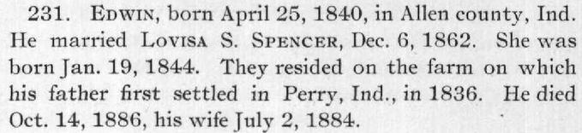
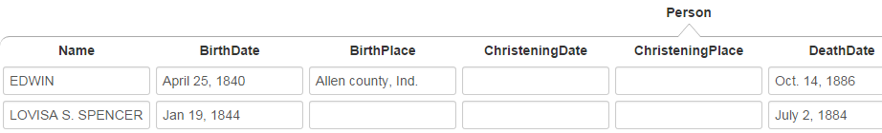
Resolve pronouns and person designators to the primary name to which they refer.

Slide 9
Gender Designators – choose any one
If wondering which to choose, prefer the closest – here “son” and “dau.”

