Slide 1
Towards large-scale, open-domain and ontology-based named entity classification
Philipp Cimiano and Johanna Völker
University of Karlsruhe
Proceedings of the International Conference on Recent Advances in Natural Language Processing (RANLP’05) 2005

Slide 2
Objectives
Abstract
Named entity recognition and classification research
has so far mainly focused on supervised techniques
and has typically considered only small sets of classes
with regard to which to classify the recognized entities.
In this paper we address the classification of
named entities with regard to large sets of classes
which are specified by a given ontology. Our approach
is unsupervised as it relies on no labeled training data
and is open-domain as the ontology can simply be
exchanged. …
682
Ontology = Concept Hierarchy

Slide 3
Supervised v. Handcrafted v. Bootstrapping
… a supervised approach requiring thousands
of training examples seems quite unfeasible. On the other
hand, the use of handcrafted resources such as gazetteers
or pattern libraries … is equally unfeasible. Interesting
and very promising are approaches which operate in a
bootstrapping-like fashion, using a set of seeds to derive
more training data …

Slide 4

Annotator Disagreement
682 concepts: A produced 436; B produced 392.
There were 277 named entities that were annotated by
both subjects. For these 277 named entities, they used
59 different concepts and coincided in 176 cases, the
agreement thus being 63.54%.

Slide 5
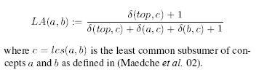
Learning Accuracy
Instead of whether a word is classified, it is how close it is classified in the concept hierarchy
How should we think of and measure learning accuracy?

Slide 6
Word Windows
Harris' distributional hypothesis,
i.e. that words are semantically similar to the extent
to which they share syntactic contexts. [Informally, “a word is known by the company it keeps.”]
In the first experiment we used n words to the left and
right of a certain word of interest excluding so called stopwords
and without trespassing sentence boundaries.
F = 19.7 LA = 57.8

Slide 7
Pseudo-Syntactic Dependencies
Instead of “bag of words” like word windows, it’s first preprocess the surrounding words to create these syntactic dependencies and use them as the “bag of features” to consider.
nice city → nice(city)
a city near the river → near_river(city) & near_city(river)
…
a flamingo is a bird → is_bird(flamingo)
Every country has a capital → has_capital(country)
F = 19.6 LA = 60.0

Slide 8
Dealing with Data Sparseness
Conjunctions (and & or)
Exploiting the Taxonomy (isa hierarchies)
Anaphora Resolution (pronouns)
Downloading Documents from the web
  20 additional documents for entity
  Correct sense? (cosine measure)
Best F = 26.2 LA = 65.9

Slide 9
Postprocessing with
Check statistical plausibility on the Web
Hearst Patterns
  plural(c) such as e
  e and other plural(c)
  e or other plural(c)
  plural(c), especially e
  plural(c), including e
Best F = 32.6 LA = 69.9

Slide 10
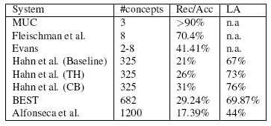
Comparison of Results

