Slide 1
“Sanity-Checks” over
Auto-Extracted
Family-History Data

Slide 2

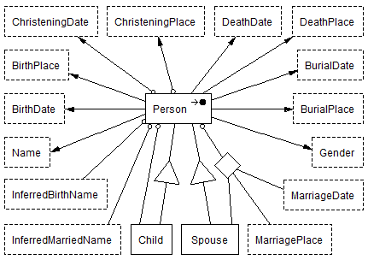
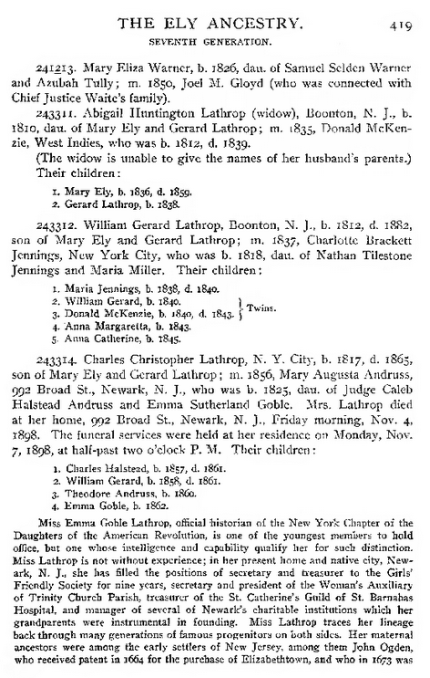
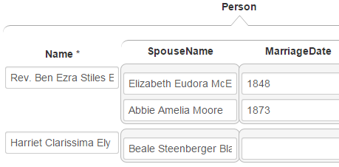
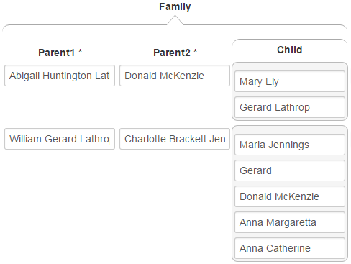
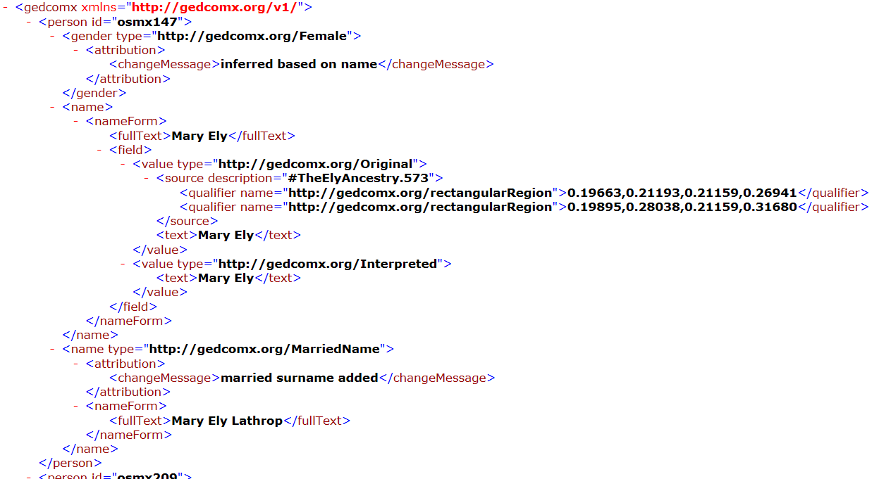
High-Level Architecture
COMET
FROntIER
ListReader
OntoSoar
GreenFIE
Model
Notes:
Overview of Project
Don’t skip the model
Even automated extractors make mistakes – often silly ones
Manual Correction with COMET

Slide 3
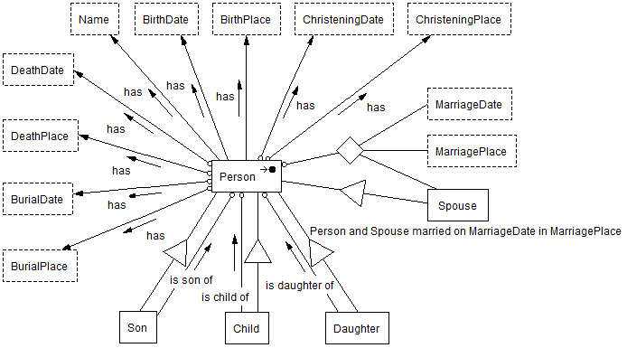
The Model
Child(c) is child of Person(p),
Person(c) has BirthDate(cb),
Person(p) has BirthDate(pb),
person’s Age(cb-pb) at child’s birth has probability(pr)) ⇒
Person(p)’s Age(a) at Child(c)’s birth has Probability(pr)
Notes:
UML-like
A non-valid model
major advantage, you don’t have to weaken constraints
you can thus detect constraint violations
Hard Constraints: Person has 1 and only 1 BirthDate -- it is either true or false
Soft Constraints: The probability of a parent being a given age when a child is born
threshold
cutoff
General Constraints use a Datalog-like syntax and implementation

Slide 4
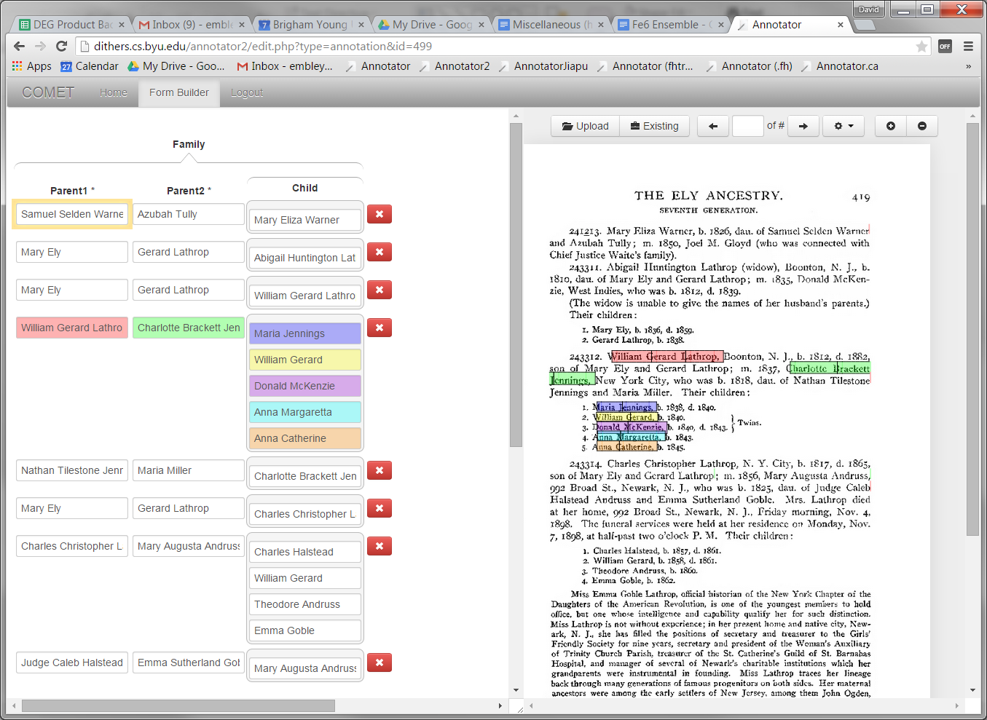
COMET
Notes:
The color coding helps but it is still difficult to manually extract information with pieces spread all over the page
It would be nice if we could automatically detect problems and suggest them to the human inspector

Slide 5
The Constraint Enforcer
FROntIER
Constraint
Enforcer
ListReader
OntoSoar
GreenFIE

Slide 6
Constraint Checker Architecture
Constraint Checker
  Model builder
    Input the model and data
    Outputs DOM
  Constraint compiler produces list of constraints
    A constraint is a command
  Each constraint contains
    A checker – compute probabilities
    One or more handlers – each determines if there are constraint violations and reacts accordingly
Notes:
Constraint Generates a relation of information (e.g. Person’s Age at Childs Birth)
Checker Adds probability to each tuple from Constraint producing a consequent relation
participation constraints are compiled
soft general constraints are linked to a checker that is loaded at run time
due to syntax of general constraints we can extract the name of the checker and load it.
Handler receives consequent tuple plus corresponding antecedent tuples determines if violation occurred
Can do what ever it wants with it (Debug handler, COMET handler)
Typically stored in libraries and dynamically linked

Slide 7
Advantages of Architecture
Because of constraint compiler
  Constraints are declarative
    Not hard wired into the constraint checker
Pluggable nature of components
  Using a configuration file we can add
    General constraints – compiled by constraint compiler
    Checkers – assigned to constraints
    Handler – assigned to constraints
By feeding the constraint checker a different model, it can be used with a different application
Notes:
All it needs is to have the model for the input data.

Slide 8
Execution
for(Constraint constraint : constraints)
Constraint.execute()

Slide 9
Example Result Sent To COMET
Mary Ely is child of Mary Eliza Warner
Mary Ely has Birthdate(1836)
Mary Eliza Warner has Birthdate(1826)
Mary Eliza Warner’s Age(10) at Mary Ely’s birth has Probability(0.05%)

Slide 10
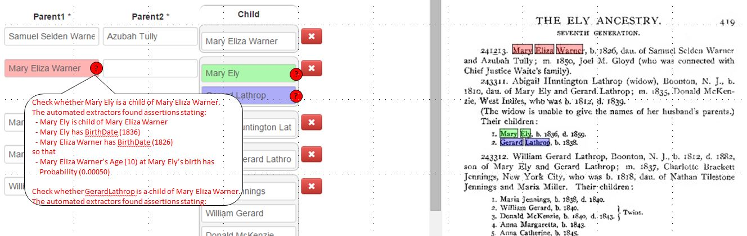
Constraint Violations and Possible Error Sources Integrated Into Family View of COMET

Slide 11
Advantages
Automatic generation of executable constraints
Use of probability-distribution constraints
Flexible
We can suggest reasons for constraint violation
To work with other applications, we just change the model
Notes:
The handlers can be used for much more than error detection. They can be used for research suggestion

