Slide 1
Tree Construction from Semi-Structured Books
Team Members
David W. Embley, Scott N. Woodfield,
Stephen W. Liddle, Deryle W. Lonsdale, George Nagy

Slide 2
Tree-Construction Pipeline
Extract entities
Form and curate persona records
  Group sequences of entities into records
  Add implied relationships
  Add and enhance data values
Merge persona records
  Block on shallow match
  Create deep match equivalence classes
    Check corresponding data values
    Check temp-merge self-consistency
    Check for sufficient evidence
  Merge
Generate intergenerational trees

Slide 3
Tree-Construction Pipeline
Extract entities
Form and curate persona records
  Group sequences of entities into records
  Add implied relationships
  Add and enhance data values
Merge persona records
  Block on shallow match
  Create deep match equivalence classes
    Check corresponding data values
    Check temp-merge self-consistency
    Check for sufficient evidence
  Merge
Generate intergenerational trees
Notes:
Persona Record: a name mention in a book with its associated information

Slide 4
Tree-Construction Pipeline
Extract entities
Form and curate persona records
  Group sequences of entities into records
  Add implied relationships
  Add and enhance data values
Merge persona records
  Block on shallow match
  Create deep match equivalence classes
    Check corresponding data values
    Check temp-merge self-consistency
    Check for sufficient evidence
  Merge
Generate intergenerational trees

Slide 5
Tree-Construction Pipeline
Extract entities
Form and curate persona records
  Group sequences of entities into records
  Add implied relationships
  Add and enhance data values
Merge persona records
  Block on shallow match
  Create deep match equivalence classes
    Check corresponding data values
    Check temp-merge self-consistency
    Check for sufficient evidence
  Merge
Generate intergenerational trees

Slide 6
Extract Entities
8028
Hans Böse, Brinksitzer, Hs. Nr. 56, ~ 5.3.1726, * aus 8025, + 9.8.1804,
oo 3.12.1756 Mette Catharina Schörfmann, ~ 15.8.1728, * aus S024, + 17.8.1790,
Kinder: Anna Cathrina * 18.9.1757, oo 17.1.1788 Claus Huljus, H068
Marie Alheit * 30.12.1759, oo 14.11 .1786 Johann Hinrich Henken, H033
Hans Hinrich * 5.1.1763, + 14.6.1779
Georg Christian * 24.1.1766, + 11.8.1766
Sophie Dorothea * 3.7.1767, oo 10.5.1795 Garsten Hinke, H048
Extraction Templates Created by Example
Label = Type = Class | Entity Type Indicator | Extracted Entity Text
BirthDate | * | 3.7.1767
DeathDate | + | 11.8.1766
ChildName | SOL Kinder: | Anna Cathrina
ChildName | SOL TAB | Marie Alheit
Parent | aus | 8025
Notes:
Program GreenQQ by example.
* Analysis to lexical analysis (author chooses syntax)
* Machine Learning (one-shot learning, and active learning)
GN’s implementation programmed by hand

Slide 7
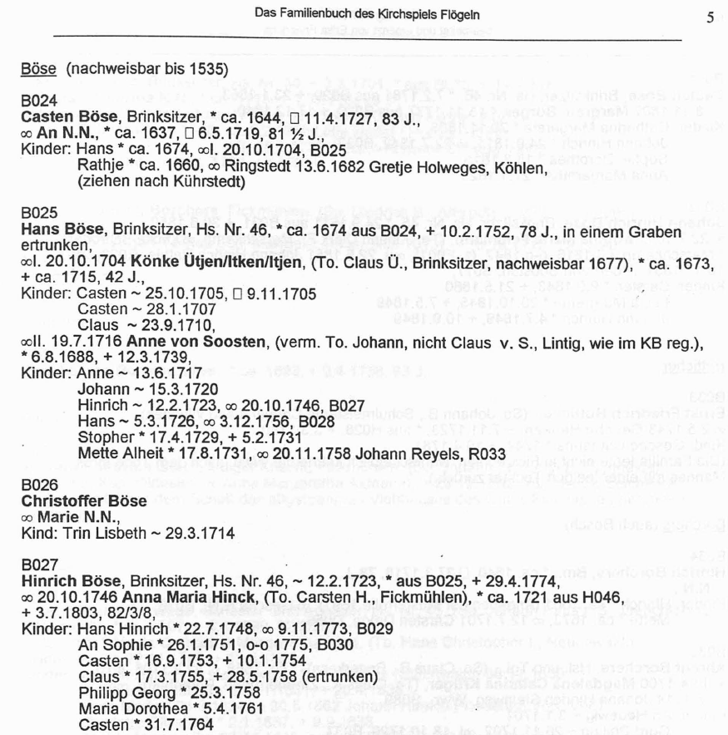
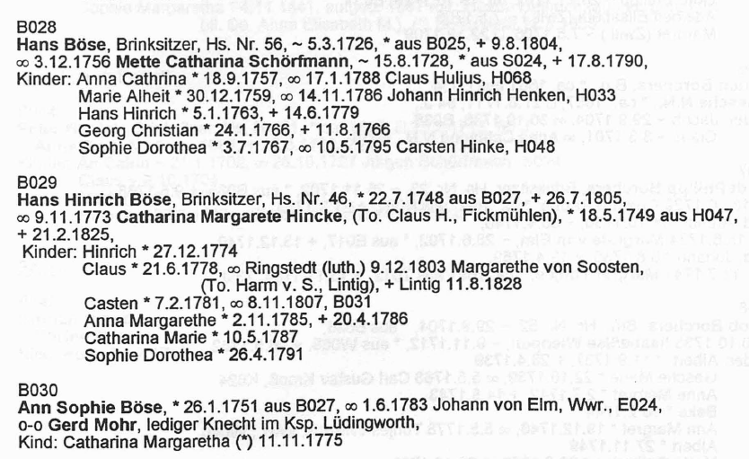
Extract Entities
8024
Casten Böse
Reference ID
Head Name
Casten Böse
Gender Designator
An N.N.
Name
ca. 1644
Birth Place
Christening Date
Christening Place
17.4.1729
Birth Date
Death Date
Death Place
Burial Date
Burial Place
Casten Böse
8024
Parent 2
Name
H046
Parent 1
Casten Böse
Spouse Name
Marriage Event Date
Marriage Event Place
Name
Casten Böse
Child
Name
Notes:
Equivalent to copy paste, but faster

Slide 8
Extract Entities
8024
Casten Böse
Reference ID
Head Name
Casten Böse
Gender Designator
An N.N.
Name
ca. 1644
Birth Place
Christening Date
Christening Place
17.4.1729
Birth Date
Death Date
Death Place
Burial Date
Burial Place
Casten Böse
8024
Parent 2
Name
H046
Parent 1
Casten Böse
Spouse Name
Marriage Event Date
Marriage Event Place
Name
Casten Böse
Child
Name
Notes:
Resolve ReferenceIDs

Slide 9
Extract Entities
8024
Casten Böse
Aggregate Grouping Identifier
Reference ID
Head Name
Casten Böse
Gender Designator
Vital Information Record
An N.N.
Name
ca. 1644
Birth Place
Christening Date
Christening Place
17.4.1729
Birth Date
Death Date
Death Place
Burial Date
Burial Place
Casten Böse
8024
Parent 2
Parent Record
Name
H046
Parent 1
Casten Böse
Spouse Name
Marriage Event Date
Marriage Event Place
Name
Marriage Record
Casten Böse
Child
Name
Parent-Child Record

Slide 10
Form and Curate Persona Records
Vital Information Record
Marriage Record
Parent Record
Parent-Child Record
Notes:
For each Persona, merge the base records (Person, ChildOf, Marriage, and Family)

Slide 11
Form and Curate Persona Records
Notes:
For each Persona, merge the four base records (Person, ChildOf, Marriage, and Family); we get a Persona record for every mention of an extracted name in the book – many thousands.

Slide 12
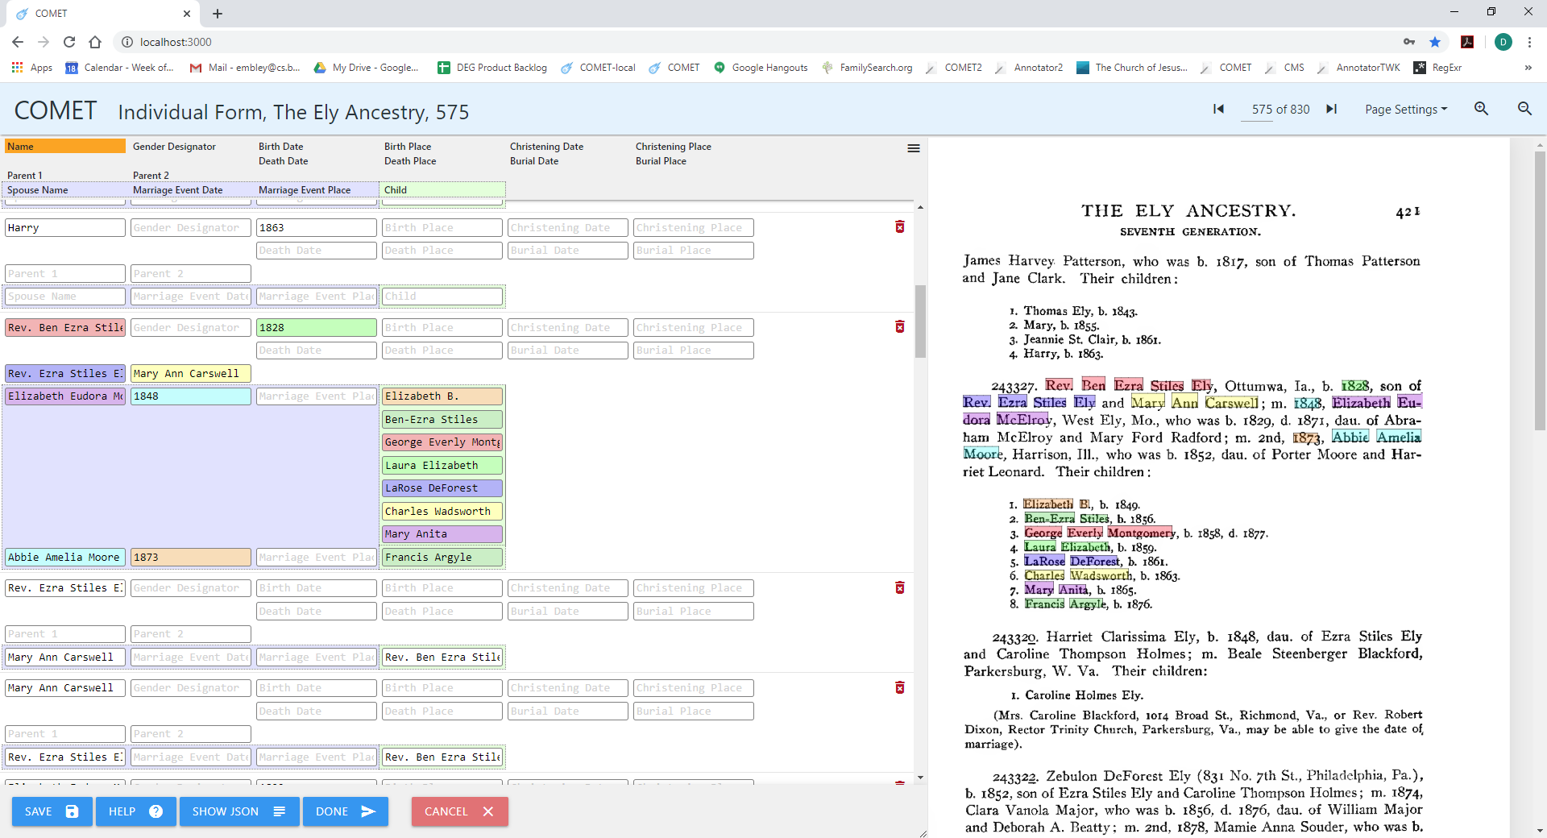
Form and Curate Persona Records
Notes:
Curate records: (1) add non-extracted but implied relationships among people, …;
41 persona records on this page

Slide 13
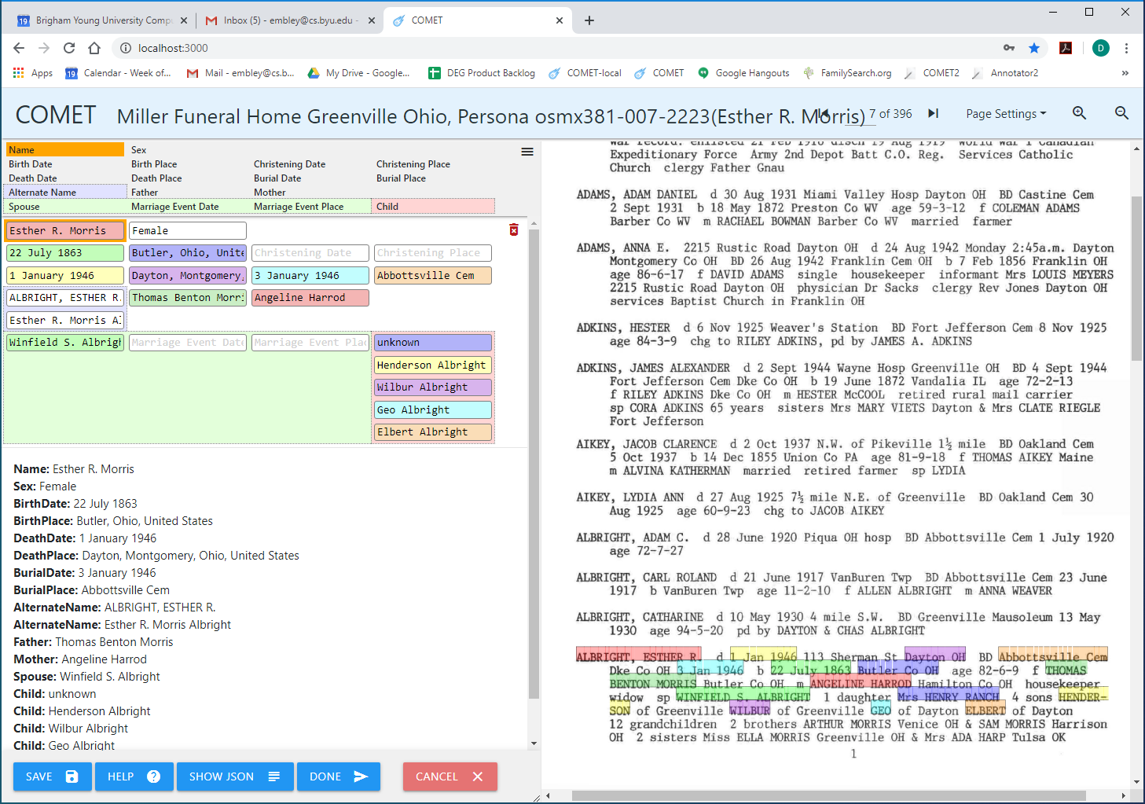
Form and Curate Persona Records
Name:
Birth Surname: Morris
Given Names: Esther R.
Married Surname(s): Albright
Death Date: 1946001-1946001
Death Place: 39.76139,-84.19417
------------------
Original Extracted Entity Text:
ALBRIGHT, ESTHER R.
Mrs HENRY RANCH (“unknown”)
Notes:
Curate records: (1) …, (2) add inferred non-extractable data;
Canonical: Name (name parts), Date (Julian date), Place (Latitude, Longitude)

Slide 14
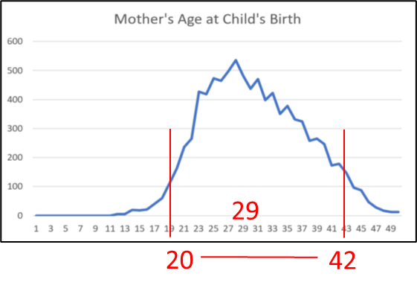
Merge Persona Records
…
Notes:
Shallow-match blocking
For each persona, estimate birth date (if no extracted birth date); e.g. Jane Lyle was most likely born ~1713-1735
Order persona records by information richness
For each Persona, greedily drop into first equivalence in which the name and (estimated) birth date could be a match

Slide 15
Merge Persona Records
…
Notes:
When checking for deep match equivalence classes, push red-flagged and unconfident merges downstream

Slide 16
Merge Persona Records
PAIRWISE COMPARISON OF PERSONA IN SAME EQUIVALENCE CLASS: Book: TheElyAncestry, pages: 432-701
Total number of persona pairwise constraints tested: 13926
Total number of persona pairs red flagged: 1121
Percent of persona pairs that where red flagged = 8.0%
HISTOGRAM OF NUMBER OF RED FLAGGED PAIRS(BY CONSTRAINT) -- 3.8 test cases per X
TwoPeopleHaveTheSameBirthDate XXXXXXXXXXXXXXXXXXXXXXXXXXXXXXXXXXXXXXXXXXXXXXXXXXXXXXXXXXXXXXXXXXXXXXXXXXXXXXXX(300/675 failed 44.4%)
TwoPeopleHaveTheSameDeathDate XXXX(16/67 failed 23.9%)
TwoPeopleHaveTheSameGender XXXXXXXXXXXXXXXX(60/6027 failed 1.0%)
TwoPeopleHaveTheSameName XXXXXXXXXXXXXXXXXXXXXXXXXXXXXXXXXXXXXXXXXXXXXXXXXXXXXXXXXXXXXXXXXXXXXXX(268/6138 failed 4.4%)
TwoPeopleHaveTheSameParents
Mother XXXXXXXXXXXXXXXXXXXXXXXXXXXXXXXXXXXXXXXXXXXXXXXXXXXXXXXXXXXXXXXXXXXX(256/486 failed 52.7%)
Father XXXXXXXXXXXXXXXXXXXXXXXXXXXXXXXXXXXXXXXXXXXXXXXXXXXXXXXXXXX(221/533 failed 41.5%)
According to the TwoPeopleHaveTheSameParents constraint, the probability of James Ely(osmx344-474-603) and James Ely(osmx411-542-674)
having the same Mother is 0.0
The THRESHOLD was 80.0
James Ely's Mother is Betsy Hetfield(osmx476-474-670)
Names:
Betsy Hetfield
Birthdates:
None
James Elys Mother is Lucretia Ray(osmx159-542-767)
Names:
Lucretia Ray
Birthdates:
None

Slide 17
Merge Persona Records
CHECK OF INTEGRITY OF TEMPORARY PAIRWISE MERGE OF PERSONA IN SAME EQUIVALENCE CLASS: Book: TheElyAncestry, pages: 432-701
Total number of merged persona tested by all constraints: 27025
Total number of defective merged persona found by all constraints: 164
Percent of persona who were defective = 0.6%
HISTOGRAM OF NUMBER OF DEFECTIVE MERGED PERSONA(BY CONSTRAINT) -- 1.1 test cases per X
ChildBeingBornYearsAfterMarriageEventDat XXXXXXXXXXXXXXXXXXXXXXXXXXXXXXXXXXXXXXXXXXXXXXXXXXXXXXXXXXXXXXXXXXXXXXXXXXXXXXXX(86/1107 failed 7.8%)
ChildBeingChristenedYearsAfterMarriageEv None Tested
MarriedCoupleCannotHaveSameGenderConstra XXXXXXXXXXXXXXXXXXXXXXXXXXXXXXXXXXXXXXXXXXXXXXXX(52/9919 failed 0.5%)
MotherDiedBeforeChildWasBorn XXXXXXXXXXXXXXXXXXX(20/1339 failed 1.5%)
MotherDiedBeforeChildWasChristened None Tested
ParentHasAgeAtBirthOfChild X(1/6843 failed 0.0%)
ParentsChildrenSpacedFarEnoughApart All Passed(5216 tested)
ParentsOfChildMeetMustMeetParentalConstr All Passed(1347 tested)
PersonCantHaveOverlappingSpouses All Passed(47 tested)
PersonDyingBeforeOrToLongAfterBirth X(1/686 failed 0.1%)
PersonMarriedAfterDeath XXXX(4/521 failed 0.8%)
PersonNotOwnAncestorConstraint None Tested
PersonNotOwnSpouseConstraint None Tested
In the MotherDiedBeforeChildWasBorn constraint (osmx355-504-1596osmx509-650-100T_MERGED) was rejected because
its probability ( 0.0%) did NOT meet the error threshold(0.00010%)
Child: Frederick William(osmx166-505-367)
MothersDeathDate: From: 1856/1/1 To: 1856/12/31
ChildsBirthDate: From: 1869/1/1 To: 1869/12/31

Slide 18
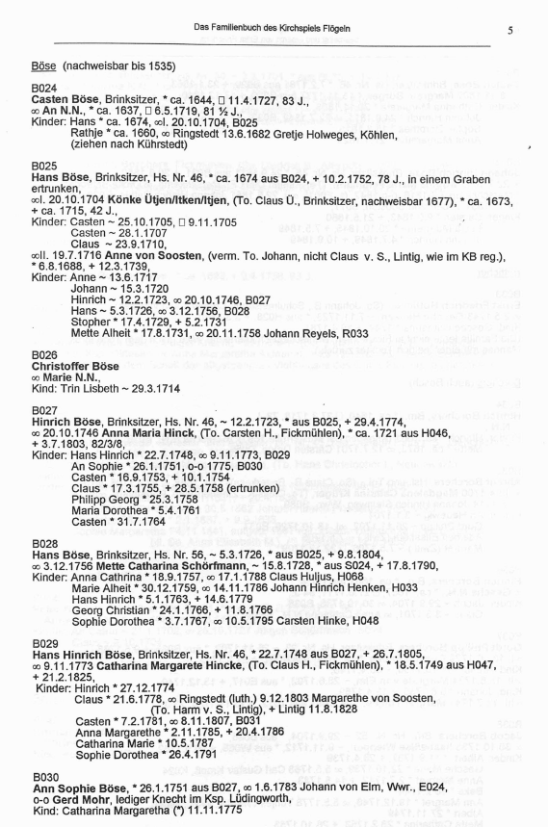
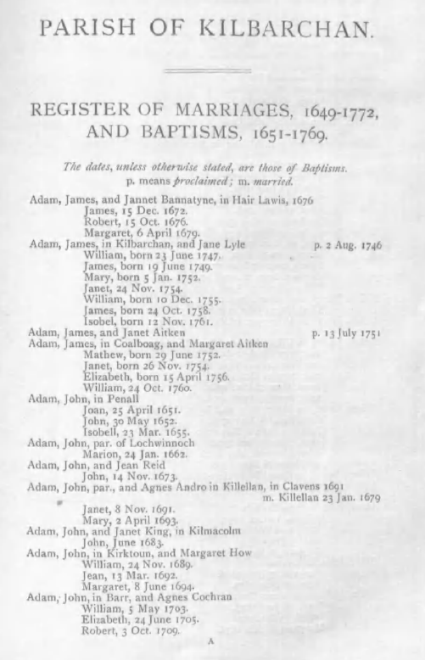
Merge persona records: Check for sufficient confidence
SIMILARITY REPORT FOR Book: FloegelnOFB, pages: 011-123, SHOWING HISTOGRAM OF EQIVALENT PAIR SIMILARITY VALUES
Confidence Threshold = 5.38 (MinNumberOfAttributesRequiredConstant * AverageConstraintResolutionPower)
ALL SIMILARITY VALUES
0.00 <= value <= 1.00 (0)
1.00 < value <= 2.00 (0)
2.00 < value <= 3.00 (0)
3.00 < value <= 4.00 XXXXXXXXXXXXXXXXXXXXXXXXXXXXXXXXXXXXXXXXXXXXXXXXXXXXXXXXXXXXXXXXXXXXXXXXXXXXXXXX(259)
4.00 < value <= 5.00 XXXXXXXXXXXXXXXXXXX(62)
5.00 < value <= 5.38 X(1)
---------------------------------------------------------------------------------------------------- Threshold
5.38 < value <= 6.00 XXXX(4)
6.00 < value <= 7.00 XXXXXXXXXXXXXXXXXXXX(66)
7.00 < value <= 8.00 XXXXXXXXXXXXXXXXXXXXXXXXXXXXXXX(101)
8.00 < value <= 9.00 XXXXXXXXXXXXXXXXXXXXXXXXXXXXXXXXXXXXXXXXXXXXXXXXXX(163)
9.00 < value <= 10.00 (1)
10.00 < value <= 11.00 XXXXXXXXXXXXXXXX(51)
11.00 < value <= 12.00 XXXX(12)
12.00 < value <= 13.00 XXXXXXXXXXXXXXXXXXXXXX(72)
13.00 < value <= 14.00 XXXXXXXXXXXXXXXXX(56)
Number of compatible merge candidates = 526, Number of incompatible merge candidates = 322
Percent of persona pairs with sufficient information for merging = 62.03%
SIMILARITY REPORT FOR Book: KilbarchanParish, pages: 004-128, SHOWING HISTOGRAM OF EQIVALENT PAIR SIMILARITY VALUES
Confidence Threshold = 8.89 (MinNumberOfAttributesRequiredConstant * AverageConstraintResolution Power)
ALL SIMILARITY VALUES
0.00 <= value <= 1.00 (0)
1.00 < value <= 2.00 (33)
2.00 < value <= 3.00 XXXXXXXXXXXXX(872)
3.00 < value <= 4.00 XXXXXXXXXXXXXXXXXXXXXXXXXXXXXXXXXXXXXXXXXXXXXXXXXXXXXXXXXXXXXXXXXXXXXXXXXXXXXXXX(5302)
4.00 < value <= 5.00 XX(163)
5.00 < value <= 6.00 X(83)
6.00 < value <= 7.00 (25)
7.00 < value <= 8.00 (0)
---------------------------------------------------------------------------------------------------- Threshold
Number of compatible merge candidates = 0, Number of incompatible merge candidates = 6478
Percent of persona pairs with sufficient information for merging = 0.00%

Slide 19
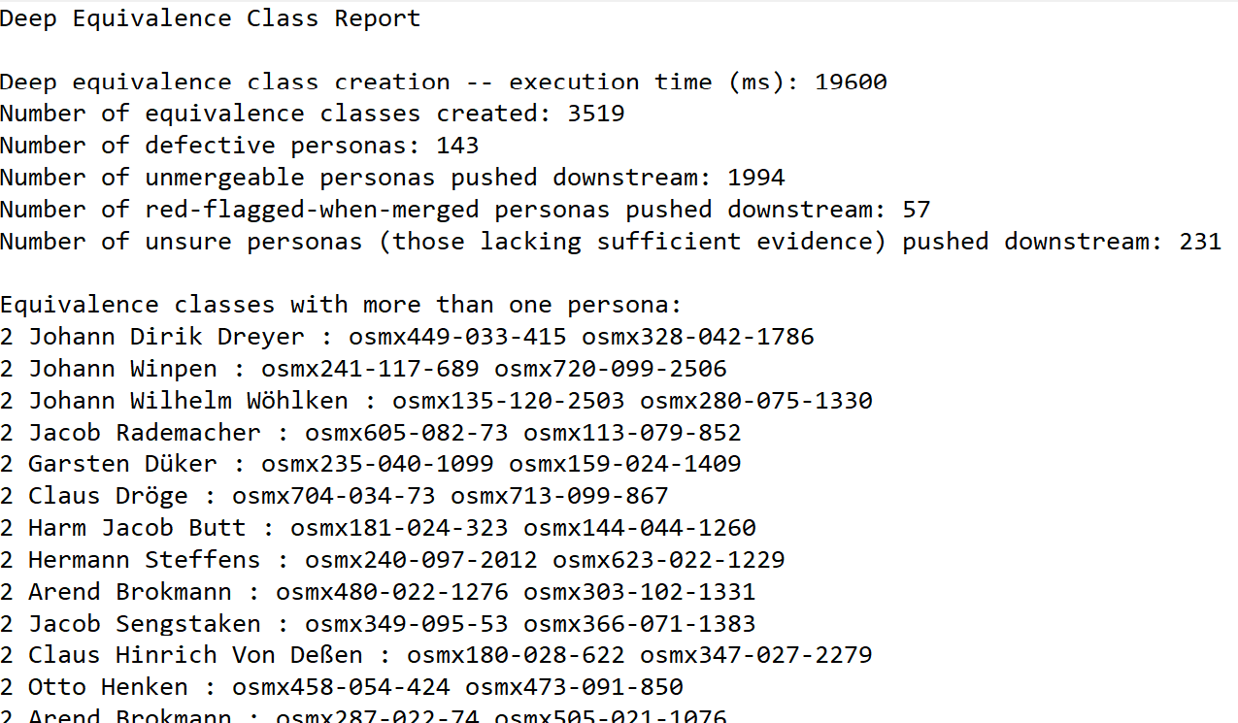
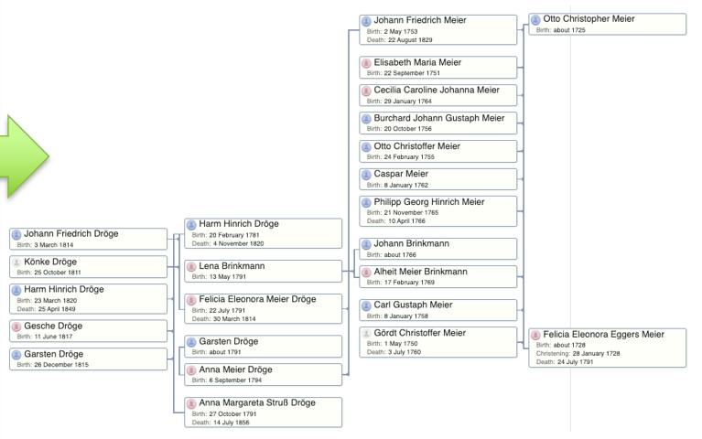
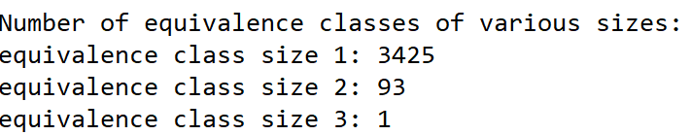
Generate Intergenerational Trees
…

Slide 20
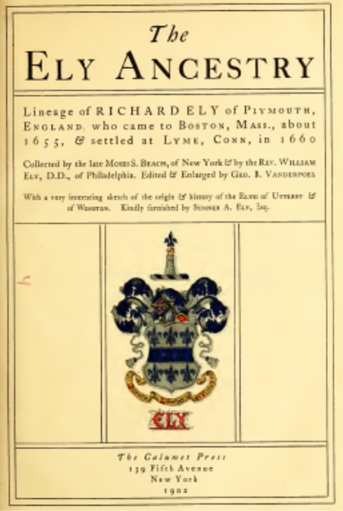
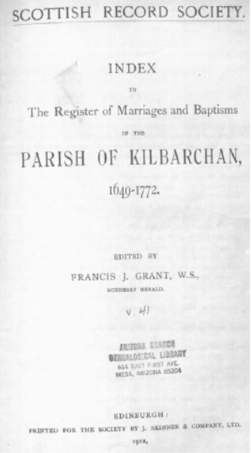
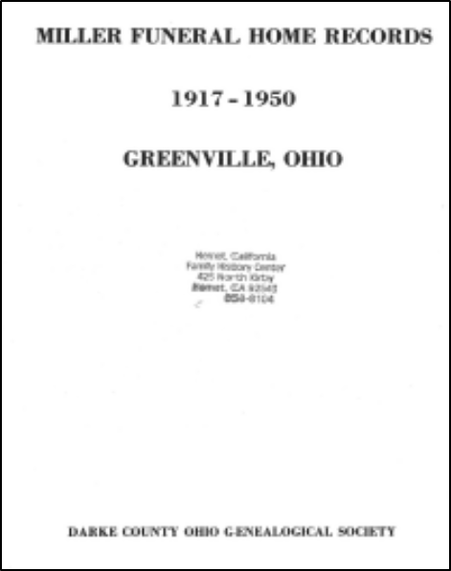
Experimental Results
14,000+ inferred birth and married surnames
17,000+ estimated birth dates
145 seconds vs. 5 days
highly accurate: 90%−99%
Notes:
Recall: all records that should be included are included in a deep-match equivalence class
Precision: no record is included that doesn’t belong

