Slide 1
Semi-automatic Ontology Creation through Conceptual-Model Integration
David W. Embley
Brigham Young University
ER2008

Slide 2
Avi’s Questions
1. Describe a scenario in your field of expertise where data integration plays a major role and the absence of conceptual modeling has a detrimental effect.
2. Introduce a new ‘wacky’ idea to leverage conceptual modeling in data integration.
3. Explain its applicability to data integration, what are its great potentials, what are the great risks.
4. Suggest a few specific research challenges with your idea.

Slide 3
TANGO
(A scenario in which data integration plays a major role, and the absence of conceptual modeling has a detrimental effect.)
TANGO in a nutshell: TANGO repeatedly turns raw tables into conceptual mini-ontologies and integrates them into a growing ontology.
fleck | velter
 | gonsity (ld/gg) | hepth (gd)
burlam | 1.2 | 120
falder | 2.3 | 230
multon | 2.5 | 400
Growing
Ontology

Slide 4
‘Wacky’ Idea
Use the growing ontology itself (and other knowledge resources) to help with the integration.

Slide 5
‘Wacky’ Idea
Use the growing ontology itself (and other knowledge resources) to help with the integration.
Do so by letting the ontologies and knowledge resources be extraction ontologies.

Slide 6
Applicability, Potential, and Risks
Applicability
Not just integration
Also recognizing and conceptualizing semi-structured data
fleck | velter
 | gonsity (ld/gg) | hepth (gd)
burlam | 1.2 | 120
falder | 2.3 | 230
multon | 2.5 | 400

Slide 7
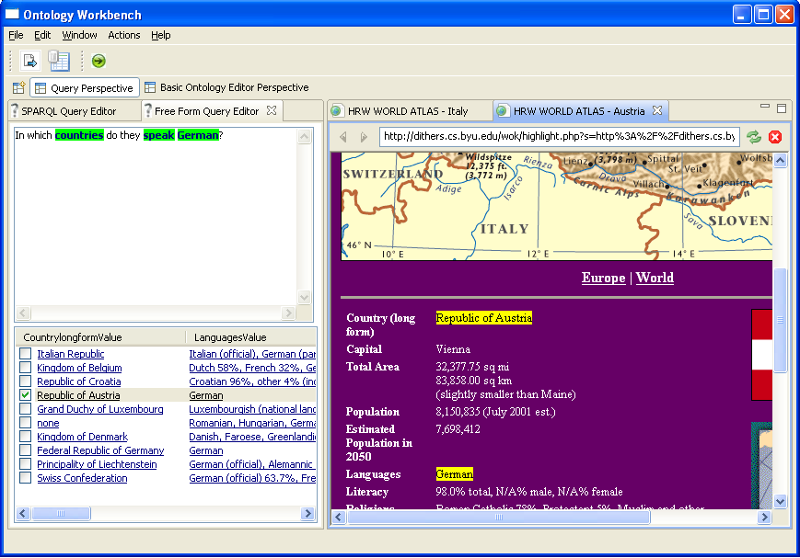
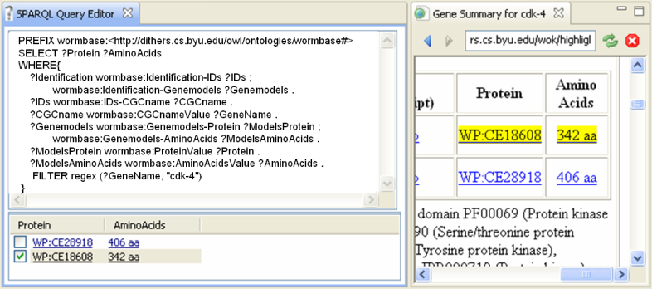
Applicability, Potential, and Risks
Applicability
Not just integration
Also recognizing and conceptualizing semi-structured data
Potential
Not just ontology creation
Also automated annotation & Web of Knowledge construction
OWL
...
RDF

Slide 8
Applicability, Potential, and Risks
Applicability
Not just integration
Also recognizing and conceptualizing semi-structured data
Potential
Not just ontology creation
Also automated annotation & Web of Knowledge construction
Risks
May not work well enough
May be too costly to construct
?

Slide 9
Research Challenges
?
Mitigate the risks
May not work
How do we create an extraction ontology?
What are the formal underpinnings?
Too costly
Synergistic knowledge construction
Learn as you go—self improving
Achieve the potential

