Slide 1
Cross-Language Hybrid Keyword and Semantic Search
David W. Embley, Stephen W. Liddle, Deryle W. Lonsdale, Joseph S. Park, Andrew Zitzelberger
Brigham Young University, USA
&
Byung-Joo Shin
Kyungnam University, Korea
BYU Data Extraction Research Group

Slide 2
Cross-Language Information Retrieval
Q_{English}
Q
한국어
C_{English}
C
한국어
English
한국어

Slide 3
Cross-Language Information Retrieval
Q_{English}
Q
한국어
C_{English}
C
한국어
English
한국어

Slide 4
Cross-Language Information Retrieval
Q_{English}
Q
한국어
C_{English}
C
한국어
English
한국어

Slide 5
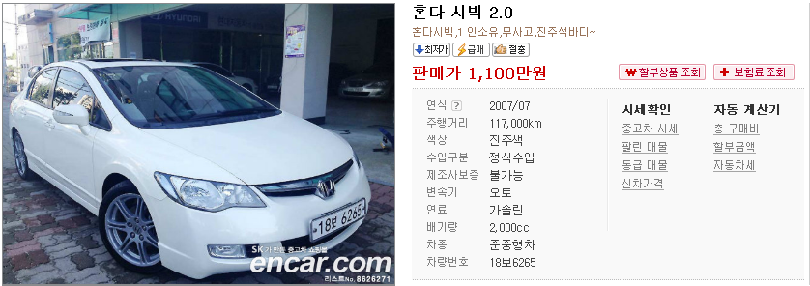
Cross-Language Information Retrieval
Hondas in ‘excellent condition’ under 12 grand
Q
한국어
C_{English}
C
한국어
English

Slide 6
Cross-Language Information Retrieval
Hondas in ‘excellent condition’ under 12 grand
Q
한국어
Make Cost
Honda $9,853
C_{English}
C
한국어
English

Slide 7
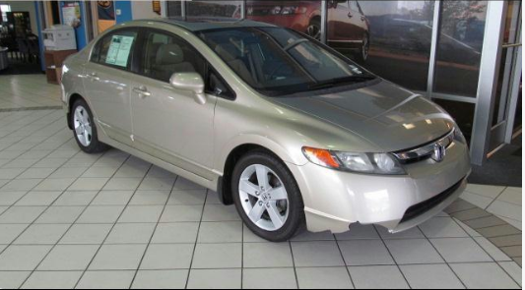
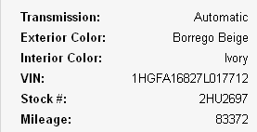
Cross-Language Information Retrieval
1,340 만원 미만의 좋은 상태인 혼다 자동차
Q_{English}
제조사 가격 혼다 1,284 만원
C_{English}
C
한국어
한국어

Slide 8
Cross-Language Information Retrieval
Hondas in ‘excellent condition’ under 12 grand
12 달러 이하 '좋은 조건'에 혼다
12 dollars less than good condition with honda
C_{English}
English
한국어
Notes:
Korean Query: 12 (next 2 characters =) dollars, (next 2 characters =) less than, (next 2 =) good, (next 2 =) condition, (next 1 =) with, (next 2 =) Honda
(literal translation to English)
The translation is from the Google translator. It’s possible to do better—but that’s the point: When we translate at the deep conceptual level, we win.
Google really does give us “dollars”

Slide 9
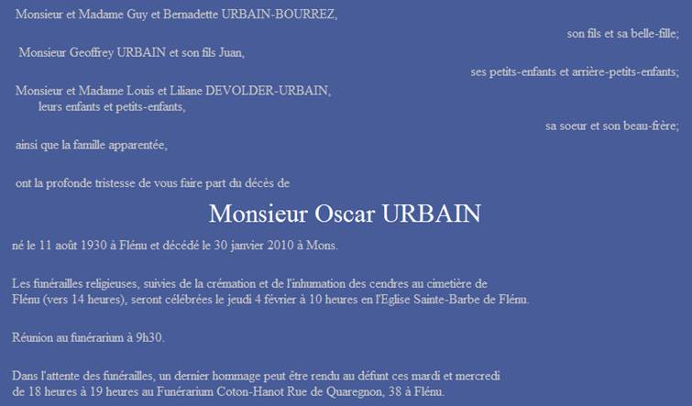
Cross-Language Information Retrieval
Address of funeral home for Oscar Urbain
Q
français
Funérarium Coton-Hanon
rue de Quaregnon, 38
Flénu
C_{English}
C
français
English
Notes:
One other thing to mention by way of introduction: we want this to work for any language and any application that can be conceptualized with a conceptual model. (Here we want an English query over a French obituary.)

Slide 10
ML-HyKSS
Free-form query
Q_{English}
Q
한국어
C_{English}
C
한국어
English
한국어
Semi-structured/unstructured repository
Notes:
Making it all work, our solution: ML-HyKSS
Given

Slide 11
ML-HyKSS
Free-form query
Q_{English}
Q
한국어
Cross-language mappings
C_{English}
C
한국어
Linguistically grounded extraction ontology
English
한국어
Semi-structured/unstructured repository
Notes:
We build structural components to make the algorithmic processes work.

Slide 12
ML-HyKSS
Free-form query
Q_{English}
Q
한국어
Query interpreter
Cross-language mappings
C_{English}
C
한국어
Translator
Linguistically grounded extraction ontology
Keyword and semantic indexer
English
한국어
Semi-structured/unstructured repository
Notes:
… mention keyword indexer is Lucene (standard keyword indexer)

Slide 13
ML-HyKSS
Free-form query
Advanced query form
Q_{English}
Q
한국어
Query interpreter
Cross-language mappings
C_{English}
C
한국어
Translator
Linguistically grounded extraction ontology
Keyword and semantic indexer
English
한국어
Semi-structured/unstructured repository
Notes:
Since free-form queries are treated as conjunctive queries, need advanced query forms (similar to advanced form queries for keyword search).

Slide 14
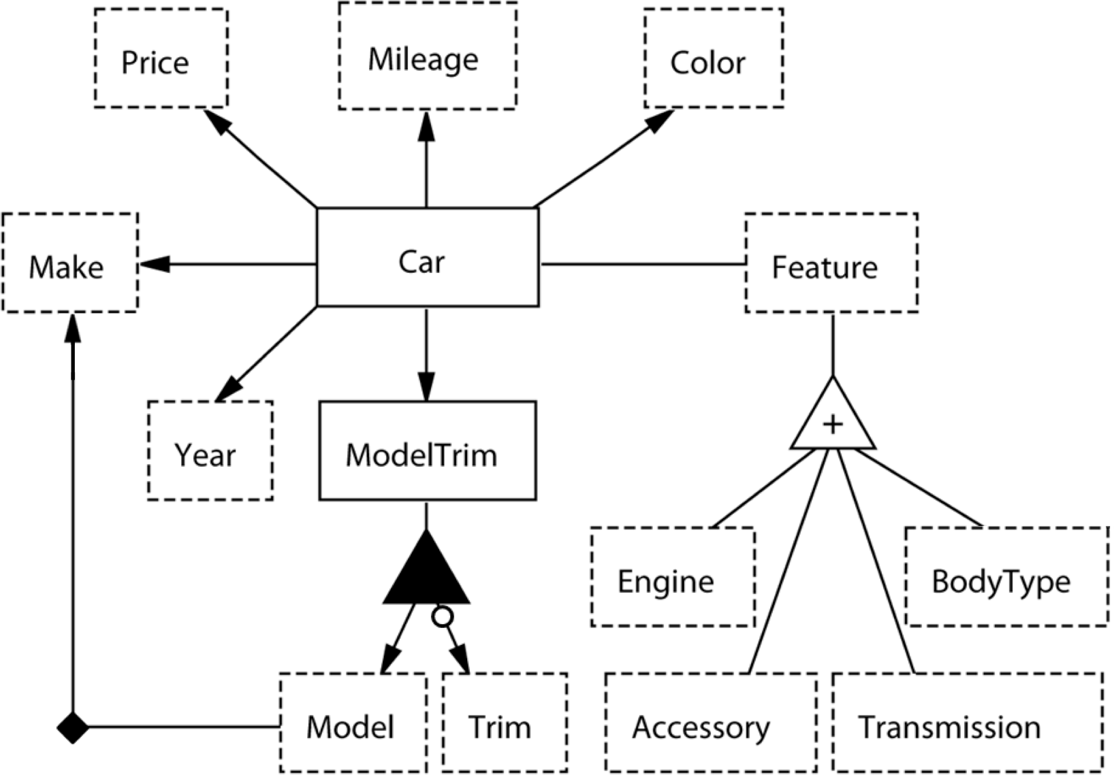
Linguistically Grounded Extraction Ontology
Price
internal representation: Double
external representations: \$[1-9]\d{0,2},?\d{3}
| \d?\d [Gg]rand | ...
context keywords: price|asking|obo|neg(\.|otiable)| ...
...
units: dollars|[Kk] ...
canonicalization method: toUSDollars
comparison methods:
LessThan(p1: Price, p2: Price) returns (Boolean)
external representation: (less than | <
| under | ...)\s*{p2} | ...
...
output method: toUSDollarsFormat
...
end
Make
...
external representation: CarMake.lexicon
...

Slide 15
Semantic & Keyword Indexing
Free-form query
Advanced query form
Q_{English}
Q
한국어
Query interpreter
Cross-language lexicons
C_{English}
C
한국어
Translator
Linguistically grounded extraction ontology
Keyword and semantic indexer
English
한국어
Semi-structured/unstructured repository
Notes:
Since free-form queries are treated as conjunctive queries, need advanced query forms (similar to advanced form queries for keyword search).

Slide 16
Semantic Indexing
‘97 CHEVY Cavalier, Red, 5 spd, only 7,000 miles on her.
Previous owner heart broken! Asking only $11,995. #1415
JERRY SEINER MIDVALE, 566-3800 or 566-3888

Slide 17
Semantic Indexing
‘97 CHEVY Cavalier, Red, 5 spd, only 7,000 miles on her.
Previous owner heart broken! Asking only $11,995. #1415
JERRY SEINER MIDVALE, 566-3800 or 566-3888

Slide 18
Semantic Indexing
‘97 CHEVY Cavalier, Red, 5 spd, only 7,000 miles on her.
Previous owner heart broken! Asking only $11,995. #1415
JERRY SEINER MIDVALE, 566-3800 or 566-3888

Slide 19
Semantic Indexing
‘97 CHEVY Cavalier, Red, 5 spd, only 7,000 miles on her.
Previous owner heart broken! Asking only $11,995. #1415
JERRY SEINER MIDVALE, 566-3800 or 566-3888

Slide 20
Hybrid Semantic & Keyword Queries
Free-form query
Advanced query form
Q_{English}
Q
한국어
Query interpreter
Cross-language lexicons
C_{English}
C
한국어
Translator
Linguistically grounded extraction ontology
Keyword and semantic indexer
English
한국어
Semi-structured/unstructured repository
Notes:
Since free-form queries are treated as conjunctive queries, need advanced query forms (similar to advanced form queries for keyword search).

Slide 21
Free-Form Query Interpretation
Hondas in ‘excellent condition’ under 12 grand

Slide 22
Free-Form Query Interpretation
Hondas in ‘excellent condition’ under 12 grand
< $12,000
= Honda
Notes:
From the conceptual model, we generate a SPARQL query

Slide 23
Keywords in Queries
Remove stop words
Hondas in ‘excellent condition’ under 12 grand
Remove inequality semantic phrases
Keep equality semantic words and phrases
(singular as semantics, literals as keywords)

Slide 24
Query Processing
Hondas in ‘excellent condition’ under 12 grand
Demo
Notes:
Really is an index …
Apparently, must type in query – copy and paste does not work – check

Slide 25
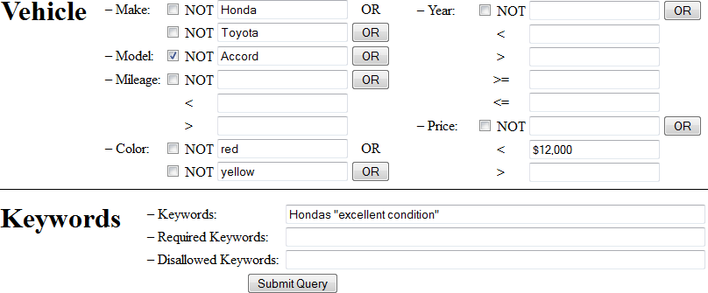
Advanced Form Queries

Slide 26
Conceptual-Level Translation
Free-form query
Advanced query form
Q_{English}
Q
한국어
Query interpreter
Cross-language lexicons
C_{English}
C
한국어
Translator
Linguistically grounded extraction ontology
Keyword and semantic indexer
English
한국어
Semi-structured/unstructured repository
Notes:
Since free-form queries are treated as conjunctive queries, need advanced query forms (similar to advanced form queries for keyword search).

Slide 27
Structural Equivalence
가격
주행거리
색상
제조사
자동차
특징
연식
모델등급
엔진
차대
모델
등급
액세서리
변속기

Slide 28
Structural Equivalence
Accident
가격
주행거리
색상
사고유무
제조사
자동차
특징
연식
모델등급
엔진
차대
모델
등급
액세서리
변속기
Notes:
About 80% of the car ads in Korean say whether the car has been in an accident or not.
Shaken required and expensive smog, safety, and registration certification that can be transferred to new owners if it has not expired

Slide 29
Translations
Lexicon translations
Formulaic translations
Currency translations
Transliterations
Keyword translations
Commentary translations

Slide 30
Lexicon Translations
Honda
혼다
blue

Slide 31
Formulaic Translations
foot
meter
Good Friday, 2012
Karfreitag, 2012
4/6/12
2012년 4월 6일
April 6, 2012
Vendredi saint 2012
Notes:
Julian date – April 6, 2012 is Good Friday. … central language agnostic ontology

Slide 32
Formulaic Translations
foot
meter
Good Friday, 2012
Karfreitag, 2012
4/6/12
2012년 4월 6일
April 6, 2012
Vendredi saint 2012
Notes:
Julian date – April 6, 2012 is Good Friday. … central language agnostic ontology

Slide 33
Formulaic Translations
foot
meter
meter
Good Friday, 2012
Karfreitag, 2012
4/6/12
2012097
2012년 4월 6일
April 6, 2012
Vendredi saint 2012
Notes:
Julian date – April 6, 2012 is Good Friday. … central language agnostic ontology. The writing is likely standardized in only one way, e.g., April 6, 2012.

Slide 34
Currency Translations
under 12 grand
< $12,000
< 13,361,331원
$9,880
1,100 만원

Slide 35
Transliterations
신병주
Hangul/Latin-Language Transliterator
Byungjoo Shin
Notes:
Gives us one way of Romanizing his name

Slide 36
Keyword Translations
‘excellent condition’ <<excellent état>>
‘excellent condition’
(good condition)
좋은 상태인
인
“inn” (i.e., “hotel”)
“is in”
Notes:
Bing translator examples: include OK translations and incorrect translations. Stop word problems. excellent -> good (1st 2 characters), condition -> condition (last 3 characters)
‘excellent condition’ becomes ‘which is in good condition’

Slide 37
Commentary Translations
Korean age reckoning is a newborn child was one year old. Since then, the age is changed in the new year. In this way, children born on December 31, the next day is changed to two years of age. In this age of reckoning is not used officially (and legally) on a daily basis, and widely accepted in Korea.
Notes:
Bing translation service

Slide 38
Construction Issues
Semi-automatic construction of extraction ontologies
Information extraction research
Query ontologies vs. extraction ontologies (WordNet)
Semi-automatic construction of cross-language mappings
Language-agnostic, star-shaped mapping configuration
Pay-as-you-go construction

Slide 39
Evaluation: Semantic Indexer
Free-form query
Advanced query form
Q_{English}
Q
한국어
Query interpreter
Cross-language lexicons
C_{English}
C
한국어
Translator
Linguistically grounded extraction ontology
Keyword and semantic indexer
English
한국어
Semi-structured/unstructured repository
Notes:
Since free-form queries are treated as conjunctive queries, need advanced query forms (similar to advanced form queries for keyword search).

Slide 40
Evaluation: Semantic Indexer
Make Model Year Price Color Mileage
French Recall 87% 76% 96% 89% 82% 98%
Precision 65% 67% 90% 95% 47% 92%
Korean Recall 99% 99% 100% 100% 100% 95%
Precision 99% 99% 100% 100% 100% 95%
Death Funeral Mortuary Relative Name
Title Name Date Date Time Place Name &Relation
French Recall 76% 42% 80% 69% 43% 38% N/A
Precision 99% 63% 88% 70% 30% 83% N/A
Korean Recall N/A 97% 97% 50% 50% 100% 99% 97%
Precision N/A 97% 97% 100% 100% 67% 94% 94%
Notes:
Precision and recall for Korean car ads are high because these ads mostly have
a regular structure, allowing our Korean expert to quickly tune the extraction
ontology. Results for French car ads are lower both because French ads are more
free-form and because we were not able to spend enough time with our French
expert tuning the extraction ontology (as one consequence, we did not finish
relative-name extraction—hence the empty cell in Table 2). Overall, the numbers
are in line with what we have come to expect in this domain [4]. The obituaries
domain is much broader and extraction is more challenging—particularly
for names and places. Even so, our Korean expert was able to quickly tune the
extraction ontology, and performance for most concepts was remarkably high.
French extraction was hampered by greater variability and complex sentence
structures. For example, there are only 187 names in our Korean surname lexicon,
compared with 228,429 in our French surname lexicon, which partially
explains the relatively high performance for Korean name extraction. Most Korean
obituaries do not mention a funeral, and in our test set there were only
two examples of funerals. Our extractor did well with one of the two declared
funerals, so the 50% recall we report for funeral date and time represents only
one missed concept for the entire corpus. Another cultural difference is that
the mortuary name is important in a Korean obituary because that is where
friends and family make condolence calls. In contrast, French obituaries refer to
viewings, funerals, and interments, much like typical English obituaries. Since
mortuary name does not appear in the French obituary ontology, and title does
not appear in the Korean ontology, we mark their cells as “N/A”. Performance
for concepts not listed in Table 2 (e.g. viewing, interment, birth date) is similar
to the performance for concepts that are listed.

Slide 41
Evaluation: Interpreter/Translator
Q_{English}
Q
한국어
Query interpreter
C_{English}
C
한국어
Translator
Keyword and semantic indexer
English
한국어
Notes:
Add algorithmic processes.

Slide 42
Evaluation: Interpreter/Translator
Recall Precision
Car Ad Queries σ π κ σ π κ
French to English 77% 86% 100% 81% 90% 74%
Korean to English 98% 100% 100% 93% 99% 52%
}
}
within language query interpretation
(cross-language, necessarily correct)
cross-language translation
Notes:
The lower recall and precision for French conditionals () points to a need
for better recognizers. For example, we missed recognizing “une 1990 ou moins
récente” as the conditional Year 1990. Better recognizers, along with more
complete synonym sets for ontological concepts, would also increase the recall
for requested French results (). Conditional recognition failures also account
for some of the lower keyword () precision, especially for French, as words in
missed semantic conditionals remain as possible keywords. Expanded stopword
lists in French would remove spurious keywords like “list” and “want”. Stopwords
in Korean make little sense because most of the standard English-like stopwords
are prefixes and suffixes and become part of characters themselves. An attempt
to remove them after translation often fails because translations themselves are
Cross-Language Hybrid Keyword and Semantic Search 13
often poor; e.g., , which in our query should translate as “which is”—both
English stopwords—instead was translated as “inn” (or “hotel”).

Slide 43
Conclusions
Cross-language query translation
At conceptual level
Rather than at language level
Prototype implementation
Semantic indexing (average F-measures)
90% for semi-structured car-ads
75% for unstructured obituaries
Query interpretation (average F-measures)
94% for identifying semantic constraints
87% for identifying referenced concepts
77% for identifying keywords
www.deg.byu.edu
Notes:
Experimental results show that ML-HyKSS is able to identify and
index the semantics in data-rich, narrow-domain French and Korean documents
with an average F-measure of about 90% for semi-structured documents (car
ads) and about 75% for unstructured documents (obituaries). Interpretation of
French and Korean queries have average F-measures of about 94% for identifying
semantic constraints, 87% for identifying referenced concepts of interest, and
77% for identifying keywords. Non-semantic keyword translations are often less
than ideal, but since ML-HyKSS translates queries at the conceptual level across
language-diverse but structurally identical ontologies, its semantic translations
are necessarily correct. Hence, results returned are surprisingly accurate.

