Slide 1
FOCIH: Form-based Ontology Creation and Information Harvesting
Cui Tao, David W. Embley, Stephen W. Liddle
Brigham Young University
Nov. 11, 2009
Supported in part by the National Science Foundation under Grant #0414644 and by the Rollins Center for Entrepreneurship and Technology at BYU

Slide 2
Outline
Research challenge: enabling the “web of data”
Possible solution: create ontologies and populate them with data
Our contribution: FOCIH
  Form creation and annotation
  Ontology generation
  Automatic semantic annotation
  Experimental results
  Future work and conclusions

Slide 3
Challenge
One vision for Web 3.0 is a machine-readable “web of data” or “knowledge web”
  Users query for facts directly, instead of searching for pages containing facts
Creating ontologies and populating them with data would produce such a web of data
But content creation is a major challenge
  Creating ontologies is difficult
  Populating them is difficult
  Difficult means “human intensive” & “technically challenging”

Slide 4
Web Scalability
Researchers are working on web-of-data scalability
Journal of Web Semantics call for papers
  “human-scalable and user-friendly tools that open the Web of Data to the current Web user”
Significant automation is required
  Ontology creation support
  Automatic semantic annotation support

Slide 5
Current Approaches
Semi-automatic ontology-creation tools derive concepts from source data, not users
  Some users need to express their own ontological world views
Automatic semantic annotation tools also have problems
  Post-extraction alignment with ontologies
  Creation of extraction ontologies requires human expertise to create, assemble, tune

Slide 6
Our Vision
FOCIH (Form-based Ontology Creation and Information Harvesting)
  Eases burden of manual ontology creation while still giving users control over ontological views
  Enables automatic annotation
    Aligns with user-specified ontologies
    Does not require manual ontology creation
    Is precise

Slide 7
FOCIH Overview
Goal: facilitate semi-automatic construction of web of data
User creates ontology by specifying a “form”
  Not an HTML form, but an every-day form
FOCIH harvests information by filling in the form for each relevant page in a web site
  Machine-generated display pages (hidden web)
FOCIH automatically annotates information according to user’s view

Slide 8
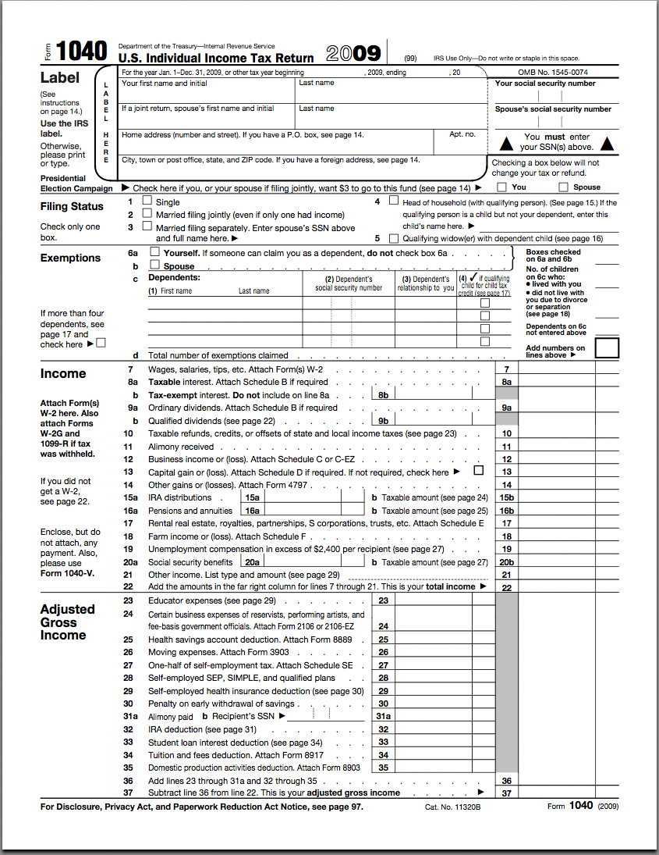
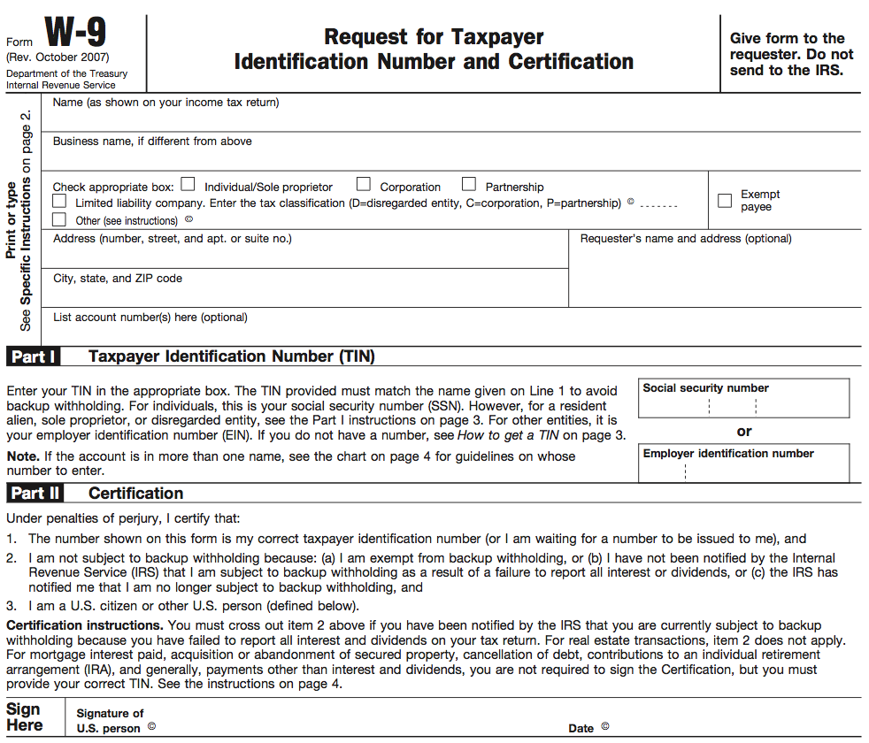
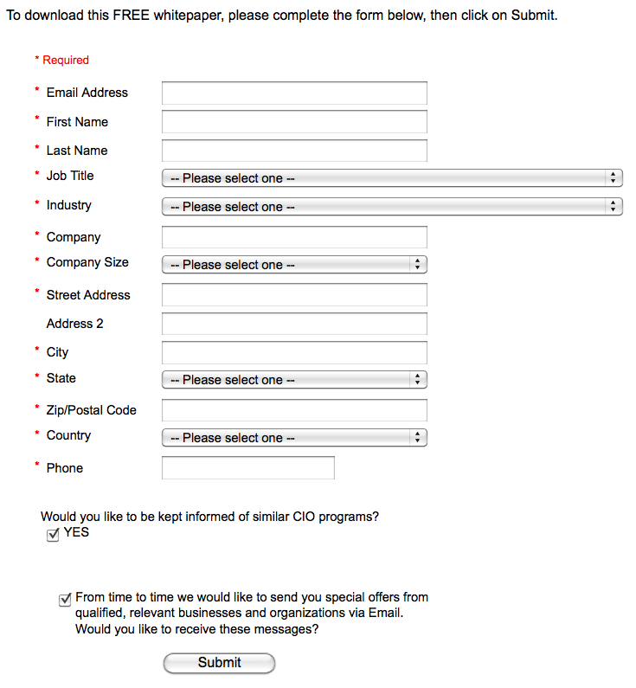
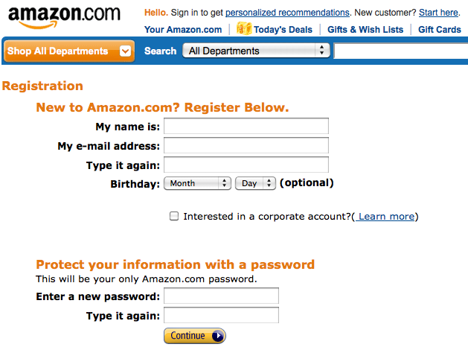
“Every-day” Forms
We use forms all the time
Examples:
  Government tax forms
  Account creation forms

Slide 9
FOCIH Operation Modes
Form creation
  Users create forms that express how they want to organize information
Form annotation
  Annotate pages with respect to created forms

Slide 10
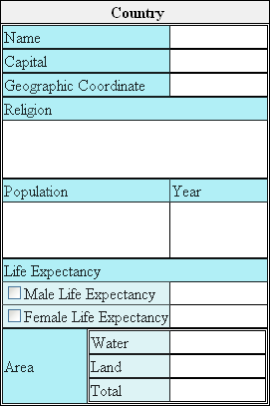
Form Creation
Single-label/single-value
Single-label/multiple-value
Multiple-label/multiple-value
Mutually-exclusive choice
Non-exclusive choice
Form elements may nest
to an arbitrary depth
Typical form for country information
Blue indicates labels
White indicates spaces for entering data

Slide 11
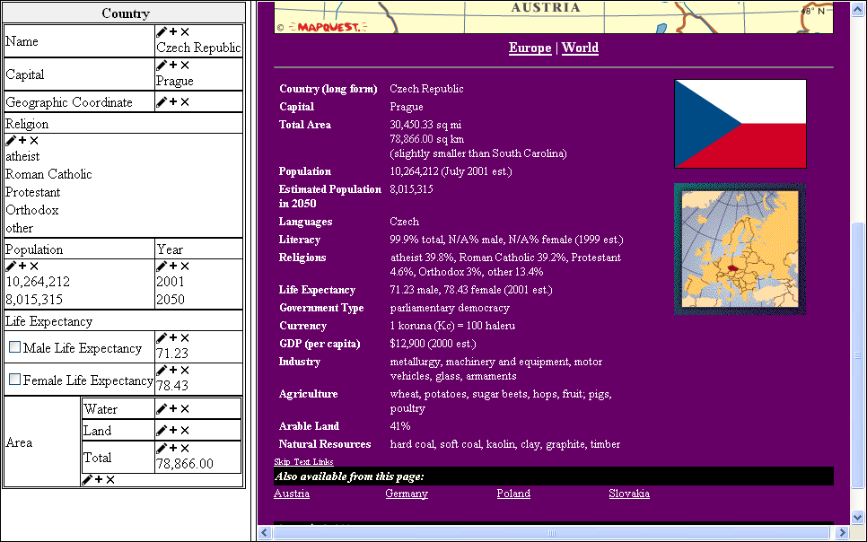
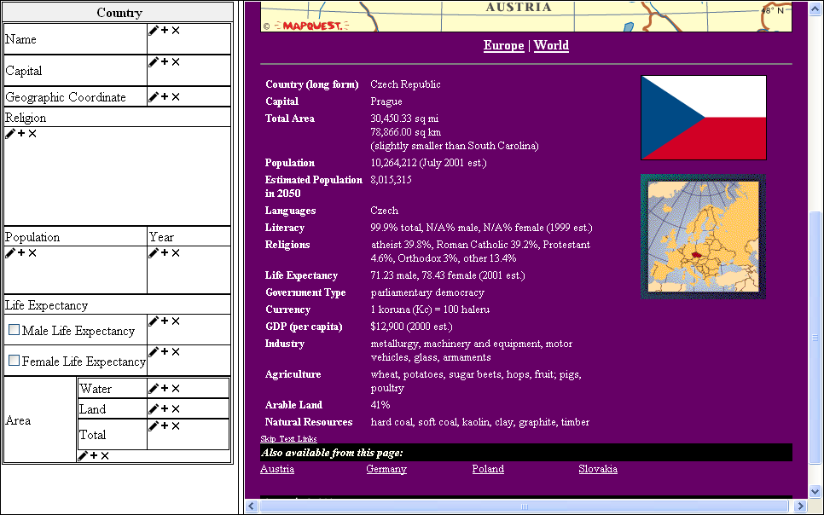

Form Annotation
After creating a form, user can annotate web pages with respect to the form
Operations include:
  Annotate selection
  Concatenate selection
  Delete annotation

Slide 12
Ontologies from Forms
FOCIH infers and generates ontology from user-created form
We use OSM as the conceptual-model basis for extraction ontologies
  High-level graphical representation translates directly to predicate calculus
  Translation to OWL and various description logics is straightforward
  We have implemented data-extraction tools for OSM

Slide 13
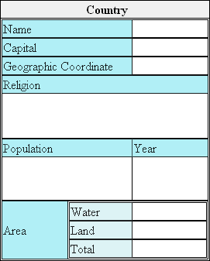
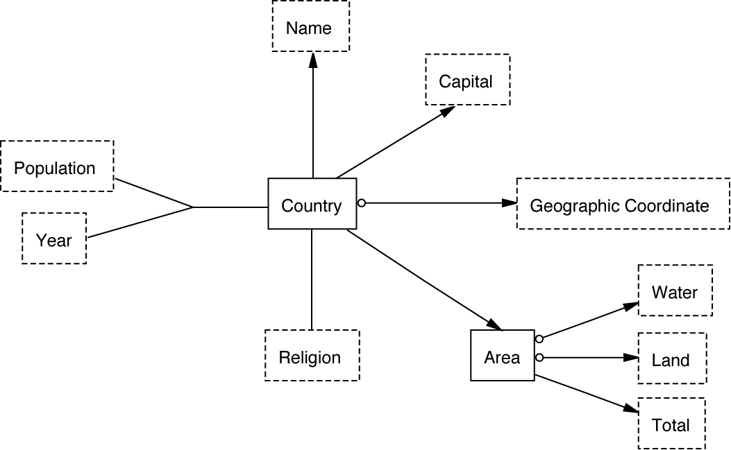
Country Ontology

Slide 14
Generation Notes
Can only generate some of the desirable constraints
  Inverse direction functionality (child to parent)
  Mandatory vs. optional
Harvesting phase adds information

Slide 15
Automatic Semantic Annotation
User must annotate the first page manually, but only one page
FOCIH harvests the rest
  Uses layout patterns to identify paths to instance values and location of instance-value substrings in DOM-tree nodes
Context is machine-generated web pages
  These are sibling pages with a fairly regular structure

Slide 16
DOM Processing
FOCIH identifies XPath expressions for each instance value
  Or, more precisely, for each component of an instance value
Instance value may cover the target node
  E.g., “Prague” in our running example is the entire text of the corresponding DOM node
Harder case: instance value may be a proper substring of the target node

Slide 17
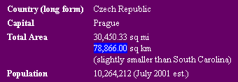
Substring Identification
May need to extract either individuals or lists
Individual pattern:
  Left context \bsq\s*mi\s*
  Right context \s*sq\s*km$
  Instance recognizer decimal number

Slide 18

List Patterns
List pattern:
  Left context sos
  Right context eos
  Instance recognizer \b([a-z]\s*)+\b
  Delimiter [,;]\s*

Slide 19
End Result: RDF
Given path and instance recognition patterns, FOCIH can locate and harvest sibling pages
With data harvested into the user-created form, we have a semantic annotation layer for the web site
Semantic annotations are stored in an RDF file
  Identifies each item of information
  Links each to a concept in the ontology
  Links each to its location within the source page
  Thus we superimpose web of data over web of pages

Slide 20
Experimental Results
FOCIH results depend on regularity of subject web site
40 country pages
  Individual-pattern fields exhibited 100% precision and recall
  Area: 100% precision and recall
  Population: 100% precision, 95-100% recall
    Recall increased to 100% with additional examples
  Less accurate with less-regular fields
    When using Germany as the FOCIH seed page, only harvested 2/3 of the possible values
    When we added alternate annotation patterns derived from other seed pages, precision rose to 95%, recall to 96%
Results from Gene Expression Omnibus and several e-commerce sites were similar

Slide 21
Further Labor Reductions
Two major opportunities when sibling pages have table structures
  We can create initial form automatically
  We can automatically fill in the initial form
TISP (Table Interpretation for Sibling Pages) converts tables on sibling pages into FOCIH forms
  And automatically extracts data from all sibling pages
But user may want to reorganize initial form

Slide 22
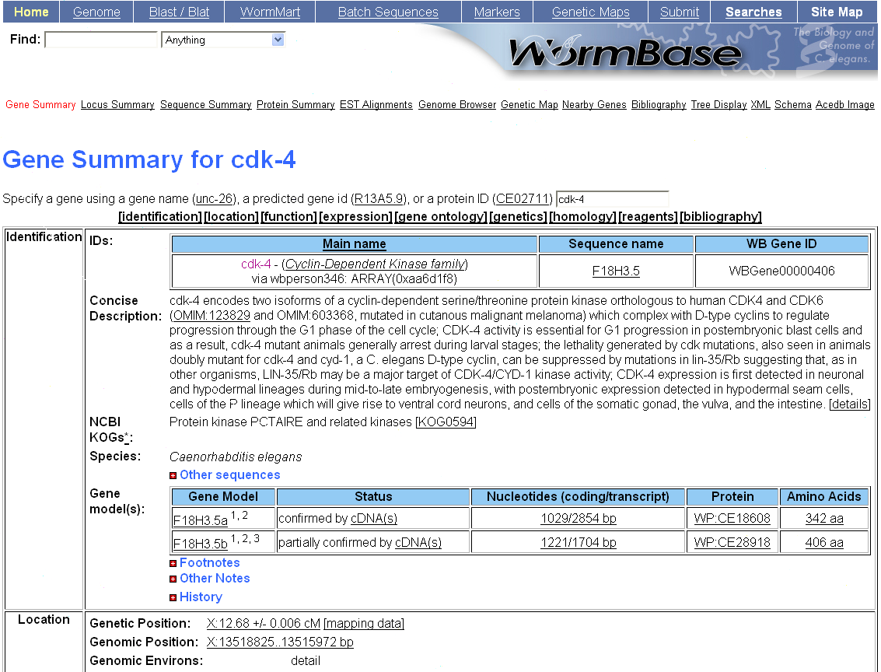
Wormbase Sibling Page

Slide 23
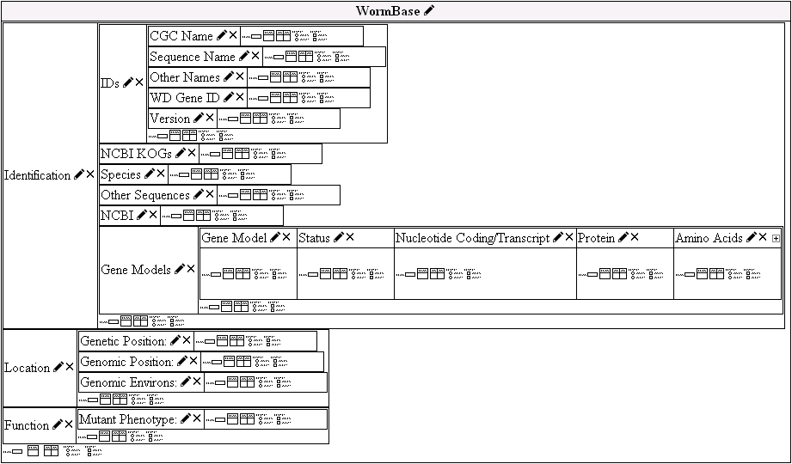
TISP-Generated Form for Wormbase Site

Slide 24
Future Work
Improve on-the-fly generalization capabilities
  Improve overall robustness, especially w.r.t. less-regular pages
Relevant data is sometimes encoded in the mark-up
  E.g., “alt” attribute contains user ratings on NewEgg.com
Mark-up tags could be useful delimiters
  BarnesAndNoble.com embeds authors in “em” nested within an “h1”
HTML anchor tag might help parse lists better

Slide 25
Conclusion: Web of Data
Non-expert users can create ontologies and semantically annotate corresponding web pages
  FOCIH does as much as it can
For regular web sites, automatic information harvesting works well
Resulting semantic annotations can be queried directly as with any RDF data
  Annotations link to location on source page

