Slide 1
Enabling Efficient Chinese Jiapu Information Extraction
Stephen W. Liddle
BYU Information Systems Department
Derek Dobson, David W. Embley, Chuck Liu
FamilySearch

Slide 2
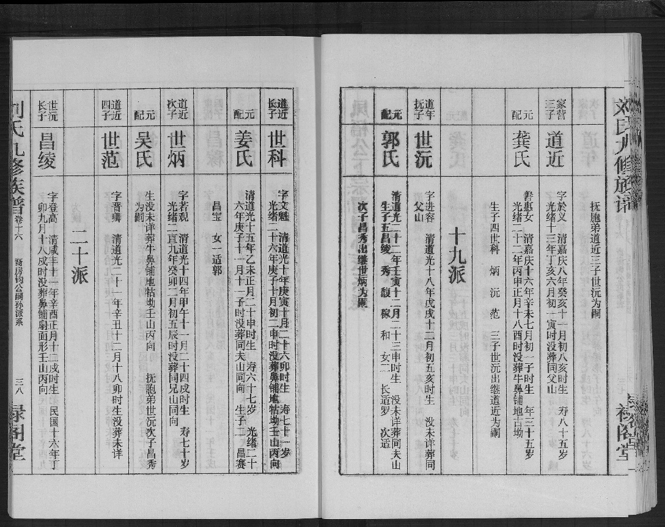
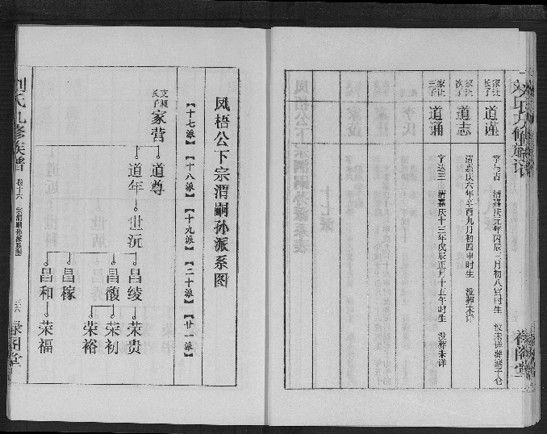
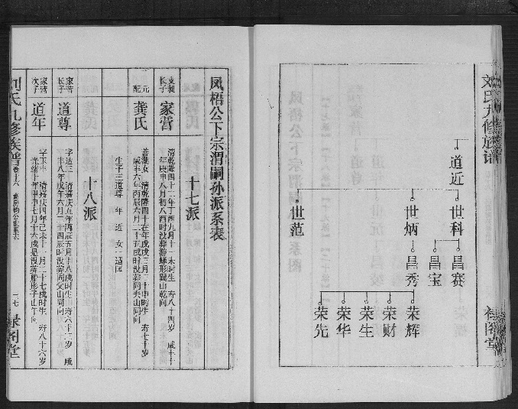
Chinese Jiapu: Clan Family Record
12,871,979 Jiapu images
~ half billion fact assertions
Notes:
Top right image left page: lineage with 5 generations (17, 18, 19, 20, 21), starting from the head (top right, in the large frame), with two sons and a third on the continuation page
Bottom right image right page: continuation of top right page, with more sons
Bottom right image left page: vital information, 3rd column from the right is the head, 4th is his wife

Slide 3
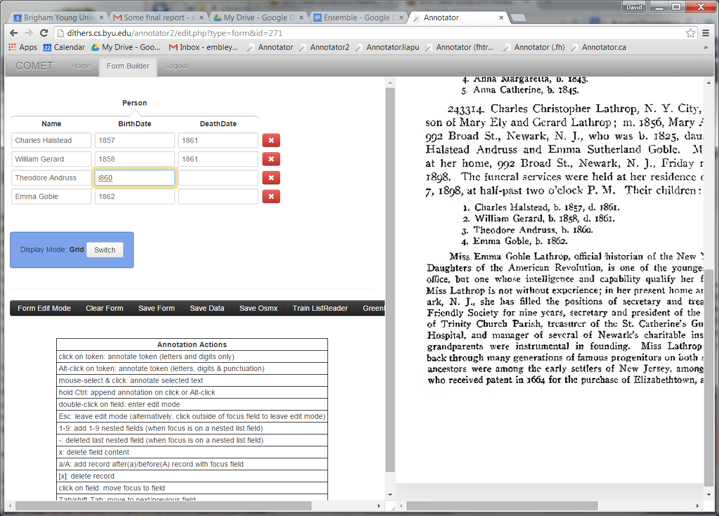
COMET
Click-Only (or at least Mostly) Extraction Tool

Slide 4
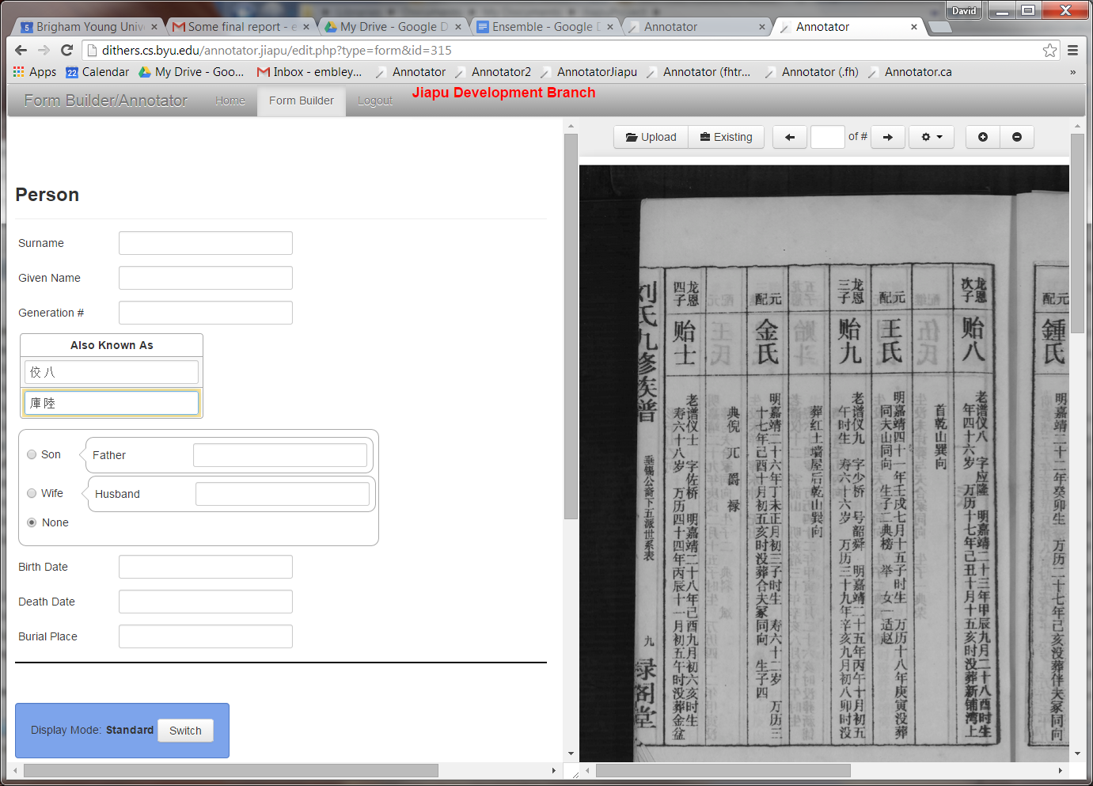
COMET with Jiapu
Notes:
Add additional blow up (not animated on) that shows the IME (Input Method Editor).

Slide 5
COMET with Jiapu
Notes:
Add additional blow up (not animated on) that shows the IME (Input Method Editor).

Slide 6
COMET with Jiapu
Notes:
Add additional blow up (not animated on) that shows the IME (Input Method Editor).

Slide 7
Structured Data Stored for Query and Search

Slide 8
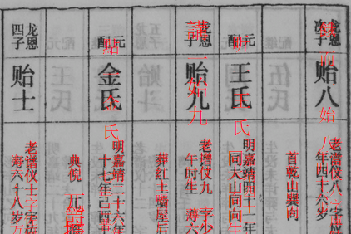
Requirements for COMET to work well with Jiapu
Good alignment
Good OCR

Slide 9
Requirements for COMET to work well with Jiapu
Good alignment
Good OCR
not OK
OK

Slide 10
Requirements for COMET to work well with Jiapu
Good alignment
Good OCR
four characters as one
bad OCR
??
missing OCR
many incorrect characters

Slide 11
OCR Resolution
Currently insufficient:
Acrobat Professional
Tesseract
Abbyy
Is there a better OCR engine for Chinese?
Can we do better with what we have?
Image enhancement
Resize glyphs
Use an ensemble of OCR engines
Train Tesseract for Jiapu peculiarities

Slide 12
Alignment Resolution
Currently
Open source PDFBox: needs work for Acrobat Pro
Tesseract & Abbyy interact incorrectly with PDFBox
Engineering solution (but lots of work)

Slide 13
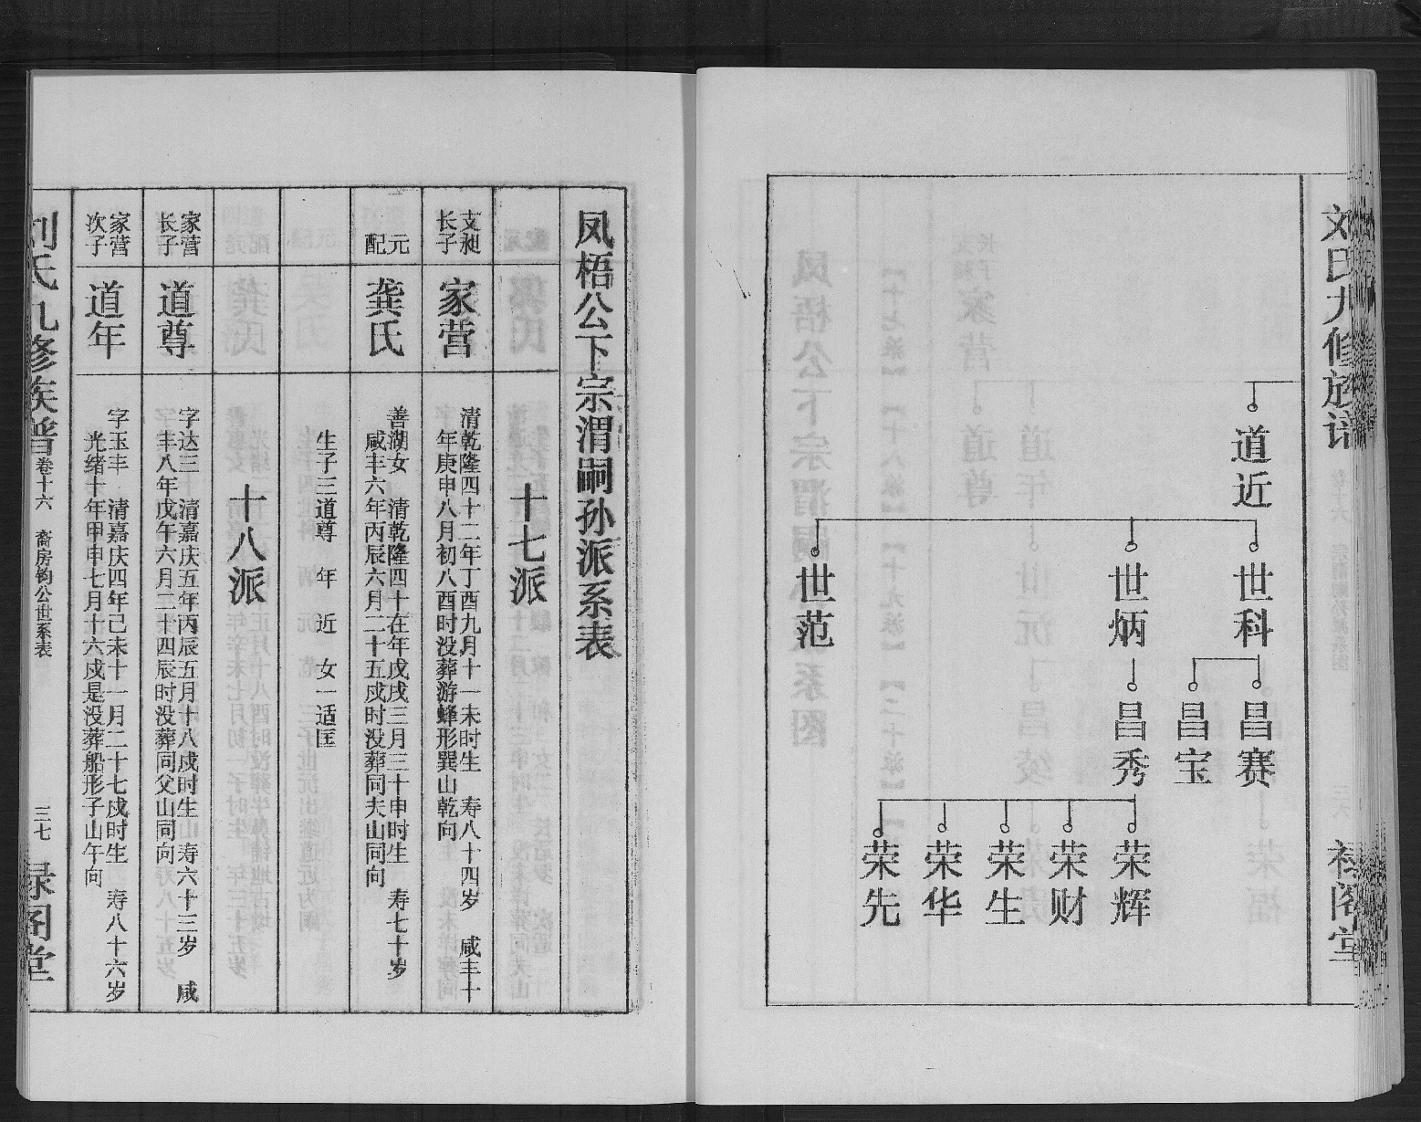
Automating Jiapu Data Extraction
Future Work

Slide 14
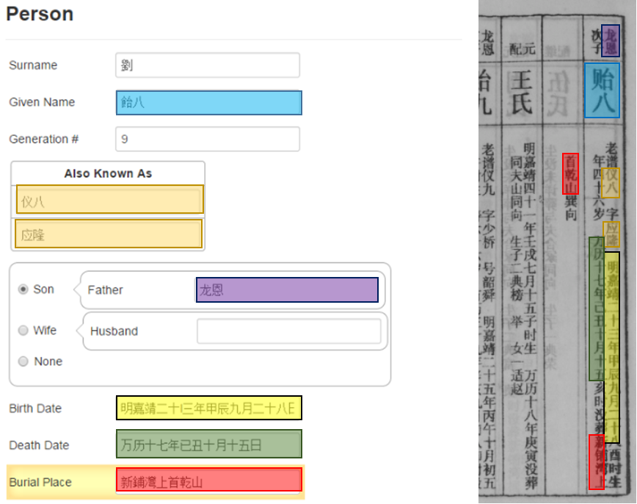
Verify & Correct
Future Work

Slide 15
Conclusions
“Failed” experiment ?
A way out
Alignment engineering
OCR: find or do R&D
Potential
Click-Only (Mostly) Extraction – a win
Semi-automatic extraction – a big win

Slide 16
Conclusions
“Failed” experiment ?
A way out
Alignment engineering
OCR: find or do R&D
Potential
Click-Only (Mostly) Extraction – a win
Semi-automatic extraction – a big win

