Slide 1
“The Future of Family History Technology” in Academic Research
FHTW15 – Panel
David W. Embley
Notes:
Conferences/Workshops/Books/Journals (2015, just in the diversity of interests of DEG, Nagy, FH research team) (visuals of logos for color)
Cognitive Systems, AAAI-15 Cognitive Systems Track (OntoSoar)
Multi-Lingual Semantic Web (ML-OntoES)
Information Extraction, HIP-13, Bill Barrett (chair)
Conceptual Modeling Superstructure, QMMQ (Woodfield)
Handwriting Recognition, contest in ICDAR-13 ?? (International Conference on Document Analysis and Recognition), ICDAR topics
NLP Treebank (Namebank), Iceland 2014 (Pat Schone) ??
DRR-2015 topics, Eric Ringger (PC chair), table understanding (Nagy) (Document Recognition and Retrieval XXII, 11-12 Feb)
OCR Nagy, Bill Lund (PhD dissertation – ensemble)
High-interest academic research in FHTW-15
ML-based automatic form classification
Chinese OCR
UI research suggested by reviewer’s of our paper
Security (Dale Lowry presentation on Friday)
Name variance (phonetic, orthographic, OCR correction)
…

Slide 2

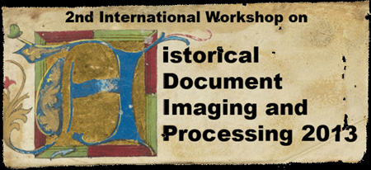

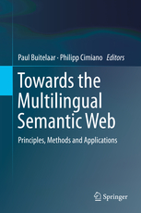
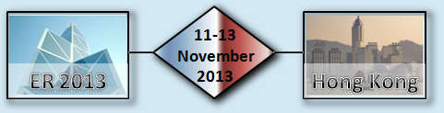
Publish Papers with Family History Technology Themes in Academic Venues

Slide 3
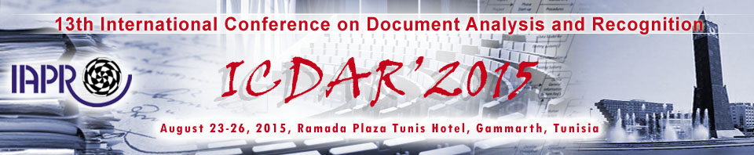

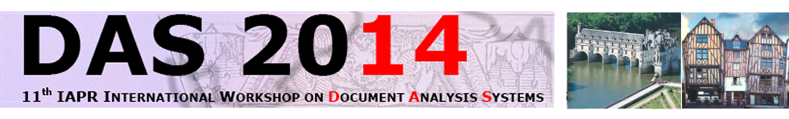
Look for Research Challenges that have Family-History-Technology Applications
ICDAR-15
  Language and script recognition
  Map, drawing, diagram analysis
  Image enhancement
  Printed/handwriting separation
  Information extraction
  Scene text analysis (e.g. of grave headstones)
DRR (Document Recognition and Retrieval)
HIP (Historical Document Imaging and Processing)
DAS (Document Analysis Systems)
Notes:
DRR: 11-12 Feb. 2015, Eric Ringger, Conference Chair

Slide 4
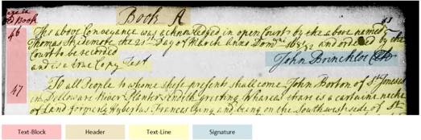
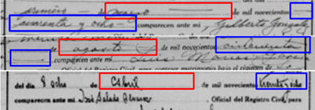
Directly Encourage Research in
Family-History-Technology Topics
Sponsor Competitions
  Ancestry’s segmentation and layout analysis at ICDAR-15
  FamilySearch’s automatic waypointing at HIP-2013
Create Ground-Truth Data Sets
Serve on Conference Committees
Notes:
Ancestry and FamilySearch have also sponsored handwriting-recognition competitions
Interesting possibilities: Crowd-sourcing competitions: best solution gets $1,000 … (Randy)
Waypoint in FamilySearch: Waypointing is a process used to group images together according to locality, record type, and year range in preparation for online publication. The Waypointing process creates a browse structure allowing users to focus their search to a single place and time. Waypointing is, in essence, a digital microfilm reader, allowing patrons of FamilySearch access to many images that they would otherwise have to access at a Family History Library on microfilm.

