Slide 1
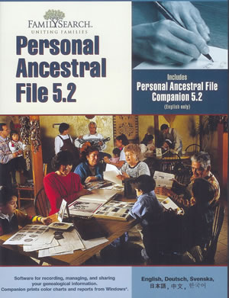
From Pencil and Paper to A Better Way
Notes:
I am now computerized.
It is free.
.

Slide 2
The New PAF The Best Way
PAF is dead
Long live Family Search – the new PAF
Notes:
For all people that have lived, are living, and will live: One person, one place, one truth
A collaboration forum
It is still my information.

Slide 3
Thankful For the Help with My Information

Slide 4
Modifying My Information without My Permission
Notes:
I want it my way, I know what is true
Others don’t have a clue
They repeat the same mistakes over and over

Slide 5
I Can’t Change Family Search, So
I will fight the intruder
Eternal, cyclic, modification wars
I will flee
In some cases quit doing family history all together

Slide 6
The Problem
Feeling of loss of control/loss of ownership
A feeling of violation

Slide 7
Some Solutions
Make it Personal
Personal views controlled by the patron
Branching version control
Foster synchronous as well as asynchronous communication
Notes:
You can even make it distributed with non-central control.
Family Tree becomes a big node in the network.
Family Tree becomes more of a repository of possibly contradictory knowledge.

