Slide 1
Scanned Books:
Annotator Training

Slide 2
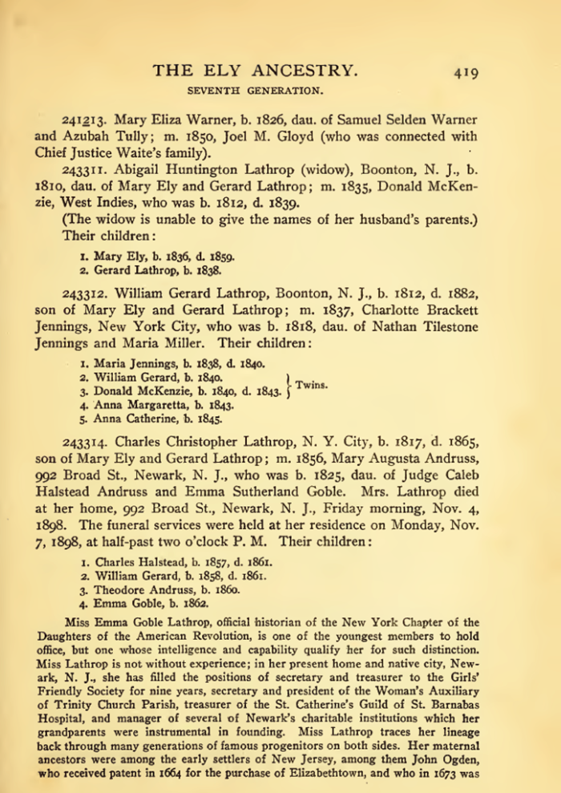
Project Overview
Untapped sources
  100,000+ scanned/OCRed books
  Problem: cost-effective extraction
Extraction tools
  Read and do form-fill type-in
  Form-fill by clicking
    Copy/paste & correction
    Family tree construction by inference
  Synergistic
    Automated form-fill with user correction
    Manual specification of rules (FROntIER)
    Machine-learned extraction rules
      Discover author-specified patterns (ListReader)
      Parse sentences & match concepts (OntoSoar)
      Learn from observing users work (GreenFIE-HD)
Groundtruthing
Notes:
Explain: we are “Groundtruthing” – you will be asked to extract some easily inferred information, e.g., spouses both ways, gender, same name extracted multiple times. Don’t worry about it and realize that you are helping with research of underlying extraction tools, not experimenting with expected form types for patrons.

Slide 3
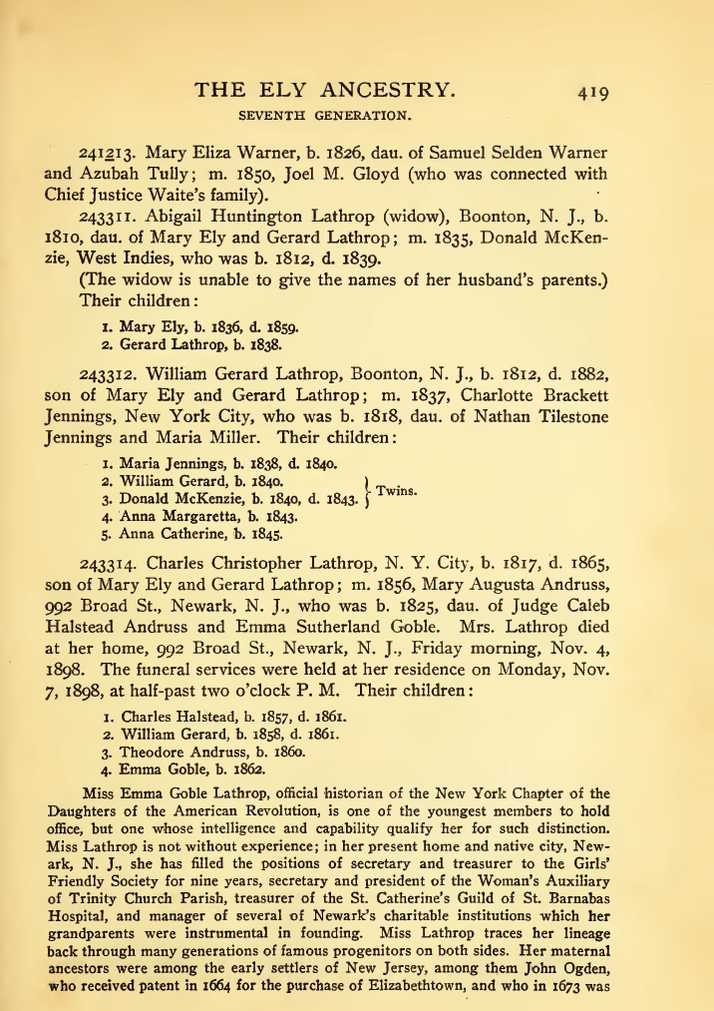

Slide 4
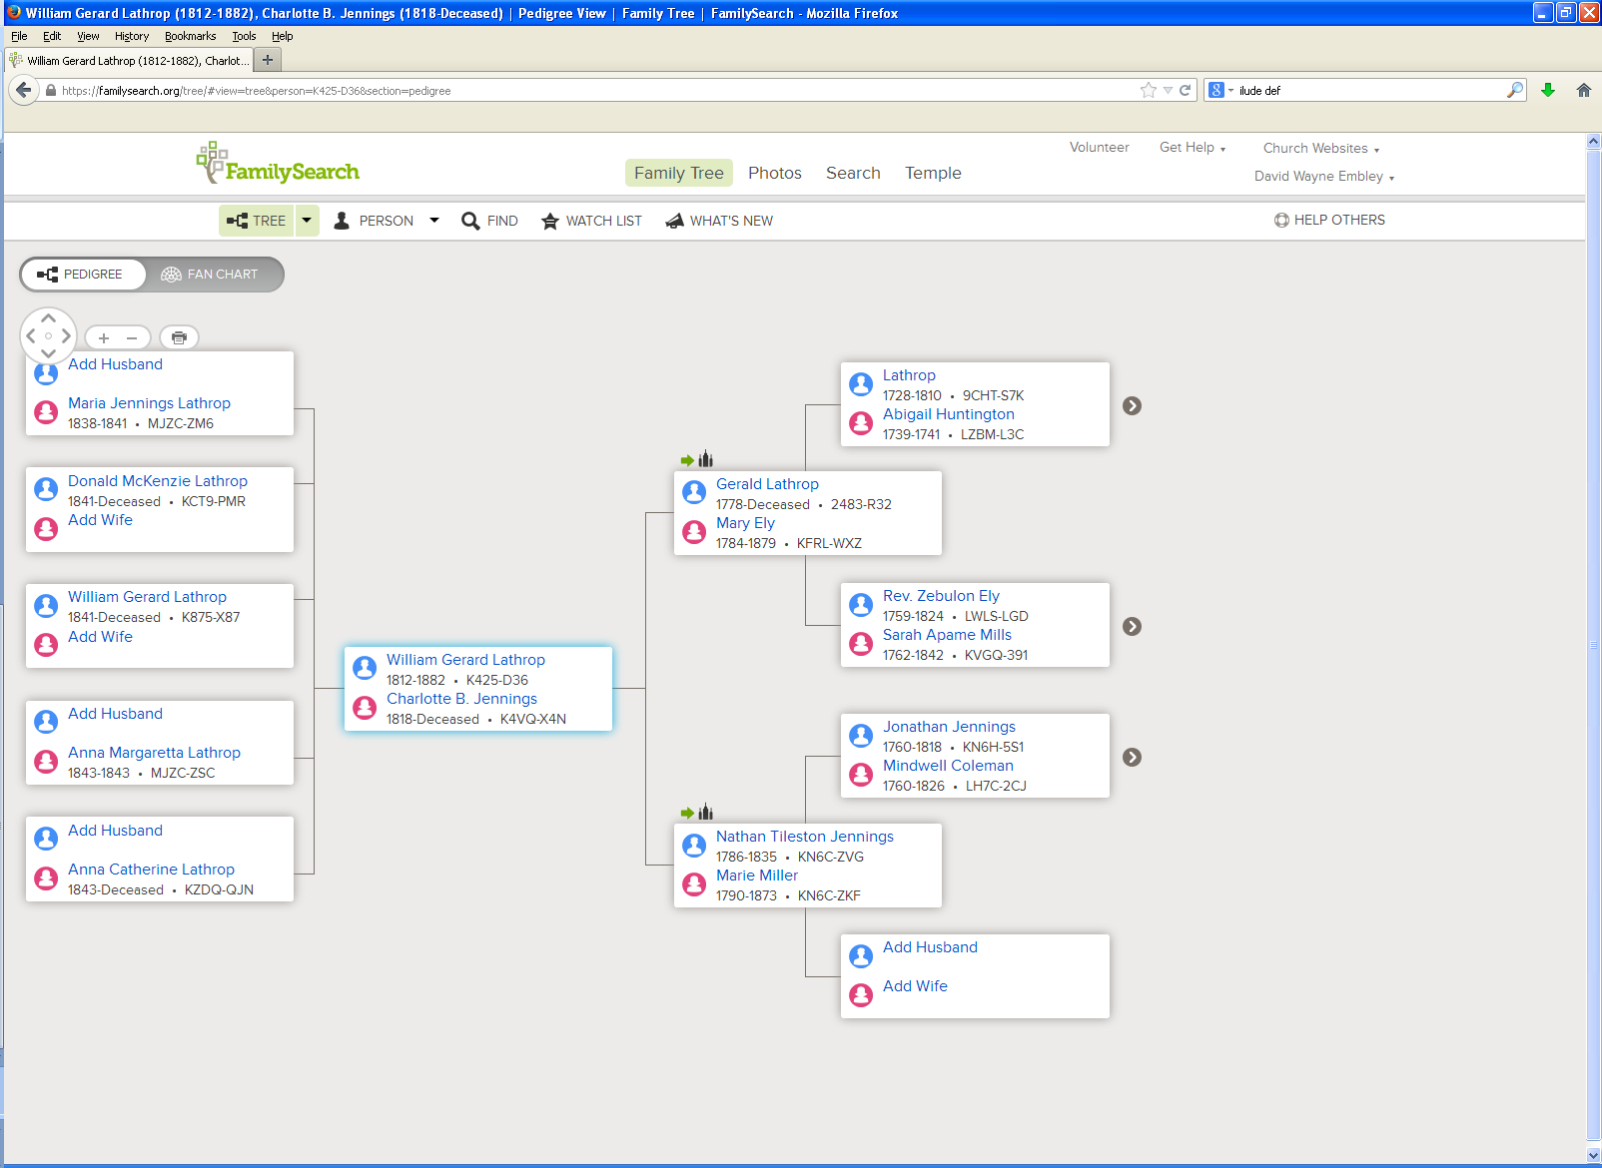
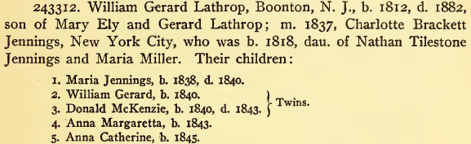

Slide 5
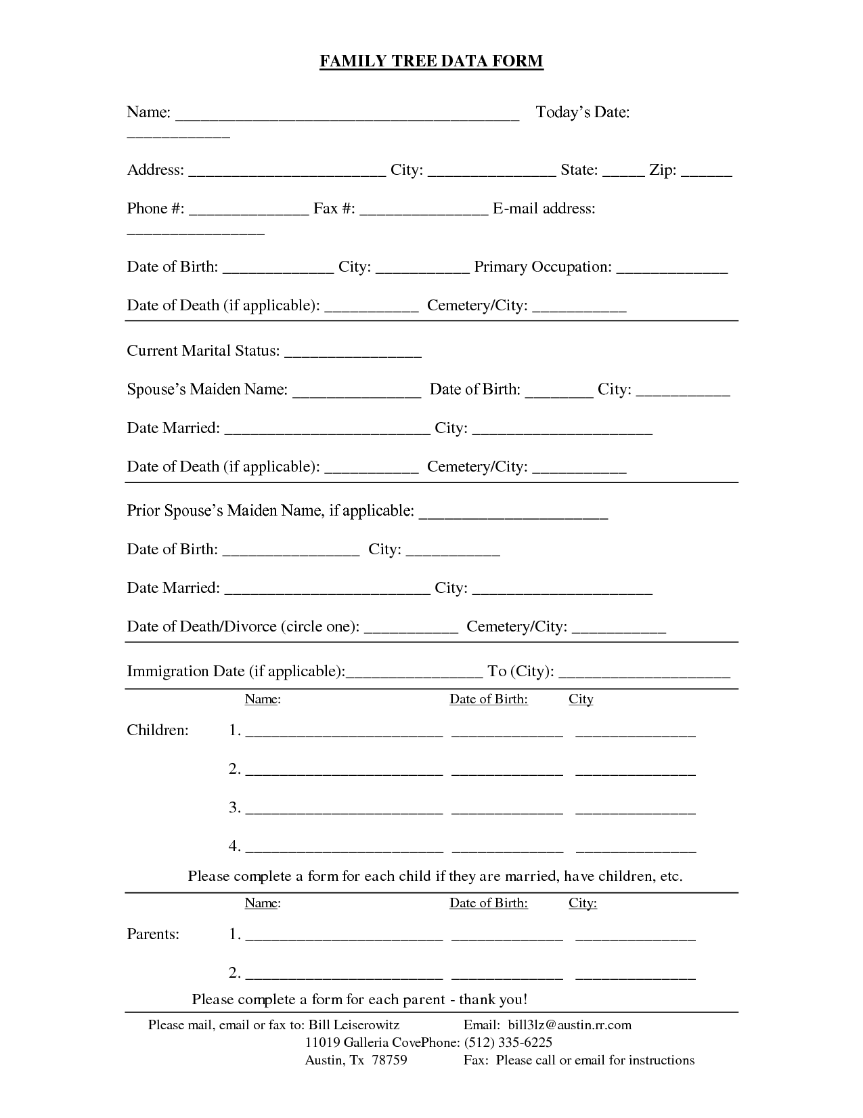
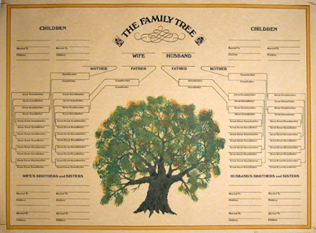
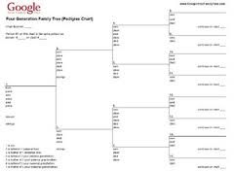
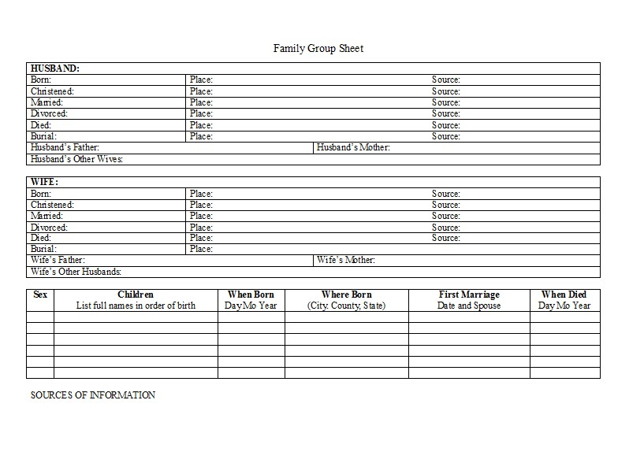
Read and Do Form-fill Type-in

Slide 6
Form-fill: Click-only

Slide 7
Synergistic: Automatic Form-fill with Human Confirmation/Correction
√
√
√
√

Slide 8
Demo
Annotator Framework
  Session initialization/save/termination
  Page mode/magnification/navigation
Form Fill-in
  Person
  Marriages
  Children
Notes:
Use Ely for basic demo
Run through and show basics (all forms briefly)
Walk through the Steele page with them practicing at the same time
Let them ask questions or point out questions that should be asked
Show rules (which they’ll have available to them while they work)
Modify rules if new questions arise

Slide 9
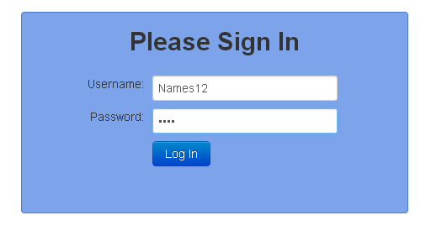
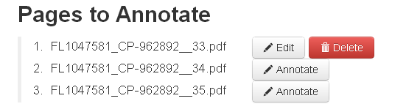
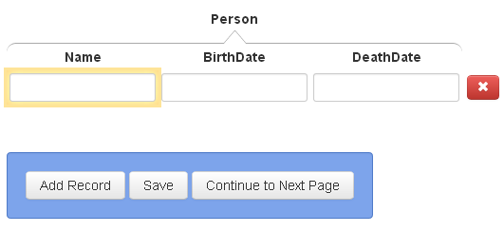
  Session Initialization/Save/Termination
Navigate to “dithers.cs.byu.edu/bookannotator” and login:
You will be given several username-password pairs. Each is associated with an annotation job to do.
Select page to annotate:
Save / Continue to Next Page:
When you have finished all assigned pages and have saved your work, you need do nothing more. To start another job, navigate to “dithers.cs.byu.edu/fhannotator”

Slide 10



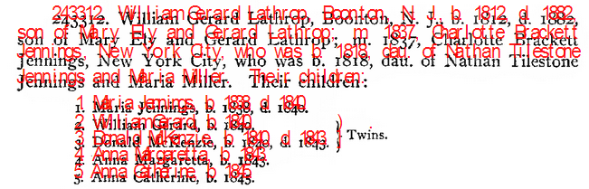
  Page Mode/Magnification/Navigation
magnify: zoom in and out
go to previous page, next page
mode
bounding box
scroll bars
Notes:
Replace image when font-size issue is resolved. Also, there’s talk about a shaded bounding box around the text a click extracts.

Slide 11
Rules and Hints for All Forms
Rules
  Record only typeset information (nothing written by hand).
  Do not fix errors (OCR, typesetting, misspellings, …).
  Close up words with end-of-line hyphens unless the hyphen is “real.”
  For items that cross page boundaries, extract complete records with the first page. (If no previous/subsequent page, extract partial records.)
  Use click, Alt-click, or mouse-drag-and-click only (to the extent possible—should always be possible).
Hints
  For click and Alt-click, hold down Ctrl to add tokens to a field. (Sometimes a click doesn’t “take”; just click again.)
  To edit a field value, click on the field and edit; then Esc when done.
  The field focus changes automatically; to change manually, use Tab and shift-Tab or click on a field and Esc.
  A blank record or field at the end need not be deleted.
  Be familiar with all Actions and use Keyboard Shortcuts.
Notes:
Put the real Keyboard Shortcuts in place of this old one.
Instead of Ctrl, use Command on a MAC.

Slide 12
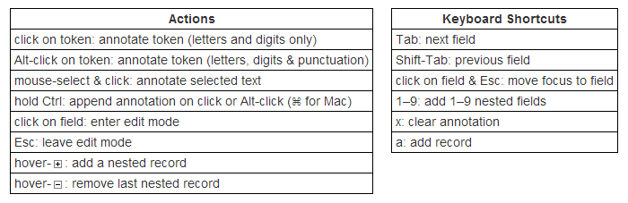
Rules and Hints for All Forms
Rules
  Record only typeset information (nothing written by hand).
  Do not fix errors (OCR, typesetting, misspellings, …).
  Close up words with end-of-line hyphens unless the hyphen is “real.”
  For items that cross page boundaries, extract complete records with the first page. (If no previous/subsequent page, extract partial records.)
  Use click, Alt-click, or mouse-drag-and-click only (to the extent possible—should always be possible).
Hints
  For click and Alt-click, hold down Ctrl to add tokens to a field. (Sometimes a click doesn’t “take”; just click again.)
  To edit a field value, click on the field and edit; then Esc when done.
  The field focus changes automatically; to change manually, use Tab and shift-Tab or click on a field and Esc.
  A blank record or field at the end need not be deleted.
  Be familiar with all Actions and use Keyboard Shortcuts.
Notes:
Put the real Keyboard Shortcuts in place of this old one.
Instead of Ctrl, use Command on a MAC.

Slide 13
  Record only typeset information
  (nothing written by hand).
This, not that

Slide 14
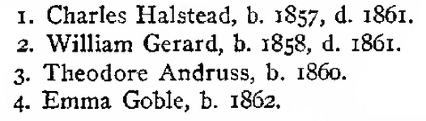
  Do not fix errors
  (OCR, typesetting, misspellings, …).

Slide 15

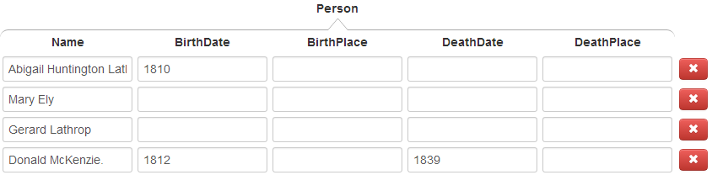
  Close up words with end-of-line hyphens unless the hyphen is “real.”
Click on “McKen-” or on “zie” properly extracts all of “McKenzie”.
Click on “Latter-” or “day” in: “Latter-
day Saints” also yields “Latterday”, but Alt-click yields “Latter-day”. Use Alt-click to retain the “real” hyphen.

Slide 16

  For items that cross page boundaries, extract complete record with the first page. (If no previous/subsequent page, extract partial records.)
page 1
page 2
record together with first page
(page 418)

Slide 17
Rules and Hints for Person Form
Rules
  Extract every name on a page (except names that don’t designate people, e.g., “George Washington University”).
  Extract non-names that designate a person (e.g., “Baby Ely”)
  Get full name, including any punctuation, title(s) and suffix, but not non-name components associated with the name such as possessives (i.e., ’s).
  Extract names as written (e.g., not implied surnames or maiden names).
  Get full date and place names, including punctuation.
  Extract dates and place names only for birth and death events.
  Do not extract implied dates and place names (e.g., not birth date when only age and death date appear and not place names unless explicitly stated as birth or death places)
  In the absence of birth or death dates and places, use christening or burial dates and places, and include designations (e.g., “bapt. 1854” and “bur. Salt Lake City Cemetery).
Hints
  For names and dates with punctuation, use Alt-click.
  Use Ctrl to append name parts.
  Use Keyboard Shortcut “a” to add a record.
Notes:
If we do shift-click to include punctuation, change the hint to use it rather than mouse-drag-and-click. Say, “For names with punctuation, use shift-click or mouse-drag-and click.”

Slide 18
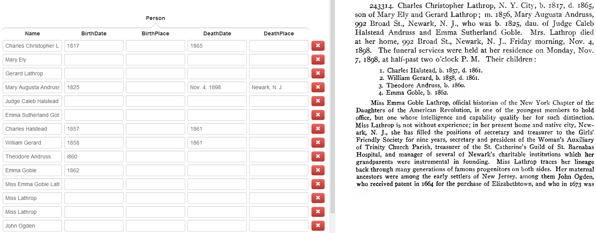
Extract all names, but dates and places only for birth and death events
this place but not these places
this date but
not this date
all names, even when a name appears more than once on a page

Slide 19
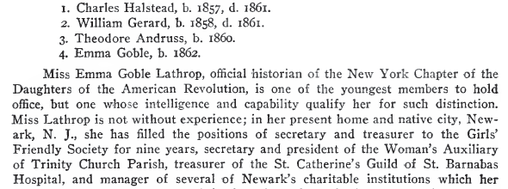
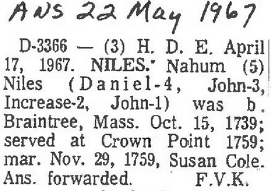
  Omit non-name components.
not embedded reference markers
not names that are part of place or thing names
not paragraph headers
not names used for internal designators

Slide 20
  Get full name, including any punctuation, title(s) and suffix. Omit possessives.
Isaac Steel, Sr.
Azubah Tully
Joel M. Gloyd
Chief Justice Waite
David Vance CALL
Rex – omit the surname, “Call” (not written with the name “Rex”)
Arta (Shippee) Call – include the parentheses
Jolayne Lois SILLITO

Slide 21
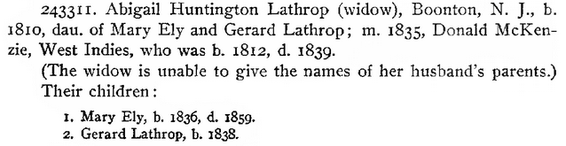
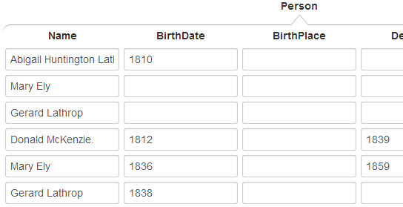
Do not include implied maiden names and surnames.
not “Mary Ely Lathrop”
not “Mary Ely McKenzie”
not “Gerard Lathrop McKenzie”
just the names as written

Slide 22
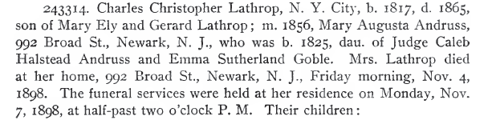
Get full date and place names, including punctuation.
include date modifiers
not date modifiers, not date explanations
(do not include)
days of the week (do not include)
punctuation part of date
(include)
punctuation not part of date (do not include)

Slide 23
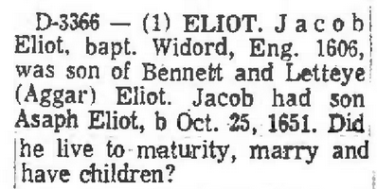
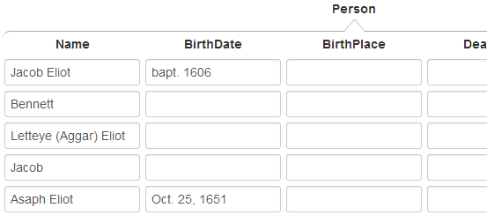
In the absence of birth or death dates, use christening or burial dates and include designations.
include the parentheses as punctuation associated with the name

Slide 24
Rules and Hints for Marriages Form
Rules
  Record all marriages, both stated and implied (e.g., if A is mentioned as the son of B and C, then record B and C as being married).
  Record marriages with respect to a person. Either spouse may the primary person.
  Make a person with multiple marriages be the primary person and list each spouse with the primary person.
  Extract names as specified for the person form—full name including punctuation, but only the name as written, not including implied maiden and surnames.
Hints
  For multiple marriages, count the number of additional spouses and create additional nested records with a number key—1 to add one more spouse, 2 to add two additional spouses, etc.
  Use “a” to add a new blank marriage record for a person.
  Since the primary spouse can be either the husband or the wife, record names in the order they appear in the document.
Notes:
Note: Tab is not yet implemented.

Slide 25
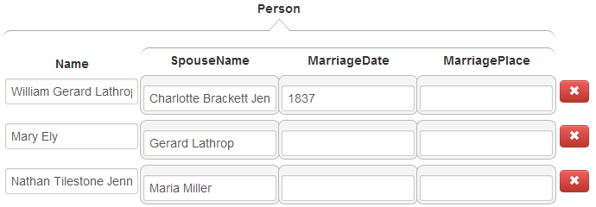
Record all marriages, both stated and implied.
stated
implied
names, as written (maiden name and married name not included)

Slide 26
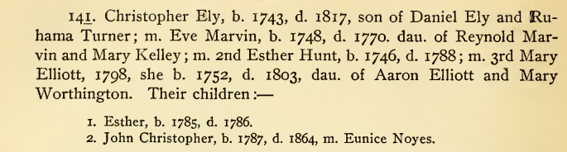
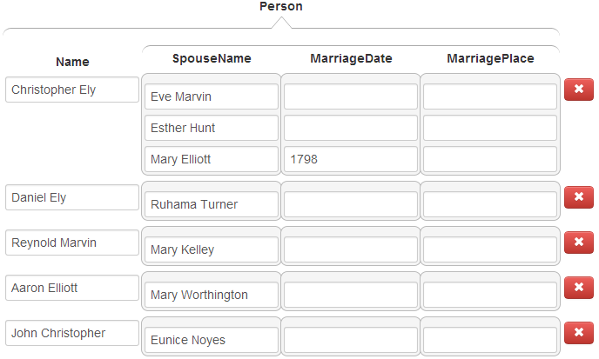
Make a person with multiple marriages be the primary person and list each spouse with the person.
Christopher with three marriages

Slide 27
Rules and Hints for Children Forms
Rules
  Parents may be specified in either order—father first or mother first.
  Parentage can sometimes be complex especially with multiple marriages and blended families. Writers are usually clear, but read carefully to correctly determine parentage.
  Record families that extend across page boundaries with the first page.
  Sometimes the same surname appears for every child. Be sure to properly include each separate surname with each separate name.
Hints
  When the focus is on a nested list field, a number key, n, adds n more blank fields to the list. Count the number of children and add the right number of fields first, then fill them in (e.g., if there are 5 children, enter 4 to add 4 more fields for the children; for 24 children, enter 9, then 9 again, and finally 5).
  Use “a” to add a new record if you wish to jump out of the middle of the record you’re working on and start a new record.
  Since the parents can be in either order, record names in the order they appear in the document.

Slide 28
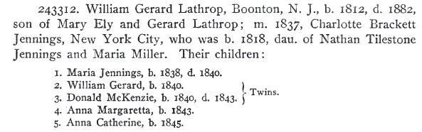

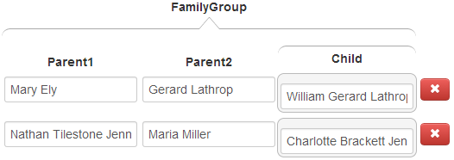
Don’t forget children, not explicitly marked as “children”.

Slide 29
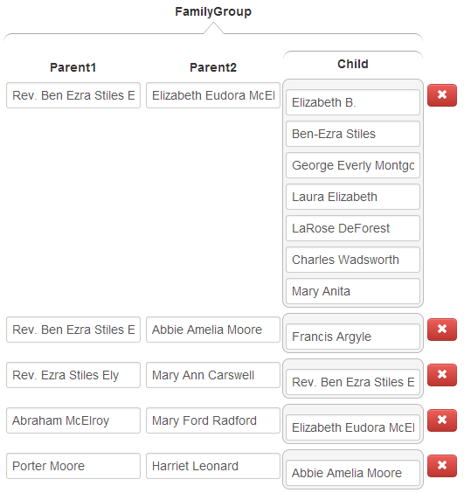
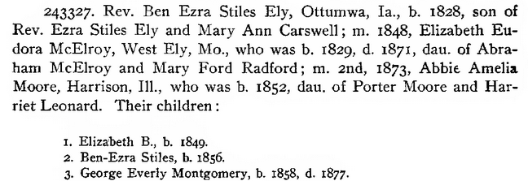

Determine correct parentage.
Note that Elizabeth died in 1873 and could not have been Francis’s mother.

Slide 30
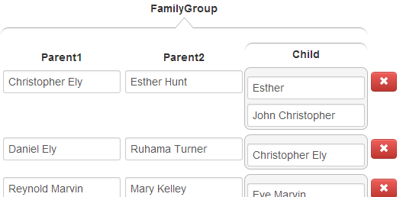
Determine correct parentage.
Eve cannot be the mother of either of Christopher’s children since she died before they were born. Esther was Christopher’s wife at the time both children were born, so she is the likely mother. Mary became Christopher’s wife in 1798, after both children were born.

Slide 31
  Record children with families that extend across page boundaries with the first page.
record Christopher with parents on a previous page
no children, but don’t forget the “dau of” child
record all 5 children, not forgetting Lawrence Allen K.
record children on a next page with this page

Slide 32
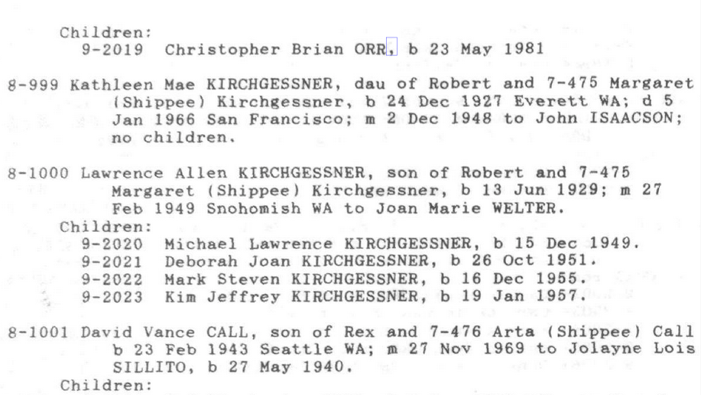
Be sure to properly include each separate surname with each separate name.
For “Michael Lawrence KIRCHGESSNER”, click here, here, and here.
For “Deborah Joan KIRCHGESSNER”, click here, here, and here.

Slide 33
Good Luck!
(our ancestors are waiting)

