Slide 1
Scanned Books: Annotator Training

Slide 2
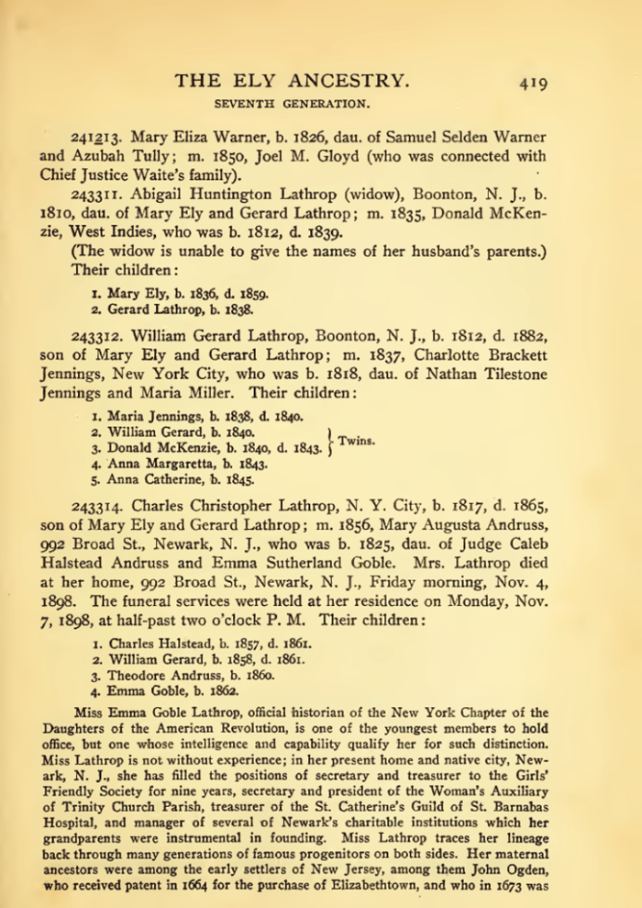
Project Overview
Untapped sources
100,000+ scanned/OCRed books
Problem: cost-effective extraction
Extraction tools
Read and do form-fill type-in
Form-fill by clicking
Copy/paste & correction
Family tree construction by inference
Synergistic
Automated form-fill with user correction
Manual specification of rules (FROntIER)
Machine-learned extraction rules
Discover author-specified patterns (ListReader)
Parse sentences & match concepts (OntoSoar)
Learn from observing users work (GreenFIE-HD)
Ground truthing
Notes:
Explain: we are “Groundtruthing” – you will be asked to extract some easily inferred information, e.g., spouses both ways, gender, same name extracted multiple times. Don’t worry about it and realize that you are helping with research of underlying extraction tools, not experimenting with expected form types for patrons.

Slide 3
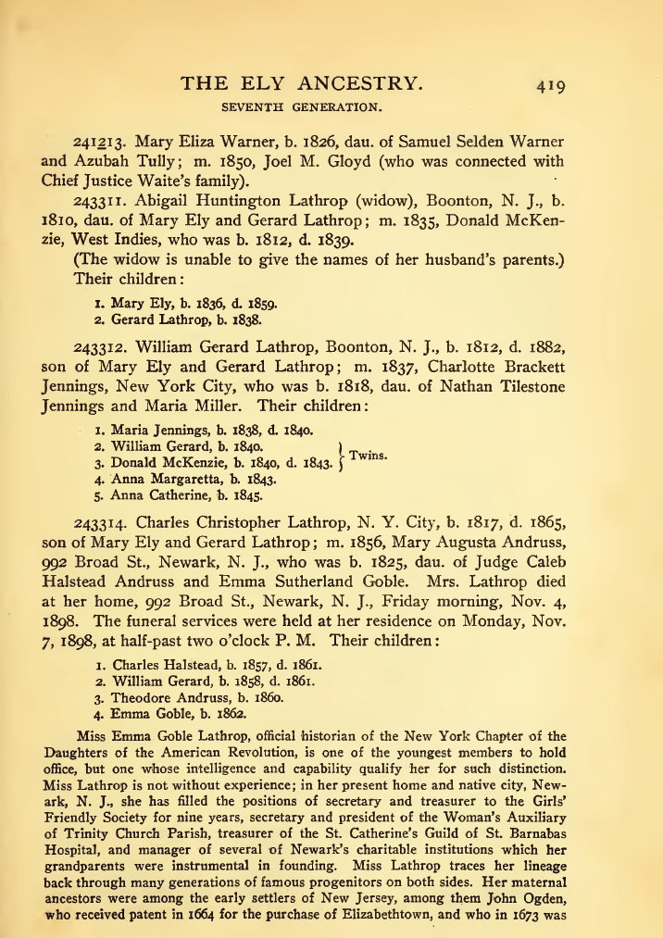

Slide 4
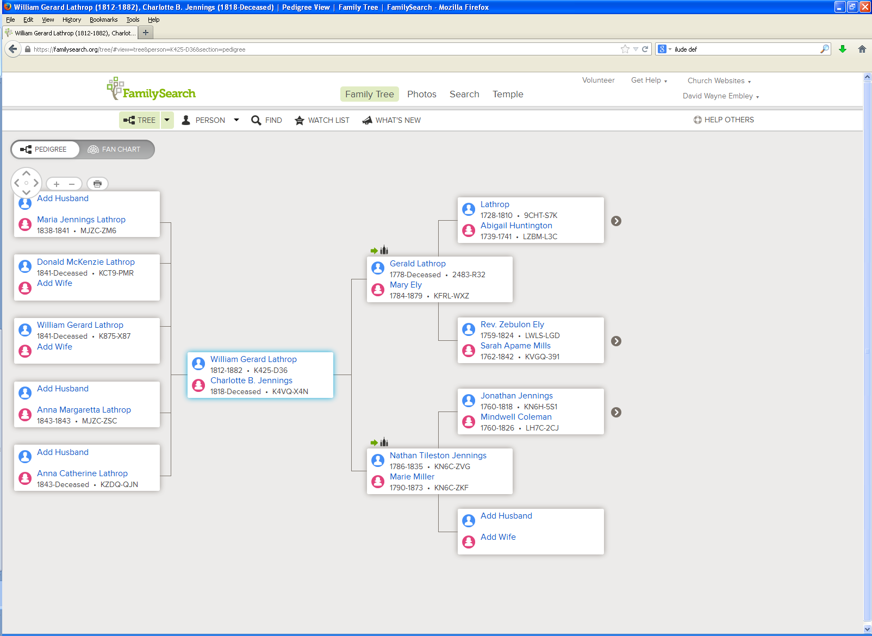

Slide 5
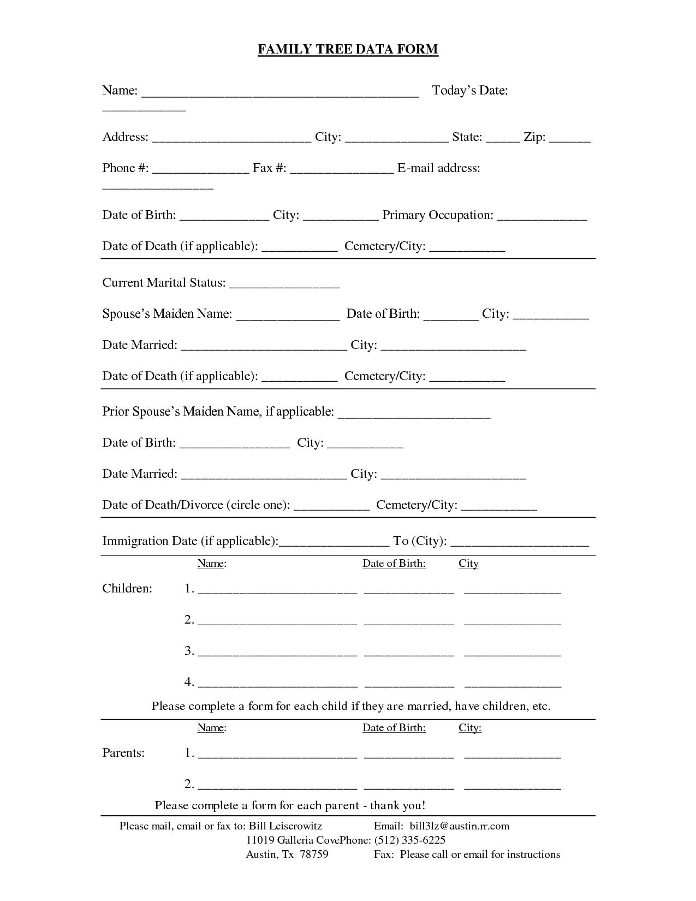
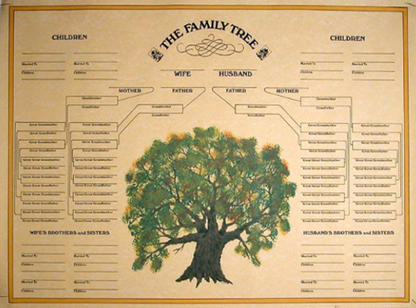
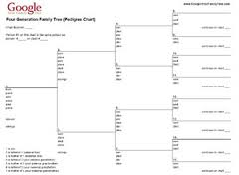
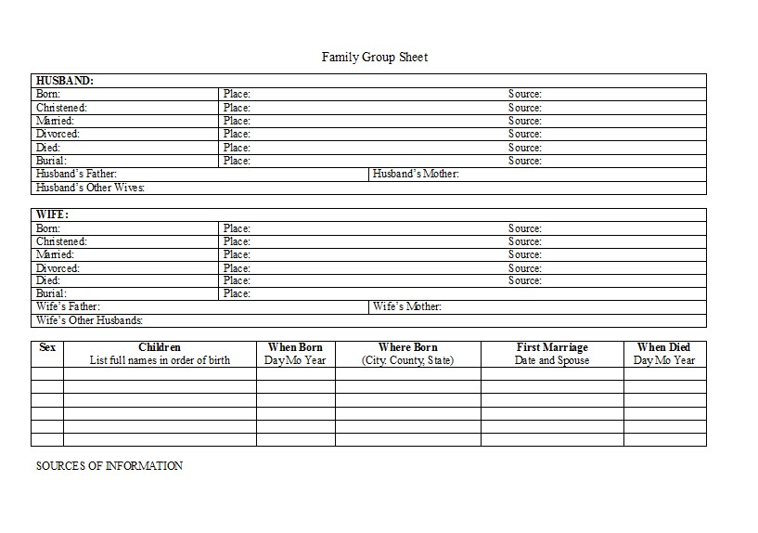
Read and Do Form-fill Type-in

Slide 6
Form-fill: Click-only

Slide 7
Synergistic: Automatic Form-fill with Human Confirmation/Correction
√
√
√
√

Slide 8
Demo
Annotator Framework
Session initialization/save/termination
Page mode/magnification/navigation
Form Fill-in
Person
Couple (Marriages)
FamilyGroup (Parents with Children)
Notes:
Use Ely for basic demo
Run through and show basics (all forms briefly)
Walk through the Steele page with them practicing at the same time
Let them ask questions or point out questions that should be asked
Show rules (which they’ll have available to them while they work)
Modify rules if new questions arise

Slide 9
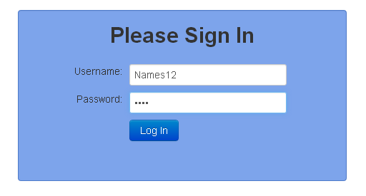
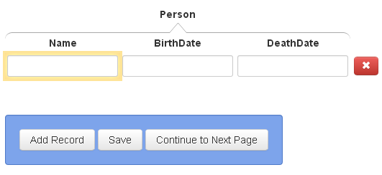
Session Initialization/Save/Termination
Navigate to “dithers.cs.byu.edu/bookannotator” and login:
You will be given several username-password pairs. Each is associated with an annotation job to do.
Select page to annotate:
Save / Continue to Next Page:
When you have finished all assigned pages and have saved your work, you need do nothing more. To start another job, navigate to “dithers.cs.byu.edu/fhannotator”

Slide 10
Page Mode/Magnification/Navigation
magnify: zoom in and out
go to previous page, next page
mode
bounding box
scroll bars
Notes:
Replace image when font-size issue is resolved. Also, there’s talk about a shaded bounding box around the text a click extracts.

Slide 11
Rules and Hints for All Forms
Rules
Record only typeset information (nothing written by hand).
Do not fix errors (OCR, typesetting, misspellings, …).
Close up words with end-of-line hyphens unless the hyphen is “real.”
For items that cross page boundaries, extract complete records with the first page. (If no previous/subsequent page, extract partial records.)
Use click, Alt-click, or mouse-drag-select-and-click only (to the extent possible—should always be possible).
Hints
For click and Alt-click, hold down Ctrl to add tokens to a field. (Sometimes a click doesn’t “take”; watch for character bounding boxes & click again.)
To edit a field value, click on the field and edit; then Esc when done.
The field focus changes automatically; to change manually, use Tab to go forward and shift-Tab to go backward or just click on the field.
Be familiar with all Actions and use Keyboard Shortcuts.
Notes:
Put the real Keyboard Shortcuts in place of this old one.
Instead of Ctrl, use Command on a MAC.
Rule #5: For ground truthing, typed-in information is useless for checking whether the tool should have extracted it. (Sometimes, however, the upstream OCR and alignment make it impossible to obtain by clicking, in which case the tool won’t be able to extract it either. But we do want to know that the tools and upstream have missed something. So, do type it in. Just don’t type in something when it can be obtained by clicking.)
Hint#3: Since releasing Ctrl moves the cursor, it is also a convenient way to move the focus forward.

Slide 12
Rules and Hints for All Forms
Rules
Record only typeset information (nothing written by hand).
Do not fix errors (OCR, typesetting, misspellings, …).
Close up words with end-of-line hyphens unless the hyphen is “real.”
For items that cross page boundaries, extract complete records with the first page. (If no previous/subsequent page, extract partial records.)
Use click, Alt-click, or mouse-drag-select-and-click only (to the extent possible—should always be possible).
Hints
For click and Alt-click, hold down Ctrl to add tokens to a field. (Sometimes a click doesn’t “take”; watch for character bounding boxes & click again.)
To edit a field value, click on the field and edit; then Esc when done.
The field focus changes automatically; to change manually, use Tab to go forward and shift-Tab to go backward or just click on the field.
Be familiar with all Actions and use Keyboard Shortcuts.
Notes:
Put the real Keyboard Shortcuts in place of this old one.
Instead of Ctrl, use Command on a MAC.
Rule #5: For ground truthing, typed-in information is useless for checking whether the tool should have extracted it. (Sometimes, however, the upstream OCR and alignment make it impossible to obtain by clicking, in which case the tool won’t be able to extract it either. But we do want to know that the tools and upstream have missed something. So, do type it in. Just don’t type in something when it can be obtained by clicking.)
Hint#3: Since releasing Ctrl moves the cursor, it is also a convenient way to move the focus forward.

Slide 13
Record only typeset information (nothing written by hand).
This, not that

Slide 14
Do not fix errors (OCR, typesetting, misspellings, …).

Slide 15
Close up words with end-of-line hyphens unless the hyphen is “real.”
Click on “McKen-” or on “zie” properly extracts all of “McKenzie”.
Click on “Latter-” or “day” in: “Latter-
day Saints” also yields “Latterday”, but Alt-click yields “Latter-day”. Use Alt-click to retain the “real” hyphen.

Slide 16
For items that cross page boundaries, extract complete record with the first page. (If no previous/subsequent page, extract partial records.)
page 1
page 2
record together with first page
(page 418)

Slide 17
Rules and Hints for Person Form
Rules
Extract only names that have either associated birth or death information.
Get full name, including any punctuation, title(s) and suffix, but not non-name components associated with the name such as possessives (i.e., ’s).
Extract names as written (e.g., not implied surnames or maiden names).
Get full date and place names, including punctuation.
Do not extract implied dates and place names (e.g., not birth date when only age and death date appear and not place names unless explicitly stated as birth or death places)
Resolve each pronoun or name designator (e.g., “the family patriarch”) that links to birth or death information to the nearest preceding name to which it refers.
Hints
For names and dates with punctuation, use Alt-click.
Use Ctrl-click to append name parts.
The Keyboard Shortcut “a” to add a record may be useful.

Slide 18
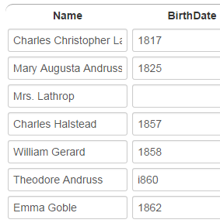
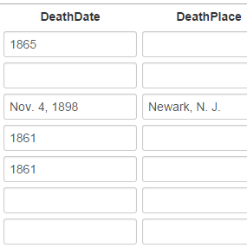
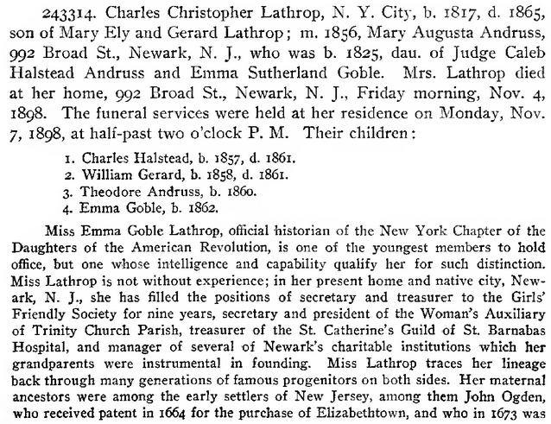
Extract only names that have either associated birth or death information.
this place but not these places
…
this date but
not this date
Note that although Mary Augusta Andrus and Mrs. Lathrop are the same person, the birth and death information should be linked to the name in the sentence or phrase in which it appears.
not these names, since no birth or death information is associated with them
Notes:
Note that the death date for Mary Augusta Andruss is associated with the name Mrs. Lathrop (which is a reference to Mary Augusta Andruss). (The inference engine should sort this out by equating Mrs. Lathrop with Mary Augusta Andruss.)

Slide 19
Get full name, including any punctuation, title(s) and suffix. Omit possessives.
Isaac Steel, Sr.
Azubah Tully
Joel M. Gloyd
Chief Justice Waite
omit the apostrophe “s”
David Vance CALL
Rex – omit the surname, “Call” (not written with the name “Rex”)
Arta (Shippee) Call – include the parentheses
Jolayne Lois SILLITO

Slide 20
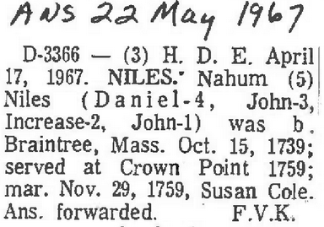
Omit non-name components.
not embedded reference markers
not paragraph headers
not names used for
internal designators

Slide 21
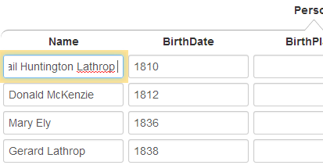
Extract names as written (e.g., not implied surnames or maiden names).
not “Abigail Huntington Lathrop McKenzie”
not “Mary Ely McKenzie”
not “Gerard Lathrop McKenzie”
just the names as written
Notes:
Point out: “Abigail Huntington Lathrop” is in type-in mode and scrolled over to show that McKenzie is not extracted.

Slide 22
Get full date and place names, including punctuation.
include date modifiers
not date modifiers, not date explanations
(do not include)
punctuation part of place (include)
days of the week (do not include)
punctuation part of date
(include)
punctuation not part of date (exclude)
punctuation not part of place (exclude)
Notes:
Picking up “Newark, N. J.” by clicking only is tricky: one way to do it is Alt-click on “Newark,”, Alt-click on “N.”, and select-click for “J.” where the selection omits the trailing comma “,”.

Slide 23
Resolve each pronoun or name designator that links to birth or death information to the nearest preceding name to which it refers.

Slide 24
Resolve each pronoun or name designator that links to birth or death information to the nearest preceding name to which it refers.

Slide 25
Resolve each pronoun or name designator that links to birth or death information to the nearest preceding name to which it refers.

Slide 26
Rules and Hints for Couples Form
Rules
Record all couples as marriages, both stated and implied (e.g., if A is mentioned as the son of B and C, then record B and C as being married).
Record marriages with respect to a person. Either spouse may be the primary person.
Make a person with multiple marriages be the primary person and list each spouse with the primary person.
Extract names as specified for the person form—full name including punctuation, but only the name as written, not including implied maiden and surnames.
Resolve each pronoun or name designator (e.g., “his widow”) that links to marriage information to the nearest preceding name to which it refers.
Hints
For multiple marriages, count the number of additional spouses and create additional nested records with a number key—1 to add one more spouse, 2 to add two additional spouses, etc.
Since the primary spouse can be either the husband or the wife, record names in the order they appear in the document.
Notes:
Note: Tab is not yet implemented.

Slide 27
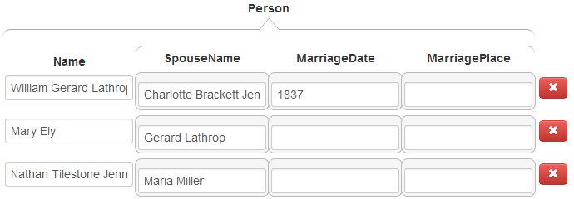
Record all marriages, both stated and implied.
stated
implied
names, as written (here, the maiden name only—the implied married name not included, e.g. “Mary Ely”, not “Mary Ely Lathrop”)

Slide 28
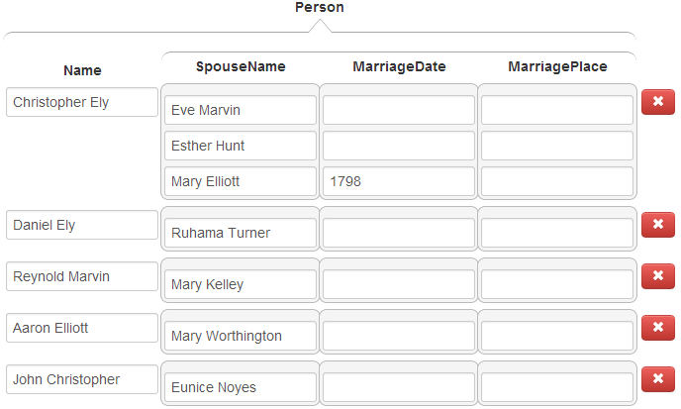
Make a person with multiple marriages be the primary person and list each spouse with the person.
Christopher with three marriages

Slide 29
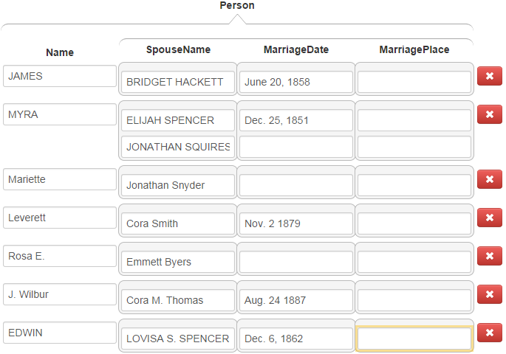
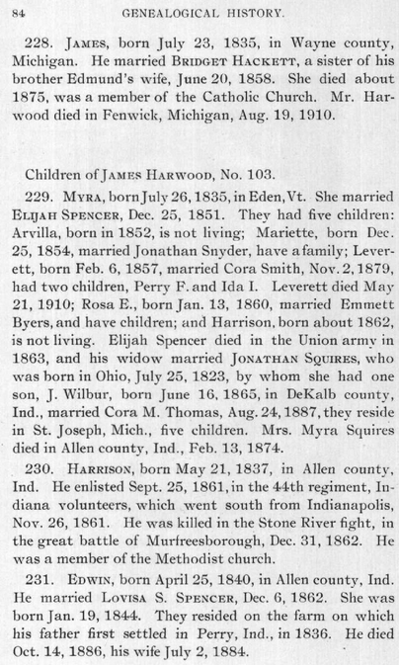
Resolve each pronoun and person designator that links to marriage information to the nearest preceding name of the person to which it refers.
In this example, pronoun references to spouses are easily resolved, but the resolution of the person designator “his widow” as the spouse of Jonathan Squires requires a deeper understanding of the text.

Slide 30
Rules and Hints for Children Forms
Rules
Parents may be specified in either order—father first or mother first.
Parentage can sometimes be complex especially with multiple marriages and blended families. Writers are usually clear, but read carefully to correctly determine parentage.
Record families that extend across page boundaries with the first page.
Sometimes the same surname appears for every child. Be sure to properly include each separate surname with each separate name.
Resolve each pronoun or name designator that links to parent-child information to the nearest preceding name to which it refers.
Hints
When the focus is on a nested list field, a number key, n, adds n more blank fields to the list. Count the number of children and add the right number of fields first, then fill them in (e.g., if there are 5 children, enter 4 to add 4 more fields for the children; for 24 children, enter 9, then 9 again, and finally 5).
Since the parents can be in either order, record names in the order they appear in the document.

Slide 31
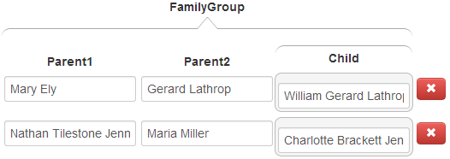
Don’t forget children, not explicitly marked as “children”.

Slide 32
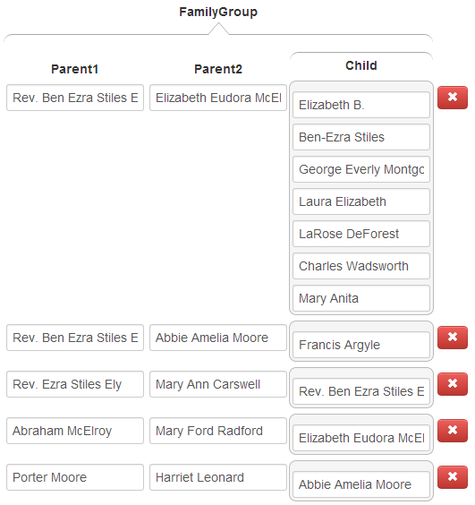
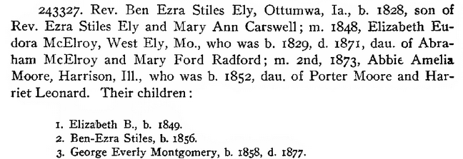
Determine correct parentage.
Note that Elizabeth died in 1871 and could not have been Francis’s mother.

Slide 33
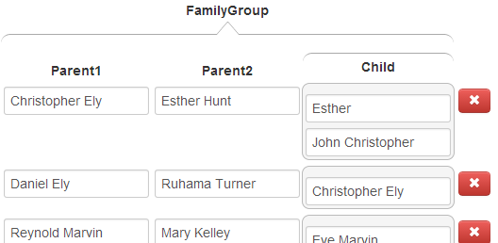
Determine correct parentage.
Eve cannot be the mother of either of Christopher’s children since she died before they were born. Esther was Christopher’s wife at the time both children were born, so she is the likely mother. Mary became Christopher’s wife in 1798, after both children were born.

Slide 34
Record children with families that extend across page boundaries with the first page.
record Christopher with parents on a previous page
no children, but don’t forget the “dau of” child
record all six children in these two families, not forgetting the two “son of” children
record children on a next page with this page

Slide 35
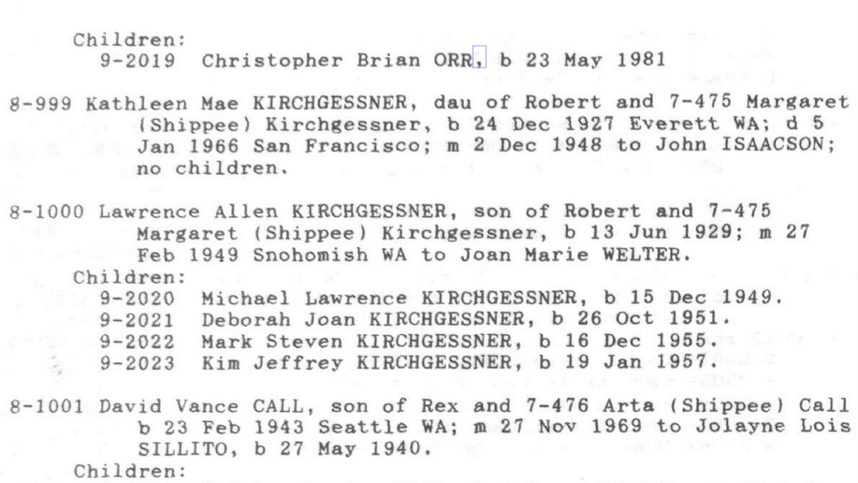
Be sure to properly include each separate surname with each separate name.
For “Michael Lawrence KIRCHGESSNER”, click here, here, and here.
For “Deborah Joan KIRCHGESSNER”, click here, here, and here.

Slide 36
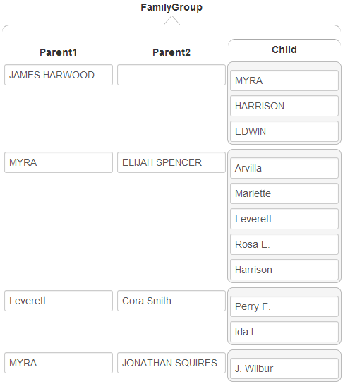
Resolve each pronoun or name designator that links to parent-child information to the nearest preceding name to which it refers.
An understanding of the text (e.g., “by whom she had one son”) is sometimes required to link children to parents.

Slide 37
Good Luck!
(our ancestors are waiting)

