Slide 1
Scanned Books:
Annotator Training

Slide 2
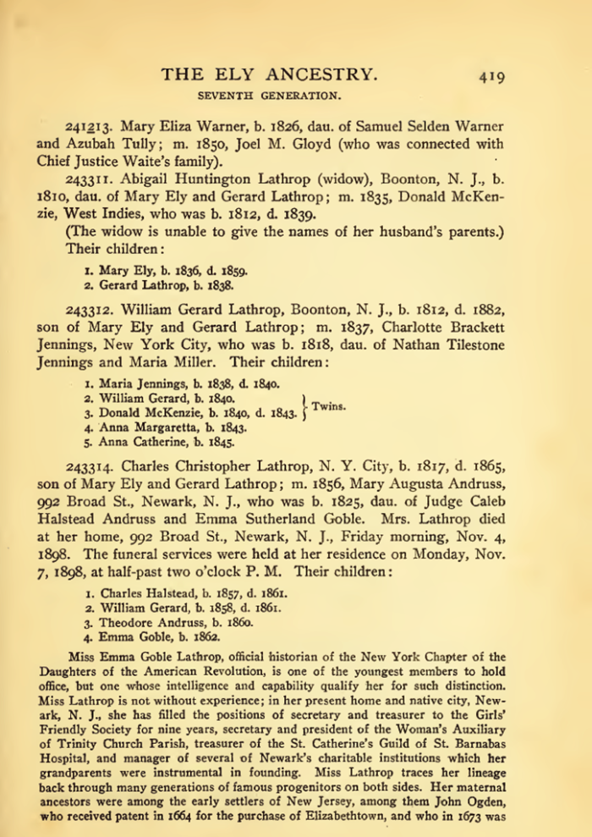
Project Overview
Untapped sources
  100,000+ scanned/OCRed books
  Problem: cost-effective extraction
Extraction tools
  Read and do form-fill type-in
  Form-fill by clicking
    Copy/paste & correction
    Family tree construction by inference
  Synergistic
    Automated form-fill with user correction
    Manual specification of rules (FROntIER)
    Machine-learned extraction rules
      Discover author-specified patterns (ListReader)
      Parse sentences & match concepts (OntoSoar)
      Learn from observing users work (GreenFIE-HD)
Alpha testing
Notes:
Explain: we are doing some initial testing (Alpha testing) of a tool we hope will let us “index” our scanned-book collection cost effectively.

Slide 3
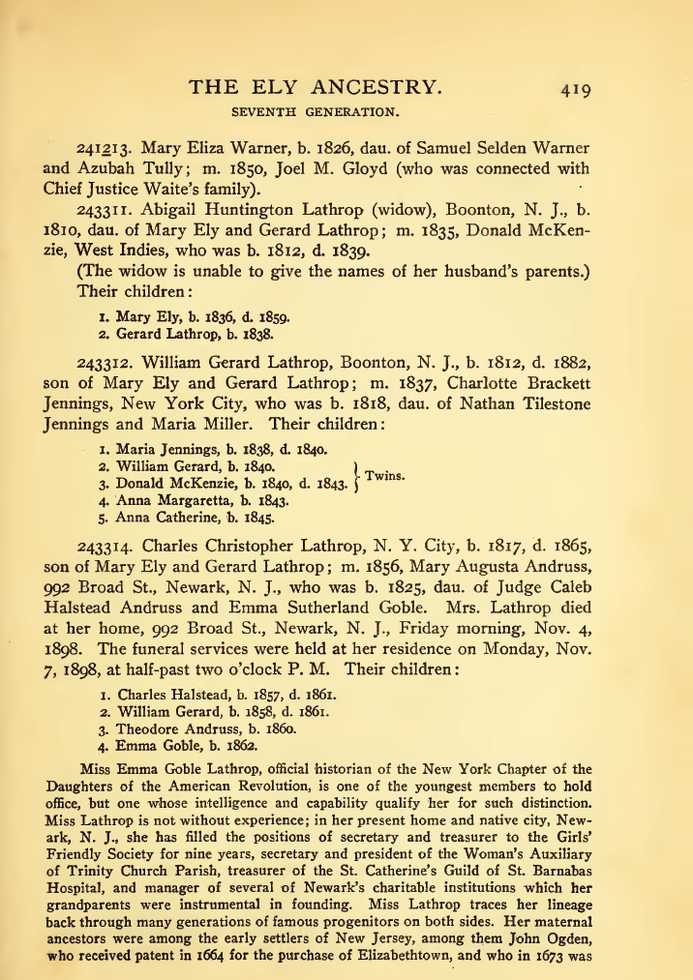

Slide 4
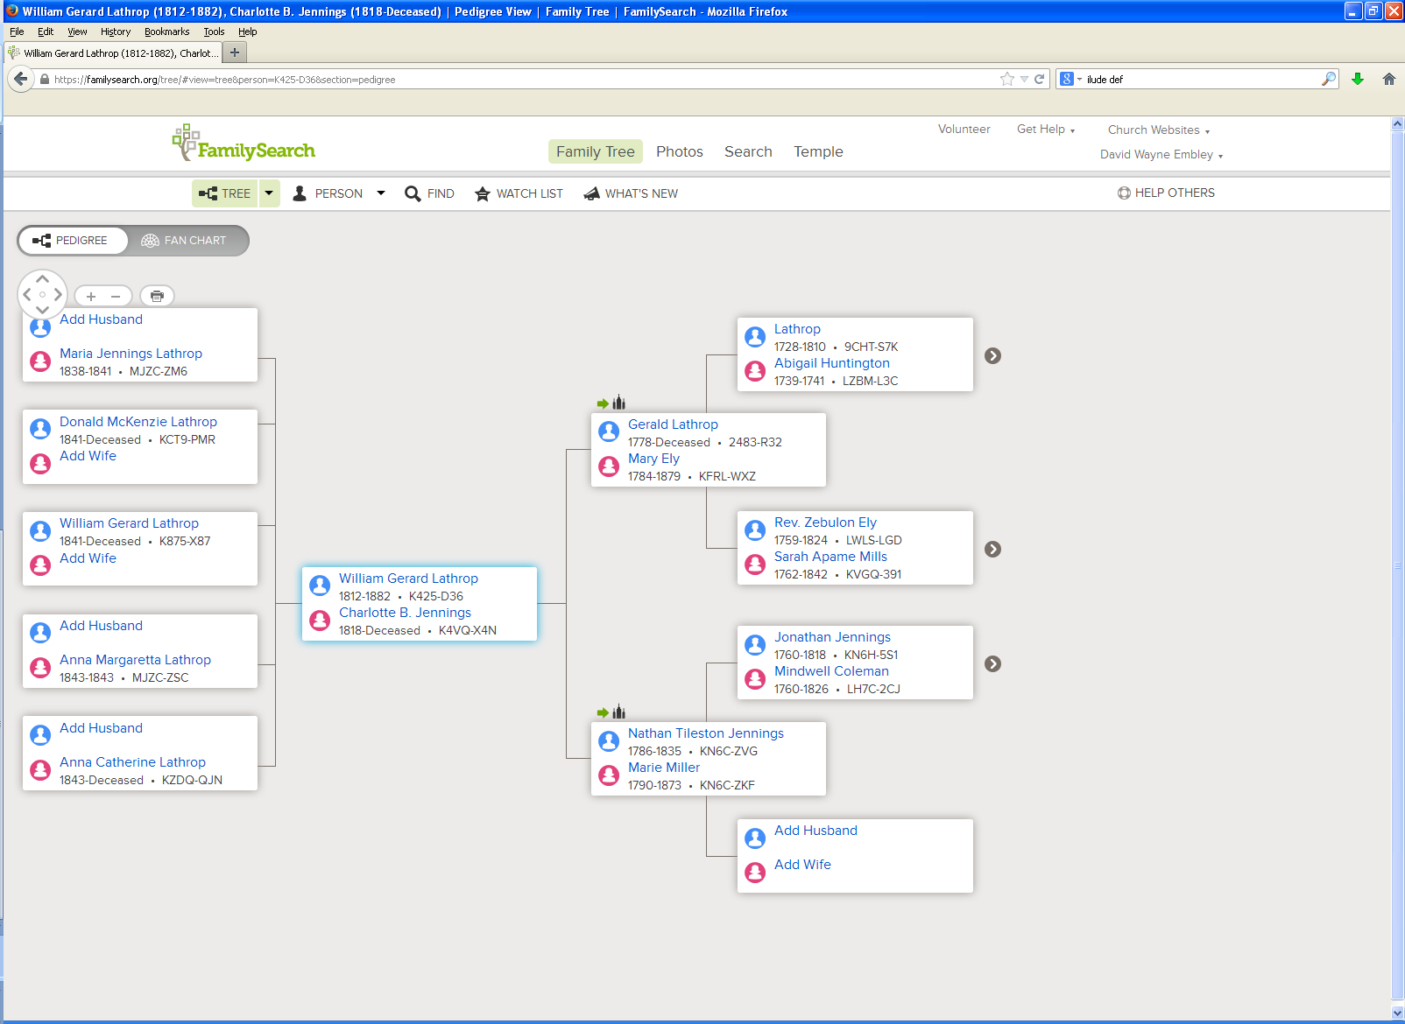
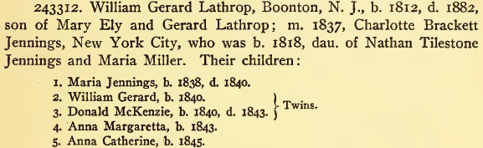
Notes:
Note discrepancies: Maria Jennings death year, William Gerard’s birth year, Donald McKenzie’s birth year and missing death year, Anna Margaretta’s death year, Charlotte’s middle name, the spelling of Gerard (the father of William Gerard Lathrop), the spelling of Nathan’s middle name, the spelling of Maria Miller’s first name.

Slide 5
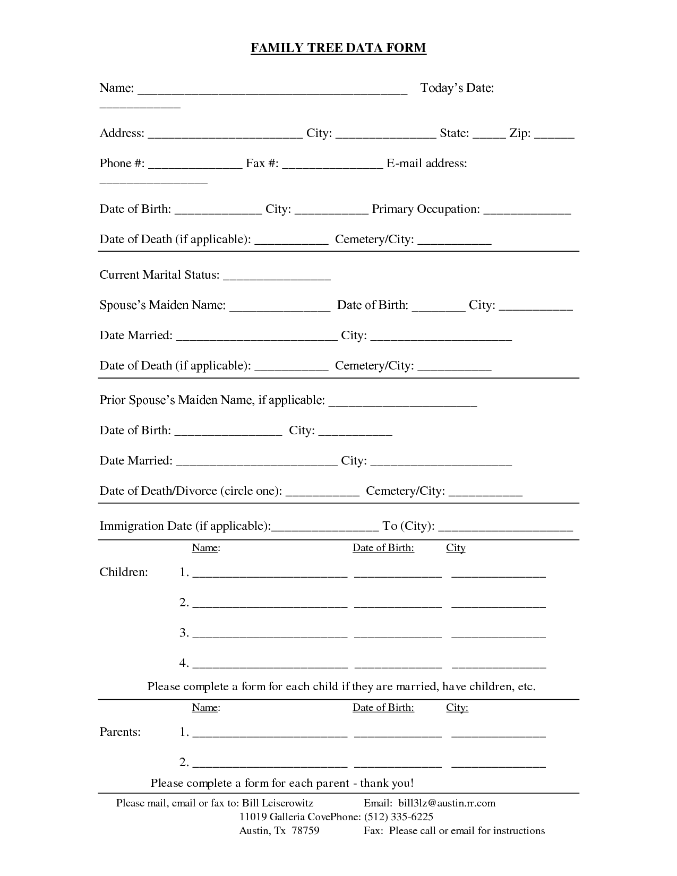
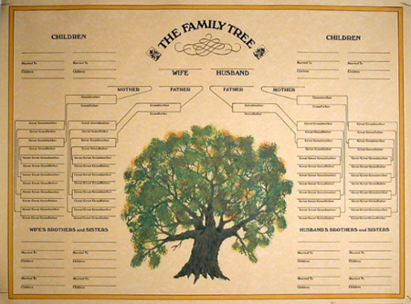
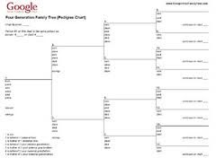
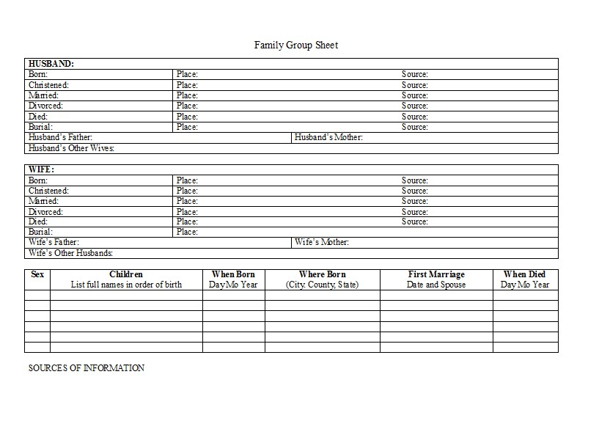
Read and Do Form-fill Type-in

Slide 6
Form-fill: Click-only

Slide 7
Synergistic: Automatic Form-fill with Human Confirmation/Correction
√
√
√
√

Slide 8
Demo
Extraction Tasks
  Batch selection/completion
  Page display-mode/magnification/navigation
  Form field-fill/correction
Forms
  Person (Vital Information)
  Couple (Marriages)
  FamilyGroup (Parents with Children)
Notes:
Use Ely for basic demo
Run through and show basics (all forms briefly)
Walk through the Steele page with them practicing at the same time
Let them ask questions or point out questions that should be asked
Show rules (which they’ll have available to them while they work)
Modify rules if new questions arise

Slide 9
  Batch selection/completion
the system works by assigning page sequences in batches … users select batches to work on … when a user starts working on a batch, the first page in the batch immediately comes up with all system-determined annotations in place … the user corrects precision and recall errors and then declares the page “done” … the system then brings up the next page in the batch until all pages in the batch are complete … the current page being worked on is the “focus page” … all other pages before and after the focus page can be accessed by paging forward or backward … any annotations made on preceding or subsequent pages are stored with the current focus page

Slide 10



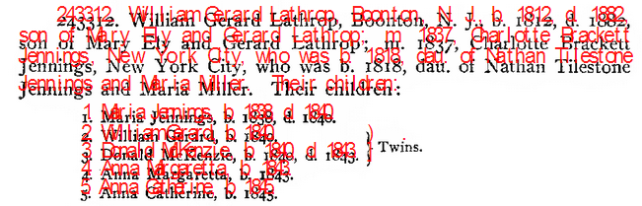
  Page display-mode/magnification/navigation
magnify: zoom in and out
go to previous page, next page
mode
bounding box
scroll bars
Notes:
Replace image when font-size issue is resolved. Also, there’s talk about a shaded bounding box around the text a click extracts.

Slide 11
Form field-fill/correction
Annotation Actions
click on token: annotate token (letters and digits only)
Alt-click on token: annotate token (letters, digits & punctuation)
mouse-select & click: annotate selected text
hold Ctrl: append annotation on click or Alt-click
double-click on field: enter edit mode
Esc: leave edit mode (alternatively, click outside of focus field to leave edit mode)
1–9: add 1–9 nested fields (when focus is on a nested list field)
-: delete last nested field (when focus is on a nested list field)
x: delete field content
a/A: add record after(a)/before(A) record with the focus field
[x]: delete record
click on field: move focus to field
Tab/shift-Tab: move to next/previous field
hover over filled-in field: highlight extracted text
Notes:
Replace with image of Annotation Actions
Current thoughts:
“click on field: enter edit mode” -> “double-click on field: enter edit mode”
Remove hover-write/append/delete feature – all have other alternatives and we need hover to highlight for all annotation tasks, especially the Ensemble
Move “1-9…” to Actions and make it the only way to add nested fields
Add “-” to Actions and make it the only way to delete a nested field: “-: delete a nested field
“click on field & Esc: move focus to field” -> “click on field: move focus to field” – and move to Actions
Permanently remove the following keyboard shortcuts: “r: Repeat annotation”, “s: Append current selection”, “d: Delete current annotation”, “z Undo previous annotation”, “e: Enter editing mode for current field”
Although useful, I think we should also remove: “w: Previous field” and “q: Next field” (We should have Tab and shift-Tab because they are standard, and we should not have two keys do exactly the same thing.)
Have only one column: Annotation Actions

Slide 12
Rules and Hints for All Forms
Rules
  Use click, Alt-click, or mouse-drag-select-and-click to extract text; then fix errors, if any. (Don’t just type in information, for then the system has no way of knowing where the information is on the page.)
  Fix OCR and type-setting errors in extracted field values
  Make corrections to extracted field values recorded in handwritten notes.
  Close up words with end-of-line hyphens unless the hyphen is “real.”
  For items that cross page boundaries, extract complete record information with the focus page.
Hints
  For click and Alt-click, hold down Ctrl to add tokens to a field. (Sometimes a click doesn’t “take”; look to be sure the cursor is within a character bounding box and click again.)
  The field focus changes automatically; to change manually, use Tab to go forward and shift-Tab to go backward or just click on the desired field.
Notes:
Hint#3: Since releasing Ctrl moves the cursor, it is also a convenient way to move the focus forward.

Slide 13
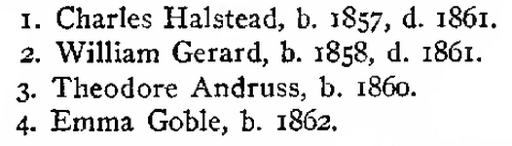
  Fix OCR and type-setting errors in extracted field values.
Notes:
For presentation, it may be fun to animate the location of the error, but for reading instructions, it’s better to omit the animation.

Slide 14
  Make corrections to extracted field values recorded in handwritten notes.
Click here to extract “1840”; then edit the extracted “1840”, making it “1841”.
Notes:
As a matter of interest, note that the tree in FamilySearch has Maria Jennings’ birth year recorded as 1841. (One might assume that the other information recorded here is correct even though it is different in the tree in FamilySearch – see earlier slide, #4.)

Slide 15

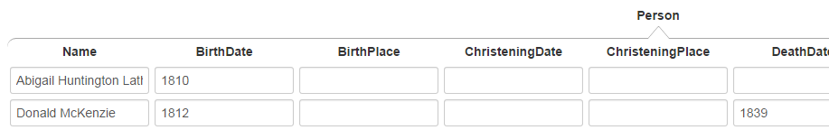
  Close up words with end-of-line hyphens unless the hyphen is “real.”
Click on “McKen-” or on “zie” properly extracts all of “McKenzie”.
Click on “Latter-” or “day” in: “Latter-
day Saints” also yields “Latterday”, but Alt-click yields “Latter-day”. Use Alt-click to retain the “real” hyphen.

Slide 16


  For items that cross page boundaries, extract complete record information with the focus page.
previous page
next page
focus page
next page
record together with the
focus page (page 418)

Slide 17
Rules and Hints for Person Form
Rules
  Extract only names that have either associated birth or death information.
  Get full name, including any punctuation, title(s) and suffix, but not non-name components associated with the name such as possessives (i.e., ’s).
  Extract names as written. Do not extract implied name parts even if the name part is present elsewhere in the text (e.g., not implied surnames or maiden names, not commentary about alternate names).
  Get full date and place names, including punctuation. Do not extract implied dates and place names (e.g., not birth date when only age and death date appear and not place names unless explicitly stated as birth or death places).
  Resolve each pronoun and person designator that links birth or death information to the name to which it refers.
Hints
  Use Ctrl-click to append name, date, and place parts.
  For names, dates, and places with punctuation, use Alt-click.
  The Keyboard Shortcut “a” to add a record may be useful.

Slide 18
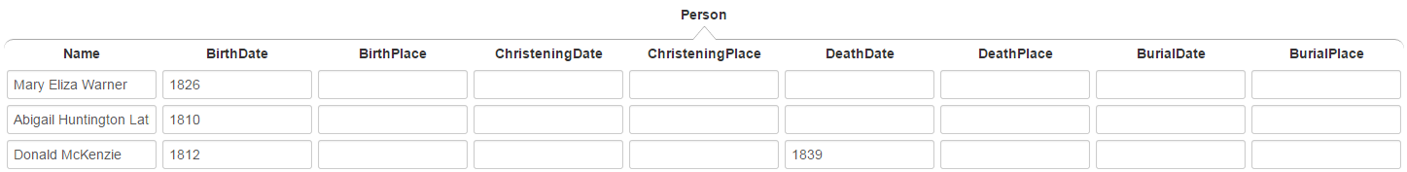
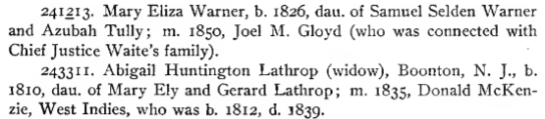
Extract only names that have either associated birth or death information.
not these names, since no birth or death information is associated with them
Notes:
These other names will be extracted with other forms, not the Person form.

Slide 19
  Get full name, including any punctuation, title(s) and suffix, but not non-name components associated with the name such as possessives.
Mrs. Lathrop (include title “Mrs.”)
Isaac Steel, Sr. (include the comma after “Steele” but not after “Sr.”)
Chief Justice Waite (omit apostrophe “s”)

Slide 20
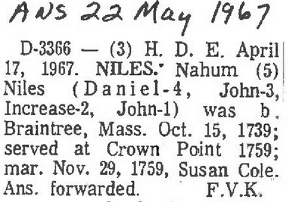
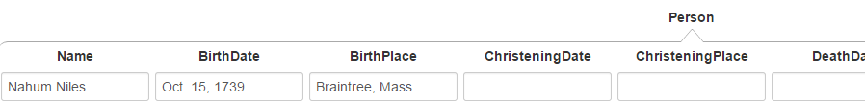
  More on omitting non-name components.
not embedded reference markers
not paragraph headers
not names used for
internal designators
extraction for Person form:

Slide 21
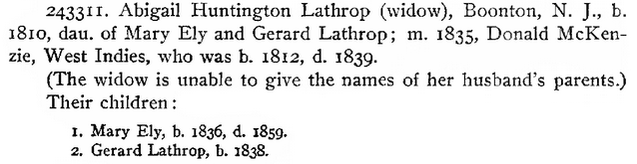
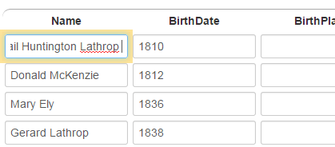
Extract names as written.
not “Abigail Huntington Lathrop McKenzie”
not “Mary Ely McKenzie”
not “Gerard Lathrop McKenzie”
just the names as written
Note: The field for “Abigail Huntington Lathrop” is in edit mode and scrolled right to show that “McKenzie” is not extracted.

Slide 22



Extract names as written.
The nickname is not included (not written as part of name). The nickname would be included if the name had been written “Ira “Bina” Zabina” or “Ira Zabina (Bina)”.
Note: The extraction has several OCR errors, which should all be corrected (left unaltered here to show examples of what to look for).

Slide 23
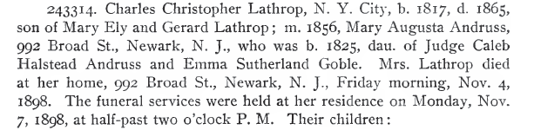
Get full date and place names, including punctuation.
date modifiers (include)
not date modifiers, not date explanations
(do not include)
punctuation part of place (include)
Note: Do not include street addresses in place names.
days of the week (do not include)
punctuation part of date
(include)
punctuation not part of date (exclude)
punctuation not part of place (exclude)
Notes:
Picking up “Newark, N. J.” by clicking only is tricky: one way to do it is Alt-click on “Newark,”, Alt-click on “N.”, and select-click for “J.” where the selection omits the trailing comma “,”. Another way: select-click “Newark, N. J.” (omitting the comma). If frustrating, another way is to include the comma “J.,” and then edit to remove the comma. Don’t, however, just type in “Newark, N. J.” or any part of it without first extracting.

Slide 24
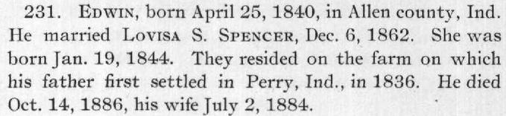
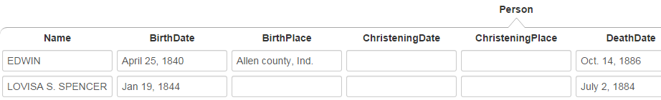
Resolve each pronoun and person designator that links birth or death information to the name to which it refers.

Slide 25
Resolve each pronoun and person designator that links birth or death information to the name to which it refers.

Slide 26
Resolve each pronoun and person designator that links birth or death information to the name to which it refers.

Slide 27
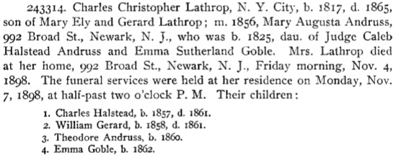
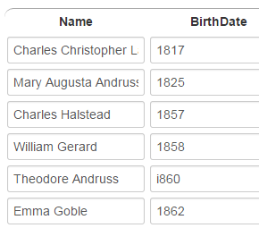
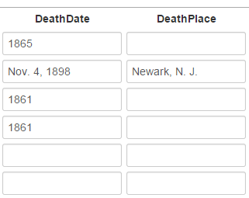
Resolve each pronoun and person designator that links birth or death information to the name to which it refers.
Note: “Mrs. Lathrop” is a person designator here for Mary Augusta Andruss and the death date and death place should thus be associated with Mary Augusta Andruss. (“Mrs. Lathrop” would not be a person designator, but rather the primary name for the person if it were the only name associated with the birth and death dates and the death place.)
…
…

Slide 28
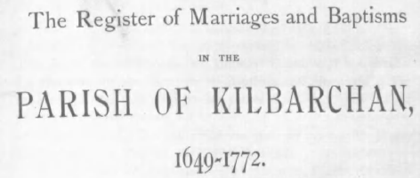
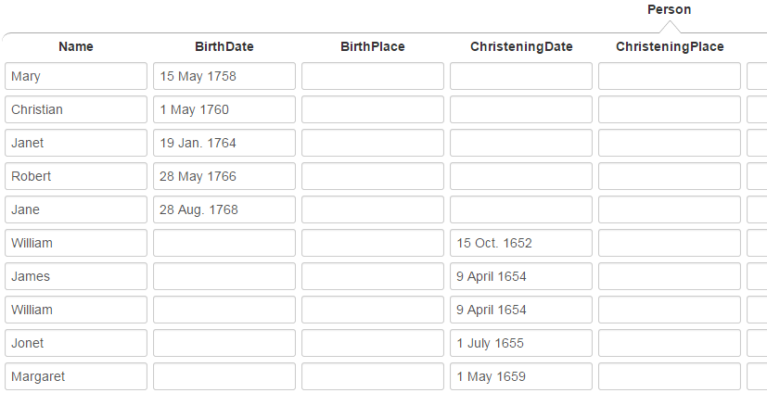
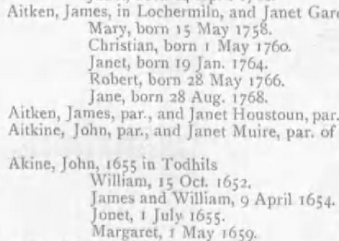
Special Cases
The ChristeningPlace is known but not stated in the entry. Omit; the system will provide it.
The BirthPlace is unknown. Omit.
For twins, extract the common date twice.
If the names of the twins had been combined, e.g., “James and William Akine”, extract the common name twice: “James Akine” and “William Akine”.

Slide 29





Special Cases
name designator without a name
name designator with no OCR: click on a token or character close by and edit (here the annotator clicked on the comma and then entered “-----” for the name designator)
name designator with no OCR, but explanatory context: extract the explanatory context and edit (here the annotator mouse-selected “, daughter” and then entered “-----”)

Slide 30
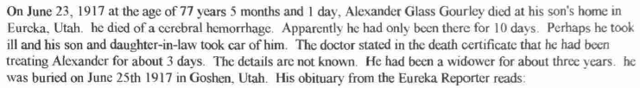
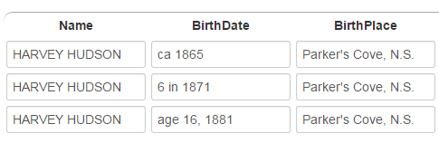
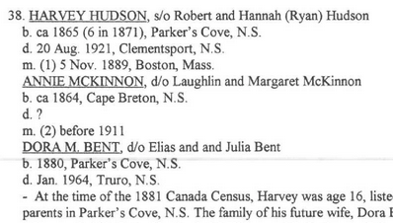
Special Cases
Use age as of date for BirthDate when no birth date is given:
extracted text: “age of 77 years 5 months and 1 day, On June 23, 1917”
When several BirthDate designators appear, choose only the best—only the first here:
For age birth dates, extract (rather than type) a phrase that gives both the age and date of age (pieced together as in the third example, if necessary).

Slide 31
Rules and Hints for Couples Form
Rules
  Record all couples as marriages, both stated and implied (e.g., if A is mentioned as the son of B and C, then record B and C as being married).
  Record marriages with respect to a person. Either spouse may be the primary person.
  Make a person with multiple marriages be the primary person and list each spouse with the primary person.
  Extract names as specified for the person form—full names including punctuation, but only names as written, not including implied maiden names and surnames.
  Resolve each pronoun and person designator that links to marriage information to the name to which it refers.
  For combined names (e.g., “John J. and Mary Adams Smith”), extract complete names of both (e.g., “John J. Smith” and “Mary Adams Smith”).
Hints
  For multiple marriages, count the number of additional spouses and create additional nested records with a number key—1 to add one more spouse, 2 to add two additional spouses, etc.
  Since the primary spouse can be either the husband or the wife, record names in the order they appear in the document.
Notes:
Note: Tab is not yet implemented.

Slide 32
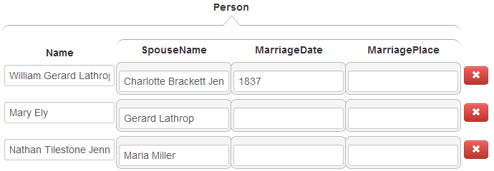
Record all couples as marriages, both stated and implied.
stated
implied
names, as written (here, the maiden name only—the implied married name is not included, e.g. “Mary Ely”, not “Mary Ely Lathrop”)

Slide 33
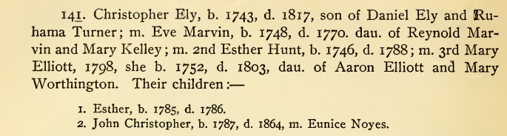
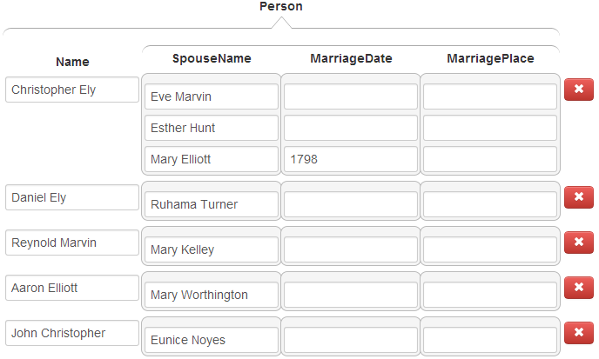
Make a person with multiple marriages be the primary person and list each spouse with the person.
Christopher with three marriages

Slide 34
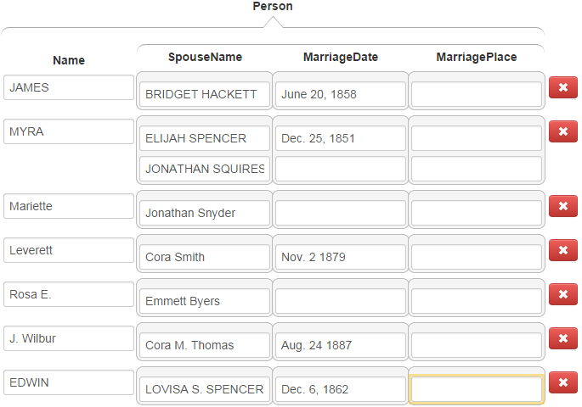
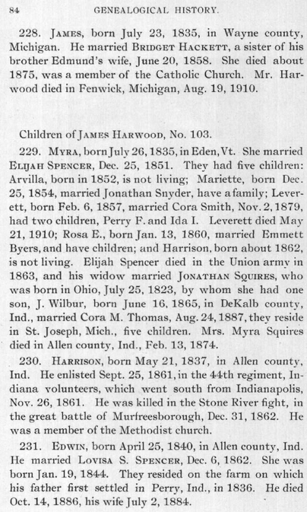
Resolve each pronoun and person designator that links to marriage information to the name to which it refers.
In this example, pronoun references to spouses are easily resolved, but the resolution of the person designator “his widow” as the spouse of Jonathan Squires requires a deeper understanding of the text.

Slide 35

For combined names, extract complete names of both.
George McKown
Myrtle Parker McKown
Mr. Ovidio D. Ferrara
Mrs. Ovidio D. Ferrara
Rex Call
Arta (Shippee) Call
Note: Retain the parentheses in the name.

Slide 36
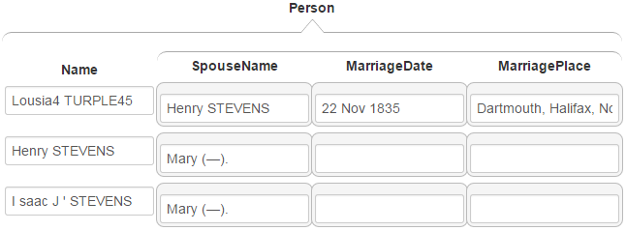
Special Cases
The second mention of the couple, Lousia TURPLE and Henry STEVENS, should not be extracted.
The name designator “(---)” should be extracted.
Several field values need to be edited (left here unedited to show what needs to be done: delete the “4”, “45”, the two periods after each “(---)” and the extra spaces between “I” and “saac” and between “J” and the apostrophe).

Slide 37
Rules and Hints for Children Forms
Rules
  Parents may be specified in either order—father first or mother first.
  Correctly determine parentage. Parentage can sometimes be complex especially with multiple marriages and blended families. Writers are usually clear, but read carefully to correctly determine parentage.
  Record families that extend across page boundaries with the focus page.
  Sometimes the same surname appears for every child. Be sure to properly include each separate surname with each separate name.
  Resolve each pronoun and person designator that links to parent-child information to the name(s) to which it refers.
  For combined names, extract complete names of both.
Hints
  When the focus is on a nested list field, a number key, n, adds n more blank fields to the list. Count the number of children and add the right number of fields first, then fill them in (e.g., if there are 5 children, enter 4 to add 4 more fields for the children; for 24 children, enter 9, then 9 again, and finally 5).
  Since the parents can be in either order, record names in the order they appear in the document.

Slide 38
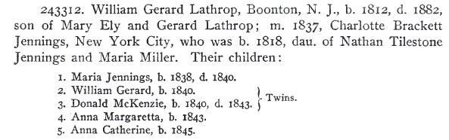

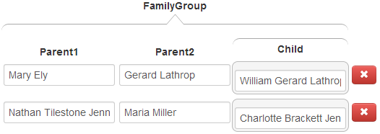
Don’t forget children, not explicitly marked as “children”.

Slide 39
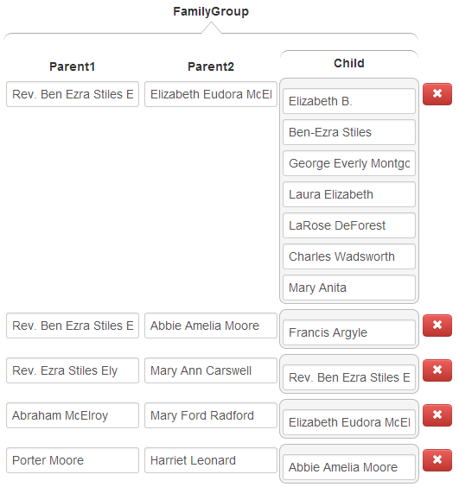
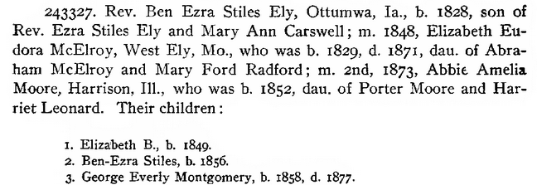

Correctly determine parentage.
Note that Elizabeth died in 1871 and could not have been Francis’s mother.
Pronoun resolution can be complex.

Slide 40
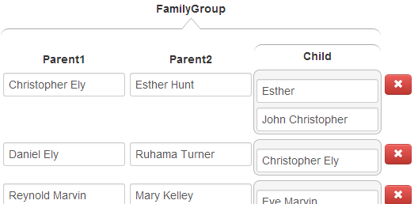
Correctly determine parentage.
Eve cannot be the mother of either of Christopher’s children since she died before they were born. Esther was Christopher’s wife at the time both children were born, so she is the likely mother. Mary became Christopher’s wife in 1798, after both children were born.

Slide 41
  Record families that extend across page boundaries with the focus page.
record Christopher with parents on a previous page (omit when this is the page of focus, even if your batch does not include the previous page)
no children, but don’t forget the “dau of” child
record all five children with their parents here, not forgetting the “son of” child
record children on a next page with this page; also don’t forget the “son of” child in this family

Slide 42
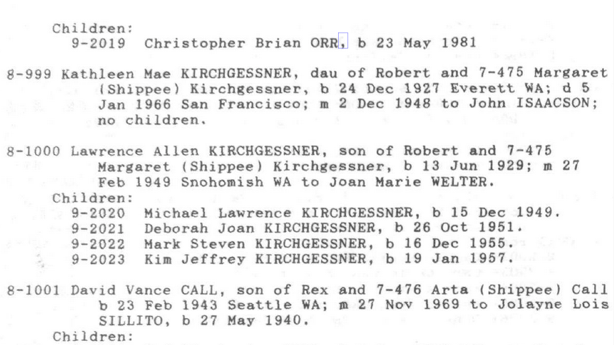
Be sure to properly include each separate surname with each separate name.
For “Michael Lawrence KIRCHGESSNER”, click here, here, and here.
For “Deborah Joan KIRCHGESSNER”, click here, here, and here.

Slide 43
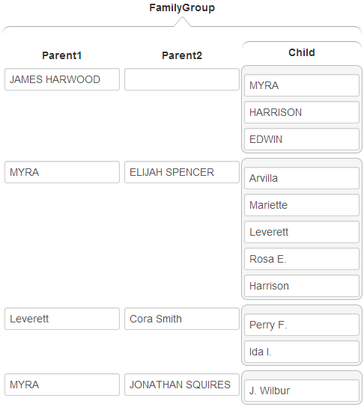
Resolve each pronoun and person designator that links to parent-child information to the name(s) to which it refers.
An understanding of the text (e.g., “by whom she had one son”) is sometimes required to link children to parents.

Slide 44
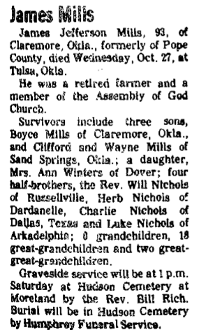
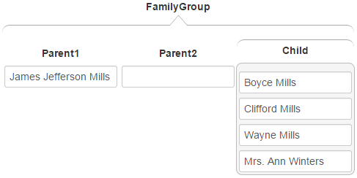
For combined names, extract complete names of both.

Slide 45
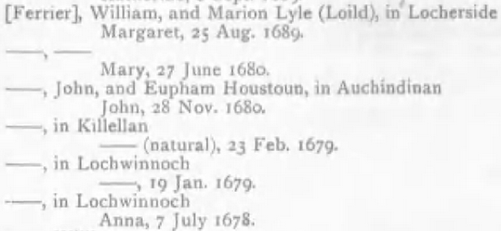
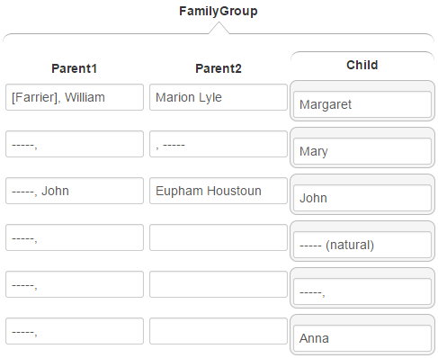
Special Cases
Include the name designator ``[Ferrier]’’. (A ferrier is a person who shoes horses.)
For name designators with no OCR, be sure to click on a near-by token or explanatory phrase and then add a close equivalent to the non-OCRed name designator. (Here, “natural” is an explanatory phrase for a name specifying that a child was born before the parents married.)

Slide 46
Good Luck!
(our ancestors are waiting)

