Slide 1
Scanned Books:
Annotator Training

Slide 2
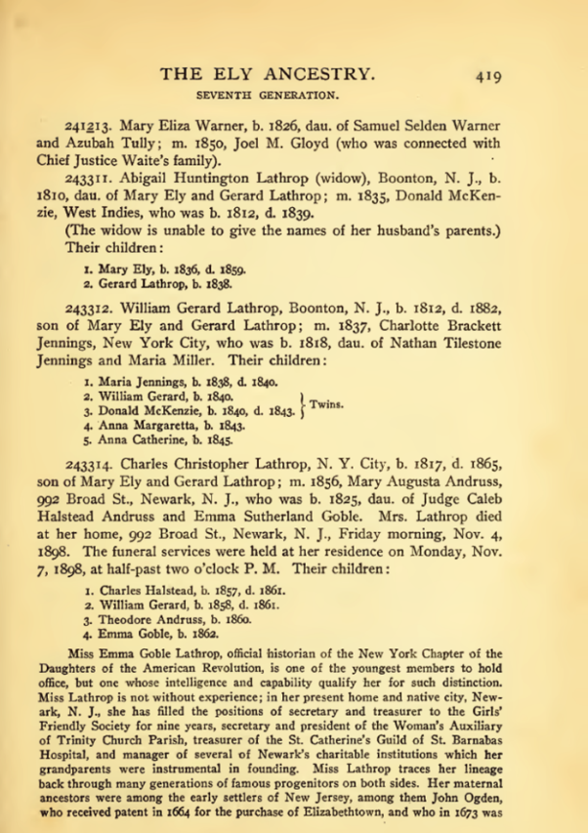
Project Overview
Untapped sources
  200,000+ scanned/OCRed books
  Problem: cost-effective extraction
Extraction tools
  Read and do form-fill type-in
  Form-fill by clicking
    Copy/paste & correction
    Family tree construction by inference
  Automated form-fill with user correction
    Automated form-fill tools
      Manual specification of rules (FROntIER)
      Discover author-specified patterns (ListReader)
      Parse sentences & match concepts (OntoSoar)
      Learn from observing users work (GreenFIE-HD)
    Correction mostly by copy/paste clicks
Notes:
Explain: we are doing some initial testing of a tool we hope will let us “index” our scanned-book collection cost effectively.

Slide 3
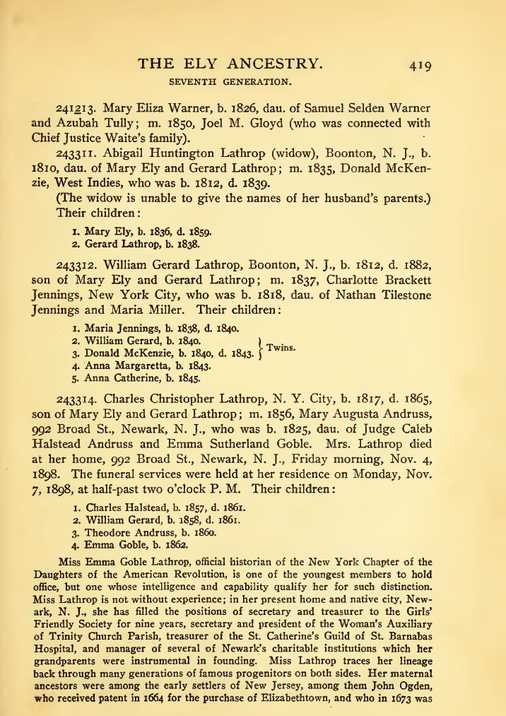

Slide 4
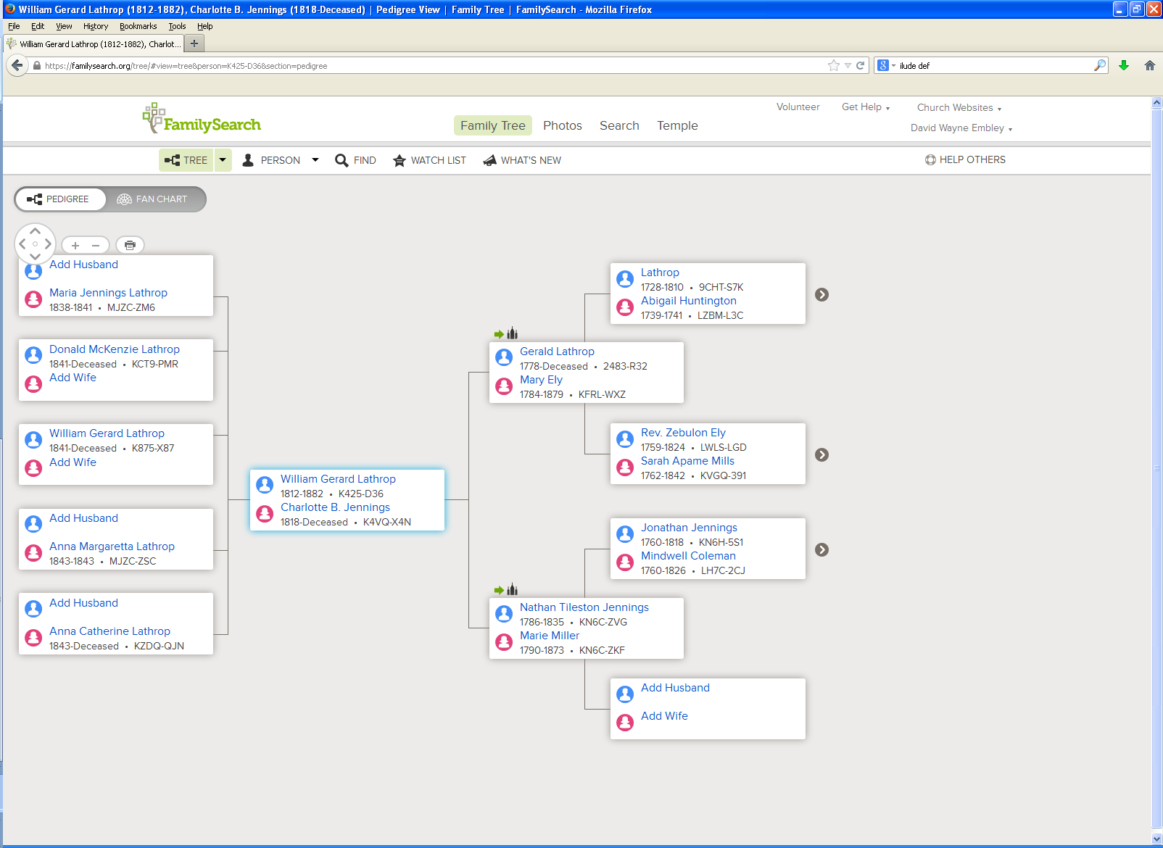
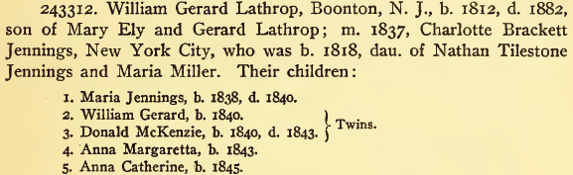
Notes:
Note issues: Maria Jennings death year is different; Donald McKenzie’s birth year is different and death year is missing; child William Gerard’s birth year is different; Anna Margaretta’s death year is recorded, but does not appear in TheElyAncestry; Anna Catherine’s birth year is different; Charlotte’s middle name is missing; the spelling of Gerard (the father of William Gerard Lathrop, is “Gerald”); the spelling of Nathan’s middle name is different; Maria Miller’s first name is different.

Slide 5
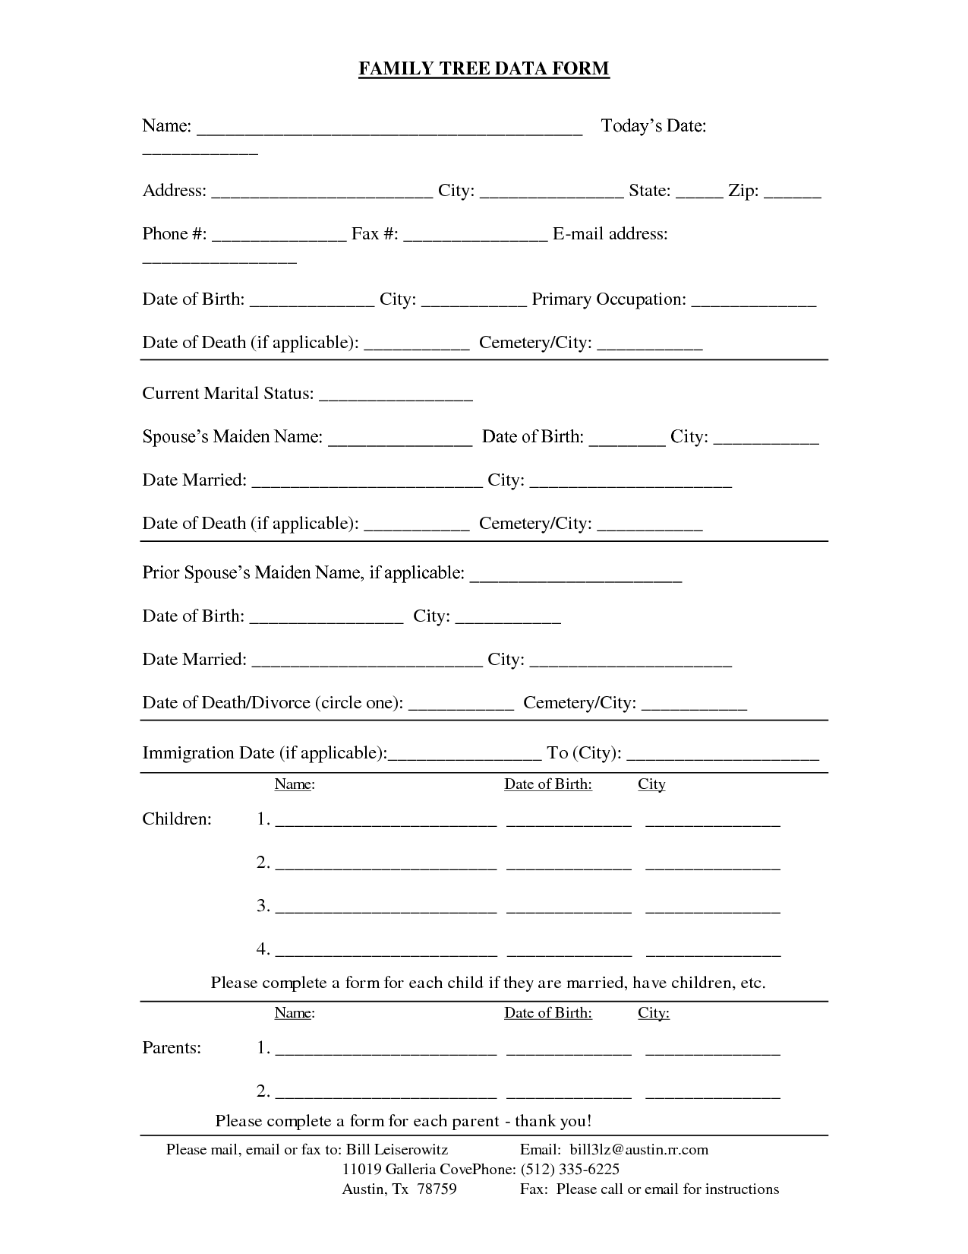
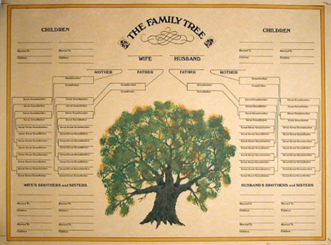
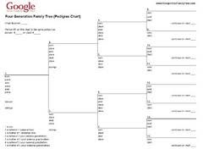
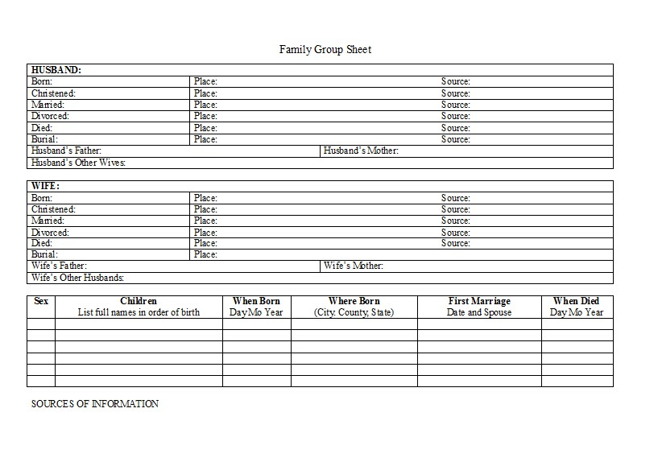
Read and Do Form-fill Type-in

Slide 6
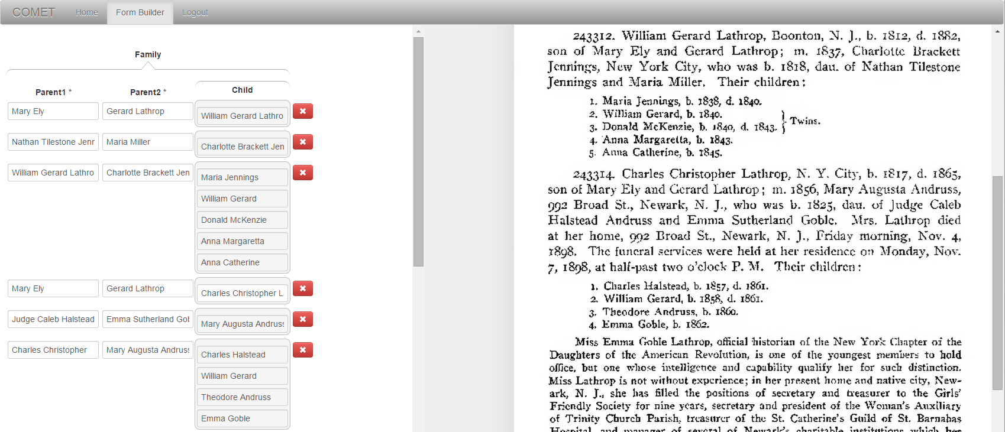
Form-fill: Click-only

Slide 7
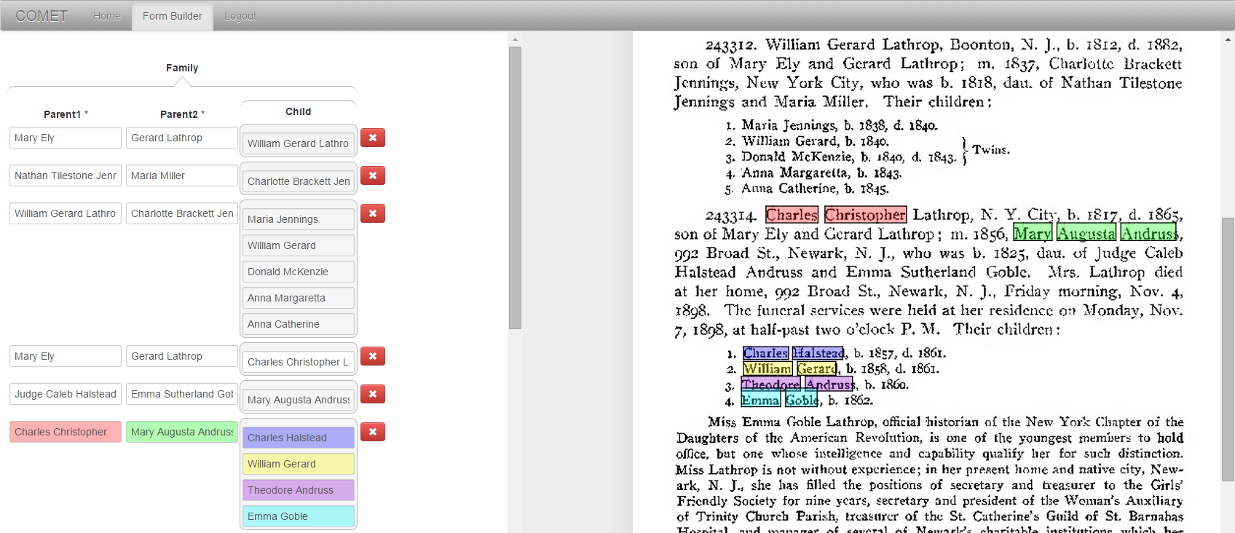
Synergistic: Automatic Form-fill with Human Confirmation/Correction
√
√
√
√

Slide 8
Demo
Batch selection/completion
  Person Form (Vital Information)
  Couple Form (Marriages)
  Family Form (Parents with Children)
Page display-mode/magnification/hover
Form field navigation/fill/correction
Form record deletion/insertion

Slide 9
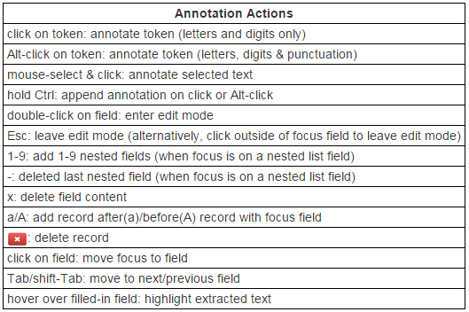
Form field-fill/correction

Slide 10
Rules and Hints for All Forms
Rules
  !! Use click, Alt-click, or mouse-drag-select-and-click to extract text; then fix errors, if any. (Don’t just type in information, for then the system has no way of knowing where the information is on the page.)
  Fix OCR and type-setting errors in extracted field values
  Make corrections to extracted field values recorded in handwritten notes.
  Close up words with end-of-line hyphens unless the hyphen is “real.”
  For annotations crossing page boundaries, extract complete record information with the focus page (the given page to work on).
Hints
  For click and Alt-click, hold down Ctrl to add tokens to a field. (Sometimes a click doesn’t “take”; look to be sure the cursor is within a character bounding box and click again.)
  The field focus changes automatically; to change manually, use Tab to go forward and shift-Tab to go backward or just click on the desired field.
  Pressing and releasing Ctrl is also a convenient way to move the field focus forward.

Slide 11
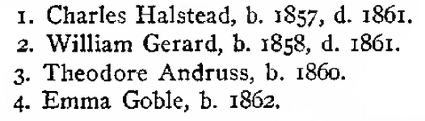
  Fix OCR and type-setting errors in extracted field values.
Notes:
For presentation, it may be fun to animate the location of the error, but for reading instructions, it’s better to omit the animation.

Slide 12
  Make corrections to extracted field values recorded in handwritten notes.
Click here to extract “1840”; then edit the extracted “1840”, making it “1841”.
Notes:
As a matter of interest, note that the tree in FamilySearch has Maria Jennings’ birth year recorded as 1841. (One might assume that the other information recorded here is correct even though it is different in the tree in FamilySearch – see earlier slide.)

Slide 13

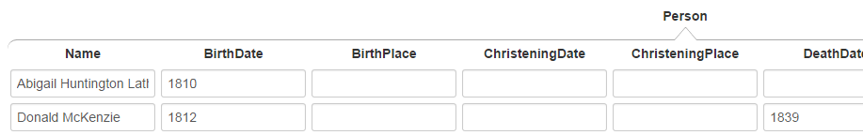
  Close up words with end-of-line hyphens unless the hyphen is “real.”
Click on “McKen-” or on “zie” properly extracts all of “McKenzie”.
Click on “Latter-” or “day” in: “Latter-
day Saints” also yields “Latterday”, but Alt-click yields “Latter-day”. Use Alt-click to retain the “real” hyphen.

Slide 14



  For annotations crossing page boundaries, extract complete record information with the focus page.
previous page
next page
focus page
next page
record together while working on page 418 (the focus page)
Notes:
Mention, since the buttons are live, but for annotating random pages, these instructions should be ignored.

Slide 15
Rules and Hints for Person Form
Rules
  Extract only names that have either associated birth or death information.
  Get full name, including any punctuation, title(s) and suffix, but not non-name components associated with the name such as possessives (i.e., ’s).
  Extract names as written. Do not extract implied name parts even if the name part is present elsewhere in the text (e.g., not implied surnames or maiden names, not commentary about alternate names).
  Get full date and place names (city/town, county, state, country), including punctuation. Do not get implied dates and place names (e.g., not birth date when only age and death date appear and not place names unless explicitly stated as birth or death places).
  Resolve each pronoun and person designator that links birth or death information to the primary name to which it refers.
Hints
  Use Ctrl-click to append name, date, and place parts.
  For names, dates, and places with punctuation, use Alt-click.
  Reminder: use the Keyboard Shortcut “a” and “A” to add a record.

Slide 16
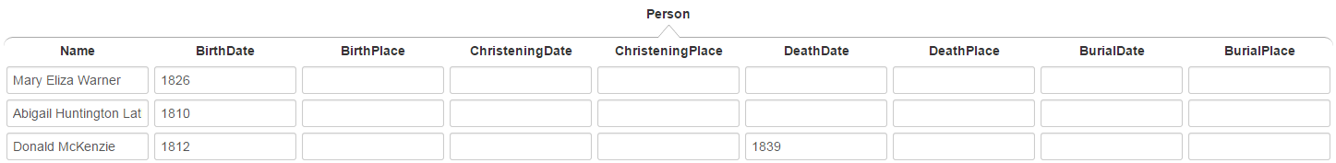
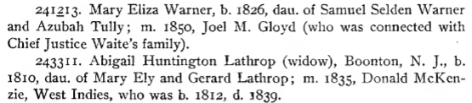
Extract only names that have either associated birth or death information.
extraction for Person form:
not these names, since no birth or death information is associated with them
Notes:
These other names will be extracted with other forms, not the Person form.

Slide 17
  Get full name, including any punctuation, title(s) and suffix, but not non-name components associated with the name such as possessives.
Mrs. Lathrop (include title “Mrs.”)
Isaac Steel, Sr. (include the comma after “Steele” but not after “Sr.”)
Chief Justice Waite (omit apostrophe “s”)

Slide 18
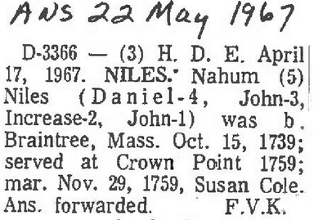
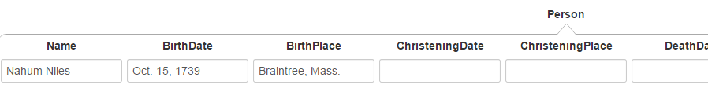
  More on omitting non-name components.
not embedded reference markers
not paragraph headers
not names used for
internal designators
extraction for Person form:

Slide 19
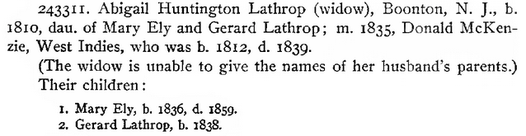
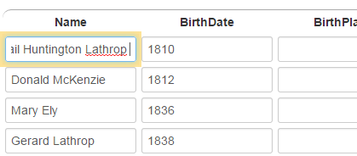
Extract names as written.
not “Abigail Huntington Lathrop McKenzie”
not “Mary Ely McKenzie”
not “Gerard Lathrop McKenzie”
just the names as written
Note: The field for “Abigail Huntington Lathrop” is in edit mode and scrolled right to show that “McKenzie” is not extracted.

Slide 20



Extract names as written.
The nickname is not included (not written as part of name). The nickname would be included if the name had been written “Ira “Bina” Zabina” or “Ira Zabina (Bina)”.
Note: The extraction has several OCR errors, which should all be corrected (left unaltered here to show examples of what to look for).

Slide 21
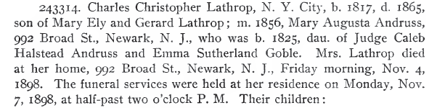
Get full date and place names, including punctuation.
date modifiers (include)
not date modifiers, not date explanations
(do not include)
punctuation part of place (include)
street addresses (do not include)
days of the week (do not include)
punctuation part of date
(include)
punctuation not part of date (exclude)
punctuation not part of place (exclude)
Notes:
Picking up “Newark, N. J.” by clicking only is tricky: one way to do it is Alt-click on “Newark,”, Alt-click on “N.”, and select-click for “J.” where the selection omits the trailing comma “,”. Another way: select-click “Newark, N. J.” (omitting the comma). If frustrating, another way is to include the comma “J.,” and then edit to remove the comma. Don’t, however, just type in “Newark, N. J.” or any part of it without first extracting.

Slide 22
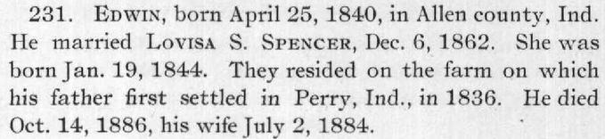
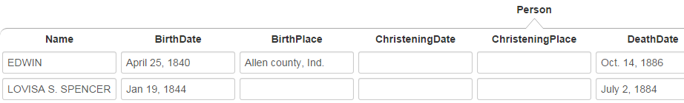
Resolve each pronoun and person designator that links birth or death information to the primary name to which it refers.

Slide 23
Resolve each pronoun and person designator that links birth or death information to the primary name to which it refers.

Slide 24
Resolve each pronoun and person designator that links birth or death information to the primary name to which it refers.

Slide 25
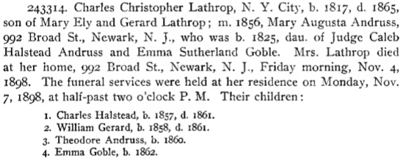
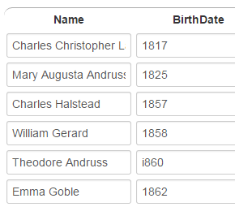
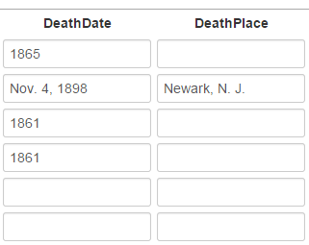
Resolve each pronoun and person designator that links birth or death information to the primary name to which it refers.
Note: “Mrs. Lathrop” is a person designator here for Mary Augusta Andruss and the death date and death place should thus be associated with Mary Augusta Andruss. (“Mrs. Lathrop” would not be a person designator, but rather the primary name for the person if it were the only name associated with the birth and death dates and the death place.)
…
…

Slide 26
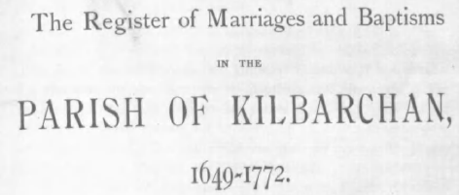
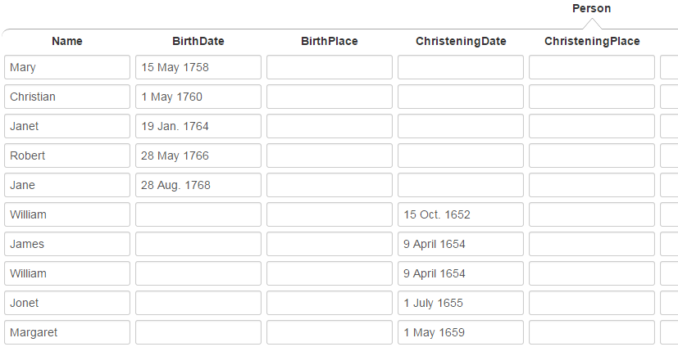
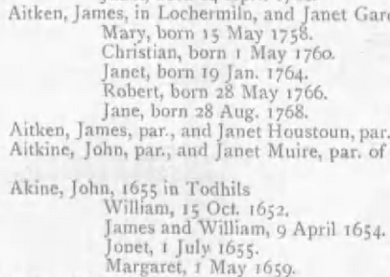
Special Cases
The ChristeningPlace is known but not stated in the entry. Omit; the system will provide it.
The BirthPlace is unknown. Omit.
For twins, extract the common date twice.
If the names of the twins had been combined, e.g., “James and William Akine”, extract the common name twice: “James Akine” and “William Akine”.

Slide 27
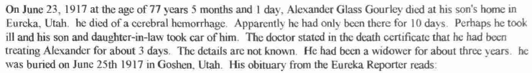
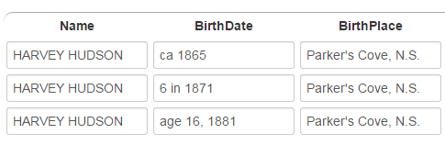
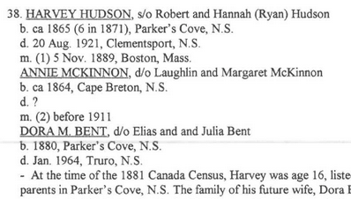
Special Cases
Use age as of date for BirthDate when no birth date is given:
extract: “age of 77 years 5 months and 1 day, On June 23, 1917”
Do not infer the actual birth date and type it in.
When several BirthDate designators appear, choose only the best—only the first here:
For age birth dates, extract a phrase that gives both the age and date of age, pieced together as in the third example, if necessary.
(The last two examples here are only for illustrating how to extract birth dates.)

Slide 28
Special Cases
Use the funeral date as the burial date, if no date is specifically designated as the burial date.
BurialDate: Nov. 7, 1898

Slide 29
Rules and Hints for Couples Form
Rules
  Record all couples as marriages, both stated and implied (e.g., if A is mentioned as the son of B and C, then record B and C as a couple).
  Record marriages with respect to a person. Either spouse may be the primary person.
  Make a person with multiple marriages be the primary person and list each spouse with the primary person. If both spouses have multiple marriages, make a record with each spouse as the primary person.
  Extract names as specified for the person form—full names including punctuation, but only names as written, not including implied maiden names and surnames.
  Resolve each pronoun and person designator that links to marriage information to the name to which it refers.
  For combined names (e.g., “John J. and Mary Adams Smith”), extract complete names of both (e.g., “John J. Smith” and “Mary Adams Smith”).
Hints
  For multiple marriages, count the number of additional spouses and create additional nested records with a number key—1 to add one more spouse, 2 to add two additional spouses, etc.
  Since the primary spouse can be either the husband or the wife, record names in the order they appear in the document.

Slide 30
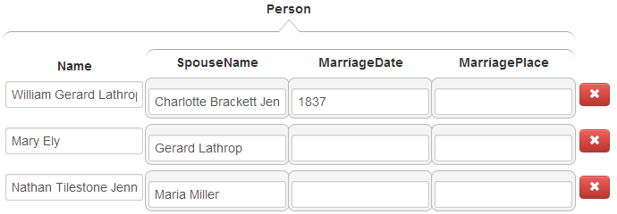
Record all couples as marriages, both stated and implied.
stated
implied
names, as written (here, the maiden name only—the implied married name is not included, e.g. “Mary Ely”, not “Mary Ely Lathrop”)

Slide 31
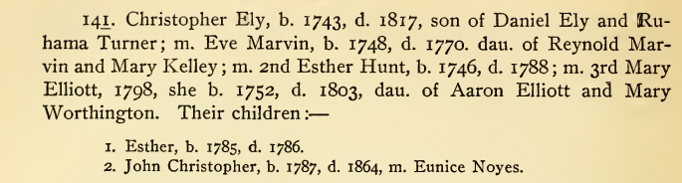
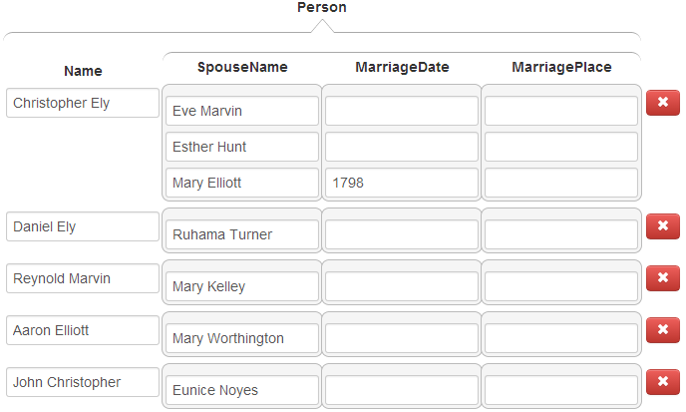
Make a person with multiple marriages be the primary person and list each spouse with the person.
Christopher with three marriages

Slide 32
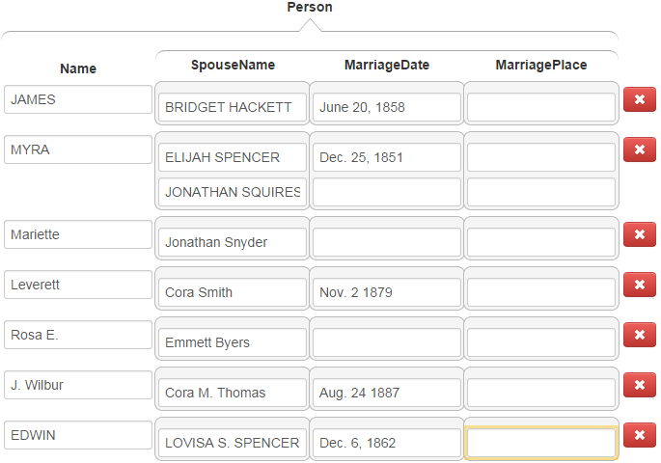
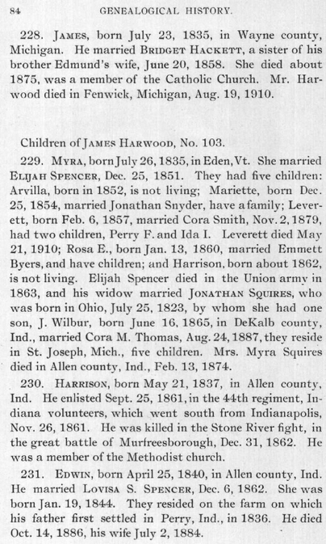
Resolve each pronoun and person designator that links to marriage information to the primary name to which it refers.
In this example, pronoun references to spouses are easily resolved, but the resolution of the person designator “his widow” as the spouse of Jonathan Squires requires a deeper understanding of the text.

Slide 33

For combined names, extract complete names of both.
George McKown
Myrtle Parker McKown
Mr. Ovidio D. Ferrara
Mrs. Ovidio D. Ferrara
Rex Call
Arta (Shippee) Call
Note: Retain the parentheses in the name.

Slide 34
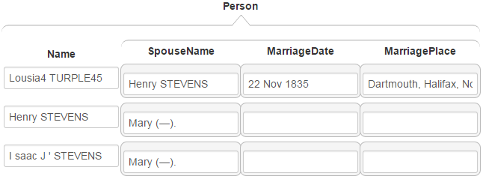
Special Cases
The second mention of the couple, Lousia TURPLE and Henry STEVENS, should not be extracted.
The name designator “(---)” should be extracted.
Several field values need to be edited (left here unedited to show what needs to be done: delete the “4”, “45”, the two periods after each “(---)” and the extra spaces between “I” and “saac” and between “J” and the apostrophe).

Slide 35
Rules and Hints for Children Forms
Rules
  Parents may be specified in either order—father first or mother first.
  Correctly determine parentage. Parentage can sometimes be complex especially with multiple marriages and blended families. Writers are usually clear, but read carefully to correctly determine parentage.
  Record families that extend across page boundaries with the focus page.
  Sometimes the same surname appears for every child. Be sure to properly include each separate surname with each separate name.
  Resolve each pronoun or person designator to the primary name to which it refers.
  For combined names, extract complete names of both.
Hints
  When the focus is on a nested list field, a number key, n, adds n more blank fields to the list. Count the number of children and add the right number of fields first, then fill them in (e.g., if there are 5 children, enter 4 to add 4 more fields for the children; for 24 children, enter 9, then 9 again, and finally 5).
  Since the parents can be in either order, record names in the order they appear in the document.

Slide 36
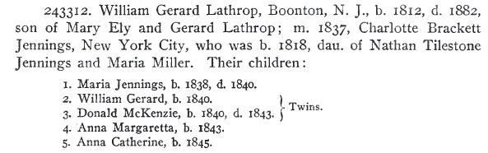

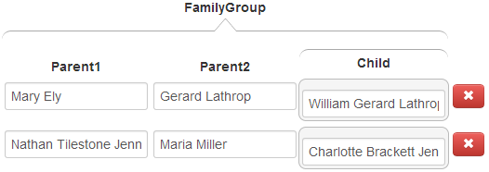
Don’t forget children, not explicitly marked as “children”.

Slide 37
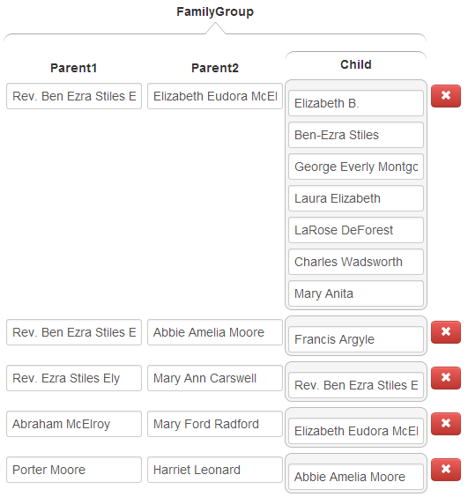
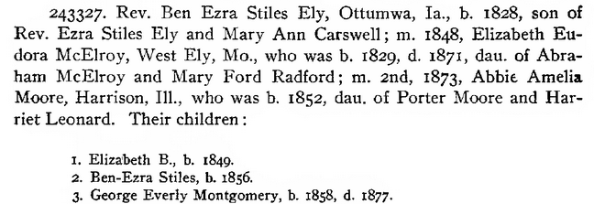

Correctly determine parentage.
Note that Elizabeth died in 1871 and could not have been Francis’s mother.
Pronoun resolution can be complex.

Slide 38
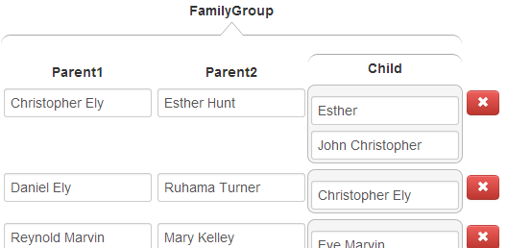
Correctly determine parentage.
Eve cannot be the mother of either of Christopher’s children since she died before they were born. Esther was Christopher’s wife at the time both children were born, so she is the likely mother. Mary became Christopher’s wife in 1798, after both children were born.

Slide 39
  Record families that extend across page boundaries with the focus page.
record Christopher with parents on a previous page (omit when this is the page of focus, even if your batch does not include the previous page)
no children, but don’t forget the “dau of” child
record children on a next page with this page; also don’t forget the “son of” child in this family

Slide 40
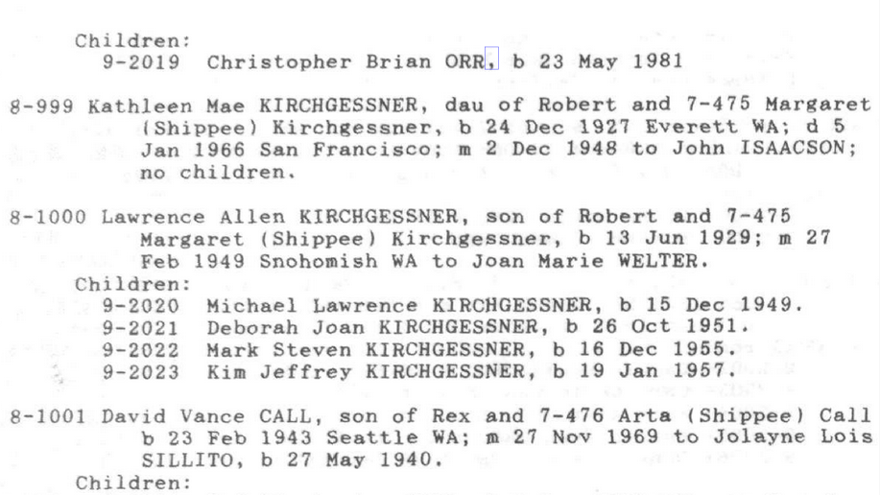
Be sure to properly include each separate surname with each separate name.
For “Michael Lawrence KIRCHGESSNER”, click here, here, and here.
For “Deborah Joan KIRCHGESSNER”, click here, here, and here.

Slide 41
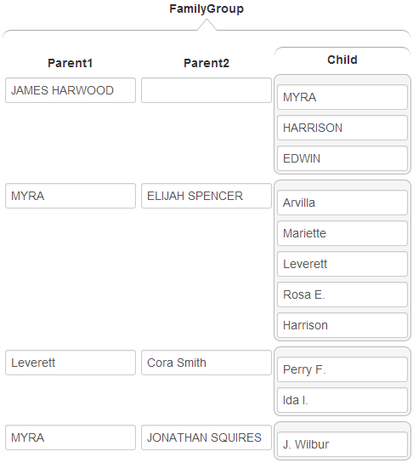
  Resolve each pronoun or person designator to the primary name to which it refers.
An understanding of the text (e.g., “by whom she had one son”) is sometimes required to link children to parents.

Slide 42
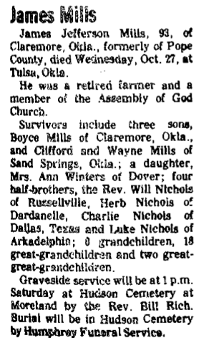
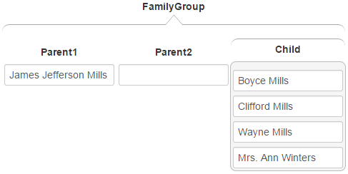
For combined names, extract complete names of both.

Slide 43
Good Luck!
(our ancestors are waiting)

