Slide 1
FROntIER: Annotator Training

Slide 2
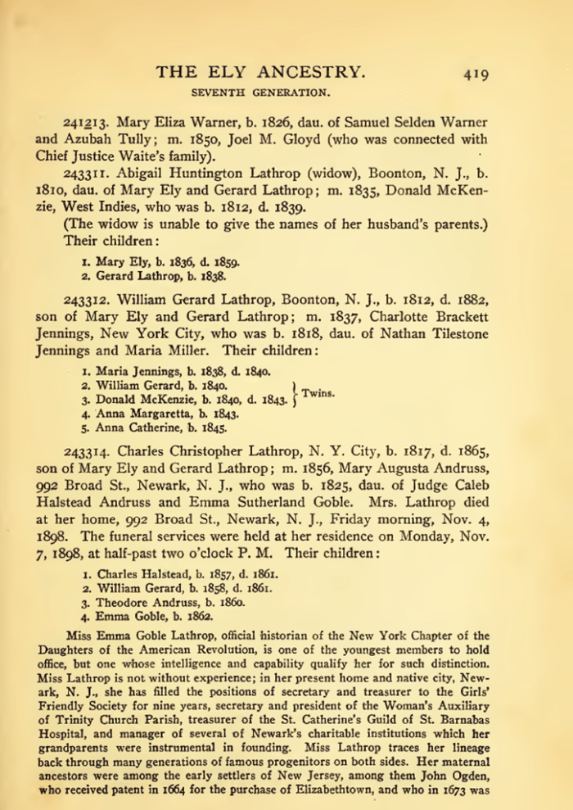
Project Overview
Untapped sources
100,000+ scanned/OCRed books
Problem: how to cost-effectively extract
Extraction tools
Read and do form-fill type-in
Form-fill by clicking
Copy/paste & correction
Genealogy construction by inference
Synergistic
Automated form-fill with user correction
Manual specification of rules (FROntIER)
Machine-learned extraction rules
Discover author-specified patterns (ListReader)
Parse sentences & match concepts (OntoSoar)
Learn from observing users work (GreenFIE-HD)
Groundtruthing
Notes:
Explain: we are “Groundtruthing” – you will be asked to extract some easily inferred information, e.g., spouses both ways, gender, same name extracted multiple times. Don’t worry about it and realize that you are helping with research of underlying extraction tools, not experimenting with expected form types for patrons.

Slide 3
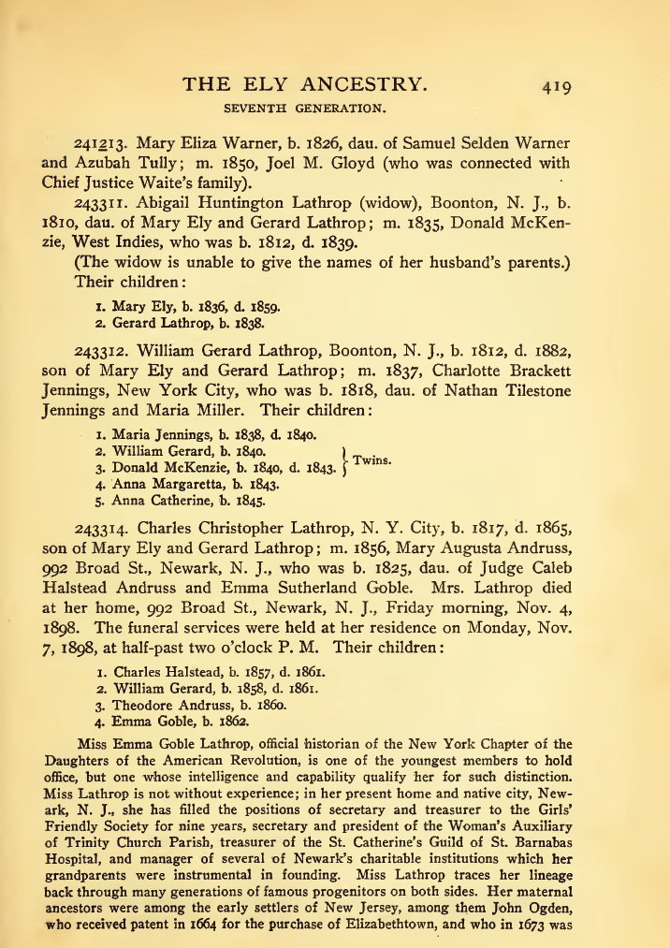

Slide 4
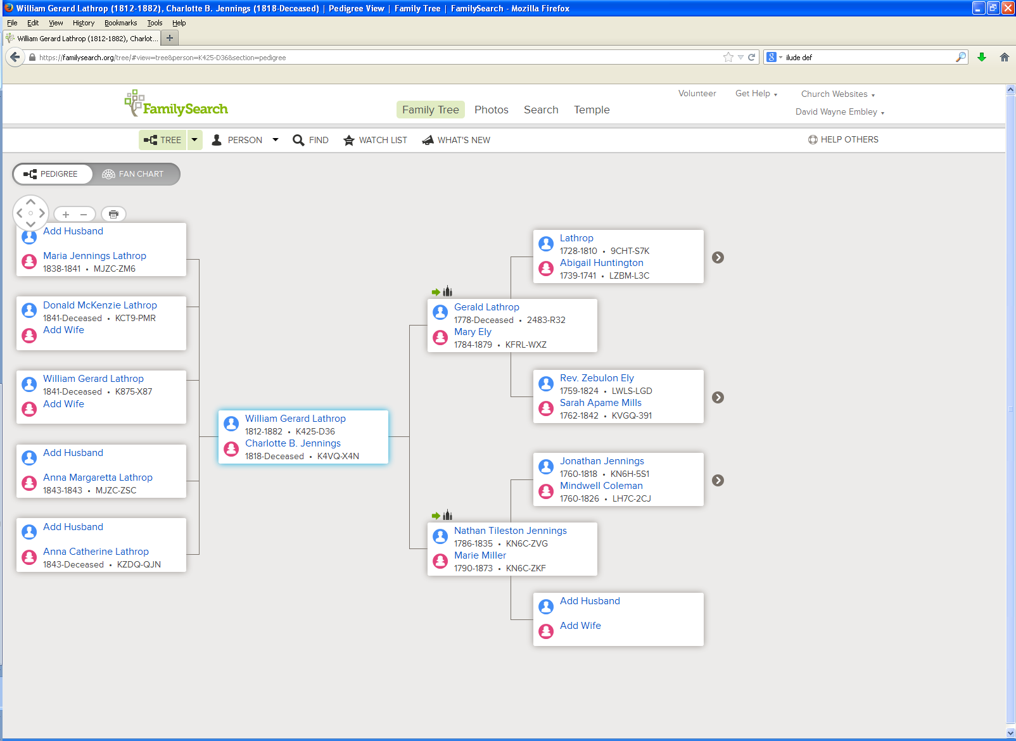

Slide 5
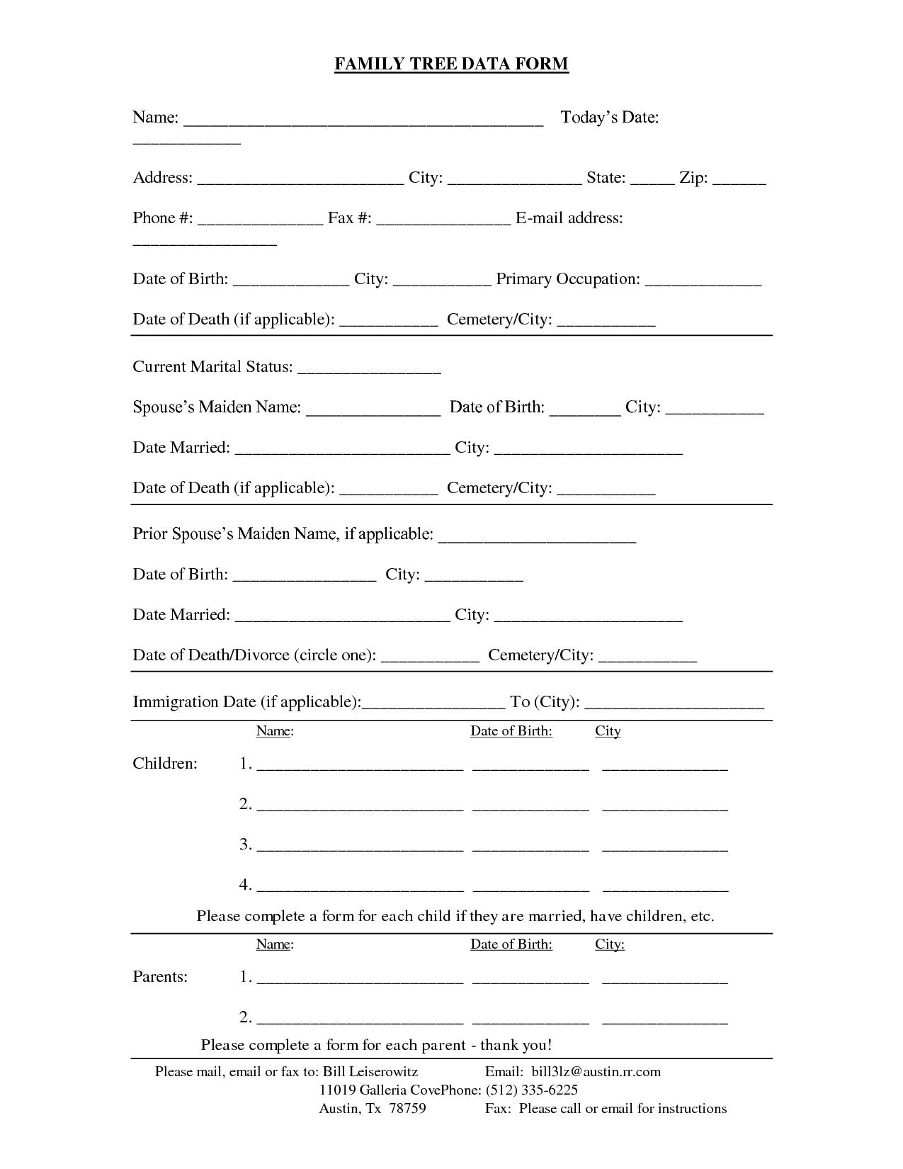
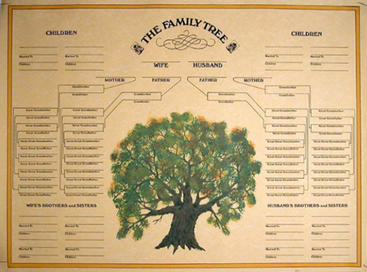
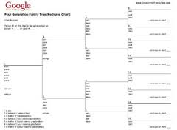
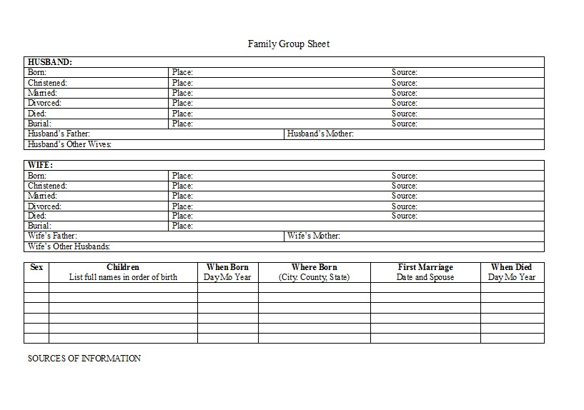
Read and Do Form-fill Type-in

Slide 6
Form-fill: Click-only

Slide 7
Synergistic: Automatic Form-fill with Human Confirmation/Correction
√
√
√
√

Slide 8
Demo
Annotator Framework
Session initialization/save/termination
Page mode/magnification/navigation
Form Fill-in
Names
Dates
Marriages
Children
Duplicates
Notes:
Use Ely for basic demo
Run through and show basics (all forms briefly)
Walk through the Steele page with them practicing at the same time
Let them ask questions or point out questions that should be asked
Show rules (which they’ll have available to them while they work)
Modify rules if new questions arise

Slide 9
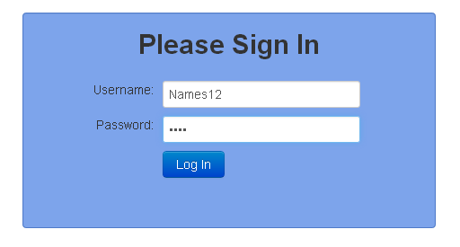
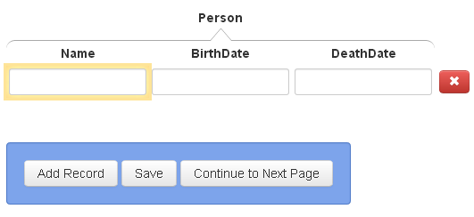
Session initialization/save/termination
Navigate to “dithers.cs.byu.edu/ling240” and login:
You will be given several username-password pairs. Each is associated with an annotation task to do.
Select page to annotate:
Save / Continue to Next Page:
When you have finished all three and have saved your work, you need do nothing more. To start on another task, navigate to “dithers.cs.byu.edu/ling240”

Slide 10
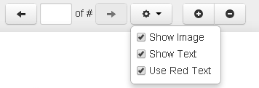
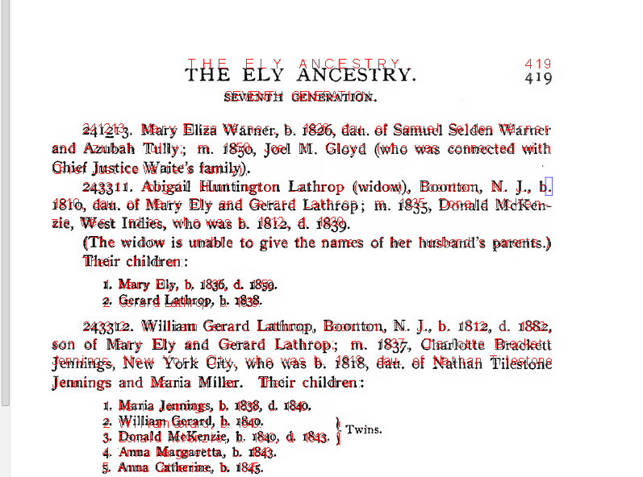
Page mode/magnification/navigation
magnify: zoom in and out
mode
go to previous or next page
bounding box: appears when hovering so you can see selection point
scroll bars
Notes:
Replace image when font-size issue is resolved. Also, there’s talk about a shaded bounding box around the text a click extracts.

Slide 11
Rules and Hints for All Forms
Rules
Record only typeset information (nothing written by hand).
Do not fix errors (OCR, typesetting, misspellings, …).
Record end-of-line hyphens as hyphen-space.
For items that cross page boundaries, extract with the first of the two pages. (If no subsequent/previous page, omit the extraction altogether.)
Hints
Use click or mouse-drag-and-click only (to the extent possible).
Hold down Ctrl to add tokens to a field. (Sometimes a click doesn’t “take”; just click again.)
To remove a character that should be omitted, click on the character and use Backspace/Delete, and Esc when done.
The field focus changes automatically; to change manually, use Tab and shift-Tab or click on a field and Esc.
A blank record or field at the end need not be deleted.
Be familiar with all Actions and use Keyboard Shortcuts.
Notes:
Put the real Keyboard Shortcuts in place of this old one.
Instead of Ctrl, use Command on a MAC.

Slide 12
Rules and Hints for All Forms
Rules
Record only typeset information (nothing written by hand).
Do not fix errors (OCR, typesetting, misspellings, …).
Record end-of-line hyphens as hyphen-space.
For items that cross page boundaries, extract with the first of the two pages. (If no subsequent/previous page, omit the extraction altogether.)
Hints
Use click or mouse-drag-and-click only (to the extent possible).
Hold down Ctrl to add tokens to a field. (Sometimes a click doesn’t “take”; just click again.)
To remove a character that should be omitted, click on the character and use Backspace/Delete, and Esc when done.
The field focus changes automatically; to change manually, use Tab and shift-Tab or click on a field and Esc.
A blank record or field at the end need not be deleted.
Be familiar with all Actions and use Keyboard Shortcuts.
Notes:
Put the real Keyboard Shortcuts in place of this old one.
Instead of Ctrl, use Command on a MAC.

Slide 13
Record only typeset information (nothing written by hand).
This, not that

Slide 14
Do not fix errors (OCR, typesetting, misspellings, …).

Slide 15
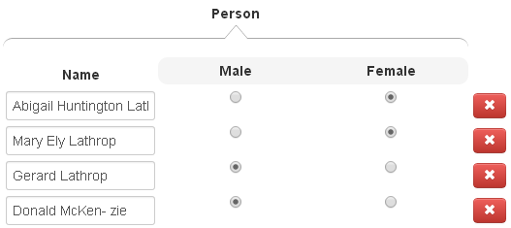
Record end-of-line hyphens as hyphen-space.
space

Slide 16
For items that cross page boundaries, extract with the first of the two pages. (If no subsequent/previous page, omit the extraction altogether.)
page 1
page 2
record together with page 1

Slide 17
Rules and Hints for Names Form
Rules
Extract every name on a page (except names that don’t designate people, e.g., “George Washington University”).
Extract non-names that designate a person (e.g., “Baby Ely”)
Get full name, including any punctuation, title(s) and suffix, but not non-name components associated with the name such as footnote references. Omit possessives (i.e., ’s).
Include implied maiden names and surnames (when possible).
Infer gender (if clues aren’t sufficient, guess).
Hints
For names with punctuation, use mouse-drag-and-click.
Otherwise, use Ctrl to append name parts.
Do all names first; then do gender.
Notes:
If we do shift-click to include punctuation, change the hint to use it rather than mouse-drag-and-click. Say, “For names with punctuation, use shift-click or mouse-drag-and click.”

Slide 18
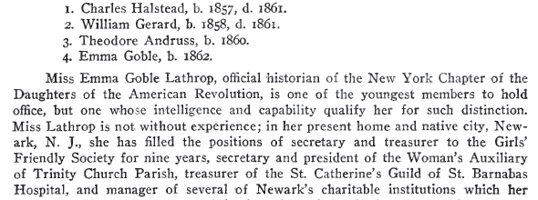
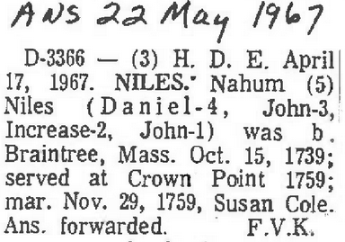
Extract every name on a page (except names that don’t designate people). Omit non-name components
not embedded reference markers
not names that are part of place or thing names
not paragraph headers
not names used for internal designators

Slide 19
Get full name, including any punctuation, title(s) and suffix. Omit possessives.
Isaac Steel, Sr.
Asubah Tully
Joel M. Gloyd
Chief Justice Waite
David Vance CALL
Rex Call
Arta (Shippee) Call
Jolayne Lois SILLITO

Slide 20
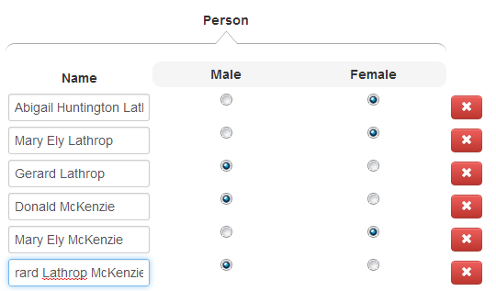
Include implied maiden names and surnames (when possible).
required fix for end-of-line hyphen

Slide 21
Infer gender (if clues aren’t sufficient, guess).
The name “Azubah” may not be clearly female, but she’s the wife of Samuel who is clearly male.
We may not know that Chief Justice Waite is male, but we can guess.

Slide 22
Rules and Hints for Dates Form
Rules
Record names as given; unless part of the name as written implied surnames should not be included.
Get full date, including punctuation.
Extract the most complete date possible (e.g., “March 21, 1865”, not just “1865” or “March 1865”).
Do not include days of the week (e.g., just “Nov. 7, 1898” for “Monday, Nov. 7, 1898”).
Include date modifiers such as “ca” in “ca 1898” or “before” in “before 1982”
Include date explanations (e.g., include the entire phrase “between 1882 and 1884”).
In the absence of birth or death dates, use christening or burial dates and include designations (e.g., “bapt. 1854).
Hints
For names and dates with punctuation, use mouse-drag-and-click.
Otherwise, use Ctrl to append name or date parts.
When there is no DeathDate, use Tab or “a” to add a new blank record.
Notes:
Tab not yet coded. If shift-click is coded (which includes punctuation), it’s better than mouse-drag.
Note: the OCR may not be perfect (e.g., there may be spaces between characters that aren’t really there – mouse over or click on all)

Slide 23
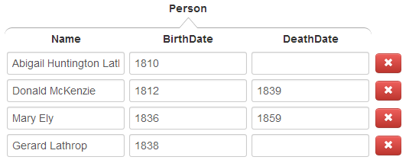
Record names as given (surnames not needed on Date forms).
Abigail, Mary, and Gerard are all McKenzies, but surnames not explicitly part of the name as written should not be included on Date forms.

Slide 24
Examples for Date Rules
include date modifiers
not date modifiers, not date explanations
(do not include)
days of the week (do not include)
punctuation part of date
(include)
punctuation not part of date (do not include)

Slide 25
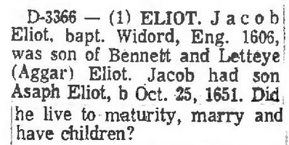
In the absence of birth or death dates, use christening or burial dates and include designations.

Slide 26
Rules and Hints for Marriages Form
Rules
Record all marriages, both stated and implied (e.g., if A is mentioned as the son of B and C, then record B and C as being married).
Record the maiden name for a wife.
For persons with multiple marriages, record each marriage in a separate record.
Hints
Use Tab or “a” to add a new blank marriage record (when there is no MarriageDate).
“Spouse1” can be either the husband or the wife; record names in the order they appear in the document.
Notes:
Note: Tab is not yet implemented.

Slide 27
Record all marriages, both stated and implied. Record just the maiden name for a wife.
stated
implied
maiden names

Slide 28
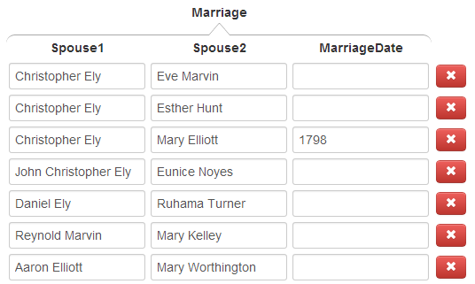
For persons with multiple marriages, record each marriage in a separate record.
Christopher with three marriages & three records

Slide 29
Rules and Hints for Children Forms
Rules
Add surnames for children, when known. Record just the maiden name for a mother.
Sometimes the same surname appears for every child. Be sure to properly include each separate surname with each separate name.
Include families only if both parents and at least one child appear in the three-page sequence.
Record families that extend across page boundaries with the first page.
Hints
When the focus is on a list field, a number key, n, adds n more blank fields to the list. Count the number of children and add the right number of fields first, then fill them in (e.g., if there are 5 children, enter 4 to add 4 more fields for the children; for 24 children, enter 9, then 9 again, and finally 5).
Use “a” to add a new record if you wish to jump out of the middle of the record you’re working on and start a new record.

Slide 30
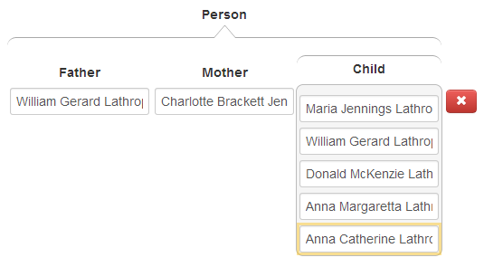
Add surnames for children, when known but not stated. Record just the maiden name for a mother.
maiden name
For “Anna Catherine Lathrop”, click here, here, and then here.

Slide 31
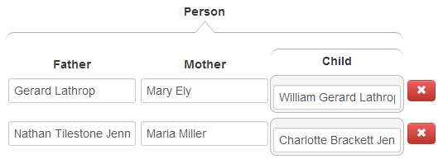
Don’t forget children, not explicitly marked as “children”.

Slide 32
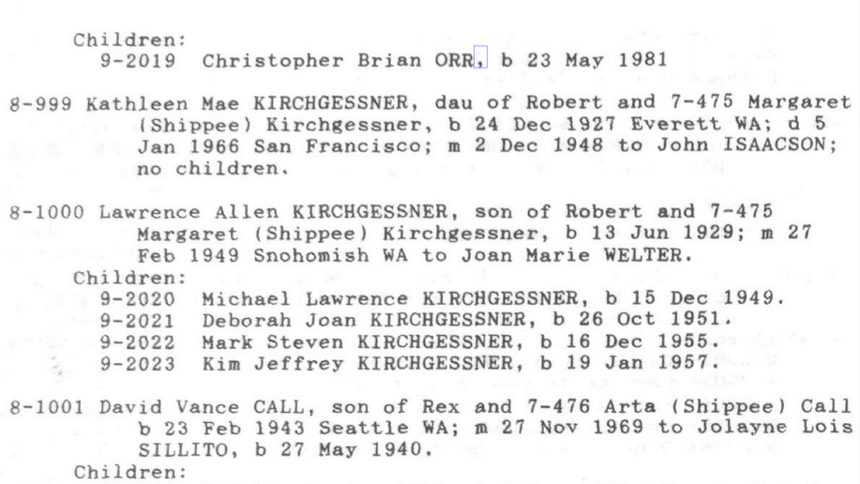
Be sure to properly include each separate surname with each separate name.
For “Michael Lawrence KIRCHGESSNER”, click here, here, and here.
For “Deborah Joan KIRCHGESSNER”, click here, here, and here.

Slide 33
Include families only if both parents and at least one child appear in the three-page sequence. Record families that extend across page boundaries with the first page.
omit, if first page; otherwise record with parents on previous page
no children,
omit
include
omit, if last page; otherwise record children with this page

Slide 34
Rules and Hints for Duplicates Form
Rules
Only record duplicates found on the same page. (In the rare occasion that a duplicate name starts on one page and ends on another, record the entire name with the first page.)
Implied surnames need not be included.
Record the first appearance of a duplicate as the Person-Name and each subsequent appearance of a name for the same person as a DuplicatePerson-Name.
If the names are different but do refer to the same person, record the duplicate.
Hints
Duplicates can be subtle. (Read what’s written to make the determination.)
Both: “same name, different person” and “different name, same person” are possible.

Slide 35
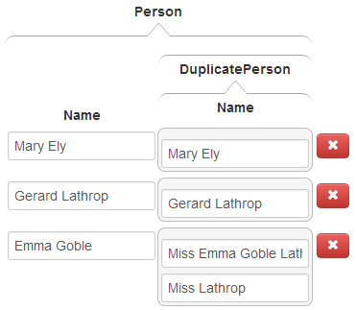
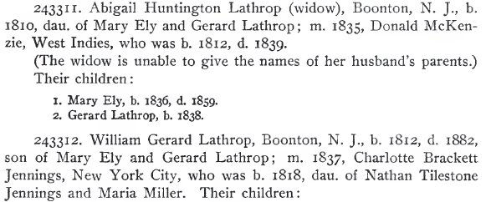
Examples for Duplicates Rules

Slide 36
Good Luck!
(our ancestors are waiting)

