Slide 1
(Semi)automatic Extraction of Genealogical Information from Scanned & OCRed Historical Documents
Elder David W. Embley
Stephen W. Liddle, Deryle W. Lonsdale, and Scott N. Woodfield

Slide 2
Overview
Big Picture
  Diagram
  Details & Demo
Current Status and Expectations

Slide 3
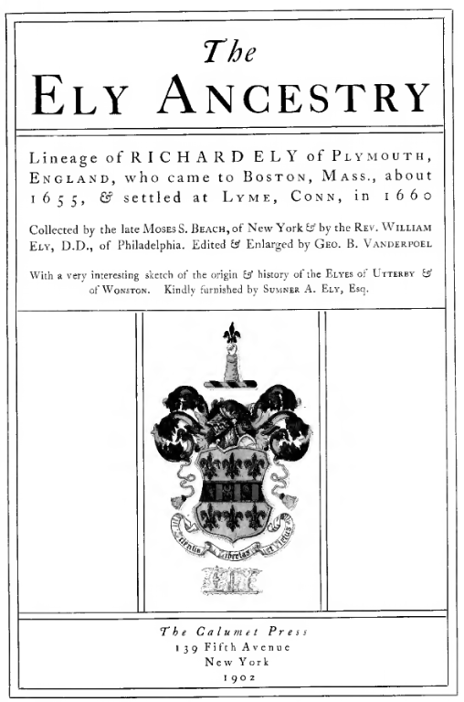
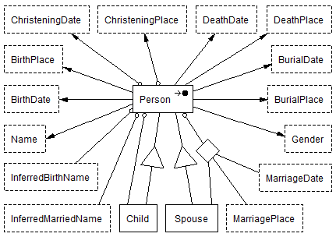
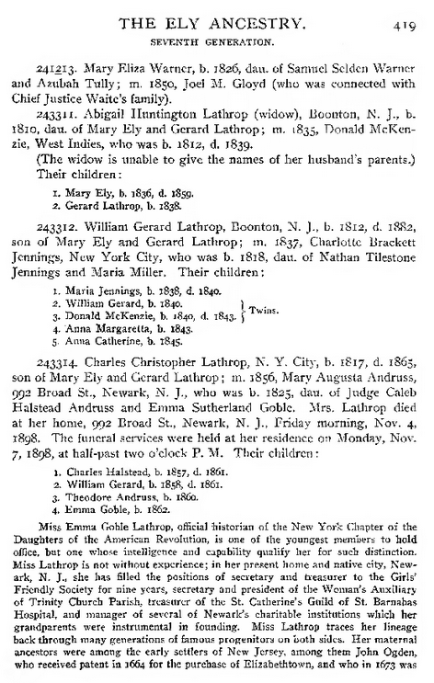
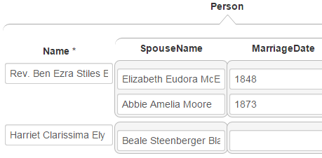
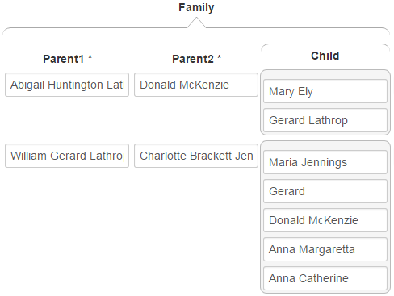
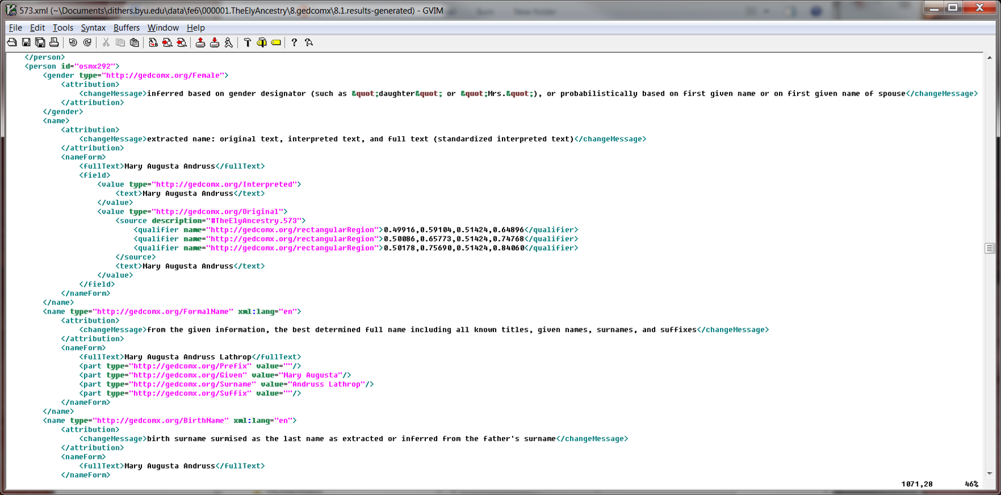
Fe6: 1. Prepare 2. Extract 3. Merge&Split 4. Check&Correct 5. Generate 6. Convert
FROntIER
ListReader
OntoSoar
GreenFIE
COMET

Slide 4
Fe6: 1. Prepare 2. Extract 3. Merge&Split 4. Check&Correct 5. Generate 6. Convert
FROntIER
ListReader
OntoSoar
GreenFIE

Slide 5
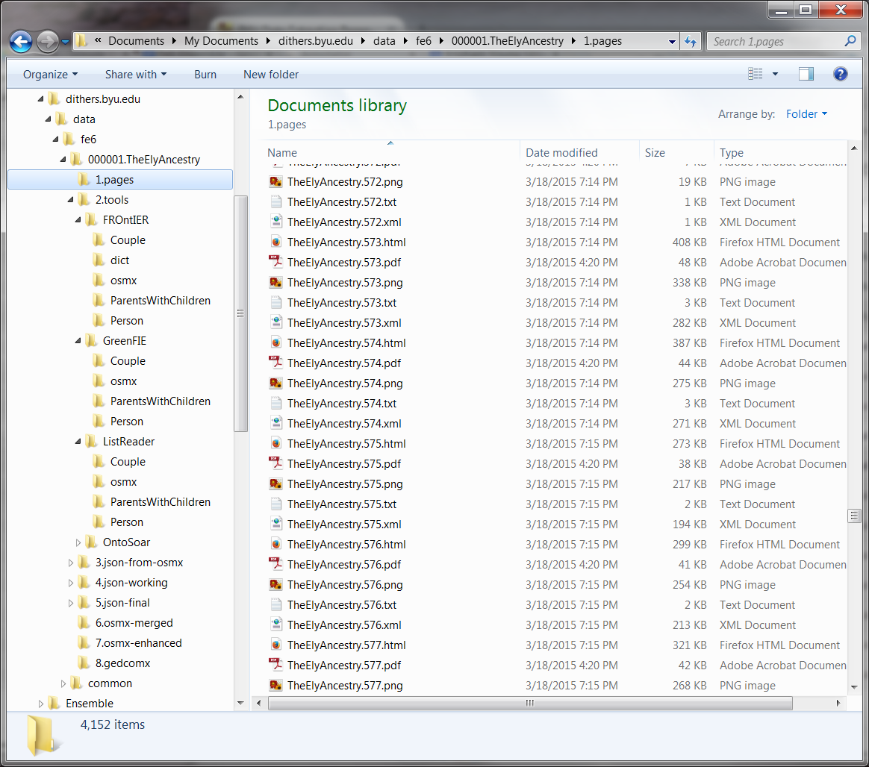
1. Prepare
{

Slide 6
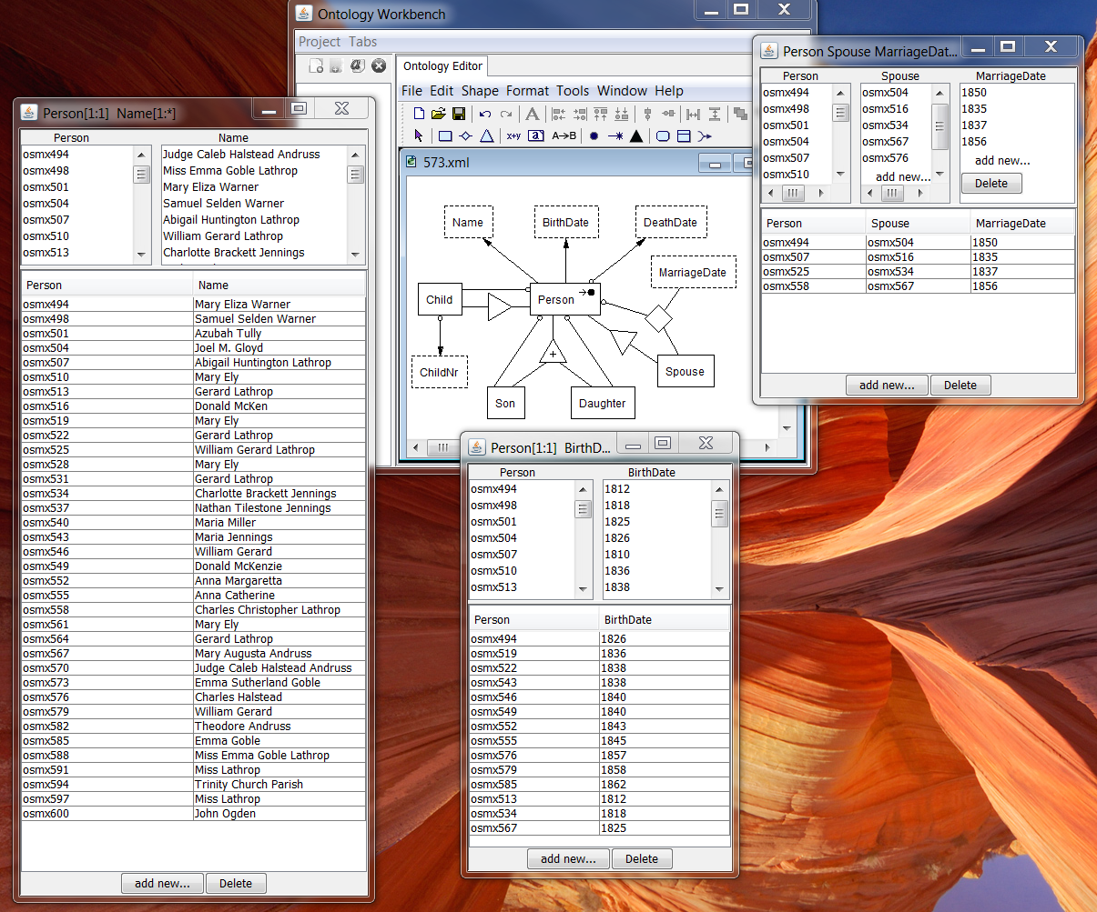
2. Extract

Slide 7
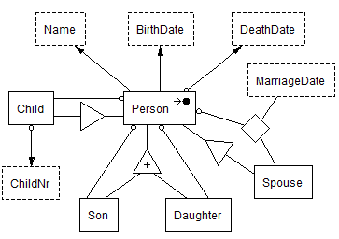
3. Merge & Split
Person
Couple
Family

Slide 8
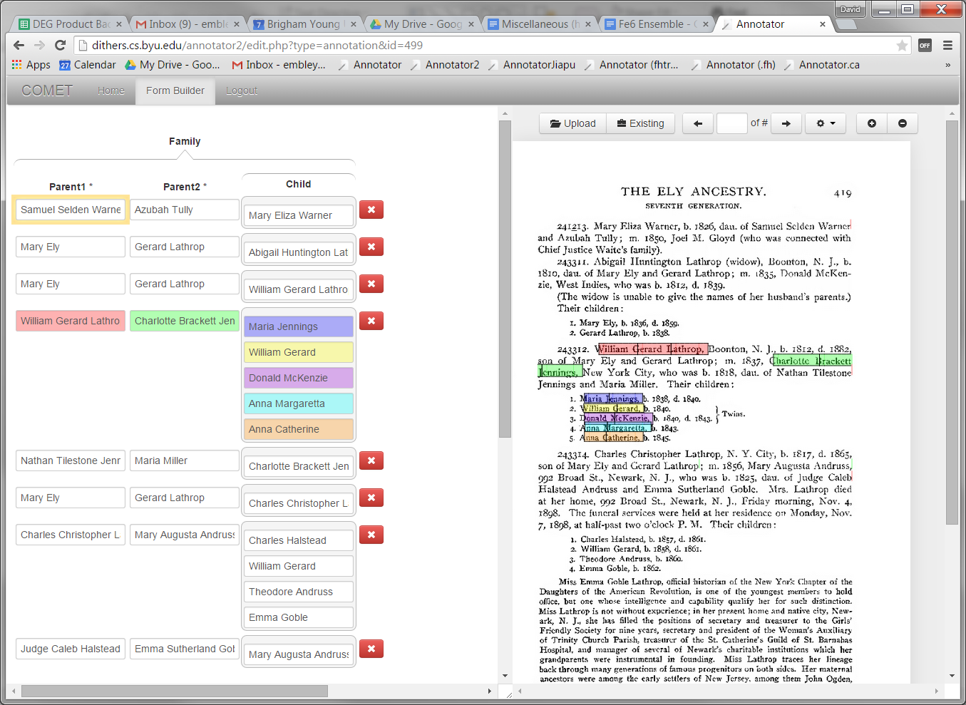
4. Check & Correct

Slide 9
5. Generate

Slide 10

6. Convert

Slide 11
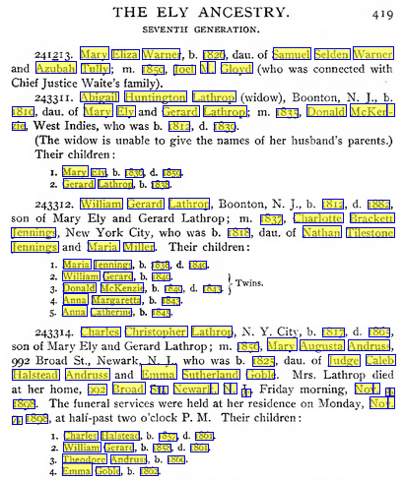
Results

Slide 12
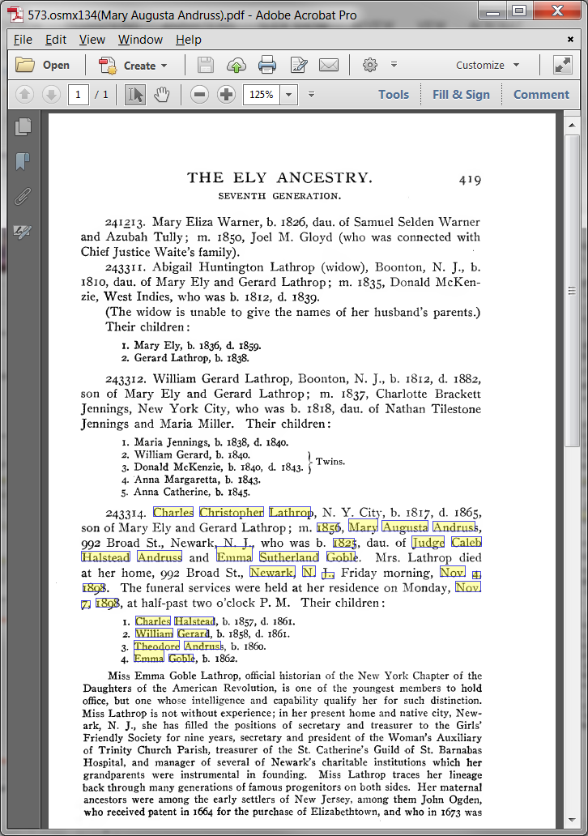
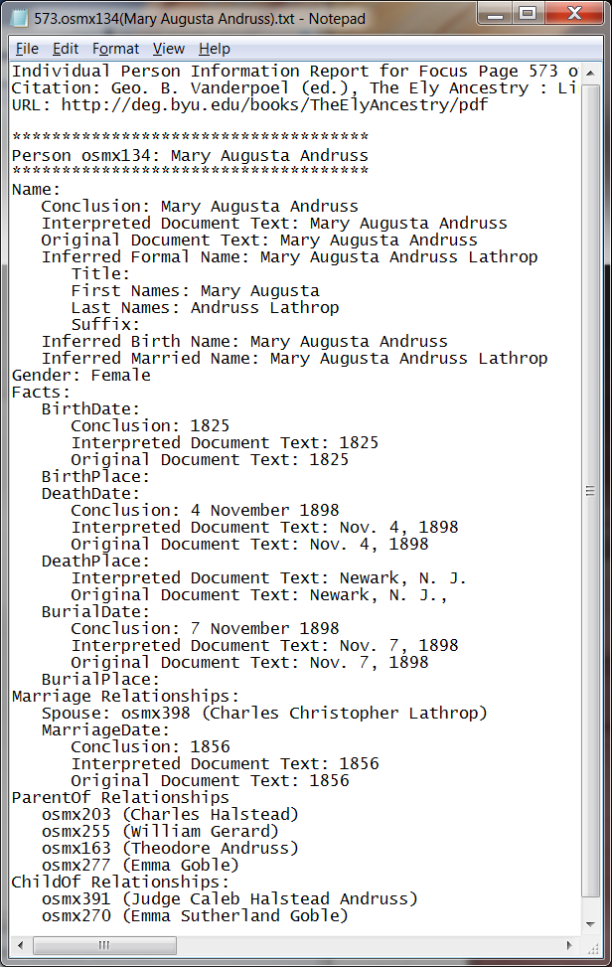
Results

Slide 13
Precision, Recall, F-Measure Results
 | Precision | Recall | F-Measure
FROntIER (relationships)
Person | 0.86 | 0.66 | 0.75
Couple | 1.00 | 0.40 | 0.57
ParentsWithChildren | 0.89 | 0.89 | 0.89
FROntIER (PCF views)
Person | 0.94 | 0.83 | 0.88
Couple | 1.00 | 0.90 | 0.95
ParentsWithChildren | 1.00 | 0.78 | 0.86
OntoSoar
Person | 0.67 | 0.67 | 0.67
Couple | 0.75 | 0.30 | 0.43
ParentsWithChildren | 1.00 | 0.44 | 0.62

Slide 14
Fe6: 1. Prepare 2. Extract 3. Merge&Split 4. Check&Correct 5. Generate 6. Convert
Administrative and Batch-Processing Management System
Automated Check (Fix & Warn)
Name, Date, Place
Standardization
“Sanity”
Check
FROntIER
ListReader
OntoSoar
GreenFIE
Feedback
Loop
COMET

Slide 15
Fe6: 1. Prepare 2. Extract 3. Merge&Split 4. Check&Correct 5. Generate 6. Convert
Administrative and Batch-Processing Management System
Non-English Languages
Automated Check (Fix & Warn)
Name, Date, Place
Standardization
“Sanity”
Check
FROntIER
ListReader
OntoSoar
GreenFIE
Extraction Tools:
Layout
Machine Learning
Feedback
Loop
COMET
Bootstrapping, Ever-learning, Feedback Loop

Slide 16
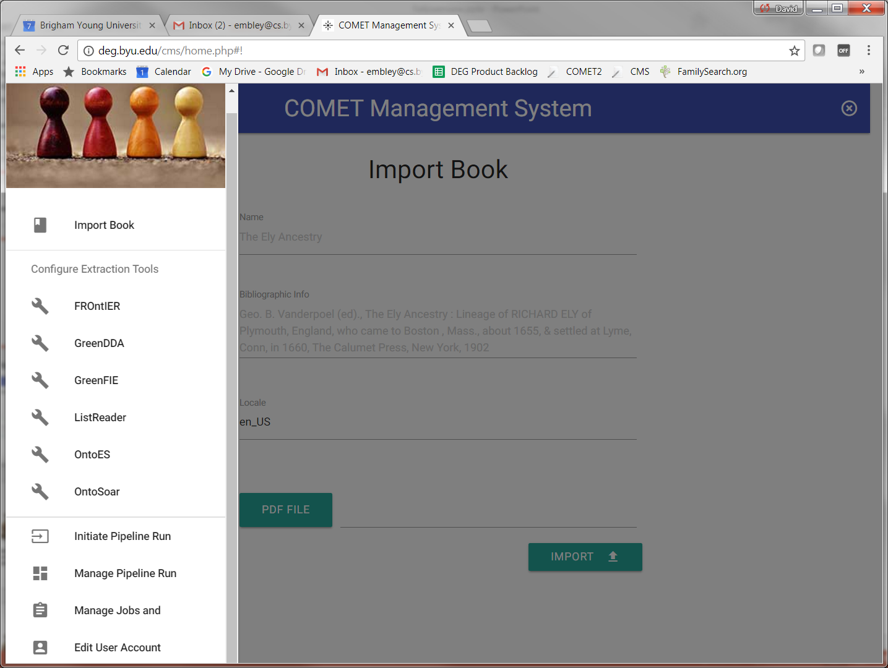

Slide 17
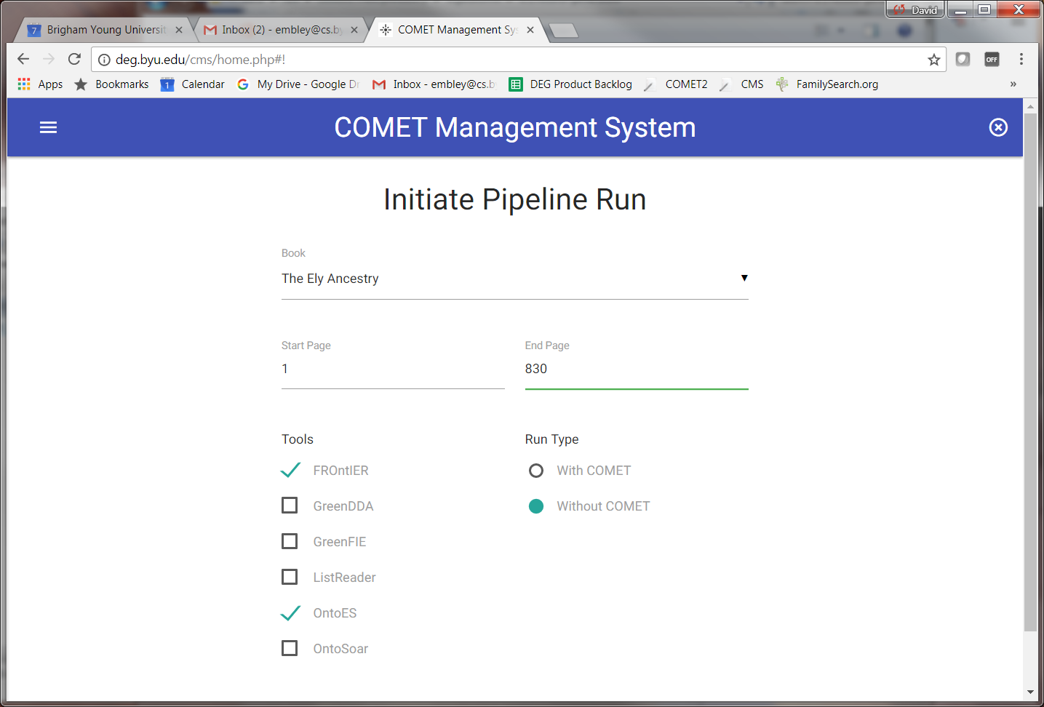

Slide 18

Summary
(Semi)automatic Extraction
Green, Ever-Learning System
(improves with use)
Status:
  Extraction Tools (tech-transfer of academic prototypes)
  Ensemble Prototype (pipeline runs and is being enhanced)
  Management System (underway; minimally usable)

Slide 19




Summary
(Semi)automatic Extraction
Green, Ever-Learning System
(improves with use)
Status:
  Extraction Tools (tech-transfer of academic prototypes)
  Ensemble Prototype (pipeline runs and is being enhanced)
  Management System (underway; minimally usable)
www.deg.byu.edu
BYU Data Extraction Research Group

