Slide 1
(Semi)automatic Extraction of Genealogical Information from Scanned & OCRed Historical Documents
Elder David W. Embley

Slide 2
Overview
Big Picture
  Diagram
  Details & Demo
Current Status and 3rd Quarter Expectations
4th Quarter Projections (and beyond)

Slide 3
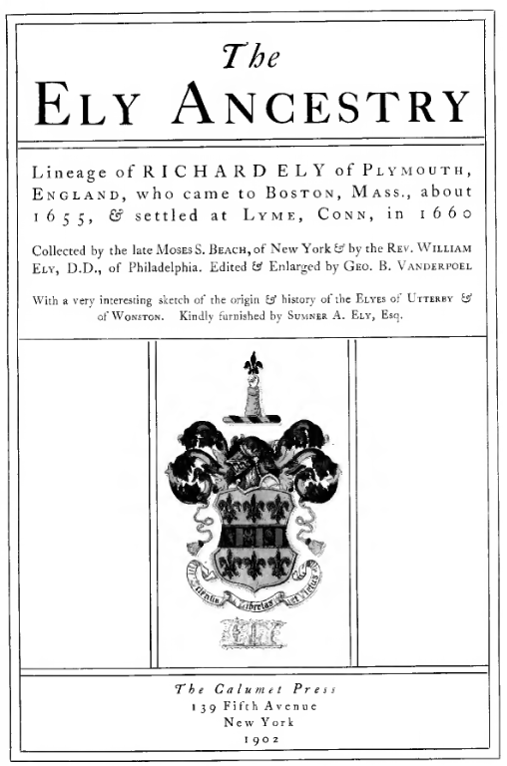
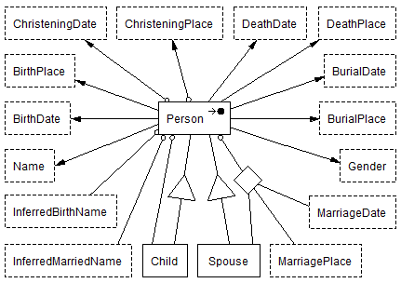
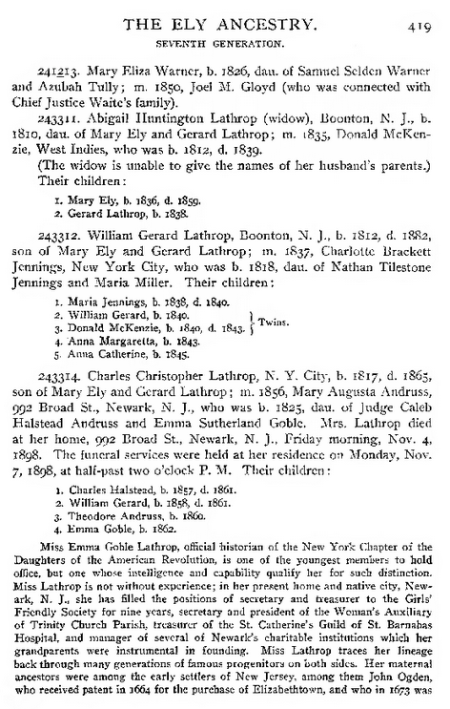
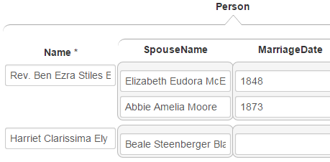
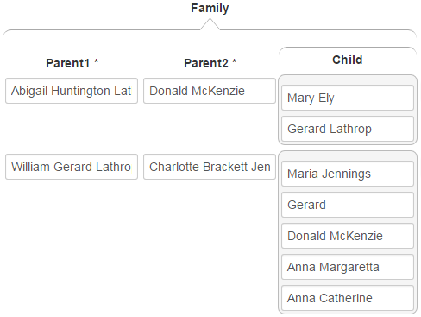
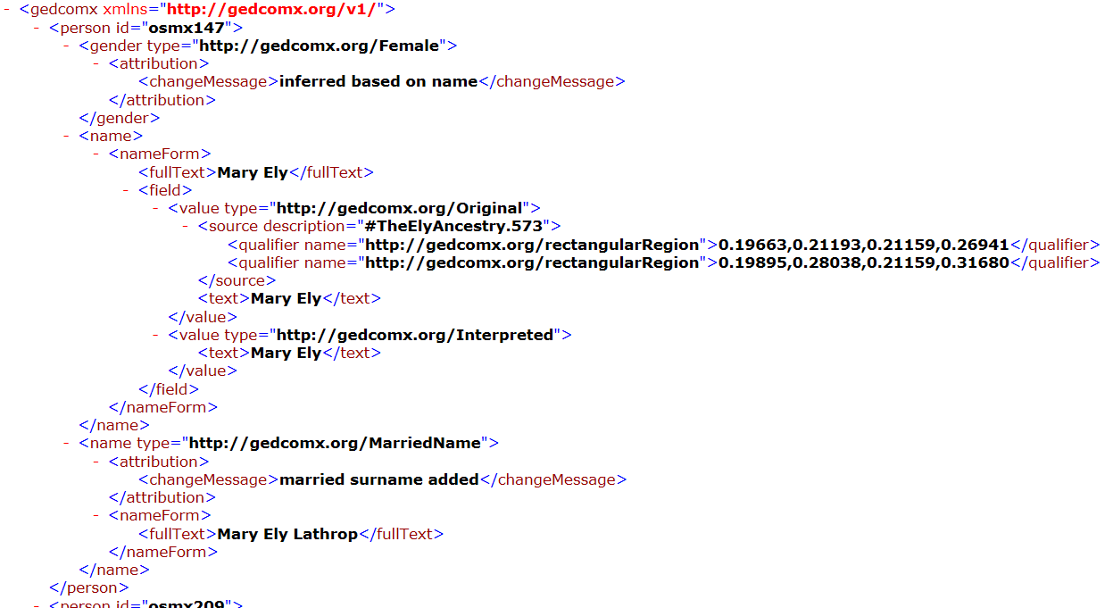
Fe6: 1. Prepare 2. Extract 3. Split & Merge 4. Check & Correct 5. Generate 6. Convert
FROntIER
ListReader
OntoSoar
GreenFIE
COMET

Slide 4
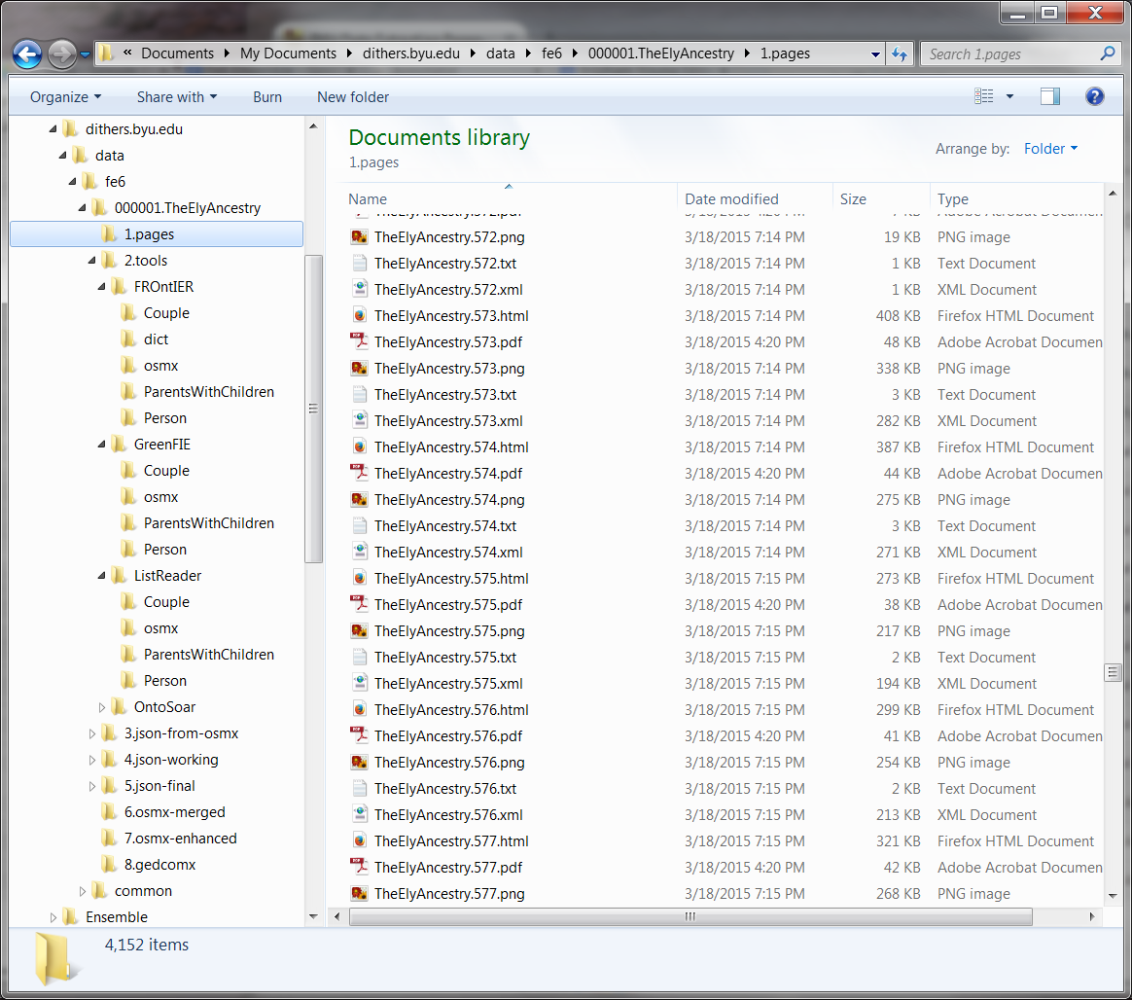
1. Prepare
{

Slide 5
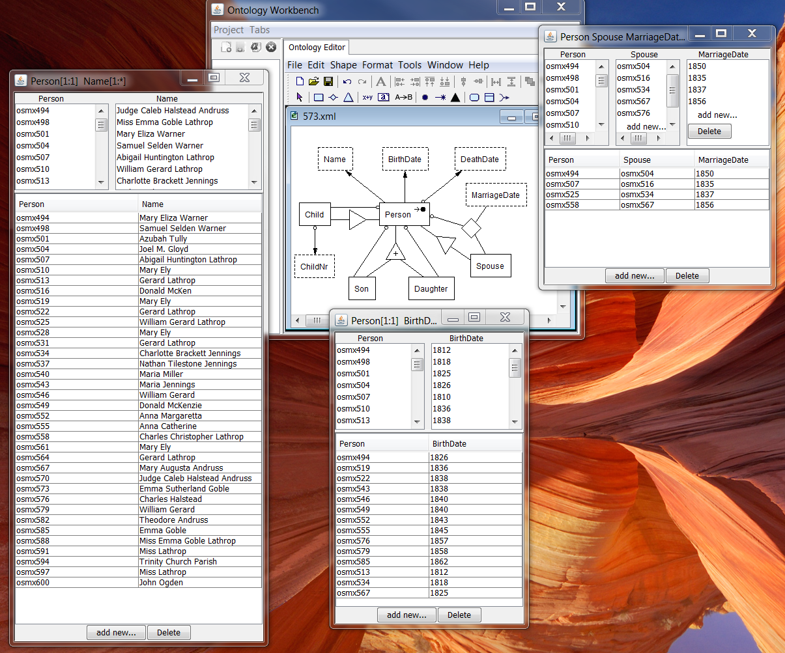
2. Extract

Slide 6
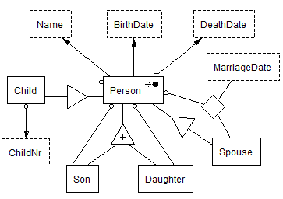
3. Split & Merge
Person
Couple
ParentsWithChildren

Slide 7
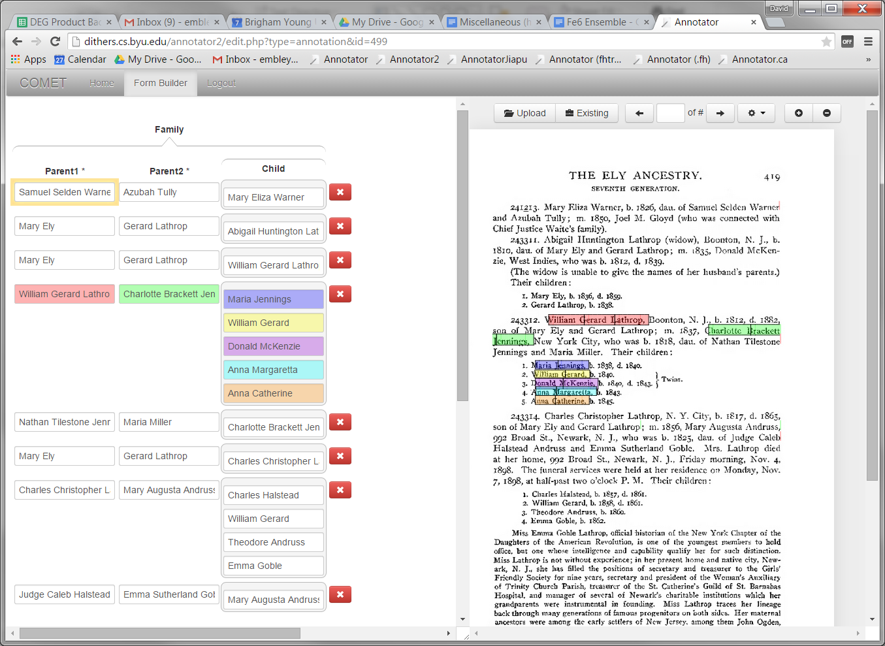
4. Check & Correct

Slide 8
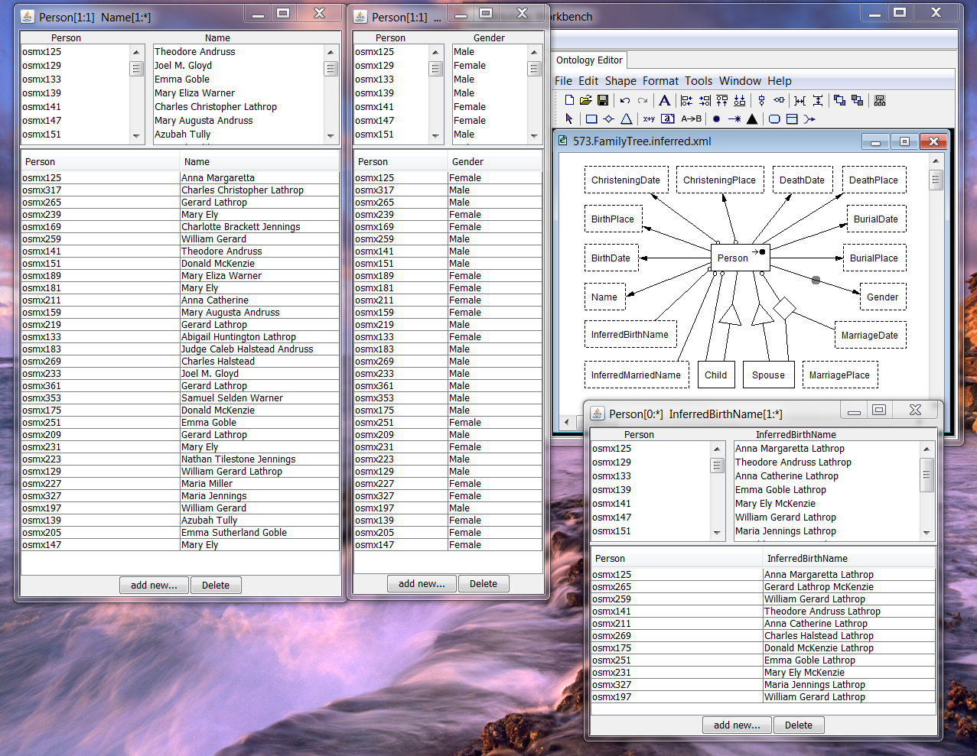
5. Generate

Slide 9
6. Convert

Slide 10
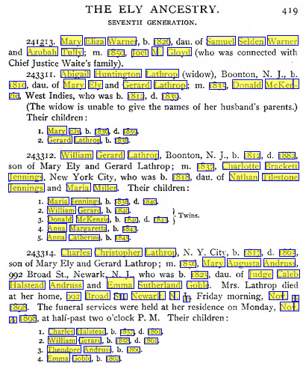
Highlighted
Results

Slide 11
Fe6: 1. Prepare 2. Extract 3. Split & Merge 4. Check & Correct 5. Generate 6. Convert
FROntIER
ListReader
OntoSoar
GreenFIE
COMET

Slide 12
Precision, Recall, F-Measure Results
 | Precision | Recall | F-Measure
FROntIER
Person | 0.86 | 0.66 | 0.75
Couple | 1.00 | 0.40 | 0.57
ParentsWithChildren | 0.89 | 0.89 | 0.89
GreenFIE
Person | 0.94 | 0.83 | 0.88
Couple | 1.00 | 0.90 | 0.95
ParentsWithChildren | 1.00 | 0.78 | 0.86
OntoSoar
Person | 0.67 | 0.67 | 0.67
Couple | 0.75 | 0.30 | 0.43
ParentsWithChildren | 1.00 | 0.44 | 0.62

Slide 13
Fe6: 1. Prepare 2. Extract 3. Split & Merge 4. Check & Correct 5. Generate 6. Convert
Administrative and Batch-Processing Management System
Automated Check & Correct
Name, Date, Place
Standardization
“Sanity”
Check
FROntIER
ListReader
OntoSoar
GreenFIE
Feedback
Loop
COMET

Slide 14
Fe6: 1. Prepare 2. Extract 3. Split & Merge 4. Check & Correct 5. Generate 6. Convert
Administrative and Batch-Processing Management System
Non-English Languages
Automated Check & Correct
Name, Date, Place
Standardization
“Sanity”
Check
FROntIER
ListReader
OntoSoar
GreenFIE
Extraction Tools:
Layout
Machine Learning
Feedback
Loop
COMET
Bootstrapping, Ever-learning, Feedback Loop

Slide 15
Machine-Assisted Genealogical Data Extraction
Fe6: Form-based ensemble with a 6-phase pipeline:
  (1) Prepare, (2) Extract, (3) Split & Merge, (4) Check & Correct, (5) Generate, (6) Convert
  Machine extraction and information organization with human verification
2nd Quarter Expectations
  All tools integrated; generation of GedcomX from processed pages working
  Alpha-user ready
3rd Quarter Expectations
  All tools integrated; process management system integrated; standardization complete
  Extraction rule generation by observation basically working
  Beta-user ready
4th Quarter Projections (and beyond)
  “Sanity” check and semantic check & correct basically working
  Bootstrapping, ever-learning, and layout & machine-learning extraction underway
  Patron-user pilot-testing ready

