Slide 1
Extracting information from French obituaries
Deryle W. Lonsdale, David W. Embley, Stephen W. Liddle, and Joseph Park
BYU Data Extraction Research Group

Slide 2
Previous work
Extracting data from documents using:
  Conceptual modeling techniques and ontologies
  Formalized concepts, relationships, and constraints
Particular focus: English obituaries
  Extract information about deceased, data associated with passing (date, place, events, place)

Slide 3
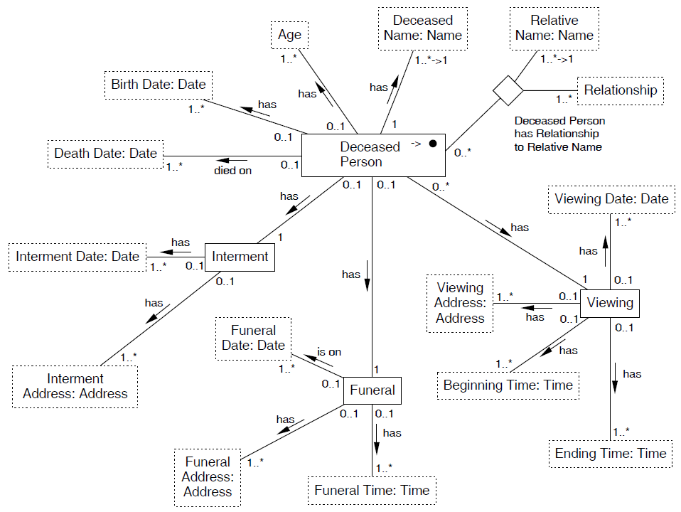
English obituary ontology
Primary object set
Object sets
Relationship sets
Participation constraints
Non-lexical objects
Lexical objects

Slide 4
English extraction results
Few dozen obituaries from Utah, twice as many from Arizona
  16 attributes: good performance (>95% precision, somewhat lower recall)
Other parts of the world: Florida, Maine, India, Ireland, New Zealand, Sri Lanka
  4 attributes: lower results
  Cultural differences

Slide 5
Beyond English?
Demonstrate viability of ontologies beyond English
  Declare narrow-domain ontologies in other languages
  Develop lexicons, value recognizers, data frames for multilingual processing
  Create crosslinguistic mappings
Develop working prototype showing multilingual capabilities

Slide 6
Multilingual adaptation
OntoES, workbench are already largely multilingual-capable
  UTF-8, Java
  Some fine-grained testing remains
Knowledge sources
  Many exist; don’t have to re-invent the wheel
  NLP resources: lexical databases, WordNet, …
  Termbases, multilingual lexicons, …
  Aligned bitext

Slide 7
Basic premises
Analogous data-rich documents should not differ substantially crosslinguistically
Ontological content should only involve minimal conceptual variation across langua-ges/cultures
  Obituaries: “tenth-day kriya”, “obsequies”
Existing technologies can provide large-scale mapping between languages

Slide 8
French obituaries
Found in sources similar to English ones
Regional variation
  Europe: cremation, more relatives named, rarely a life history, more direct
  French Canada: more similar to U.S. obituaries
  French Switzerland: more euphemisms, figurative language

Slide 9
Developing knowledge sources
Regular expressions when tractable
Lexicons when more open-ended
Harvested names from baby naming sites
  Given name list relatively small (< 10,000)
  Surname list more substantial
  Issue: uppercase + deaccented in Europe
Gazetteer lists for place names
Editor for developing ontology

Slide 10
French ontology

Slide 11
Evaluation (1)
Preliminary evaluation
  A few features: name, age, title, birth date, death date, death place
  A few dozen files
Results: around 80% precision, little less on recall
Main problems: lexicon coverage (especially place names), occasional typos, some obits don’t have deceased’s name

Slide 12
Evaluation (2)
Detailed evaluation
  Collected corpus of 1,500 obituaries
  Training/testing split (1000/500)
  Annotating gold standard testing set with custom tool

Slide 13
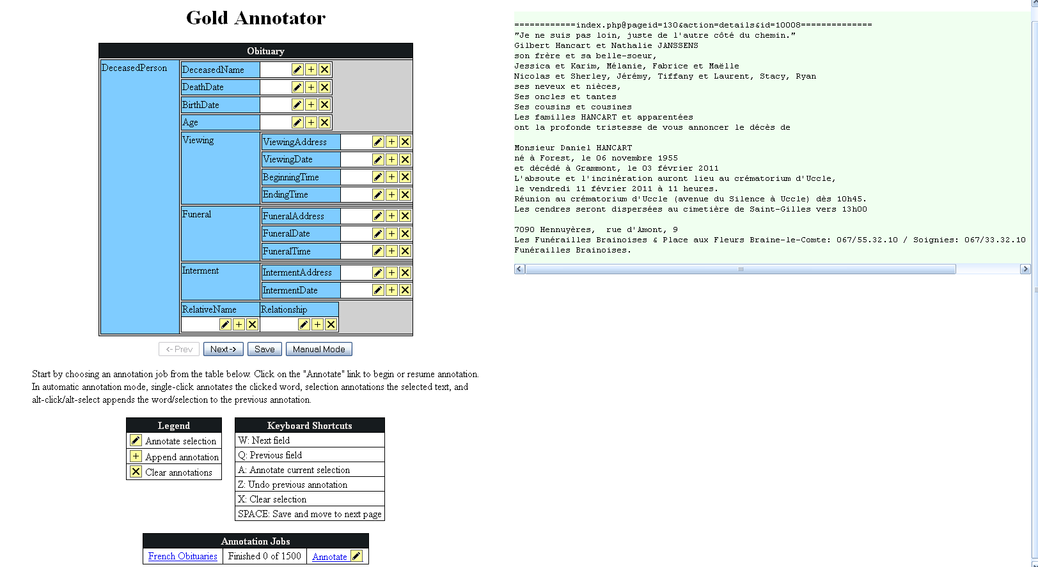
Annotating obituary data
Integrated with rest of extraction system
  Ontology-based
  i/o file format
Efficient entry methods

Slide 14
Future work
Detailed evaluation
Wider-varying French samples
Crosslinguistic queries on extracted French data
Morpholexical cues for gender
Factored lists:
Pierre et Marie, son fils et belle-fille
Anaphora resolution: Né à Paris et y décédé…

Slide 15
More information:
http://deg.byu.edu
lonz@byu.edu

