Slide 1


GreenFIE: A Green Form-Based Information-Extraction System for Historical Documents
(Self-improving Extraction Systems)
Tae Woo Kim
David W. Embley
Stephen W. Liddle

Slide 2
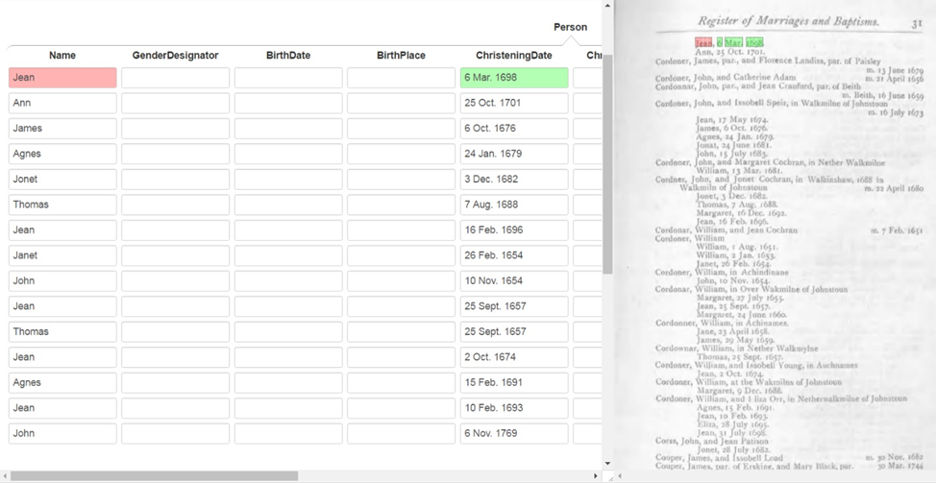
A Green Information Extraction System
“Green” systems improve with use
GreenFIE
  Green Form-based Information Extraction
  Generates extraction rules by watching users work
COMET

Slide 3
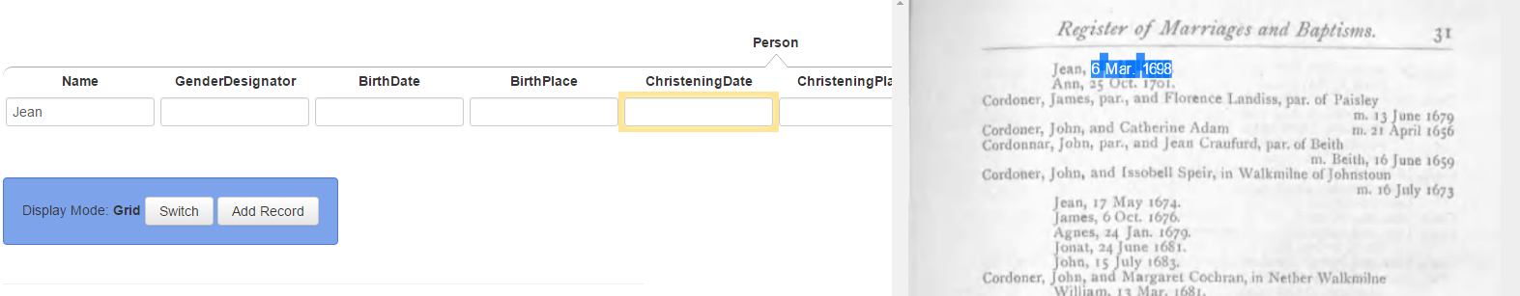
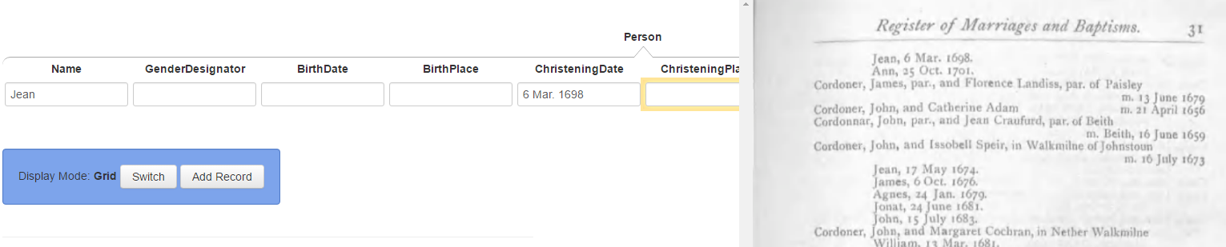
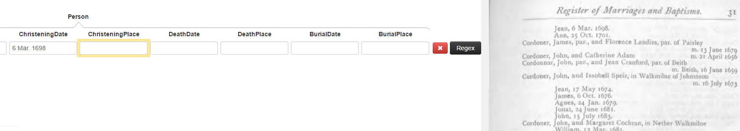

DEMO

Slide 4
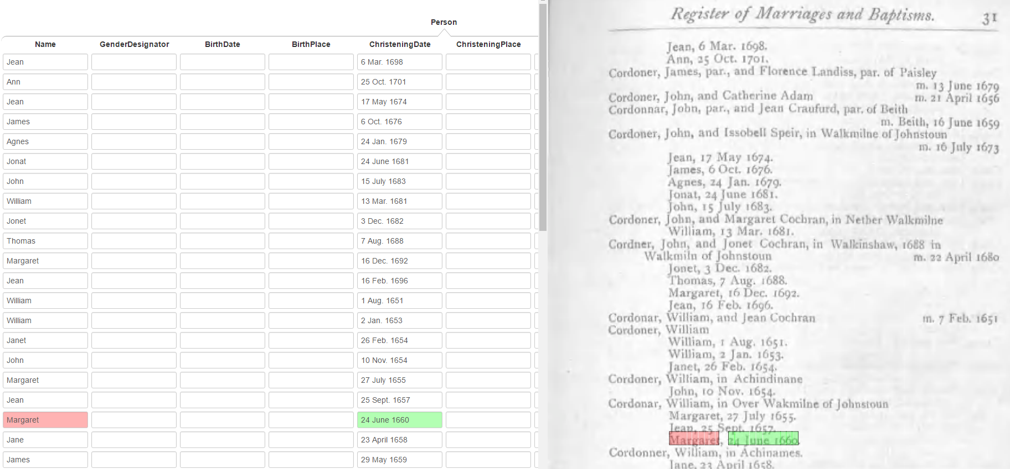
DEMO

Slide 5
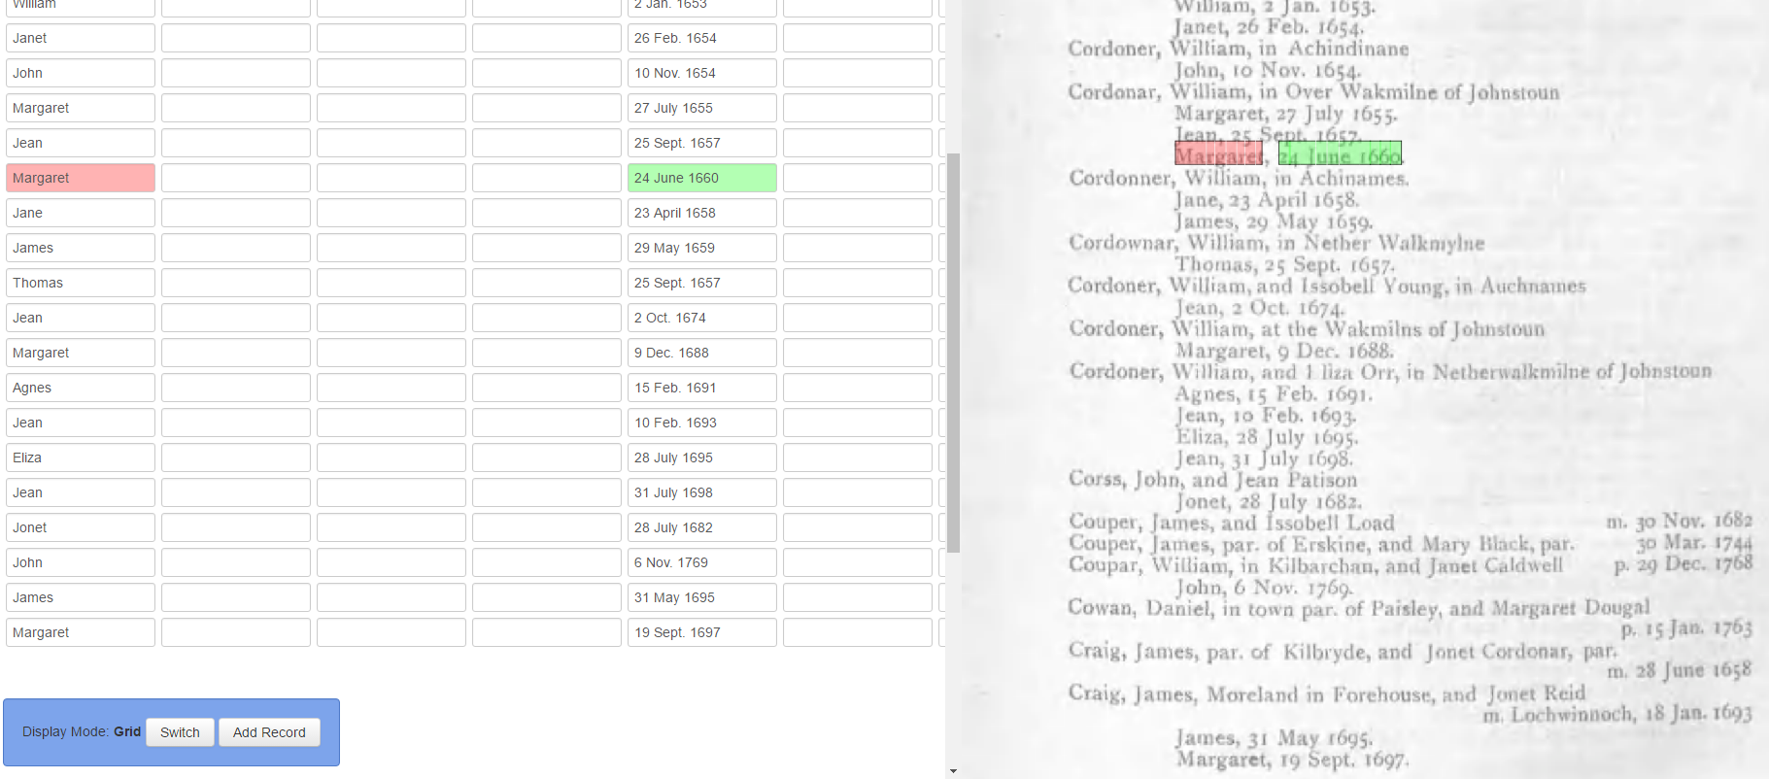
DEMO

Slide 6
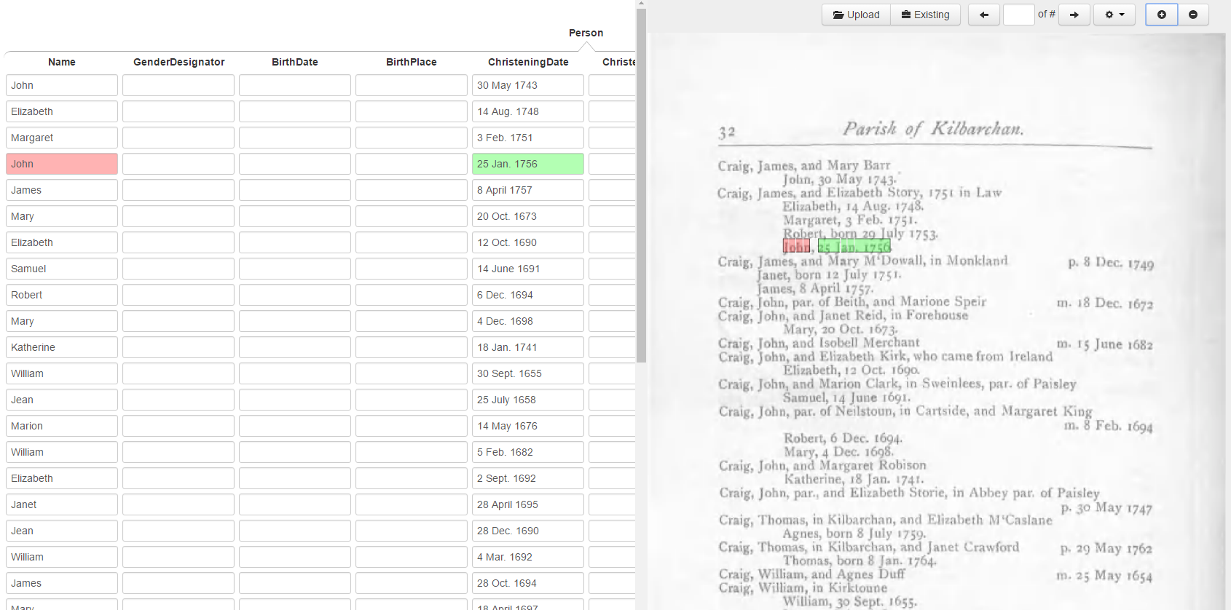
DEMO

Slide 7
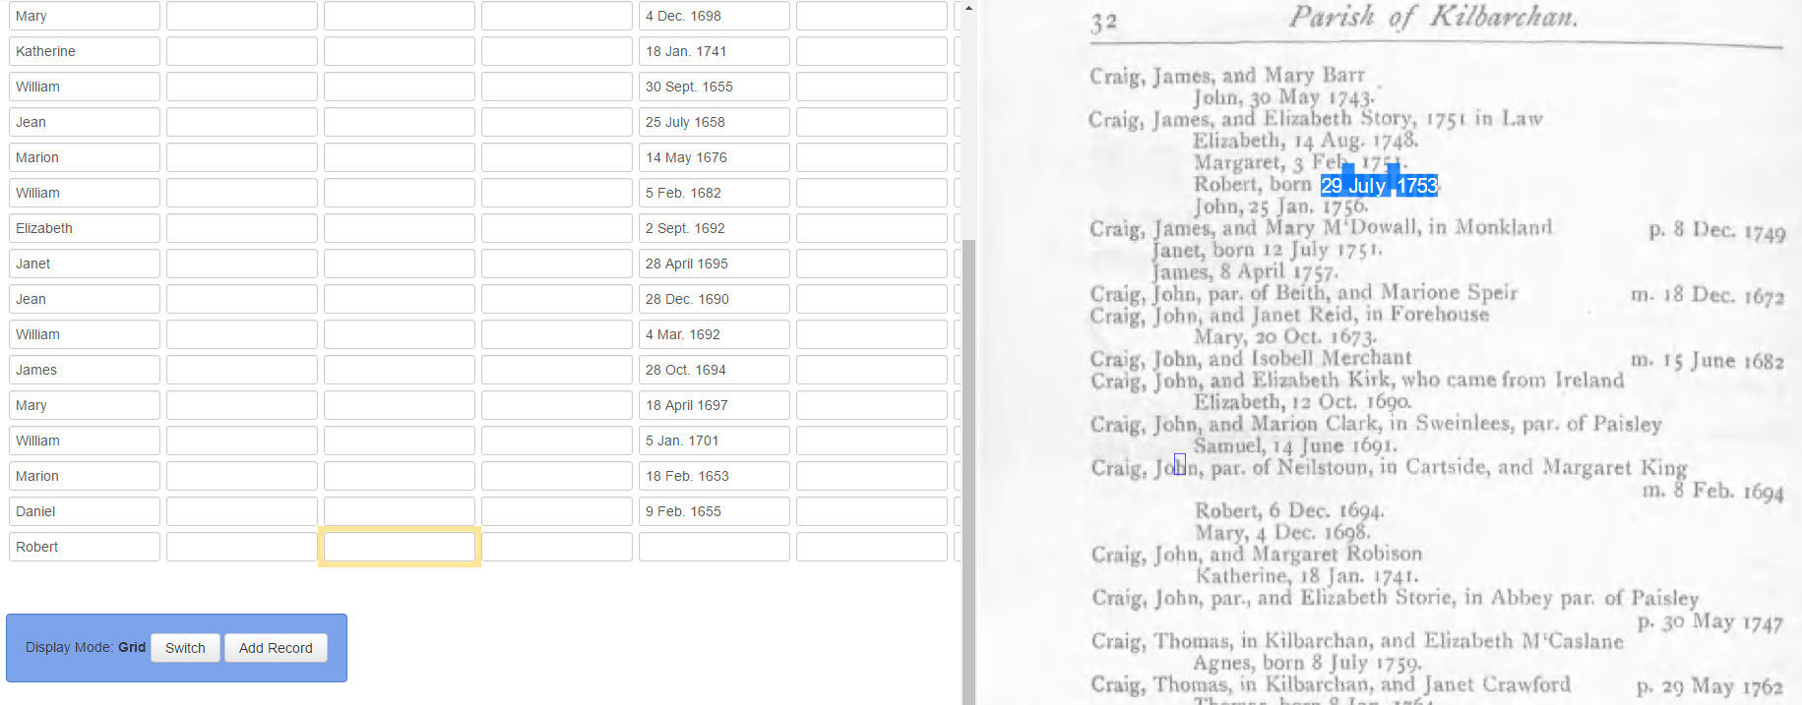
DEMO

Slide 8
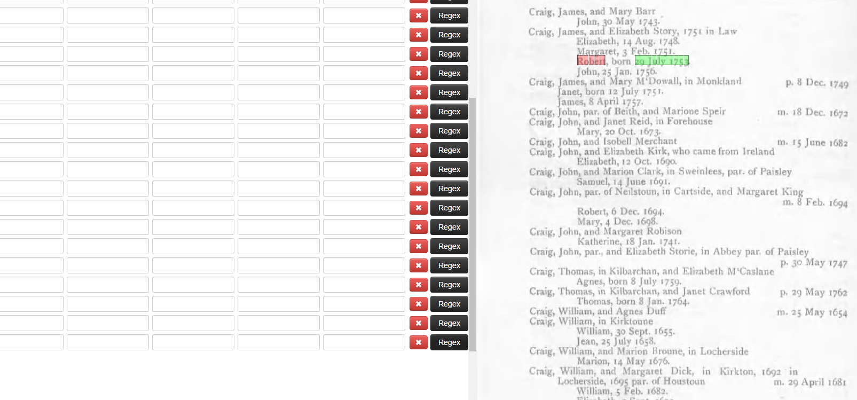
DEMO

Slide 9
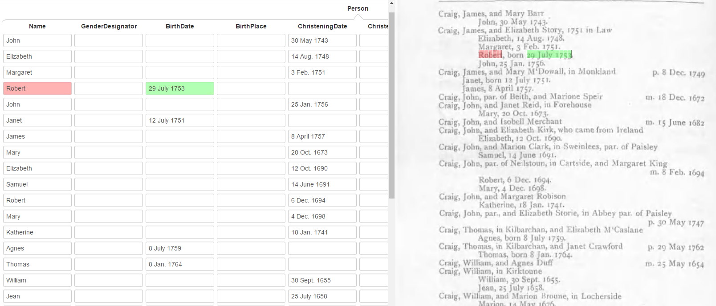
DEMO

Slide 10
Regex Extraction Rules
Register of Marriages and Baptisms. 31
Jean, 6 Mar. 1698.
Ann, 25 Oct. 1701.
Cordoner, James, par., and Florence Landiss, par. of Paisley
m. 13 June 1679
…
Elizabeth, 2 Sept. 1692.
\n([A-Z]{1}[a-z]{3}),\s(\d{1}\s[A-Z]{1}[a-z]{2}\.\s\d{4})\.

Slide 11
Regex Extraction Rules
Register of Marriages and Baptisms. 31
Jean, 6 Mar. 1698.
Ann, 25 Oct. 1701.
Cordoner, James, par., and Florence Landiss, par. of Paisley
m. 13 June 1679
…
Elizabeth, 2 Sept. 1692.
\n([A-Z]{1}[a-z]{3}),\s(\d{1}\s[A-Z]{1}[a-z]{2}\.\s\d{4})\.
\n([A-Z]{1}[a-z]{1,5}),\s(\d{0,2}\s[A-Z]{1}[a-z]{1,3}\.\s\d{2,6})\.

Slide 12
Regex Extraction Rules
Register of Marriages and Baptisms. 31
Jean, 6 Mar. 1698.
Ann, 25 Oct. 1701.
Cordoner, James, par., and Florence Landiss, par. of Paisley
m. 13 June 1679
…
Elizabeth, 2 Sept. 1692.
Name
ChristeningDate
\n([A-Z]{1}[a-z]{3}),\s(\d{1}\s[A-Z]{1}[a-z]{2}\.\s\d{4})\.
\n([A-Z]{1}[a-z]{1,5}),\s(\d{0,2}\s[A-Z]{1}[a-z]{1,3}\.\s\d{2,6})\.
\n([A-Z]{1}[a-z]{1,10}),\s(\d{1,2}\s[JFMASOND][a-z]{1,5}\.?\s\d{4})\.

Slide 13
Regex Extraction Rules
…
Margaret, 3 Feb. 1751.
Robert, born 29 July 1753.
John, 25 Jan. 1756.
Craig, James, and Mary M'Dowall, in Monkland p. 8 Dec. 1749
Janet, born 12 July 1751.
…
\n([A-Z]{1}[a-z]{3}),\s(\d{1}\s[A-Z]{1}[a-z]{2}\.\s\d{4})\.
\n([A-Z]{1}[a-z]{1,5}),\s(\d{0,2}\s[A-Z]{1}[a-z]{1,3}\.\s\d{2,6})\.
\n([A-Z]{1}[a-z]{1,10}),\s(\d{1,2}\s[JFMASOND][a-z]{1,5}\.?\s\d{4})\.

Slide 14
Regex Extraction Rules
…
Margaret, 3 Feb. 1751.
Robert, born 29 July 1753.
John, 25 Jan. 1756.
Craig, James, and Mary M'Dowall, in Monkland p. 8 Dec. 1749
Janet, born 12 July 1751.
…
Name
BirthDate
\n([A-Z]{1}[a-z]{3}),\s(\d{1}\s[A-Z]{1}[a-z]{2}\.\s\d{4})\.
\n([A-Z]{1}[a-z]{1,5}),\s(\d{0,2}\s[A-Z]{1}[a-z]{1,3}\.\s\d{2,6})\.
\n([A-Z]{1}[a-z]{1,10}),\s(\d{1,2}\s[JFMASOND][a-z]{1,5}\.?\s\d{4})\.
\n([A-Z]{1}[a-z]{1,10}),\sborn\s(\d{1,2}\s[JFMASOND][a-z]{1,5}\.?\s\d{4})\.

Slide 15
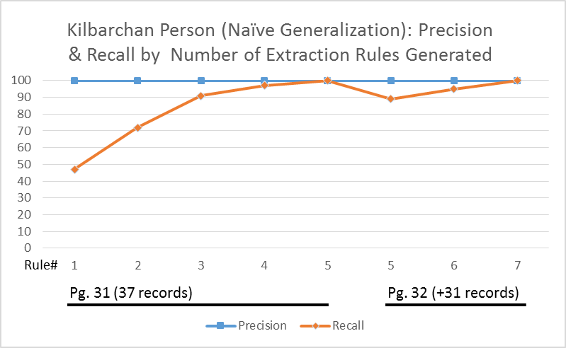
Results: Naïve Generalization

Slide 16
Results: Type-Specific Generalization
Type-Dependent
Pg. 31
Pg. 32

Slide 17
Couple Form

Slide 18
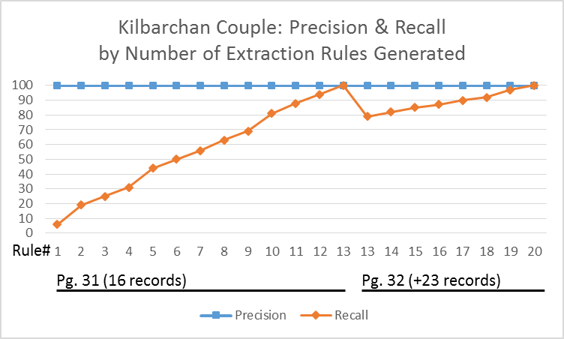
Results: Couple Form

Slide 19
Couple Patterns
Cordoner, James, par., and Florence Landiss, par. of Paisley m. 13 June 1679
Cordoner, John, and Catherine Adam m. 21 April 1656
Cordonnar, John, par., and Jean Craufurd, par. of Beith m. Beith, 16 June 1659
Cordoner, John, and Issobell Speir, in Walkmilne of Johnstoun m. 16 July 1673
Cordoner, John, and Margaret Cochran, in Nether Walkmilne
Cordner, John, and Jonet Cochran, in Walkinshaw, 1688 in Walkmiln of Johnstoun m. 22 April 1680
Cordonar, William, and jean Cochran m. 7 Feb. 1651
Cordoner, William, and Issobell Young, in Auchnames
Cordoner, William, and 1 liza Orr, in Netherwalkmilne of Johnstoun
Corss, John, and Jean Patison
Couper, James, and Issobell Load m. 30 Nov. 1682
Couper, James, par. of Erskine, and Mary Black, par. 30 Mar. 1744
Coupar, William, in Kilbarchan, and Janet Caldwell p. 29 Dec. 1768
Cowan, Daniel, in town par. of Paisley, and Margaret Dougal
Craig, James, par. of Kilbryde, and Jonet Cordonar, par. m. 28 June 1658
Craig, James, Moreland in Forehouse, and Jonet Reid m. Lochwinnoch, 18 Jan. 1693

Slide 20


Couple Patterns
Cordoner, James, par., and Florence Landiss, par. of Paisley m. 13 June 1679
Cordoner, John, and Catherine Adam m. 21 April 1656
Cordonnar, John, par., and Jean Craufurd, par. of Beith m. Beith, 16 June 1659
Cordoner, John, and Issobell Speir, in Walkmilne of Johnstoun m. 16 July 1673
Cordoner, John, and Margaret Cochran, in Nether Walkmilne
Cordner, John, and Jonet Cochran, in Walkinshaw, 1688 in Walkmiln of Johnstoun m. 22 April 1680
Cordonar, William, and jean Cochran m. 7 Feb. 1651
Cordoner, William, and Issobell Young, in Auchnames
Cordoner, William, and 1 liza Orr, in Netherwalkmilne of Johnstoun
Corss, John, and Jean Patison
Couper, James, and Issobell Load m. 30 Nov. 1682
Couper, James, par. of Erskine, and Mary Black, par. 30 Mar. 1744
Coupar, William, in Kilbarchan, and Janet Caldwell p. 29 Dec. 1768
Cowan, Daniel, in town par. of Paisley, and Margaret Dougal
Craig, James, par. of Kilbryde, and Jonet Cordonar, par. m. 28 June 1658
Craig, James, Moreland in Forehouse, and Jonet Reid m. Lochwinnoch, 18 Jan. 1693

Slide 21
Couple Patterns
Cordoner, James, par., and Florence Landiss, par. of Paisley m. 13 June 1679
Cordoner, John, and Catherine Adam m. 21 April 1656
Cordonnar, John, par., and Jean Craufurd, par. of Beith m. Beith, 16 June 1659
Cordoner, John, and Issobell Speir, in Walkmilne of Johnstoun m. 16 July 1673
Cordoner, John, and Margaret Cochran, in Nether Walkmilne
Cordner, John, and Jonet Cochran, in Walkinshaw, 1688 in Walkmiln of Johnstoun m. 22 April 1680
Cordonar, William, and jean Cochran m. 7 Feb. 1651
Cordoner, William, and Issobell Young, in Auchnames
Cordoner, William, and 1 liza Orr, in Netherwalkmilne of Johnstoun
Corss, John, and Jean Patison
Couper, James, and Issobell Load m. 30 Nov. 1682
Couper, James, par. of Erskine, and Mary Black, par. 30 Mar. 1744
Coupar, William, in Kilbarchan, and Janet Caldwell p. 29 Dec. 1768
Cowan, Daniel, in town par. of Paisley, and Margaret Dougal
Craig, James, par. of Kilbryde, and Jonet Cordonar, par. m. 28 June 1658
Craig, James, Moreland in Forehouse, and Jonet Reid m. Lochwinnoch, 18 Jan. 1693

Slide 22
Results: Couple Form
Precision: not necessarily 100% (over-generalization)

Slide 23
Conclusions
GreenFIE is “green”!
Extraction-rule generation
  Document pattern consistency
  Number and variability of patterns
Go green!!
www.deg.byu.edu
BYU Data Extraction Research Group

