Slide 1
Enabling Search for Facts and Implied Facts in Historical Documents
David W. Embley, Stephen W. Liddle, Deryle W. Lonsdale, Spencer Machado, Thomas Packer, Joseph Park, Nathan Tate, Andrew Zitzelberger
Brigham Young University
BYU Data Extraction Research Group
Notes:
15 minutes + 5 minutes Q/A

Slide 2
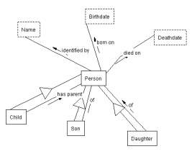
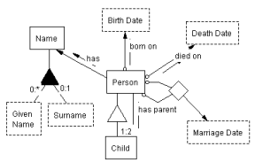
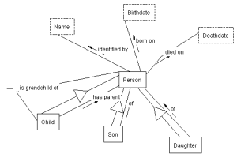
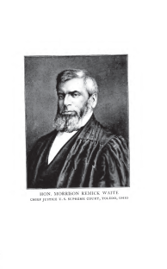
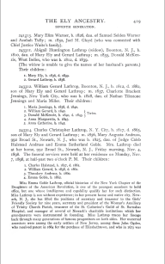
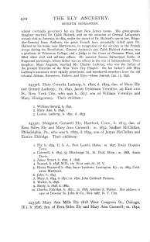
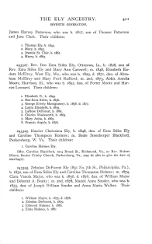
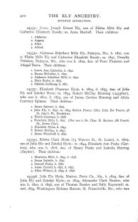
WoK-HD (A Web of Knowledge Superimposed over Historical Documents)
…
…
…
…
Notes:
Automatic extraction builds links.

Slide 3
WoK-HD (A Web of Knowledge Superimposed over Historical Documents)
grandchildren of Mary Ely
…
…
…
…
Notes:
Automatic extraction also builds query links.

Slide 4
WoK-HD (A Web of Knowledge Superimposed over Historical Documents)
grandchildren of Mary Ely
…
…
…
…
Notes:
Selection of best ontology to answer query.

Slide 5
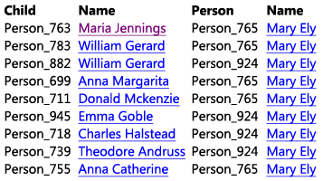
WoK-HD (A Web of Knowledge Superimposed over Historical Documents)
grandchildren of Mary Ely
…
…
…
…

Slide 6
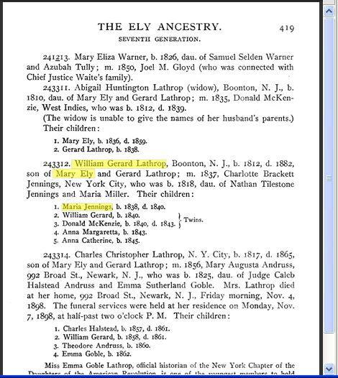
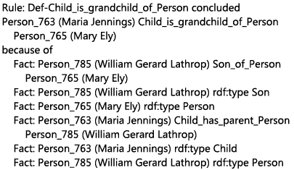
WoK-HD (A Web of Knowledge Superimposed over Historical Documents)
grandchildren of Mary Ely
…
…
…
…
Notes:
Mockup as designed. Actual implementation quite close. The differences point to where we need to add finishing touches.

Slide 7
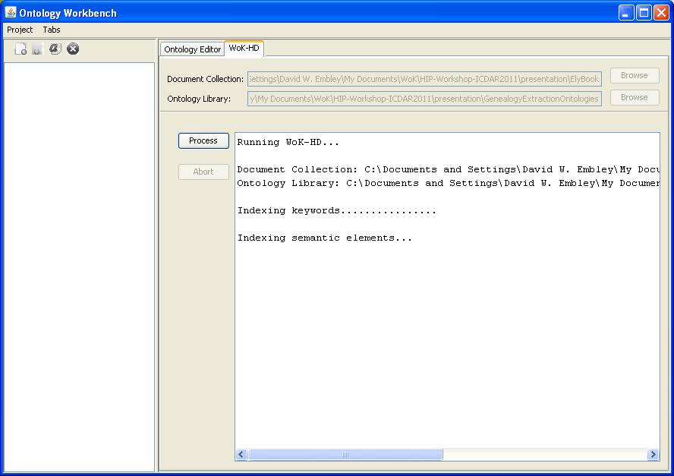
WoK-HD Input
Notes:
Demo: initial screen

Slide 8
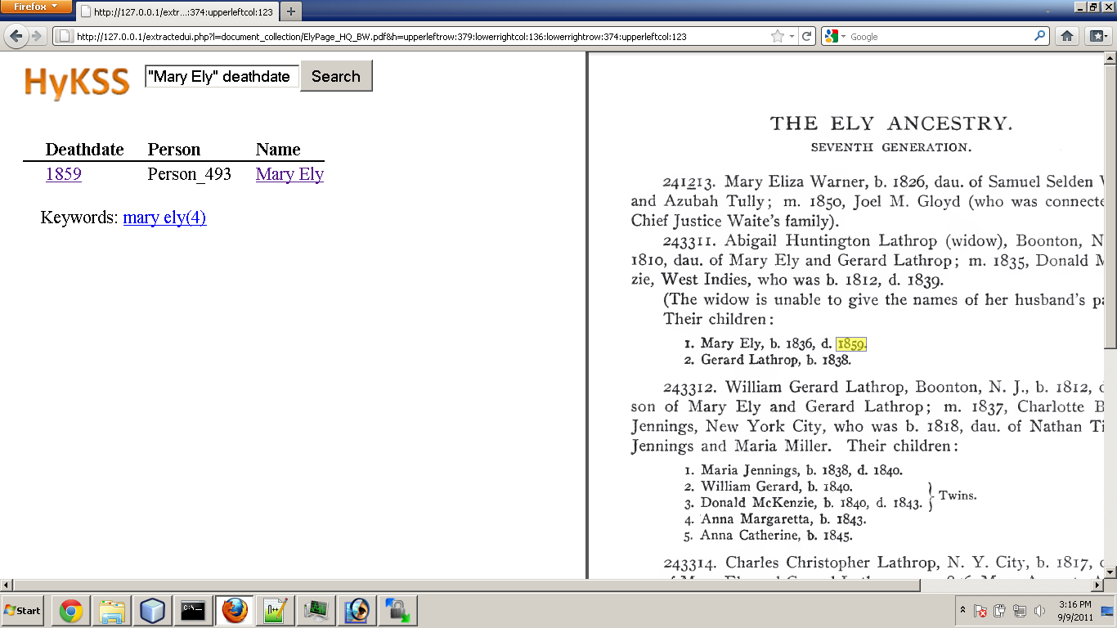
Querying for Facts & Implied Facts
Notes:
Facts. Demo: Query screen shots

Slide 9
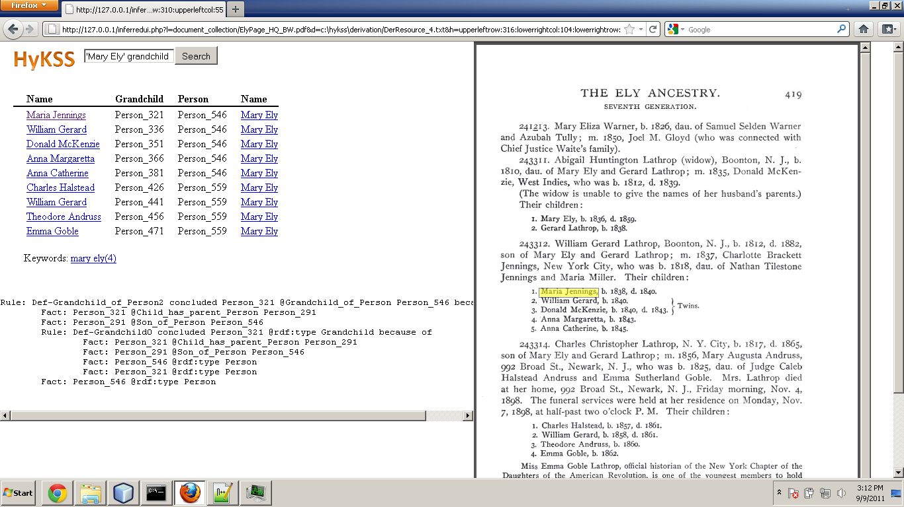
Querying for Facts & Implied Facts
Animation of
Extraction query, results, highlighting
Reasoned Query, results, reasoning chain, highlighting
Notes:
Implied Facts. Demo: Query screen shots

Slide 10
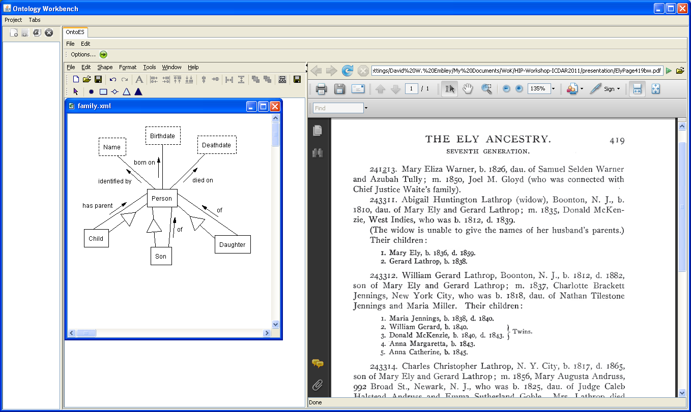
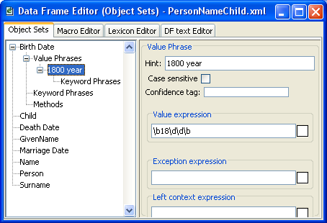
Extraction Ontologies
Notes:
This begins the explanation of how it works.

Slide 11
Extraction Ontologies
Notes:
… indexing …

Slide 12
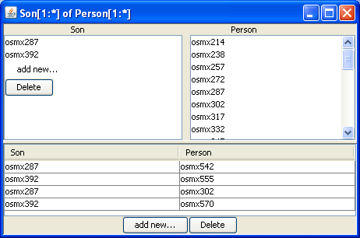
Fact Extraction
Notes:
Populated object and relationship sets

Slide 13
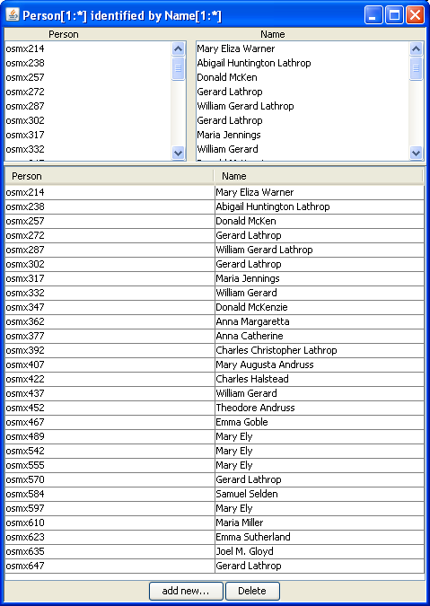
Fact Extraction

Slide 14
Fact Extraction

Slide 15
Reasoning for Implied Facts
Notes:
Declaration of reasoning rules.

Slide 16
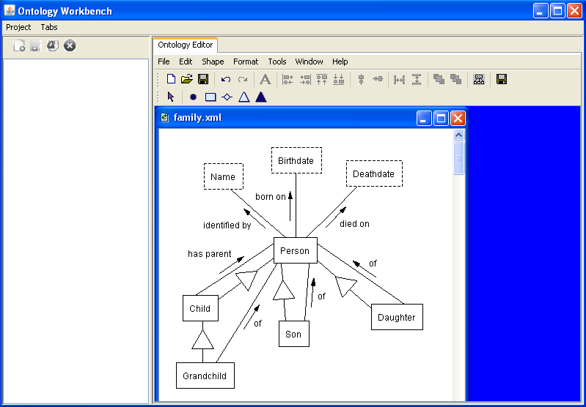
Reasoning for Implied Facts
Notes:
Reasoning rules yields new object and relationship sets.

Slide 17
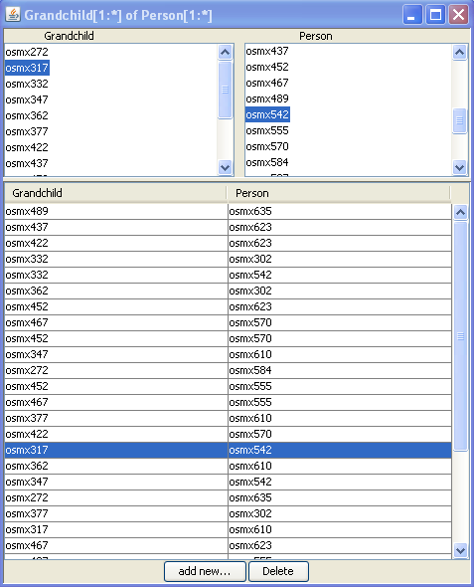
Reasoning for Implied Facts
Notes:
… and new data instances

Slide 18
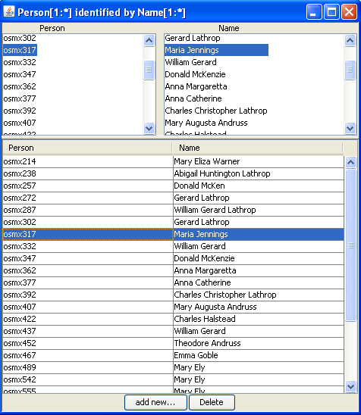
Reasoning for Implied Facts

Slide 19
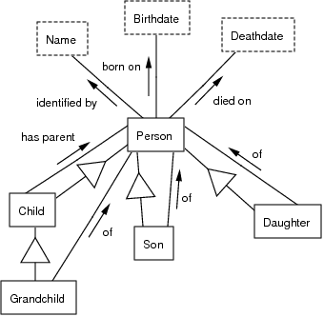
Query Interpretation
“Mary Ely” grandchild

Slide 20
Query Interpretation
“Mary Ely” grandchild

Slide 21
Query Interpretation
“Mary Ely” grandchild

Slide 22
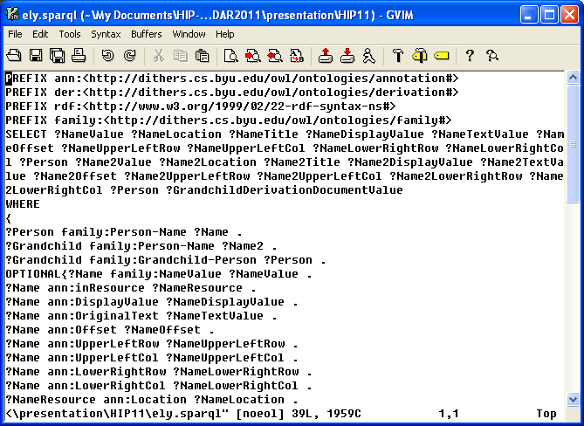
Generated SPARQL Query

Slide 23
Generated SPARQL Query

Slide 24
Query Results

Slide 25
Results of Processing the Ely Ancestry (all 830 Pages)
Number of facts extracted: 22,251
8,740 Person-Birthdate facts
3,803 Person-Deathdate facts
9,708 children facts, including
5,020 Child-has-parent-Person facts
2,394 Son-of-Person facts
2,294 Daughter-of-Person facts
Number of implied grandchild facts inferred: 5,277
Processing time:
~18 seconds per page
CPU time: ~4 hours
Processing 10 in parallel: ~24 minutes
Notes:
Grand total: 27,528
Each page took an average of about 18 seconds, so the entire job took roughly 4 hours of CPU time to process (4 hours 9 min, when estimated using 18 seconds per page on the 100 pages sampled). Run on Marylou, processing 10 pages at a time in parallel. ?? So, wall-clock time should be 240 minutes / 10 = 24 minutes. (Does the 18 seconds include the time to do the inferencing? yes)
Person-Name facts not counted (miscommunication about whether they were wanted)

Slide 26
Results of Processing the Ely Ancestry (all 830 Pages)
Precision: .52 (by randomly selecting & checking 100 of the 22,251 facts)
Recall: .33 & Precision: .40 (by randomly selecting and checking 2 fact-filled family pages)
Errors:
Name recognizer
Text pattern expectations
OCR
Varying accuracy (for pages checked)
Recall: .11, Precision: .11 (bad combination of all problems)
Recall: .50, Precision: .68 (some problems, but closer to expectations)
Recall: .59, Precision: .71 (10 pages, mostly as expected)
Recall: .91, Precision: .94 (tuned, no problems except a few OCR errors)
Notes:
Failures of name recognizer: (1) names weren’t in dictionary (occasionally due to OCR errors), (2) names such as the month “May” that are in the name dictionary, (3) relationship set recognizers such as “son of” or “born on” that “forced” the system to pick out a name, which it sometimes did incorrectly. Layout expectations: expected “children:” but not “children of” (switch for no apparent reason), window extent for relationships such as “children:”, “son of”, and “daughter of” turned out to be longer than expected

Slide 27
Current and Future Work
Implementation Status:
Full line works (but is fragile & needs finishing touches)
HyKSS integrated (but not all features)
Scalability:
Handcrafted extraction ontologies & reasoning rules (worth the work for certain applications)
ListReader (plus bootstrapping for lists and general extraction)
Optimization (especially for query processing)
Integration:
Mapping extraction ontologies to domain ontologies
Object identity for people and places
Notes:
Note that we already completed item #1 on our future-work list, however, not quite fully integrated so, to WoK-HD we need to add advanced form processing, ranking & column sorting.
Optimization: keyword & semantic indexing off-line (OK), but Query processing must be fast and requires optimization when large ontology libraries are involved.
Hurst patterns: automatically discovered and used to find even more facts with high precision.

Slide 28
Summary and Conclusion
WoK-HD
Superimposes a web of knowledge over a collection of historical documents
Works as a proof-of-concept prototype
To build and deploy the WoK-HD successfully:
Efficient implementation
Better, more cost-effective extraction
Integration and record linkage
www.deg.byu.edu

