Slide 1


Cost-Effective
Information Extraction from Lists in OCRed Historical Documents
Thomas Packer and David W. Embley
Brigham Young University
FamilySearch International
Notes:
15+5 minutes

Slide 2
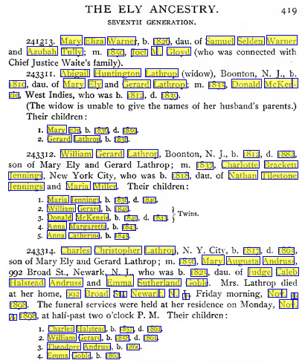

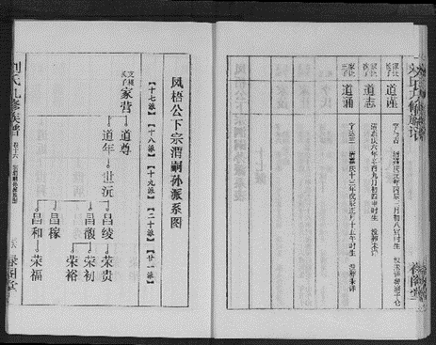
Information Extraction Issues
150K scanned books
  + 25K/yr
  ~ 7.5B fact assertions
12M Jiapu images
  ~ 0.5B fact assertions
  + many more
+ …
Notes:
150,000 books x ~500 pages / book x ~100 fact assertions / page = 7,500,000,000
Family search has several hundred workers in the field collecting images – more and more of which will be printed, OCRable documents.

Slide 3
Information Extraction Issues
150K scanned books
  + 25K/yr
  ~ 7.5B fact assertions
12M Jiapu images
  ~ 0.5B fact assertions
  + many more
+ …
Notes:
150,000 books x ~500 pages / book x ~100 fact assertions / page = 7,500,000,000
Family search has several hundred workers in the field collecting images – more and more of which will be printed, OCRable documents.

Slide 4
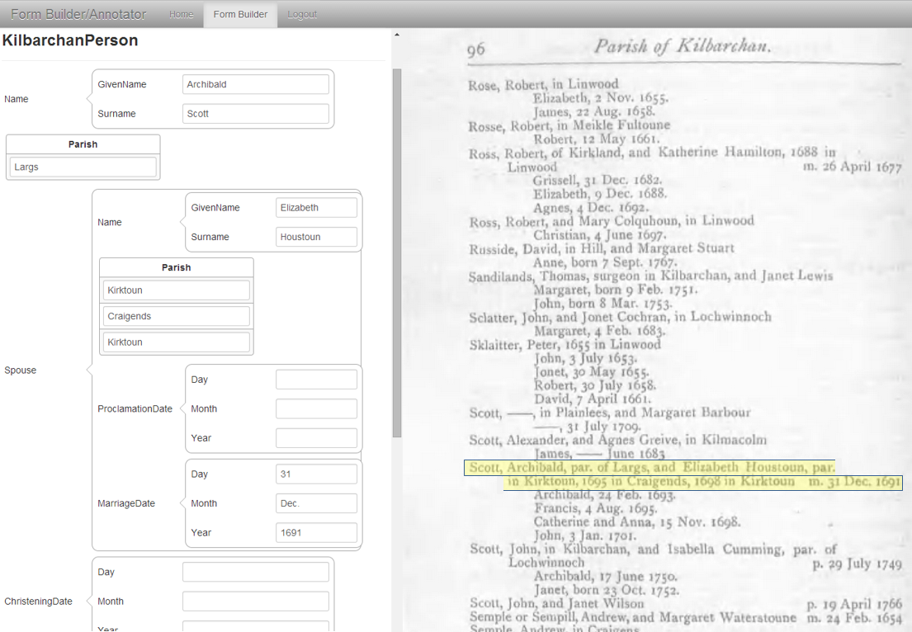
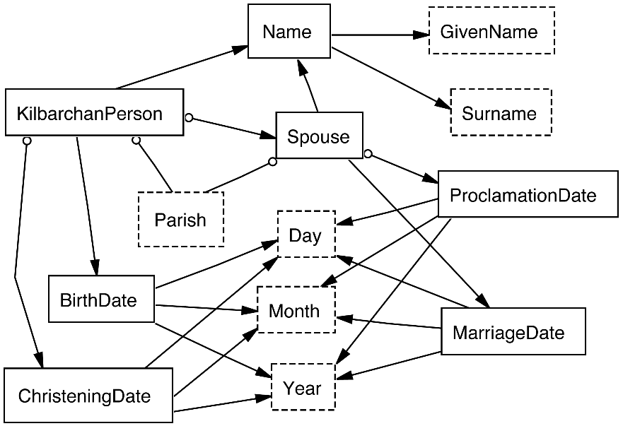
ListReader
<KilbarchanPerson.Name.Surname>Scott</KilbarchanPerson.Name.Surname>
, <KilbarchanPerson.Name.GivenName>Archibald</KilbarchanPerson.Name.GivenName>
, par. of <KilbarchanPerson.Parish[1]>Largs</KilbarchanPerson.Parish[1]>
, and <KilbarchanPerson.Spouse.Name.GivenName>Elizabeth</…> …
Notes:
The form, labeling, and ontology all correspond and have direct mappings to one another. The ontological conceptualization maps to a schema for an internal data store.
“. . .” is for ChristeningDate and BirthDate.
This set-up, which consists only of creating a form + the labeling of a few ListReader selected records is the full extent of required knowledge engineering – no feature engineering, no labeled training data.

Slide 5

ListReader
<KilbarchanPerson.Name.Surname>Scott</KilbarchanPerson.Name.Surname>
, <KilbarchanPerson.Name.GivenName>Archibald</KilbarchanPerson.Name.GivenName>
, par. of <KilbarchanPerson.Parish[1]>Largs</KilbarchanPerson.Parish[1]>
, and <KilbarchanPerson.Spouse.Name.GivenName>Elizabeth</…> …
Notes:
The form, labeling, and ontology all correspond and have direct mappings to one another. The ontological conceptualization maps to a schema for an internal data store.
“. . .” is for ChristeningDate and BirthDate.
This set-up, which consists only of creating a form + the labeling of a few ListReader selected records is the full extent of required knowledge engineering – no feature engineering, no labeled training data.

Slide 6
ListReader
<KilbarchanPerson.Name.Surname>Scott</KilbarchanPerson.Name.Surname>
, <KilbarchanPerson.Name.GivenName>Archibald</KilbarchanPerson.Name.GivenName>
, par. of <KilbarchanPerson.Parish[1]>Largs</KilbarchanPerson.Parish[1]>
, and <KilbarchanPerson.Spouse.Name.GivenName>Elizabeth</…> …
Notes:
The form, labeling, and ontology all correspond and have direct mappings to one another. The ontological conceptualization maps to a schema for an internal data store.
“. . .” is for ChristeningDate and BirthDate.
This set-up, which consists only of creating a form + the labeling of a few ListReader selected records is the full extent of required knowledge engineering – no feature engineering, no labeled training data.

Slide 7
ListReader
<KilbarchanPerson.Name.Surname>Scott</KilbarchanPerson.Name.Surname>
, <KilbarchanPerson.Name.GivenName>Archibald</KilbarchanPerson.Name.GivenName>
, par. of <KilbarchanPerson.Parish[1]>Largs</KilbarchanPerson.Parish[1]>
, and <KilbarchanPerson.Spouse.Name.GivenName>Elizabeth</…> …
Notes:
The form, labeling, and ontology all correspond and have direct mappings to one another. The ontological conceptualization maps to a schema for an internal data store.
“. . .” is for ChristeningDate and BirthDate.
This set-up, which consists only of creating a form + the labeling of a few ListReader selected records is the full extent of required knowledge engineering – no feature engineering, no labeled training data.

Slide 8
Text Abstraction
[\n][UpLo],[Sp][Dg][Sp][UpLo].[Sp][DgDgDgDg].[\n]
… [\n][∅][\n][DgDg][Sp][UpLo][Sp][of][Sp][UpLo].[\n][-][\n]
[UpLo],[Sp][UpLo],[Sp][in][Sp][UpLo][\n][UpLo],[Sp][Dg][Sp]
[UpLo].[Sp][DgDgDgDg].[\n][UpLo],[Sp][DgDg][Sp][UpLo].[Sp]
[DgDgDgDg].[\n][UpLo],[Sp][UpLo],[Sp][in][Sp][UpLo][Sp]
[UpLo][\n][UpLo],[Sp][DgDg][Sp][UpLo][Sp][DgDgDgDg].[\n]
[UpLo],[Sp][UpLo],[Sp][of][Sp][UpLo],[Sp][and][Sp][UpLo] …
Notes:
Add more to the lower example – maybe 10 more lines.

Slide 9
Candidate Record Clusters
[\n][Sp][UpLo],[Sp][DgDg][Sp][UpLo].[Sp][DgDgDgDg].[Sp][\n]
Record instance count: 1296
\nJames, 15 Dec. 1672.\n
\nRobert, 15 Oct. 1676.\n
...
[\n][Sp][UpLo+],[Sp][DgDg][Sp][UpLo+][Sp][DgDgDgDg].[Sp][\n]
Record instance count: 710
\nJoan, 25 April 1651.\n
\nJohn, 30 May 1652.\n
...
[\n][Sp][UpLo],[Sp][born][Sp][DgDg][Sp][UpLo].[Sp][DgDgDgDg].[Sp][\n]
Record instance count: 441
\nWilliam, born 10 Dec. 1755.\n
\nJames, born 24 Oct. 1758.\n
...
[\n][Sp][UpLo],[Sp][UpLo],[Sp][and][Sp][UpLo][Sp][m].[Sp][DgDg][Sp][UpLo].[Sp][DgDgDgDg][Sp][\n]
Record instance count: 61
\nAiken, David, and Janet Stevenson m. 29 Sept. 1691\n
\nAitkine, Thomas, and Geills Ore m. 21 Dec. 1661\n
...
...

Slide 10
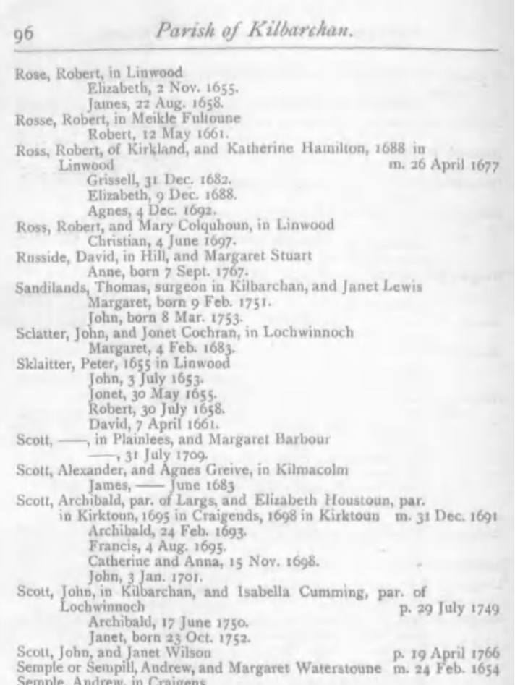
Record and Field Group Templates
[[\n-Segment][\n-End-Segment]]
[\n-Segment]
\n[UpLo],[Sp][DgDg][Sp][UpLo][Sp][DgDgDgDg] \nRobert, 12 May 1661
\n[UpLo],[Sp][UpLo] \nAllasoun, Richard
\n[UpLo] \nLochwinnoch
[\n-End-Segment]
.\n : .\n
\n : \n
[[\n-Segment][born-Segment][\n-End-Segment]]
[\n-Segment]
\n[UpLo] \nJanet
[born-Segment]
,[Sp][born][Sp][DgDg][Sp][UpLo].[Sp][DgDgDgDg] , born 23 Oct. 1752
[\n-End-Segment]
.\n : .\n
\n : \n
Notes:
Here we also check the templates for over-clustering and split them apart if the pattern variations differ too much.
Splitting templates is better than either of the extremes: split out every variation into its and accept all variations within a group.

Slide 11
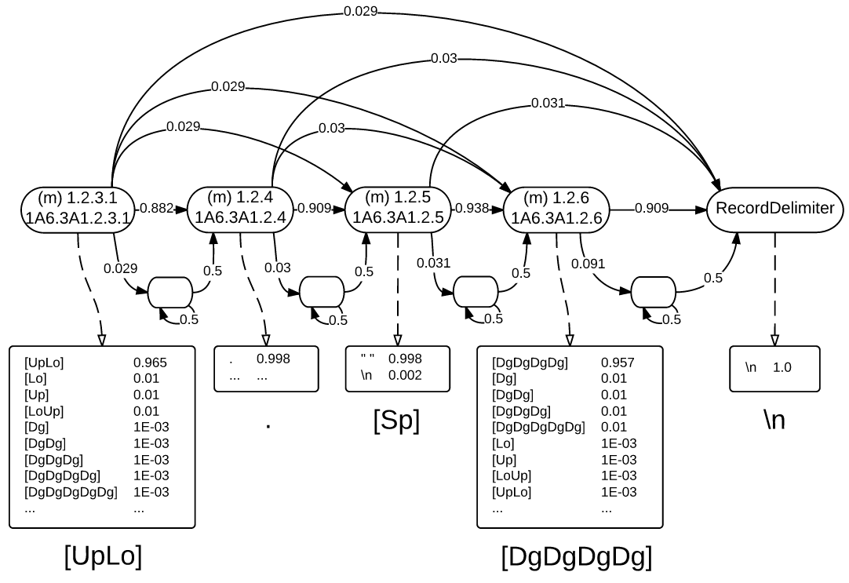
HMM Fragment
Notes:
Hidden Markov Model: state transition probabilities & emission model for a sequence of symbols in a record template

Slide 12
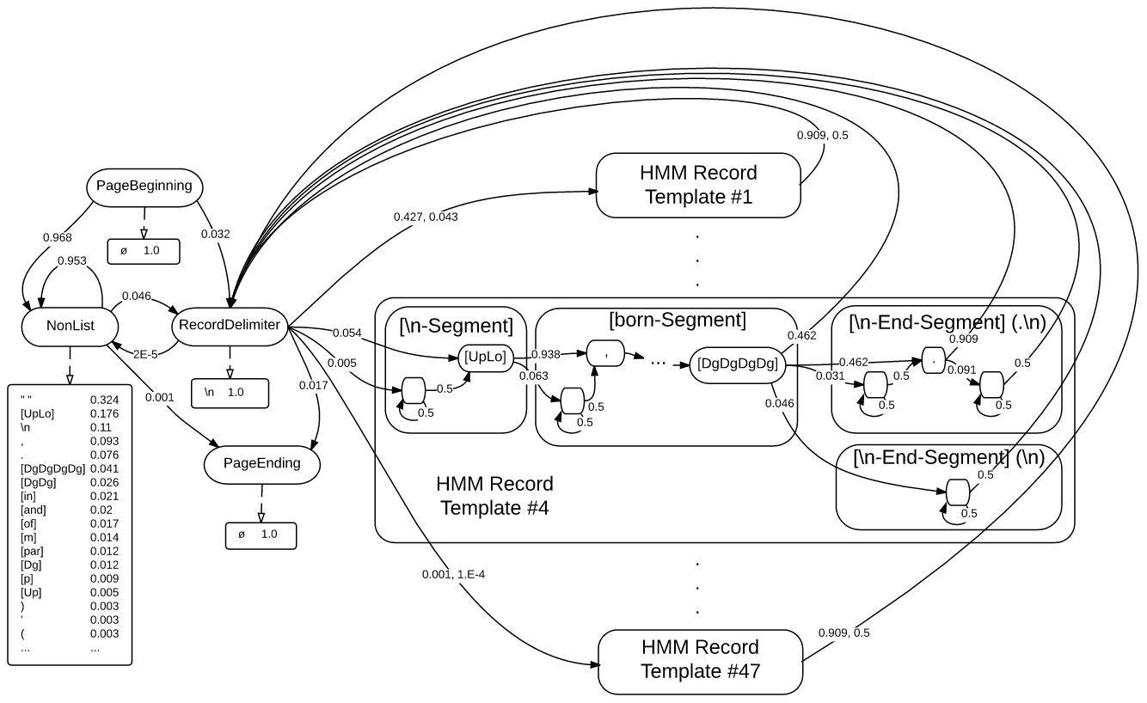
Full HMM

Slide 13
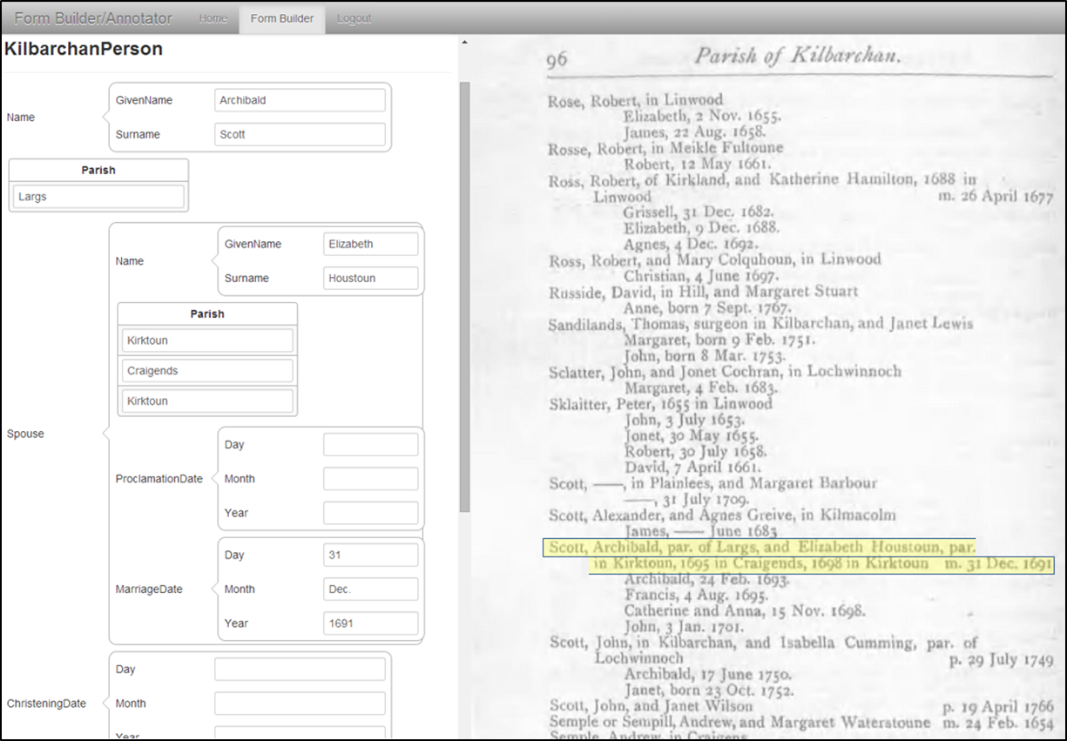
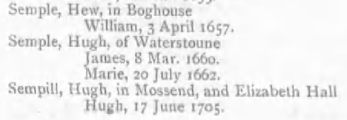
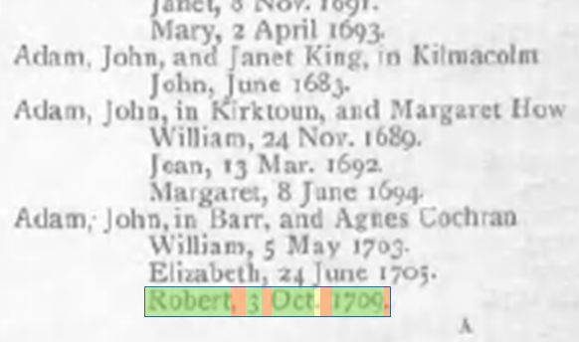
Labeling
First labeling
Second labeling (only the period)
Third labeling
Fourth labeling
. . .
. . .
. . .

Slide 14
Test Set Characteristics
Characteristic | Shaver | Kilbarchan
Pages | 498 | 143
Labeled pages | 68 | 3
Labeled tokens | 14,314 | 852
Labeled field instances | 13,748 | 768
Record instances | 2,516 | 165
Field types | 46 | 12
Ground Truth
3,284 | Records
14,516 | Instance predicates
11,232 | Relationship predicates
25,748 | Predicates
Notes:
Shaver: Shaver-Doughterty Genealogy; Kilbarchan: Kilbarchan Parish Record
More labeled tokens than field instances because we needed to label some non-field/non-delimiter tokens for the CRF.
How much accuracy at what human labeling cost.
Ground Truth:
2,516+768 = 3,284 records
13,748+768 = 14,516 instance predicates
14,516−(3,284+1,642) = 9,590 relationship predicates (i.e. each record should include a person name and the person’s related information; the relationships are between the person’s name and every other instance in the record; so if we subtract the person name, which about half the time has two or more parts, from each record, the number of remaining instances is the number of relationships; but wait: if the name has two parts, we need the parts related too, so the original w/o subtracting 1,642 was correct)
24,106 predicates

Slide 15
Learning Curve Results
Kilbarchan
Shaver
Precision
Recall
F₁
Precision
Recall
F₁
Notes:
ALC: Area under the Learning Curve: measures accuracy and cost together.

Slide 16
Area under Learning Curve Metrics (%)
Shaver-Doughterty Genealogy
Results statistically significant at p<0.05
 | Precision | Recall | F₁
CRF | 50.6 | 40.0 | 38.8
ListReader (Regex) | 97.6 | 32.6 | 48.8
ListReader (HMM) | 69.6 | 42.8 | 52.5
Except Recall of ListReader-Regex & CRF
Kilbarchan Parish Record
Except Precision of ListReader Regex & HMM
and Recall of ListReader-Regex & CRF
 | Precision | Recall | F₁
CRF | 68.9 | 63.0 | 65.5
ListReader (Regex) | 96.3 | 54.3 | 67.9
ListReader (HMM) | 91.4 | 72.7 | 79.2
Notes:
Shaver-Doughterty ALC Metrics (%): All differences are statistically significant at p<0.05 using an unpaired t test except for the difference in Recall of ListReader-Regex and the CRF.
Kilbarchan ALC Metrics (%): All differences are statistically significant at p<0.05 using an unpaired t test except for the difference in Precision of the two ListReaders and the difference in Recall of ListReader-Regex and the CRF.

Slide 17
Space / Time Characteristics
 | ListReader HMM Regex |  | CRF
 | Extractor Size
 | # states | # chars. | # states
Shaver | 2,015 | 319,096 | 28
Kilbarchan | 255 | 54,600 | 15
 | Running Time
Shaver | 59m 18s | 2m 47s | 52s
Kilbarchan | 2m 11s | 26s | 9s
Notes:
Complexity: Space – linear wrt text size for both Regex & HMM; wrapper construction time – linear wrt text size for construction of both Regex & HMM; wrapper execution time – linear for Regex and quadratic for HMM.

Slide 18
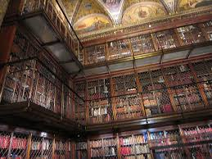
ListReader Status
Limitations
  Only semi-structured text
  No nested record structures
Future Work
  Pragmatic adjustments
  Ensemble integration
  Text abstraction wrt ontological concepts
  Reuse discovered patterns from one book to another
  Discovery of nested-record patterns
Notes:
Pragmatic adjustments: make it work in the field for our application; e.g., cross page patterns, typical field identifiers as themselves (e.g., b., m., p., d., born, died), central field identifiers (conjunctions such as “and” along with context to distinguish marriages from twins), alignment with other tools, …
One of the anonymous referees asked: “Have you considered not making the template creation process completely independent of the ontology fields that are defined?” initial abstraction of people names, dates, and place names is one example; reuse of patterns from one book to another is another; field identification across books for labeling is another.
Conflict resolution: based on confidence of a tool’s extraction work and on the type of document (narrative, semi-structured, structured).
Additional extraction tools to compensate for ListReader’s limitations
High-level nested-record pattern discovery where records themselves are the basic text-abstraction unit – presumably in a second pass after completing the first (current) pass that discovers records.

Slide 19

Conclusion
Unsupervised HMM construction
Cost minimization of labeling
Good performance:
  Accuracy
  Labeling cost
  Time and space complexity
  Required knowledge engineering

Slide 20


Conclusion
Unsupervised HMM construction
Cost minimization of labeling
Good performance:
  Accuracy
  Labeling cost
  Time and space complexity
  Required knowledge engineering
www.deg.byu.edu
BYU Data Extraction Research Group

Slide 22
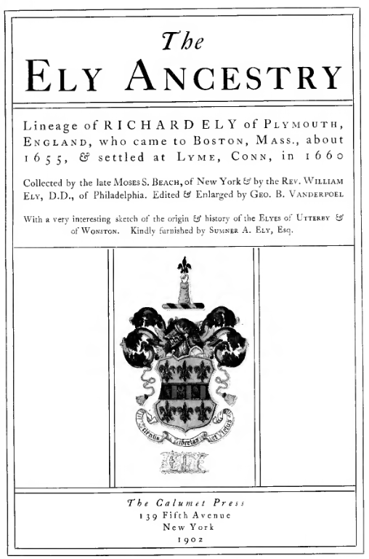
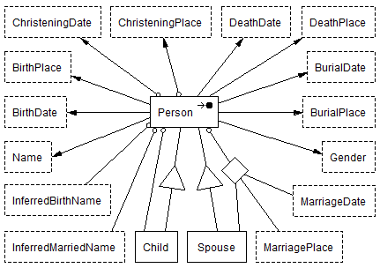
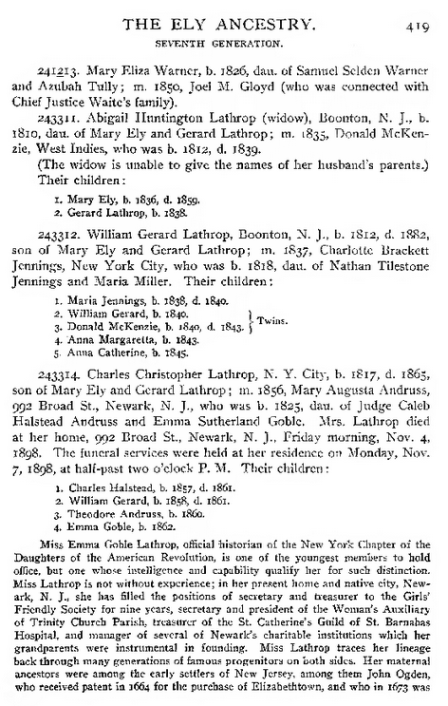
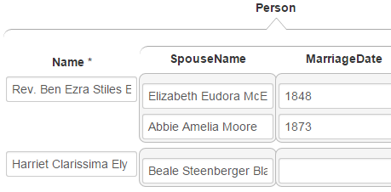
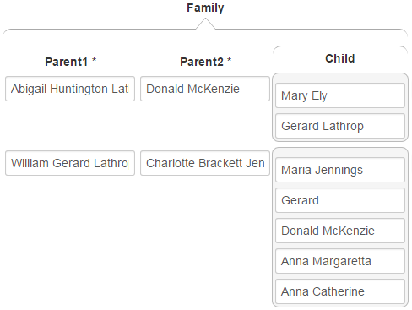
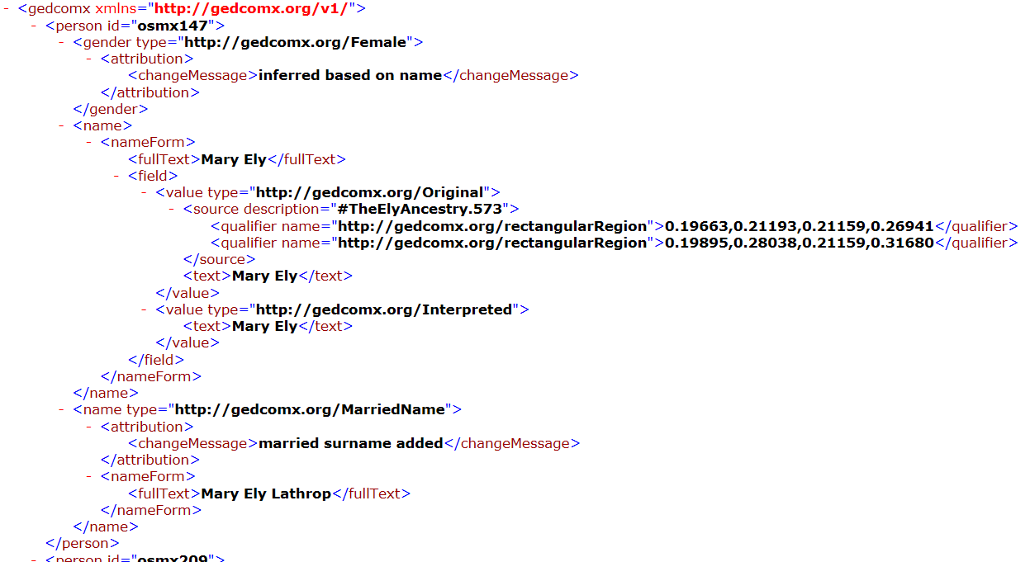
Fe6: 1. Prepare 2. Extract 3. Split & Merge 4. Check & Correct 5. Generate 6. Convert
FROntIER
ListReader
OntoSoar
GreenFIE
COMET
Notes:
Limitations of ListReader: (1) only patterned text (OntoSoar for free running text); (2) only record-size patterns – not nested records (FROntIER, although costly; GreenFIE).
Future work: next slide

Slide 23
Fe6: 1. Prepare 2. Extract 3. Split & Merge 4. Check & Correct 5. Generate 6. Convert
Administrative and Batch-Processing Management System
Automated Check & Correct
Name, Date, Place
Standardization
“Sanity”
Check
FROntIER
ListReader
OntoSoar
GreenFIE
Feedback
Loop
COMET

Slide 24
Fe6: 1. Prepare 2. Extract 3. Split & Merge 4. Check & Correct 5. Generate 6. Convert
Administrative and Batch-Processing Management System
Non-English Languages
Automated Check & Correct
Name, Date, Place
Standardization
“Sanity”
Check
FROntIER
ListReader
OntoSoar
GreenFIE
Extraction Tools:
Layout
Machine Learning
Feedback
Loop
COMET
Bootstrapping, Ever-learning, Feedback Loop

