Slide 1
FROntIER: A Framework for Extracting and Organizing Biographical Facts in Historical Documents
Joseph Park
Brigham Young University

Slide 2
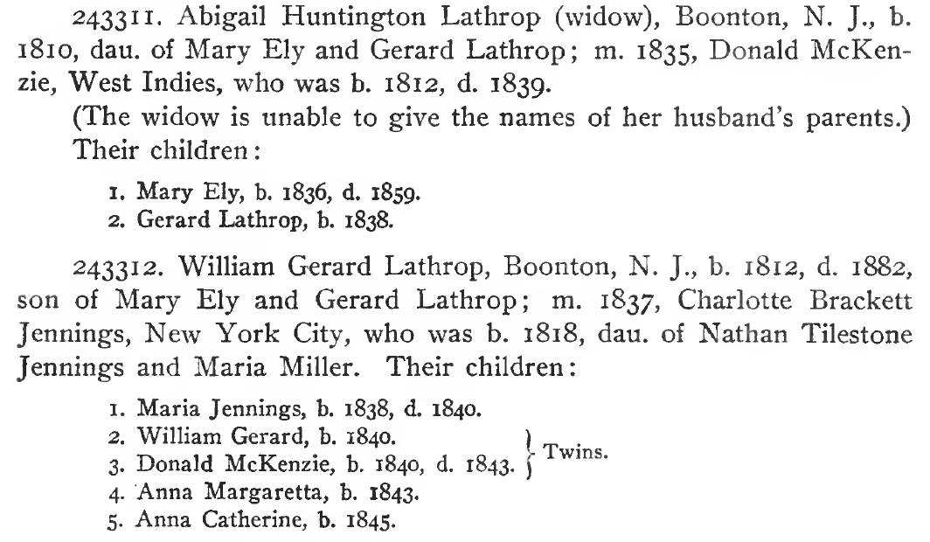
Motivation
Notes:
Historians, genealogists, and enthusiasts are interested in extracting facts about persons and places found in historical documents and organizing these facts into disambiguated entity records.

Slide 3
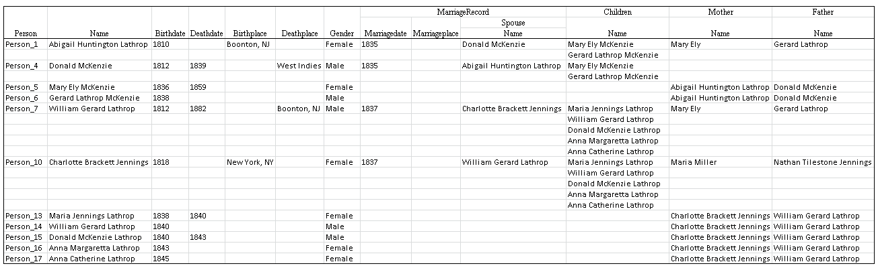
Motivation

Slide 4
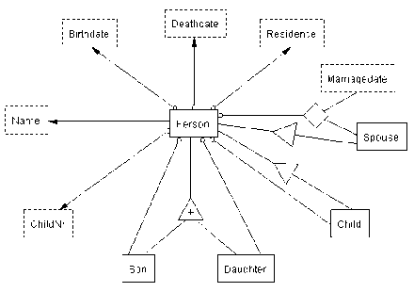
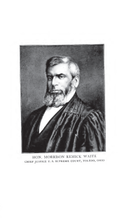
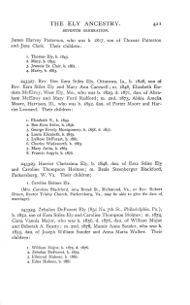
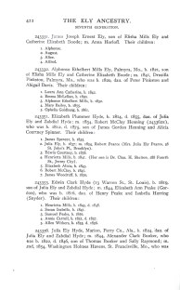
FROntIER: Fact Recognizer for Ontologies with Inference and Entity Resolution
Extract facts—extraction ontologies
Organize facts
  Inference rules
  Entity resolution
[(?x rdf:type source:Person) -> (?x rdf:type target:Person)]
[(?x rdf:type source:Name) -> (?x rdf:type target:Name)]
[(?x rdf:type source:Birthdate),(?x source:BirthdateValue ?bv) ->
(?x rdf:type target:Birthdate),(?x target:BirthdateValue ?bv)]
[(?x rdf:type source:Deathdate),(?x source:DeathdateValue ?dv) ->
(?x rdf:type target:Deathdate),(?x target:DeathdateValue ?dv)]
[(?p source:Person-Birthdate ?y),(?p source:Person-Residence ?x),(?x source:ResidenceValue ?rv) ->
(?x rdf:type target:Birthplace),(?x target:BirthplaceValue ?rv),(?p target:Person-Birthplace ?x)]
[(?p source:Person-Deathdate ?y),(?p source:Person-Residence ?x),(?x source:ResidenceValue ?rv) ->
(?x rdf:type target:Deathplace),(?x target:DeathplaceValue ?rv),(?p target:Person-Deathplace ?x)]
…
Name
external representation: \b{FirstName}\s{LastName}\b
external representation: \b{FirstName}\s [A-Z]\w+\b
left context: \d{1,2}\.\s
…
Residence
external representation: \b{City},\s{State}\b
…
Birthdate
external representation: \b{Month}\.?\s*(1\d|2\d|30|31|\d)[.,]?\s*\b[1][6-9]\d\d\b
left context: b\.\s
right context: [.,]
exclusion: \b(February|Feb\.?)\s*(30|31)\b|…
external representation: \b[1][6-9]\d\d\b
left context: b\.\s
right context: [.,]
…

Slide 5
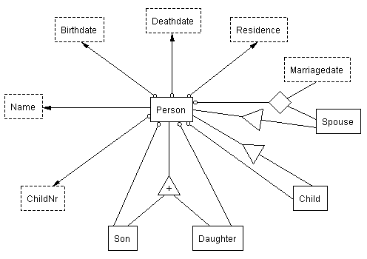
Extraction Ontologies
Linguistically grounded conceptual model

Slide 6
Data Frames
Instance recognizers
Operators
Name
external representation: \b{FirstName}\s{LastName}\b
external representation: \b{FirstName}\s [A-Z]\w+\b
left context: \d{1,2}\.\s
…
Residence
external representation: \b{City},\s{State}\b
…
Birthdate
external representation: \b{Month}\.?\s*(1\d|2\d|30|31|\d)[.,]?\s*\b[1][6-9]\d\d\b
left context: b\.\s
right context: [.,]
exclusion: \b(February|Feb\.?)\s*(30|31)\b|…
external representation: \b[1][6-9]\d\d\b
left context: b\.\s
right context: [.,]
…

Slide 7
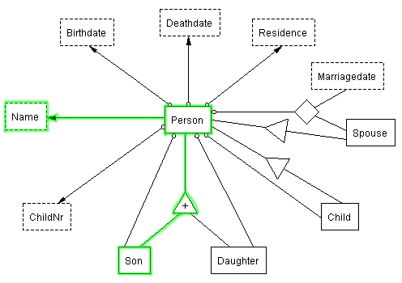
Recognizers for Nonlexical Object Sets
Identify nonlexical objects
Person
object existence rule: {Name}
…
Son
object existence rule: {Person}[.,]?.{0,50}\s[sS]on\b
…
William Gerard Lathrop
Person_14
Person_14

Slide 8
Recognizers for Relationship Sets
Identify phrases that relate objects
Person-Birthdate
external representation: ^\d{1,3}\.\s{Person},\sb\.\s{Birthdate}[.,]
…
Son-Person
external representation: {Son}[.,]?.{0,50}\s[sS]on\s+of\s.*?\s{Person}
…
Person-Marriagedate-Spouse
external representation: {Person}[.,]?.{0,50};\s*m[.,]\s{MarriageDate}[,]?\s*{Spouse}
…

Slide 9
Data Frames for Ontology Snippets
Recognizers identify patterns for identify multiple lexical instances
Predicate mappings generate objects and relationships
ChildRecord
external representation: ^(\d{1,3})\.\s+([A-Z]\w+\s[A-Z]\w+)
(,\sb\.\s([1][6-9]\d\d))?(,\sd\.\s([1][6-9]\d\d))?\.
predicate mappings: Child(x); Person-ChildNr(x,1); Person-Name(x,2);
Person-Birthdate(x,4); Person-Deathdate(x,6)
…

Slide 10
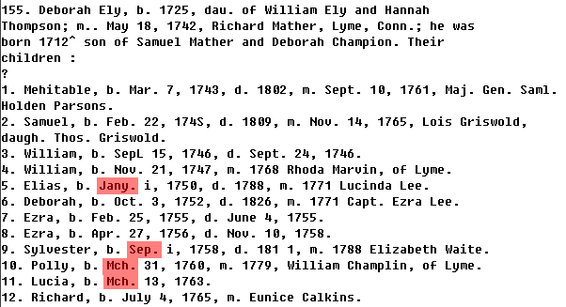
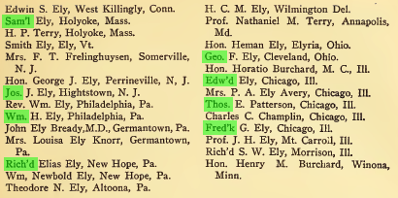
Canonicalization

Slide 11
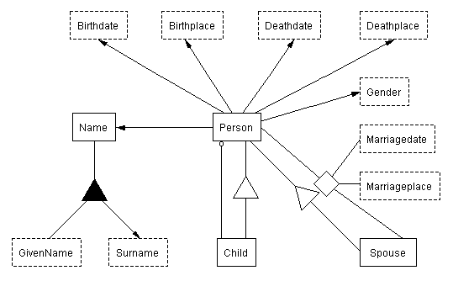
Inference Rules
Organize facts in conformance to a target ontology
Specify schema mapping
  Logic
  Onomastics
  Cultural pragmatics

Slide 12
Example Inference Rules
[(?x rdf:type source:Person) -> (?x rdf:type target:Person)]
[(?x rdf:type source:Birthdate),(?x source:BirthdateValue ?bv) ->
(?x rdf:type target:Birthdate),(?x target:BirthdateValue ?bv)]
[(?n source:NameValue ?nv),(?n rdf:type source:Name),
regex(?nv, '\b([A-Z][a-z]+)\b\s\b([A-Z][a-z]+)\b', ?x, ?y),makeTemp(?g) ->
(?g rdf:type target:GivenName),(?g target:GivenNameValue ?x),(?g target:GivenName-Name ?n)]
[male: (?x target:Person-Name ?n),(?n target:Name-GivenName ?g),
(?g target:GivenNameValue ?gv),isMale(?gv),makeTemp(?gender) ->
(?x target:Person-Gender ?gender),(?gender rdf:type target:Gender),
(?gender target:GenderValue 'Male'^^xsd:string)]
[childInheritsFatherSurname: (?p source:Person-Child ?c),(?c target:Person-Name ?cn),
(?cn target:Name-Surname ?middleName),(?middleName rdf:type target:Surname),
(?p target:Person-Name ?pn),(?pn target:Name-Surname ?sn),(?sn target:SurnameValue ?snv),
(?p target:Person-Gender ?gender),(?gender target:GenderValue 'Male'^^xsd:string),
makeTemp(?newSurname) ->
(?newSurname rdf:type target:Surname),(?newSurname target:SurnameValue ?snv),
(?cn target:Name-Surname ?newSurname),(?middleName rdf:type target:GivenName),remove(2,3)]

Slide 13
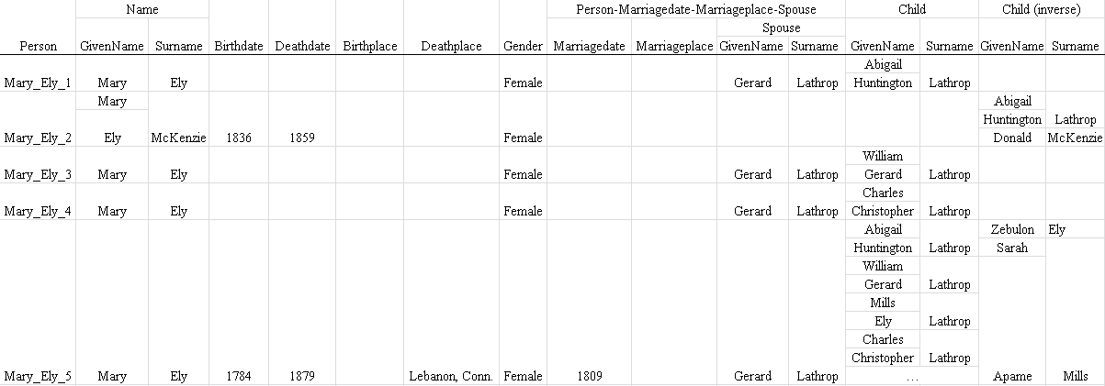
Entity Resolution
Disambiguate entity references using attribute-value pairs

Slide 14
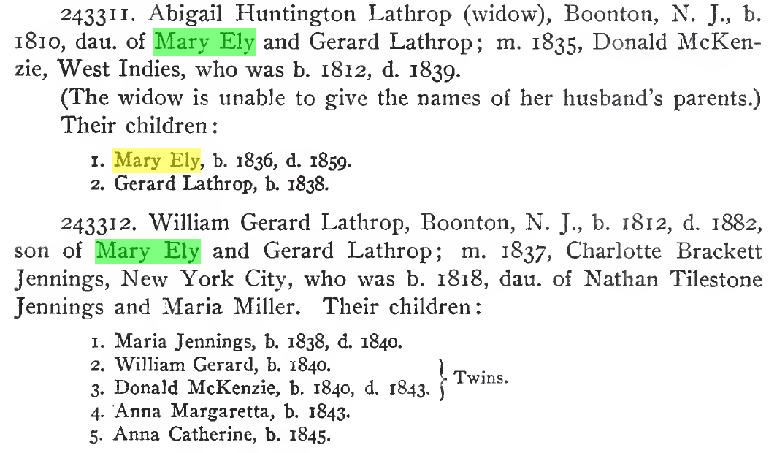
Example Entity Resolution
 | Mary_Ely_1 | Mary_Ely_2 | Mary_Ely_3 | Mary_Ely_4 | Mary_Ely_5
Mary_Ely_1 | 1 | 0.605 | 0.875 | 0. 875 | 0. 889
Mary_Ely_2 | - | 1 | 0.605 | 0.605 | 0.313
Mary_Ely_3 | - | - | 1 | 0. 875 | 0. 889
Mary_Ely_4 | - | - | - | 1 | 0. 889
Mary_Ely_5 | - | - | - | - | 1
Clusters
{Mary_Ely_1, Mary_Ely_3,
Mary_Ely_4, Mary_Ely_5}
{Mary_Ely_2}

Slide 15
Validation
Historical documents from corpus of over 50,000 scanned OCRed books provided by the LDS church
Development test and blind test sets
Gold standards using annotator tool
Precision and recall
  Extracted facts of interest
  Inferred facts of interest
  Clustered entities

Slide 16
Conclusions
Framework—FROntIER: Fact Recognizer for Ontologies with Inference and Entity Resolution
Extracts stated facts of interest
Organizes facts of interest using inference rules and entity resolution

Slide 17
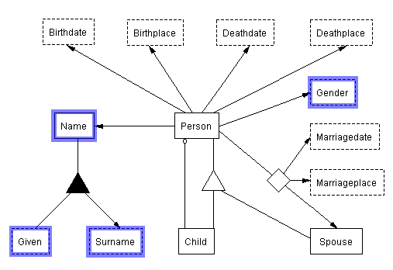
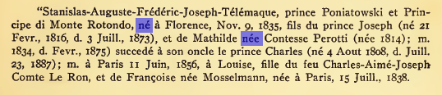
Morphology
male
female

Slide 18

Onomastics

Slide 19
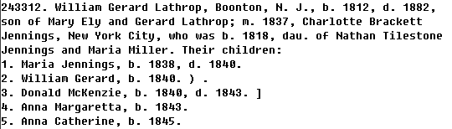
Cultural Pragmatics

