Slide 1
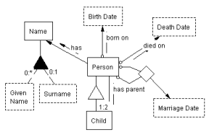
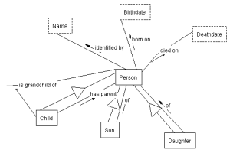
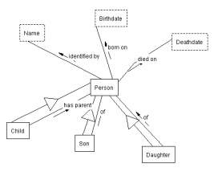
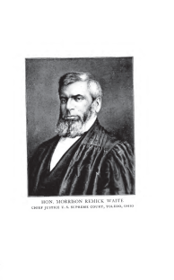
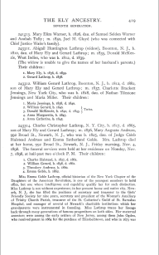
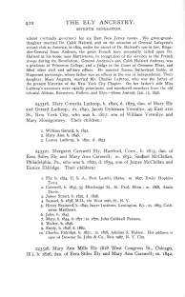
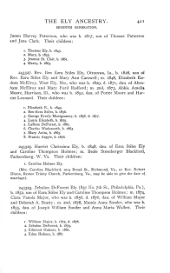
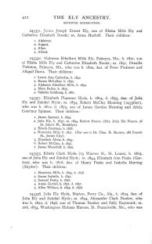
Person-Name Disambiguation using Extracted Facts
Joseph S. Park
Data Extraction Research Group
Department of Computer Science, Brigham Young University, Provo, UT, 84602
Data Extraction Research Group
www.deg.byu.edu
HIP 2011
The Ely Ancestry has 830 pages
22,251 extracted facts:
8,740 Person-Birthdate facts
3,803 Person-Deathdate facts
9,708 children facts, including
5,020 Child-has-parent-Person facts
2,394 Son-of-Person facts
2,294 Daughter-of-Person facts
Precision: 0.52 (by randomly selecting & checking
100 of the 22,251 facts)
Recall: 0.33 & Precision: 0.40 (by randomly selecting
and checking 2 family pages)
WoK-HD (A Web of Knowledge Superimposed over Historical Documents)
children of Mary Ely
 | Mary_Ely_1 | Mary_Ely_2 | Mary_Ely_3 | Mary_Ely_4 | Mary_Ely_5
Mary_Ely_1 | 1.000 | 0.542 | 0 | 0.574 | 0.574
Mary_Ely_2 | - | 1.000 | 0 | 0 | 0
Mary_Ely_3 | - | - | 1.000 | 0 | 0
Mary_Ely_4 | - | - | - | 1.000 | 0
Mary_Ely_5 | - | - | - | - | 1.000
…
…
…
…

