Slide 1
FROntIER: A Framework for Extracting and Organizing Biographical Facts in Historical Documents
Joseph Park

Slide 2
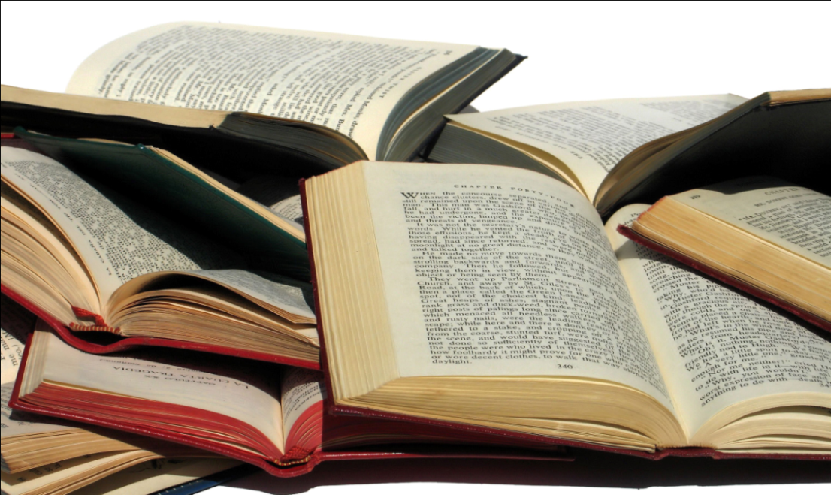
Motivation
Large collection of scanned, OCRed books

Slide 3
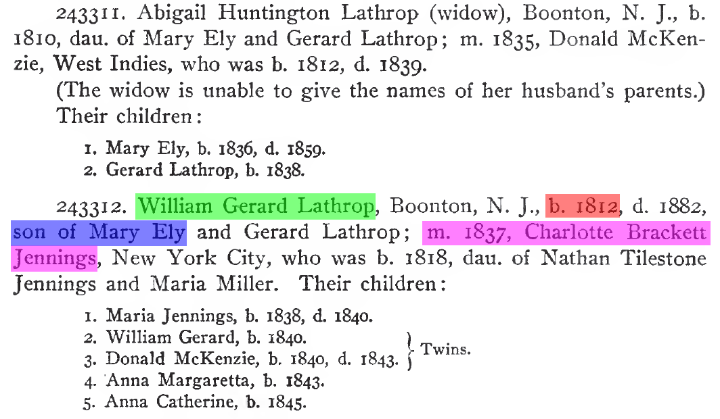
Stated Facts of Interest
William Gerard Lathrop
married Charlotte Brackett Jennings in 1837
is the son of Mary Ely
was born in 1812

Slide 4
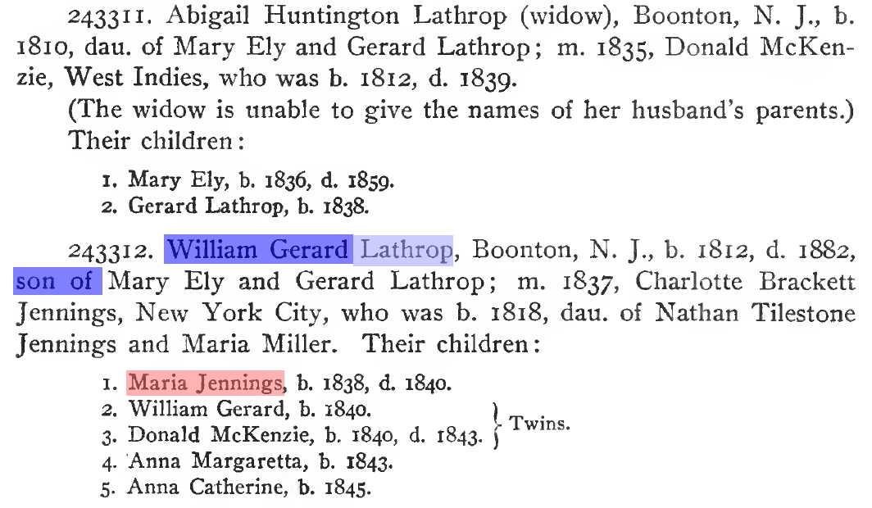
Inferred Facts of Interest
William Gerard Lathrop has gender Male
Maria Jennings has gender Female
Maria Jennings has surname Lathrop

Slide 5
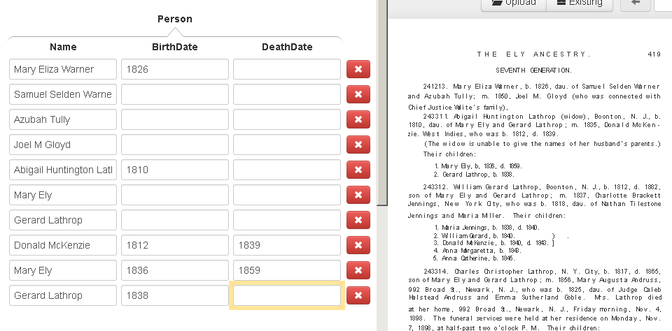
Gathering Facts

Slide 6
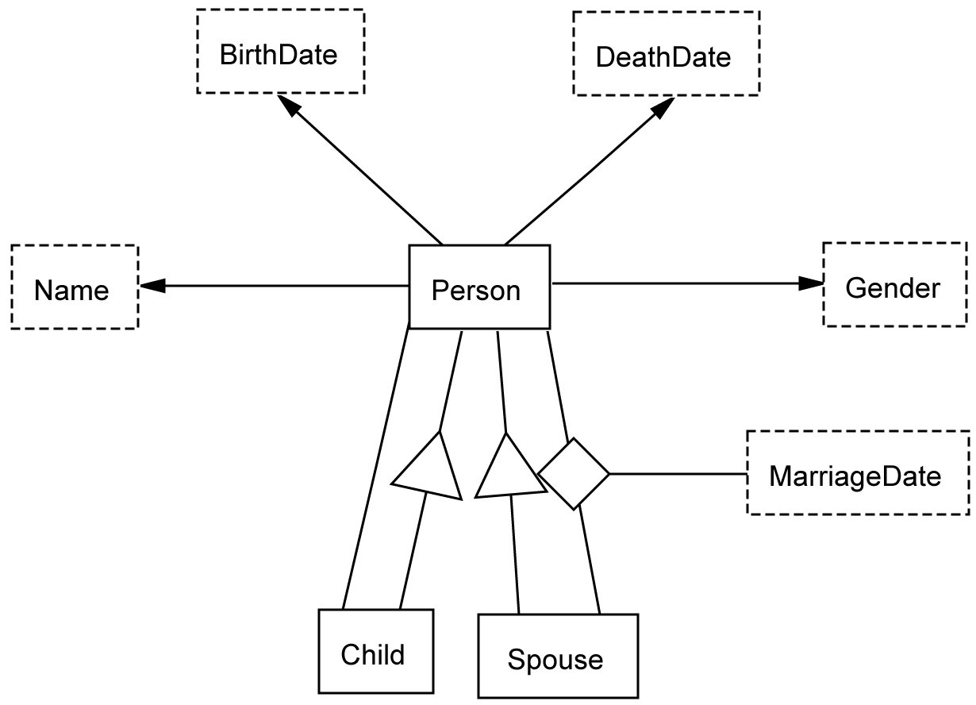
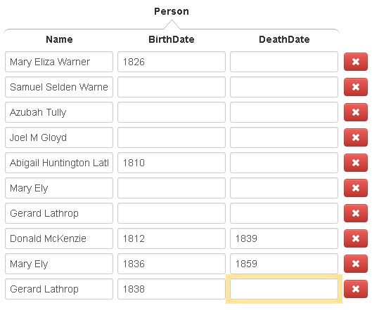
Organizing Facts
<?xml version="1.0" encoding="UTF-8" standalone="yes"?>
<OSM id="osmx1" ontol…
<obj value="Mary Eliza Warner" id="osmx325“ />
…
</OSM>

Slide 7
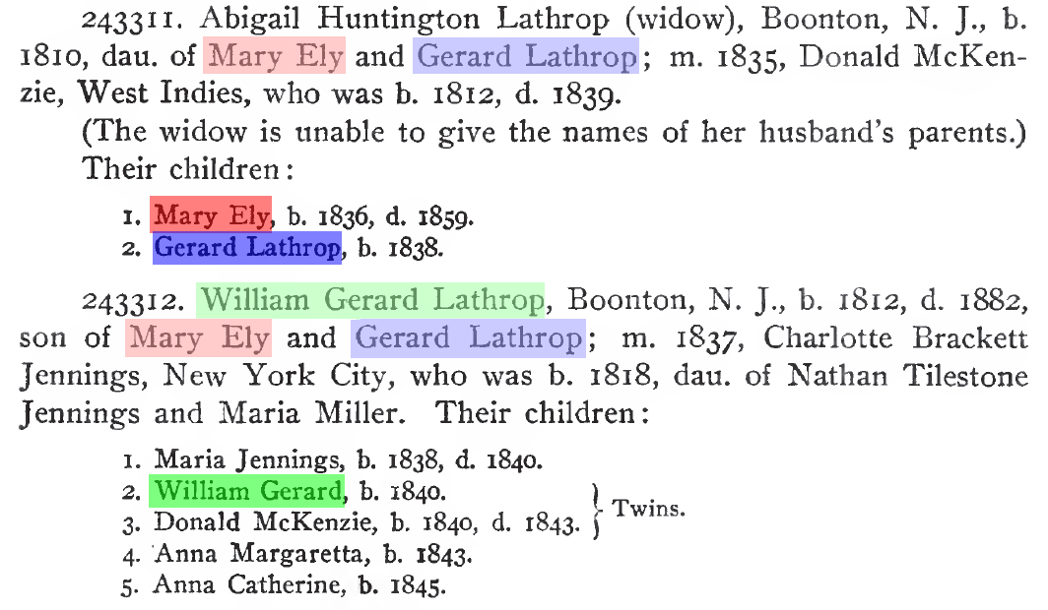
Entity Resolution
William Gerard Lathrop
Gerard Lathrop
Mary Ely

Slide 8
Focus of Research
Gathering
Stated facts
Inferred facts
Organizing
Resolve

Slide 9
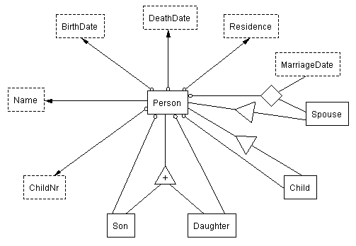
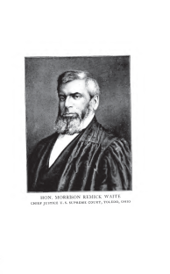
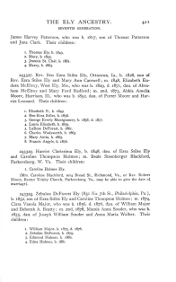
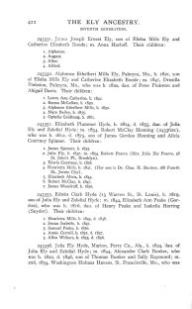
FROntIER
<owl:Thing rdf:ID="Person_1"/>
<owl:Thing rdf:about="#Person_1">
<rdf:type rdf:resource="&family;Person"/>
<rdf:type rdf:resource="&family;Child"/>
<rdf:type rdf:resource="&family;Spouse"/>
</owl:Thing>
<owl:Thing rdf:ID="Name_1"/>
<owl:Thing rdf:about="#Name_1">
<rdf:type rdf:resource="&family;Name"/>
</owl:Thing>
<owl:Thing rdf:ID="GivenName_1"/>
<owl:Thing rdf:about="#GivenName_1">
<rdf:type rdf:resource="&family;GivenName"/>
</owl:Thing>
<rdf:Description rdf:about="#GivenName_1">
<family:GivenNameValue rdf:datatype="&xsd;string">Abigail</family:GivenNameValue>
</rdf:Description>
<owl:Thing rdf:ID="GivenName_2"/>
<owl:Thing rdf:about="#GivenName_2">
<rdf:type rdf:resource="&family;GivenName"/>
</owl:Thing>
<rdf:Description rdf:about="#GivenName_2">
<family:GivenNameValue rdf:datatype="&xsd;string">Huntington</family:GivenNameValue>
</rdf:Description>
<owl:Thing rdf:ID="Surname_1"/>
<owl:Thing rdf:about="#Surname_1">
<rdf:type rdf:resource="&family;Surname"/>
</owl:Thing>
<rdf:Description rdf:about="#Surname_1">
<family:SurnameValue rdf:datatype="&xsd;string">Lathrop</family:SurnameValue>
</rdf:Description>
<owl:Thing rdf:ID="BirthDate_1"/>
<owl:Thing rdf:about="#BirthDate_1">
<rdf:type rdf:resource="&family;BirthDate"/>
</owl:Thing>
<rdf:Description rdf:about="#BirthDate_1">
<family:BirthDateValue rdf:datatype="&xsd;date">1810-00-00</family:BirthDateValue>
</rdf:Description>
<owl:Thing rdf:ID="MarriageDate_1"/>
<owl:Thing rdf:about="#MarriageDate_1">
<rdf:type rdf:resource="&family;MarriageDate"/>
</owl:Thing>
<rdf:Description rdf:about="#MarriageDate_1">
<family:MarriageDateValue rdf:datatype="&xsd;date">1835-00-00</family:MarriageDateValue>
</rdf:Description>
<owl:Thing rdf:ID="Gender_1"/>
<owl:Thing rdf:about="#Gender_1">
<rdf:type rdf:resource="&family;Gender"/>
</owl:Thing>
<rdf:Description rdf:about="#Gender_1">
<family:GenderValue rdf:datatype="&xsd;string">Female</family:GenderValue>
</rdf:Description>
<rdf:Description rdf:about="#Person_1">
<family:Person-BirthDate rdf:resource="#BirthDate_1"/>
<family:Person-Name rdf:resource="#Name_1"/>
<family:Person-Gender rdf:resource="#Gender_1"/>
<family:Person-Child rdf:resource="#Person_5"/>
<family:Person-Child rdf:resource="#Person_6"/>
</rdf:Description>
<rdf:Description rdf:about="#Name_1">
<family:Name-GivenName rdf:resource="#GivenName_1"/>
<family:Name-GivenName rdf:resource="#GivenName_2"/>
<family:Name-Surname rdf:resource="#Surname_1"/>
</rdf:Description>
<owl:Thing rdf:ID="PersonMarriageDateMarriagePlaceSpouse_1"/>
<rdf:Description rdf:about="#PersonMarriageDateMarriagePlaceSpouse_1">
<family:PersonMarriageDateMarriagePlaceSpouse-Person rdf:resource="#Person_1"/>
<family:PersonMarriageDateMarriagePlaceSpouse-Spouse rdf:resource="#Person_4"/>
<family:PersonMarriageDateMarriagePlaceSpouse-MarriageDate rdf:resource="#MarriageDate_1"/>
</rdf:Description>
RDF output
convert to RDF
Jena reasoner
parameters
comparators
OntoES
convert to csv
owl:sameAs
Duke
[(?x rdf:type source:Person) -> (?x rdf:type target:Person)]
[(?x source:Person-Name ?n),(?n source: NameValue ?nv),
isMale(?nv),makeTemp(?gender)
-> (?x target:Person-Gender ?gender),(?gender rdf:type target:Gender),
(?gender target:GenderValue `Male'^^xsd:string)]

Slide 10
FROntIER
<owl:Thing rdf:ID="Person_1"/>
<owl:Thing rdf:about="#Person_1">
<rdf:type rdf:resource="&family;Person"/>
<rdf:type rdf:resource="&family;Child"/>
<rdf:type rdf:resource="&family;Spouse"/>
</owl:Thing>
<owl:Thing rdf:ID="Name_1"/>
<owl:Thing rdf:about="#Name_1">
<rdf:type rdf:resource="&family;Name"/>
</owl:Thing>
<owl:Thing rdf:ID="GivenName_1"/>
<owl:Thing rdf:about="#GivenName_1">
<rdf:type rdf:resource="&family;GivenName"/>
</owl:Thing>
<rdf:Description rdf:about="#GivenName_1">
<family:GivenNameValue rdf:datatype="&xsd;string">Abigail</family:GivenNameValue>
</rdf:Description>
<owl:Thing rdf:ID="GivenName_2"/>
<owl:Thing rdf:about="#GivenName_2">
<rdf:type rdf:resource="&family;GivenName"/>
</owl:Thing>
<rdf:Description rdf:about="#GivenName_2">
<family:GivenNameValue rdf:datatype="&xsd;string">Huntington</family:GivenNameValue>
</rdf:Description>
<owl:Thing rdf:ID="Surname_1"/>
<owl:Thing rdf:about="#Surname_1">
<rdf:type rdf:resource="&family;Surname"/>
</owl:Thing>
<rdf:Description rdf:about="#Surname_1">
<family:SurnameValue rdf:datatype="&xsd;string">Lathrop</family:SurnameValue>
</rdf:Description>
<owl:Thing rdf:ID="BirthDate_1"/>
<owl:Thing rdf:about="#BirthDate_1">
<rdf:type rdf:resource="&family;BirthDate"/>
</owl:Thing>
<rdf:Description rdf:about="#BirthDate_1">
<family:BirthDateValue rdf:datatype="&xsd;date">1810-00-00</family:BirthDateValue>
</rdf:Description>
<owl:Thing rdf:ID="MarriageDate_1"/>
<owl:Thing rdf:about="#MarriageDate_1">
<rdf:type rdf:resource="&family;MarriageDate"/>
</owl:Thing>
<rdf:Description rdf:about="#MarriageDate_1">
<family:MarriageDateValue rdf:datatype="&xsd;date">1835-00-00</family:MarriageDateValue>
</rdf:Description>
<owl:Thing rdf:ID="Gender_1"/>
<owl:Thing rdf:about="#Gender_1">
<rdf:type rdf:resource="&family;Gender"/>
</owl:Thing>
<rdf:Description rdf:about="#Gender_1">
<family:GenderValue rdf:datatype="&xsd;string">Female</family:GenderValue>
</rdf:Description>
<rdf:Description rdf:about="#Person_1">
<family:Person-BirthDate rdf:resource="#BirthDate_1"/>
<family:Person-Name rdf:resource="#Name_1"/>
<family:Person-Gender rdf:resource="#Gender_1"/>
<family:Person-Child rdf:resource="#Person_5"/>
<family:Person-Child rdf:resource="#Person_6"/>
</rdf:Description>
<rdf:Description rdf:about="#Name_1">
<family:Name-GivenName rdf:resource="#GivenName_1"/>
<family:Name-GivenName rdf:resource="#GivenName_2"/>
<family:Name-Surname rdf:resource="#Surname_1"/>
</rdf:Description>
<owl:Thing rdf:ID="PersonMarriageDateMarriagePlaceSpouse_1"/>
<rdf:Description rdf:about="#PersonMarriageDateMarriagePlaceSpouse_1">
<family:PersonMarriageDateMarriagePlaceSpouse-Person rdf:resource="#Person_1"/>
<family:PersonMarriageDateMarriagePlaceSpouse-Spouse rdf:resource="#Person_4"/>
<family:PersonMarriageDateMarriagePlaceSpouse-MarriageDate rdf:resource="#MarriageDate_1"/>
</rdf:Description>
RDF output
convert to RDF
Jena reasoner
parameters
comparators
OntoES
convert to csv
owl:sameAs
Duke
[(?x rdf:type source:Person) -> (?x rdf:type target:Person)]
[(?x source:Person-Name ?n),(?n source: NameValue ?nv),
isMale(?nv),makeTemp(?gender)
-> (?x target:Person-Gender ?gender),(?gender rdf:type target:Gender),
(?gender target:GenderValue `Male'^^xsd:string)]

Slide 11
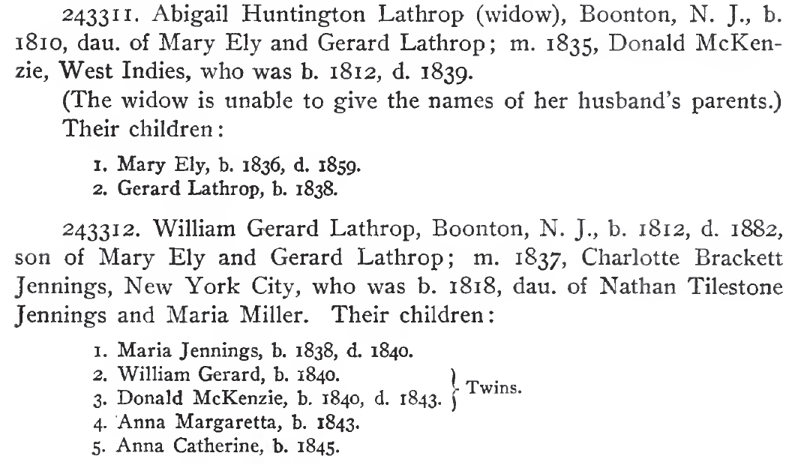
Extraction Ontologies
Conceptual model
Instance recognizers

Slide 12
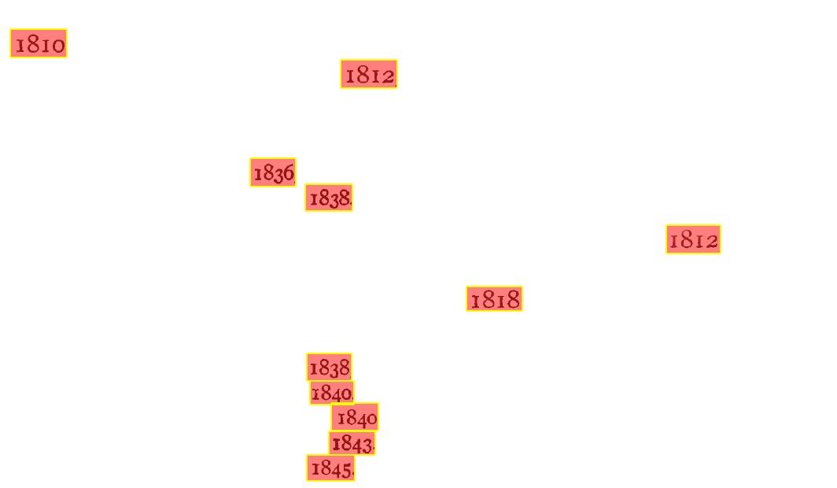
Lexical Object-Set Recognizers
BirthDate
Value expression: \b(\d\d\d\d)\b
Left context expression: b[.,]?\s*
Right context expression: [.,]
…

Slide 13
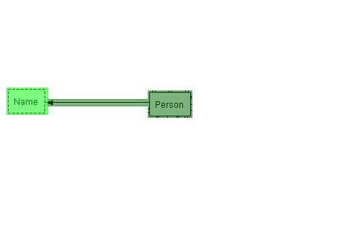
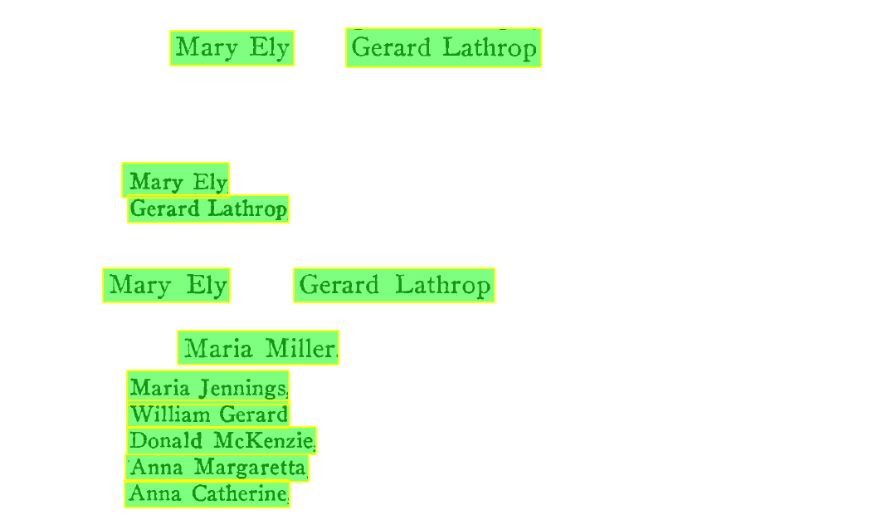
Non-lexical Object-Set Recognizers
Person
Object Existence Rule expression: {Name}
…
Name
Value expression: \b{FirstName}\s{LastName}\b
…

Slide 14
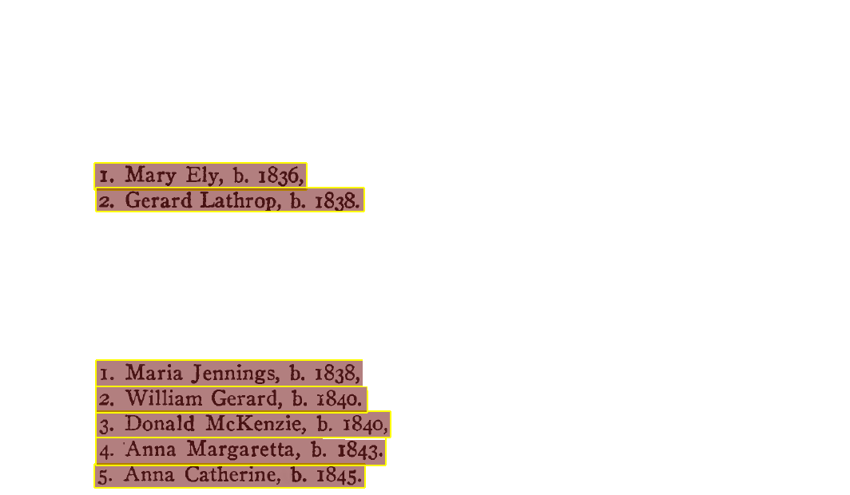
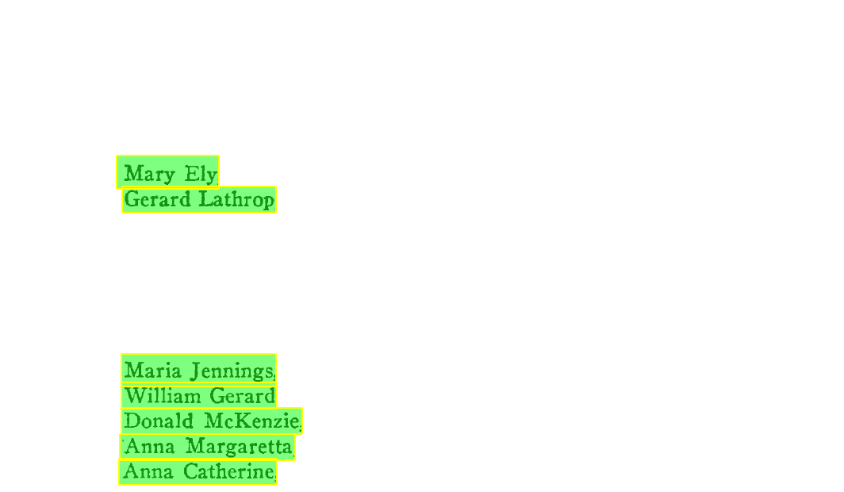
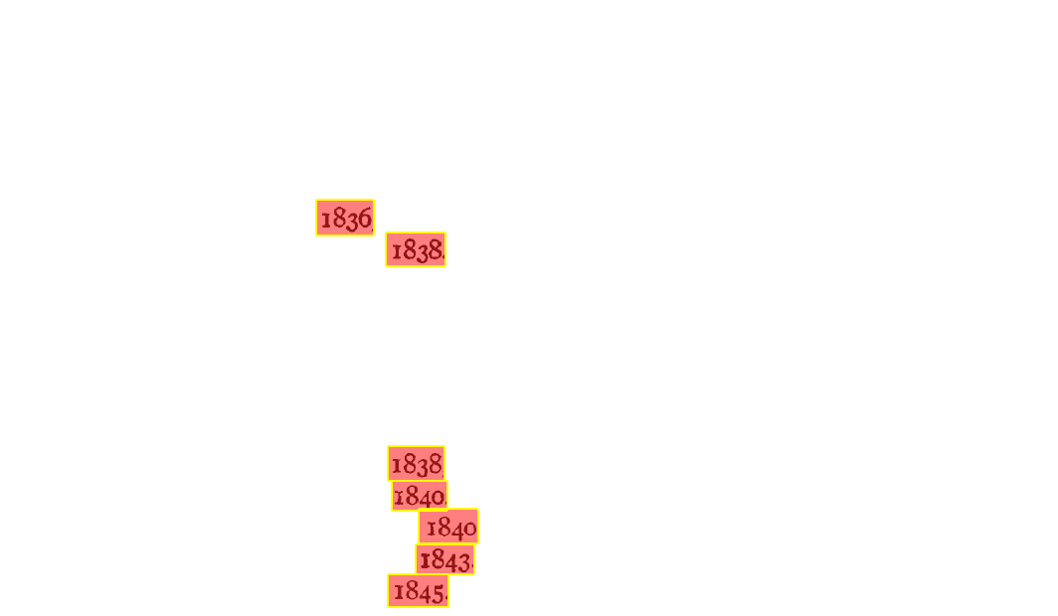
Relationship-set Recognizers
Person-BirthDate
RelPhrase expression: ^\d{1,3}\.\s{Person},\sb\.\s{BirthDate}[.,]
…

Slide 15
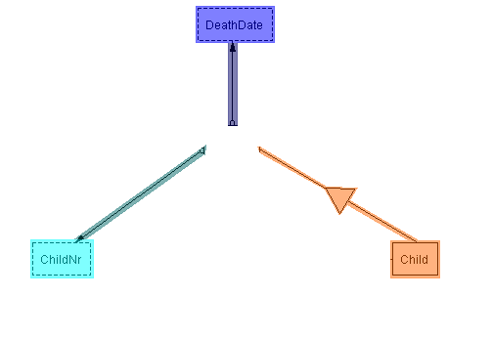
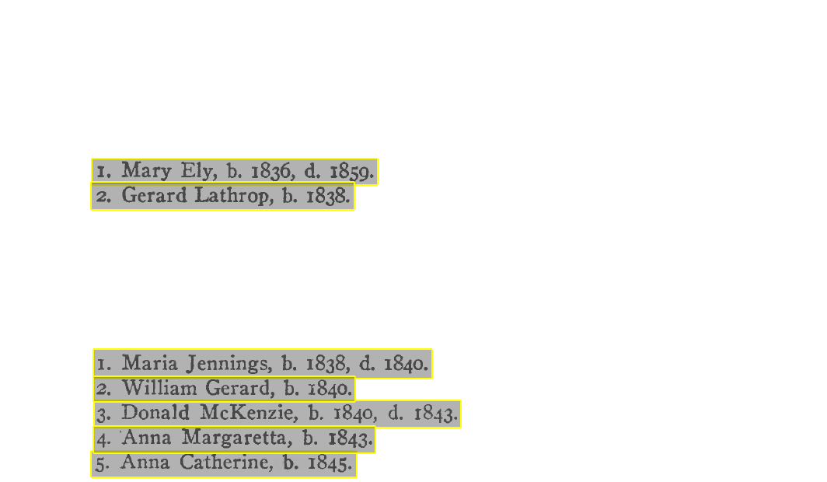
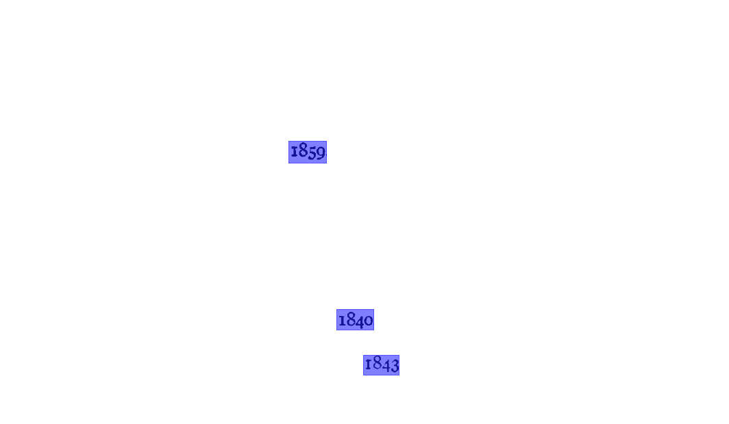
Ontology-snippet Recognizers
ChildRecord
Ontology Snippet expression: ^(\d{1,3})\.\s+([A-Z]\w+\s[A-Z]\w+)
(,\sb\.\s([1][6-9]\d\d))?(,\sd\.\s([1][6-9]\d\d))?\.

Slide 16
FROntIER
<owl:Thing rdf:ID="Person_1"/>
<owl:Thing rdf:about="#Person_1">
<rdf:type rdf:resource="&family;Person"/>
<rdf:type rdf:resource="&family;Child"/>
<rdf:type rdf:resource="&family;Spouse"/>
</owl:Thing>
<owl:Thing rdf:ID="Name_1"/>
<owl:Thing rdf:about="#Name_1">
<rdf:type rdf:resource="&family;Name"/>
</owl:Thing>
<owl:Thing rdf:ID="GivenName_1"/>
<owl:Thing rdf:about="#GivenName_1">
<rdf:type rdf:resource="&family;GivenName"/>
</owl:Thing>
<rdf:Description rdf:about="#GivenName_1">
<family:GivenNameValue rdf:datatype="&xsd;string">Abigail</family:GivenNameValue>
</rdf:Description>
<owl:Thing rdf:ID="GivenName_2"/>
<owl:Thing rdf:about="#GivenName_2">
<rdf:type rdf:resource="&family;GivenName"/>
</owl:Thing>
<rdf:Description rdf:about="#GivenName_2">
<family:GivenNameValue rdf:datatype="&xsd;string">Huntington</family:GivenNameValue>
</rdf:Description>
<owl:Thing rdf:ID="Surname_1"/>
<owl:Thing rdf:about="#Surname_1">
<rdf:type rdf:resource="&family;Surname"/>
</owl:Thing>
<rdf:Description rdf:about="#Surname_1">
<family:SurnameValue rdf:datatype="&xsd;string">Lathrop</family:SurnameValue>
</rdf:Description>
<owl:Thing rdf:ID="BirthDate_1"/>
<owl:Thing rdf:about="#BirthDate_1">
<rdf:type rdf:resource="&family;BirthDate"/>
</owl:Thing>
<rdf:Description rdf:about="#BirthDate_1">
<family:BirthDateValue rdf:datatype="&xsd;date">1810-00-00</family:BirthDateValue>
</rdf:Description>
<owl:Thing rdf:ID="MarriageDate_1"/>
<owl:Thing rdf:about="#MarriageDate_1">
<rdf:type rdf:resource="&family;MarriageDate"/>
</owl:Thing>
<rdf:Description rdf:about="#MarriageDate_1">
<family:MarriageDateValue rdf:datatype="&xsd;date">1835-00-00</family:MarriageDateValue>
</rdf:Description>
<owl:Thing rdf:ID="Gender_1"/>
<owl:Thing rdf:about="#Gender_1">
<rdf:type rdf:resource="&family;Gender"/>
</owl:Thing>
<rdf:Description rdf:about="#Gender_1">
<family:GenderValue rdf:datatype="&xsd;string">Female</family:GenderValue>
</rdf:Description>
<rdf:Description rdf:about="#Person_1">
<family:Person-BirthDate rdf:resource="#BirthDate_1"/>
<family:Person-Name rdf:resource="#Name_1"/>
<family:Person-Gender rdf:resource="#Gender_1"/>
<family:Person-Child rdf:resource="#Person_5"/>
<family:Person-Child rdf:resource="#Person_6"/>
</rdf:Description>
<rdf:Description rdf:about="#Name_1">
<family:Name-GivenName rdf:resource="#GivenName_1"/>
<family:Name-GivenName rdf:resource="#GivenName_2"/>
<family:Name-Surname rdf:resource="#Surname_1"/>
</rdf:Description>
<owl:Thing rdf:ID="PersonMarriageDateMarriagePlaceSpouse_1"/>
<rdf:Description rdf:about="#PersonMarriageDateMarriagePlaceSpouse_1">
<family:PersonMarriageDateMarriagePlaceSpouse-Person rdf:resource="#Person_1"/>
<family:PersonMarriageDateMarriagePlaceSpouse-Spouse rdf:resource="#Person_4"/>
<family:PersonMarriageDateMarriagePlaceSpouse-MarriageDate rdf:resource="#MarriageDate_1"/>
</rdf:Description>
RDF output
convert to RDF
Jena reasoner
parameters
comparators
OntoES
convert to csv
owl:sameAs
Duke
[(?x rdf:type source:Person) -> (?x rdf:type target:Person)]
[(?x source:Person-Name ?n),(?n source: NameValue ?nv),
isMale(?nv),makeTemp(?gender)
-> (?x target:Person-Gender ?gender),(?gender rdf:type target:Gender),
(?gender target:GenderValue `Male'^^xsd:string)]

Slide 17
Schema Mapping
our view
author’s view

Slide 18
Direct Transfer
[(?x rdf:type source:Person) -> (?x rdf:type target:Person)]
Person₈
Person₈

Slide 19
Transfer and Infer Names
[(?p t:Person-Child ?c), (?p s:Person-Name ?n), (?n s:NameValue ?nv), (?p t:Person-Gender ?g), (?g t:GenderValue 'Male'), (?c rdf:type s:Child), (?c s:Person-Name ?cn),
(?cn s:NameValue ?cnv), noValue(?c rdf:type s:Son), noValue(?c rdf:type s:Daughter),
getsurname(?nv, '^(([A-Z][A-Za-z]+)[- ]*)+', ?x), strConcat(?cnv, ' ', ?x, ?nx)
-> (?cn rdf:type t:Name), (?cn t:NameValue ?nx), remove(7)]
Name₈
Person₈
Name₈
Person₈
William
Gerard
William
Gerard
Lathrop
Person₃₅
Gerard Lathrop
19

Slide 20
Infer Inverse Marriage Relationships
[(?x s:PersonSpouseMarriageDate-MarriageDate ?md), (?x s:PersonSpouseMarriageDate-Person ?p),
(?x s:PersonSpouseMarriageDate-Spouse ?q), notEqual(?p, ?q), makeSkolem(?mr, ?p, ?q, ?md)
-> (?mr rdf:type t:PersonSpouseMarriageDate), (?mr t:PersonSpouseMarriageDate-Person ?q),
(?mr t:PersonSpouseMarriageDate-Spouse ?p), (?mr t:PersonSpouseMarriageDate-MarriageDate ?md)]
1837
Name₂₄
Person₂₄
Person₁₈
Name₁₈
Person₁₈
William
Gerard
Lathrop
1837
Charlotte
Brackett
Jennings
Charlotte
Brackett
Jennings
Person₂₄
William Gerard Lathrop

Slide 21
Infer Gender
[(?x rdf:type source:Son), makeSkolem(?gender, ?x)
-> (?x target:Person-Gender ?gender), (?gender rdf:type target:Gender),
(?gender target:GenderValue 'Male'^^xsd:string)]
Name₇
Person₈
Name₇
Person₈
Male
William
Gerard
Lathrop
William
Gerard
Lathrop
Person₈

Slide 22
FROntIER
<owl:Thing rdf:ID="Person_1"/>
<owl:Thing rdf:about="#Person_1">
<rdf:type rdf:resource="&family;Person"/>
<rdf:type rdf:resource="&family;Child"/>
<rdf:type rdf:resource="&family;Spouse"/>
</owl:Thing>
<owl:Thing rdf:ID="Name_1"/>
<owl:Thing rdf:about="#Name_1">
<rdf:type rdf:resource="&family;Name"/>
</owl:Thing>
<owl:Thing rdf:ID="GivenName_1"/>
<owl:Thing rdf:about="#GivenName_1">
<rdf:type rdf:resource="&family;GivenName"/>
</owl:Thing>
<rdf:Description rdf:about="#GivenName_1">
<family:GivenNameValue rdf:datatype="&xsd;string">Abigail</family:GivenNameValue>
</rdf:Description>
<owl:Thing rdf:ID="GivenName_2"/>
<owl:Thing rdf:about="#GivenName_2">
<rdf:type rdf:resource="&family;GivenName"/>
</owl:Thing>
<rdf:Description rdf:about="#GivenName_2">
<family:GivenNameValue rdf:datatype="&xsd;string">Huntington</family:GivenNameValue>
</rdf:Description>
<owl:Thing rdf:ID="Surname_1"/>
<owl:Thing rdf:about="#Surname_1">
<rdf:type rdf:resource="&family;Surname"/>
</owl:Thing>
<rdf:Description rdf:about="#Surname_1">
<family:SurnameValue rdf:datatype="&xsd;string">Lathrop</family:SurnameValue>
</rdf:Description>
<owl:Thing rdf:ID="BirthDate_1"/>
<owl:Thing rdf:about="#BirthDate_1">
<rdf:type rdf:resource="&family;BirthDate"/>
</owl:Thing>
<rdf:Description rdf:about="#BirthDate_1">
<family:BirthDateValue rdf:datatype="&xsd;date">1810-00-00</family:BirthDateValue>
</rdf:Description>
<owl:Thing rdf:ID="MarriageDate_1"/>
<owl:Thing rdf:about="#MarriageDate_1">
<rdf:type rdf:resource="&family;MarriageDate"/>
</owl:Thing>
<rdf:Description rdf:about="#MarriageDate_1">
<family:MarriageDateValue rdf:datatype="&xsd;date">1835-00-00</family:MarriageDateValue>
</rdf:Description>
<owl:Thing rdf:ID="Gender_1"/>
<owl:Thing rdf:about="#Gender_1">
<rdf:type rdf:resource="&family;Gender"/>
</owl:Thing>
<rdf:Description rdf:about="#Gender_1">
<family:GenderValue rdf:datatype="&xsd;string">Female</family:GenderValue>
</rdf:Description>
<rdf:Description rdf:about="#Person_1">
<family:Person-BirthDate rdf:resource="#BirthDate_1"/>
<family:Person-Name rdf:resource="#Name_1"/>
<family:Person-Gender rdf:resource="#Gender_1"/>
<family:Person-Child rdf:resource="#Person_5"/>
<family:Person-Child rdf:resource="#Person_6"/>
</rdf:Description>
<rdf:Description rdf:about="#Name_1">
<family:Name-GivenName rdf:resource="#GivenName_1"/>
<family:Name-GivenName rdf:resource="#GivenName_2"/>
<family:Name-Surname rdf:resource="#Surname_1"/>
</rdf:Description>
<owl:Thing rdf:ID="PersonMarriageDateMarriagePlaceSpouse_1"/>
<rdf:Description rdf:about="#PersonMarriageDateMarriagePlaceSpouse_1">
<family:PersonMarriageDateMarriagePlaceSpouse-Person rdf:resource="#Person_1"/>
<family:PersonMarriageDateMarriagePlaceSpouse-Spouse rdf:resource="#Person_4"/>
<family:PersonMarriageDateMarriagePlaceSpouse-MarriageDate rdf:resource="#MarriageDate_1"/>
</rdf:Description>
RDF output
convert to RDF
Jena reasoner
parameters
comparators
OntoES
convert to csv
owl:sameAs
Duke
[(?x rdf:type source:Person) -> (?x rdf:type target:Person)]
[(?x source:Person-Name ?n),(?n source: NameValue ?nv),
isMale(?nv),makeTemp(?gender)
-> (?x target:Person-Gender ?gender),(?gender rdf:type target:Gender),
(?gender target:GenderValue `Male'^^xsd:string)]

Slide 23
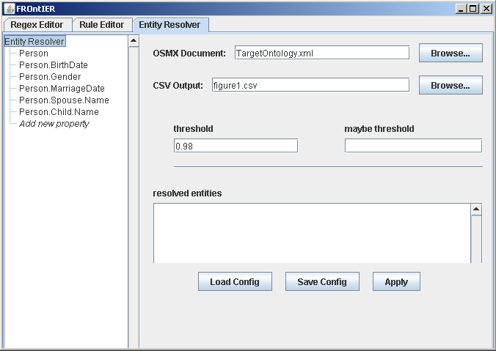
Setting Up Duke Config

Slide 24
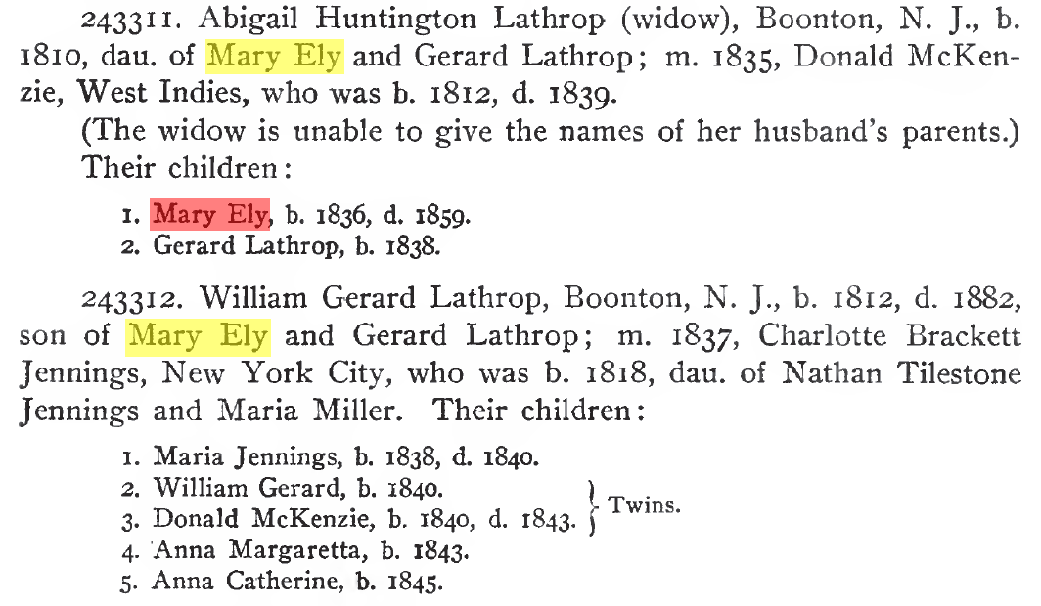
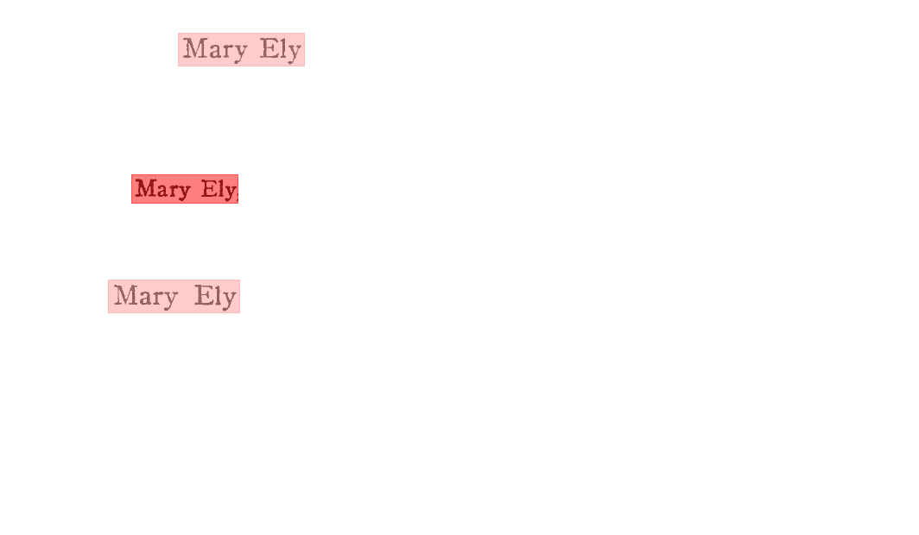
Resolving Mary Elys Example
Mary Ely (osmx226) owl:sameAs
Mary Ely (osmx75)
0.56
0.82
0.56

Slide 25
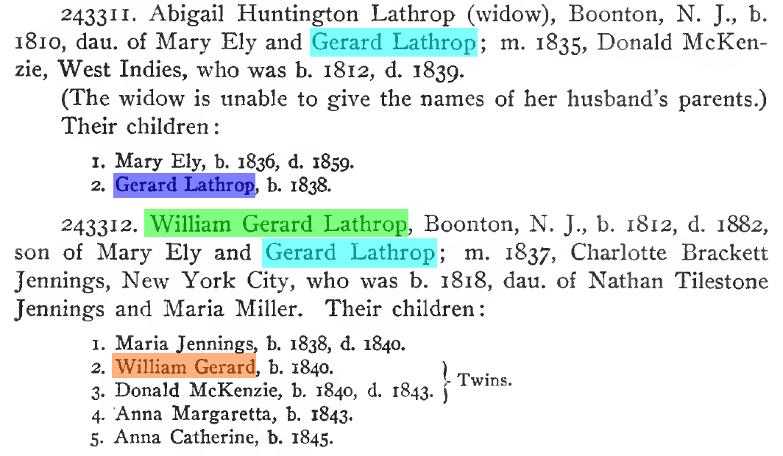
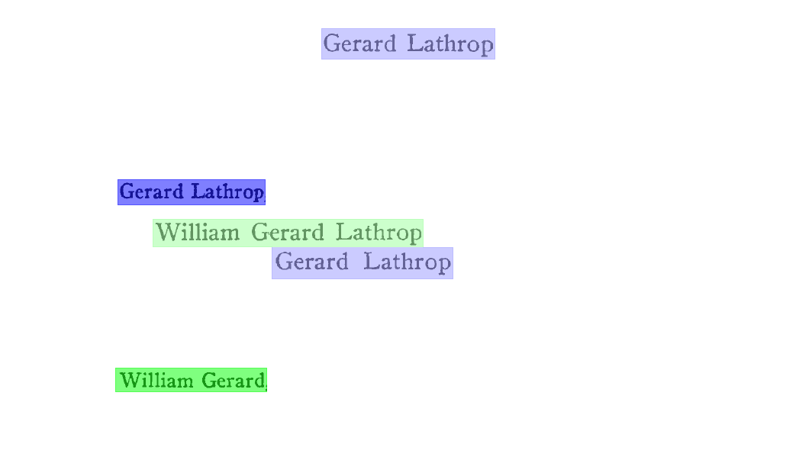
Resolving Gerard Lathrop Example
Gerard Lathrop (osmx85) owl:sameAs
Gerard Lathrop (osmx272)
~0.0
0.02
0.56
0.82
0.03
0.56
~0.0
0.56
~0.0
0.70

Slide 26
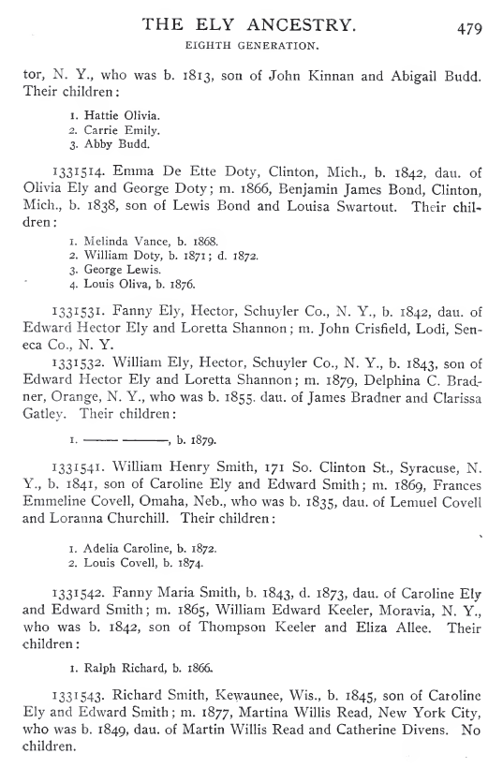
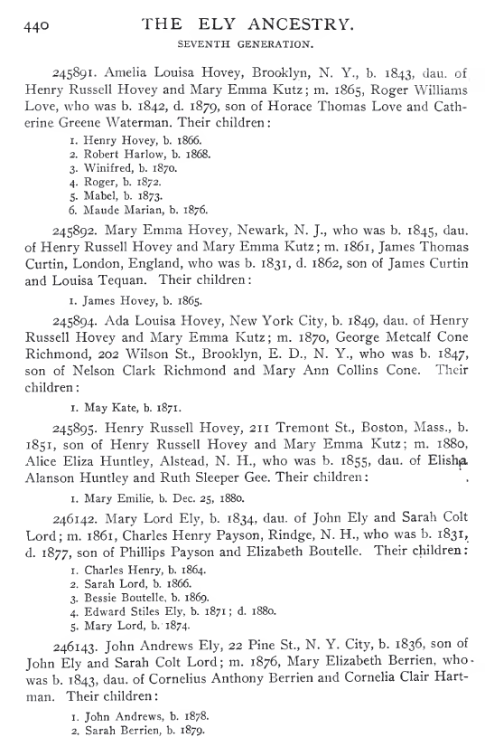
Case Studies
The Ely Ancestry

Slide 27
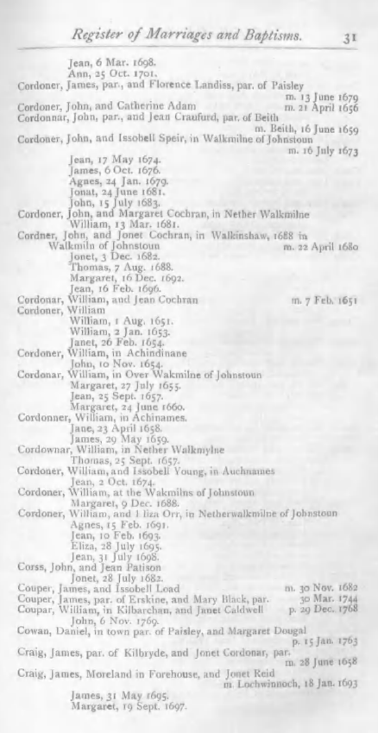
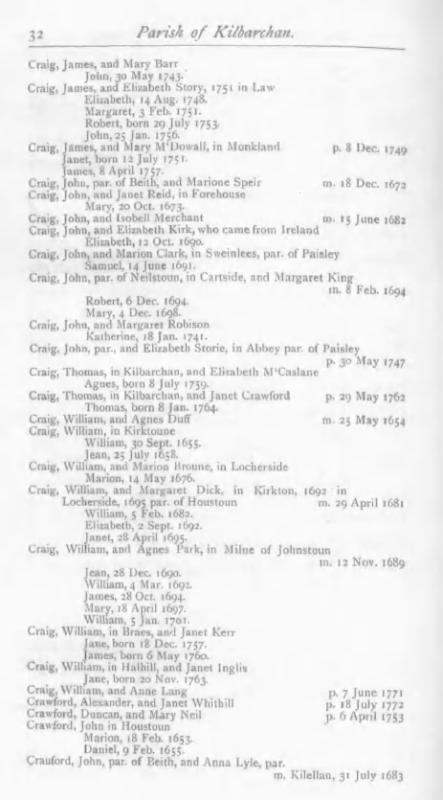
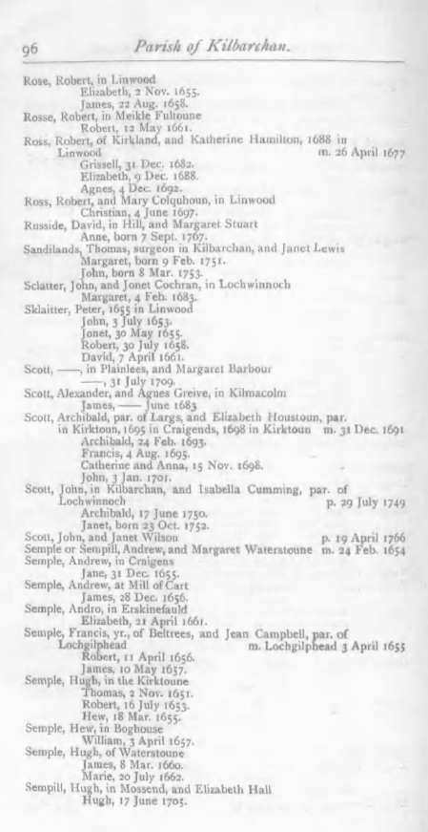
Case Studies
Kilbarchan Parish Record

Slide 28
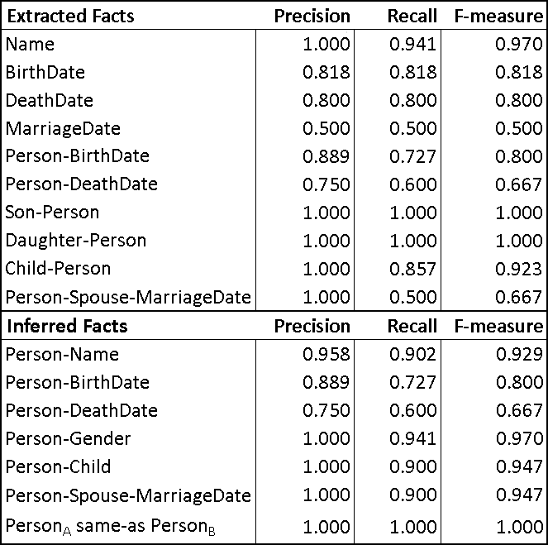
Evaluation of Excerpt from Ely Ancestry page 419

Slide 29
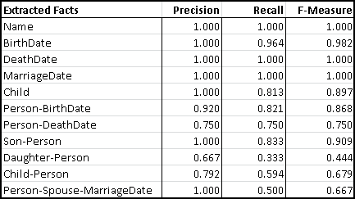
Evaluation of Ely Ancestry page 440

Slide 30
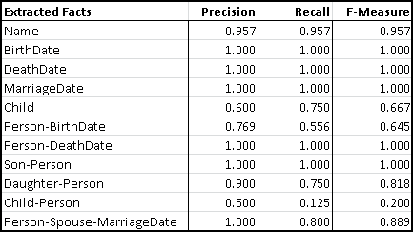
Evaluation of Ely Ancestry page 479

Slide 31
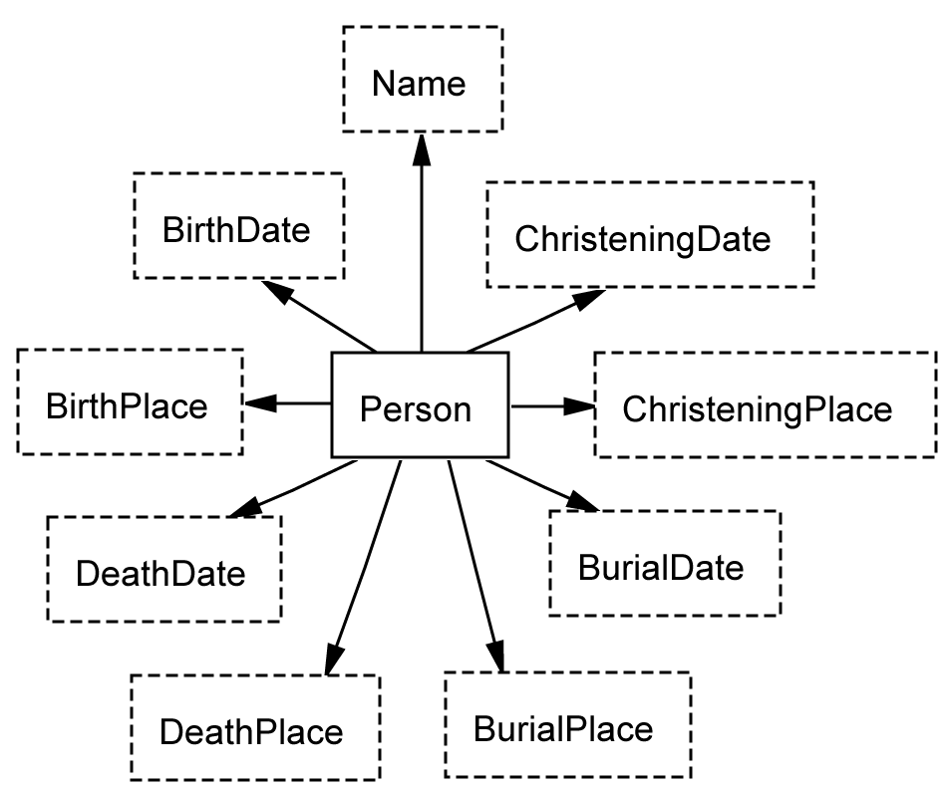
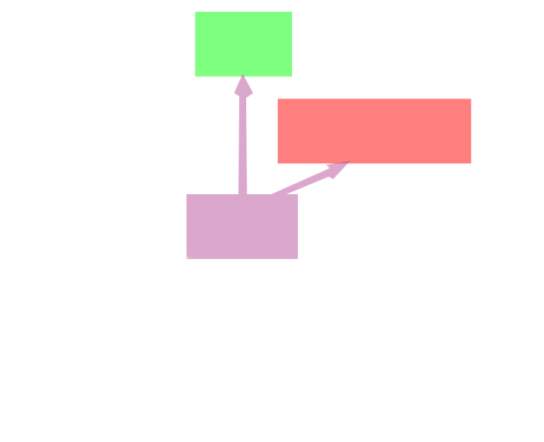
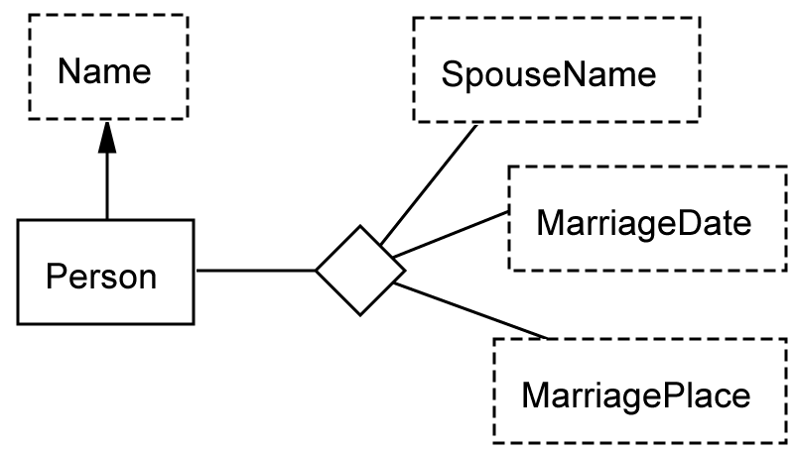
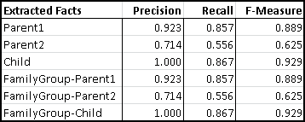
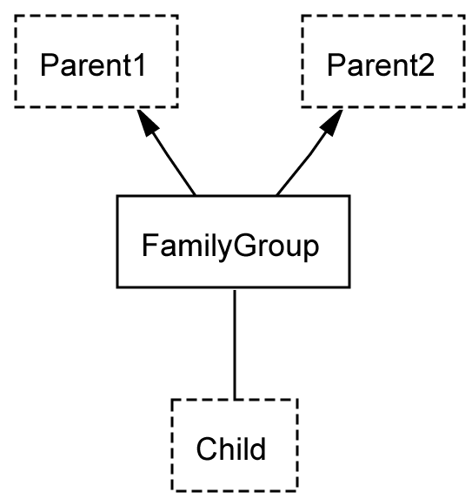
Evaluation of Kilbarchan Parish Record page 31

Slide 32
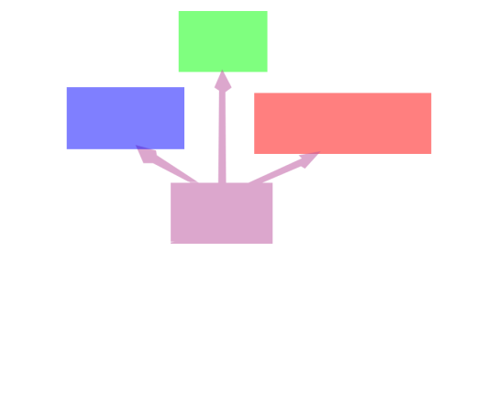
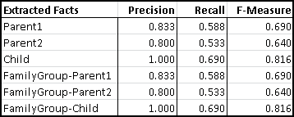
Evaluation of Kilbarchan Parish Record page 32

Slide 33
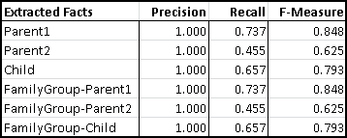
Evaluation of Kilbarchan Parish Record page 96

Slide 34
Conclusions
Recognizers
non-lexical object sets
relationship sets
ontology snippets
Inference
Object Identity Resolution
Evaluation of Case Studies
high extraction precision
need to improve recall

Slide 35
Duke Probabilities
Naïve Bayes algorithm
compare(String v1, String v2) { double sim = comparator.compare(v1, v2); if (sim >= 0.5) return ((high - 0.5) * (sim * sim)) + 0.5; else return low; }
computeBayes(double prob1, double prob2) { return (prob1 * prob2) / ((prob1 * prob2) + ((1.0 - prob1) * (1.0 - prob2))); }
https://code.google.com/p/duke/wiki/HowItWorks

