Slide 1
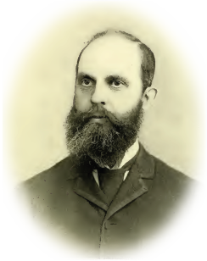
Toward Automatically Extracting Facts about People in OCRed Historical Documents
Joseph Park Brigham Young University
jspark2012@gmail.com

Slide 2
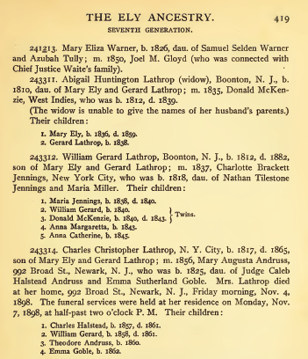
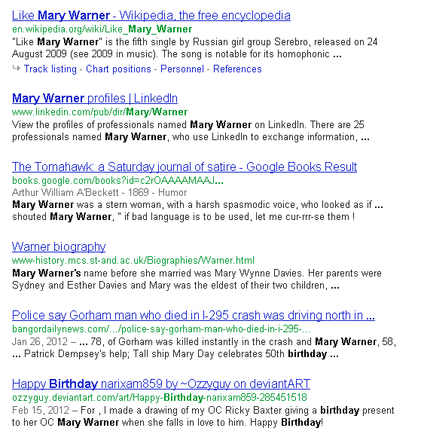
Motivation

Slide 3
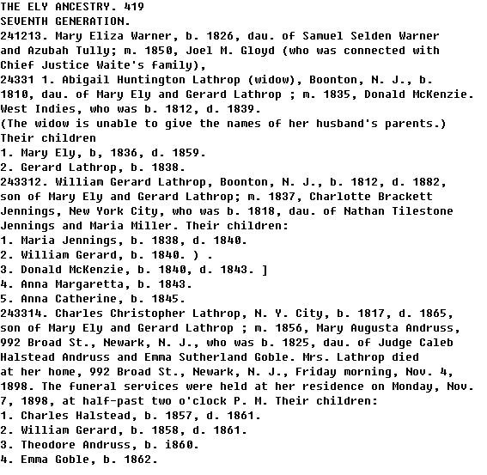
Motivation

Slide 4
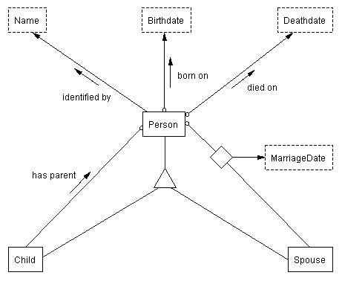
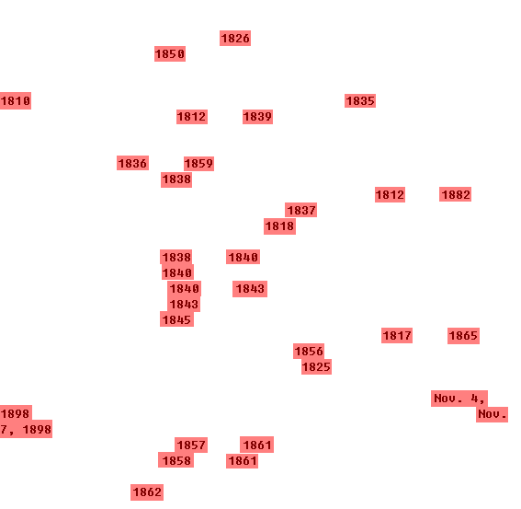
OntoES
\b([1][6-9]\d\d)\b
\b{Month}\.?\s*(1\d|2\d|30|31|\d)[.,]?\s*(\d\d\d\d)\b
Date
Notes:
*refer to semantic index

Slide 5
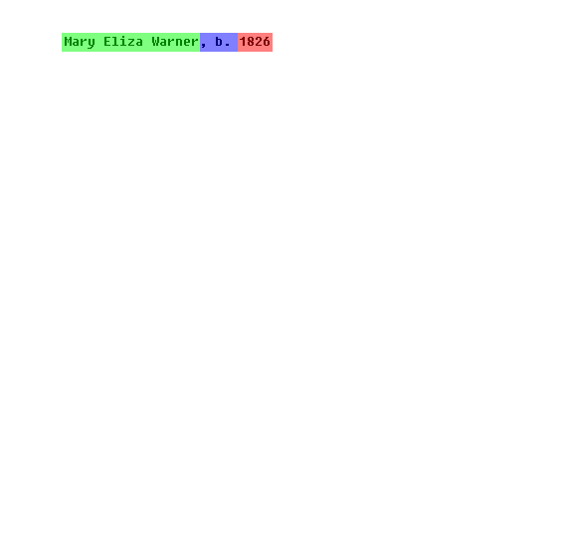
Relationship Recognition
{Person}[.,]?.{0,50}\s*b[.,]?\s*{Birthdate}
Person-born on-Birthdate

Slide 6
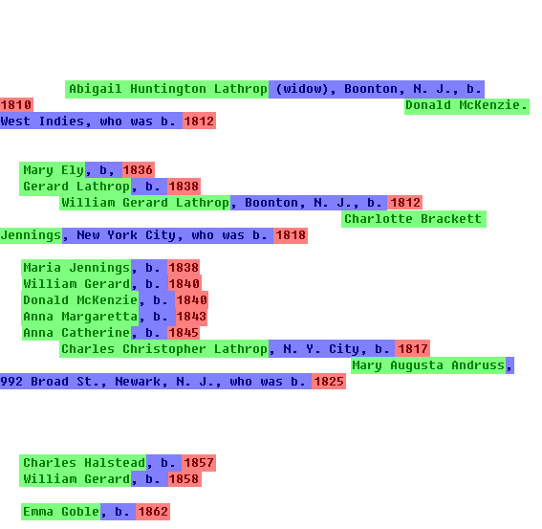
Relationship Recognition
{Person}[.,]?.{0,50}\s*b[.,]?\s*{Birthdate}
Person-born on-Birthdate

Slide 7
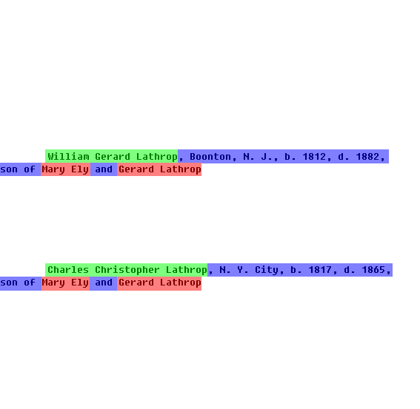
Recursive Relationships
{Child}[.,]?.{0,50}\s*[sS]on\s+of\s*.*?\s*{Person}
{Child}[.,]?.{0,50}\s*[sS]on\s+of.{0,40}and\s+.*?\s*{Person}
Child-has parent-Person

Slide 8
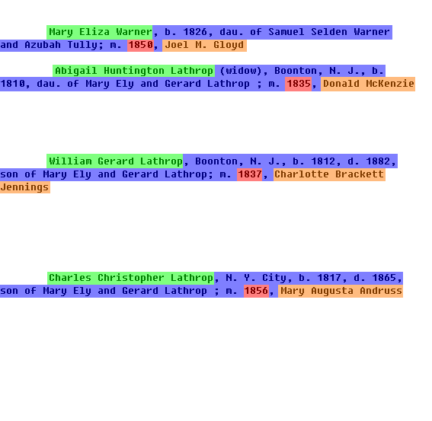
N-ary Relationships
{Person}[.,]?.{0,50};\s*m[.,]\s*{MarriageDate}[,]?\s*{Spouse}
{Person}[.,]?.{0,50}\s*(son|dau)[.,]?\s+of\s*.{0,50};\s*m[.,]\s*
{MarriageDate}[,]?\s*{Spouse}
Person-MarriageDate-Spouse

Slide 9
Query Interpretation
When is the birthday of “Mary Warner”?
PREFIX rdf:<http://www.w3.org/1999/02/22-rdf-syntax-ns#>
PREFIX family:<http://dithers.cs.byu.edu/owl/ontologies/family#>
SELECT ?NameValue ?Person ?BirthdateValue
WHERE
{
?Person familyMarriage:Person-Name ?Name .
?Person familyMarriage:Person-Birthdate ?Birthdate .
FILTER (regex( str(?Name), "Mary Warner", "i")) .
}
Notes:
*Say a few comments about SPARQL and RDF; include an example of a SPARQL query using the above query

Slide 10
Ely Ancestry Facts
Number of facts extracted: 178,713
154,761 Person-Name facts
8,740 Person-Birthdate facts
3,803 Person-Deathdate facts
12,491 Child-has-parent-Person facts
1,080 Person-Spouse-MarriageDate facts
Processing time:
~54 seconds per page
CPU time: ~12 hours
Processing in parallel: ~15 minutes
Notes:
*say a few words about query processing time that we’ve done

Slide 11
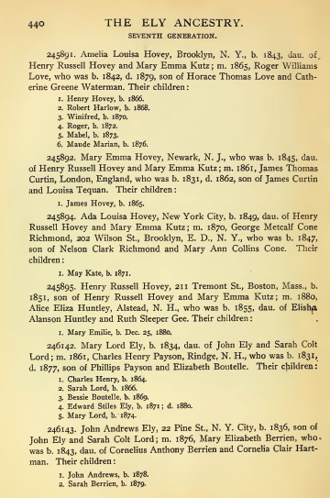
Ely Ancestry page 440
 | Precision | Recall
Person-Name | 0.80 | 0.94
Person-Birthdate | 0.92 | 0.86
Person-Deathdate | 0.75 | 0.75
Child-has-parent-Person | 0.69 | 0.58
Person-Spouse-MarriageDate | 0.75 | 0.50
Overall | 0.78 | 0.73
<^au.
OCR errors
d^^^- of
Elishja
Alanson Huntley

Slide 12
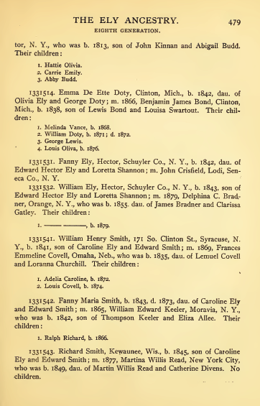
Ely Ancestry page 479
 | Precision | Recall
Person-Name | 0.68 | 0.87
Person-Birthdate | 0.64 | 0.50
Person-Deathdate | 1.00 | 1.00
Child-has-parent-Person | 0.49 | 0.46
Person-Spouse-MarriageDate | 0.40 | 0.40
Overall | 0.64 | 0.65
I. , b. 1879.
OCR errors
I. Ralph Richard, b. 1866.
Martina WilHs Read

Slide 13
Conclusion
Works as a proof-of-concept
Sensitive to OCR errors
Future Work:
Improve recognizers
Tolerate OCR errors
Identify inferred relationships
Notes:
*explain recognizing patterns rather than using dictionaries for OCR error toleration

