Slide 1
KBB: A Knowledge-Bundle Builder for Research Studies
David W. Embley, Stephen W. Liddle,
Deryle W. Lonsdale, Aaron Stewart, and Cui Tao*
Brigham Young University, Provo, Utah, USA
*Mayo Clinic, Rochester, Minnesota, USA
Sponsored in part by NSF

Slide 2
Knowledge Bundles for Research Studies
Problem: locate, gather, organize data
Solution: semi-automatically create KBs with KBBs
KBs
Conceptualized data + reasoning and provenance links
Linguistically grounded & thus extraction ontologies
KBBs
KB Builder tool set
Actively “learns” to build KBs
ACM-L
Notes:
What’s my take-home message? “KBs and KBBs can play a significant role in assisting researchers locate, gather, and organize information for research studies.” As an example, this may well be the essence of what ACM-L means: conceptual modeling (CM) is the foundation for KBs and active learning (A…-L) is the foundation for KBBs.
Emphasize here and later. (What must listeners understand to be able to take the message home?)

Slide 3
Example: Bio-Research Study
Objective: Study the association of:
TP53 polymorphism and
Lung cancer
Task: locate, gather, organize data from:
Single Nucleotide Polymorphism database
Medical journal articles
Medical-record database
Notes:
Doesn’t matter whether it is the essence of ACM-L or not – may be better to pitch it as one possible way to achieve Active Conceptual Modeling for Learning (ACM-L).

Slide 4
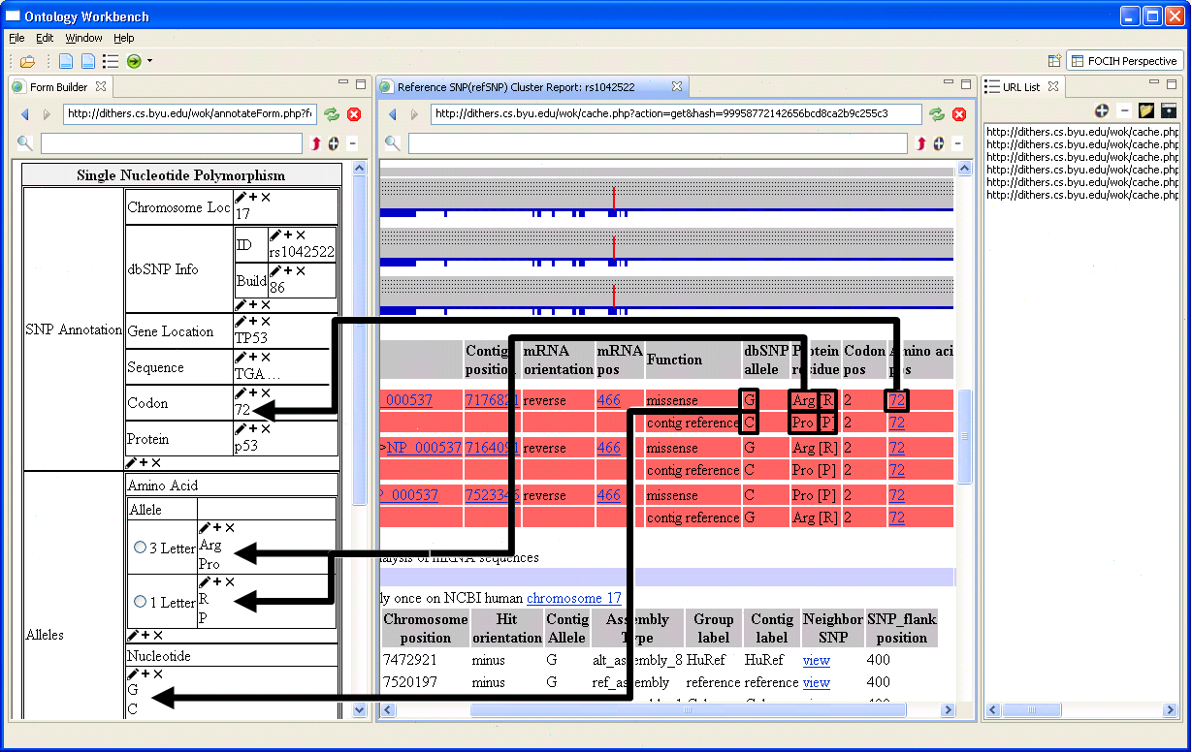
Gather SNP Information from the NCBI dbSNP Repository
SNP: Single Nucleotide Polymorphism
NCBI: National Center for Biotechnology Information
Notes:
Explain how FOCIH works. Also, how it will work when we add a filtering mechanism (e.g., minor allele frequency > 1%)

Slide 5
Search PubMed Literature
PubMed: Search-engine access to life sciences and biomedical scientific journal articles
Notes:
Works by linguistically grounding an extraction ontology. (e.g., people in the bioInformatics community may know about OpenDMAP)

Slide 6
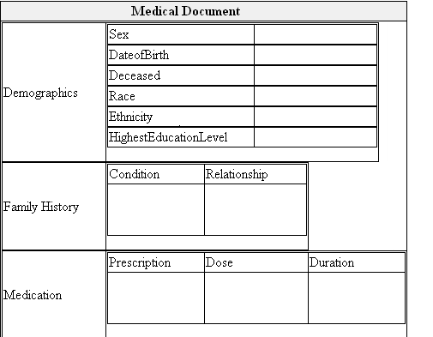
Reverse-Engineer Human Subject Information from INDIVO
INDIVO: personally controlled health record system

Slide 7
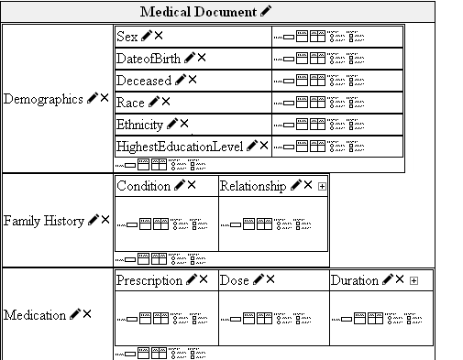
Reverse-Engineer Human Subject Information from INDIVO
INDIVO: personally controlled health record system

Slide 8
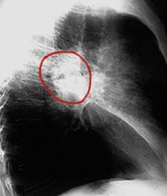
Add Annotated Images
Radiology Report
(John Doe, July 19, 12:14 pm)

Slide 9
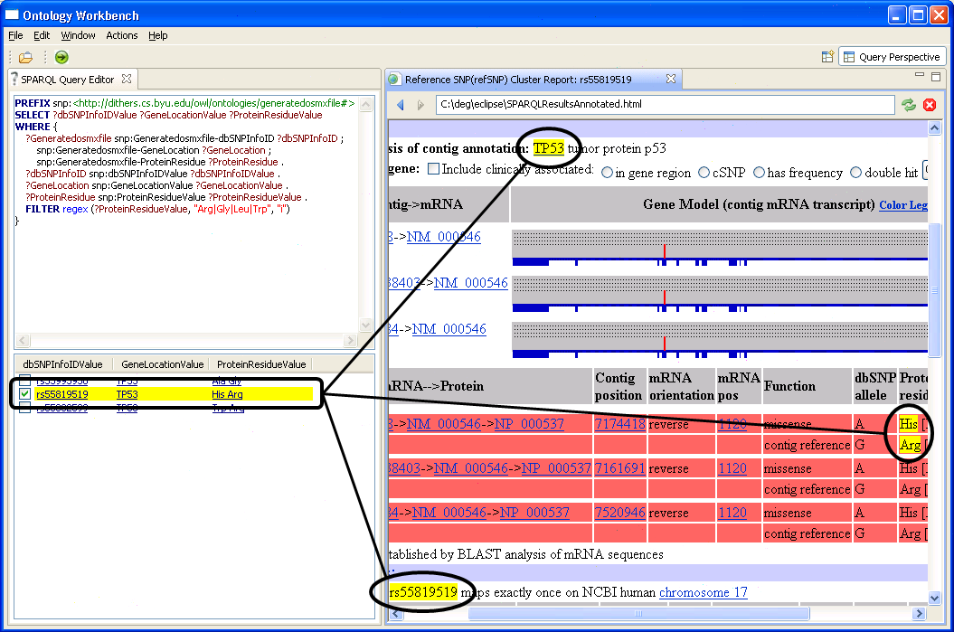
Query and Analyze Data in Knowledge Bundle (KB)

Slide 10
Many Applications
Genealogy and family history
Environmental impact studies
Business planning and decision making
Academic-accreditation studies
Purchase of large-ticket items
Web of Knowledge
Interconnected KBs superimposed over a web of pages
Yahoo’s “Web of Concepts” initiative [Kumar et al., PODS09]
Notes:
Not just bio-research studies. I’ll draw from some of these as I further explain KBs and KBBs. (Switching applications because 1. Cui is not here to explain the medical biology & 2. it’s not implemented, but most of what I will present is implemented, although not fully integrated and not fully working as well as it should for the system to be commercialized.)

Slide 11
Many Challenges
KB: How to formalize KBs & KB extraction ontologies?
KBB: How to (semi)-automatically create KBs?
Notes:
Explain formal framework and semi-automatic creation in the rest of the presentation. Tie into ACM-L.

Slide 12
KB Formalization
KB—a 7-tuple: (O, R, C, I, D, A, L)
O: Object sets—one-place predicates
R: Relationship sets—n-place predicates
C: Constraints—closed formulas
I: Interpretations—predicate calc. models for (O, R, C)
D: Deductive inference rules—open formulas
A: Annotations—links from KB to source documents
L: Linguistic groundings—data frames—to enable:
high-precision document filtering
automatic annotation
free-form query processing

Slide 13
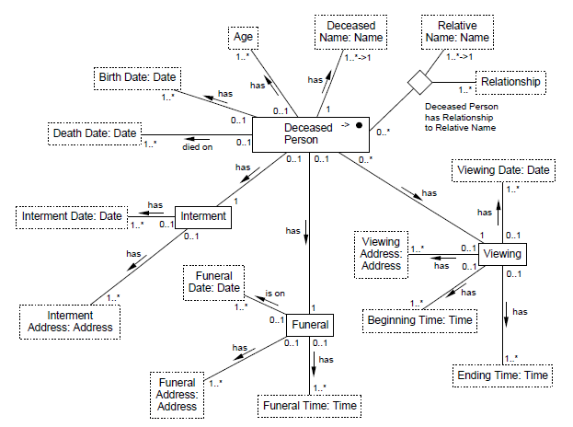
KB: (O, R, C, …)

Slide 14
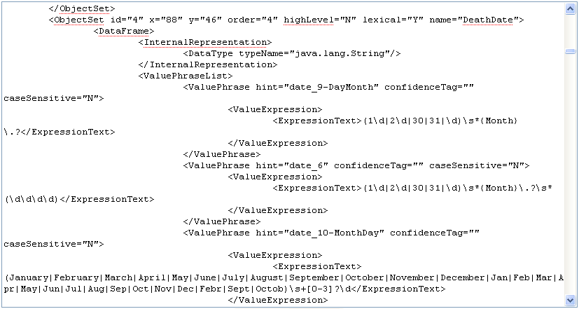
KB: (O, R, C, …, L)

Slide 15
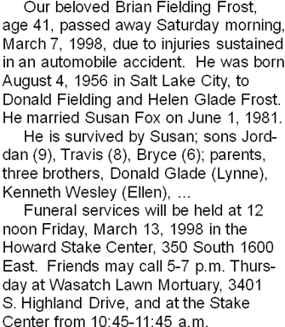
KB: (O, R, C, I, …, A, L)

Slide 16
KB: (O, R, C, I, D, A, L)
Age(x) :- ObituaryDate(y), BirthDate(z), AgeCalculator(x, y, z)
Notes:
Another reasoning possibility to point out: “Thursday”, which does not have a specific date attached to it can be reasoned about to realize that it must be March 12, 1998.

Slide 17
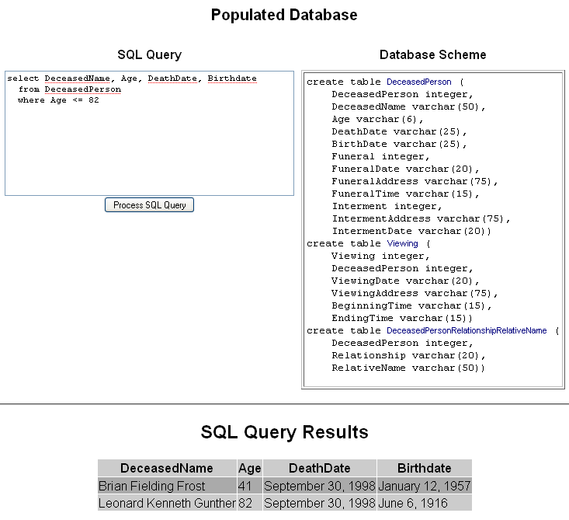
KB Query

Slide 18
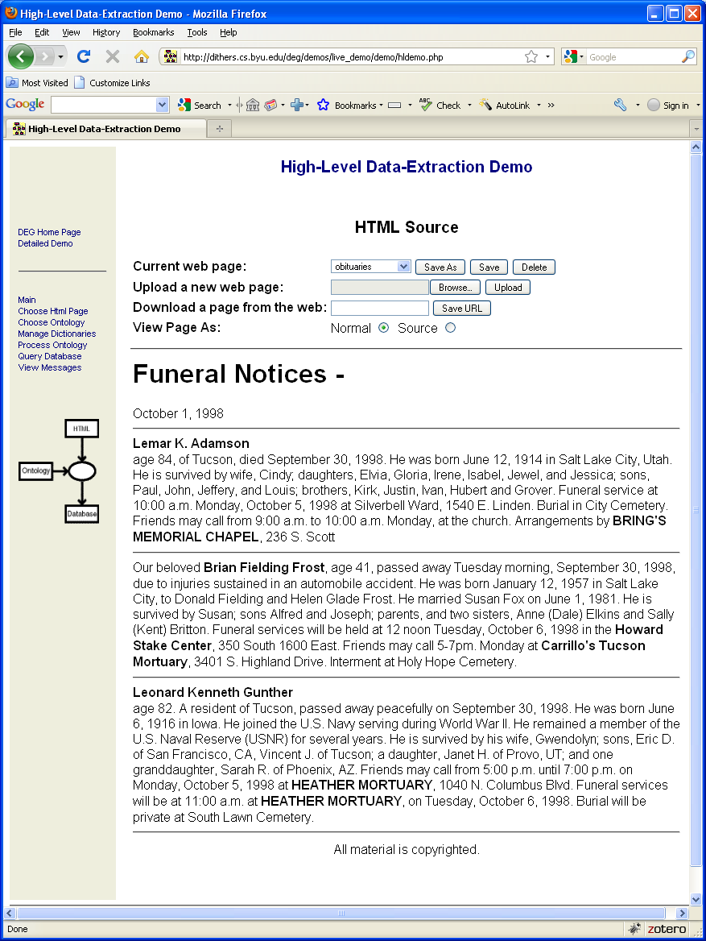
KB Query

Slide 19
KBB: (Semi)-Automatically Building KBs
OntologyEditor (manual; gives full control)
FOCIH (semi-automatic)
TANGO (semi-automatic)
TISP (fully automatic)
C-XML (fully automatic)
NER (Named-Entity Recognition research)
NRR (Named-Relationship Recognition research)

Slide 20
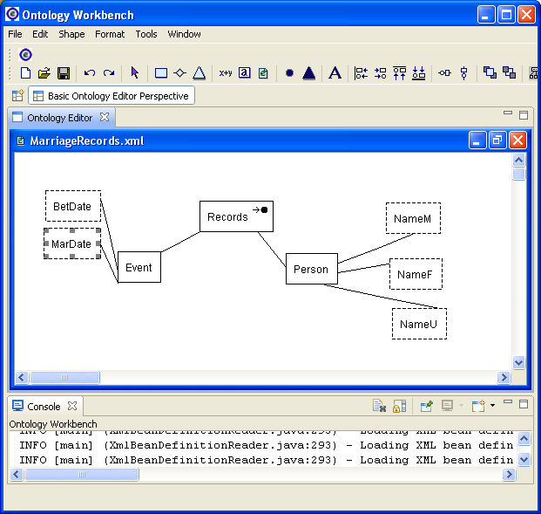
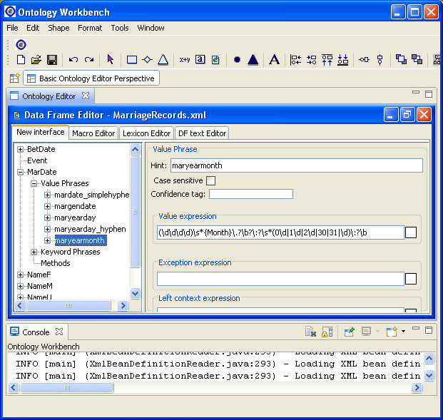
Ontology Editor

Slide 21
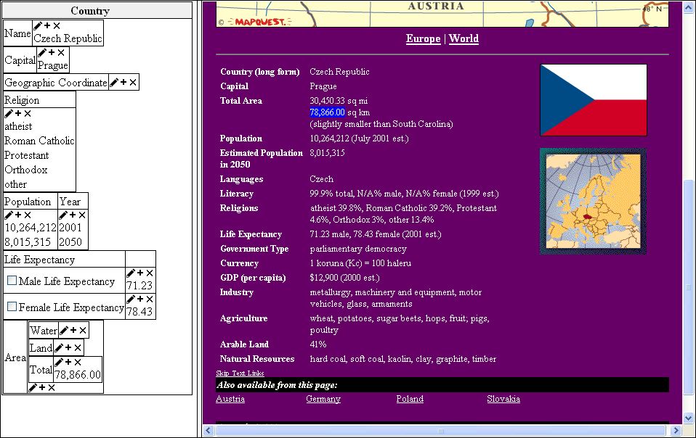
FOCIH: Form-based Ontology Creation and Information Harvesting

Slide 22
FOCIH: Form-based Ontology Creation and Information Harvesting

Slide 23
TANGO: Table ANalysis for Generating Ontologies
fleck | velter
 | gonsity (ld/gg) | hepth (gd)
burlam | 1.2 | 120
falder | 2.3 | 230
multon | 2.5 | 400
repeat:
understand table
generate mini-ontology
match with growing ontology
adjust & merge
until ontology developed
Growing
Ontology

Slide 24
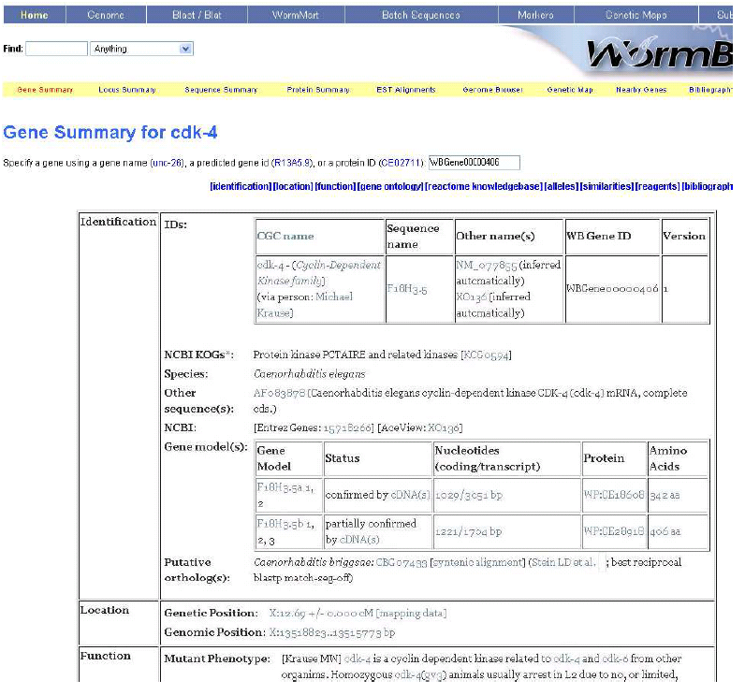
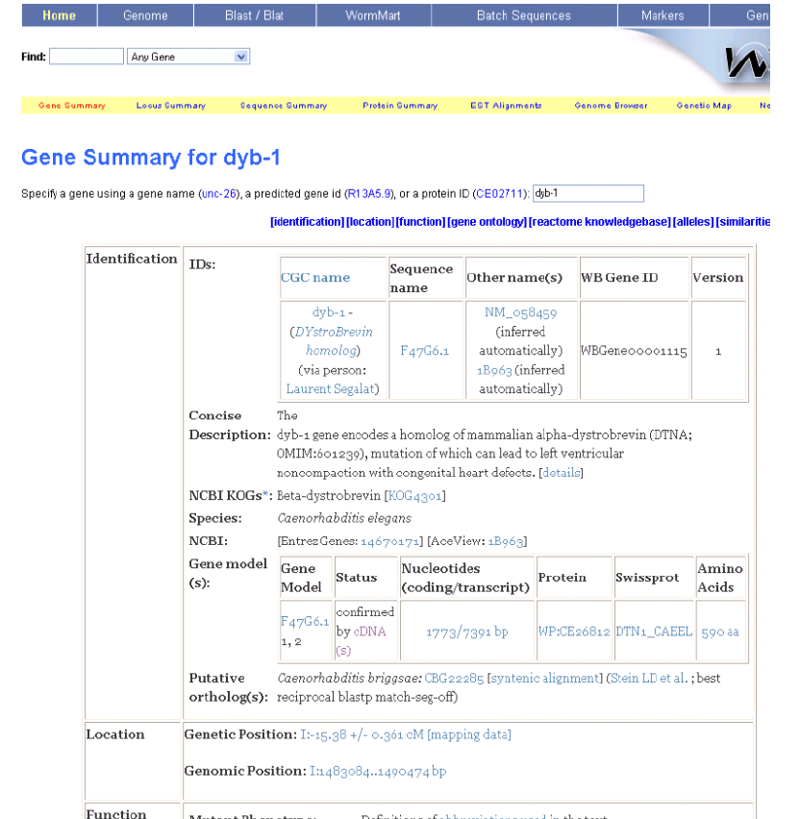
TISP: Table Interpretation by Sibling Pages
Same

Slide 25
TISP: Table Interpretation by Sibling Pages
Different
Same

Slide 26
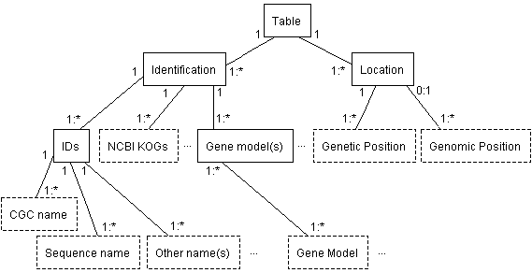
TISP: Table Interpretation by Sibling Pages

Slide 27
C-XML: Conceptual XML
XML Schema
C- XML
Notes:
In general, reverse engineering from any structured schema.

Slide 28
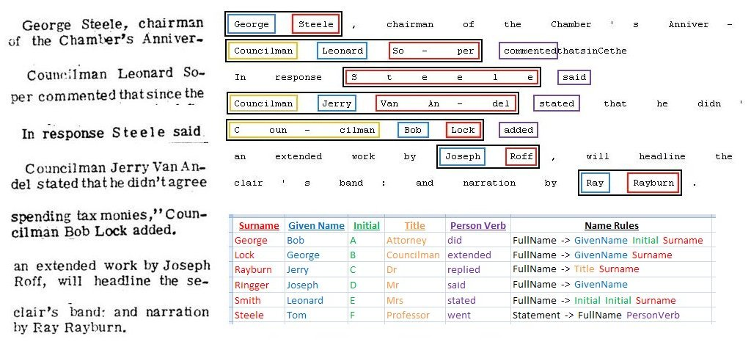
NER & NRR: Named-Entity & also Named-Relationship Recognition
Notes:
Automated extraction is critical. OpenDMAP for biology

Slide 29
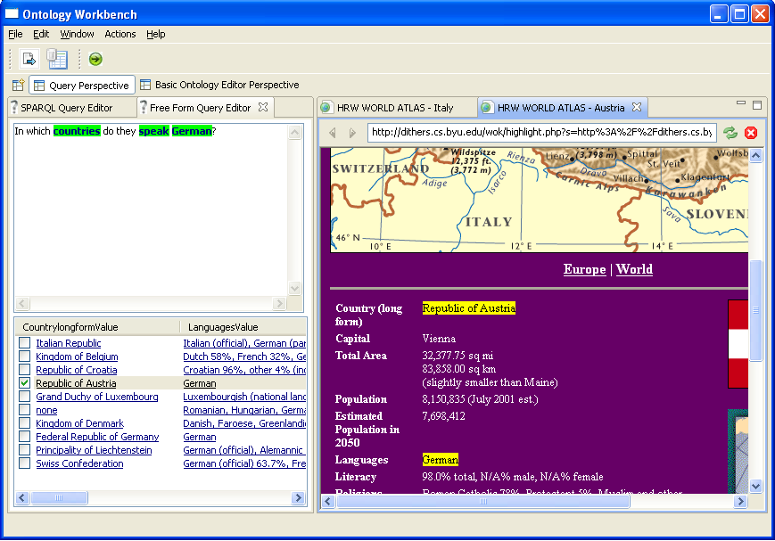
Ontology Workbench
Notes:
We are working toward KBs and KBBs …

Slide 30
Summary Vision: KBs & KBBs
Custom harvesting of information into KBs
KB creation via a KBB
Semi-automatic: shifts harvesting burden to machine
Synergistic: works without intrusive overhead
KB/KBB & ACM-L
CM-based
A..-L: actively “learns as it goes” & “improves with experience”
Challenging research issues
www.deg.byu.edu

