Slide 1
Toward Linguistically Grounded Ontologies
by
Paul Buitelaar, Philipp Cimiano, Peter Haase, and Michael Sintek
(Ireland, Netherlands, Germany)
presented by
Thomas Packer
Notes:
20 minutes in length, allowing 10 minutes of discussion. Present the main ideas and results of the paper. 35 points total.
Prepare two good questions about each other paper in advance, write them down, and print them out. Add at least one more question during the presentation. Used for class discussion. Due on the date the paper is presented, 5 points for each set of questions for a paper.
http://osm.cs.byu.edu/CS652s09/projects.html

Slide 2
Recent Research
The 6th Annual European Semantic Web Conference (ESWC2009)
31 May - 4 June 2009, Heraklion, Greece
Notes:
5 points for the overview -- introduce the work and state the goals and objectives of the authors;

Slide 3
Ontologies and Language
Are ontologies and language related?
Should an ontology contain language information?
Notes:
5 points for the overview -- introduce the work and state the goals and objectives of the authors;

Slide 4
Grounding in Natural Language is Needed
Human-readable ontologies (e.g. labels).
Ontology-based information extraction (parsing).
Ontology-based natural language generation.
Interlingua-based machine translation.
Notes:
5 points for the overview -- introduce the work and state the goals and objectives of the authors;

Slide 5
Separation between Linguistics and Semantics is Needed
There are ontological distinctions that are never lexicalized.
There are linguistic distinctions that are ontologically irrelevant.
Notes:
5 points for the overview -- introduce the work and state the goals and objectives of the authors;

Slide 6
Concept-Label Relations
RDFS/OWL specifies “n : m” relation between classes and labels.
Paradigmatic Relations:
Relations between words according to meaning.
E.g. between synonyms: “cat” and “Katze”.
Syntagmatic Relations:
Relations between words in a sentence in sequence.
E.g. between “sleeping cat”.
Notes:
5 points for the overview -- introduce the work and state the goals and objectives of the authors;

Slide 7
Syntagmatic Composition: Models of Schweineschnitzel (pork cutlet)
Tie classes to parts of words or whole words.
Make a class: Schweineschnitzel
Make a composite class:
Make only a general class: schnitzel
Make two separate classes: schnitzel, pork
Notes:
5 points for the overview -- introduce the work and state the goals and objectives of the authors;

Slide 8
Needed Linguistic Information
<rdf:Property about="#capital">
<rdfs:domain rdf:resource="#Country"/>
<rdfs:range rdf:resource="#City"/>
<rdfs:label xml:lang="en">capital</rdfs:label>
</rdf:Property>
Generate the triple: (Germany, capital, Berlin)
“Germany capitals Berlin.”
Need POS and inflectional information to do this right.
Notes:
5 points for the overview -- introduce the work and state the goals and objectives of the authors;

Slide 9
Needed Linguistic Information
<rdf:Property about="#locatedAt">
<rdfs:domain rdf:resource="#City"/>
<rdfs:range rdf:resource="#Highway"/>
<rdfs:label xml:lang="en">located at</rdfs:label>
</rdf:Property>
“The A8 passes by Karlsruhe”, “The A8 connects Karlsruhe”, “The A8 goes through Karlsruhe”.
One label can’t handle expressing or extraction all possibilities.
Wouldn’t want to label a relation with all possibilities.
Subject and object information: order matters.
Notes:
5 points for the overview -- introduce the work and state the goals and objectives of the authors;

Slide 10
Solution: LexInfo
Morphological Relations
Syntagmatic Decomposition
Complex Linguistic Patterns
Specify Meaning with Ontology
Separate Linguistics and Semantics
Notes:
15 points for the approach -- explain the basic problem and how the authors attacked and solved the problem;

Slide 11
LexInfo Pedigree
Lexical Markup Framework (LMF) (computational lexicon meta-model)
LingInfo
(Internal Structure)
LexOnto
(External Structure)
LexInfo
Notes:
15 points for the approach -- explain the basic problem and how the authors attacked and solved the problem;

Slide 12
1. Morphological Relations
Capture morphological relations between terms
e.g., through inflection
cat, cats
Schwein, Schweine, Schweins
Separate from the domain ontology
Notes:
15 points for the approach -- explain the basic problem and how the authors attacked and solved the problem;

Slide 13
2. Syntagmatic Decomposition
Represent the morphological or syntactic decomposition of composite terms
Link components to the ontology
Schweineschnitzel composed of two LexicalEntry objects: class pork and class cutlet.
Notes:
15 points for the approach -- explain the basic problem and how the authors attacked and solved the problem;

Slide 14
3. Complex Linguistic Patterns
Map linguistic patterns to arbitrary ontological structures.
Subcategorization frames for specific verbs
Intransitive verb “flow”:
Maps to “flowsThrough” predicate.
Subject maps to predicate domain.
Prepositional object maps to predicate range.
Notes:
15 points for the approach -- explain the basic problem and how the authors attacked and solved the problem;

Slide 15
4. Specify Meaning with Ontology
Specify the meaning of linguistic constructions with respect to an arbitrary (domain) ontology.
(Follows from 3.)
Notes:
15 points for the approach -- explain the basic problem and how the authors attacked and solved the problem;

Slide 16
5. Separate Linguistics and Semantics
Clearly separate the linguistic and semantic (ontological) representation levels.
(Exemplified above.)
Notes:
15 points for the approach -- explain the basic problem and how the authors attacked and solved the problem;

Slide 17
Conclusion
Good
The gap between knowledge research and language research is narrowing.
Bad
No evaluation.
No probabilities.
Future Work
Can efficient parsers/extractors be based on this?
Notes:
10 points for the conclusion -- interpret the results and give your assesment of the strengths, weakness, and possible future work;

Slide 18
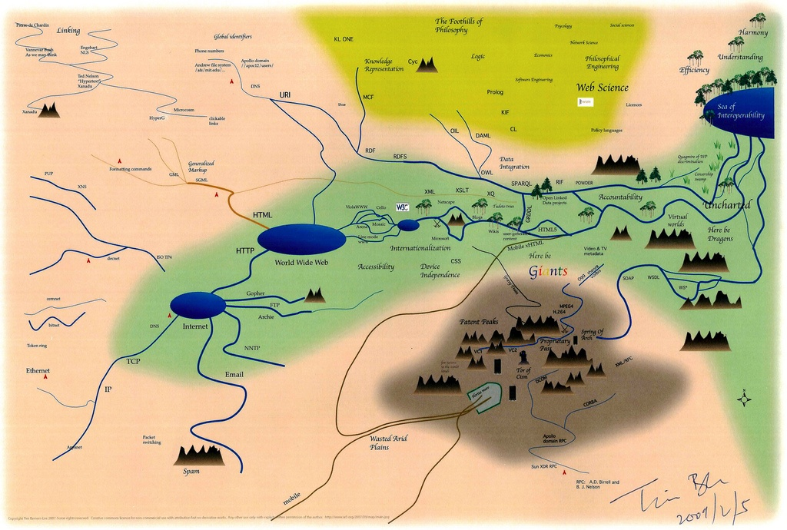
Questions
Notes:
5 points for answers to questions -- answer the questions as posed by the class.

Slide 19
Current Standards
RDFL/OWL allow labels on ontology elements.
<rdfs:Class about="#Cat">
<rdfs:label xml:lang="en">cat</rdfs:label>
<rdfs:label xml:lang="en">cats</rdfs:label>
<rdfs:label xml:lang="de">Katze</rdfs:label>
<rdfs:label xml:lang="de">Katzen</rdfs:label>
</rdfs:Class>
Is this enough?
What more could you want?
Notes:
5 points for the overview -- introduce the work and state the goals and objectives of the authors;

