Slide 1
Linking Families with Enriched Ontologies
David W. Embley (FamilySearch), Stephen W. Liddle (BYU),
Deryle W. Lonsdale (BYU), Scott N. Woodfield (BYU & FamilySearch)
Notes:
The idea: transform the data extracted from a book to intergenerational family trees

Slide 2
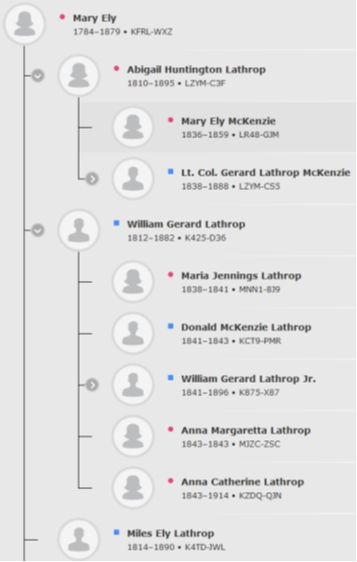
Linking Families
Notes:
… we link families by linking records about the same individual

Slide 3
Enriched Ontologies
“An ontology is a formal, explicit specification of a shared conceptualization” [Gruber93]
Conceptual Model
Enrichments
  Linguistic Grounding
  Pragmatic Constraints
  Cultural Normatives
  Evidential Reasoning
Notes:
… ontology is a bundle of knowledge computationally explaining some snippet of the real world
Linguistic Grounding: … how we communicate (in writing) about the conceptualized snippet of the real world
Pragmatic Constraints, Cultural Normatives, Evidential Reasoning: … how to deal with it sensibly using known constraints, cultural edicts, and our understanding of it

Slide 4
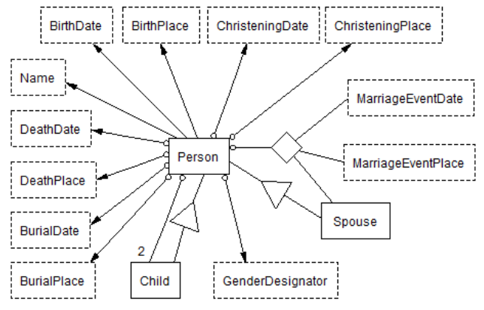
Linguistic Grounding
(syntactically extract text elements into conceptual components)
Acknowledgement: George Nagy, RPI
Notes:
… using examples, we specify templates
… first get the primary person in a logical grouping (family or record about an individual such as a funeral home record, birth record, …)
… then get related people: children, spouses, parents
… finally, get birth and death info
8 templates

Slide 5
Pragmatic Constraints
(semantic analysis of syntactically extracted information)
Example: A mother cannot give birth to a child after she dies:
Example (can’t die before being born): John Adams (1756 − i797)
Notes:
Pragmatic: dealing with things sensibly and realistically

Slide 6
Cultural Normatives
(augment extracted information by inference)
Notes:
… interpret what’s been extracted
… funeral home record

Slide 7
Cultural Normatives
(augment extracted information by inference)
a span of 0 − 56 days covers 95% of the data
Notes:
… Julian Date of the form yyyyddd
… less specific dates: 1863: 1863001-1863365
… estimated birth dates: graph based on sampling the first 10,000 encountered of which 8,910 had both a standardized birth date and christening date
… median: 3 days after birth
… span: 0-56 covers 95%

Slide 8
Evidential Reasoning
Shallow Match Blocking
Deep Match Equivalence-Class Creation
Record Merge
Family Tree Creation
Notes:
Equivalence Class: reflexive, symmetric, and transitive

Slide 9
Evidential Reasoning
Shallow Match Blocking (ordered by info content size)
  Inferred name parts e.g. TEEGARDEN, WM. WALTER ≈ W. W. TEEGARDEN
  Extracted/inferred birth dates
Deep Match Equivalence-Class Creation
Record Merge
Family Tree Creation
29
20
42
Notes:
10,000 mother-child relationships sampled of which 8,919 were acceptable (both mother and child had standardized birth dates)

Slide 10
Evidential Reasoning
Shallow Match Blocking (ordered by info content size)
  Inferred name parts e.g. TEEGARDEN, WM. WALTER ≈ W. W. TEEGARDEN
  Extracted/inferred birth dates
Deep Match Equivalence-Class Creation
  Within and across shallow-match blocks
  Pairwise merge consistency
  Match odds confidence
Record Merge
Family Tree Creation
29
20
42
Notes:
… push downstream if it doesn’t pass mustard … e.g. birth dates don’t match, too many parents, …

Slide 11
Evidential Reasoning
Shallow Match Blocking (ordered by info content size)
  Inferred name parts e.g. TEEGARDEN, WM. WALTER ≈ W. W. TEEGARDEN
  Extracted/inferred birth dates
Deep Match Equivalence-Class Creation
  Within and across shallow-match blocks
  Pairwise merge consistency
  Match odds confidence
    P(M|E₁, …, E_{n}) = P(E₁, …, E_{n}|M) P(M)/P(E₁, …, E_{n})
    log P(E₁, …, E_{n}|M) P(M)/P(E₁, …, E_{n}) = P(M) + ∑^{n}_{i=1}P(E_{i}|M)/P(E_{i}) yielding ∑^{n}_{i=1}1/P(E_{i})
    Odds weight, 1/P(E_{i}), tempered by probability of a match, e.g. P(“Waddington” ≈ “Clitheroe”)
Record Merge
Family Tree Creation
29
20
42
= 1
Notes:
“given names match”: we can estimate the probability that with two random draws the given names match by counting the occurrences of given names, N, and then for a given name, x, count the occurrences, n, of x and computing ∑_{nεName}#n(#n-1)/N² where N is # occurrences of all given names and #n is the number of occurrences of a particular given name, n.

Slide 12
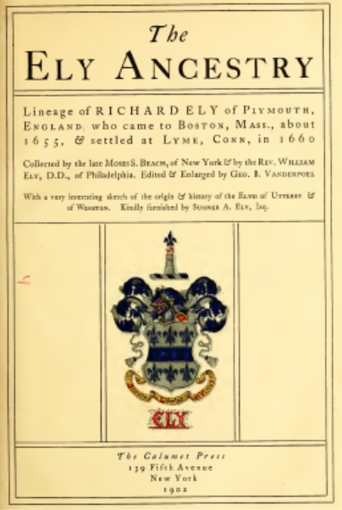
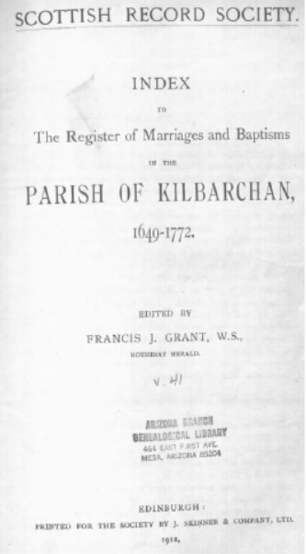
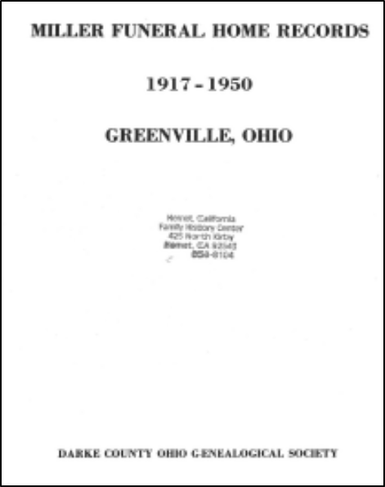
Experimental Results

Slide 13
Experimental Results
14,000+ inferred birth and married surnames
17,000+ estimated birth dates
145 seconds vs. 5 days
highly accurate: 90%−99%
Notes:
Recall: all records included in the deep-match equivalence class
Precision: no record included that doesn’t belong

Slide 14
Conclusion
With enriched ontologies, it is possible to extract information from semi-structured documents and create intergenerational family trees with high accuracy (90%­­­­­­−99% F-score).
# Extracted Records: 8,622 11,440 8,724
# Merged Records: 6,594 10,573 8,660
Largest Generated Tree: 2,965 27 16
Notes:
… on a later run

